Slide 1
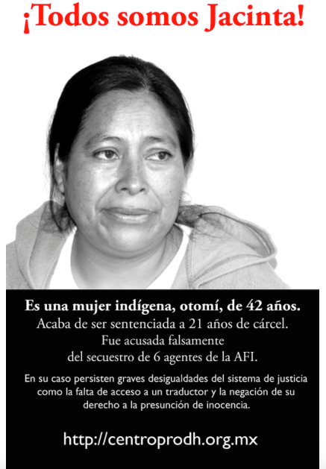
The Story of Jacinta Francisco Marcial
Judith A. Schechter Lexington School for the Deaf
Source: https://c2.staticflickr.com/4/3311/3334943786_928edd1fb7_b.jpg

Slide 2
Like Santiago Ventura Morales, Jacinta Francisco Marcial is a speaker of a minority language indigenous to Mexico.

Slide 3
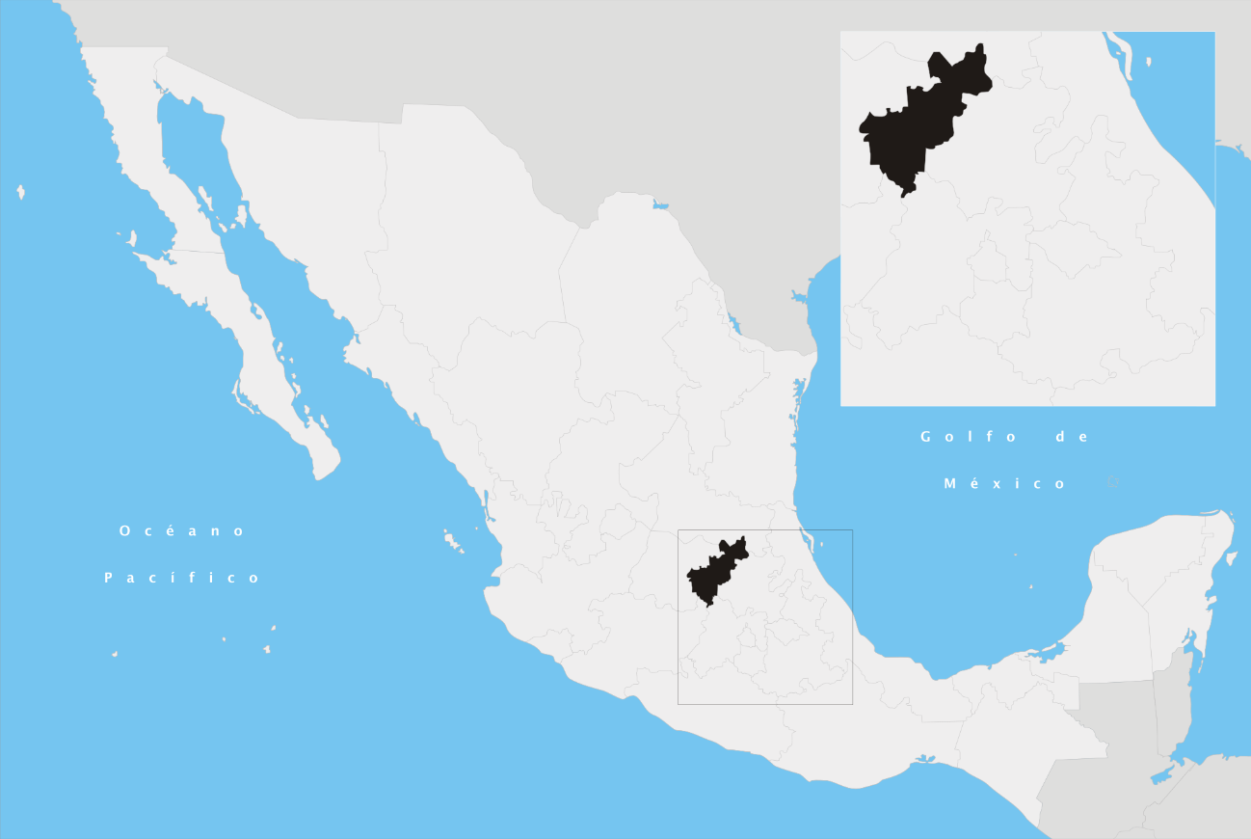
Like Santiago Ventura Morales, Jacinta Francisco Marcial is a speaker of a minority language indigenous to Mexico.
Francisco Marcial is an Otomí woman from Querétaro state, Mexico. Otomí is her native language.
Source: https://upload.wikimedia.org/wikipedia/commons/thumb/c/cf/Quer%C3%A9taro_en_M%C3%A9xico.svg/2000px-Quer%C3%A9taro_en_M%C3%A9xico.svg.png

Slide 4
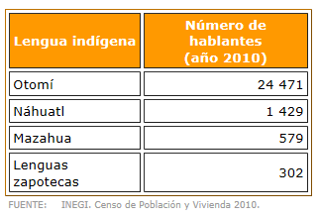
The Otomí Language
According to Mexico’s Instituto Nacional de Estadística y Geografía (INEGI), Otomí is the most widely spoken indigenous language in the Mexican state of Querétaro.
Source: http://cuentame.inegi.org.mx/monografias/informacion/queret/poblacion/diversidad.aspx?tema=me

Slide 5
Let’s hear some of Francisco Marcial’s story in her own words:

Slide 6

Source:
https://vimeo.com/7330092

Slide 7
Why was Francisco Marcial singled out for arrest?

Slide 8
Why was Francisco Marcial singled out for arrest?
According to Amnesty International and other organizations, women like Francisco Marcial are arrested and incarcerated due to their marginalized status as poor indigenous women.

Slide 9
Why was Francisco Marcial singled out for arrest?
According to Amnesty International and other organizations, women like Francisco Marcial are arrested and incarcerated due to their marginalized status as poor indigenous women.
While the charges against Francisco Marcial appear patently ridiculous in light of day, other poor indigenous women sometimes find themselves facing charges that seem more legitimate.

Slide 10
Keep in mind, though, that poor indigenous women in Mexico . . .
Have few economic choices and opportunities available to them. Many of them are illiterate and uneducated. For these reasons, some indigenous women are exploited by narcotraffickers to act as drug mules.

Slide 11
Keep in mind, though, that poor indigenous women in Mexico . . .
Have few economic choices and opportunities available to them. Many of them are illiterate and uneducated. For these reasons, some indigenous women are exploited by narcotraffickers to act as drug mules.
In 2005, ____________ made the documentary “Embroidering Freedom, Unthreading Punishment” (“Bordando Libertades, Deshilando Condenas”) in order to tell the stories of some of these women and highlight the injustices they face.

Slide 12
Keep in mind, though, that poor indigenous women in Mexico . . .
Have few economic choices and opportunities available to them. Many of them are illiterate and uneducated. For these reasons, some indigenous women are exploited by narcotraffickers to act as drug mules.
In 2005, made the documentary “Embroidering Freedom, Unthreading Punishment” (“Bordando Libertades, Deshilando Condenas”) in order to tell the stories of some of these women and highlight the injustices they face.
The women you are about to see will talk about how they could not understand the proceedings against them due to a lack of interpreters.

Slide 13
“Embroidering Freedom, Unthreading Punishment”

