Slide 1
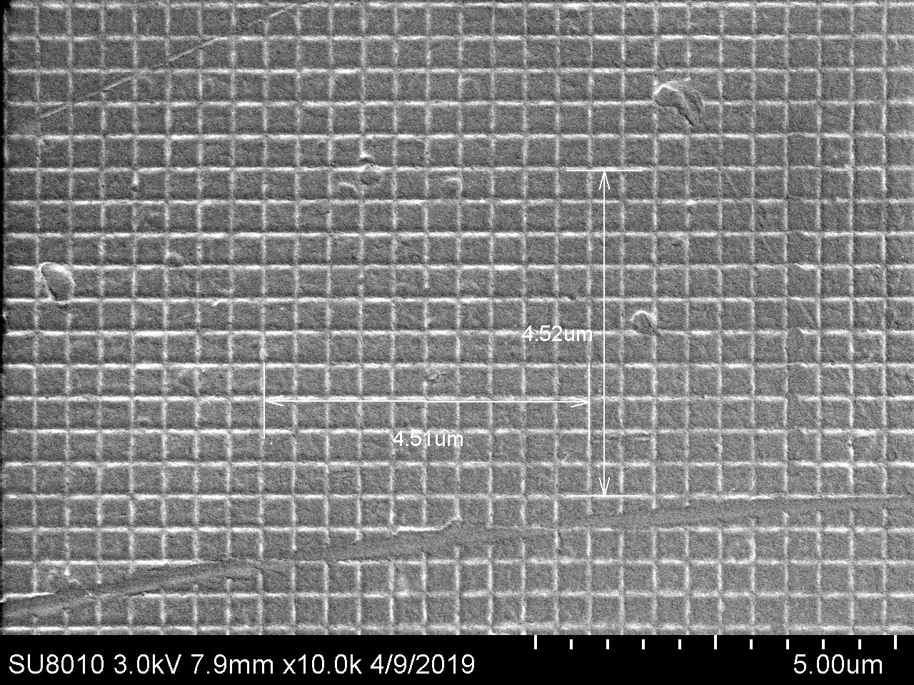
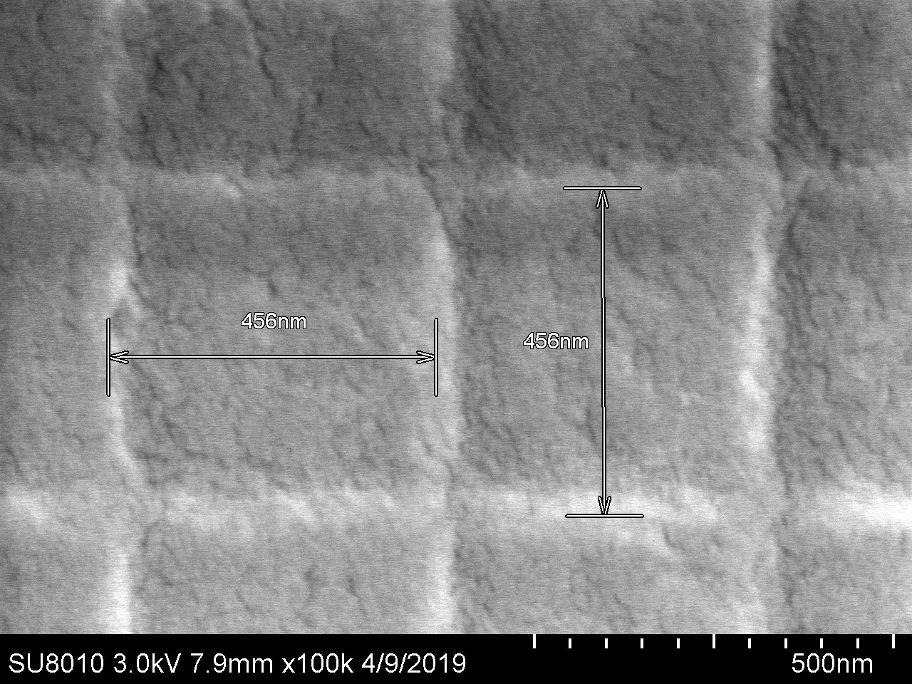
SU8010 SEM Magnification Calibration Results, 1st quarter (Mar’19-May’19)
Voltage/ Direction | Magnification 400X | Magnification 10KX | Magnification 50Kx | Magnification 100 Kx | Magnification 150Kx
3 kV Horizontal 3 kV Vertical | -2.0% -2.4% | -2.6% -2.4% | -1.5% -0.6% | -1.5% -1.5% | -0.9% +0.4%
10 kV Horizontal 10 kV Vertical | -1.6% -1.3% | -1.5% +2.4% | -3.9% -2.1% | -1.9% -0.4% | -3.9% -2.8%

