Slide 1
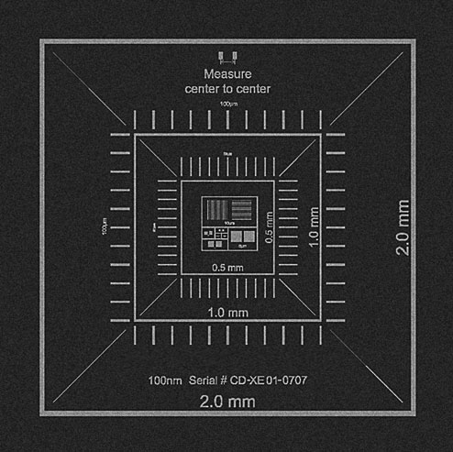
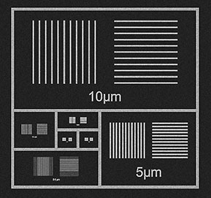
SU8230 SEM Magnification Calibration Results, 2nd quarter (May’19-Aug’19)
Voltage/ Direction | Magnification 400X | Magnification 10KX | Magnification 50Kx | Magnification 100 Kx | Magnification 150Kx
3 kV Horizontal 3 kV Vertical | +1.0% +1.0% | -3.6% 0.7% | 1.7% -1.7% | -1.5% +2.5% | -4.3% +1.7%
10 kV Horizontal 10 kV Vertical | 0.1% -0.1% | -2.8% +2.4% | 1.3% 0.6% | 0.8% -0.6% | 1.3% -0.8%

