Slide 1
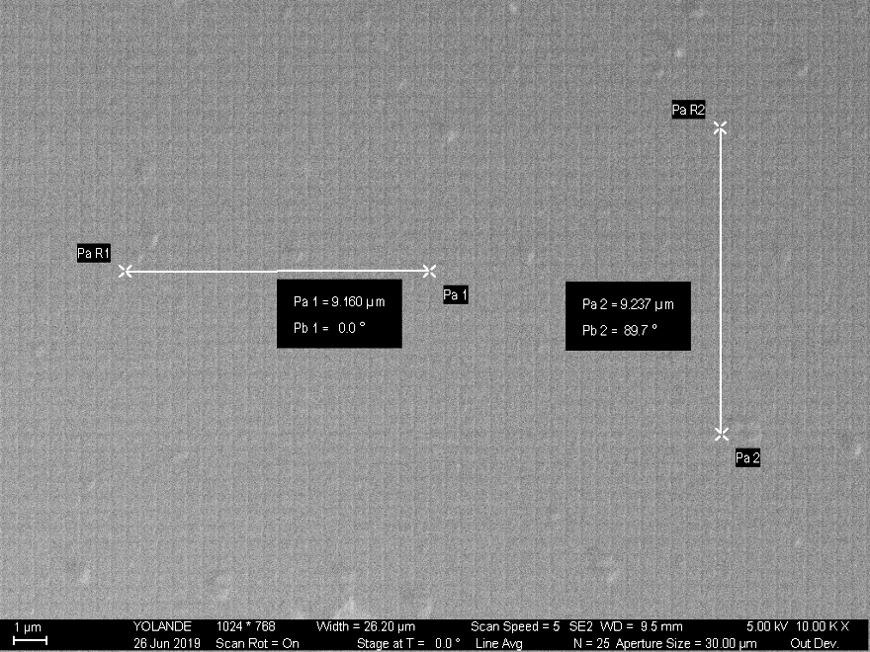
ZEISS ULTRA 60 SEM Magnification Calibration Results, July 2019
Voltage/ Direction | Magnification 1000X | Magnification 10Kx | Magnification 50 Kx | Magnification 100Kx
@ 5 kV Horizontal Vertical | -1.4% - 0.8% | -0.4% +0.5% | -1.7% -3.2% | -0.3% -2.8%
@10 kV Horizontal Vertical | +2.8% +0.3% | -1.5% -0.9% | -0.4% -0.4% | -0.9% -0.2%

