Slide 1
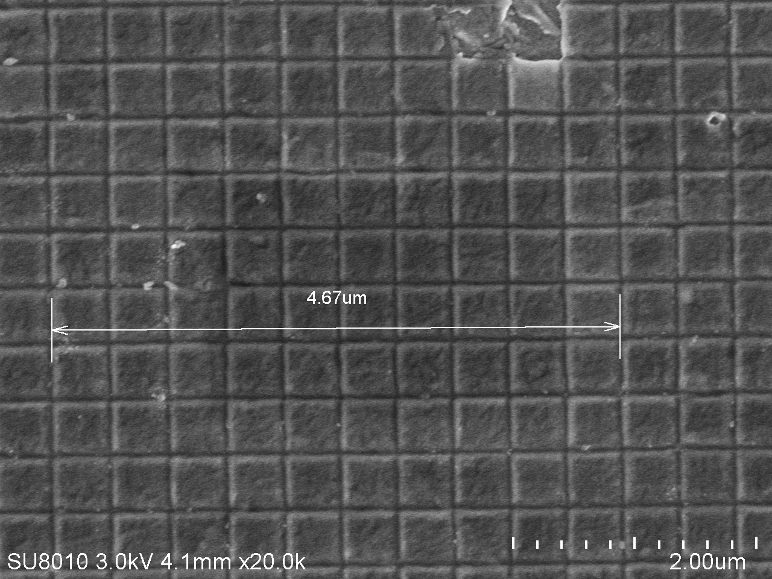
SU8010 SEM Magnification Calibration Results, 4th quarter (Dec’19-Feb’20)
Voltage/ Direction | Magnification 10KX | Magnification 50 Kx | Magnification 100Kx
1 kV Horizontal 1 kV Vertical | -4.3% -3.2% | -3.8% -4.0% | -5.6% -1.7%
5 kV Horizontal 5 kV Vertical | -4.1% -3.0% | -3.8% -5.3% | -2.6% -2.2%
10 kV Horizontal 10 kV Vertical | -2.8% -3.4% | -4.0% -3.8% | -2.6% -4.3%

