Slide 1
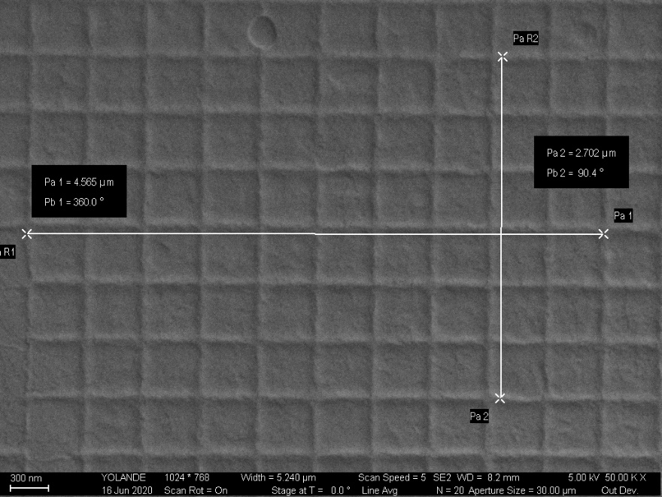
ZEISS ULTRA 60 SEM Magnification Calibration Results, June 2020
Voltage/ Direction | Magnification 1000X | Magnification 10Kx | Magnification 50 Kx | Magnification 100Kx
@ 5 kV Horizontal Vertical | -1.7% - 3.0% | -1.5% -1.9% | -1.9% -2.4% | -1.5% -2.8%
@15 kV Horizontal Vertical | -0.4% -1.7% | -1.7% -1.7% | -1.1% -1.3% | -0.4% -1.9%

