Slide 1
Nuclear Technology of the GT Fusion DEMO Reactor
Andrew Rosenstrom, Nathan Morgenstern, Wes Crane, Stephen Johnston, Christian Maniscalco, Xianwei Wang
Advisors: Dr. Stacey, Dr. Petrovic

Slide 2
Objectives
The design project will undertake the nuclear design (neutron transport, temperature distribution, stress analysis, radiation damage lifetime, tritium self-sufficiency) of this Fusion DEMO, consisting of the following:
Neutronics
Evaluate the tritium breeding ratio and tritium self-sufficiency. Determine flux distribution throughout the blanket and at the magnet systems.
Nuclear Heating
Evaluate energy deposition in blanket to determine temperature distribution and heat removal. Conduct coupled thermal and stress analysis.
Radiation Damage
Determine the lifetime of magnet and breeding systems. Estimate replacement intervals of first wall and diverter.

Slide 3
Background
Pursuit of sustainable fusion energy began with plans for experimental power reactors once the deuterium-tritium fusion interaction was more closely studied in the later years of the 1970's
1980
1990
2000
2010
First plasma achieved in a tokamak reactor using magnetic confinement in JET (UK)
Plans for the International Thermonuclear Experimental Reactor were set into motion
JET Tokomak continues to produce record breaking amounts of power while its magnetic confinement design becomes the standard for future projects
First instances of deuterium-tritium plasma making for a higher standard of power output alongside a more stable operation become standard
Timetable for the future of the fusion DEMO project presented in 2004 to IAEA for construction to begin in 2024 and end 2033 looking to generate marketable power
Start of building construction for ITER project in 2010 after agreement in 2006

Slide 4
State Of The Art
Advancing design of the latest models of fusion reactors focuses on certain main components:
Tritium Breeding Blanket
The amount of tritium used in ratio to the amount of tritium produced by a breeding material is the Tritium Breeding Ratio (TBR) and is of high importance in making fusion viable
Lithium composites makes a strong tritium producer, and here will be in a ceramic mixture
Shielding Materials
Radiation resistant materials are necessary to durability, and have been researched to reveal Eurofer 97, or ODS Steel, as the best choice among others (Be, W)
Coolant
Among coolant options explored, water provides the most stable heat transfer

Slide 5
Motivation
Fusion energy is clean. It produces no greenhouse gases, only helium and a high energy neutron. Additionally, there are no dangerous fission products that are associated with most nuclear reactors.
Fuel for fusion is abundant in the form of deuterium that can be found in water, while tritium can be produced by the lithium/neutron reaction that will occur in the core.
Fusion reactors are inherently safe. Any malfunctions in the reactor will cause the plasma to cool and the reactions to cease. No meltdowns or runaway reactions will occur.
5
Notes:
Fusion energy offers an unlimited supply of clean safe energy

Slide 6
Scope
This project will only be to design a water cooled ceramic breeder blanket and will not consider other methods of cooling or breeding.
The neutronics modeling in MCNP will not consist of a detailed blanket module design. For simplicity the TBM will be treated as a homogenous mixture.
The tritium recovery system and external coolant systems will not be considered; however, the blanket modules will be designed with anticipation of their eventual removal and replacement.
Component lifetimes will not take into account damage created from transient plasma disruptions. The system will be assumed at steady-state.
Divertor lifetime will not consider charged particle flux from the convergence of magnetic field lines.
ANSYS will be used to simulate thermal/stress analysis, considering the cell with the maximum heat flux as determined by MCNP.

Slide 7
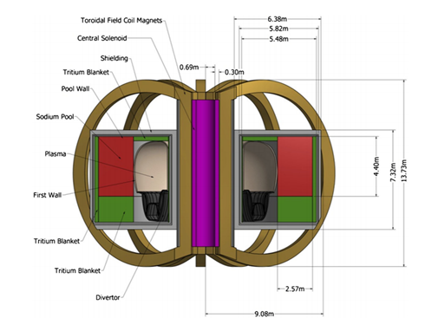
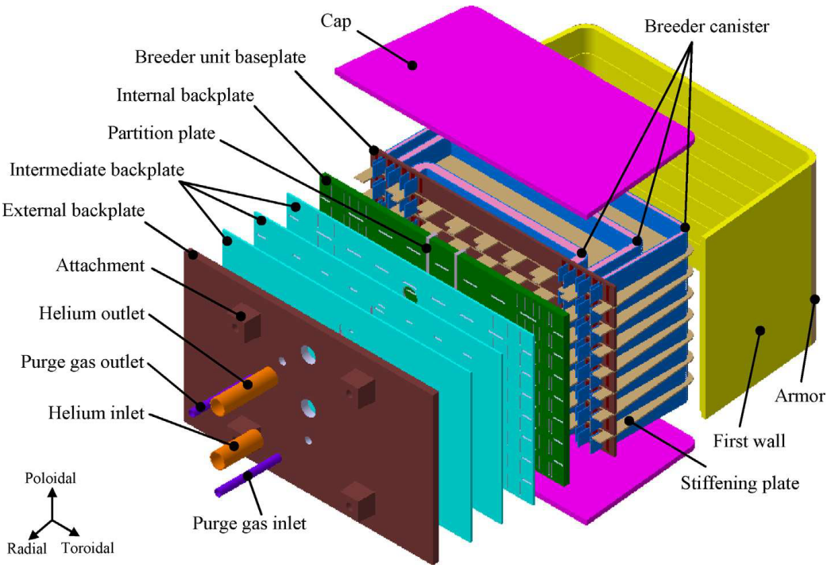
Design Basis
Subcritical Advanced Burner Reactor [1]
Conceptual Design of a Water Cooled Breeder Blanket [2]

Slide 8
Success Metrics
TBR ≥1.15
Radiation Damage
Limits
Magnets - 2x10²² >1 MeV [n / m²][3]
Blanket Structure - 200 dpa
Significant Li Burnup will not occur within the lifetime of the reactor.
Graphite Shielding - N/A
First Wall - 200 dpa
Lifetime
First Wall: >20 Effective Full Power Years
Blanket: >20Yr
Temperature distribution within Li₄SiO₄ operational parameters.
325 to 925 degrees celsius

Slide 9
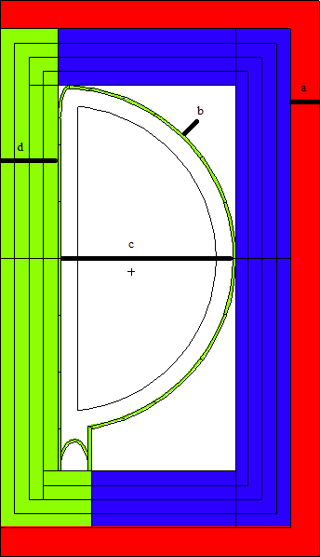
Test Blanket Module Design
Red - Graphite Shield
Green - ODS Steel
Blue - Homogenous Breeding Blanket
a = 50 cm
b = 5 cm
c = 300 cm
d = 100 cm

Slide 10
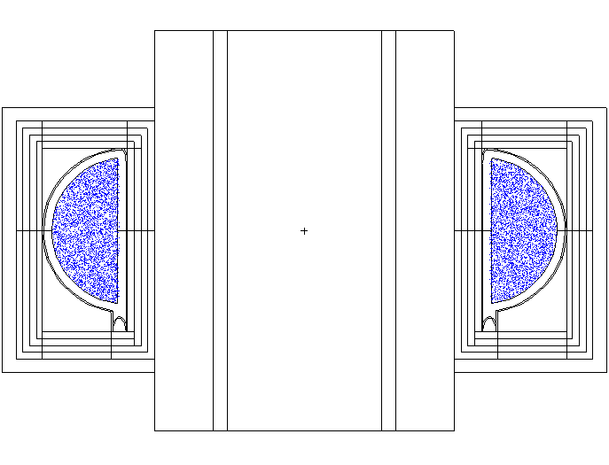
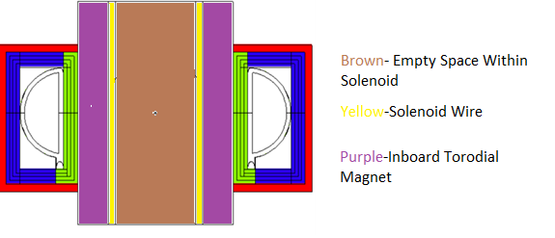
Tokamak Design

Slide 11
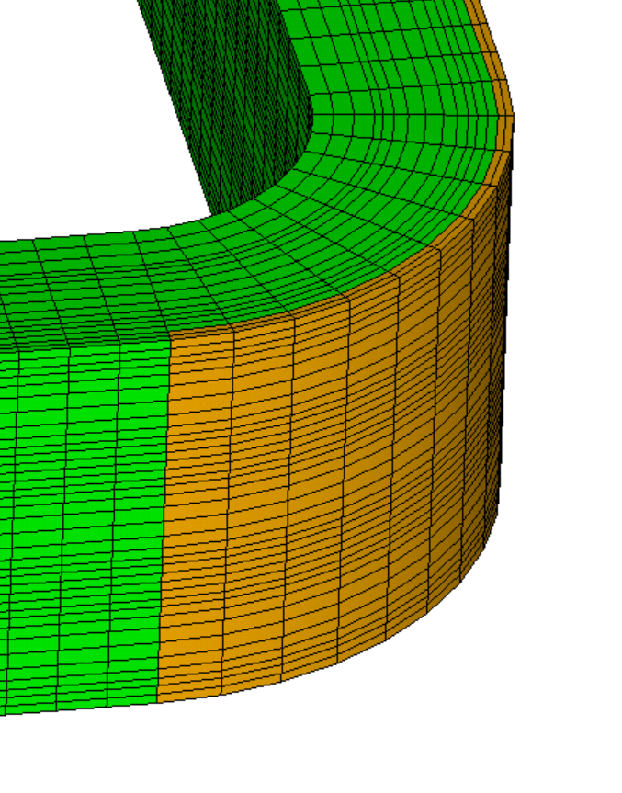
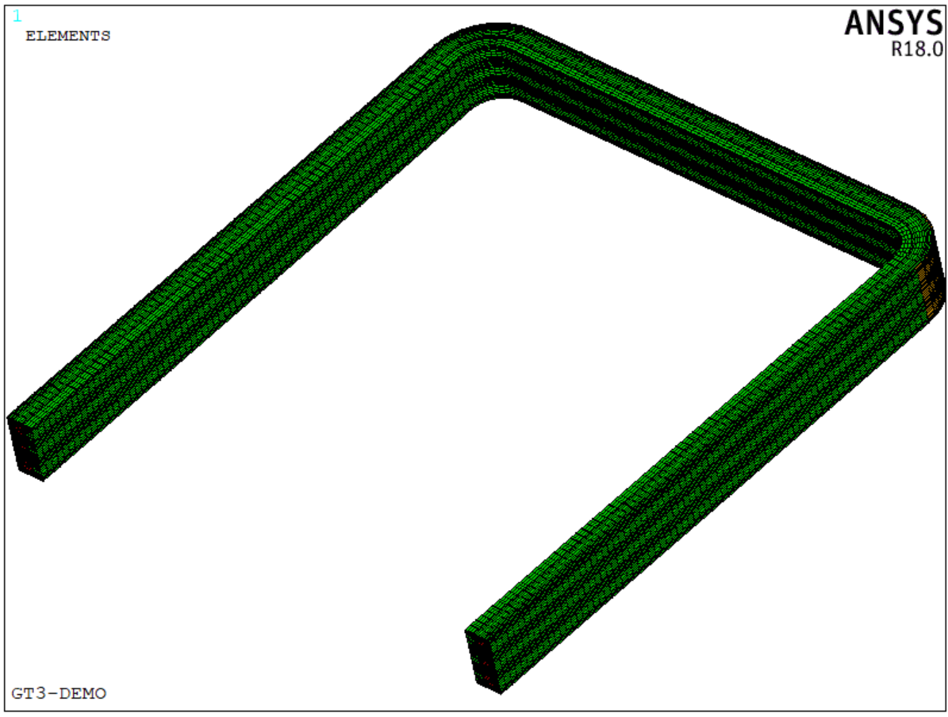
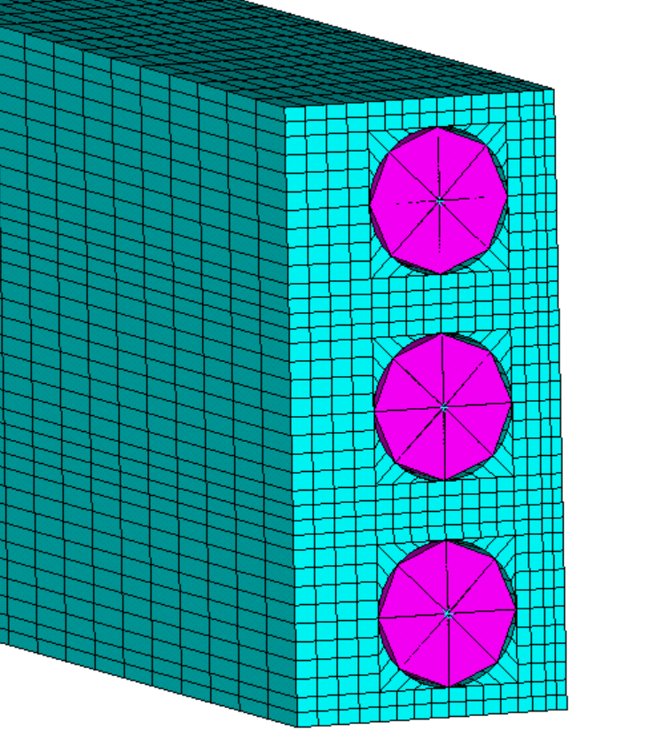
Coolant System Design
Radius (cm) | Poloidal spacing (cm) | Poloidal spacing including tube (cm) | Number of tubes at r
956.5 | 1.70 | 3.20 | 1878
958 | 1.70 | 3.20 | 1878
961.5 | 1.17 | 2.67 | 2260
966.5 | 2.52 | 4.02 | 1510
976.5 | 6.64 | 8.14 | 754
986.5 | 6.72 | 8.22 | 753
996.5 | 6.81 | 8.31 | 753
1006.5 | 6.89 | 8.39 | 753
1016.5 | 6.98 | 8.48 | 753
1026.5 | 7.06 | 8.56 | 753
1036.5 | 7.14 | 8.64 | 753
1046.5 | 7.23 | 8.73 | 753
Protection layer
with the thickness
of 3 mm
Circular channels are used
Blanket Coolant Tube Spacing
FW Finite Element ANSYS Model

Slide 12
Homogenous Material Composition
Eurofer 97 [3]:
Tritium Breeding Blanket:
Element | Nominal Percentage
C | 0.46
Si | 0.11
Mn | 0.38
Fe | 88.96
Cr | 8.6
Ta | 0.04
V | 0.21
W | 0.3
Atom | Total Number of atoms | Atom Fraction
Li | 4.24E+30 | 2.05E-01
Si | 1.06E+30 | 5.12E-02
O | 4.25E+30 | 2.05E-01
C | 2.32E+27 | 1.12E-04
Mn | 1.91E+27 | 9.23E-05
Fe | 4.48E+29 | 2.16E-02
Cr | 4.33E+28 | 2.09E-03
Ta | 2.01E+26 | 9.71E-06
V | 1.06E+27 | 5.10E-05
W | 1.51E+27 | 7.29E-05
H | 2.63E+28 | 1.27E-03
Be | 1.06E+31 | 5.14E-01

Slide 13
Calculation of Critical Values Using MCNP6 Results
Tallies used: F2, F4 and F6
MCNP6 using the following equation to preform tally multiplication.
$$C\int{φ(E)R(E)dE}$$
In the equation φ(E) is the flux in particles/cm² and R(E) is the response function from the MCNP cross-section libraries for a given tally multiplier. If the constant C is the particles generated per second, 5.326E20 and is multiplied by the atomic density in atoms per centimeter barn the results of the multiplication will be in reactions/cm³sec.

Slide 14
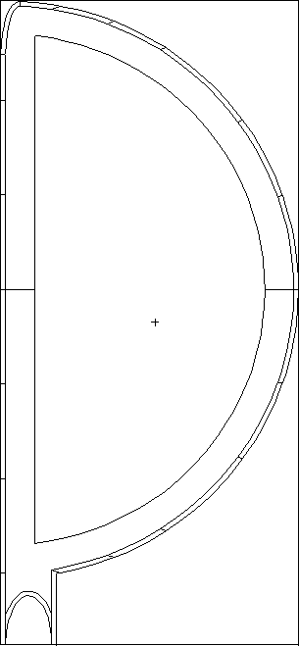
Flux On First Wall/Vacuum Vessel
24
25
2
26
6
27
Cell | Area [cm²] | Flux [n/cm²s] | Uncertainty | Cell | Area [cm²] | Flux [n/cm²s] | Uncertainty
2 | 2.38E+05 | 5.92E+14 | 0.0052 | 25/30 | 5.48E+05 | 6.49E+14 | 0.0029
6 | 1.97E+05 | 6.57E+14 | 0.0048 | 26/31 | 6.06E+05 | 6.73E+14 | 0.0028
19 | 4.06E+05 | 6.91E+14 | 0.0033 | 27/32 | 1.20E+06 | 6.94E+14 | 0.0021
20 | 4.06E+05 | 7.14E+14 | 0.0032 | 28/33 | 1.03E+06 | 7.15E+14 | 0.0022
21 | 4.06E+05 | 7.06E+14 | 0.0032 | 29/34 | 1.19E+06 | 3.71E+14 | 0.0029
22 | 4.06E+05 | 6.77E+14 | 0.0033 | 35 | 3.04E+05 | 4.35E+14 | 0.0057
23 | 4.06E+05 | 6.15E+14 | 0.0036 | 36 | 5.34E+05 | 2.93E+14 | 0.0051
24 | 1.42E+05 | 6.22E+14 | 0.0056 | 37 | 3.46E+05 | 4.20E+14 | 0.0053
28
19
20
29
21
34
22
33
23
32
36
31
30
35
37
Notes:
Nathan

Slide 15
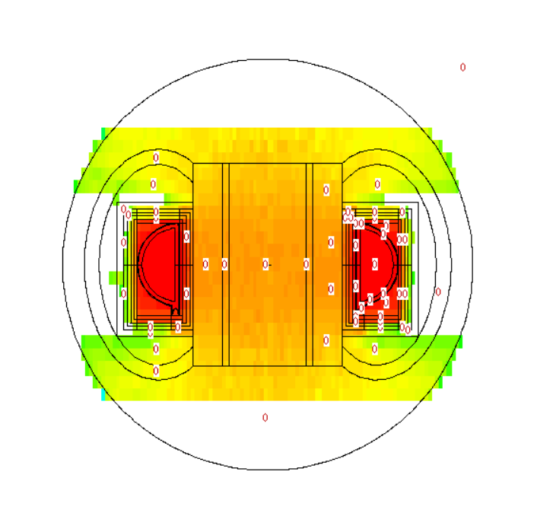
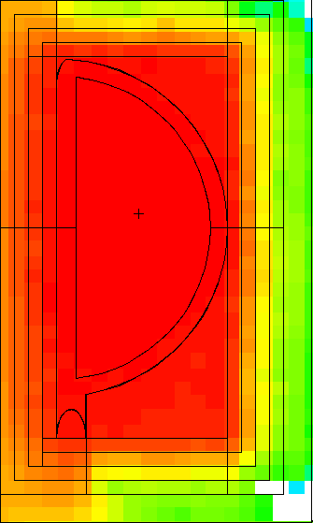
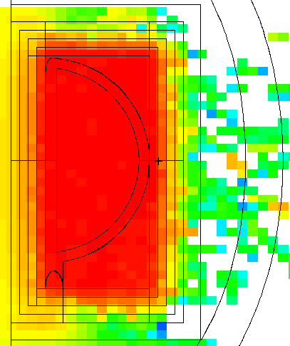
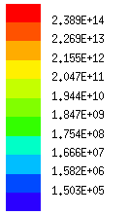
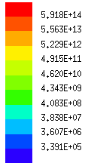
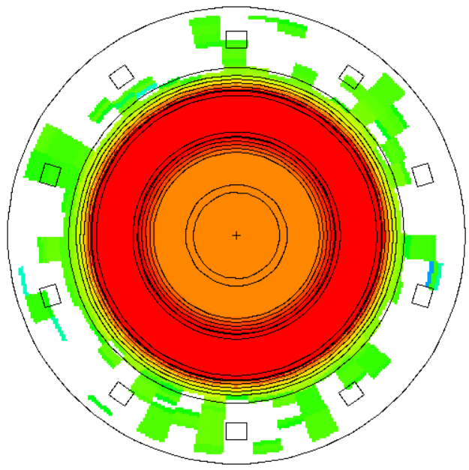
Neutron and Photon Flux Distribution
Photon Flux [p/cm²s]
Neutron Flux [n/cm²s]

Slide 16
Flux at Magnet Systems
Inboard Toroidal Magnet System
Flux of 8.7179E12 [n/m²s] with a uncertainty of 0.0168 of neutrons greater than 1 MeV
Would take 2.3566E9 seconds or 72 years of full power operation to reach fluence limit.
Outer Toroidal Magnet Systems
Flux of 4.07E11 [n/m²s] with a uncertainty of 0.0125 of neutrons greater than 1 MeV
Would take 4.991E10 seconds or 1557 years to reach fluence limit.

Slide 17
Heating of the First Wall
24
25
2
26
Cell | F6 Tally Output [MeV/g] | FW Heating [MeV/g*sec] | FW Volumetric Heating [MeV/cm³s] | Uncertainty
2 | 1.58E-08 | 8.44E+12 | 6.60E+13 | 0.0022
6 | 1.76E-08 | 9.39E+12 | 7.34E+13 | 0.0023
19 | 2.02E-08 | 1.08E+13 | 8.41E+13 | 0.0015
20 | 2.19E-08 | 1.17E+13 | 9.11E+13 | 0.0015
21 | 2.18E-08 | 1.16E+13 | 9.11E+13 | 0.0015
22 | 2.01E-08 | 1.07E+13 | 8.38E+13 | 0.0015
23 | 1.58E-08 | 8.42E+12 | 6.59E+13 | 0.0017
24 | 1.68E-08 | 8.93E+12 | 6.98E+13 | 0.0025
25 | 1.89E-08 | 1.01E+13 | 7.87E+13 | 0.0018
26 | 2.01E-08 | 1.07E+13 | 8.40E+13 | 0.0017
27 | 2.11E-08 | 1.12E+13 | 8.79E+13 | 0.0012
28 | 2.21E-08 | 1.18E+13 | 9.22E+13 | 0.0012
29 | 2.30E-08 | 1.22E+13 | 9.57E+13 | 0.0011
30 | 1.85E-08 | 9.87E+12 | 7.72E+13 | 0.0018
31 | 1.97E-08 | 1.05E+13 | 8.21E+13 | 0.0017
32 | 2.09E-08 | 1.12E+13 | 8.73E+13 | 0.0012
33 | 2.21E-08 | 1.18E+13 | 9.23E+13 | 0.0012
34 | 2.30E-08 | 1.22E+13 | 9.58E+13 | 0.0011
35/37 | 7.96E-09 | 4.24E+12 | 3.32E+13 | 0.003
36 | 6.22E-08 | 3.31E+13 | 2.59E+14 | 0.0025
6
27
19
28
20
29
21
34
22
33
23
32
36
31
30
35
37
Notes:
Nathan

Slide 18
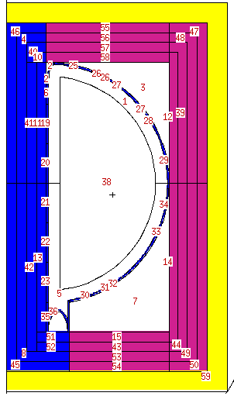
Heating of the Blanket
Cell | Volume [cm³] | Mass [g] | Density[g/cm³] | Heating of Blanket [MeV/g*s] | Heating of Blanket [W/cm³] | Uncertainty
12 | 4.99E+07 | 1.09E+08 | 2.1791 | 1.79E+13 | 1.3148 | 0.0024
39 | 5.89E+07 | 1.28E+08 | 2.1791 | 1.61E+12 | 0.1180 | 0.0061
47 | 7.77E+07 | 1.69E+08 | 2.1791 | 1.59E+10 | 0.0012 | 0.0326
48 | 6.81E+07 | 1.48E+08 | 2.1791 | 1.38E+11 | 0.0101 | 0.0118
14 | 6.05E+07 | 1.32E+08 | 2.1791 | 1.65E+13 | 1.2133 | 0.0022
44 | 6.97E+07 | 1.52E+08 | 2.1791 | 1.46E+12 | 0.1072 | 0.0059
49 | 7.93E+07 | 1.73E+08 | 2.1791 | 1.27E+11 | 0.0093 | 0.0114
50 | 8.91E+07 | 1.94E+08 | 2.1791 | 1.42E+10 | 0.0010 | 0.0334
55 | 3.83E+07 | 8.34E+07 | 2.1791 | 2.58E+10 | 0.0019 | 0.0331
56 | 3.83E+07 | 8.34E+07 | 2.1791 | 1.90E+11 | 0.0140 | 0.0133
57 | 3.83E+07 | 8.34E+07 | 2.1791 | 1.86E+12 | 0.1364 | 0.0072
58 | 3.83E+07 | 8.34E+07 | 2.1791 | 1.69E+13 | 1.2415 | 0.0028
15 | 3.26E+07 | 7.11E+07 | 2.1791 | 1.46E+13 | 1.0706 | 0.0033
43 | 3.26E+07 | 7.11E+07 | 2.1791 | 1.64E+12 | 0.1204 | 0.0083
53 | 3.26E+07 | 7.11E+07 | 2.1791 | 1.82E+11 | 0.0134 | 0.0141
54 | 3.26E+07 | 7.11E+07 | 2.1791 | 3.17E+10 | 0.0023 | 0.0291

Slide 19
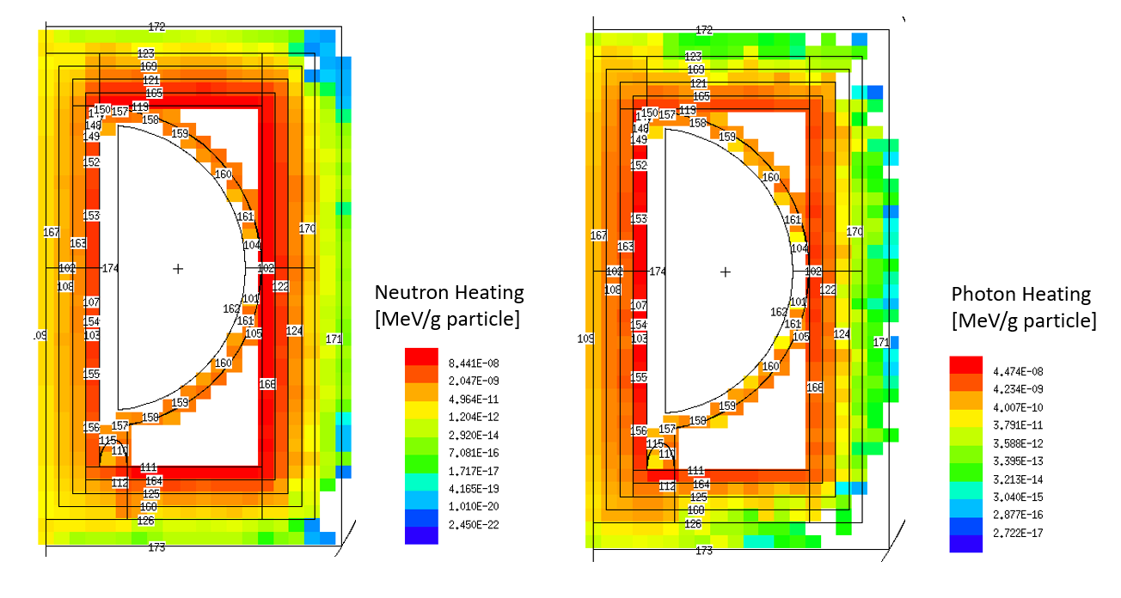
Heating Map of the Blanket

Slide 20
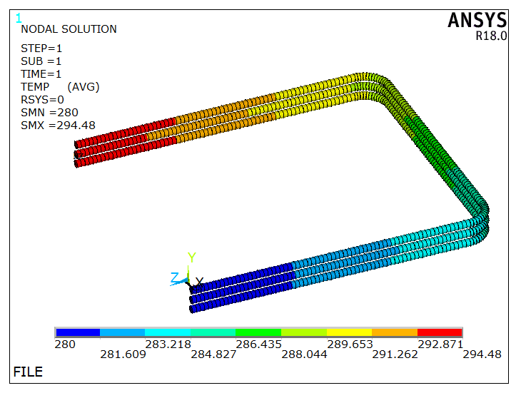
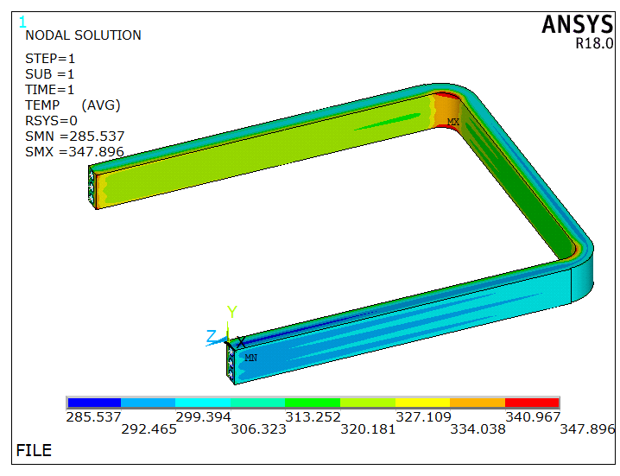
FW Fluid-solid coupling analysis: temp calculation
Based on MCNP results, the blanket cell with the max heat flux is chosen to perform temperature calculation.
Thermal boundary: inlet temp: 280°C, heat flux density: 0.3 MWm⁻², heat deposition: 15.3 MWm⁻³
outlet
inlet
Water temp distribution
FW temp distribution

Slide 21
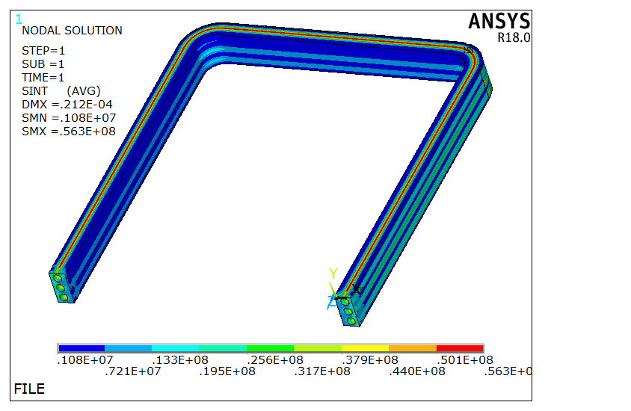
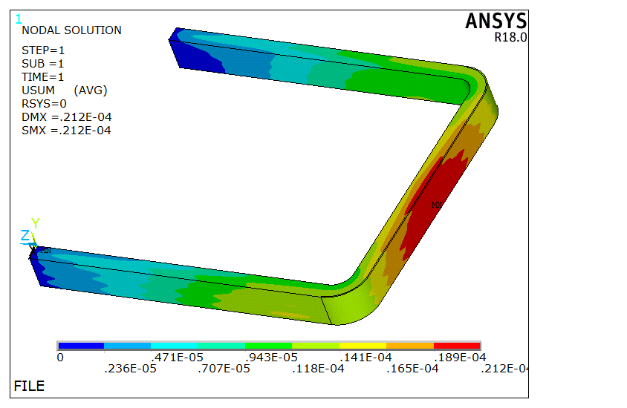
FW Thermal/Stress Analysis: under water pressure
Boundary condition: water pressure 15 MPa, fixed at the end surfaces, symmetry constraint at
the bottom surface
The max stress is within the threshold, the deformation can be neglected
S_{max}=56.3 MPa
Shear Stress
Total displacement

Slide 22
FW Thermal/Stress Analysis: under water pressure & heat flux
Boundary condition: water pressure, heat flux derived from fluid-solid coupling analysis
The maximum shear stress is below the limiting stress value of 320 MPa at the first wall temperatures
Shear Stress
Total Displacement
Shear Stress On Armor

Slide 23
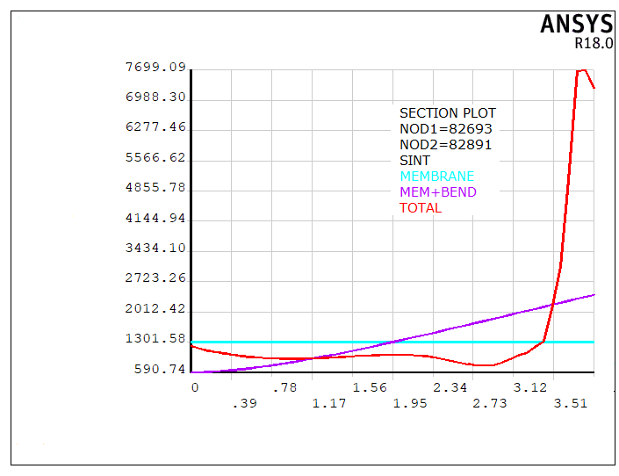
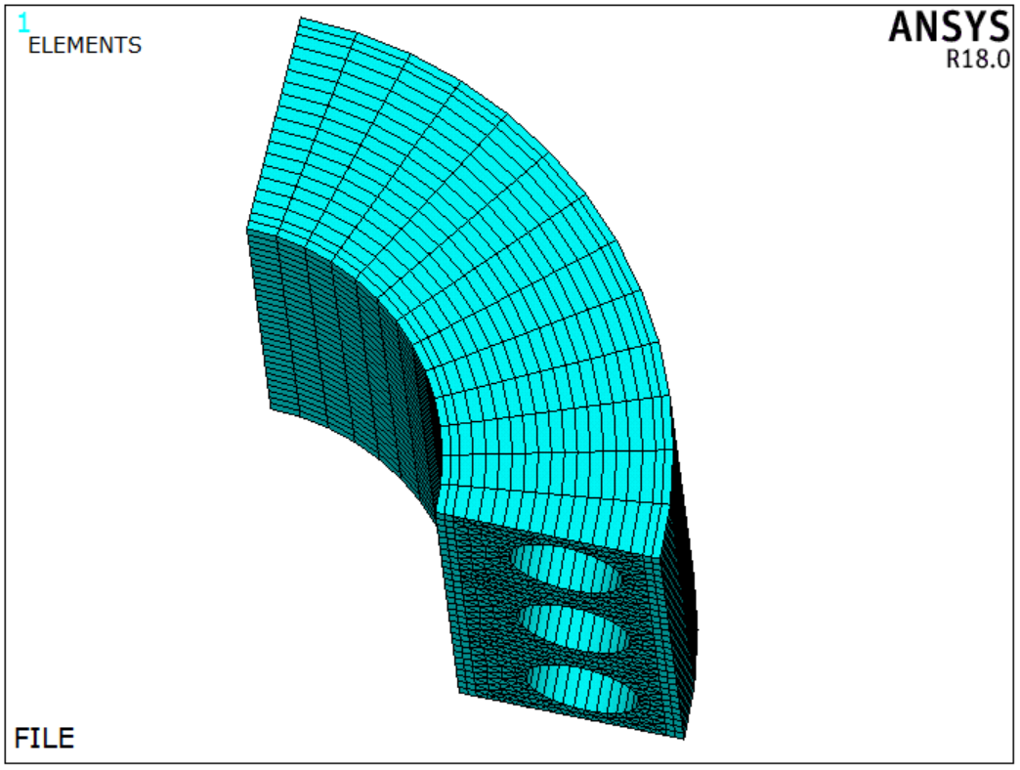
FW Thermal/Stress Analysis: stress linearization
The large stress region (corner) is selected to carry out stress linearization; the membrane stress,
bending stress, and thermal stress are determined.
×10⁵
Path 1
Stress （Pa）
×10⁻²
Distance （m）
The Path of Stress Linearization
Stress Linearization

Slide 24
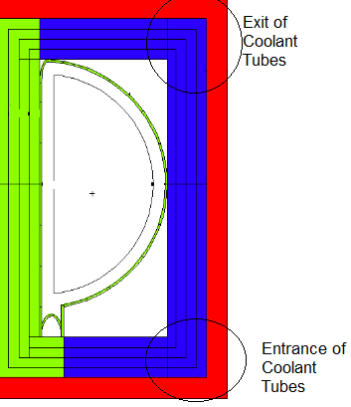
Blanket Temperature Distribution
Region | Average Temperature (0 Celsius) | Average Temperature (340 Celsius)
955 - 959 cm | 335 | 675
959 - 964 cm | 339 | 678
964 - 969 cm | 341 | 679
969 – 981.5 cm | 341 | 680
981.5 - 991.5 cm | 341 | 679
991.5 - 1005 cm | 340 | 679

Slide 25
Radiation Damage: FW
24
25
2
26
Cell | Displacements per second | Uncertainty | DPA/Year | Years to 200 DPA
24 | 3.43E+17 | 0.0051 | 10.83 | 18.47
25 | 3.78E+17 | 0.0037 | 11.92 | 16.78
26 | 3.98E+17 | 0.0034 | 12.54 | 15.95
27 | 4.11E+17 | 0.0024 | 12.97 | 15.42
28 | 4.34E+17 | 0.0025 | 13.68 | 14.62
29 | 4.54E+17 | 0.0024 | 14.32 | 13.97
2 | 3.34E+17 | 0.0046 | 10.53 | 18.99
6 | 3.71E+17 | 0.0049 | 11.69 | 17.11
19 | 4.14E+17 | 0.0034 | 13.07 | 15.30
20 | 4.44E+17 | 0.0033 | 14.01 | 14.28
21 | 4.44E+17 | 0.0033 | 13.99 | 14.30
22 | 4.11E+17 | 0.0034 | 12.96 | 15.44
23 | 3.38E+17 | 0.0037 | 10.65 | 18.79
30 | 3.72E+17 | 0.0036 | 11.73 | 17.05
31 | 3.86E+17 | 0.0034 | 12.18 | 16.42
32 | 4.08E+17 | 0.0023 | 12.87 | 15.54
33 | 4.30E+17 | 0.0025 | 13.56 | 14.75
34 | 4.53E+17 | 0.0024 | 14.29 | 14.00
35 | 2.04E+17 | 0.0058 | 6.45 | 31.02
36 | 1.46E+18 | 0.0049 | 46.04 | 4.34
37 | 1.93E+17 | 0.0045 | 6.07 | 32.93
27
6
19
28
20
29
21
34
22
33
23
32
36
31
30
35
37

Slide 26
Radiation Damage: Blanket
Cell | Displacements per second | Uncertainty | DPA/Year | Years to 200 DPA
58 | 7.43E+16 | 0.0024 | 2.34 | 8.53E+01
57 | 5.19E+15 | 0.0077 | 0.16 | 1.22E+03
56 | 4.04E+14 | 0.0156 | 0.01 | 1.57E+04
55 | 3.77E+13 | 0.0384 | 0.001 | 1.68E+05
12 | 9.06E+16 | 0.002 | 2.86 | 7.00E+01
39 | 7.17E+15 | 0.0054 | 0.23 | 8.84E+02
48 | 4.44E+14 | 0.011 | 0.01 | 1.43E+04
47 | 2.57E+13 | 0.0276 | 0.00 | 2.46E+05
14 | 8.38E+16 | 0.0018 | 2.64 | 7.57E+01
44 | 6.52E+15 | 0.0051 | 0.21 | 9.73E+02
49 | 3.96E+14 | 0.0107 | 0.01 | 1.60E+04
50 | 2.34E+13 | 0.0263 | 0.00 | 2.70E+05
15 | 6.26E+16 | 0.0028 | 1.97 | 1.01E+02
43 | 4.62E+15 | 0.0088 | 0.15 | 1.37E+03
53 | 4.05E+14 | 0.0166 | 0.01 | 1.57E+04
54 | 5.59E+13 | 0.0374 | 0.00 | 1.13E+05

Slide 27
Radiation Damage: Inboard Shielding
Cells | Displacements per second | Uncertainty | DPA/Year | Years to 200 DPA
10 | 6.11E+16 | 0.013 | 1.93 | 1.04E+02
11 | 2.06E+17 | 0.0029 | 6.49 | 3.08E+01
40 | 2.32E+16 | 0.0139 | 0.73 | 2.74E+02
41 | 9.95E+16 | 0.0043 | 3.14 | 6.38E+01
4 | 3.87E+16 | 0.0044 | 1.22 | 1.64E+02
46 | 1.60E+16 | 0.0046 | 0.51 | 3.96E+02
51 | 9.10E+16 | 0.0073 | 2.87 | 6.97E+01
13 | 1.90E+17 | 0.0028 | 5.98 | 3.35E+01
52 | 3.59E+16 | 0.0111 | 1.13 | 1.77E+02
42 | 8.48E+16 | 0.004 | 2.67 | 7.48E+01
8 | 3.60E+16 | 0.004 | 1.13 | 1.76E+02
45 | 1.53E+16 | 0.0043 | 0.48 | 4.13E+02

Slide 28
Tritium Breeding
Cell | Volume [cm3] | Tritium [Fm 105] | Tritium/Second | Uncertainty
58 | 3.83E+07 | 3.02E+13 | 1.27E+20 | 0.0035
57 | 3.83E+07 | 3.65E+12 | 1.54E+19 | 0.0082
56 | 3.83E+07 | 3.43E+11 | 1.44E+18 | 0.0117
55 | 3.83E+07 | 3.77E+10 | 1.59E+17 | 0.0159
12 | 4.99E+07 | 2.14E+13 | 1.17E+20 | 0.003
39 | 5.89E+07 | 2.07E+12 | 1.34E+19 | 0.007
48 | 6.81E+07 | 1.64E+11 | 1.23E+18 | 0.0104
47 | 7.77E+07 | 1.17E+10 | 9.98E+16 | 0.0145
14 | 6.05E+07 | 2.88E+13 | 1.91E+20 | 0.0028
44 | 6.97E+07 | 2.84E+12 | 2.18E+19 | 0.0067
49 | 7.93E+07 | 1.97E+11 | 1.72E+18 | 0.0101
50 | 8.91E+07 | 1.21E+10 | 1.19E+17 | 0.0141
15 | 3.26E+07 | 2.68E+13 | 9.62E+19 | 0.004
43 | 3.26E+07 | 3.31E+12 | 1.19E+19 | 0.0092
53 | 3.26E+07 | 3.45E+11 | 1.24E+18 | 0.0122
54 | 3.26E+07 | 6.60E+10 | 2.37E+17 | 0.0161
Total |  |  | 6.60E+20 | 0.041
 |  | TBR | 1.239 | 0.041

Slide 29
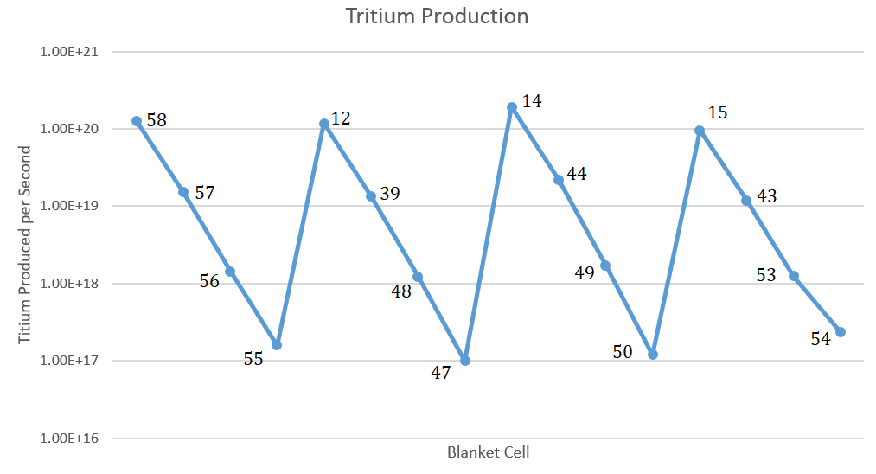
Tritium Breeding

Slide 30
Conclusion
The crucial design criteria posed by the project have been met by the design of the tritium breeding blanket and coolant system design.
The lifetime of the magnets systems for the inboard and outboard toroidal magnets system are 72 and 1557 respectively. This is an adequate operational lifetime for a fusion reactor or any power plant.
The nuclear heating due to neutron and photon heating and coolant system design was such that the temperature of the breeding material was within the operational window defined by the literature.
The components such as the first wall and shielding all had adequate lifetimes to ensure the continuous operation of the reactor with minimal interruptions.
The tritium breeding ratio was sufficiently high to generate the tritium needed for the operation of a fusion reactor.

Slide 31
References
W. M. STACEY et al, “Resolution of Fission And Fusion Technology Integration Issues: An Upgraded Design Concept For The Subcritical Advanced Burner Reactor” Nuclear Technology, 2014.
S Liu, Y Pu, X Cheng, et al. Conceptual design of a water cooled breeder blanket for CFETR[J], Fusion Engineering and Design, 2014, 89: 1380-1385
STACEY Fusion: An Introduction to the Physics and Technology of Magnetic Confinement Fusion Wiley New York (2010)
FERNANDEZ ET AL. “Reduced Activation Ferritic/Martensitic Steel Eurofer´97 as Possible Structural Material for Fusion Devices, Metallurgical Characterization on As-Received Condition and after Simulated Service Conditions” IAEA (2004)

