Slide 1
MHD Stability
Nick Fassino, Reed Herner, Alex Shaw, Corey Smith

Slide 2
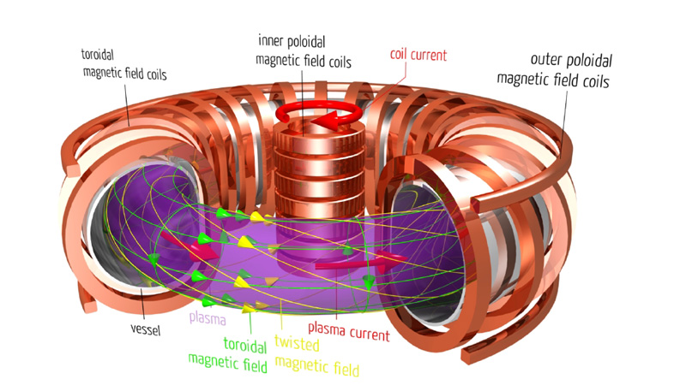
Outline
Introduction and Definition of MHD Instability
Types of MHD Instability
Predictive Tools
Concerns in Practice

Slide 3
Definition of MHD Stability
Magnetohydrodynamic (MHD) models are used to simplify the plasma component of the tokamak system
MHD stability and various instabilities determine the performance of a fusion reactor while characterizing its operational limits
Disruptions in these stabilities can lead to decreases in operational lifetime of the reactor due to material degradation and increased plasma disruptions
Notes:
(Corey)
Due to the extremely complex nature of high temperature plasmas in a tokamak, the plasma is typically modeled as a magnetic fluid to simplify the governing equations.
Magnetohydrodynamic stability and the microscopic and macroscopic effects of various classes of MHD instability underlie essentially all aspects of achievable plasma performance in tokamaks and determine the principal operational limits for tokamaks—maximum plasma current and plasma pressure and pressure gradient—and plays an important role in the closely related operational limit on maximum achievable or usable plasma density.
Since occurrence of at least a small number of disruptions is inevitable in any tokamak that seeks to explore burning plasma science in the reactor regime, the at-risk components and systems—especially the plasma-facing-component substrates and surfaces—must be designed to accommodate the immediate effects of a finite number of disruptions without premature failure or loss of function.

Slide 4
Common Terms
Beta (β): The performance of the plasma is often expressed in terms of beta. Defined as the ratio of plasma pressure to magnetic pressure
Instability: a perturbation of the plasma that has a positive calculated growth rate, resulting in an unstable condition. Can be referred to as modes
Notes:
(Reed)
Beta limit is an MHD instability driven by pressure or pressure gradients
Add that it isn’t an exact measurement since the stability analysis depends on profiles of the plasma and which modes are considered
Talk about how you can have toroidal and poloidal beta limits as well as a normalized limit.
Explain that modes are solutions to linear evolution equations, resulting in standing or propagating waves as the solutions. If equation is non linear, mode shouldn’t be used to define it

Slide 5
Outline
Introduction and Definition of MHD Instability
Types of MHD Instability
Predictive Tools
Concerns in Practice

Slide 6
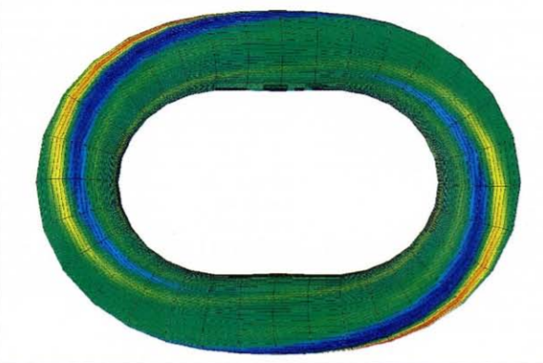
Types of MHD Instability
Ideal - Driven by current and/or pressure gradients.
Resistive - The addition of dissipation to the ideal case.
Both can be linear or nonlinear.
Impose a limit on β.
Perturbed pressure distribution at vacuum-boundary interface
Notes:
Nick

Slide 7
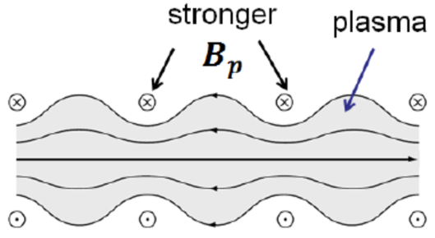


Ideal MHD: m=0
Sausage (Pinch) Instability
Considered in cylindrical plasmas with a sharp boundary.
Stability Condition:
Notes:
nick

Slide 8
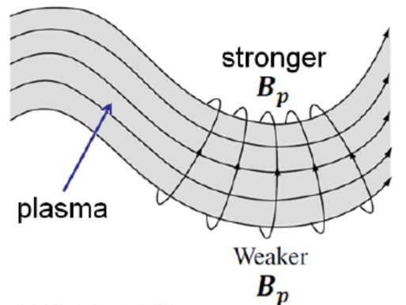
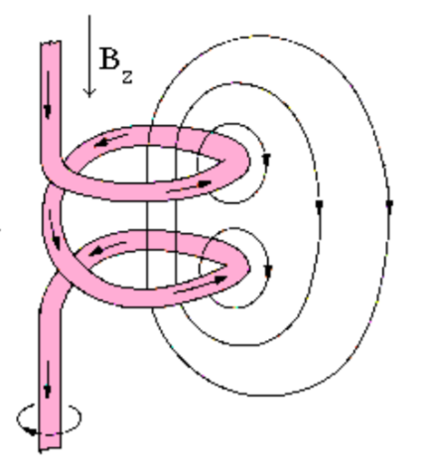

Ideal MHD: m=1
Kink Instability
Same configuration.
Stability Condition:
Operational Limit: q≥2-3
Linear
Nonlinear
Notes:
nick

Slide 9
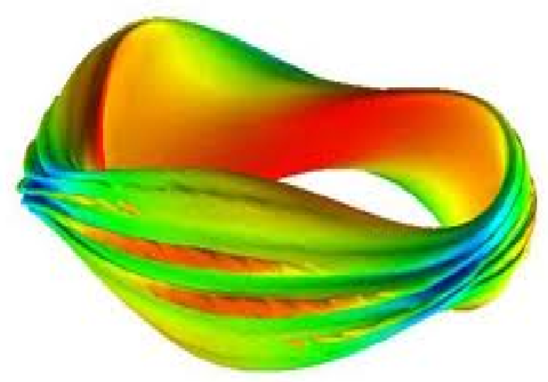

Ideal MHD: High-β
Ballooning Instability
An explosive instability.
Ballooning Limit:
Notes:
nick

Slide 10
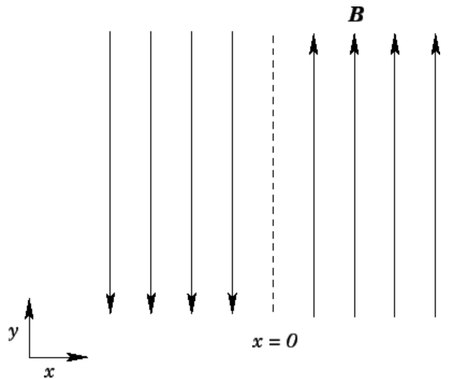
Resistive MHD: m=1
Tearing Modes
Arises in absence of perfectly-conducting PFC.
Relaxes inter-plasma interface to one of lower magnetic energy.
Magnetic Reconnection.
Magnetic energy released contributes to plasma heating.
Notes:
nick

Slide 11
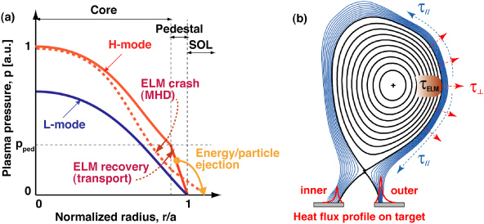
Disruptive Instability
Edge Localized Modes (ELMs)
Occurs at edge region of tokamak plasma during H-Mode transition
Major challenge because of damage to wall components (i.e. divertor plates)
ELM Crash sending plasma particles to the scrape off layer
Notes:
Reed
Talk about major energy deposition
H mode is high confinement state, energy confinement time increased
First observed at ASDEX tokamak in 1981

Slide 12
Outline
Introduction and Definition of MHD Instability
Types of MHD Instability
Predictive Tools
Concerns in Practice

Slide 13
Learning From DIII-D
For ITER development, current experimental knowledge must be configured for plasma replication
Existing tokamaks have been utilized to mirror ITER’s fusion gain, Q=10
DIII-D was used for such information, attempting to replicate key plasma parameters
Specifically, normalized plasma current I, normalized pressure β, similar aspect ratio
Such parameters combine to create an ITER baseline scenario, which can yield relevant information on the stability of such a plasma
Notes:
(Alex)

Slide 14
Plasma Disruptions
The high current present in ITER lends concern of MHD instabilities
This proved true to an extent, through direct perturbations of the DIII-D Baseline case
Initial experiments establishing the base case maintained stability; such stability collapses with the variation of neutral beam injected torque
20 Hz toroidal perturbations were introduced, measuring the plasma response
Despite low frequency, goal is to uncover underlying stability trends as a means of explaining macroscopic tearing
Notes:
(Alex)
Specifically, a reduction in NBI torque to ITER levels cases disruptions in the plasma discharge

Slide 15
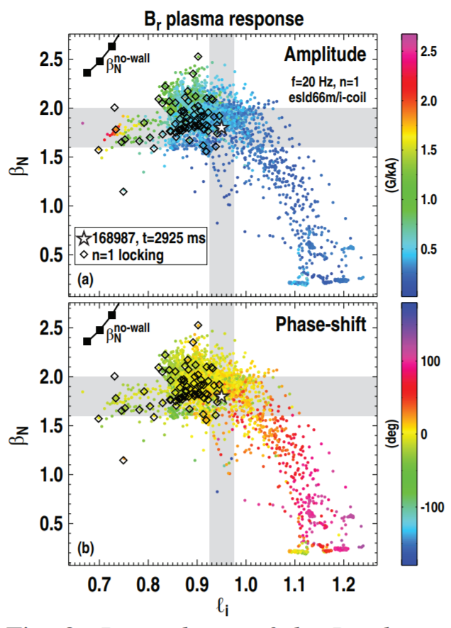
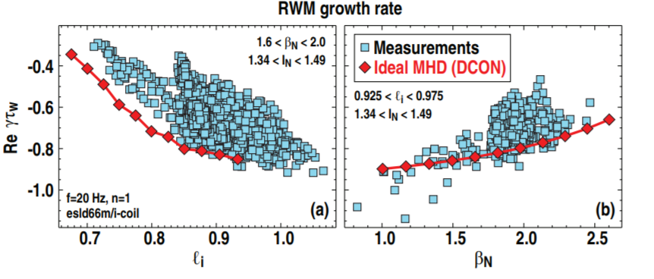
Plasma Response
Plasma stability showed sensitivity to the normalized pressure and internal inductance in particular
Resistive wall mode RWM, develop from the lack of perfectly
conducting wall
Growth rate increases with β_{N} and decreases with inductance
Measurements are closer to 0, or marginal stability, than ideal MHD calculations
Notes:
(Alex)

Slide 16
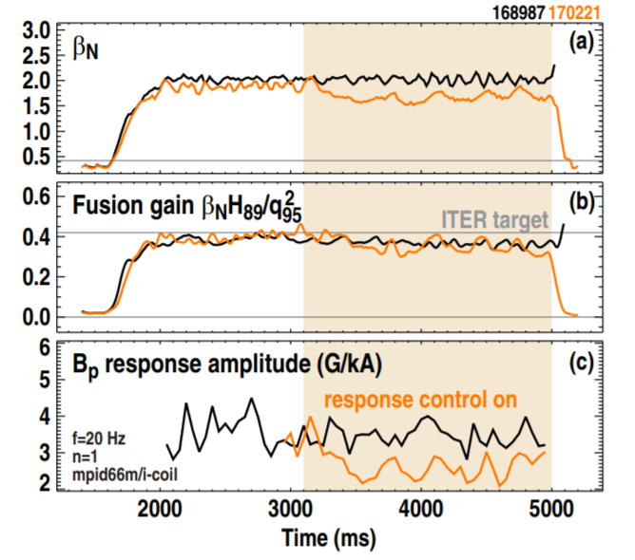

Feedback Control
Utilizing observed amplitude fluctuations, neutral beam injection is modulated to provide feedback to the system, maintaining stability despite perturbations
Closed feedback loop, consisting of gain constants, and feedback error
Feedback error between the plasma response amplitude
and a target value
Indicates direct control of stability parameters, allowing future
output optimization, maintaining stability
Notes:
(Alex)

Slide 17
ELM Simulation
ITER plasma current will result in ELMs at the edge regions, need to increase understanding to prevent major energy losses
Project Aster was developed to put together a JOREK code to evaluate high res MHD simulations of ELMs from 2007-2009
Project Aster set basis for work, did not cover full scope of ELM lifetime, specifically slow growth after crash creating another ELM
First published simulation in 2015, showed that diamagnetic effects need to be present in model equations
Notes:
Reed
Jorek is a 3D non linear MHD modeling code

Slide 18
Outline
Introduction and Definition of MHD Instability
Types of MHD Instability
Predictive Tools
Concerns in Practice

Slide 19
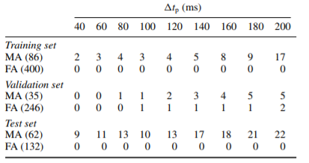
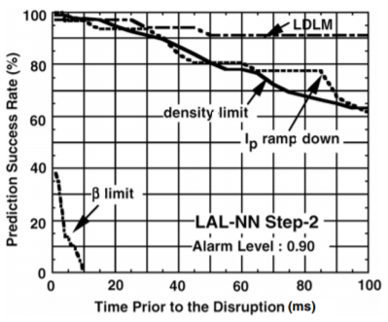
Disruption Prediction
False alarm mitigation through neural network (NN) frameworks, must undergo “training” and benchmarking
DIII-D (USA), JET (UK), JT-60U (Japan), and ASDEX Upgrade (Germany) all have performed various NN tests to find an optimal system
NN Performance for JET (left) and JT-60U (right)
Notes:
(Corey)

Slide 20
Disruption Mitigation
Most measures are still needed to be tested in a tokamak research reactor to prove their viability
  “Killer” Pellet Insertion
  Massive gas injection (MGI) into torus
  Liquid jets of cryogenically cooled gas for impurity deposition
ITER is challenged with finding the best method of mitigation that will suppress the negative effect of the disruption
Notes:
(Corey)
Pellet insertion (killer pellets) of noble gases or impurity doped deuterium thoroughly reduce both the electron current and thermal flux to the divertor
Gas injection can be performed within 10 ms of the alarm being raised for efficient instability correction, provides much faster thermal quenching compared to pellet insertion
Liquid jets are ideal, but without proper control of mass flow and pressure the liquid can damage the first wall and other plasma facing components. This has not been tested with cooled gas, but the system has been tested with water

Slide 21
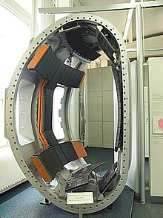
Preventing ELMs
Research is underway on methods to efficiently prevent ELM formation
One method suggested is to inject static noisy magnetic energy into containment field to decrease ELM amplitude
ASDEX Upgrade has found success using pellet injection for frequency increase to limit severity of ELM events
Model of ASDEX Upgrade system
Notes:
Reed
ASDEX upgrade is a german divertor tokamak that went into operation in 1991

Slide 22
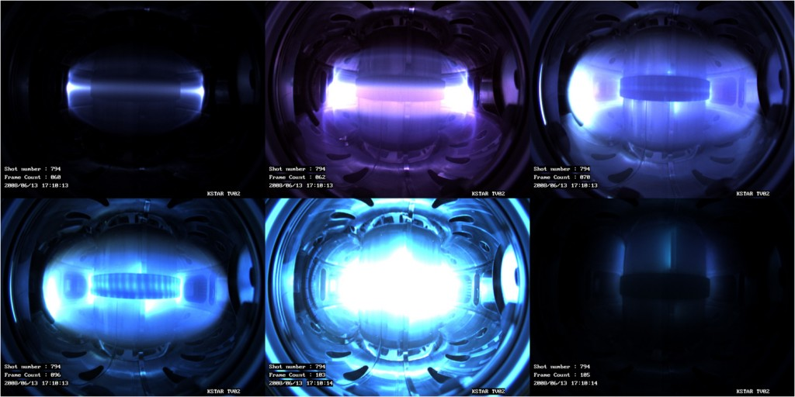
Preventing ELMs Cont.
The KSTAR tokamak in Korea asymmetric 3D magnetic field configurations to achieve this goal
Importance of ELM suppression paramount for ITER
KSTAR Tokamak achieving first plasma in 2008
Notes:
Reed
There are several methods of prevention that are working in practice.
Needs to happen since these will occur at ITER, need a strategy to compensate

Slide 23
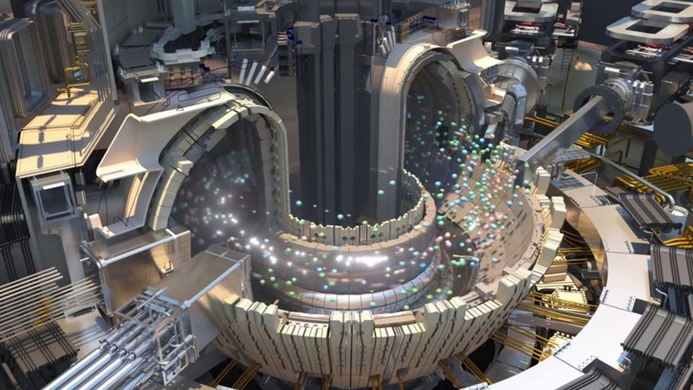
Concluding Remarks
Complete elimination is not feasible, focus is geared toward suppressing MHD instabilities when they do occur
If proper measures are not taken, the lifetime of the materials and the reactor itself will be drastically reduced
Research facilities and ITER rely on avoidance and mitigation strategies to reduce lasting negative effects
Notes:
(Corey)

Slide 24
References
F. Alladio et al. PROTO-SPHERA. (2001).
G. Khatri. Toroidal Equilibrium Feedback Control at EXTRAP T2R. (2010).
Understanding and controlling the ITER baseline plasma response. J.M. Hanson, N.C. Logan, T.C. Luce, F. Turco, G.A. Navratil, and E.J. Strait
Feedback control of the proximity to marginal RWM stability using active MHD spectroscopy. JM Hanson, H. Reimerdes, M.J. Lanctot, Y. In, R.J. La Haye, G.L. Jackson, G.A. Navratil, M. Okabayashi, P.E. Sieck and E.J. Strait
K. Miyamoto. Fundamentals of Plasma Physics and Controlled Fusion. (2000).
Physics of Plasmas 5, 2687 (1998); https://doi.org/10.1063/1.872956
Physics of Plasmas 6, 1925 (1999); https://doi.org/10.1063/1.873492
Project ASTER: http://aster.gforge.inria.fr/index.html
R. Fitzpatrick. Linear Tearing Mode Theory. (2011).
T.C. Hender et al. Nucl. Fusion 47 S128. (2000).

