Slide 1


ETI Data Science Opportunities at PNNL
Paul Whitney (PNNL)
6 November 2019
PNNL-SA-148943

Slide 2




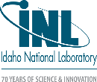
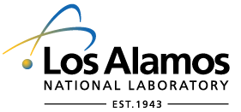


ETI National Laboratory Partners
PNNL-SA-148943

Slide 3
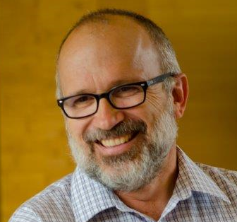
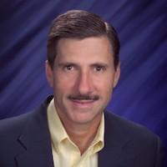
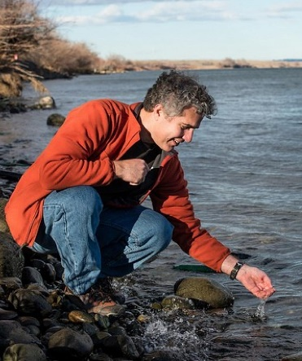
Key PNNL Staff
Paul Whitney leads PNNL’s contributions to DNN R&D Persistent Dynamics project. He also manages technical tasks in multi-source data integration whose products are both models and software for use by USG analysts. Dr. Whitney received his Ph.D. in Statistics from the University of Wisconsin with a focus on foundations of machine learning.
Dr. Robert Brigantic is Chief, Operations Research Scientist whose research includes operationalizing methodologies for national security risk analysis; modeling and simulation of operational radiation/nuclear detection processes; systems analysis; and optimization of renewable energy systems and energy efficiency measures.
Amanda Lines has significant technical experience in the design and development of sensors and on-line monitoring systems for detection and quantification of nuclear fuel cycle relevant analytes. Amanda graduated from Washington State University with her Ph.D. in analytical chemistry after earning her B.S. degrees in chemistry and chemical engineering from Purdue University.
George Bonheyo is a molecular microbiologist at the Pacific Northwest National Laboratory and a Research Professor in the Department of Chemical Engineering and Biological Engineering at Washington State University. Dr. Bonheyo is collaborating with Prof. Brian Clowers at Washington State University to examine whether radio trophic fungi (organisms able to convert gamma radiation to chemical energy) may be used to detect and quantify radiation exposure.
PNNL-SA-148943

Slide 4
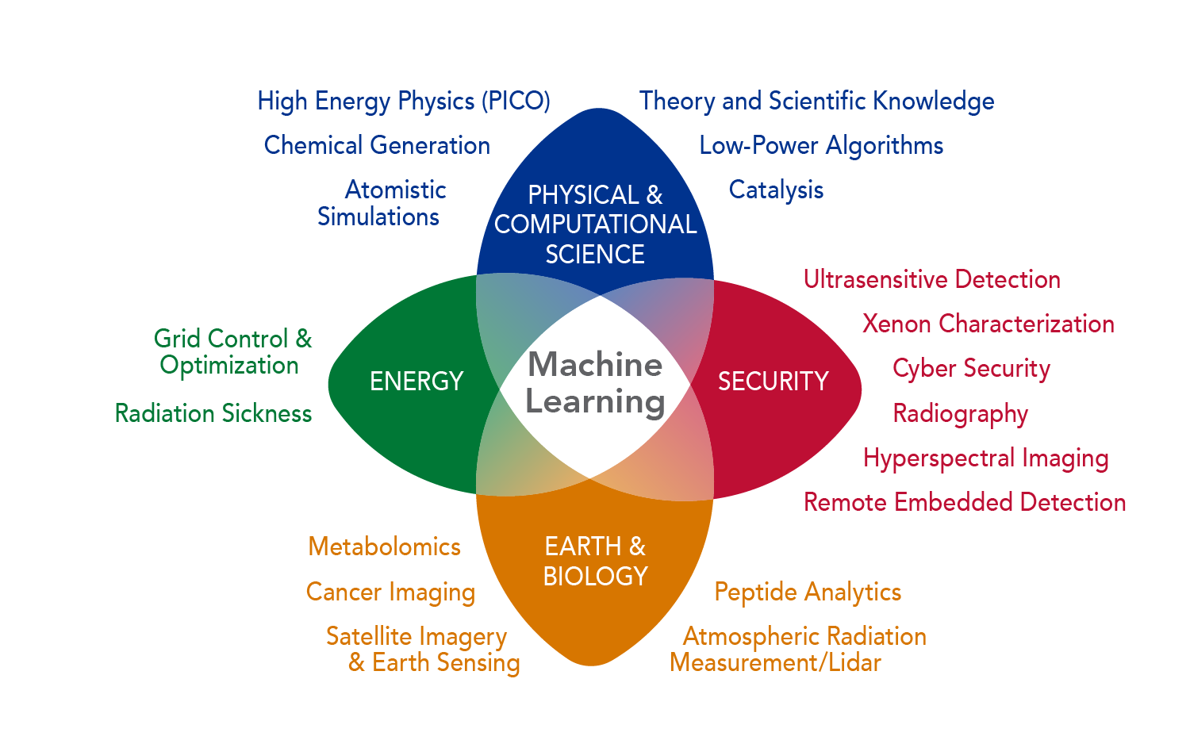
Pacific Northwest National Laboratory (PNNL)
Core capabilities relevant to ETI:
  Nuclear sciences
  Data analytics and machine learning / data visualization
  Operations research
  Biological / chemical sciences
Key facilities relevant to ETI
  Radiochemical Processing Laboratory's (RPL)
  Cloud services / GPU clusters
  Additional Scientific Facilities (see Luke Erikson’s presentation)
PNNL-SA-148943

Slide 5
Pacific Northwest National Laboratory (PNNL)
Key ETI TA1 related projects and programs
  Advanced Data Analytics for Proliferation Detection (ADAPD)
  Persistent Dynamics
  Lab Directed Research and Development
    MARS – Mathematics for Artificial Reasoning in Science
Other thrust area projects
  Optical spectroscopy combined with modeling to understand molten salt systems (TA2)
  Biological sensors for stable isotope labelling (TA3)
  …
PNNL-SA-148943

Slide 6
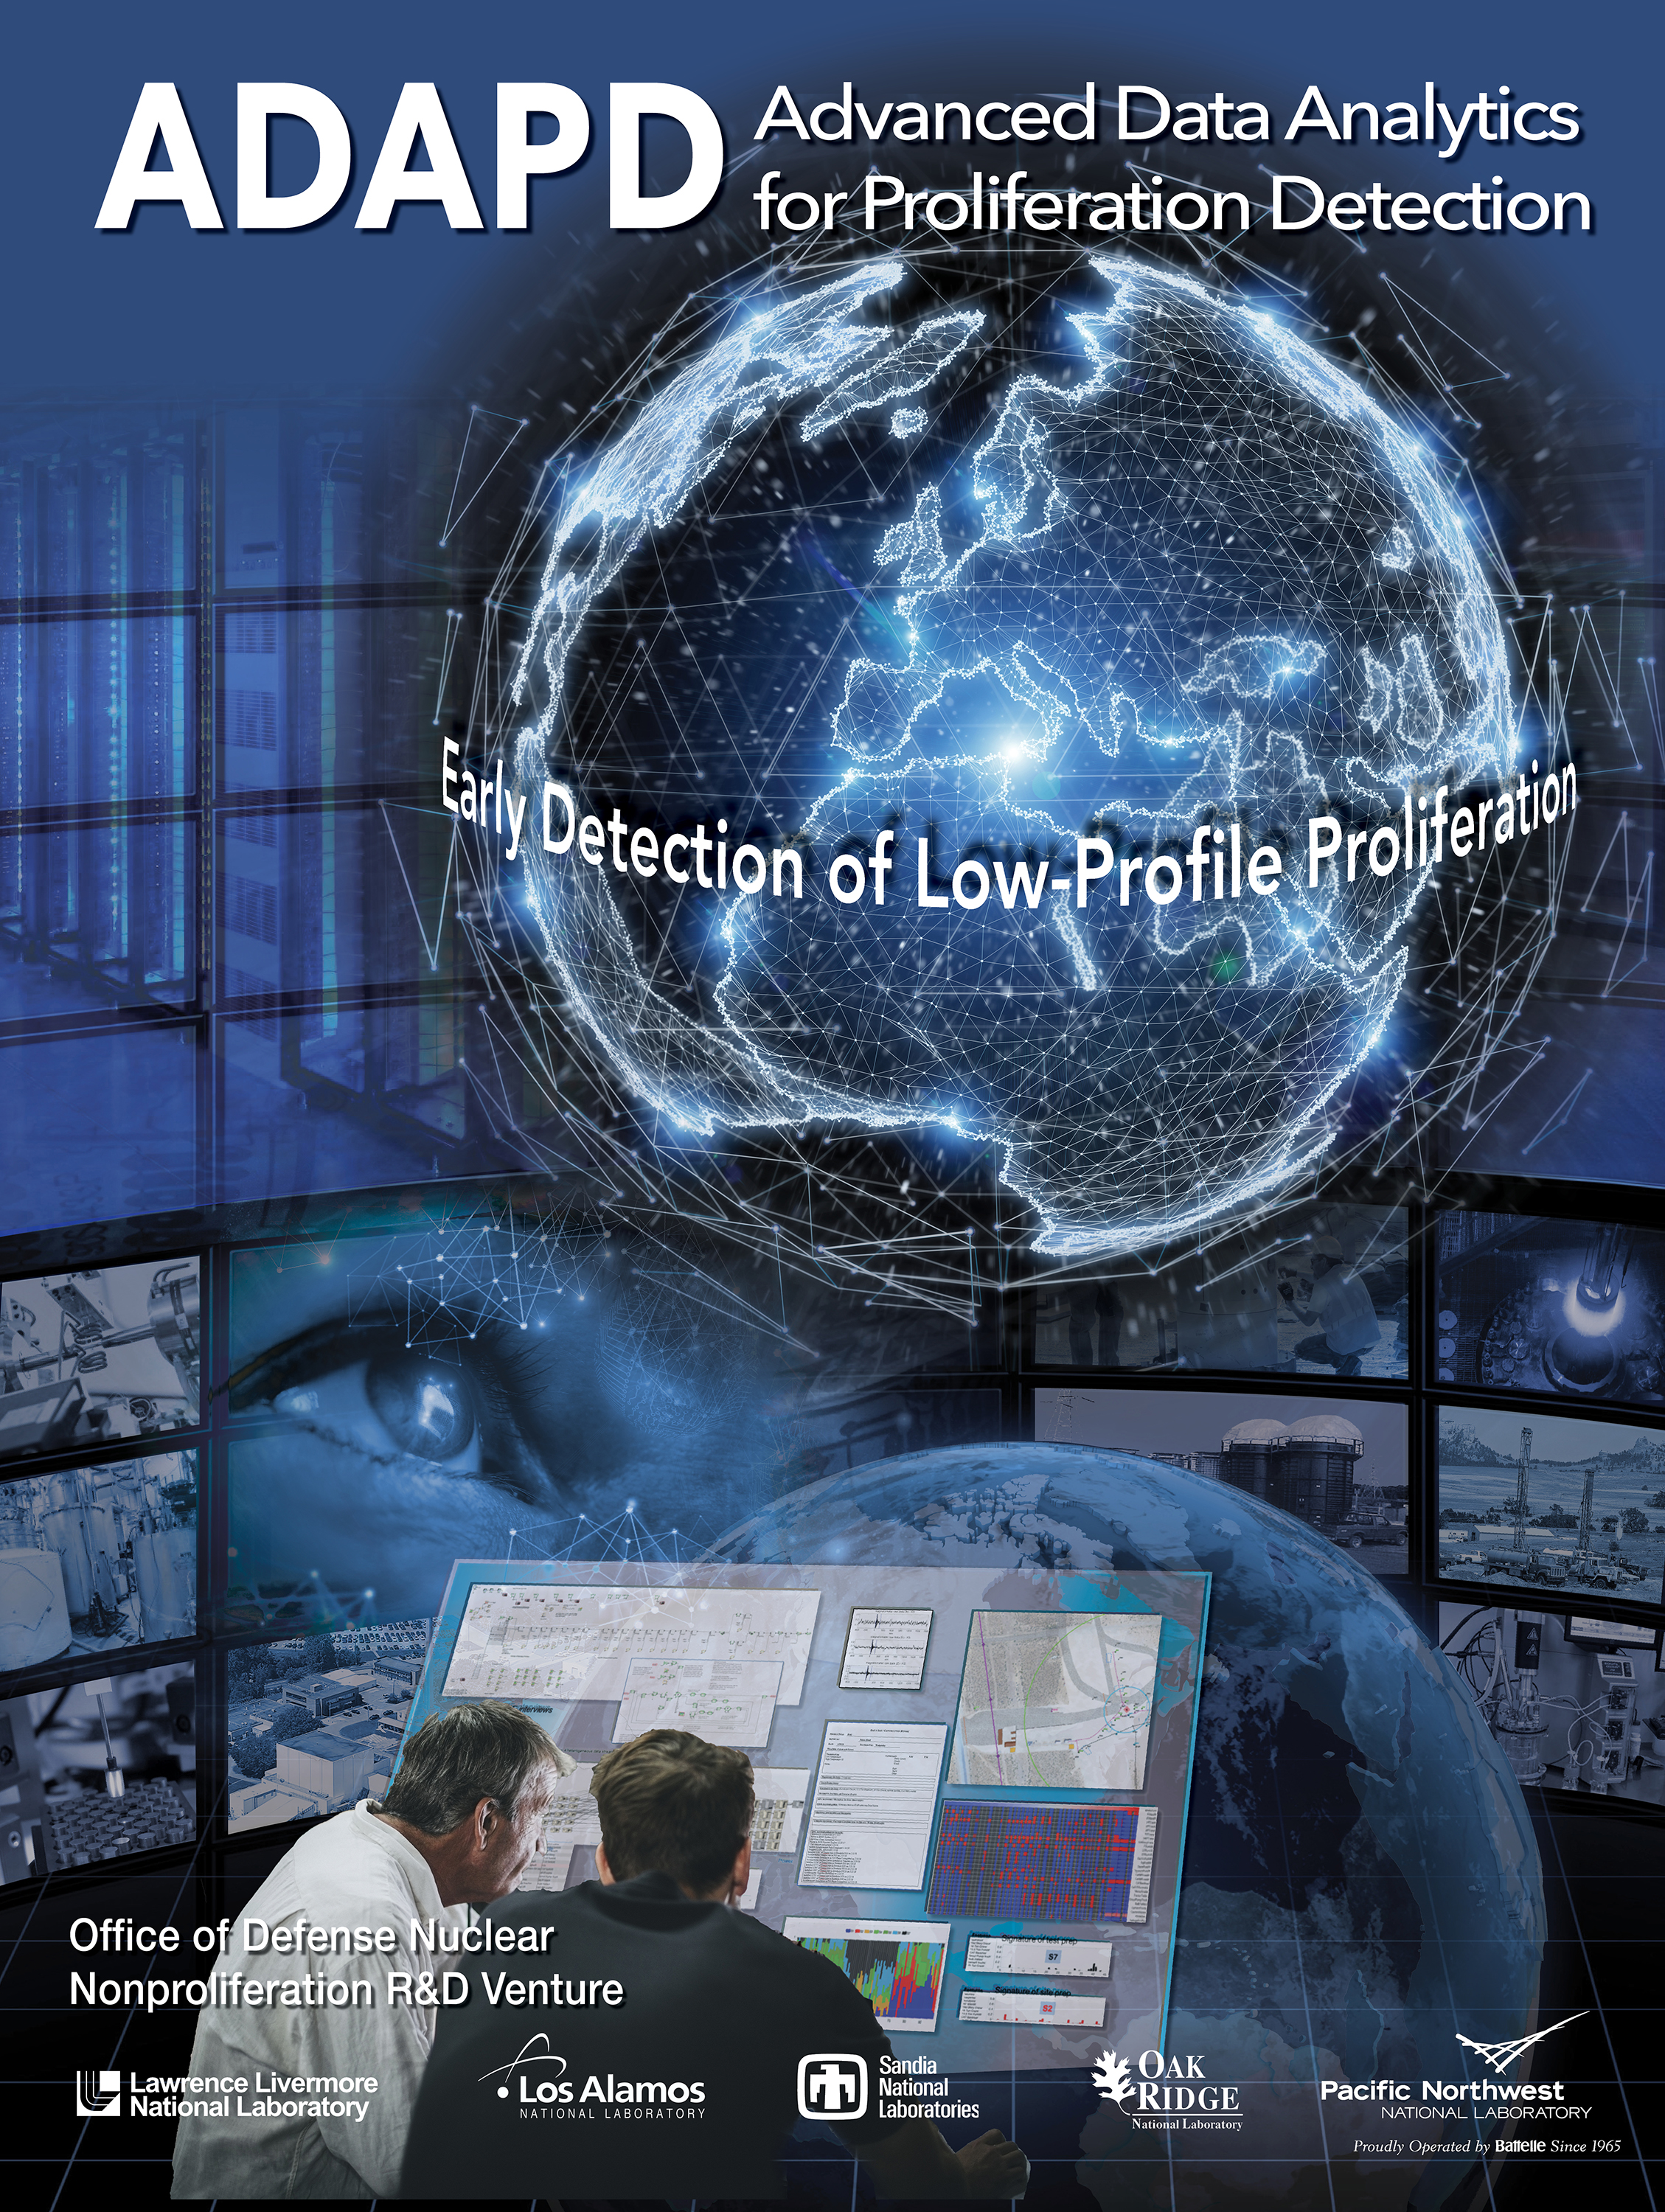
ADAPD’s focus is Early Detection of
Low-Profile Nuclear Proliferation
One of the most critical objectives of nuclear proliferation R&D is to improve early-warning capabilities.
The central idea:
Integrated exploitation of all relevant information
To do this, ADAPD will bring together
  Rapidly advancing capabilities in data science
  Deep DOE/NNSA Subject Matter Expertise on nuclear weapons development
  Unique DNN R&D testbeds and experimental data
PNNL-SA-148943

Slide 7
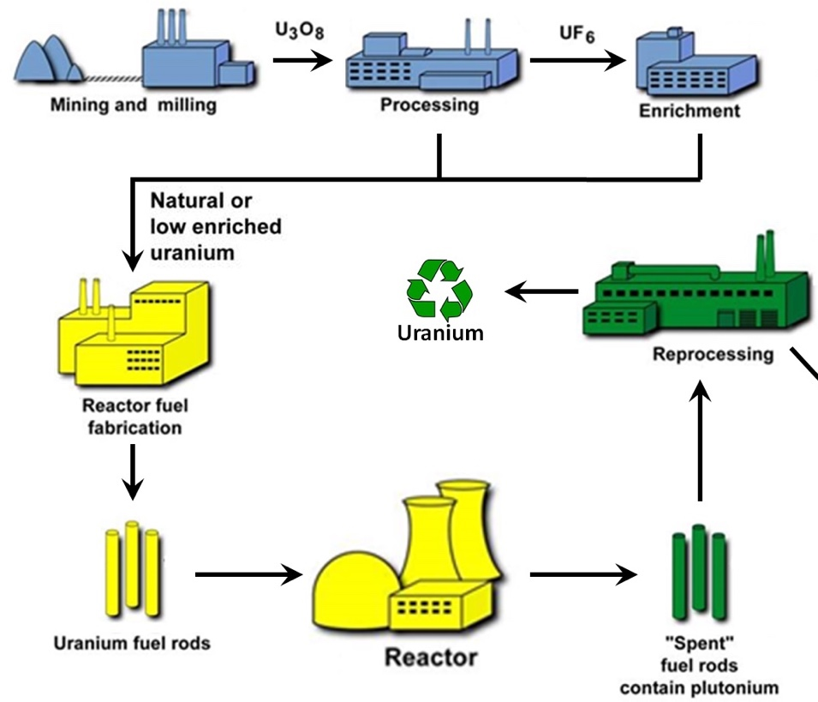
Persistent Dynamics Venture
Six laboratory research venture funded by NNSA/DNN R&D Remote Sensing Portfolio to develop a multi-sensor ‘persistent’ capability
Includes research activities in:
  Sensor information reduction
  Fuel cycle process and activity modeling
  Robust middleware computing environments
  Inference algorithms:
    Which processes are active?
    Value of information
    Machine learning applications
Goal: 2022 design and test a prototype software system
PNNL-SA-148943

Slide 8
Mathematics for Artificial Reasoning in Science (MARS LDRD)
Challenge 1: Transparency
How might we build AI systems that provide interpretable, defensible explanations that are rooted in the language and concepts of science models?
Challenge 2: Autonomy
How might we design AI systems that provide trusted autonomy and strategic reasoning under unanticipated conditions so that such systems can still maximize their chance of achieving their scientific objectives?
Challenge 3: Domain Aware
How might we design AI systems to become more aware of the domain science that underlies the phenomena so that predictions and reasoning are informed by physical laws and limitations?
PNNL-SA-148943

Slide 9
Student Opportunities at PNNL
With Consortium Funding – there are plenty of relevant projects/research to work
Or (deadlines vary)
Internships for graduate students
  National Security Internship Program (NSIP)
    PNNL funded summer and co-op internships
  Alternate Sponsored Fellows (ASF)
    Mechanism for externally funded internships such as ETI student fellows
Other relevant programs/information
  NNSA Graduate Fellowship Program (NGFP)
  Additional summer courses available
    Data Science for Safeguards Practitioners (every other summer)
    Radiation Detection for Nuclear Security
    Nonproliferation and International Safeguards Summer Course
  Joint faculty assignments
https://www.pnnl.gov/stem-internships
https://ngp.pnnl.gov
PNNL-SA-148943

Slide 10
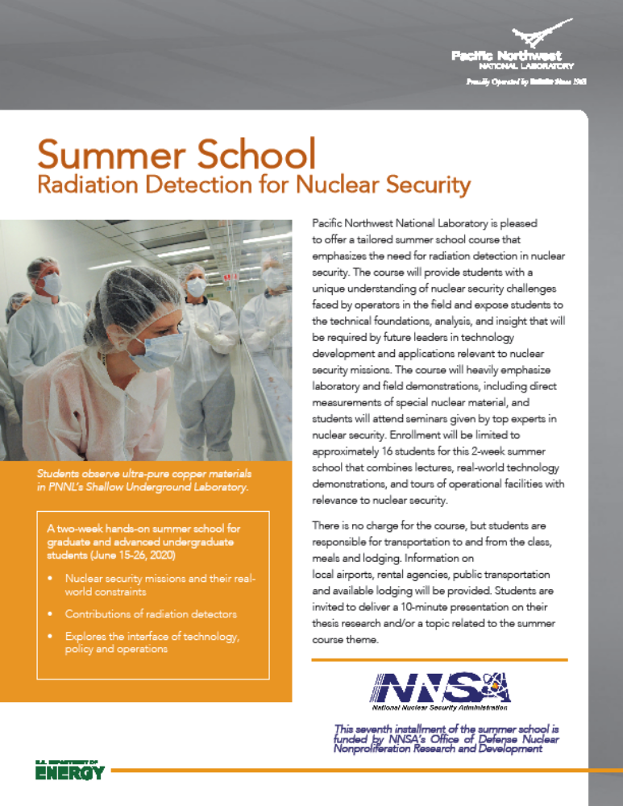
Summer School
Radiation Detection for Nuclear Security
June 15-26, 2020
For more info:
http://workbasedlearning.pnnl.gov
Ben McDonald, Physicist benjamin.mcdonald@pnnl.gov
James Baciak, Associate Professor Nuclear Engineering Program University of Florida jebaciak@mse.ufl.edu
PNNL-SA-148943

Slide 11
Thanks!
Robert.Brigantic@pnnl.gov
Paul.Whitney@pnnl.gov
George.Bonheyo@pnnl.gov
Amanda.Lines@pnnl.gov
PNNL-SA-148943

