Slide 1
Thrust Area 1 Overview: Computer & Engineering Sciences for Nonproliferation
Paul Wilson, UW-Madison
November 5, 2019

Slide 3
Overview
Background
Collaborators
Research subtopics
Cross-cutting projects

Slide 4
Background - Motivation
Machine learning is becoming ubiquitous across industry sectors
Abundance of data across many modes
Improved algorithms
Powerful computing hardware

Slide 5
Background - Challenges
Obstacles to applications in nuclear non-proliferation applications
Different incentives for algorithm development
Limited access to relevant data streams
Small community of experts

Slide 6
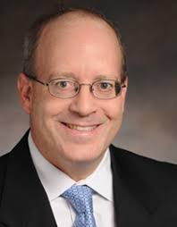
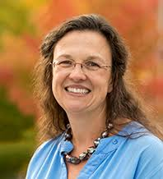
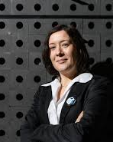
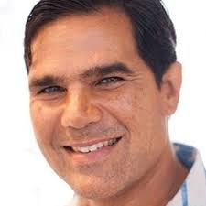
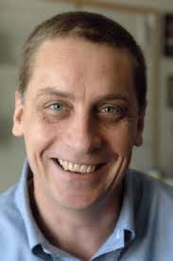
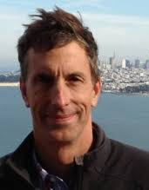
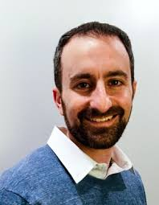
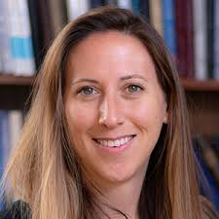
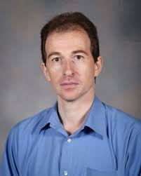
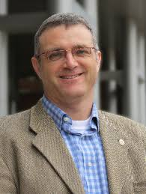
University Collaborators
Larry Carin
Duke U
Aurora Clark
Washington State U
Anna Erickson
GA Tech
John Fisher
MIT
Milton Garces
U. Hawai’i
Al Hero
U. Michigan
Jon How
MIT
Rob Nowak
U. Wisconsin- Madison
Jon Rogers
GA Tech
Jen Shafer
Colorado School of Mines
Pavel Tsvetkov
Texas A&M U.
Paul Wilson
U. Wisconsin- Madison

Slide 7
National Laboratory Partners

Slide 8
Framework for Rapid Evaluation of Novel Algorithms & Data Streams
Historical challenge with connecting academic data analytics experts with relevant data sets
Common testing framework
Algorithms
Existing
&
Novel
Data Streams
Existing
&
Novel

Slide 9
Challenges at the Interface Between Algorithms & Data Streams
Varying spatio-temporal resolution
Noisy data
Limited sample size
Uncalibrated sensors
Incompatible data types
Goals
Timeliness
Uncertainty quantification

Slide 10
Fundamental Advances in Data Science Algorithms
Leverage ongoing improvements in machine learning algorithms
Reducing the quantity of labeled data needed for robust analysis
Nonlinear kernel machines
Interactive machine learning
Assessing data quality and value of information

Slide 11
Incorporation of Ad-hoc Data Streams
New sensor platforms are being deployed every day
Best example: Smartphones
Growing scope of measurements
High volumes of heterogeneous data
Intermittent and uncalibrated
Build on existing software platforms for real-time streaming of novel data

Slide 12
Machine-guided Learning and
Data Collection
Overarching theme to guide consortium developments at various levels
Identify most valuable data to incorporate into machine learning framework
Individual data objects to be labeled by “expensive” labeling processes
Select among possible additional data streams in resource-constrained environments
Update goal of robot swarm for remote data collection

Slide 13
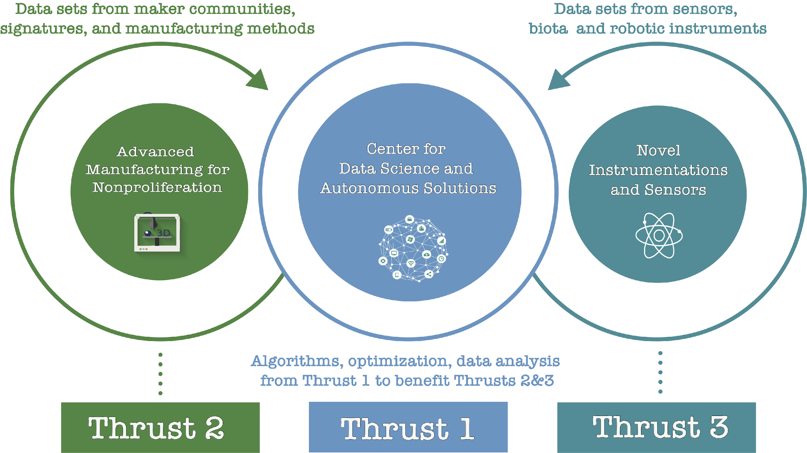
Cross-Consortium Engagement

Slide 14
Sample Project
Behavior Inference from Integrated Fuel Cycle System Models
Identify material diversion pathways in complete nuclear fuel cycles
Simulate signatures of material composition and flow
Various machine learning techniques applied to simulated signals to infer behavior of facility agents
Collaboration with MTV on facility modeling/signatures

Slide 15
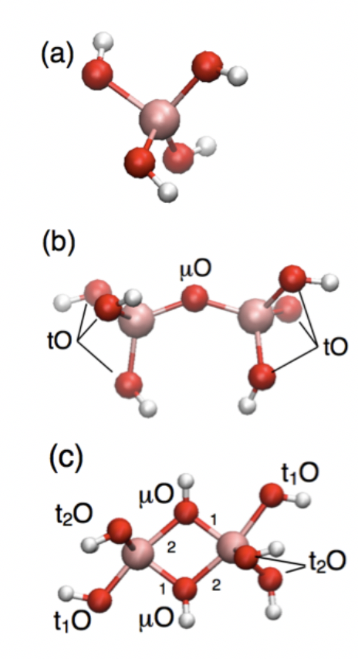
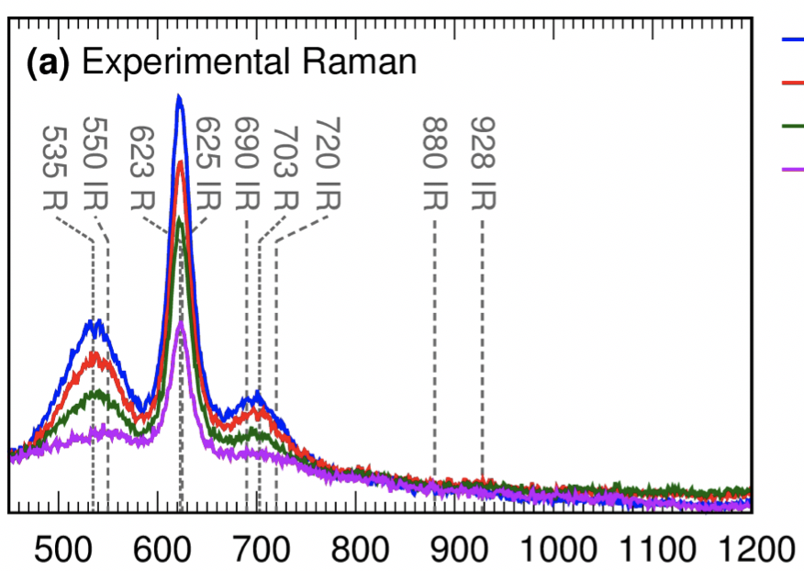
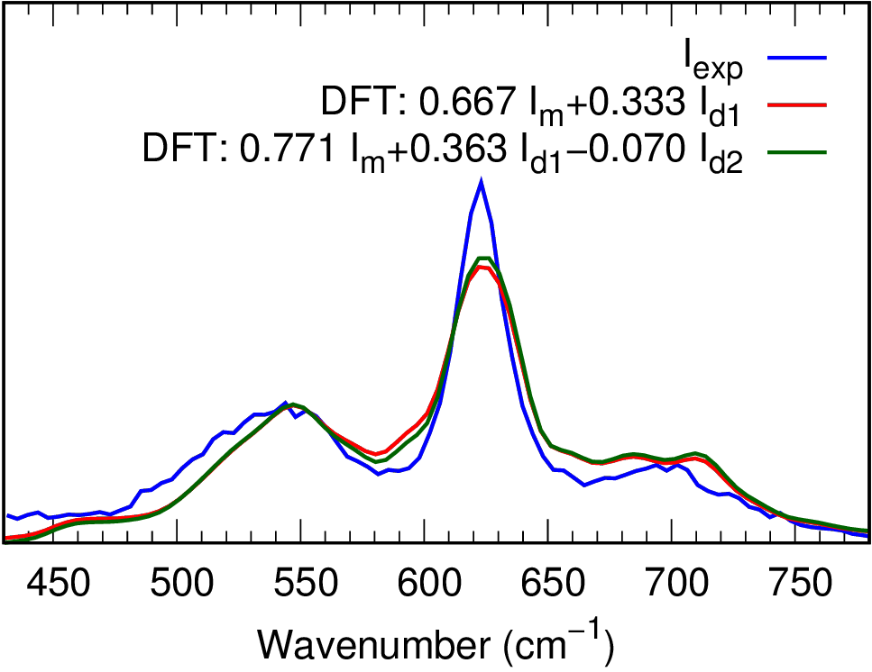
Sample Project
Online Monitoring of Chemical Separation Processes
Spectroscopy measures ensemble signatures of all chemical species
Some signatures may overlap, preventing quantitative identification of the composition of all species
Molecular modeling and simulation can provide speciation profiles and simulated signatures for UQ

Slide 16
Thrust 1 Speakers
Wesley Gillis, Georgia Tech*
Pavel Tsvetkov, Texas A&M University
Paul Whitney, Pacific Northwest National Laboratory
Milton Garces, University of Hawaii at Manoa
David Peters, Sandia National Laboratories

