Slide 1
Thrust Area 2: Advanced Manufacturing
Steven Biegalski
November 5, 2019

Slide 2
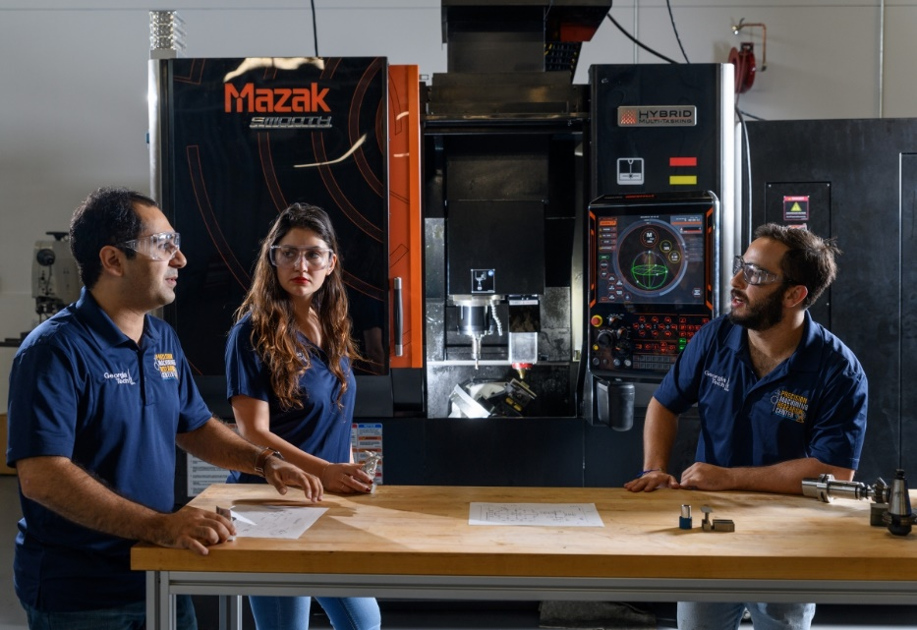
Outline
Contributors
Background
Additive Manufacturing
Micro-Manufacturing
Maker-Communities
Conclusions

Slide 3
Contributors to Thrust 2: Advanced Manufacturing
Subtopic Area | Consortium Members | National Lab Collaborators | Students
Additive Manufacturing | J. Beaman (UT) D. Haas (UT) S. Biegalski (GT) M. Short (MIT) B. Clowers (WSU) P. Tsvetkov (TAMU) | K. Terrani (ORNL) A. Roach (SNL) N. Leathe (SNL) D. Korzekwa (LANL) P. Dunn (LANL) | 4
Micro-manufacturing | J. Beaman (UT) D. Haas (UT) A. Jariwala (GT) B. Clowers (WSU) P. Tsvetkov (TAMU) | K. Terrani (ORNL) A. Roach (SNL) N. Leathe (SNL) D. Korzekwa (LANL) P. Dunn (LANL) | 3
Maker-communities | A. Jariwala (GT) M. Garces (UK) P. Tsvetkov (TAMU) | K. Dayman (ORNL) | 2
Universities:
University of Texas
University of Wisconsin
Massachusetts Institute of Technology
Washington State University
Texas A&M University
Georgia Institute of Technology
National Laboratories:
Oak Ridge National Laboratory
Sandia National Laboratories
Los Alamos National Laboratory
Note: The subtopic area of micro-reactors was removed from Thrust 2.

Slide 4
Additive Manufacturing
Advanced manufacturing methods that may be utilized for nuclear proliferation will be evaluated and identified.
Assessment will include a focus on technologies capable of utilizing specific materials including special nuclear materials, high explosives, and byproducts of the nuclear fuel cycle.
Electronics for advanced manufacturing technologies will include robotic systems, control systems, and chip sets.
Extrusion methods for energetic materials will be evaluated for their ability to make precise shapes.
High precision metal-based additive manufacturing and micro-manufacturing systems are considered for their ability to produce specific enrichment technologies and other key nuclear components.

Slide 5
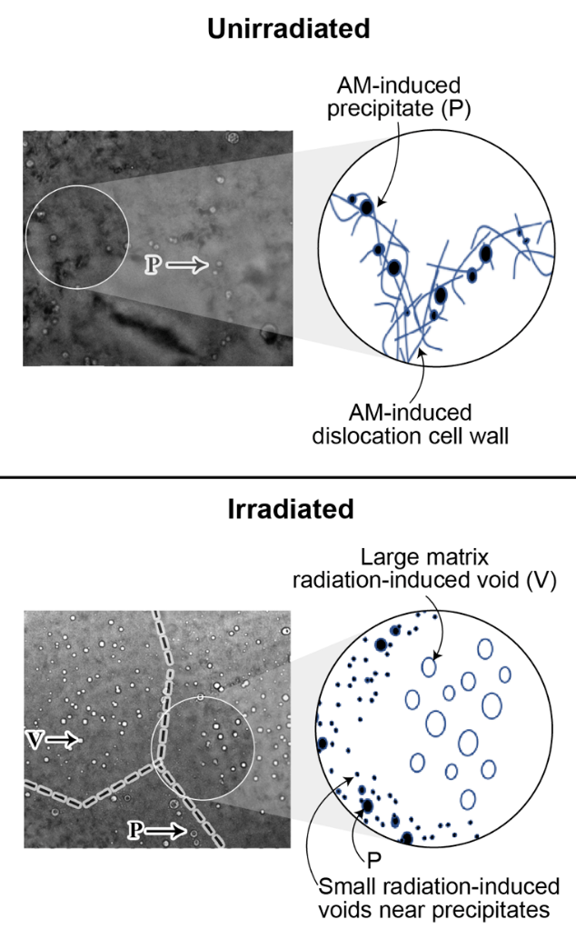
Additive Manufacturing - Thoma (UW-Madison)
Definition of key research cross-cuts that align with specific objectives of the thrust
Advanced Manufacturing Signatures
  Predictive additive manufacturing
  Understand unique processing-structure-property relationships
  Define signatures with high-throughput experiments
Key Research
  Novel properties and performance
  Physical signatures at the mesoscale
  High-throughput experiment signatures
    Energy
    Optical
    Acoustic
Physical mesocale features that enhance radiation tolerance in stainless steel

Slide 6
Analysis of Normal and Additively Manufactured Enrichment Materials – Short (MIT)
Using rapid, sensitive techniques (Flash DSC, transient grating spectroscopy (TGS)) to determine whether materials have been irradiated, and how much
Tiny amounts of radiation damage leave thermal and energetic signatures in materials
Flash DSC allows the energetic signature of tiny amounts of material (1ng – 1μg) to be measured
  Preliminary results using normal DSC show sensitivity to less than one weapon’s worth of 5% ²³⁵U enrichment
TGS can sense <mDPA of damage via changes in thermal diffusivity – see S. E. Ferry et al. J. Nucl. Mater. 523:378-382 (2019). Link to paper
Detection of 5% enrichment
Fluence expected from roughly one weapon’s worth of UF₆ enrichment
Detection of 90% enrichment
5% enrichment
90%
enrichment
Detection of UF6-equivalent radiation damage by DSC. Enrichment level detection is also believed to be possible, and will be explored in this thrust.

Slide 7
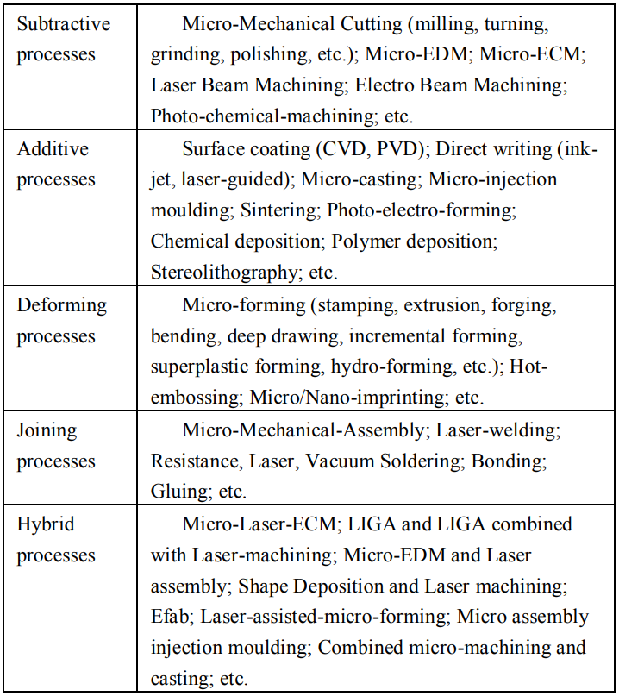
Micro-Manufacturing
Micro-manufacturing may be thought of in terms of a miniature factory.
Small manufacturing systems may be assembled to produce a product with a smaller consumption of resources.
  Materials
  Energy
  Infrastructure
Razali and Qin, “A Review on Micro-manufacturing, Micro-forming and their Key Issues,”
Procedia Engineering, 53, 665-672, 2013.

Slide 8
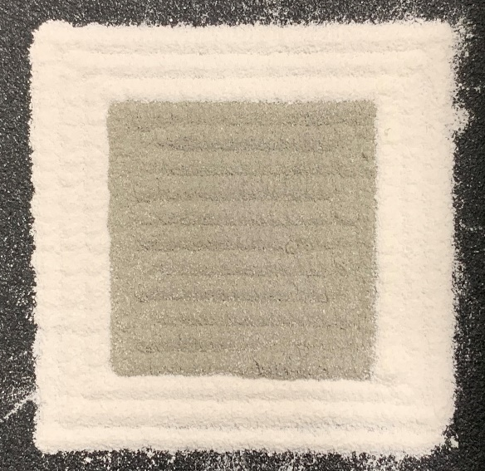
Additive and Micro-Manufacturing
Beaman and Haas (UT)
Process Control
Controlling process variables to reduce standard deviation of finished part properties
In-situ Monitoring
Imaging/Characterization techniques to allow for layer-by-layer “inspection” of parts
Multi-Material
Combine additive and micro-manufacturing to produce functional materials with nuclear applications.
Deposited Multiple-Material Powder Bed (Pre-sinter)
For example:
Fuel + cladding + heat removal
Actinides (surrogates) in complex geometries

Slide 9
Maker Communities
Methods to classify and assess makerspaces will be studied to differentiate between hackerspaces, educational makerspaces, specialty manufacturing shops and others.
An assessment framework for advanced manufacturing capabilities of a physical makerspace and the makerspace community will be developed. This framework will help develop key characteristics of maker communities that make them uniquely capable to support proliferation related activities.
Low-cost sensor technology will be developed to monitor side channel data from makerspaces. These technologies will be validated to asses their ability to accurately detect and track usage patterns within a makerspace, and thus assess manufacturing capabilities of the associated maker community.
A repository of publicly available online tools and resources for makerspaces will be curated. This database will aid in development of cyberspace detection strategies.

Slide 10

Maker Communities - Jariwala (GT)

Slide 11
Cross-Cutting Projects
Advanced Manufacturing for nonproliferation efforts will be aligned into four discrete projects that align with the objectives mentioned above. All the projects include the subtopic areas of additive manufacturing, micro-manufacturing, and maker-communities.
Identification of Advanced Manufacturing Techniques and Key Properties
Physical Signatures
Digital and Electronic Signatures
Side Channel Signatures

Slide 12

Big Data & Machine Learning – Biegalski (GT)
Advanced manufacturing systems are heavily instrumented to provide quality control data.
Quality Control data provide information on the manufacturing process.
The combination of these data may provide unique signatures on the activities conducted and items being manufactured.
Machine learning algorithms will be utilized by ETI to identify the importance of each data channel and to identify unique signatures.

Slide 13
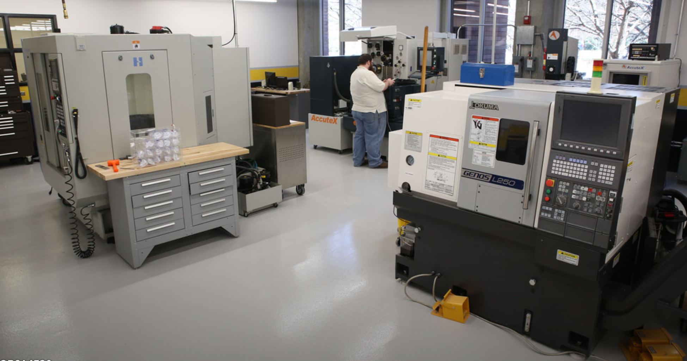
Conclusions
Advanced Manufacturing for Nonproliferation, is represented by material scientists, nuclear engineers and specialists in maker communities to address the most pressing needs in enabling technologies to determine unique signatures resulting from use of advanced manufacturing.
Results will be a foundation for policy formulation to address these concerns.

Slide 14
Thrust 2
William Smith, Washington State University
Dan Thoma, University of Wisconsin – Madison
Rachel Connick, Massachusetts Institute of Technology
Philip Bingham, Oak Ridge National Laboratory

