Slide 1

Brainstorming for Advanced Manufacturing Thrust
Derek Haas
Nov 6, 2019

Slide 2
















Slide 3
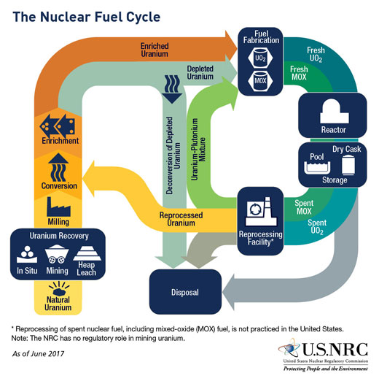
U Weapon
Pu Weapon
90+%
²³⁵U
3-5% ²³⁵U
Pu/U Sep
UF₆
U₃O₈
Yellowcake
0.05-1% of Rock
0.72% ²³⁵U
Rock
(Mill Tailings)
Modified from:

Slide 4
Process Control & In-situ Monitoring
Process Control
Controlling process variables to reduce standard deviation of finished part properties
  Mechanical, Thermal, Chemical, Geometrical, etc…
In laser powder bed fusion the main control variable is ensuring post-sintering temperature is equal across the entire powder bed
  Can be done by eliminating pre-sintering temperature gradients in the powder bed and using constant laser power (Very Difficult)
  Can be done by varying laser power across the powder bed to account for the temperature gradients (less power where hotter, more power where colder)
Notes:
In-situ monitoring would help for quicker part qualification in nuclear, and inspection of internal features. Process control will help process resolution allowing for tighter tolerances, etc. once more work is done in these areas. Also, AM part properties do vary from traditional methods but this work helps bring them closer to the properties found from traditional manufacturing processes.

Slide 5
Process Control & In-situ Monitoring
In-situ Monitoring
Imaging/Characterization techniques to allow for layer-by-layer “inspection” of parts
  Can ensure no defects are present in the part
Can reduce wasted material/time if defects are present in the part
  Identify the part will be scrap before the part is fully finished
  Potential for in-situ defect mitigation to salvage part
Notes:
In-situ monitoring would help for quicker part qualification in nuclear, and inspection of internal features. Process control will help process resolution allowing for tighter tolerances, etc. once more work is done in these areas. Also, AM part properties do vary from traditional methods but this work helps bring them closer to the properties found from traditional manufacturing processes.

Slide 6
Process Control & In-situ Monitoring @ UT-Austin
Process Control (LAMPS, Polymers)
  Utilize boresight infrared camera to measure post-sintering temperature at specific locations of the powder bed.
  Data allows for in-situ laser power adjustments to achieve equal post-sintering temperatures across entire powder bed [1].
In-situ Monitoring (LAMPS, Polymers)
  Utilize optical coherence tomography (OCT) to image each layer during a build (can see ~10 layers deep when melted) [2].
  Allows for real time defect detection such as pores in part or curling during the SLS process.
References
[1] T. Phillips, S. Fish, J. Beaman. Development of an automated laser control system for improving temperature uniformity and controlling component strength in selective laser sintering. Additive Manufacturing, 24 (2018), pp. 316- 322
[2] A. Lewis, et al. In-situ Process Monitoring and ex-Situ part Quality Assessment of Selective Laser Sintering Using optical Coherence Tomography. Solid Freeform Fabrication. Proceedings of the 27th Annual International Solid Freeform Fabrication Symposium (2016), pp. 1397-1411
Notes:
“curling” is one of the most common issues in powder bed fusion and can cause the build to be a failure. Powder will “curl” up raising that area of the part above the powder bed surface. This can cause the roller that deposits the new layer of powder to hit the part and compromise the build.

Slide 7
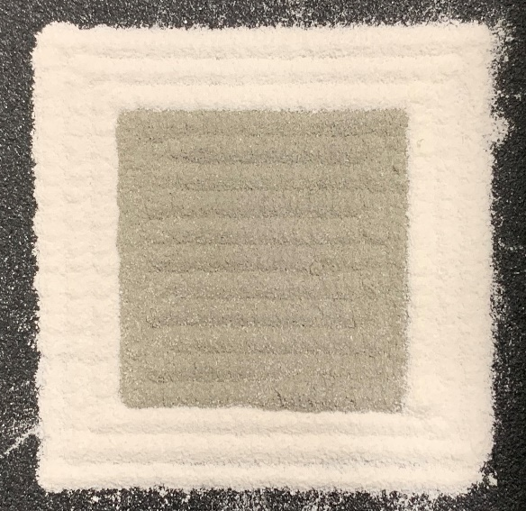
Multiple-Material Powder Bed Fusion (MMPBF)
Current multiple-material AM processes are limited by low strength parts, a limited range of materials, and poor dimensional accuracy (FDM, Material Jetting, DED)
The University of Texas MMPBF will enable multiple-material part applications with the strengths of PBF (Wide range of materials: metals, polymers, ceramics, and composites, great part strengths and material properties, good geometrical accuracy, minimal post processing)
Applications and impact of a MMPBF Machine
Match material properties to the functional requirements of a part
Imbedded sensing
Cooling and Heating channels
Exterior coatings
Reduction of part count and assembly
Deposited Multiple-Material Powder Bed (Pre-sinter)
Notes:
I bolded the applications that I think are most relevant for us

Slide 8
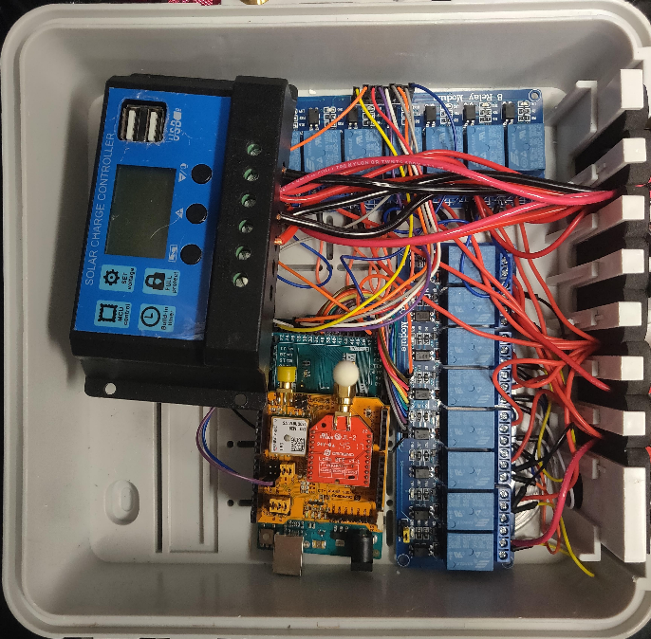
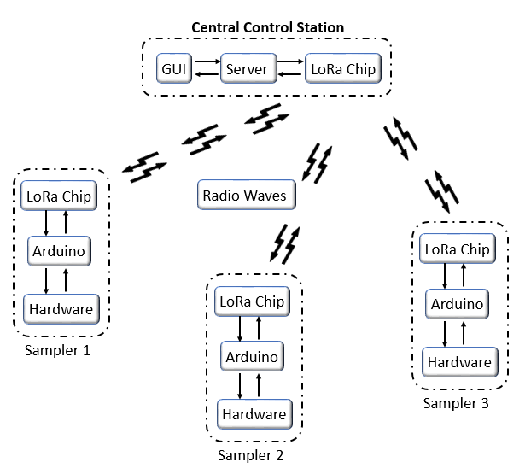
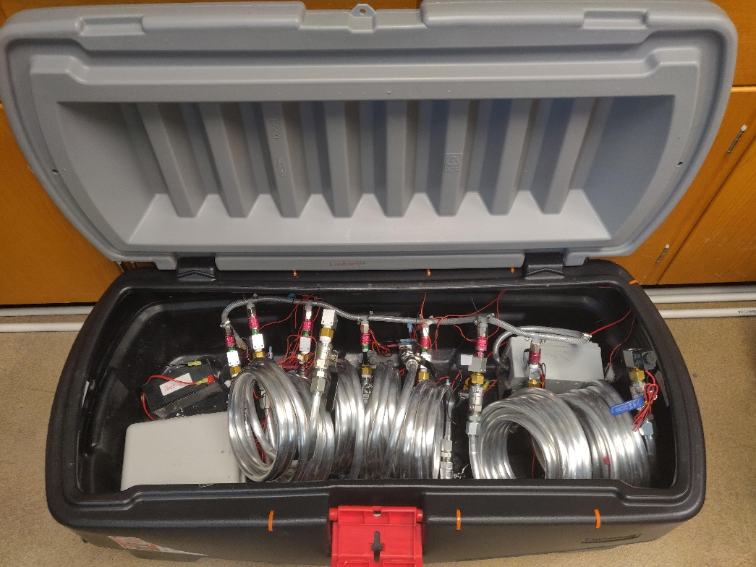
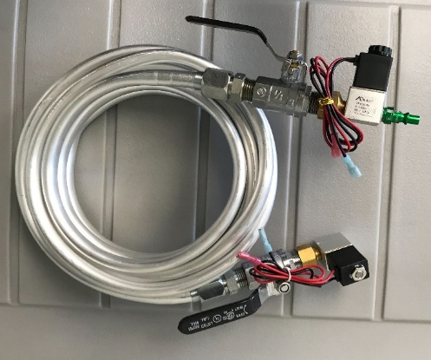
Signatures
Sampling during the testing process
Gaseous and particulate collections
Mass spec for stable and long-lived isotopes
Electronic and waveform signatures
Material characterization post-processing

Slide 9

Other Research Topics
Explosives (Extrusion)
Embedded Sensors
Structural Materials

