Slide 1


mRNA: Efficient Mapping Space Exploration for a Reconfigurable Neural Accelerator
http://synergy.ece.gatech.edu
Zhongyuan Zhao&, Hyoukjun Kwon*, Sachit Kuhar#, Weiguang Sheng&, Zhigang Mao&, and Tushar Krishna*
& Shanghai Jiao Tong University
* Synergy Lab, Georgia Institute of Technology
# Indian Institute of Technology Guwahati
ISPASS 2019, March 26

Slide 2
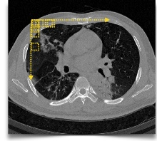

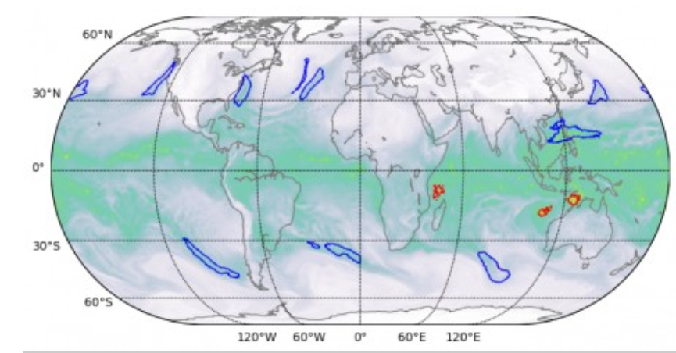

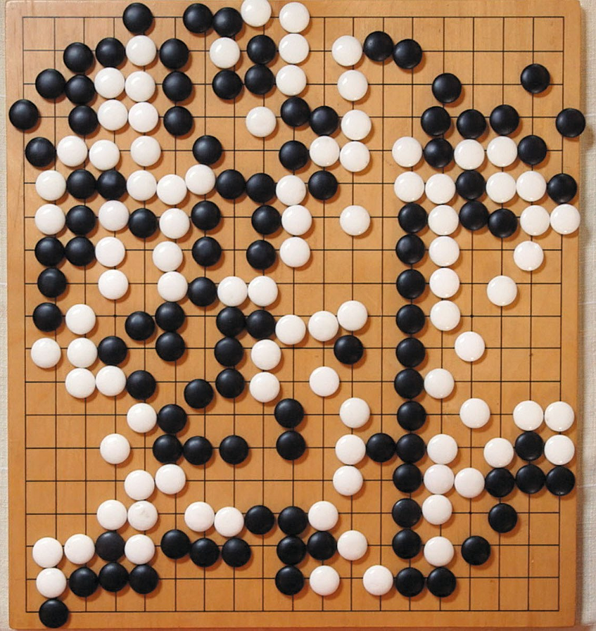
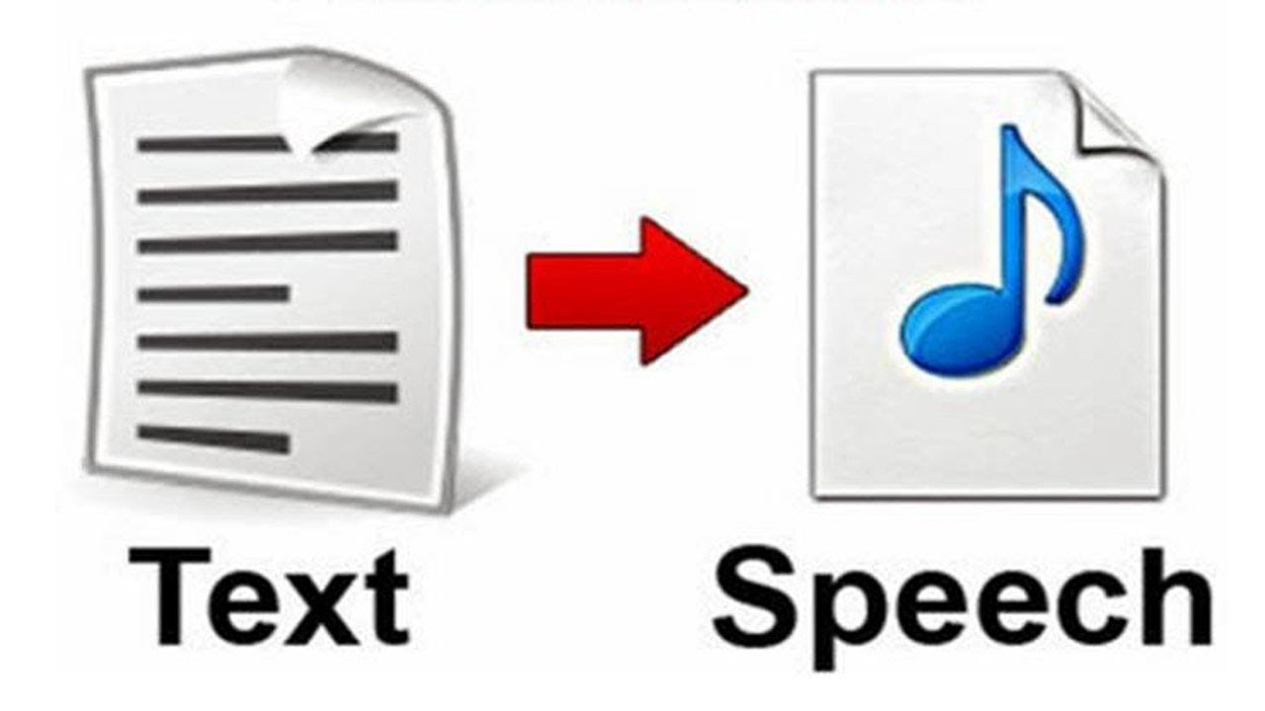
Deep Learning Applications
Object Detection
Medical Imaging
Speech Recognition
Deep Neural Network (DNN)
Image Segmentation
Text to Speech
Recommendations
Games
Notes:
Deep learning applications have been massively deployed in our daily life, such as OD, MI, SR and so on. Deep Neural Network is one of the promising solusion over these application

Slide 3
Challenges of DNN Computing
Millions of Parameters (i.e., weights) and Inputs
  Billions of computations
  Heavy data movement
Need lots of parallel compute
DNN Topology | Number of Weights
AlexNet (2012) | 3.98M
VGGnet-16 (2014) | 28.25M
GoogleNet (2015) | 6.77M
Resnet-20 (2016) | 0.27M
Resnet-110 (2016) | 1.7M
This makes CPUs inefficient
Need to reduce energy
This makes GPUs inefficient
Notes:
To overcome these challenges, architecture community has been developing hardware specialized for DNN computation which is referred to DNN Accelerator.

Slide 4
Spatial DNN Accelerators
Millions of Parameters (i.e., weights)
  Billions of computations
  Heavy data movement
Memory Hierarchy
Spread computations across hundreds of ALUs
ALU
ALU
ALU
ALU
Control
Register/FIFO/SRAM
ALU
ALU
ALU
ALU
Memory Hierarchy
ALU
ALU
ALU
ALU
Reuse data within the array via local storage and direct communication
ALU
ALU
ALU
ALU
Examples: MIT Eyeriss, Google TPU, Xilinx xDNN
Notes:
Spatial DNN accelerator is one of the popular approach for DNN accelerators, which are activlely developed by both acadamia and industry.

Slide 5


Overall Efficiency
Accelerator Microarchitecture
DNN Model
Mapping (Dataflow)
Focus of this talk
Notes:
Remove training and inference. Add figures

Slide 6
Outline
Motivation
Target DNN Accelerator: MAERI
mRNA: Mapping explorer for MAERI
Mapping examples
mRNA framework
Evaluation
Conclusion

Slide 7
Deep Learning Landscape is Diverse
DNN Topologies
  Layer size / shape
  Layer types: Convolution / Pool / FC / LSTM
  New sub-structure: e.g., Inception in Googlenet
Compiler/Mapper
  Loop scheduling
    Reordering
    Tiling
    Unrolling
  Mapping
    Output/Weight/Input/Row Stationary
Algorithmic Optimization
  Weight pruning: Sparse workload
Notes:
DNNs are multi-dimensional loops. For performance and energy-efficiency, accelerators will choose different strategies to manipulate the diverse loop schedules and the spatial/temporal mapping of data on the limited compute and memory unit of the accelerators, which we collectively refer to Dataflows. Dataflow changes dramatically due to different DNN topologies (for example ), different

Slide 8
Efficiently Mapping Diverse Dataflows
A DNN Accelerator with Flexible Interconnects
Hyoukjun Kwon, Ananda Samajdar, and Tushar Krishna
MAERI: Enabling Flexible Dataflow Mapping over DNN Accelerators via Reconfigurable Interconnects:
ASPLOS 2018, IEEE Micro Top Picks 2019 Honorable Mention

Slide 9
The MAERI Implementation
Distribution Network
Spatial Reuse via Multicasts
High Bandwidth via fat links
Distribute Switch (1x2 Switch)
Linear Local Network
Forwarding of weights/inputs
Spatial-Temporal Reuse
Reduction Network
High Bandwidth via fat links
Provably Non-blocking Reductions via forwarding links

Slide 10
MAERI Operation example
Distribute
2
Input/Weight
Fetch
1
Virtual neuron (VN)
Multiply
3
Reduce
4
5
6
Collect
7
Controller configures switches
VN size = 5
Num of VN=3
Notes:
Figure need to be revised !!!

Slide 11
Outline
Motivation
Target DNN Accelerator: MAERI
mRNA: Mapping explorer for MAERI
Mapping examples
mRNA framework
Evaluation
Conclusion

Slide 12
mRNA functionality
To/From DRAM
Weight, Input, Output SRAM
mRNA
Dataflow Configs
Search for efficient DNN mappings
Evaluate the impact of different mappings
Generate interconnection configuration
~100% Utilization
March 26, 2019
Notes:
Change the animation flow!!!

Slide 13
CNN Layer representation
C
K
C
R
Y
Y’
N
S
N
X
X’
K
…
…
…
K
C
C
Y’
R
Y
S
X’
X
Weight filters
Input feature maps
Output activations
Notes:
Almost all the layers inside DNN models can be represented as a multi-level nested loops .
Five example mappings of a customized convolutional layer on MAERI with 16 Mses.

Slide 14
Loop optimizations for CNN
Loop fission
for(n=0; n<N; n=n+T_N) {
for(c=0; c<C; c=c+T_C) {
for(x=0; x<X’; x=x+T_X’) {
for(y=0; y<Y’; y=y+T_Y’) {
for(k=0; k<K; k=k+T_K) {
for(j=0; j<R; j=j+T_X) {
for(i=0; i<S; i=i+T_Y) {
for(tn=n; tn<T_N; tn++)
for(tk=k; tk<T_K; tk++) {
for(tx=x; tx<T_X; tx++) {
for(ty=y; ty<T_Y; ty++) {
for(tc=c; tc<T_C; tc++) {
for(tj=j; tj<T_X; tj++) {
for(ti=i; ti<T_Y; ti++) {
O[tn][tk][tx][ty] +=
W[tk][tc][ti][tj] *
I[tn][tc][tx+ti][ty+tj];
}}}}}}}
for(n=0; n<N; n++) {
for(k=0; k<K; k++) {
for(y=0; x<X’; y++) {
for(x=0; y<Y’; x++) {
O[n][k][x][y] = ReLU(O[n][k][x][y] );
for(c=0; c<C; c++) {
for(j=0; j<R; j++) {
for(i=0; i<S; i++) {
O[n][k][x][y] += W[k][c][i][j] *
I[n][c][x+i][y+j];
}}}}}}}
for(n=0; n<N; n++) {
for(m=0; m<M; m++) {
for(y=0; y<O_X; y++) {
for(x=0; x<O_Y; x++) {
for(c=0; c<C; c++) {
for(j=0; j<W_X; j++) {
for(i=0; i<W_Y; i++) {
O[n][m][x][y] += W[m][c][i][j] *
I[n][c][y+S*i][x+S*j];
}}}}}}}
for(n=0; n<N; n++) {
for(m=0; m<M; m++) {
for(y=0; y<I_X; y++) {
for(x=0; x<I_Y; x++) {
O[n][m][x][y] = ReLU(O[n][m][x][y] );
}}}}
Loop
tiling/blocking
Loop unrolling
tile
Loop
interchanging
Loop fission: decide the reconfiguration format of MAERI
Loop tiling: decide the tile shape that is mapped onto MAERI
Loop unrolling: unrolling all the operations inside the kernel onto MAERI
Loop interchanging: decide the execution order of the tiles.
Notes:
Moreover, standard loop transformation methods such as loop interchanging, unrolling and tiling can be applied to the loop, as shown in Figure . The effect of such loop transformations are significant in MAERI, which dramatically changes the throughput, latency, and energy efficiency, because they influence the data communication pattern among SDM, DN, MN, RN, and DRAM

Slide 15
Tile parameters and Virtual Neuron
Symbol | Description
T_R | Number of mapped rows of inputs and weights
T_S | Number of mapped columns of inputs and weights
T_K | Number of mapped filters
T_N | Number of mapped input feature maps
T_C | Number of mapped input and weight channel
T_X’ | Number of mapped rows of output
T_Y’ | Number of mapped columns of output
Virtual Neuron (VN) | Calculation
VN Size | T_R x T_S x T_C
Number of VNs | T_K x T_N x T_X’ x T_Y’

Slide 16
Outline
Motivation
Target DNN Accelerator: MAERI
mRNA: Mapping explorer for MAERI
Mapping examples
mRNA framework
Evaluation
Conclusion

Slide 17
Mapping strategy 1 (16 MSes)
S=2
Y=4
Y’=3
K=2
C=4
w12
w13
C=4
x48
x49
x50
x51
p9
p10
p11
o9
o10
o11
w8
w9
x32
x33
x34
x35
p0
p1
p2
o0
o1
o2
R=2
x52
x53
x54
x55
p0
w4
w5
p12
p13
p14
X’=3
w14
w15
x16
x17
x18
x19
o12
o13
o14
x36
Str=1
w0
w1
x0
x1
x37
x38
x39
o3
o4
o5
w10
w11
x2
x3
X=4
p3
p4
p5
w6
w7
x20
x56
x57
x58
x59
p15
p16
p17
o15
o16
o17
x21
x22
x23
w2
w3
x4
x40
x41
x42
x43
o6
o7
o8
x5
x6
x7
p6
p7
p8
x24
x60
x61
x62
x63
x25
x26
x27
o0=ReLU(p0)
o1=ReLU(p1)
….
o35=ReLU(p35)
Filter 0
x8
x44
x45
x46
x47
Output 0
conv
x9
x10
x11
Partial sum 0
x28
x29
x30
x31
K=2
x12
x13
x14
x15
N=2
Input 0
w28
w29
w24
w25
p27
p28
p29
p27
p28
p29
w30
w31
N=2
x112
x113
x114
x115
w20
w21
x96
x97
x98
x99
p18
p19
p20
o18
o19
o20
w16
w26
w27
p30
p31
p32
p30
p31
p32
w17
x80
x81
x82
x83
x119
w22
w23
x116
x117
x118
p21
p22
p23
o21
o22
o23
x64
x65
x66
x67
x103
w18
w19
x100
x101
x102
p33
p34
p35
p33
p34
p35
T_R=2, T_S=2, T_C=4, T_K=1, T_N=1, T_X’=1, T_Y’=1
x84
x85
x86
x87
x123
x120
x121
x122
p24
p25
p26
o24
o25
o26
x68
x69
x70
x71
x107
Filter 1
x104
x105
x106
x88
x89
x90
x91
x124
x125
x126
x127
Partial Sum 1
Output 1
x72
x73
x74
x75
x108
x109
x110
x111
x92
x93
x94
x95
Input 1
x76
x77
x78
x79

Slide 18
MAERI behavior
x55
x51
x39
x35
x23
x19
x7
x3
x54
x50
x38
x34
x22
x18
x6
x2
x53
x52
x49
x48
x37
x36
x33
x32
x21
x20
x17
x16
x5
x4
x1
x0
w15
w14
w13
w12
w11
w10
w9
w8
w7
w6
w5
w4
w3
w2
w1
w0
Distribute Network (DN)
VN 0
MS15
MS14
MS13
MS12
MS11
MS10
MS9
MS8
MS7
MS6
MS5
MS4
MS3
MS2
MS1
MS0
Reduce Network (RN)
p0
o0

Slide 19
Mapping strategy 2
x48
x49
x50
x51
o9
o10
o11
x32
x33
x34
x35
p27
p28
p29
x52
x53
x54
x55
p18
p19
p20
o0
o1
o2
w12
w13
x16
x17
x18
x19
p9
p30
p31
p32
o12
o13
o14
x0
x36
x37
x38
x39
p9
p10
p11
w8
w9
x1
x2
x3
p21
p22
p23
o3
o4
o5
x56
x57
x58
x59
p0
p1
p2
w4
w5
x20
x21
x22
x23
p0
o15
o16
o17
w14
w15
p12
p33
p34
p35
x4
x40
x41
x42
x43
p13
p14
w0
w1
x5
x6
x7
w10
w11
x60
x61
x62
x63
p3
p24
p25
p26
o6
o7
o8
w6
w7
x24
x25
x26
x27
p4
p5
x8
x44
x45
x46
x47
p15
p16
p17
w2
w3
x9
x10
x11
Output 0
Filter 0
x28
x29
x30
x31
p6
p7
p8
o0=ReLU(p0+p18)
o1=ReLU(p1+p19)
….
o35=ReLU(p53+p71)
conv
x12
x13
x14
x15
Input 0
Partial sum 0
x112
x113
x114
x115
p63
p64
p65
w28
w29
x96
x97
x98
x99
p54
p55
p56
w24
w25
x80
x81
x82
x83
p66
p67
p68
p27
p28
p29
x116
x117
x118
x119
p45
p46
p47
w20
w30
w31
o18
o19
o20
w21
x64
x65
x66
x67
x103
p57
p58
p59
w26
w27
x100
x101
x102
p36
p37
p38
p30
p31
p32
w16
w17
x84
x85
x86
x87
x123
p69
p70
p71
x120
x121
x122
p48
p49
p50
o21
o22
o23
w22
w23
x68
x69
x70
x71
x107
p60
p61
p62
x104
x105
x106
p39
p40
p41
p33
p34
p35
T_R=2, T_S=2, T_C=2, T_K=2, T_N=1, T_X’=1, T_Y’=1
w18
w19
x88
x89
x90
x91
Filter 1
x124
x125
x126
x127
p51
p52
p53
x72
x73
x74
x75
o24
o25
o26
x108
x109
x110
x111
p42
p43
p44
x92
x93
x94
x95
x76
x77
x78
x79
Output 1
Input 1
Partial Sum 1

Slide 20
MAERI behavior
Computing phase 1
x23
x19
x7
x3
x22
x18
x6
x18
x2
x22
x6
x2
x16
x5
x4
x21
x16
x1
x0
x20
x17
x5
x4
x0
x21
x20
x17
x1
w23
w22
w21
w20
w19
w18
w17
w16
w7
w6
w5
w4
w3
w2
w1
w0
Distribute Network (DN)
VN 0
VN 1
MS15
MS14
MS13
MS12
MS11
MS10
MS9
MS8
MS7
MS6
MS5
MS4
MS3
MS2
MS1
MS0
Reduce Network (RN)
p9
p0

Slide 21
MAERI behavior
Computing phase 2
p33
p15
p32
p14
p31
p13
p30
p12
p29
p11
p28
p10
p27
p9
p26
p8
p25
p7
p24
p6
p23
p5
p22
p4
p21
p3
p20
p2
p19
p1
p18
p0
Distribute Network (DN)
VN 0
VN 1
VN 2
VN 3
VN 4
VN 5
VN 6
VN 7
MS15
MS14
MS13
MS12
MS11
MS10
MS9
MS8
MS7
MS6
MS5
MS4
MS3
MS2
MS1
MS0
Reduce Network (RN)
p’7
p’6
p’5
p’4
p’3
p’2
p’1
p’0
o0
o1
o2
o3
o4
o5
o6
o7

Slide 22
Mapping strategy 3
x48
x49
x50
x51
x32
x33
x34
x35
p27
p28
p29
x16
x52
x53
x54
x55
p18
p19
p20
o9
o10
o11
x17
x18
x19
x0
x36
x37
x38
x39
p30
p31
p32
x1
x2
x3
p9
p10
p11
o0
o1
o2
w12
w13
x20
x56
x57
x58
x59
p21
p22
p23
o12
o13
o14
x21
x22
x23
p0
p1
p2
x40
x41
x42
x43
p0
p33
p34
p35
w8
w9
x4
x5
x6
x7
p12
p13
p14
o3
o4
o5
w14
w15
x24
x60
x61
x62
x63
p24
p25
p26
o15
o16
o17
w4
w5
x25
x26
x27
w4
w5
p3
p4
p5
w10
w11
x8
x44
x45
x46
x47
w0
w1
x9
x10
x11
p15
p16
p17
o6
o7
o8
w0
w1
w6
w7
x28
x29
x30
x31
w6
w7
p6
p7
p8
Output 0
w2
w3
x12
x13
x14
x15
w2
w3
Input 0
o0=ReLU(p0+p18)
o1=ReLU(p1+p19)
….
o35=ReLU(p53+p71)
Filter 0
conv
Partial sum 0
x112
x113
x114
x115
x96
x97
x98
x99
p63
p64
p65
x80
x81
x82
x83
x119
p54
p55
p56
w28
w29
x116
x117
x118
x64
x65
x66
x67
p45
p66
p67
p68
w24
w25
x100
x101
x102
x103
p46
p47
p27
p28
p29
x84
x85
x86
x87
x123
p57
p58
p59
x120
x121
x122
p36
p37
p38
w20
w30
w31
p36
o18
o19
o20
w21
x68
x69
x70
x71
p48
p69
p70
p71
p49
p50
p30
p31
p32
T_R=2, T_S=2, T_C=2, T_K=1, T_N=2, T_X’=1, T_Y’=1
w16
w26
w27
x104
x105
x106
x107
w17
x88
x89
x90
x91
p60
p61
p62
w22
w23
x124
x125
x126
x127
p39
p40
p41
o21
o22
o23
x72
x73
x74
x75
p51
p52
p53
p33
p34
p35
w18
w19
x108
x109
x110
x111
Filter 1
x92
x93
x94
x95
p42
p43
p44
o24
o25
o26
x76
x77
x78
x79
Input 1
Output 1

Slide 23
MAERI behavior
x87
x83
x71
x67
x23
x19
x7
x3
x86
x82
x70
x66
x22
x18
x6
x2
x85
x84
x81
x80
x69
x68
x65
x64
x21
x20
x17
x16
x5
x4
x1
x0
w6
w4
w0
w7
w6
w7
w5
w5
w4
w3
w2
w1
w0
w3
w2
w1
Distribute Network (DN)
VN 0
VN 1
MS15
MS14
MS13
MS12
MS11
MS10
MS9
MS8
MS7
MS6
MS5
MS4
MS3
MS2
MS1
MS0
Reduce Network (RN)
p0
p36

Slide 24
Mapping strategy 4
x48
x49
x50
x51
p63
p64
p65
8 channels
x32
x33
x34
x35
…
x52
x53
x54
x55
p30
p67
p68
o9
o10
o11
x16
x17
x18
x19
p18
p19
p20
x0
x36
x37
x38
x39
x1
x2
x3
p9
p33
p70
p71
o0
o1
o2
w12
w13
x20
x56
x57
x58
x59
p9
p10
p11
o12
o13
o14
x21
x22
x23
p21
p22
p23
p0
p1
p2
x4
x40
x41
x42
x43
p0
w8
w9
x5
x6
x7
p12
p13
p14
o3
o4
o5
w4
w5
x60
x61
x62
x63
…
o15
o16
o17
w14
w15
x24
x25
x26
x27
p24
p25
p26
w0
w1
x44
x45
x46
x47
p3
p4
p5
w0
w1
x8
x9
x10
x11
w10
w11
p15
p16
p17
o6
o7
o8
w6
w7
x28
x29
x30
x31
w2
w3
p6
p7
p8
Output 0
w2
w3
x12
x13
x14
x15
Filter 0
Input 0
o0=ReLU(p0+p18+p36+p54)
o1=ReLU(p1+p19+p37+p55)
….
o35=ReLU(p89+p107+p125+p143)
conv
Partial sum 0
x112
x113
x114
x115
…
p135
p136
p137
x96
x97
x98
x99
x80
x81
x82
x83
x119
p138
p139
p140
w28
w29
x116
x117
x118
p90
p91
p92
x64
x65
x66
x67
x103
p27
p28
p29
w24
w25
x100
x101
x102
p81
p82
p83
x84
x85
x86
x87
x123
p81
p141
p142
p143
w20
w30
w31
x120
x121
x122
o18
o19
o20
w21
x68
x69
x70
x71
p72
p57
p58
p95
p72
p73
p74
T_R=2, T_S=2, T_C=1, T_K=2, T_N=2, T_X’=1, T_Y’=1
w16
w26
w27
x104
x105
x106
x107
p30
p31
p32
w16
w17
w17
x88
x89
x90
x91
p48
p49
p86
…
w22
w23
x124
x125
x126
x127
p60
p61
p98
o21
o22
o23
x72
x73
x74
x75
p75
p76
p77
p33
p34
p35
w18
w19
x108
x109
x110
x111
w18
w19
x92
x93
x94
x95
p51
p52
p89
Filter 1
o24
o25
o26
x76
x77
x78
x79
p78
p79
p80
Partial Sum 1
Output 1
Input 1

Slide 25
Mapping strategy 5
p63
p64
p65
8 channels
x48
x49
x50
x51
…
p30
p67
p68
o9
o10
o11
x32
x33
x34
x35
o0
o1
o2
x16
x52
x53
x54
x55
p18
p19
p20
w12
w13
x17
x18
x19
p9
p10
p33
p70
p71
o12
o13
o14
x0
x36
x37
x38
x39
p11
w8
w9
x1
x2
x3
p21
p22
p23
o3
o4
o5
x56
x57
x58
x59
p0
p1
w4
w5
x20
x21
x22
x23
p0
p1
p2
o15
o16
o17
w14
w15
p12
p13
p14
x4
x40
x41
x42
x43
…
w0
w1
x5
x6
x7
w10
w11
x60
x61
x62
x63
p3
p24
p25
p26
o6
o7
o8
p3
p4
p5
w6
w7
x24
x25
x26
x27
p4
x8
x44
x45
x46
x47
p15
p16
p17
Output 0
w2
w3
x9
x10
x11
Filter 0
x28
x29
x30
x31
p6
p7
p8
Partial sum 0
o0=ReLU(p0+p18+p36+p54)
o1=ReLU(p1+p19+p37+p55)
….
o35=ReLU(p89+p107+p125+p143)
conv
x12
x13
x14
x15
Input 0
x112
x113
x114
x115
…
p135
p136
p137
w28
w29
x96
x97
x98
x99
w24
w25
x80
x81
x82
x83
p138
p139
p140
p27
p28
p29
x116
x117
x118
x119
p90
p91
p92
w20
w30
w31
o18
o19
o20
w21
x64
x65
x66
x67
x103
x100
x101
x102
p81
p82
p83
p30
p31
p32
w16
w26
w27
p141
p142
p143
w17
x84
x85
x86
x87
x123
x120
x121
x122
p57
p58
p95
T_R=2, T_S=2, T_C=1, T_K=1, T_N=1, T_X’=2, T_Y’=2
w22
w23
x68
x69
x70
x71
p72
p73
p74
o21
o22
o23
x104
x105
x106
x107
p48
p49
p86
…
p33
p34
p35
w18
w19
x88
x89
x90
x91
x124
x125
x126
x127
p75
p60
p61
p98
Filter 1
x72
x73
x74
x75
p76
p77
o24
o25
o26
x108
x109
x110
x111
p51
p52
p89
Output 1
x92
x93
x94
x95
x76
x77
x78
x79
p78
p79
p80
Input 1
Partial Sum 1

Slide 26
MAERI Efficiency Compare
Best performance
Least energy consumption within single tile
 | Mapping 1 | Mapping 2 | Mapping 3 | Mapping 4 | Mapping 5
DN BW requirement for input | 16 / 8 | 8 / 4 | 16 / 8 | 8 / 4 | 9
DN BW requirement for weight | 16 | 16 | 8 | 8 | 4
RN BW requirement | 1 | 2 | 2 | 4 | 4
DN Energy for weight | 64 | 64 | 64 | 64 | 56
DN Energy for input | 64 / 32 | 64 / 32 | 64 / 32 | 64 / 32 | 42
RN Energy | 45 | 42 | 42 | 36 | 36
MSes Energy | 8 | 8 | 8 | 8 | 0
Runtime | 36 | 41 | 41 | 45 | 73
Peak Utilization Rate | 100% | 100% | 100% | 100% | 100%
Average Utilization Rate | 100% | 100% | 100% | 100% | 56%
Sensitive to DN bandwidth
Low utilization rate

Slide 27
Summary
Mapping DNN on MAERI is to make trade-offs
  Utilization rate
  Network bandwidth
  Reconfiguration time
  Network communications
  Data reuse pattern
mRNA

Slide 28
Outline
Motivation
Target DNN Accelerator: MAERI
mRNA: Mapping explorer for MAERI
Mapping examples
mRNA framework
Evaluation
Conclusion

Slide 29
Tool flow of mRNA
mRNA
Layers representation
DNN Model
Front-end parser
…
Layer n
Layer 2
Layer 1
Analyzer
MAERI configuration
Mapping candidates generation
Profile result of each layer
…
Layer n
Mapping Strategy 1: …
Layer 2
Mapping Strategy 1: …
Energy factors
Candidates evaluation
Layer 1
Mapping Strategy 1: …
Mapping Strategy 2: …
Optimization options
Candidate selection
Configuration of each layer
…
Layer n
Mapping Strategy 1: …
Layer 2
Configuration 1: …
MAERI configuration generator
Layer 1
Configuration 1: …
Configuration 2: …
Notes:
mRNA receives the neural network description, MAERI configurations, Energy factors and optimization goal (energy, runtime, etc.) as inputs and generates MAERI interconnection network configurations

Slide 30
Tool flow of mRNA
mRNA
Layers representation
DNN Model
Front-end parser
…
Layer n
Layer 2
Layer 1
Analyzer
MAERI configuration
Mapping candidates generation
Profile result of each layer
…
Layer n
Mapping Strategy 1: …
Layer 2
Mapping Strategy 1: …
Energy factors
Candidates evaluation
Layer 1
Mapping Strategy 1: …
Mapping Strategy 2: …
Optimization options
Candidate selection
Configuration of each layer
…
Layer n
Mapping Strategy 1: …
Layer 2
Configuration 1: …
MAERI configuration generator
Layer 1
Configuration 1: …
Configuration 2: …
Notes:
mRNA receives the neural network description, MAERI configurations, Energy factors and optimization goal (energy, runtime, etc.) as inputs and generates MAERI interconnection network configurations

Slide 31

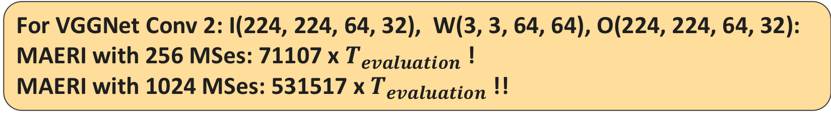
Challenges: Huge search space
Permutations and combinations of tile parameters
for(T_N=1; T_N<N; T_N++) {
for(T_K=0; T_K<K; T_K++) {
for(T_X’=0; T_X’<X’; T_X’++) {
for(T_Y’=0; T_Y’<Y’; T_Y’++) {
for(T_C=0; T_C<C; T_C’++) {
for(T_R=0; T_R<R; T_R++) {
for(T_S=0; T_S<S; T_S++) {
$T_{S}×T_{R}×T_{C}×T_{Y}^{′}×T_{X}^{′}×T_{K}×T_{N}≤N_{ms}$
Mapping_Evaluation();
}}}}}}}
Pruning !!
For VGGNet Conv 2: I(224, 224, 64, 32), W(3, 3, 64, 64), O(224, 224, 64, 32):
MAERI with 256 MSes: 71107 x $T_{evaluation}$!
MAERI with 1024 MSes: 531517 x $T_{evaluation}$!!
Notes:
Pruning !

Slide 32

Pruning Heuristic 1: Utilization
Prune candidates with low average utilization rate
Low peak UR: $N_{min}≤T_S×T_R×T_C×T_Y′×T_X′×T_K×T_N≤N_{ms}$
Low filter UR:
T_S=2
S=7
T_S=2
S=5
T_R=2
T_S=2
S=3
T_R=2
R=7
T_R=2
R=5
R=3
(3X3)/(4X4)=0.56
(5X5)/(6X6)=0.69
(7X7)/(8X8)=0.76
Notes:
Explain what is gray and what is green.

Slide 33
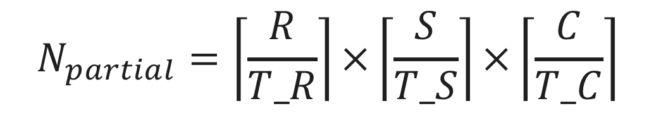
Pruning Heuristic 2: DRAM traffic
Prune the candidates which generate large size of partial sums
$$N_{partial}=\left\lceil \frac{R}{T_R}\right\rceil ×\left\lceil \frac{S}{T_S}\right\rceil ×\left\lceil \frac{C}{T_C}\right\rceil$$
For VGGNet Conv 2: I(224, 224, 64, 1), W(3, 3, 64, 64), O(224, 224, 64, 1):
Tile(T_S=3, T_R=3, T_C=28, T_K=1, T_N=1, T_X’=1, T_Y’=1) → 9 MB (8bit)
Tile(T_S=1, T_R=1, T_C=1, T_K=28, T_N=3, T_X’=3, T_Y’=1) → 1.5 GB !!

Slide 34
Pruning Heuristic 3: Dimension Reduction
Prune the tile parameters based on realistic scenarios
  Inference / low latency real-time inferences
  Fully-connected layer, RNN and LSTM
$T_N=1$, searching space reduced N times
$$K=C=Y=Y’=1, X=S, X’=R T_K=T_C=T_Y’=1$$
Notes:
Title should be reconsidered

Slide 35
Tool flow of mRNA
mRNA
Layers representation
DNN Model
Front-end parser
…
Layer n
Layer 2
Layer 1
Analyzer
MAERI configuration
Mapping candidates generation
Profile result of each layer
…
Layer n
Mapping Strategy 1: …
Layer 2
Mapping Strategy 1: …
Energy factors
Candidates evaluation
Layer 1
Mapping Strategy 1: …
Mapping Strategy 2: …
Optimization options
Candidate selection
Configuration of each layer
…
Layer n
Mapping Strategy 1: …
Layer 2
Configuration 1: …
MAERI configuration generator
Layer 1
Configuration 1: …
Configuration 2: …
Notes:
mRNA receives the neural network description, MAERI configurations, Energy factors and optimization goal (energy, runtime, etc.) as inputs and generates MAERI interconnection network configurations

Slide 36
Candidates evaluation
Cycle-level runtime calculation
  Bandwidth influence of DN, RN
  Reconfiguration influence
The number of access on different Memory hierarchies
  Between DSes
  Between RSes
  Between Mses
  Local register buffer
  On-chip Data Memory read/write
  DRAM
The number of operations that are performed
  Multiply
  Reduce (add or compare)
Multiply the operations with energy factors

Slide 37
Tool flow of mRNA
mRNA
Layers representation
DNN Model
Front-end parser
…
Layer n
Layer 2
Layer 1
Analyzer
MAERI configuration
Mapping candidates generation
Profile result of each layer
…
Layer n
Mapping Strategy 1: …
Layer 2
Mapping Strategy 1: …
Energy factors
Candidates evaluation
Layer 1
Mapping Strategy 1: …
Mapping Strategy 2: …
Optimization options
Candidate selection
Configuration of each layer
…
Layer n
Mapping Strategy 1: …
Layer 2
Configuration 1: …
MAERI configuration generator
Layer 1
Configuration 1: …
Configuration 2: …
Notes:
mRNA receives the neural network description, MAERI configurations, Energy factors and optimization goal (energy, runtime, etc.) as inputs and generates MAERI interconnection network configurations

Slide 38
Candidate selection
Sort all the evaluated candidates according to the optimization option
  -energy: minimum energy consumption
  -performance: minimum runtime
  -energy-efficiency: maximum performance per energy
Print out the profiling result of top n mappings specified in the command
Select the best mapping and send it to configuration generator.

Slide 39
Outline
Motivation
Target DNN Accelerator: MAERI
mRNA: Mapping explorer for MAERI
Mapping examples
mRNA framework
Evaluation
Conclusion

Slide 40
Methodolody
MAERI Configurations
MAERI Components | Configurations
Number of Multiplier Switches (MSes) | 512, 64, 128, 256
RN Bandwidth (RN_BW) | FULL
DN Bandwidth (DN_BW) | FULL, 16, 128
Tested Layers
Layer | Inputs (I) | Weight Filters (W) | Outputs (O)
CB3a_2 (ResNet CONV) | I(28,28,128,1) | W(3,3,128,128) | O(28,28,128,1)
CB5a_2 (ResNet CONV) | I(7,7,512,1) | W(3,3,512,512) | O(7,7,512,1)
1x1 red (GoogleNet) | I(7,7,821,1) | W(1,1,832,32) | O(7,7,32,1)
FC1 (AlexNet) | I(4096,1,1,1) | W(4096,4096,1,1) | O(4096,1,1)
FC2 (SqueezeNet) | I(2048,1,1,1) | W(2,2048,1,1) | O(2,1,1,1)
Embed (MLP) | I(1,1,138000,1) | W(11,138000,32) | O(1,1,32,1)

Slide 41
Performance and Energy
Mapping
MAERI Config
Tile(T_S, T_R, T_C, T_K, T_N, T_X’, T_Y’)
Number of Mses = 512, DN_BW=512, RN_BW=512
ResNet
CB3a_2
Notes:
Conclusion pops up

Slide 42
Bandwidth and Scale influence
Number of MSes = 512
Blue Bar DN_BW = 16
Green Bar DN_BW = 128
DN_BW = 16
Number of MSes = 64, 128, 256, 512
3,3,1,K,1,1,1 → Baseline
ResNet
CB3a_2
3,3,2,7,1,1,1
3,3,4,7,1,1,1
3,3,4,14,1,1,1
3,3,1,7,1,1,1
Notes:
First one, mapping changes. Lower is better.

Slide 43
Outline
Motivation
Target DNN Accelerator: MAERI
mRNA: Mapping explorer for MAERI
Mapping examples
mRNA framework
Evaluation
Conclusion

Slide 44
Conclusion
Search space of DNN mapping is a high dimensional optimization problem
mRNA: DNN Mapping Space Exploration tool for MAERI
  Deep learning domain-specific and MAERI-specific heuristics to reduce the searching space.
  Maximize the energy efficiency and/or minimize runtime
  Code base (HPCA 2019 Tutorial)
    http://synergy.ece.gatech.edu/tools/mrna
Future extensions:
  Extend to mapping complex DNN structures: e.g. Inceptions in GoogleNet
  Extend to mapping sparse DNNs
Thank you and open for the questions !!

Slide 45
Further research work discussion
Inception support
Multiple MAERI array mapping

Slide 46
Back ups
How to set the threshold?
Loop ordering ?

