Slide 1

MONDAY
Advanced
June 26, 2023

Slide 2
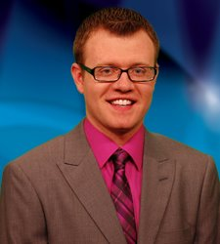
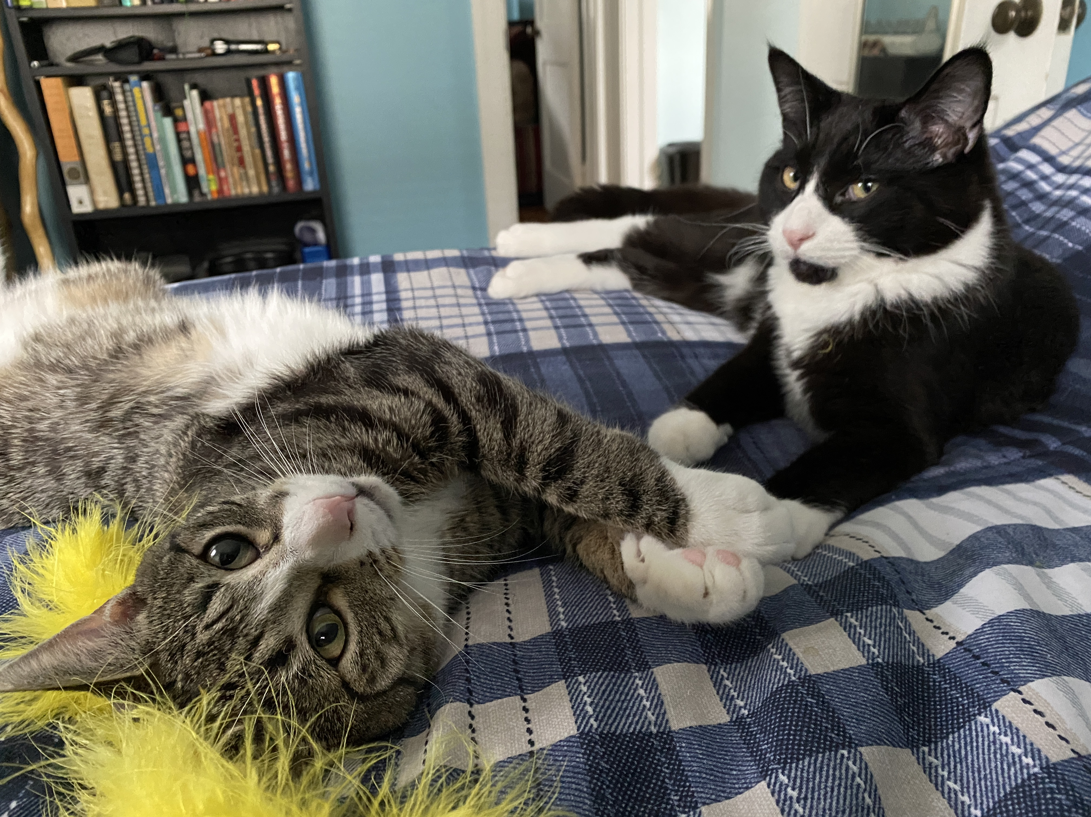

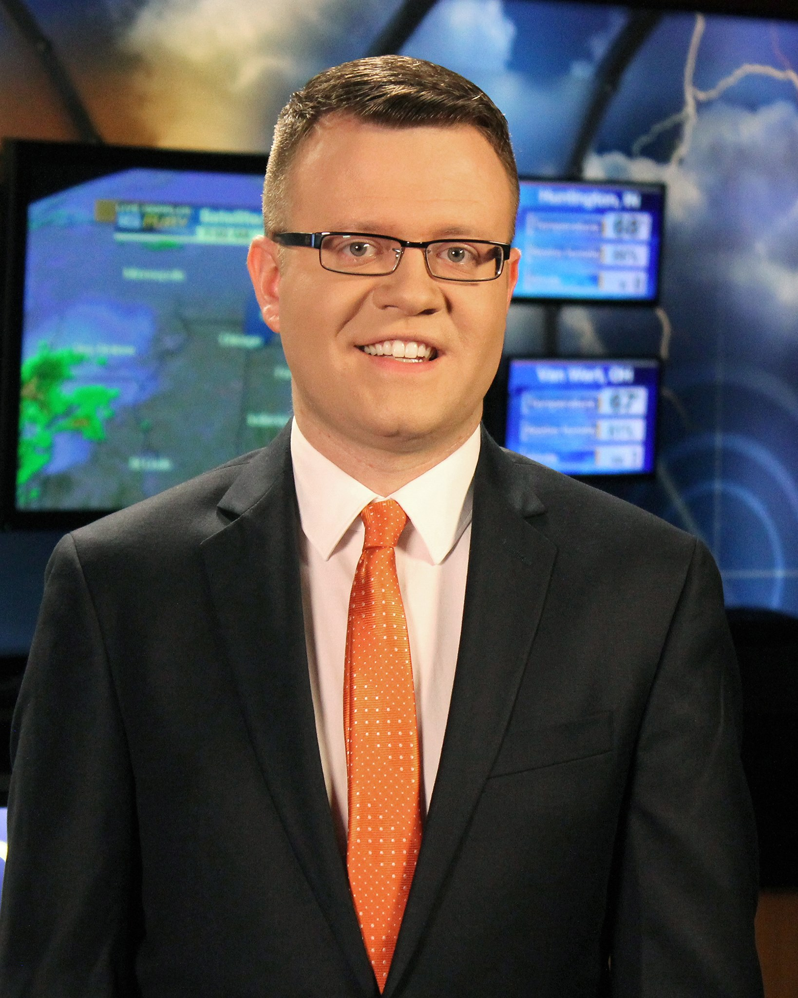
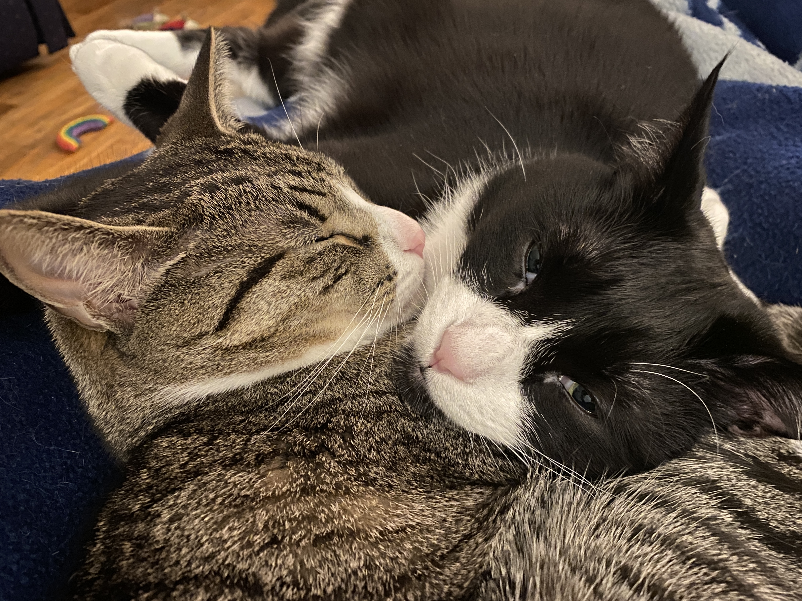

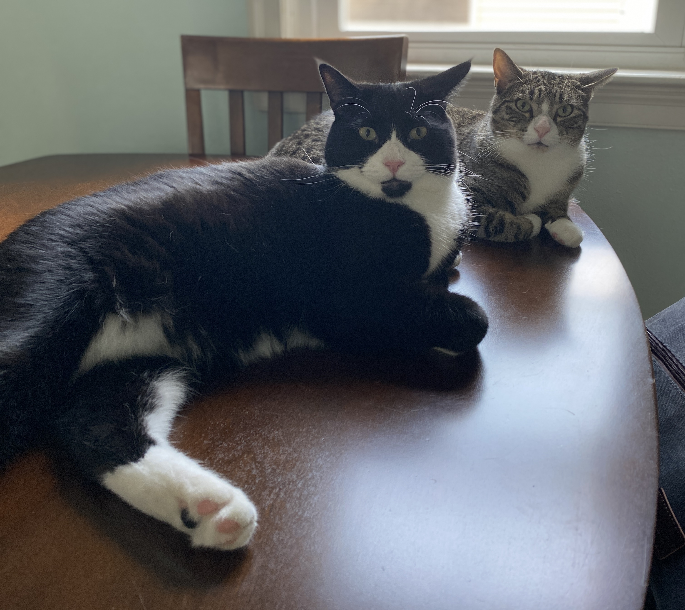
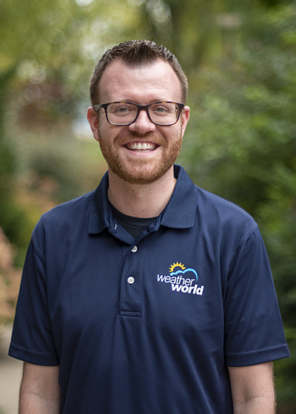

A bit about me…
BS METEO (‘11) Penn State
2011-2013 – WABI-TV5 (Bangor, ME) Weekend Meteorologist
2013-2018 – WANE-TV (Fort Wayne, IN) Weekend AM Meteorologist
2018-Present – PSU Meteo Faculty – Weather World Executive Producer & Meteorologist
Interests: hiking, camping, coffee, traveling, music
My family: 2 cats (brothers – Toby & Ty)
Notes:
First, a bit about me.

Slide 3

What is a forecast?
Outlook, prognosis, prediction
Short, medium, long-range
  Minutes, Hours, Days, Weeks, Months
Variety of variables
  Stocks, sales, scores, votes
  Temperature, dewpoint, pressure, wind, precipitation
Made with intrinsic subject knowledge/expertise, observational data, model simulations

Slide 4
Making a forecast
Important to look at Past/Present/Future
  Backwards-looking/Past - what happened?
    Climatology
  Real-time/Present - what is happening now?
    Current observations (satellite, radar, surface obs)
  Predictive/Future - what is going to happen?
    Forecast models (GFS, NAM, Euro, HRRR, ensembles)

Slide 5
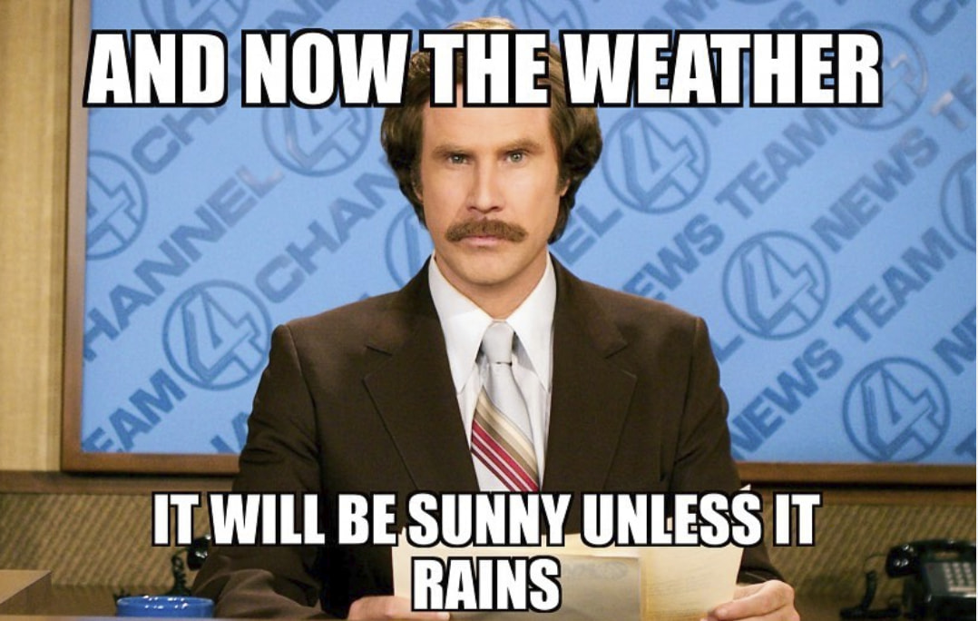
What can influence a forecast?
Topography
Bodies of water
Bad data
Unaccounted variables

Slide 6
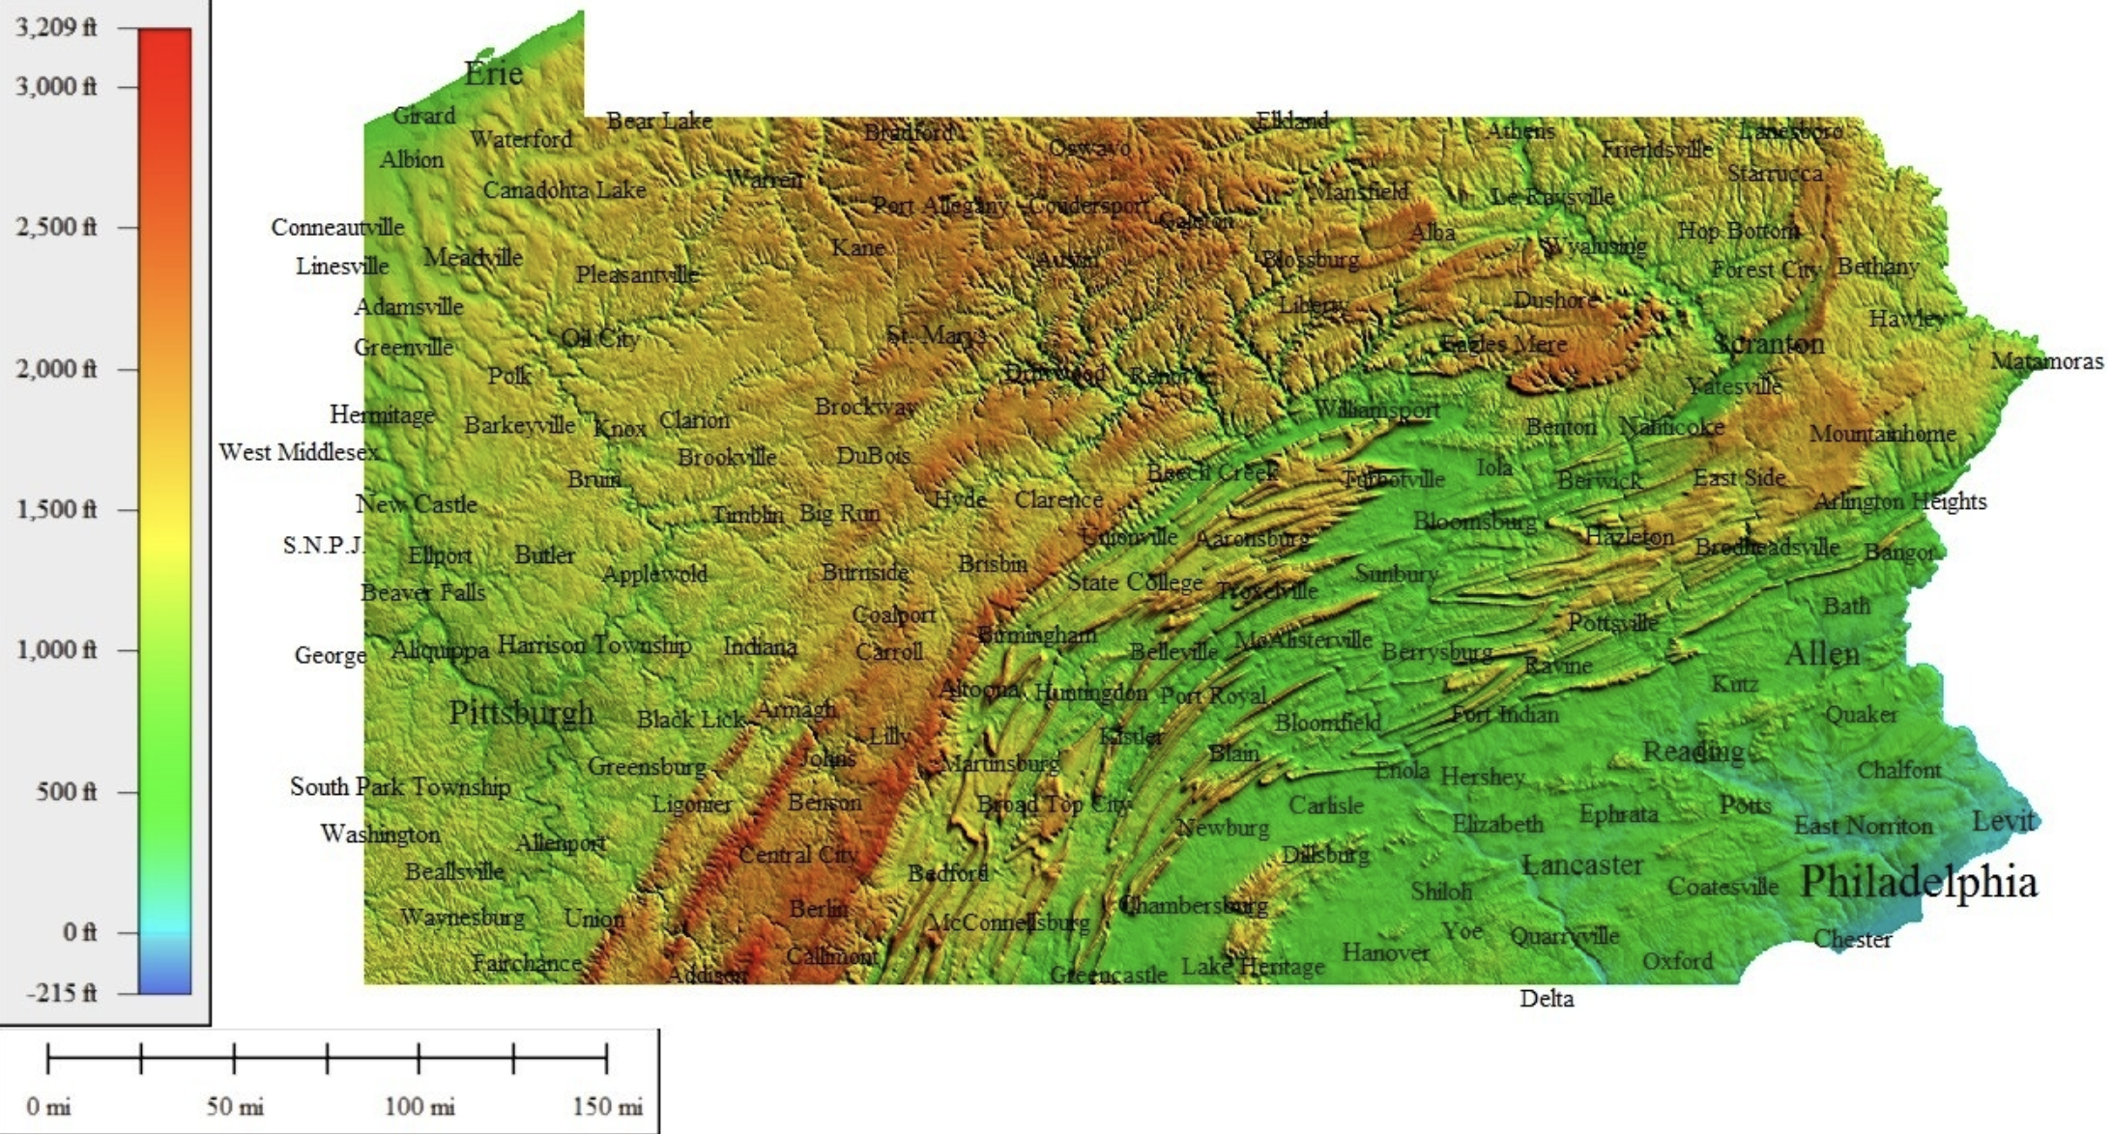
State College: 1,154 ft
Mt. Davis: 3,213 ft

Slide 7
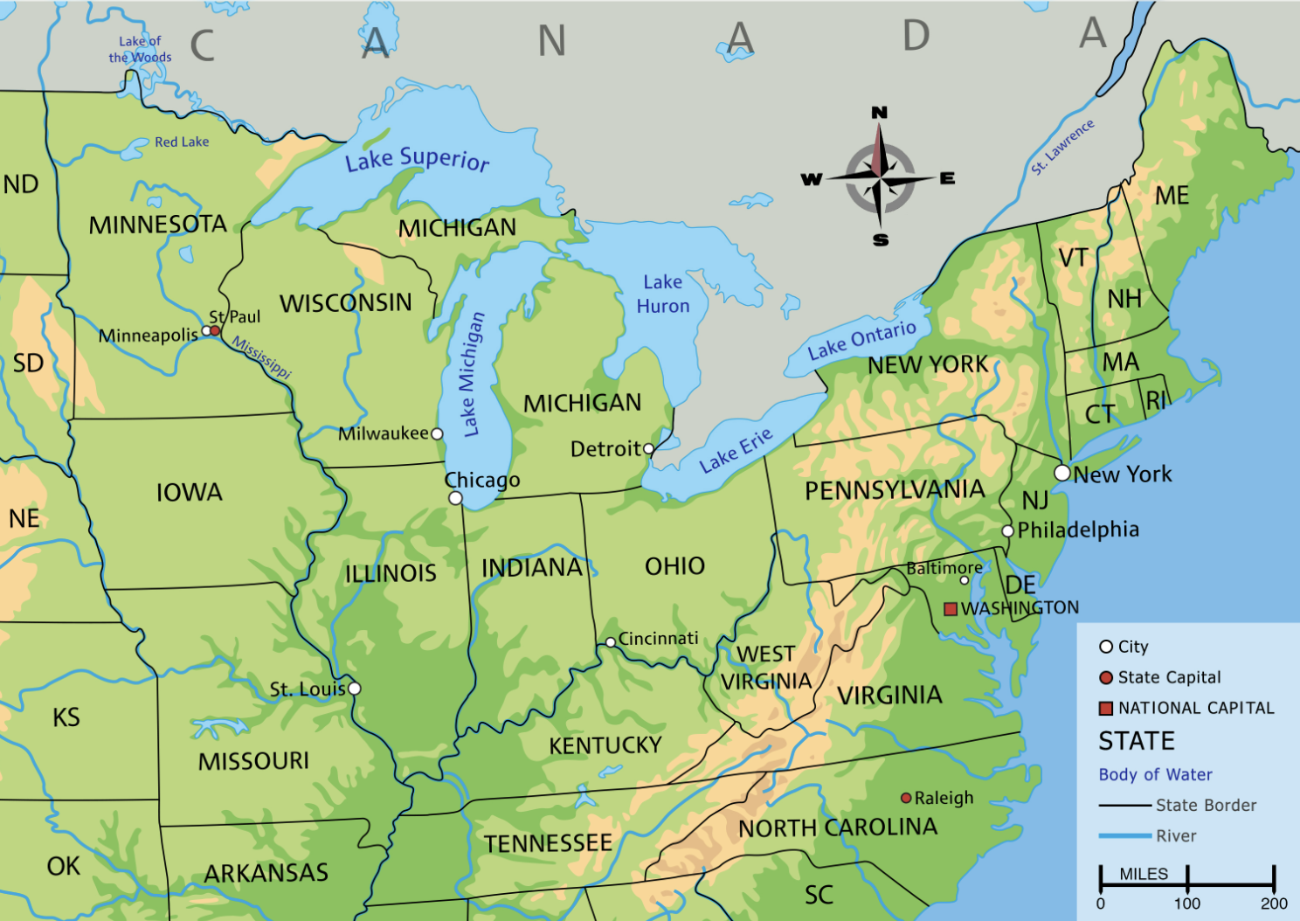

Slide 8
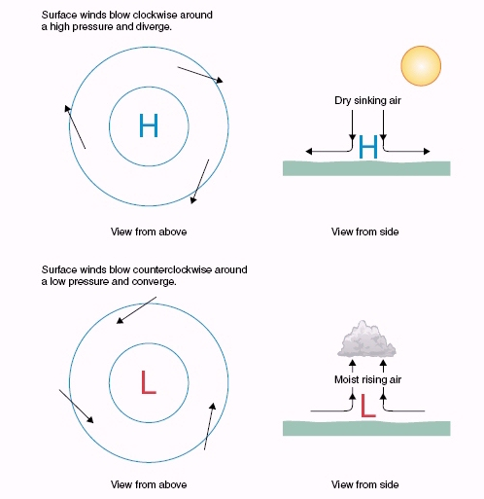
Weather Fundamentals
High & low pressure + circulation

Slide 9
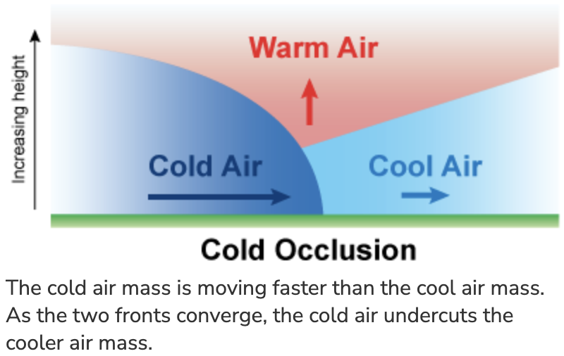
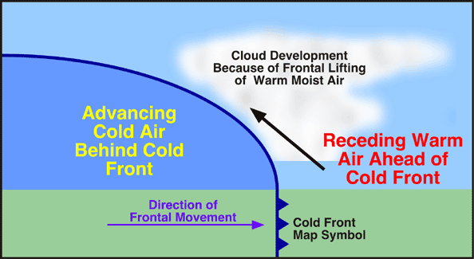
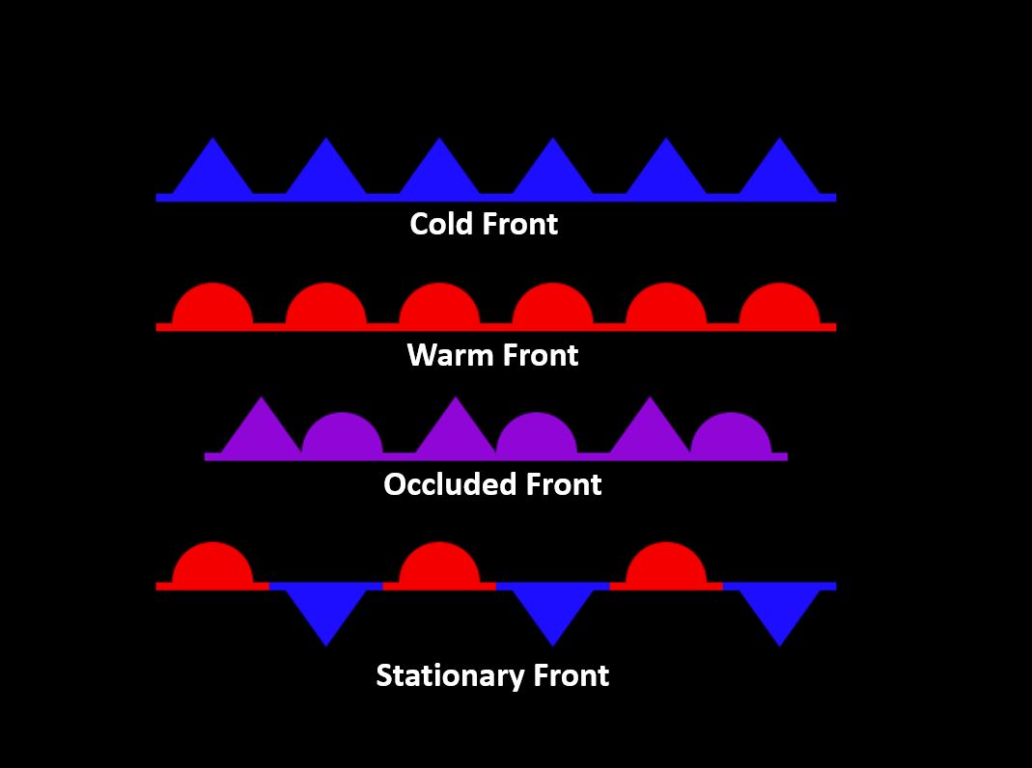
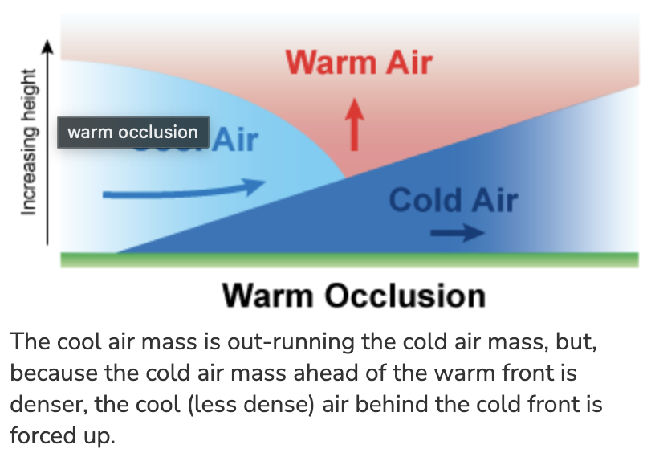
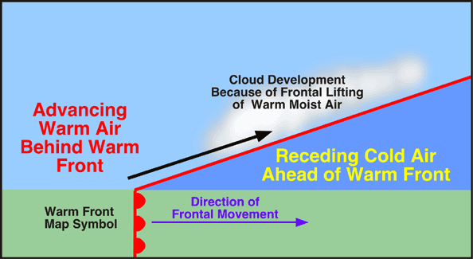
Weather Fundamentals

Slide 10
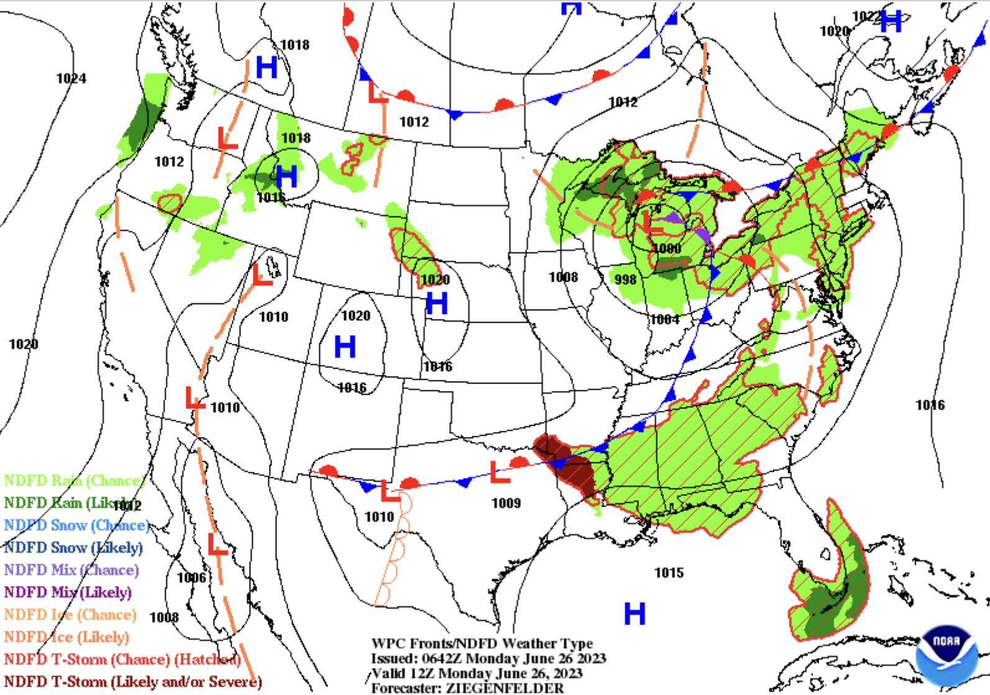

Slide 11
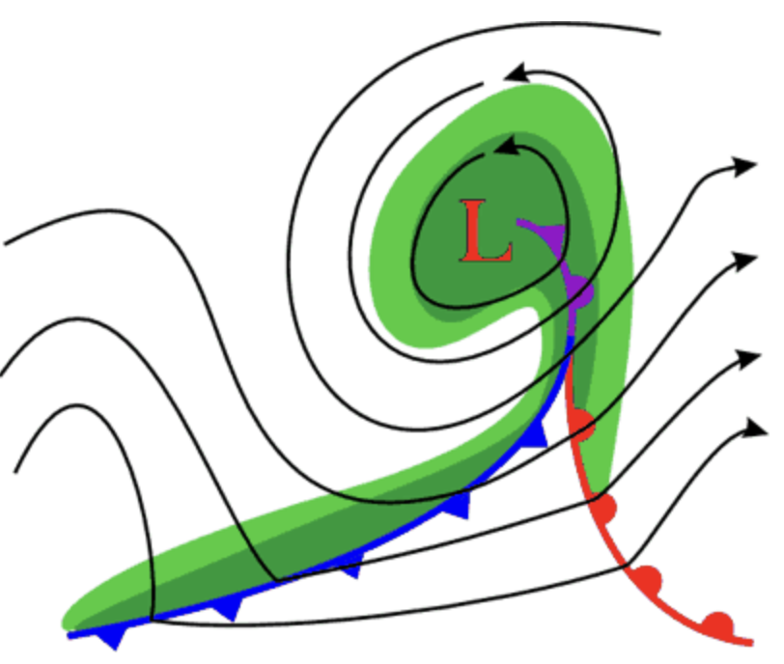
Weather Fundamentals
Useful breakdown!

Slide 12
Forecast Contest!
In this camp, we want you to learn about the weather & things that cause it, how to make forecasts, how to analyze the weather, and (most importantly) have fun doing it!
We will have a forecast contest each day
  We will always forecast at least one variable for State College, Pennsylvania (where Penn State is located)
  Some days we will forecast other variables for other places in the U.S. + world
  We may forecast for temperatures, precipitation, wind, thunderstorms, hurricanes...who knows! I will decide as we see what the weather looks like each day
Score: 1 point for temp errors (absolute value), 3 points for being off in a yes/no prediction. Like golf, you want the lowest score!
  1st place wins a prize each day!
  Best Forecaster Award at the end of Camp on Friday!

Slide 13
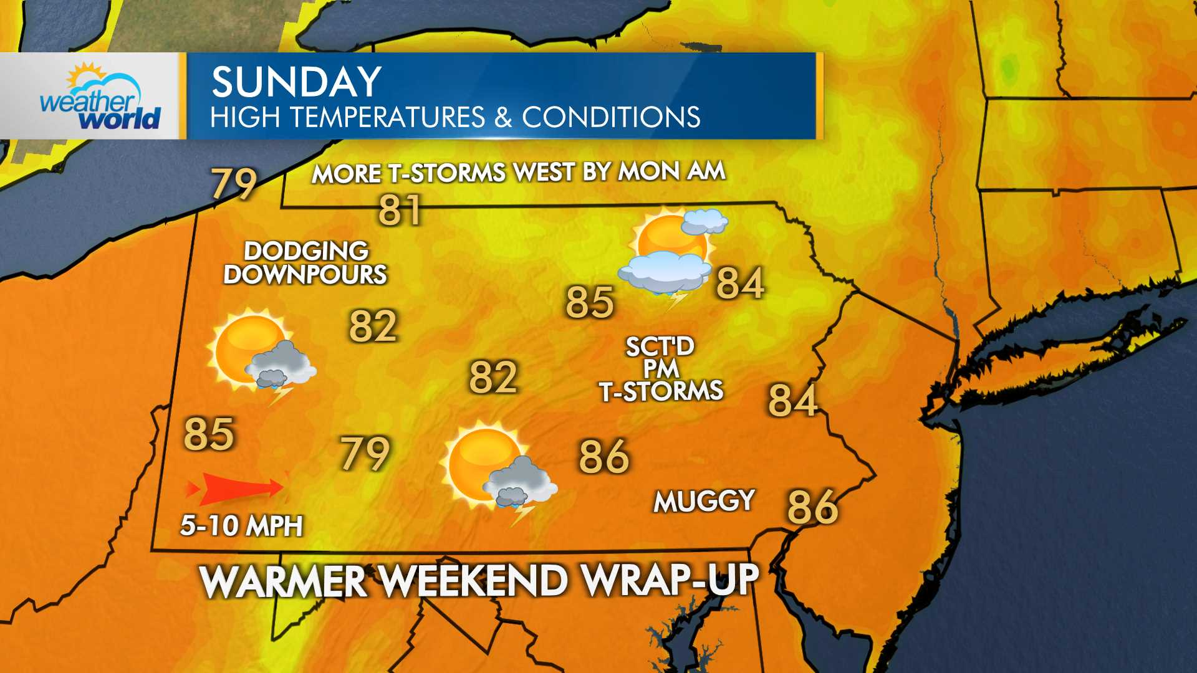
Forecast Contest!
Each day, I will share a link with you after our weather discussion for the places that we are going to forecast
When you enter the link, you will get access to a form that allows you to enter a forecast
Don't submit the forecast until you are sure – no changing afterward!

Slide 14
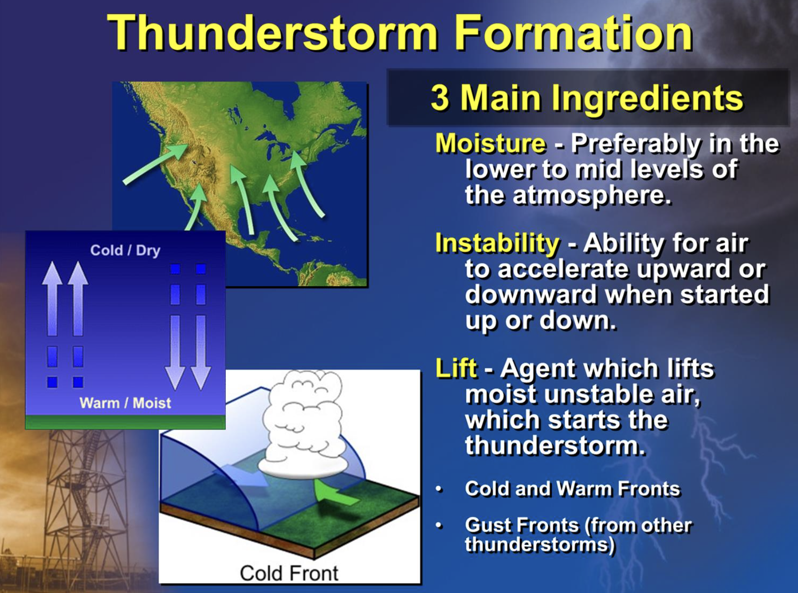
Useful sites to check out
Keystone Mesonet
Penn State e-Wall
Tropical Tidbits
Pivotal Weather
National Weather Service
Weather Prediction Center
Storm Prediction Center
National Hurricane Center
National Blend of Models
ASOS Observations
https://www.noaa.gov/jetstream/thunderstorms/ingredients-for-thunderstorm

Slide 15
Forecast Contest #1
https://forms.office.com/r/4MApxgtttC
Submit your temperature forecast as a whole number (no need for additional text, º symbols, etc)

