Slide 1
THURSDAY
June 22, 2023

Slide 2
Verifications – Forecast #3

Slide 3
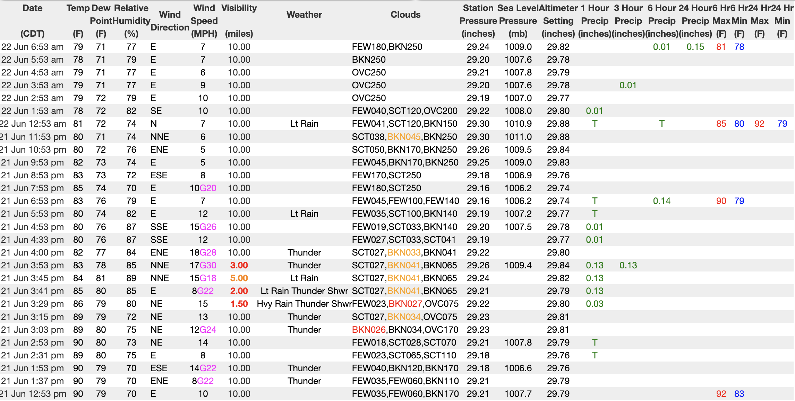
Verifications – Forecast #3

Slide 4
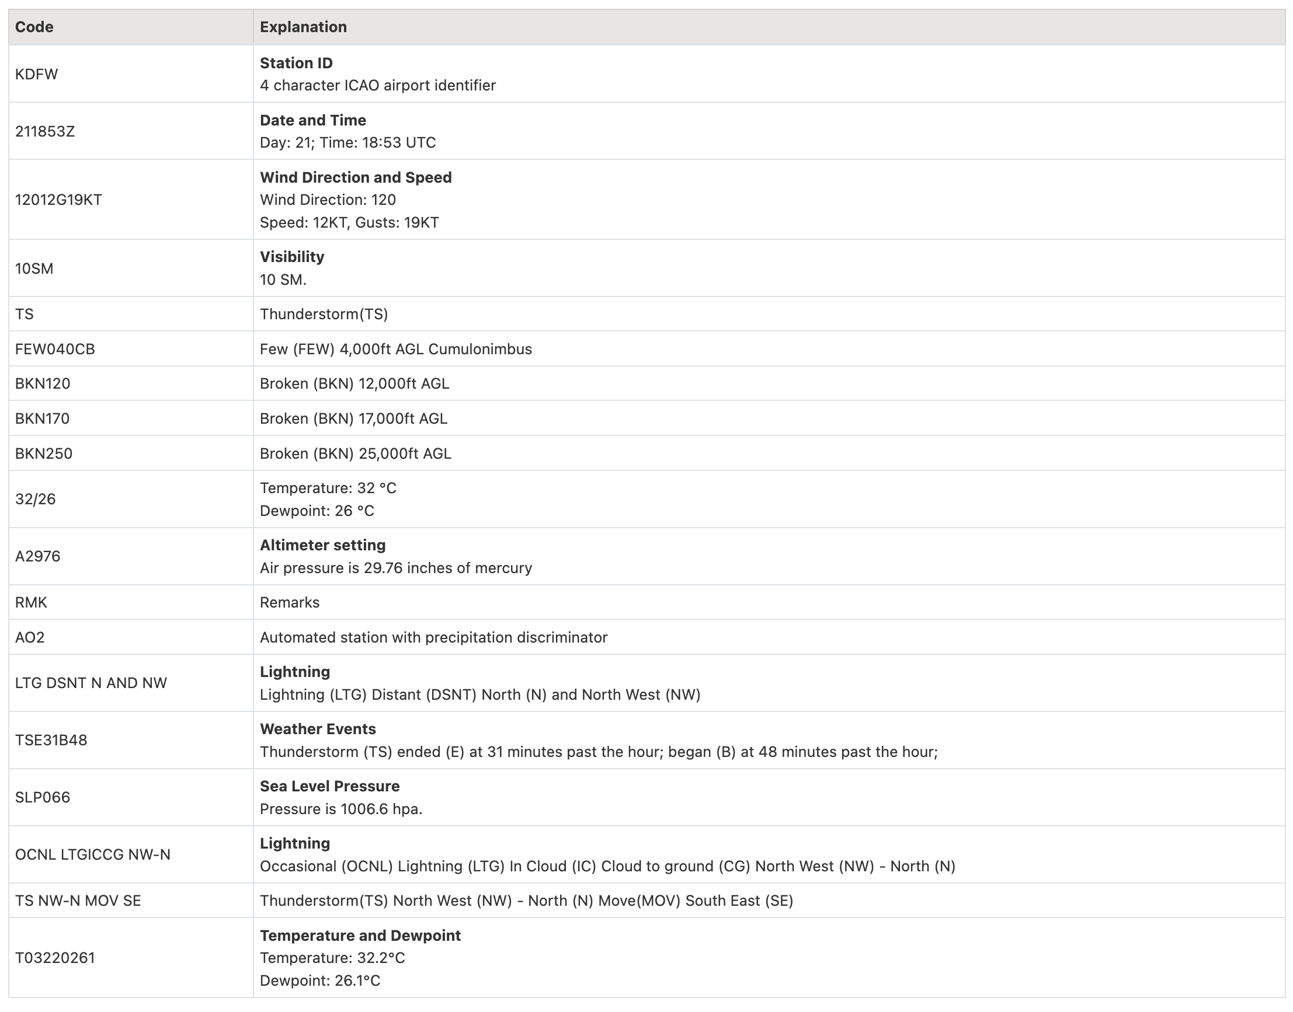
Verifications – Forecast #3

Slide 5
Verifications – Forecast #3

Slide 6
Verifications – Forecast #3

Slide 7
Verifications – Forecast #3
High temperature in State College on June 21:
Thunder at DFW by 11:59pm CDT on June 21:
Measurable rain in State College by 8AM June 22:
At least 0.10" in State College by 8AM June 22:
76º
YES
YES
YES

Slide 8
The Importance of Topography

Slide 9
What is Topography?
Simply…the measure of elevation
Elevation plays a huge role in weather
Not just the elevation, but the path that the air took to get a certain elevation, or the change in elevation

Slide 10
From: https://blog.weather.us/downsloping/

Slide 11
Upslope…Downslope
On the “upslope side” Clouds, precipitation, cooler than it would be otherwise
On the “downslope side” No clouds, no precipitation, warmer than it would be otherwise

Slide 12
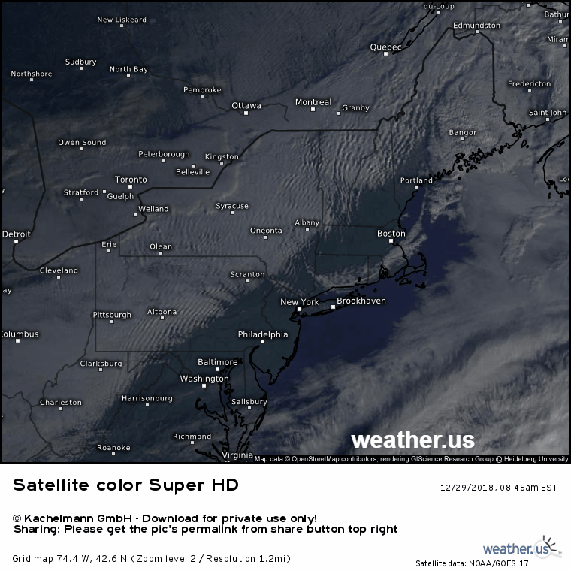
Upslope…Downslope
This doesn’t have to be a huge difference over enormous mountains
It happens in Pennsylvania all of the time

Slide 13
From: https://www.worldatlas.com/webimage/countrys/namerica/usstates/paland.htm

Slide 14
Where Does It Happen?
So let’s think about the nation as a whole, where are likely regions of upsloping and downsloping?

Slide 15
From:
https://maps-usa.com/us-map-topography

Slide 16
Rising vs. Sinking
Air that is rising, and does not have condensation, cools at 5.5 degrees Fahrenheit for every 1000 feet.
If condensation is happening (Temp=Dewpoint) it cools at 3.3 degrees Fahrenheit for every 1000 feet.
Why is it lower???
When water vapor condenses, it releases some heat (latent heat of condensation), which reduces how much cooling happens.

Slide 17
"Rain shadow"
From: https://www.theweatherprediction.com/weatherpapers/118/index.html

Slide 18
Proximity to Water

Slide 19
Proximity to Water
The physical location of a place in relation to water has a big effect on the actual weather
Water changes temperature much slower than the air

Slide 20
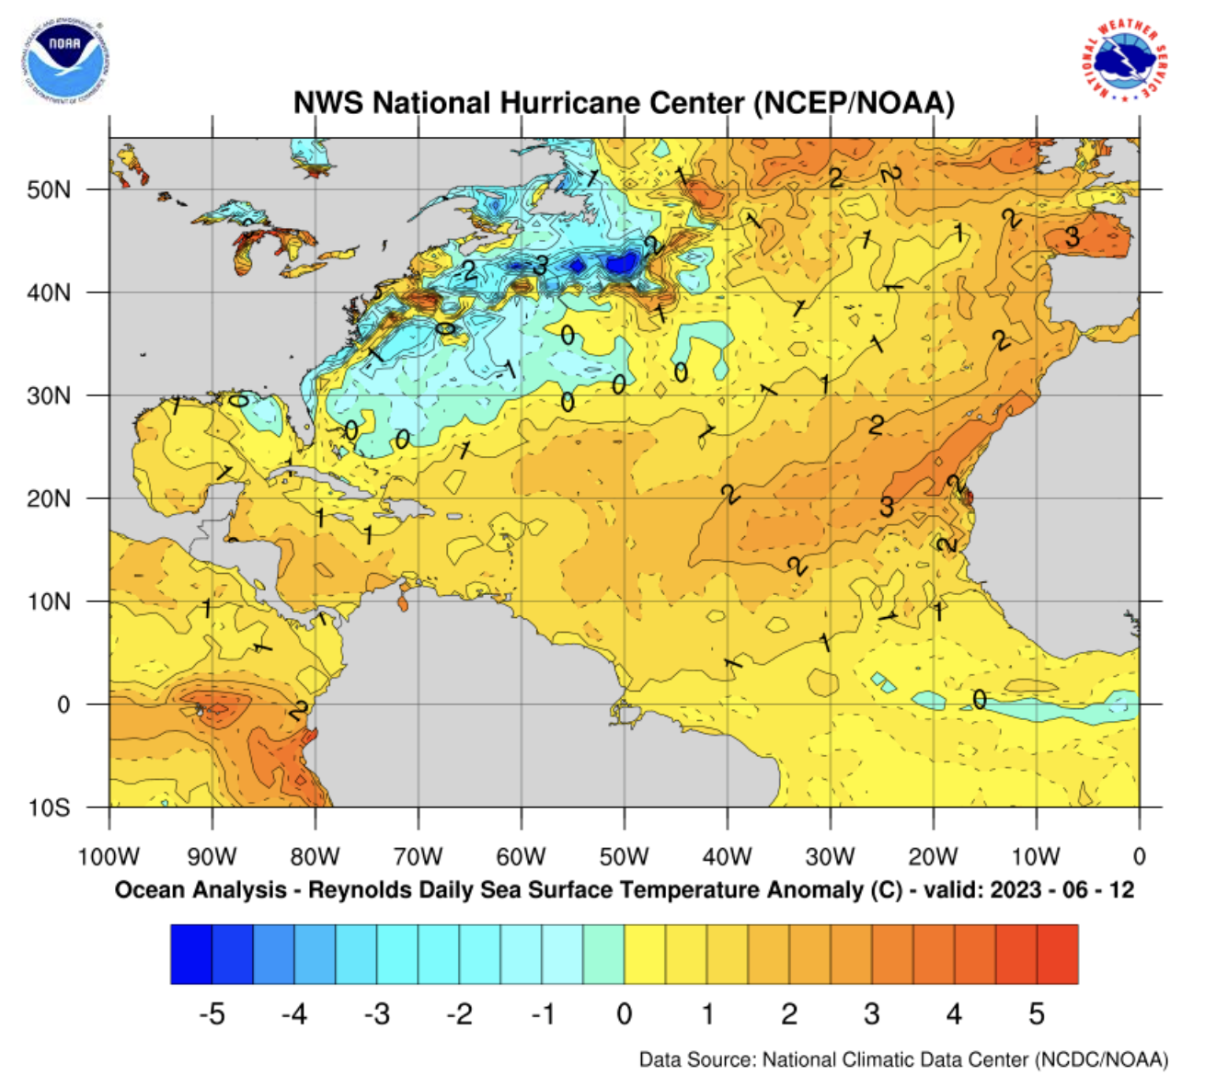
https://www.nhc.noaa.gov/sst/

Slide 21
Quick estimate: ºC x 2 + 30 = ~ºF

Slide 22
How Water Impacts Temperature
In general, the body of water needs to be fairly large to have an effect
Ocean
Large Bay
Large Lake
Large River

Slide 23
Wind and Water
The direction of the wind (whether coming from off of the water or off of land) is the biggest influence

Slide 24
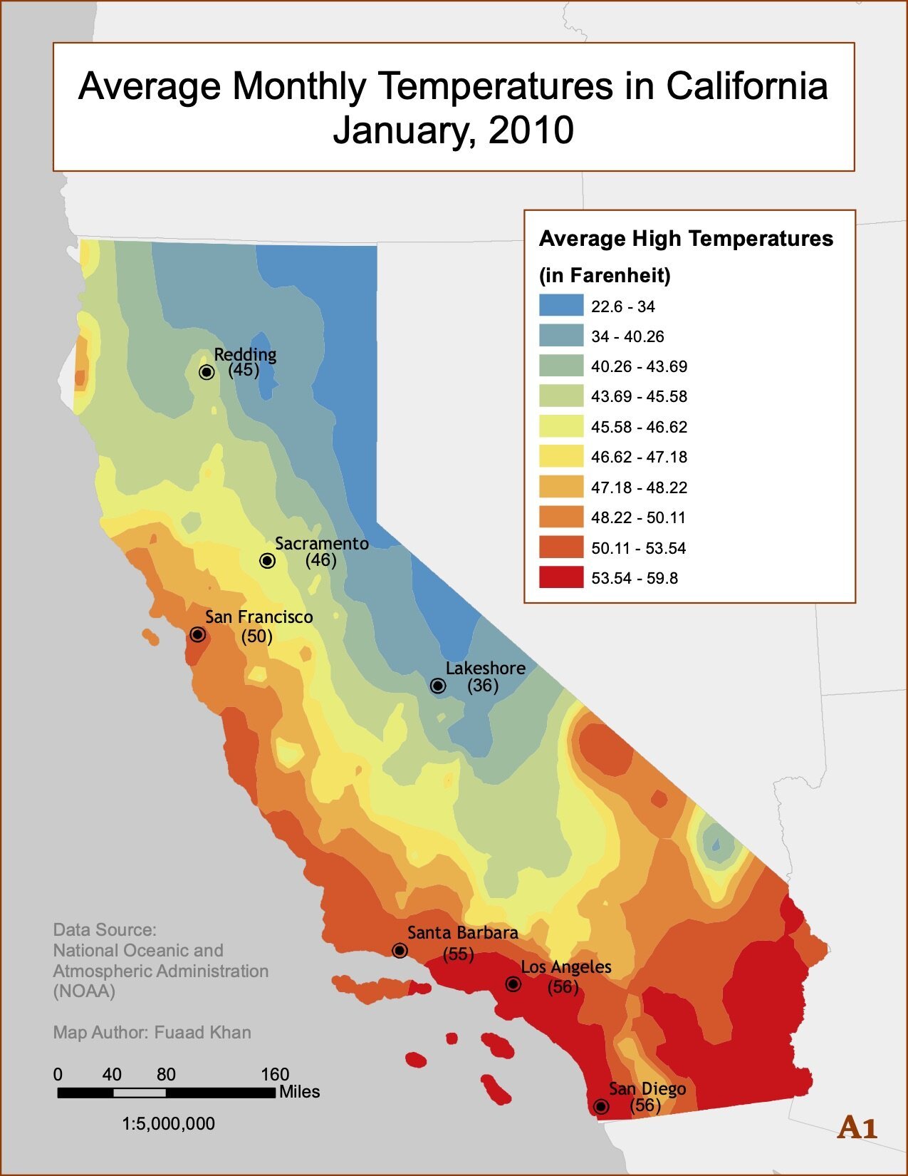
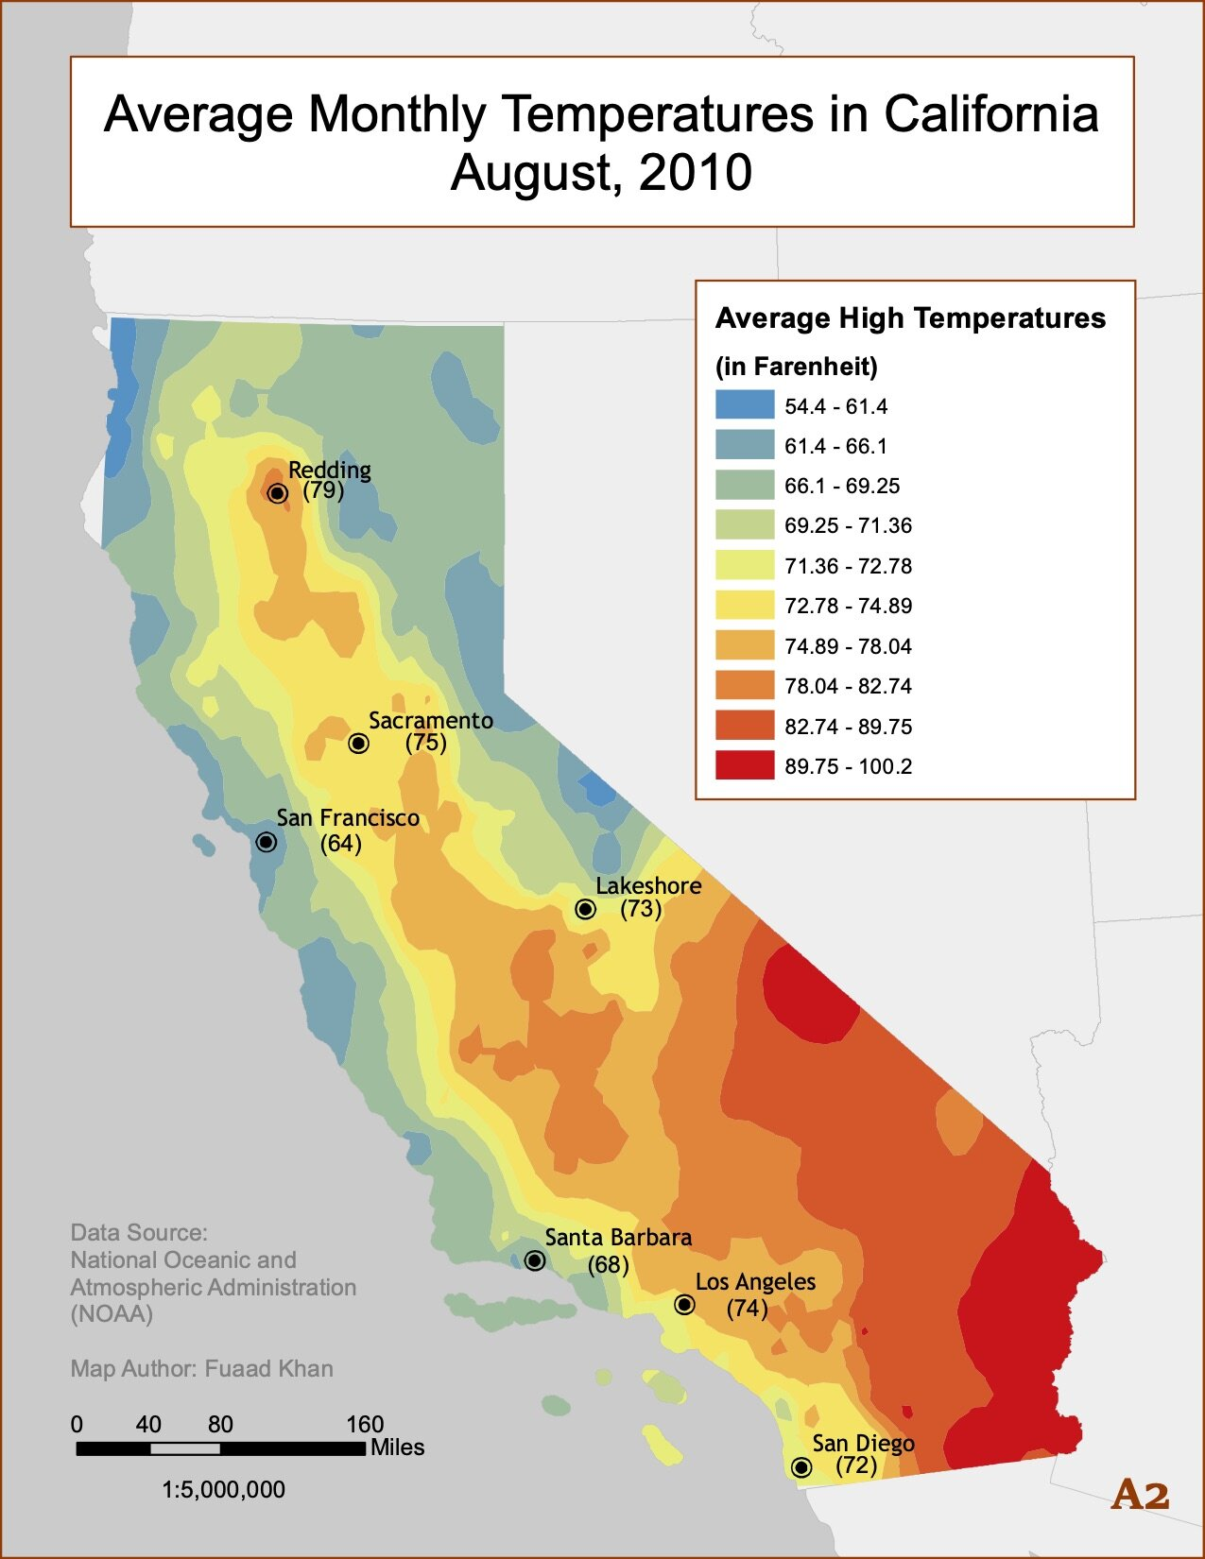
From: https://fuaadkhan.com/average-temperature-interpolation

Slide 25
Most noticeable effects during daytime?
What are some examples?
Onshore “synoptic” breezes
Synoptic=expected background wind because of large scales cyclones and anticyclones
Localized, mesoscale onshore and offshore breezes
Sea breezes, land breezes

Slide 26
From: https://www.researchgate.net/figure/Land-breeze-and-sea-breeze-from-Garrison-1993-fig-813_fig7_312317198

Slide 27
What can a sea breeze or land breeze do?
From: https://orlandoweather.wordpress.com/page/26/?app-download=android

Slide 28
From: https://ericsweatherlibrary.com/2015/07/08/what-is-the-sea-breeze/

Slide 29
From: https://ericsweatherlibrary.com/2015/07/08/what-is-the-sea-breeze/

Slide 30
Sea breezes and others on satellite
https://www.youtube.com/watch?v=Bs2PyCgOLXk
https://www.youtube.com/watch?v=Bc8mZrTjIeA

Slide 31
When is a Sea Breeze Most Likely?
If it is a warm day with light offshore winds, the sea breeze can work inland and keep weather much cooler near the coast
If it is a very windy day, with strong background breezes, or the winds are already onshore, then there is not a sea breeze effect
For days where the winds everywhere are onshore, that will keep the temperature from climbing much. This can also keep temperatures nearly isothermal as the air moving over the water takes on the attributes of the water and will not increase or decrease much.
Reduced daily temperature spread

Slide 32
Looking up climate data
weather.gov

Slide 33
Useful links
Keystone Mesonet
Penn State e-Wall
Tropical Tidbits
Pivotal Weather
National Weather Service
Weather Prediction Center
Storm Prediction Center
National Hurricane Center
National Blend of Models
Current ASOS Observations

Slide 34
Forecast Contest #4 – FINAL FORECAST!
https://forms.office.com/r/6FcfREZdnK

