Slide 1
TUESDAY
June 20, 2023

Slide 2
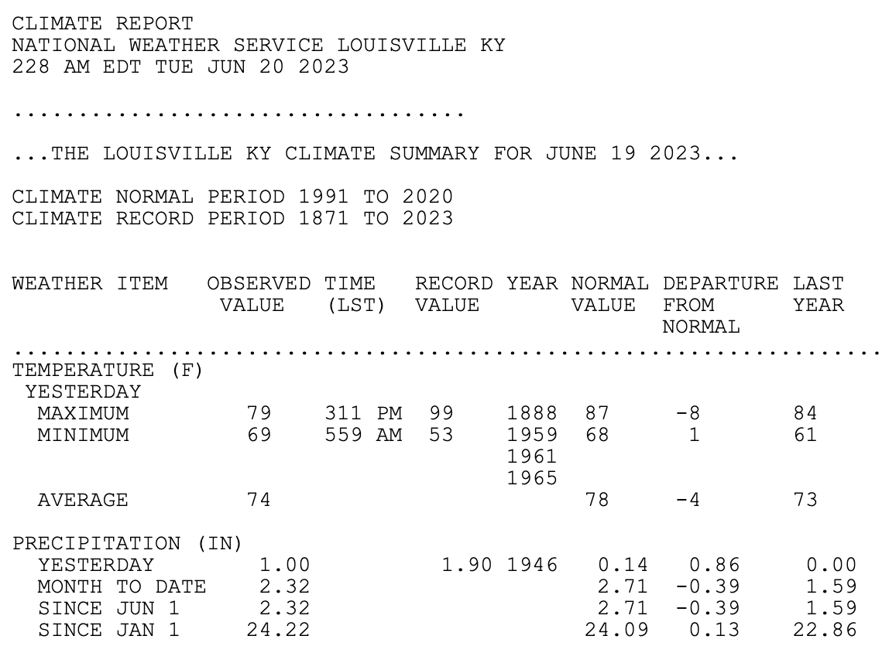
Verifications – Forecast #1

Slide 3
Verifications – Forecast #1
High temperature in State College on June 19:
Total precipitation in Louisville, KY (KSDF) midnight to midnight on June 19:
Tropical Storm Bret by 5pm on June 19:
83º
1.00"
YES!

Slide 4
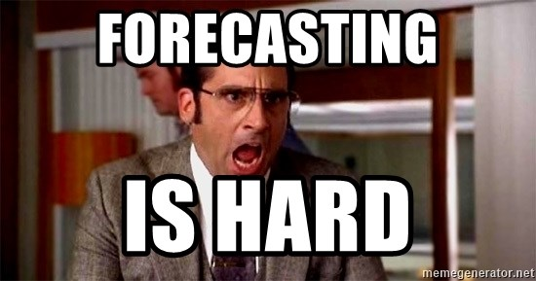
“Forecasting is difficult, especially about the future.”
Attributed to many
“All models are wrong, but some models are useful.”
George E.P. Box, statistician
“Weather forecast for tonight: dark. Continued dark overnight, with widely scattered light by morning.”
George Carlin

Slide 5
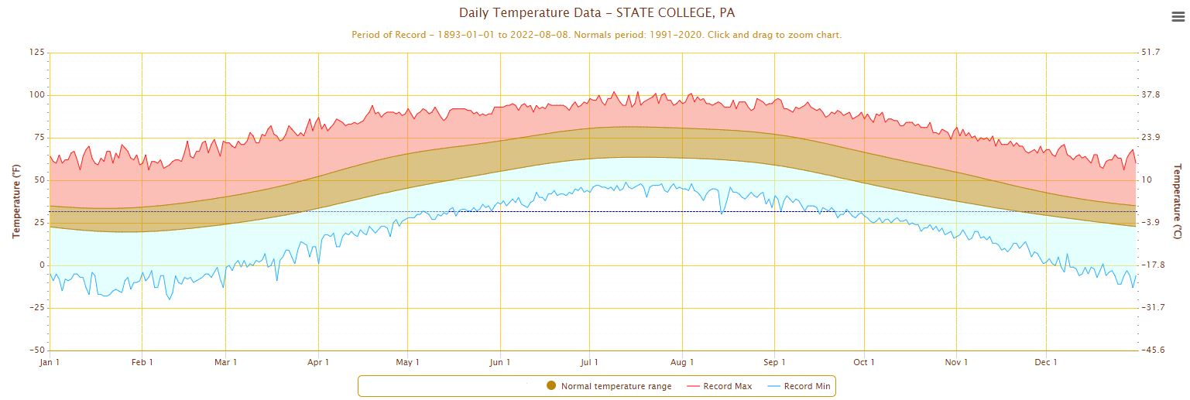
Forecasting Techniques
Very simple #1:
CLIMATOLOGY – use averages (i.e. the “normals”)
Use these as a benchmark/starting point for temperature forecast
Not a bad basepoint where the conditions don’t change much (example: the tropics), but doesn’t work well in places where weather changes frequently or in situations of record-setting weather

Slide 6
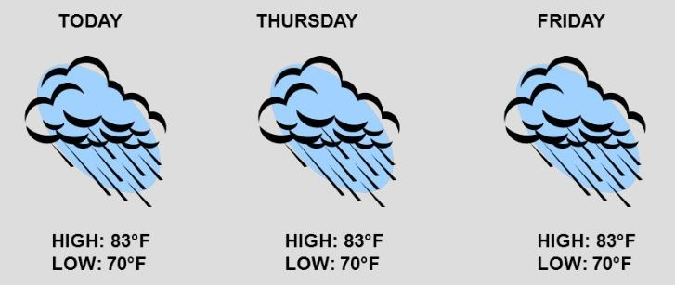
Forecasting Techniques
Very simple #2:
PERSISTENCE – weather now = weather later
Ex: use today’s weather as forecast for tomorrow
Ex: use last winter snowfall as forecast for this winter
Accuracy depends largely on the current weather patterns & on your location
Works well in places where weather changes slowly (ex: the tropics), not-so-well in the mid-latitudes

Slide 7
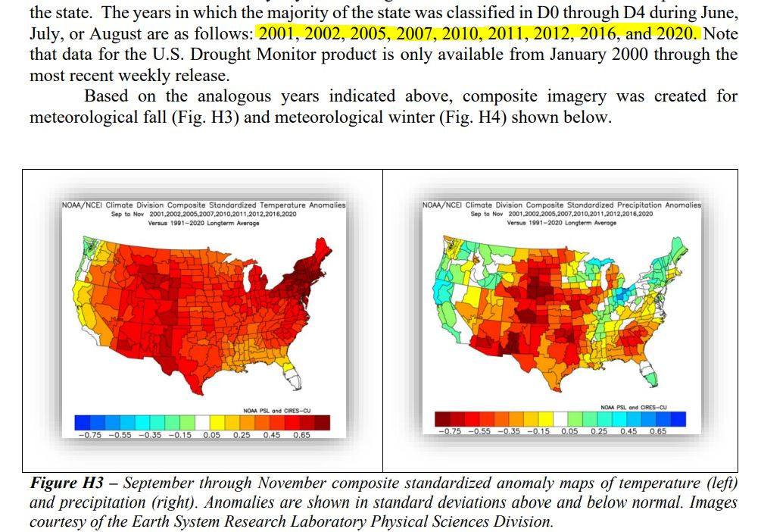
Forecasting Techniques
Somewhat simple #3:
ANALOG – assume weather repeats itself (almost)
Find examples from the past that match the current conditions (such a matching pattern is an “analog”)
See what happened next in the historical case(s)
Use that as your forecast in the current case
Requires many years of weather maps and fast ways to locate analogs (examples: CPC, SLU)

Slide 8
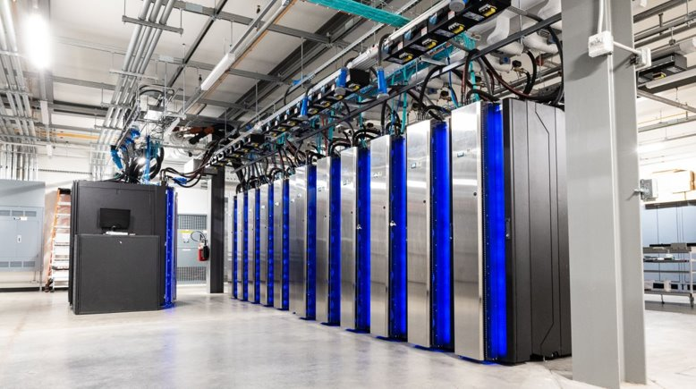
Forecasting Techniques
No-so-simple: Numerical Weather Prediction (models!)
NAM (or NMM) – primary U.S. short-range NWP model.
-- run 4 times a day, at 00Z, 06Z, 12Z, 18Z, out to 84 hours (3.5 days)
GFS – Global Forecast System; primary U.S. long-range NWP model
-- run 4 times a day, at 00Z, 06Z, 12Z, 18Z, out to 384 hours (16 days)
HRRR – High-Resolution Rapid Refresh
-- run every hour out to 18 hours, thus for very short-range forecasting
UKMET – from United Kingdom METeorological Office
-- run at 00Z and 12Z out to 72 hours
European (Euro) – run by the European Center for Medium-Range Weather Forecasting (ECMWF)
-- run at 00Z and 12Z out to 360 hours (15 days)

Slide 9
Ensemble Forecasting
Consider a set of computer model forecasts (an “ensemble”) rather than just one
The set can come from:
The same model using slightly different initial conditions
The same model using slightly different representations of the physics
Different models
All 3 of the above

Slide 10
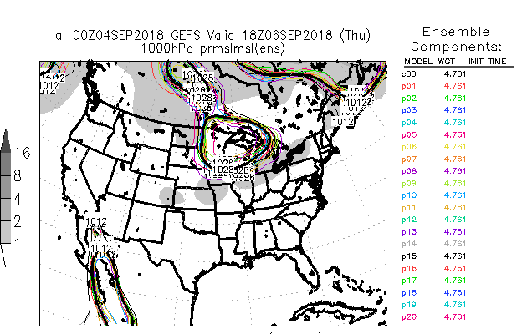
Ensemble Forecasting
Common ways of displaying the information: Spaghetti Plot
Spaghetti Plot –
A particular isopleth is displayed on a map from all ensembles members at a particular time.
Week 2 Trends Weather World segment
Spaghetti Plots: http://www.meteo.psu.edu/fxg1/ENSHGTAVGNH_0z/ensloopmref.html

Slide 11
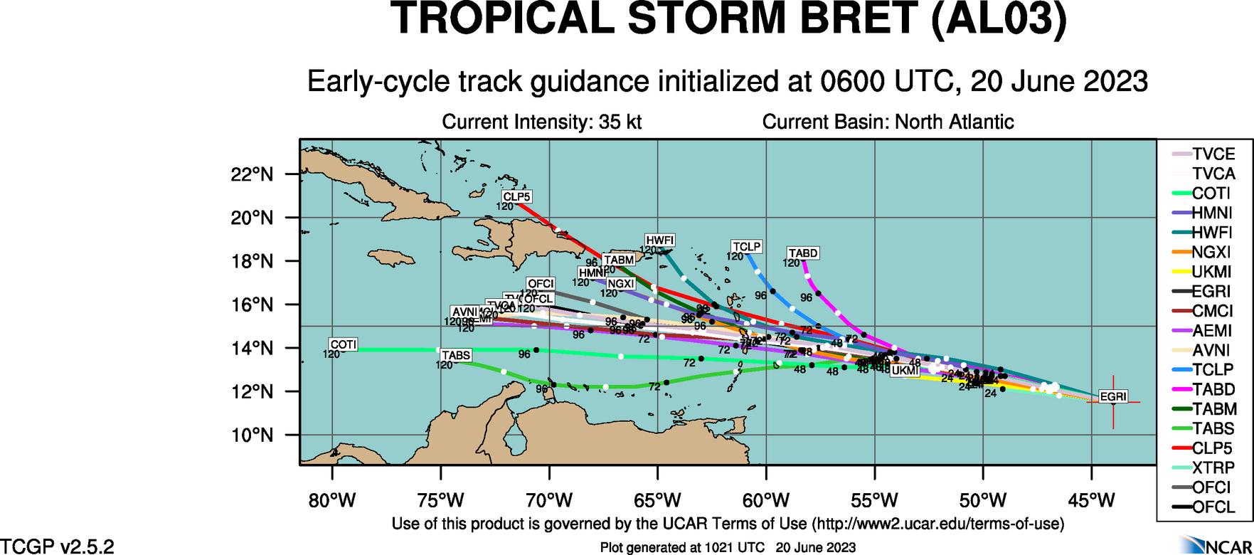
Ensemble Forecasting
Ensemble forecasts of hurricane tracks are common
http://www.ral.ucar.edu/hurricanes/realtime/current/
http://snowsquall.met.psu.edu/wxworld/

Slide 12
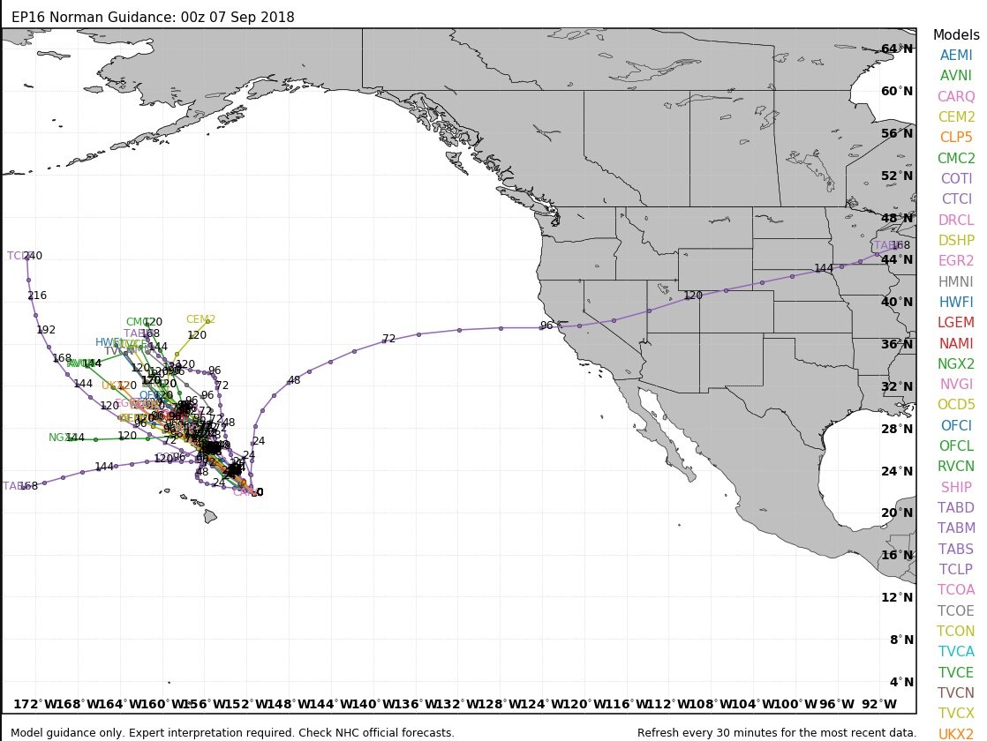
Ensemble Forecasting
Yes, occasionally some ensemble members produce wacky solutions, but we typically can recognize them (Tropical Storm Norman, September 2018)

Slide 13
More useful sites to check out...
ASOS data
Replace "UNV" with your station identifier
Plenty of others!

Slide 14
Forecast Contest #2
https://forms.office.com/r/9tpQVVMiX2

