Slide 1


TV WEATHER

Slide 2
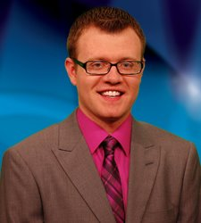
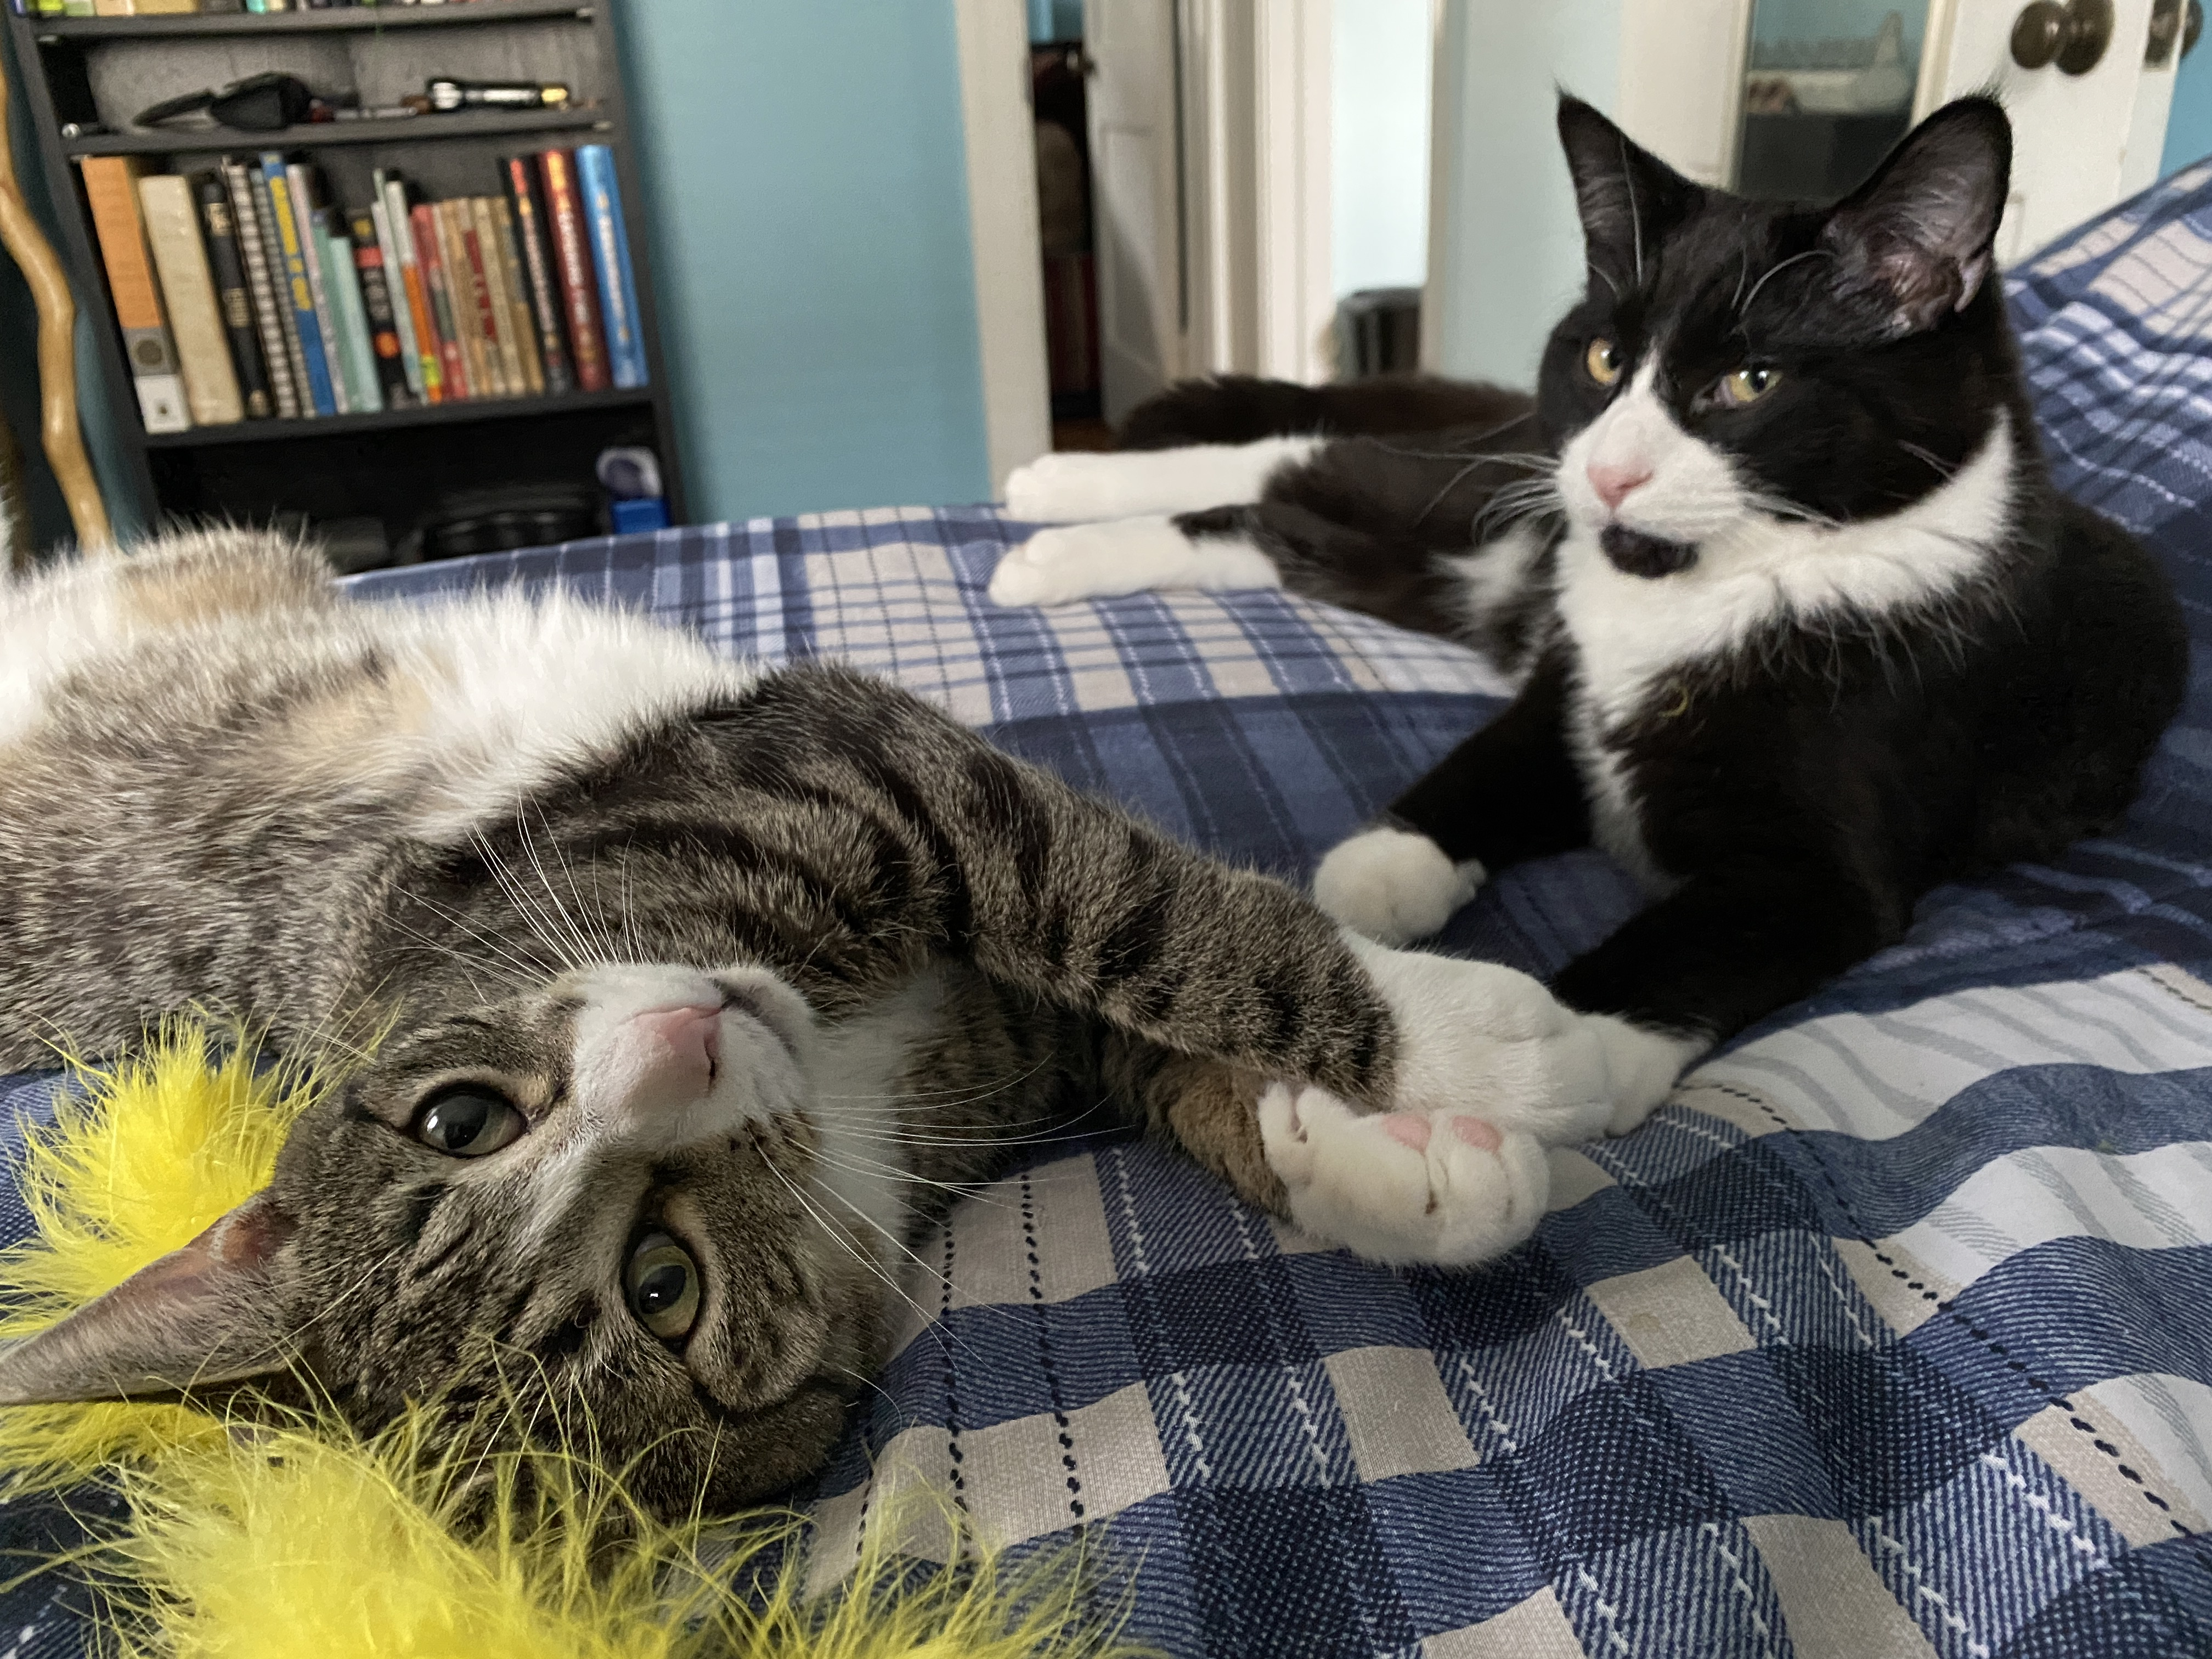

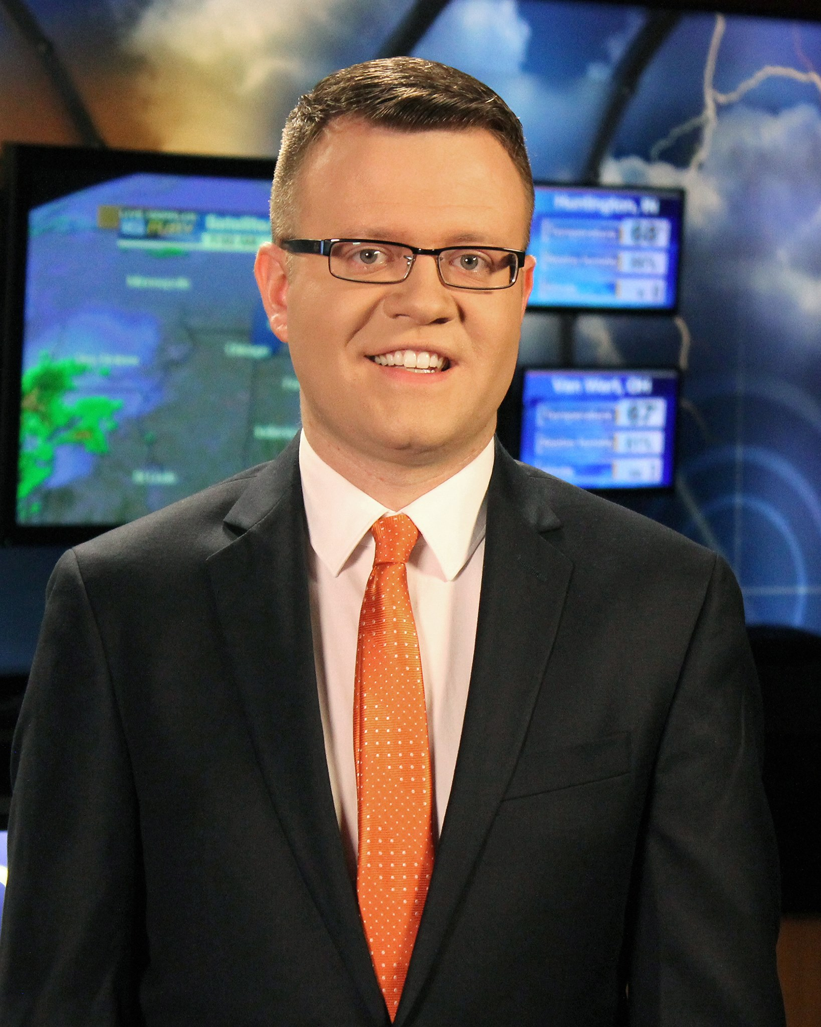
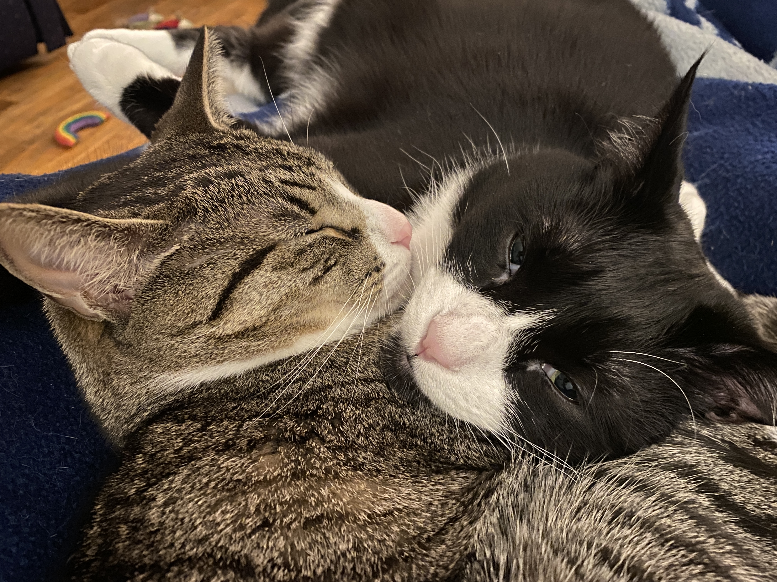

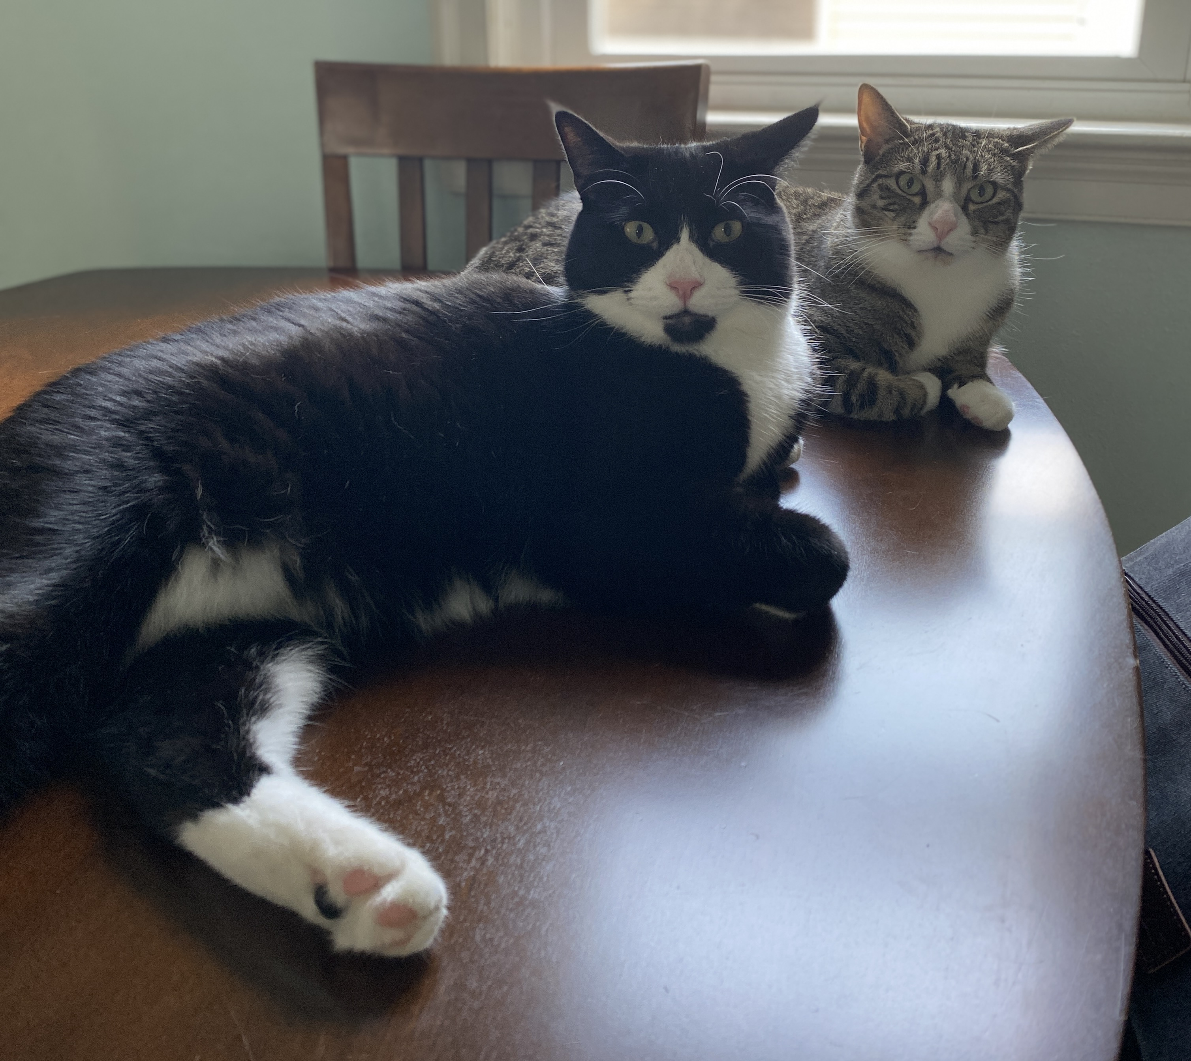
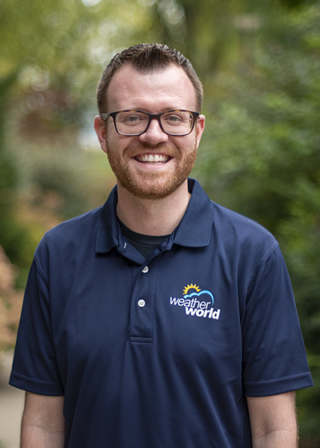

My experience
BS METEO (‘11) Penn State
2011-2013 – WABI-TV5 (Bangor, ME) Weekend Meteorologist
2013-2018 – WANE-TV (Fort Wayne, IN) Weekend AM Meteorologist
2018-Present – PSU Meteo Faculty – Weather World Executive Producer & Meteorologist
Interests: hiking, camping, coffee, traveling, music
My family: 2 cats (brothers – Toby & Ty)
Notes:
First, a bit about me.

Slide 3
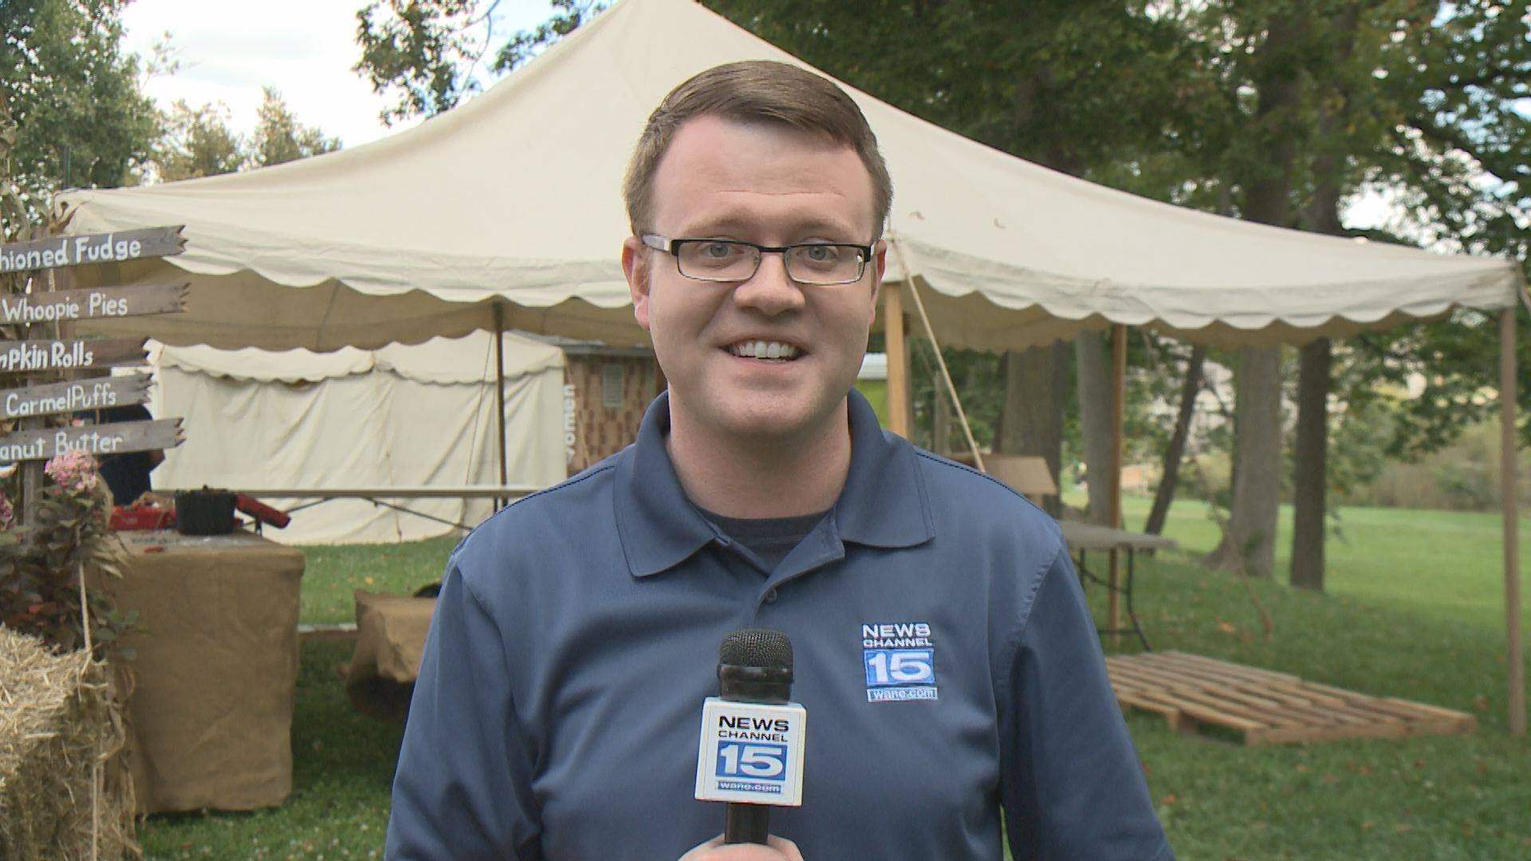
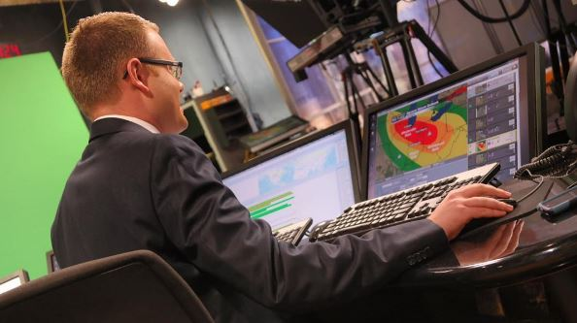

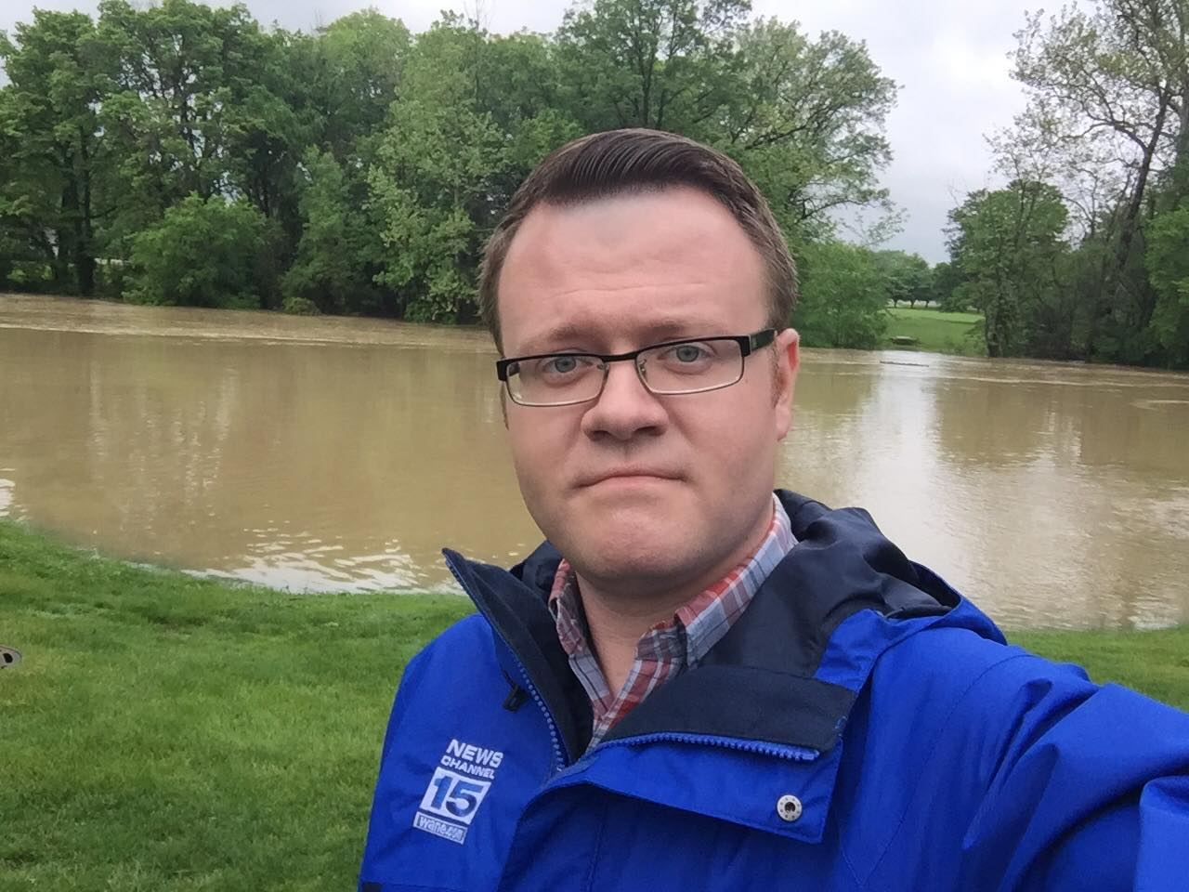
On-Air
Tools:
  Weather graphics (MAX - currents, models, planners, 7-day, etc)
  Microphone
  Earpiece (IFB)
  Remote
  iPad/script (field)
Attire:
  Formalwear
  Makeup
  Station swag (polos, hats, jackets)
LIVE:
  No teleprompter
  Studio – variety of locations
  Field – on-site at event
  Technical troubles
Notes:
First, a bit about me.

Slide 4
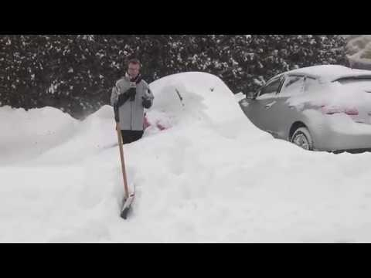
Notes:
Covering nor’easters in Maine! This was from the February 8, 2013 storm. WABI-TV5

Slide 5
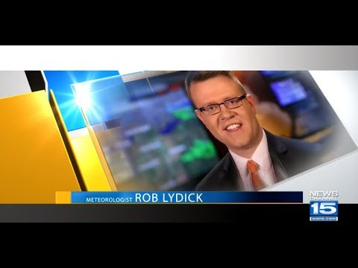

Slide 6
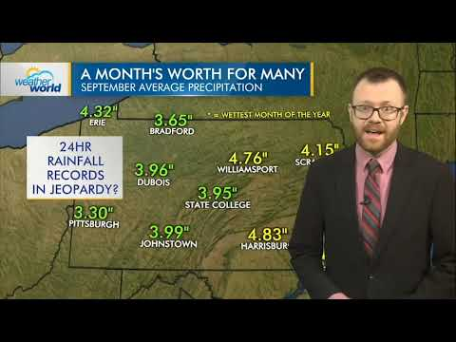

Slide 7
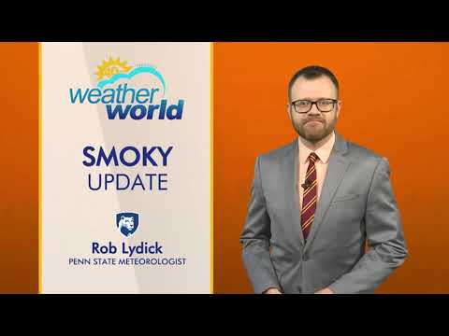

Slide 8
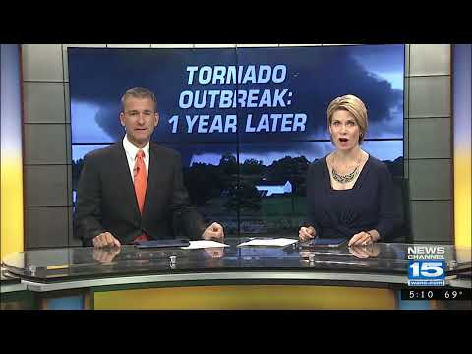
Notes:
A one year retrospective on the August 24, 2016 tornado outbreak. WANE-TV

Slide 9
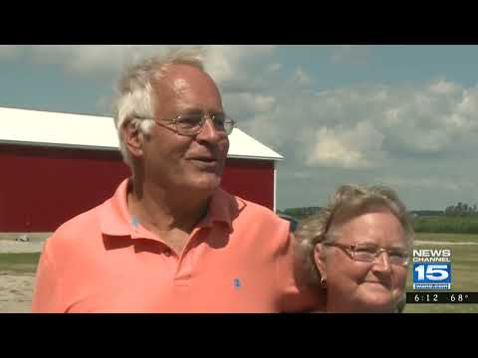
Notes:
A one year retrospective on the August 24, 2016 tornado outbreak. WANE-TV

Slide 10
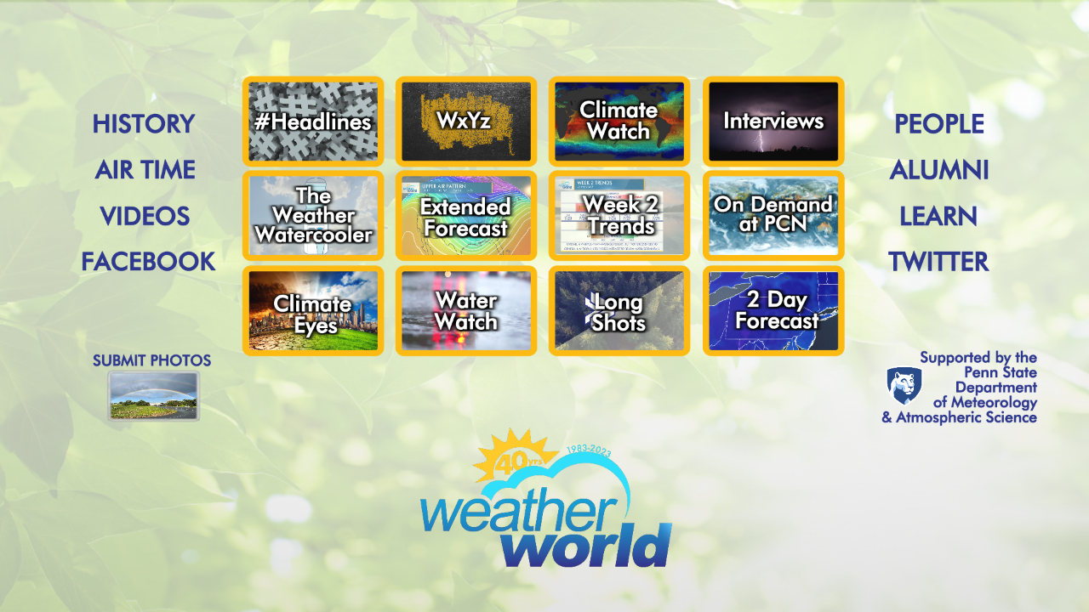

Slide 11
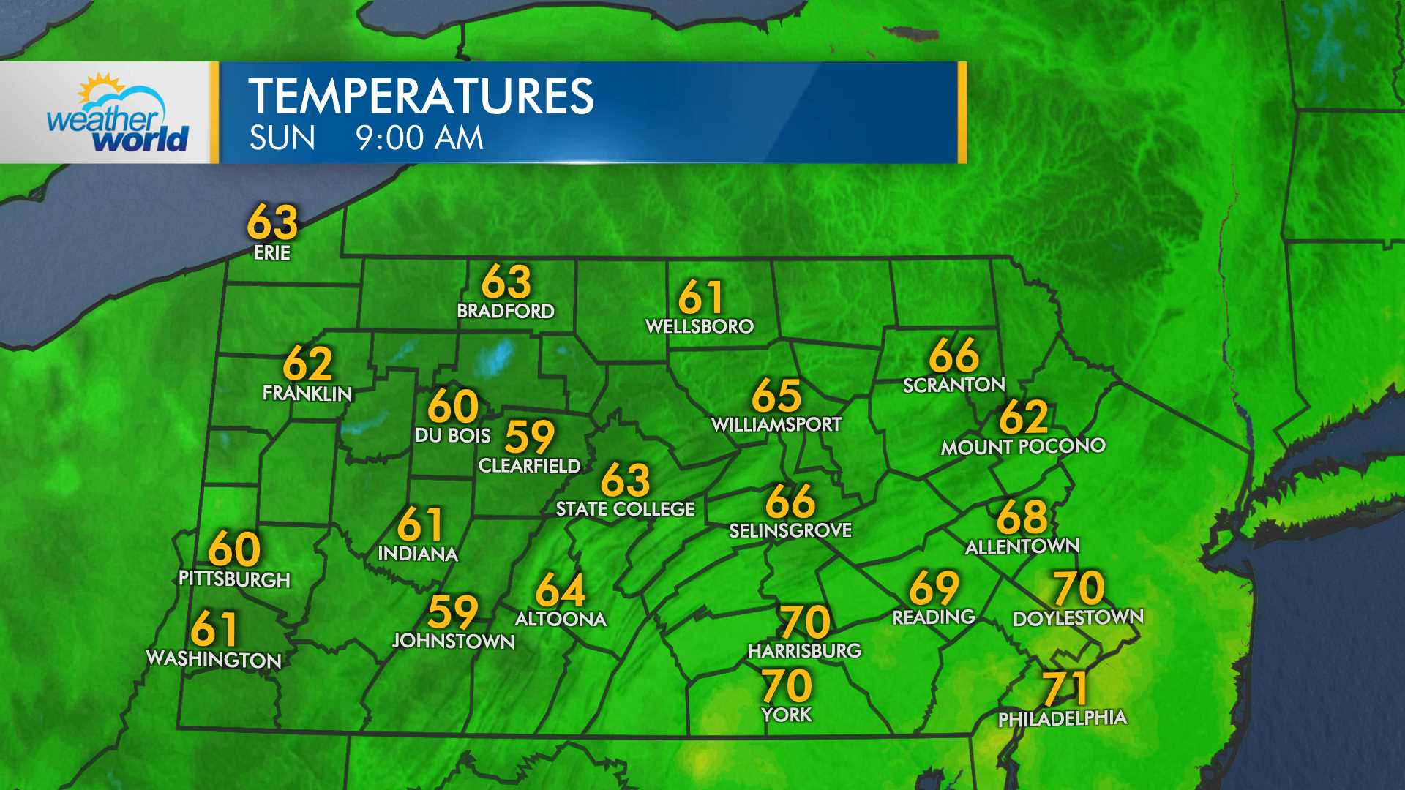
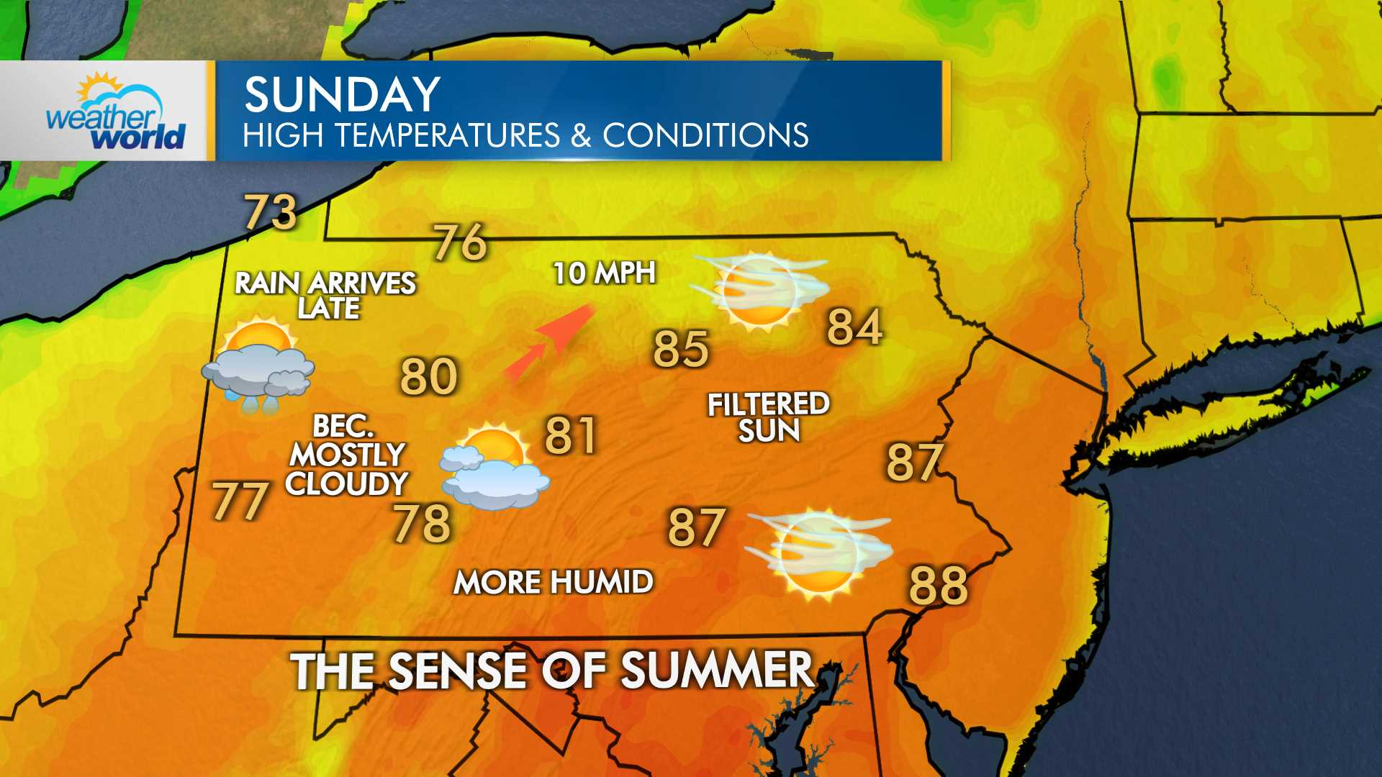
What do I need to know?
The area!
  Topography
  Lakes, rivers, streams
  Major roads & reference points
Geography!
  States
  Major cities
  Regions
Current conditions!
The forecast!
  Don't copy/paste
The tools!
  Graphics
Notes:
First, a bit about me.

