Slide 1
WEDNESDAY
June 21, 2023

Slide 2
Verifications – Forecast #2

Slide 3
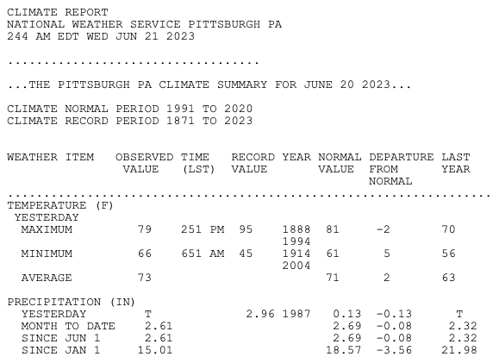
Verifications – Forecast #2

Slide 4
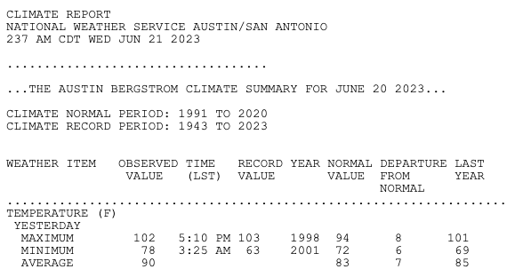
Verifications – Forecast #2

Slide 5
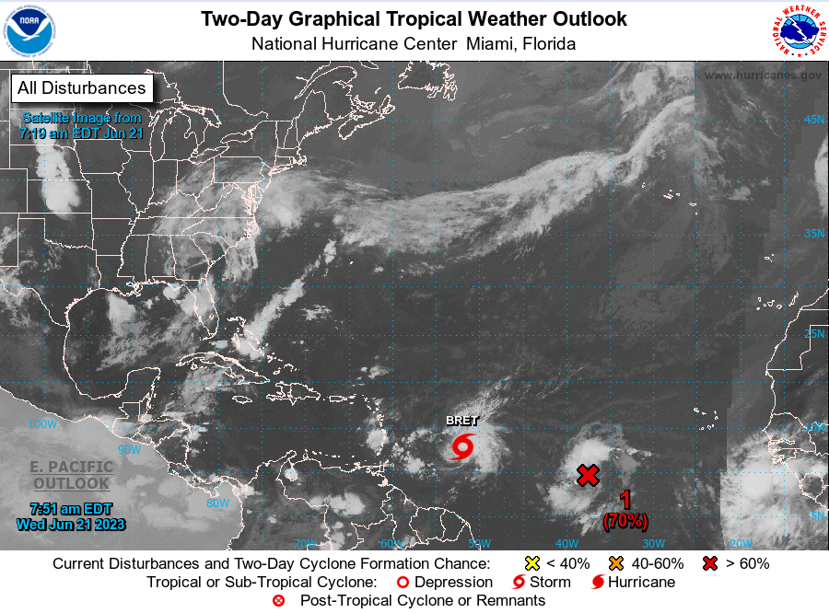
Verifications – Forecast #2

Slide 6
Verifications – Forecast #2
Low temperature in State College on June 21:
Measurable precip (at least 0.01") in Pittsburgh on June 20:
Record high beaten (>103º) in Austin, TX on June 20:
Tropical Storm Cindy by 11pm on June 20:
64º
NO
NO
NO

Slide 7
Happy First Day of Astronomical Summer!

Slide 8
#ShowYourStripesDay

Slide 9
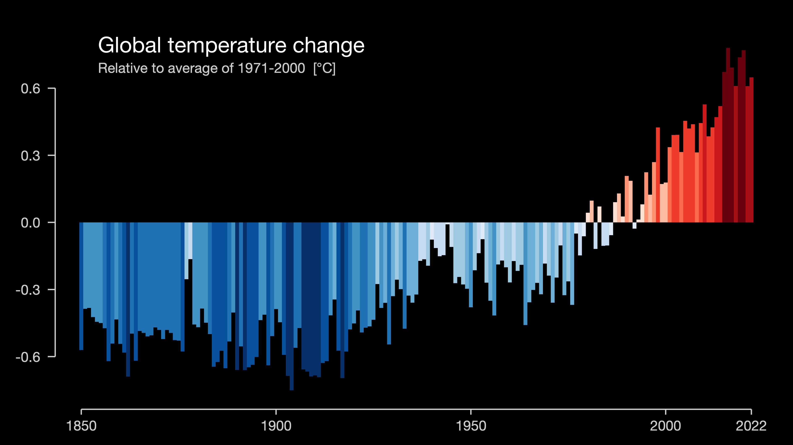
#ShowYourStripesDay

Slide 10
Useful links
Keystone Mesonet
Penn State e-Wall
Tropical Tidbits
Pivotal Weather
National Weather Service
Weather Prediction Center
Storm Prediction Center
National Hurricane Center
National Blend of Models
Current ASOS Observations

Slide 11
Forecast Contest #3
https://forms.office.com/r/zKJkuTd0i9

