Slide 1
WeatherSTEM Data Mining Tool

Slide 2
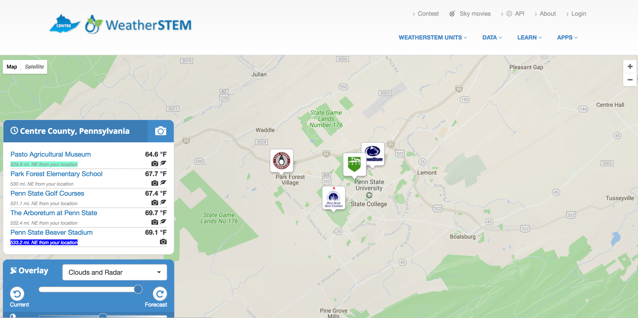
Start at the main domain page: https://centre.weatherstem.com
Select one of the stations from the main domain stage

Slide 3
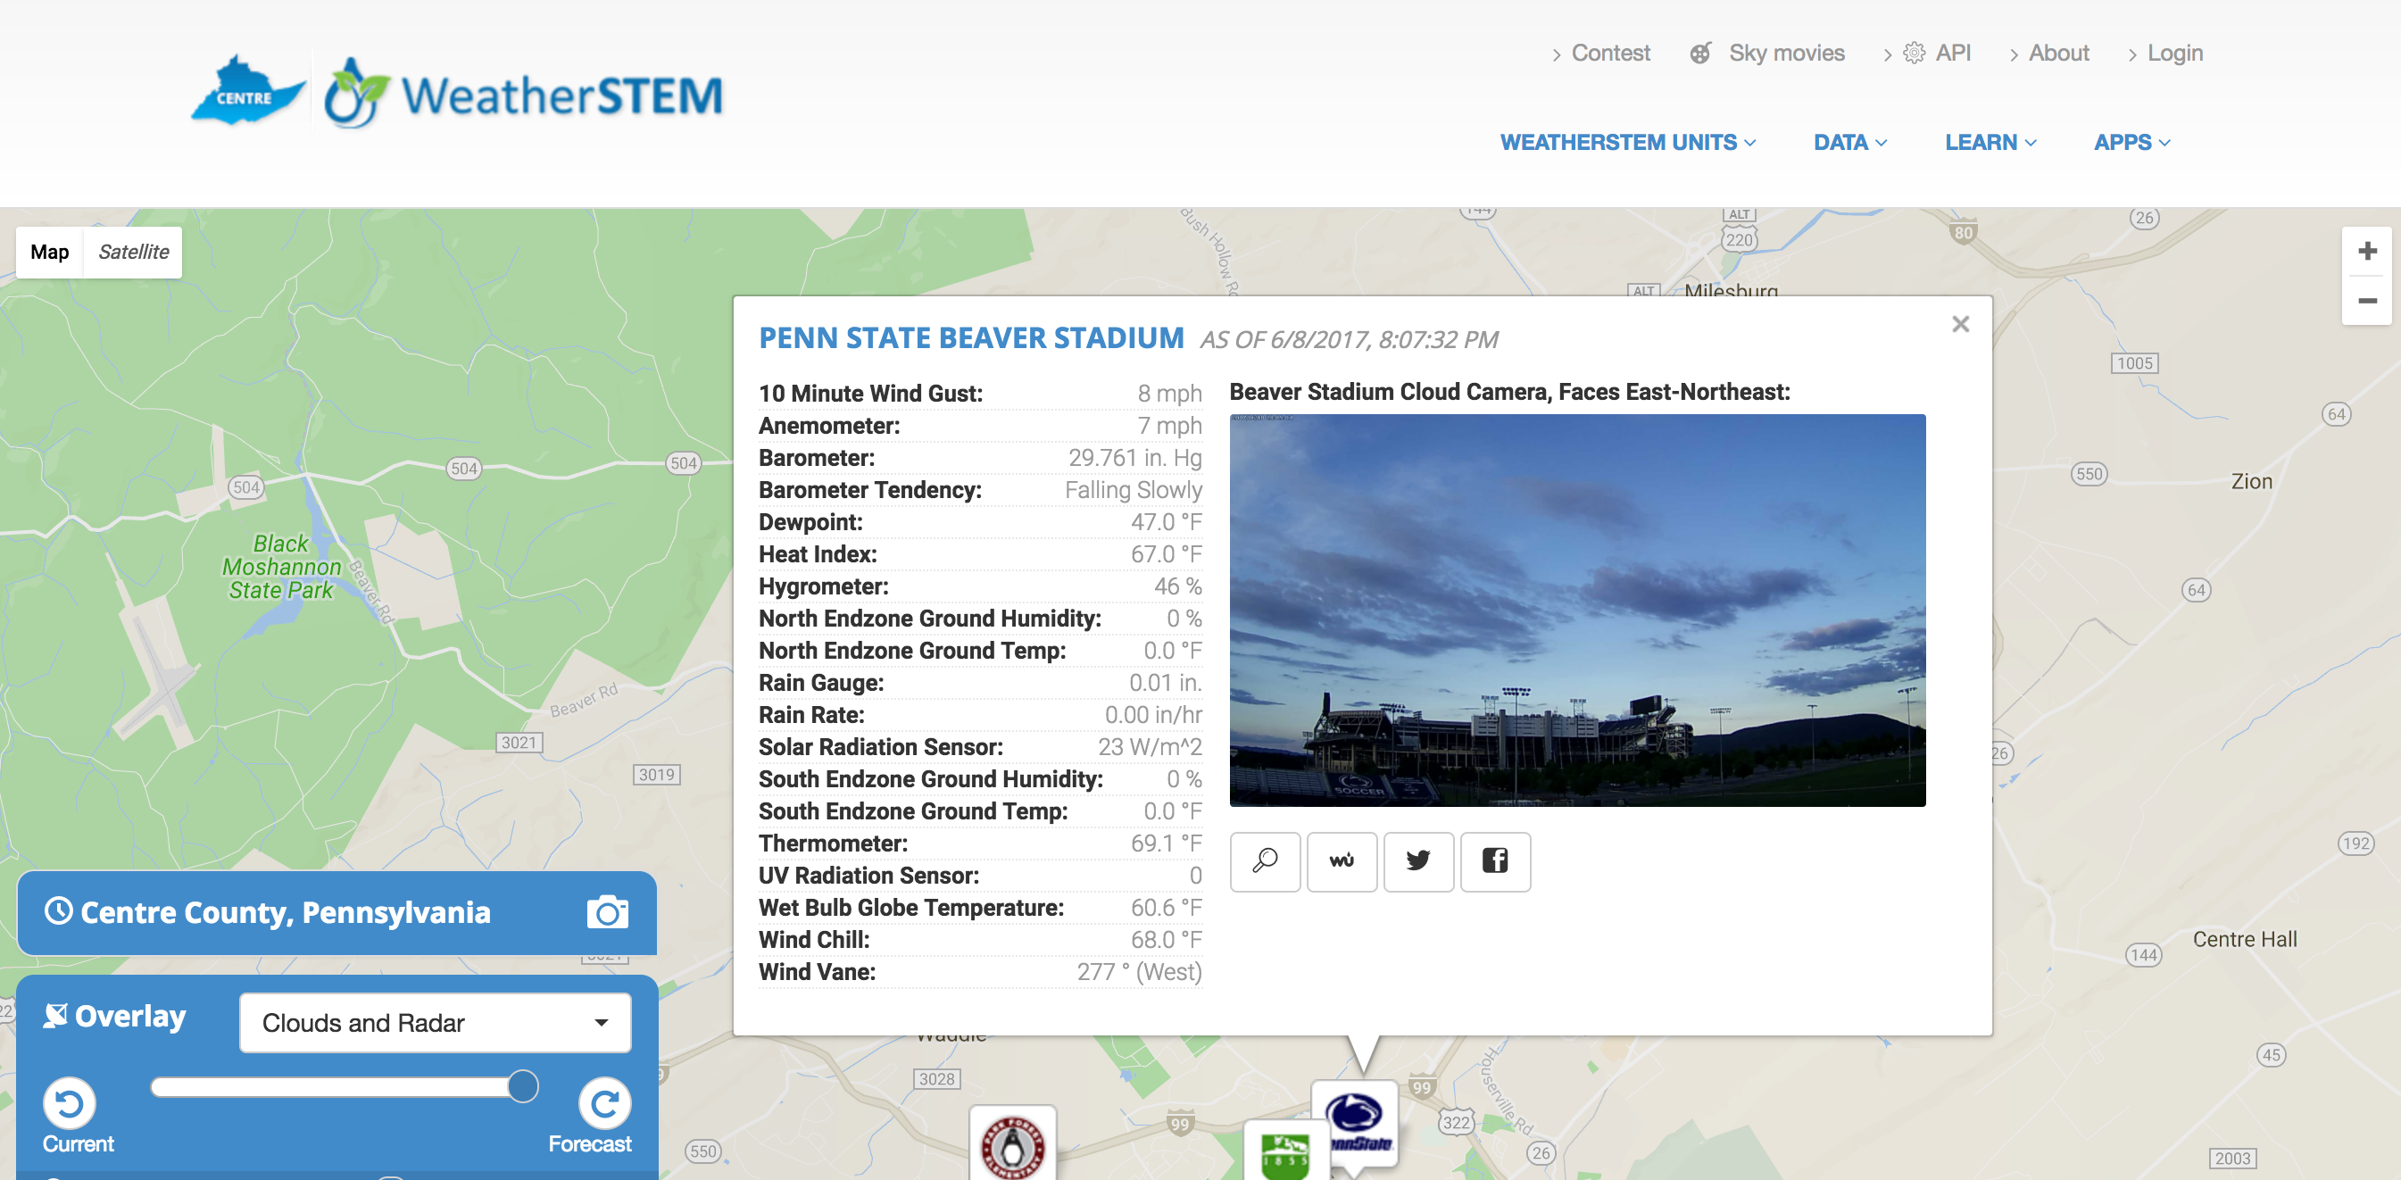
This will create a dialogue box that will show the latest cloud camera image and data from the WeatherSTEM instruments.
Click on the name of the WeatherSTEM station to go to the station page for more detailed information

Slide 4
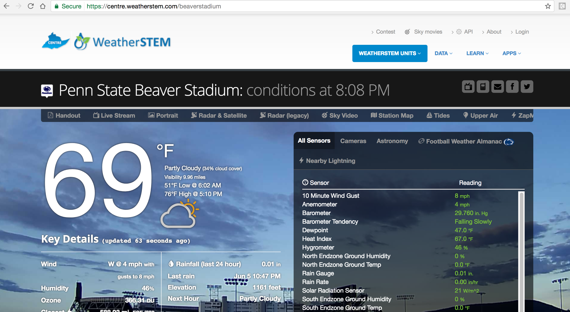
Click on the ‘Data’ tab to be taken to the data mining tool for weather analysis.
The WeatherSTEM station page has detailed information and data. Interesting features include: Sky Video, and data updated every minute.

Slide 5
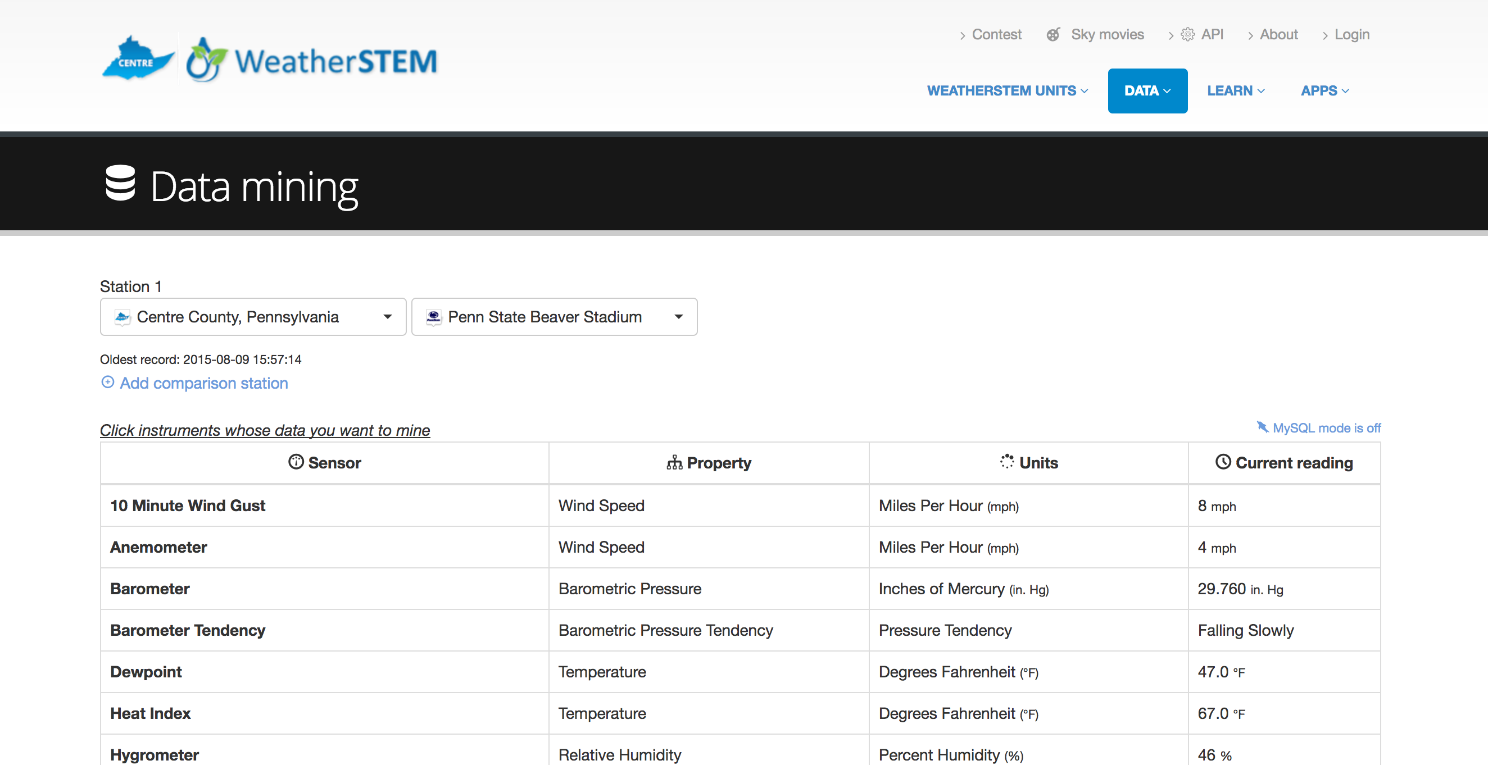
The Data Mining Tool appears as an easy to read table that allows users to select different variables to analyze.
Click on any of the rows to select the variables for analysis

Slide 6
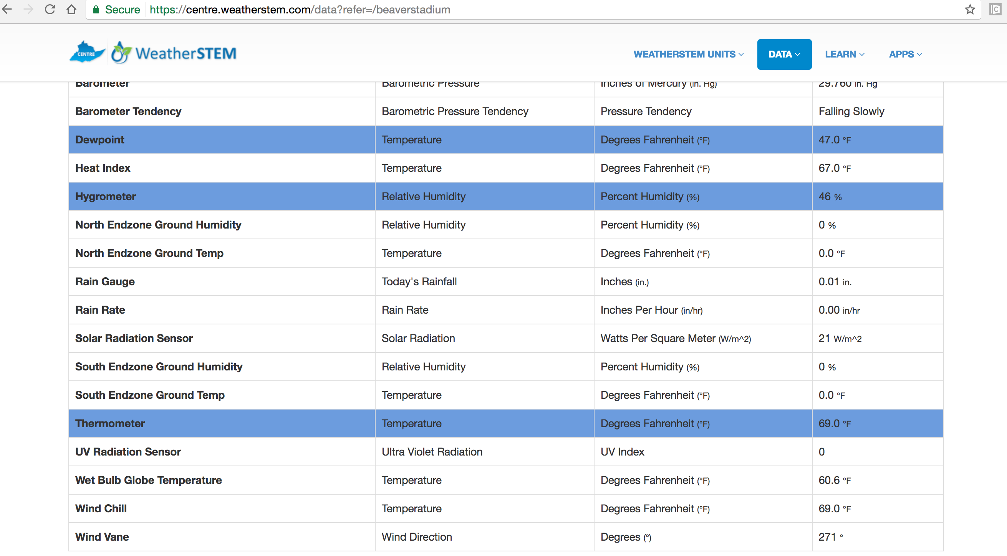
Selected rows will be highlighted. Click on a row again to ‘deselect’ the variable.

Slide 7
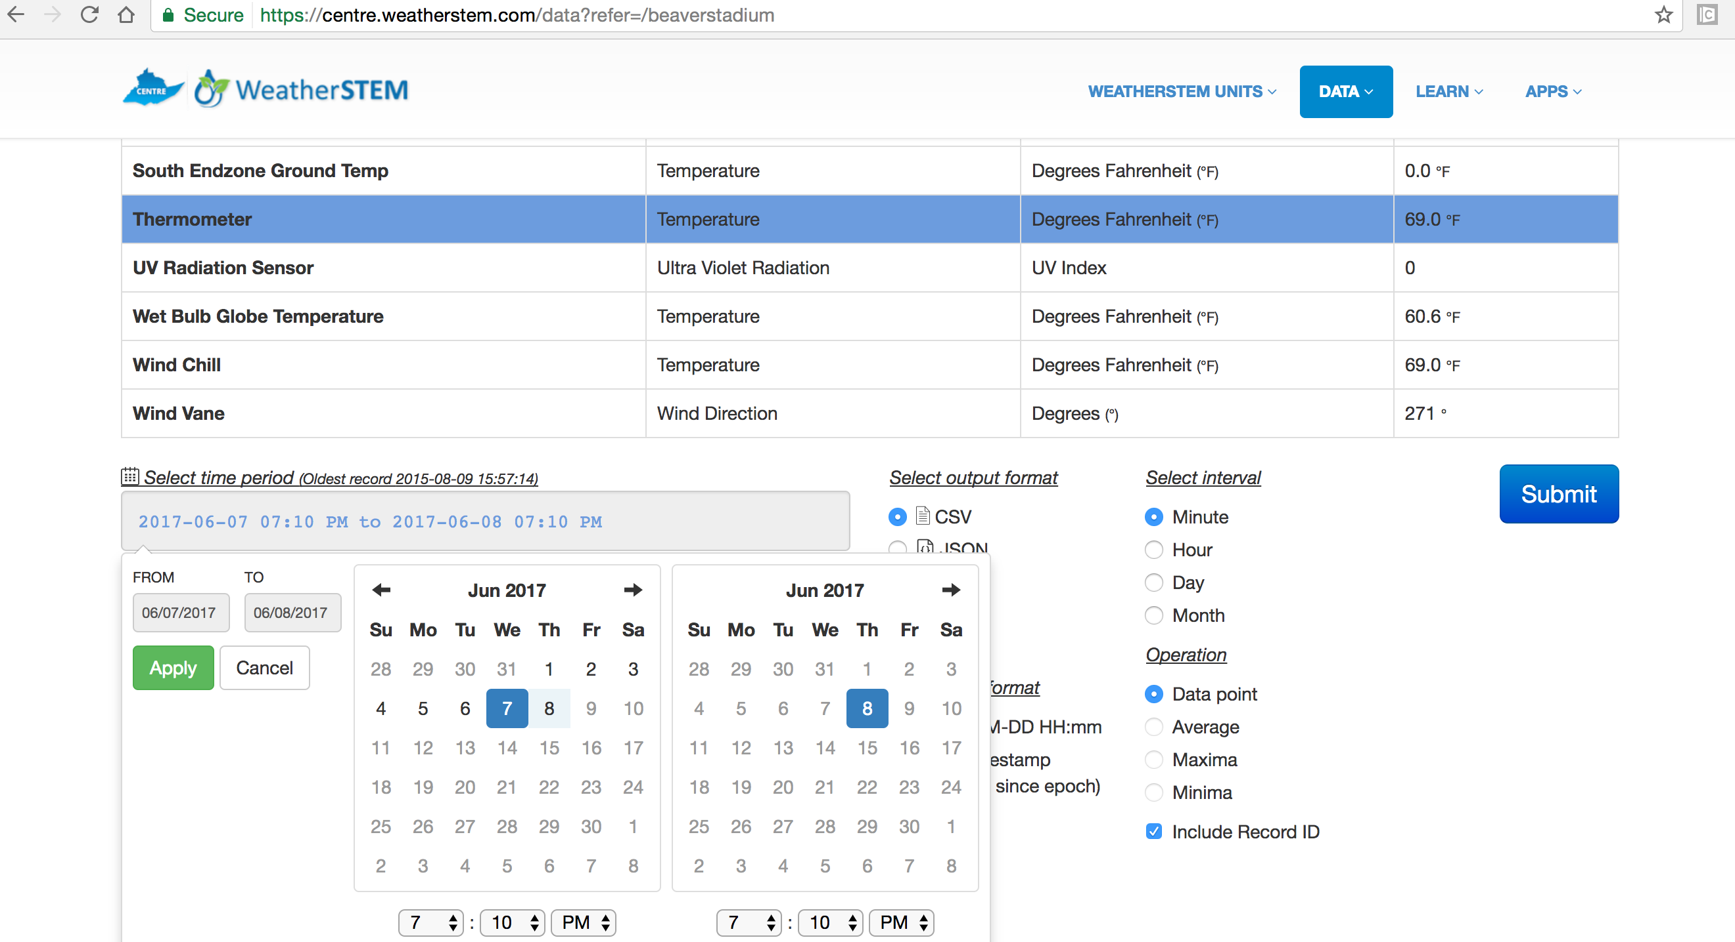
Make sure to select the data and time period for analysis and hit the ‘Apply’ button. The date of oldest record is listed.

Slide 8
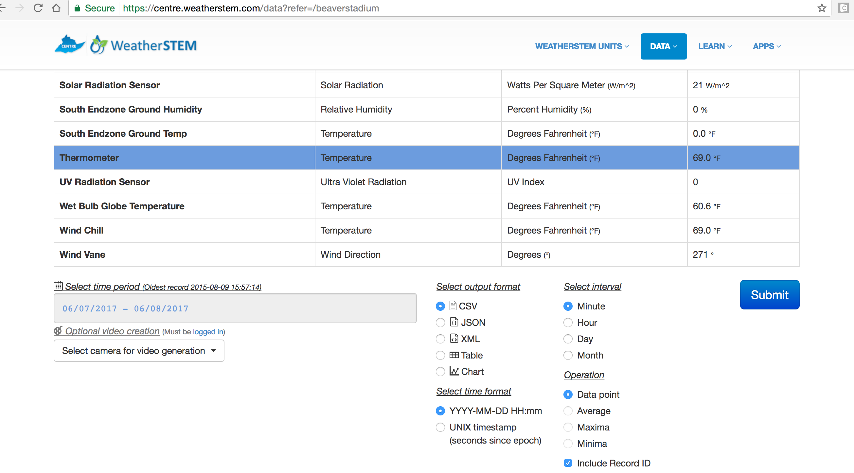
Once the time period has been selected, the output format, interval and operations can be changed to suit the needs of the user.
Common Formats: CSV (MS Excel), Chart (visual display)
Common Intervals/Operations: Minute (data point), Hour (average), Day (max/min), Month (max/min)

Slide 9
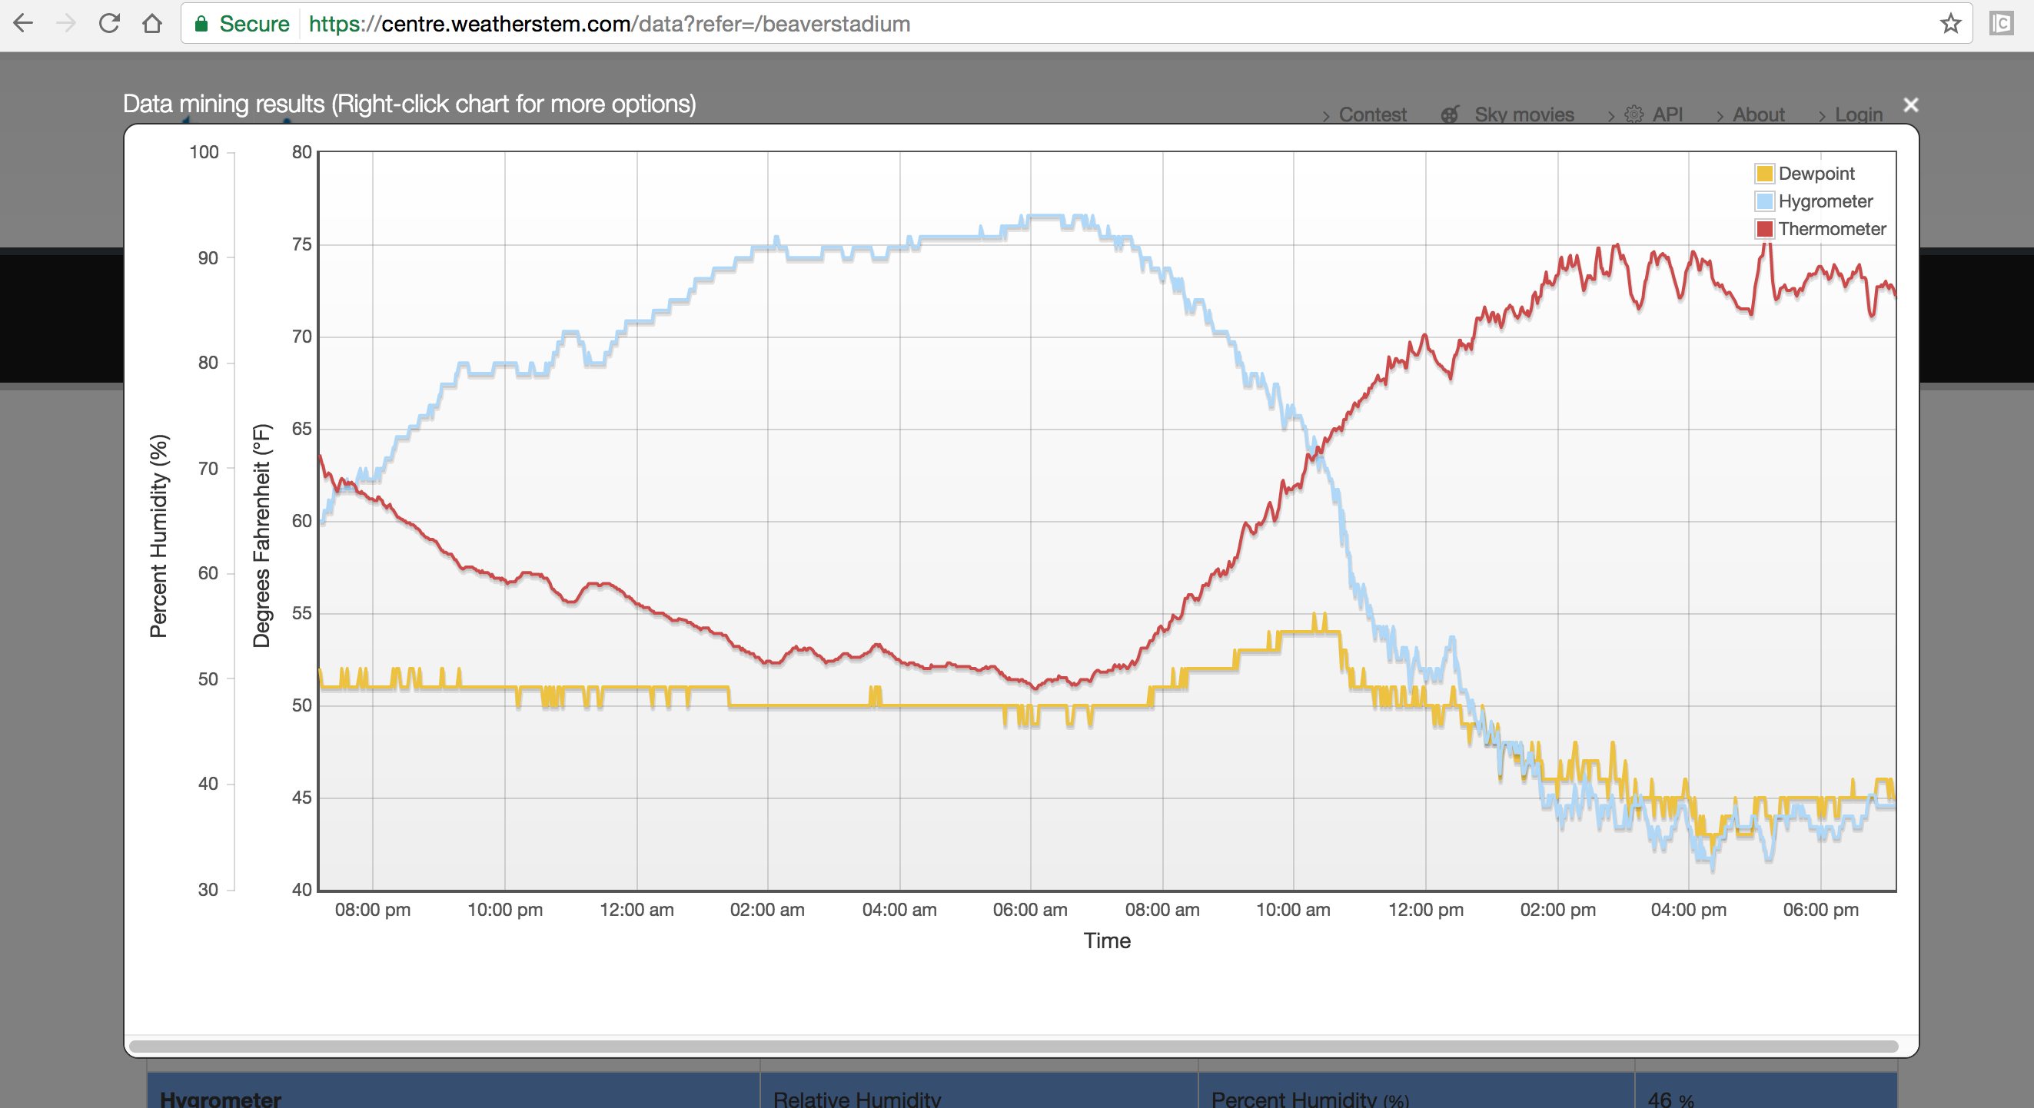
Chart of 24 hours worth of minute data from 3 different variables (Temp, Humidity, Dewpoint)
You can mouse over the data to get the values to display on the screen. Clicking on the value will create a pop with the sky camera image if a camera was available.

Slide 10
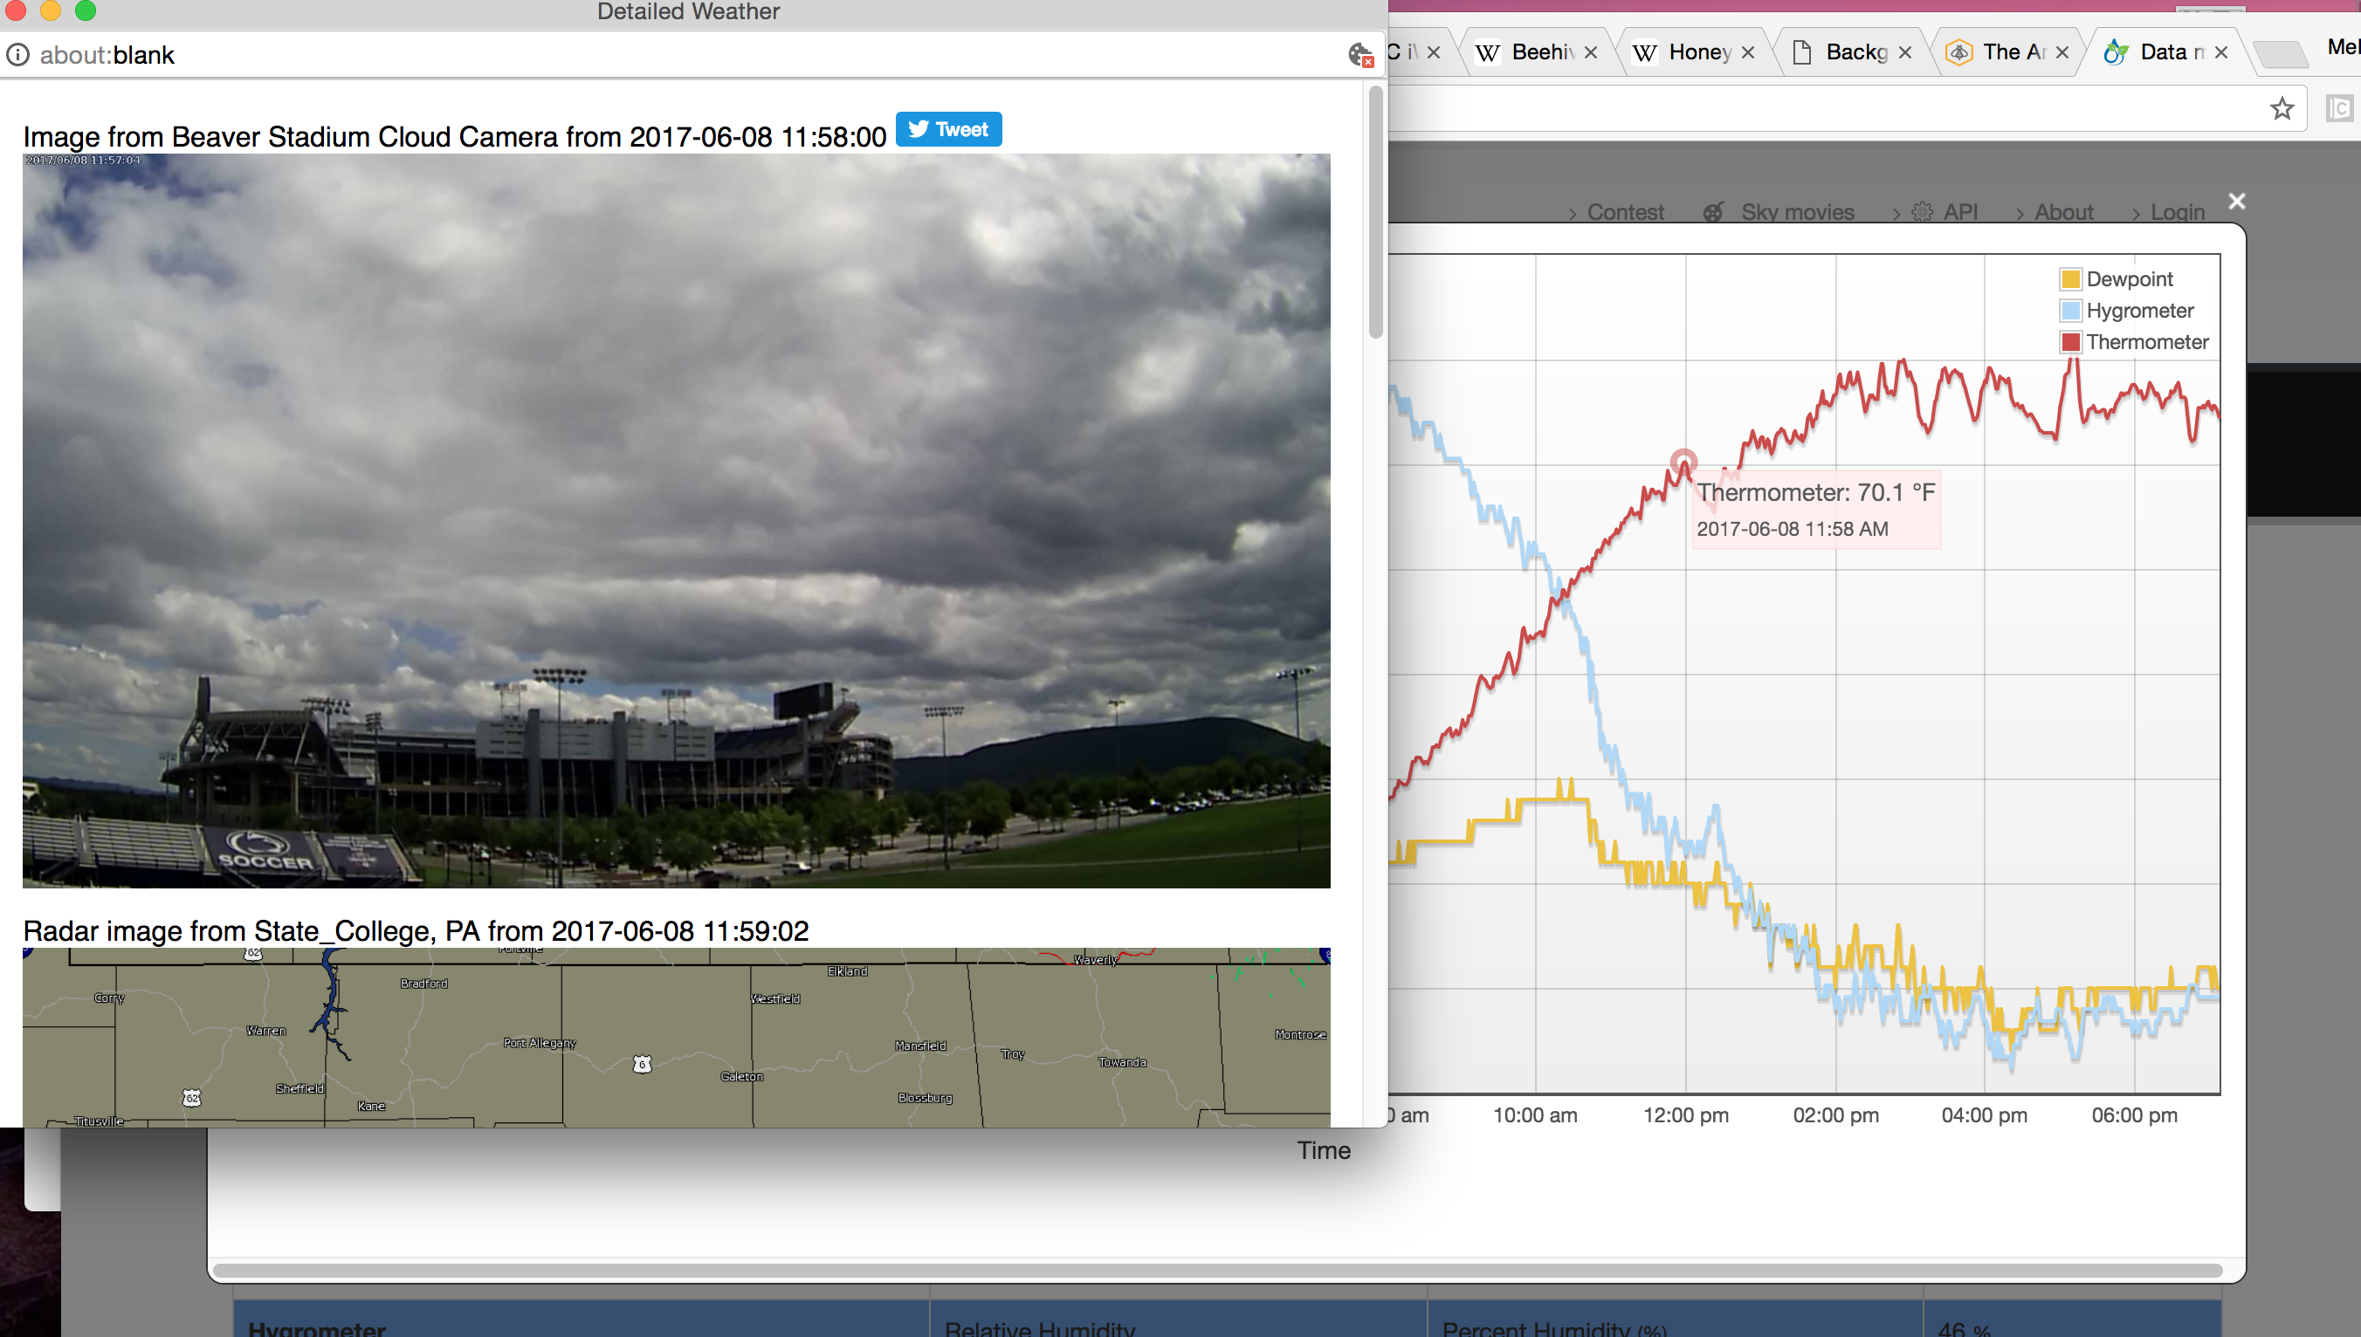
Pop ups need to be enabled to see the cloud camera.

Slide 11
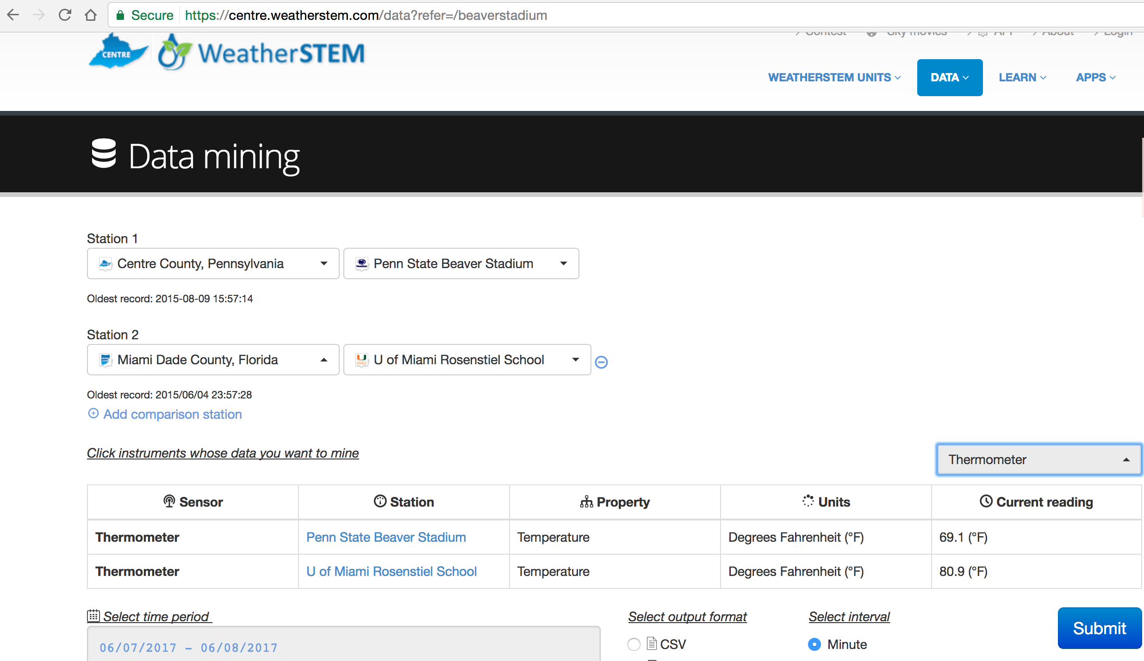
Multiple stations can be displayed at one time, using the ‘+ Add Comparison Station’ feature. The number of sensors shown can be reduced too.
Reduces the number of sensors
You can do comparisons of data across the network

Slide 12
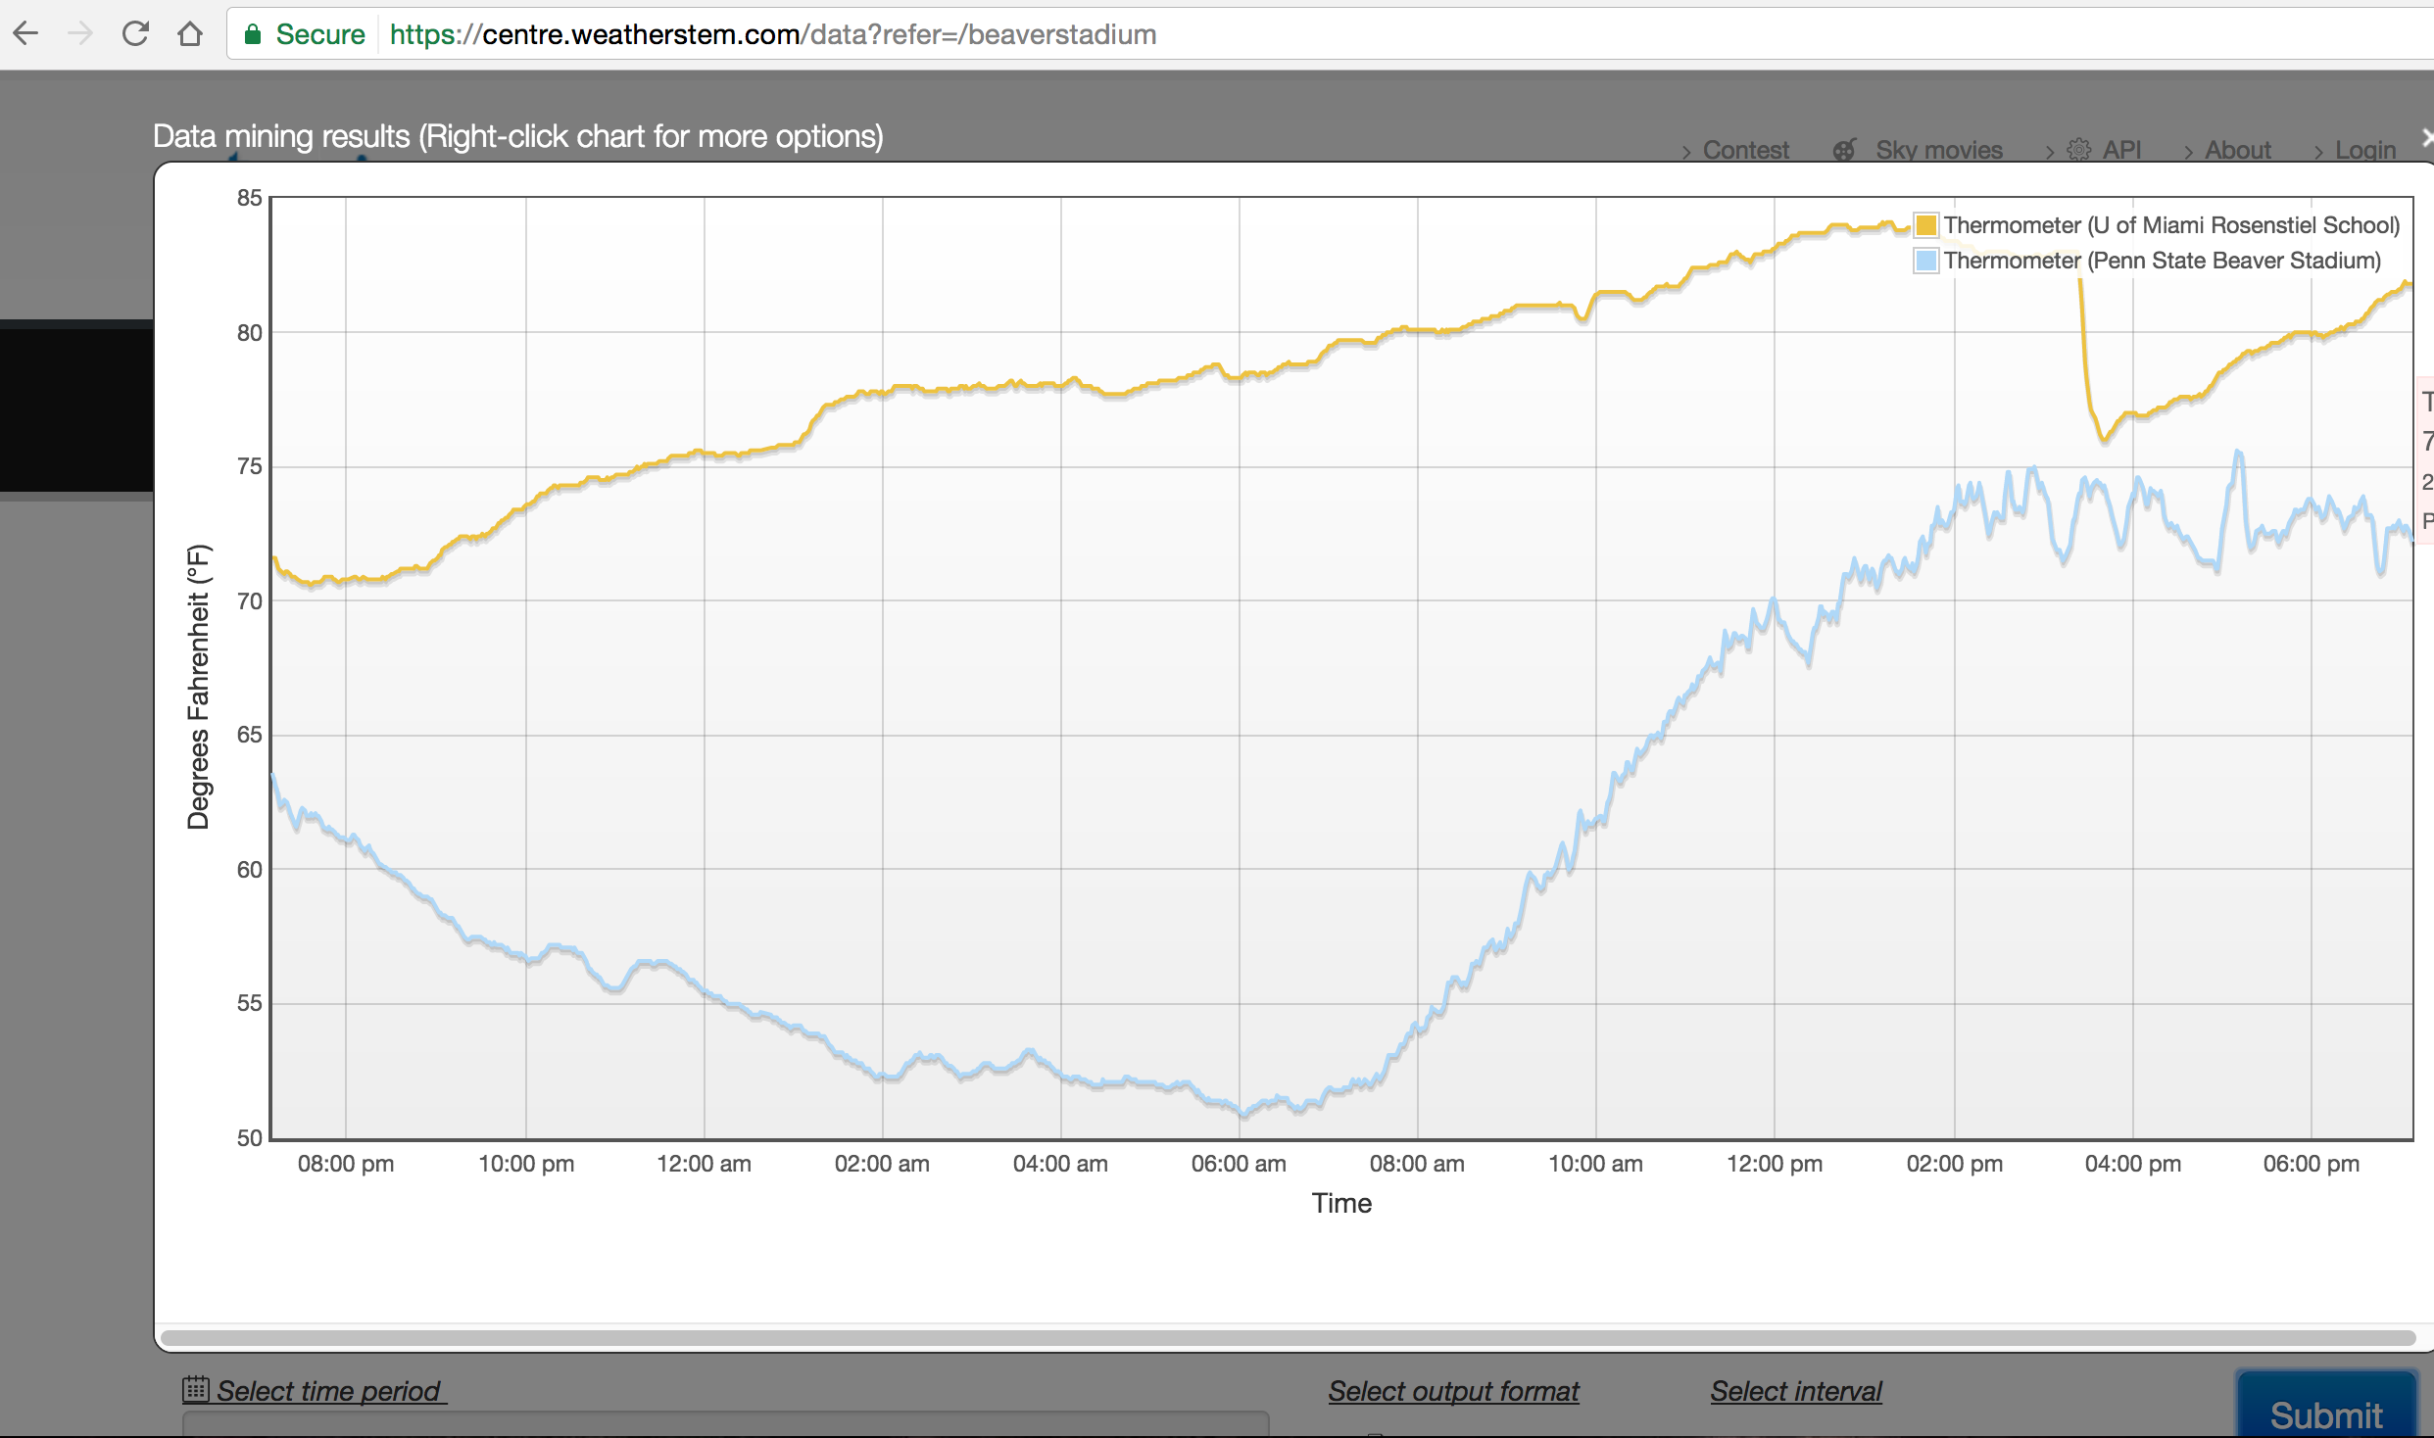
The same types of analysis can be done using multiple station data.

Slide 13
Some useful pointers for getting a report together…
Press Shift+PrtScn simultaneously to copy a chart to the workspace
Open Microsoft Word
You may then paste the image into the document and add text around it
Multiple images are encouraged
Cropping and special features are not needed, but if you’re good with Word, feel free to make it fancy!
We will look over the reports and let you know who did best. Prizes awarded for the best work!
Once you are done, the file will not save after you log off, so..
Save the file with a descriptive but short name to the desktop
Email that file as an attachment to wjs1@psu.edu and jmw139@psu.edu whenever you finish.
If you use Google Drive to save, please email an attached Word file to Bill and Jeff anyway when you are all done. Permissions needed in Drive have caused problems in the past.
Thanks and HAVE FUN!

