Slide 1
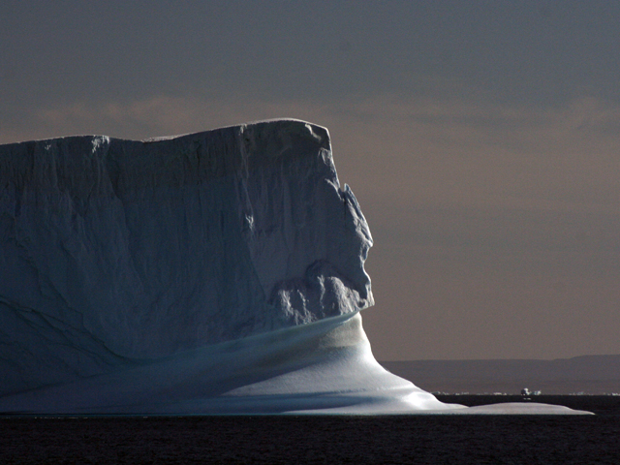






Get Rich and Save the World
(or else…)
Richard Alley
Penn State
Weather Camp
June 22, 2023
Please note: I work for Penn State University, and
help UN IPCC, NRC, etc., But I am not representing them, just me.
G. Comer Foundation
Notes:
We gain great benefits from our energy use, mostly from fossil fuels now, but they are causing highly damaging climate changes. Very strong evidence shows that we can use this knowledge to build a larger economy in a cleaner environment with more jobs, improved health, and greater national security more consistent with the Golden Rule. Students today are part of the first generation in human history with confidence that they can build a sustainable energy system, powering everyone essentially forever.

Slide 2
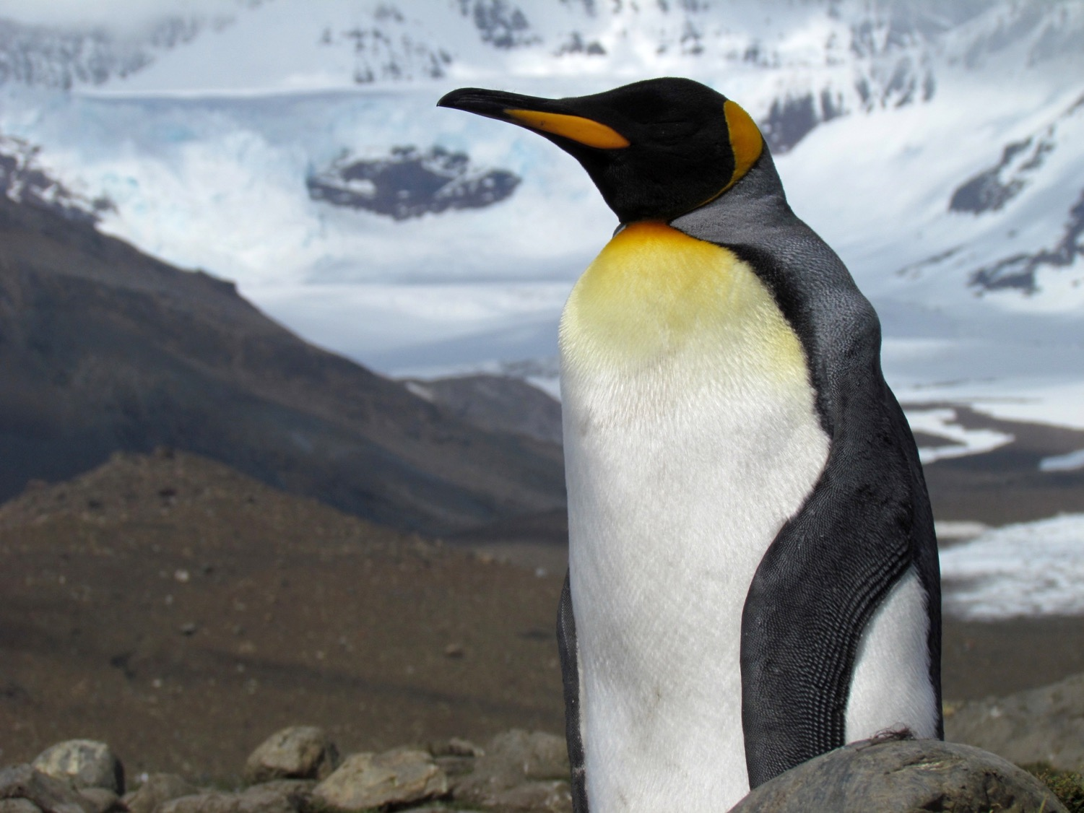
Thanks to:
→Bill Syrett and the Penn State weather team
→And you—We need you!

Slide 3
(Penguin pictures from my trips are just for fun)

Slide 4
I’m a geologist with background in metallurgical engineering
I study history, behavior & future of ice, sea level & climate
Married to Cindy, geologist turned quilter
42 years tomorrow…

Slide 5
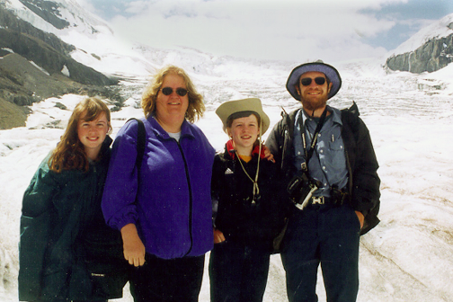
Science teacher
Glaciology professor
Janet, Cindy, Karen, Richard Alley, Athabasca Glacier, Jasper, Alberta, Canada

Slide 6






Carl Fredrick G. Aquino
Sierra Melton
Emily Schwans
Great current grad students
Thomas Givens
Amanda Willet
Ian Lee

Slide 7
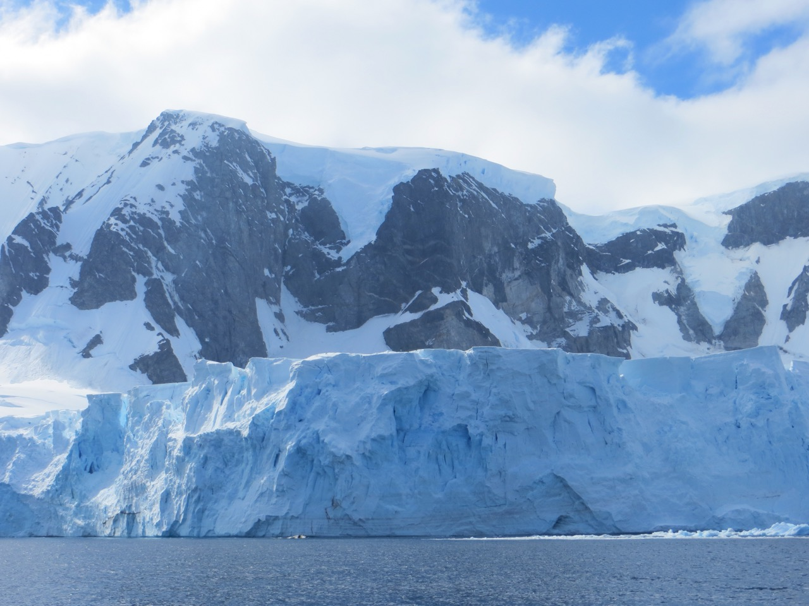
Science—My job description:
→go to some of the most beautiful places on Earth with some of the best people
→learn what nobody knows
→share that information with others
→help them use it to do good things

Slide 8
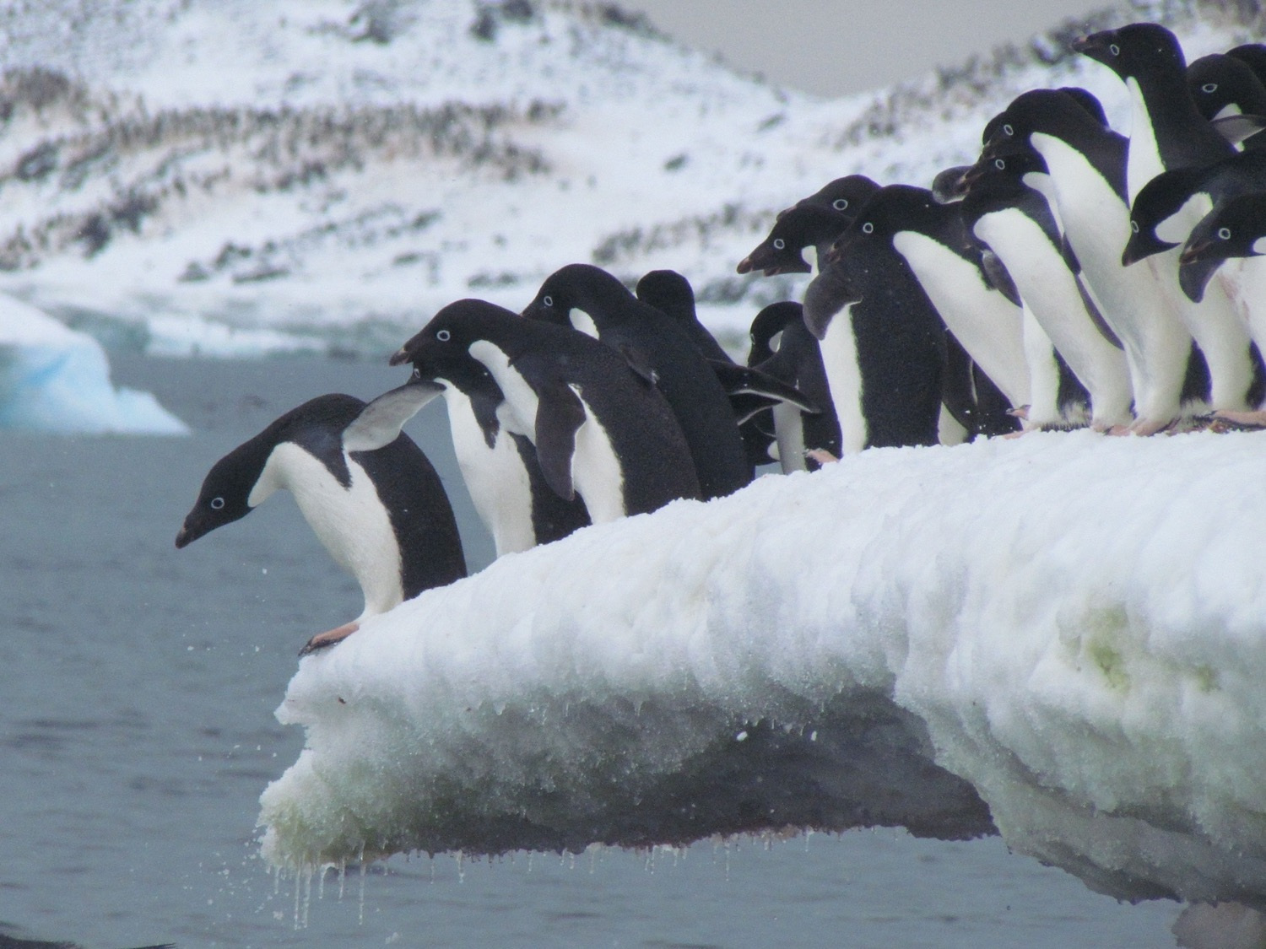
The big picture on climate and energy…

Slide 9
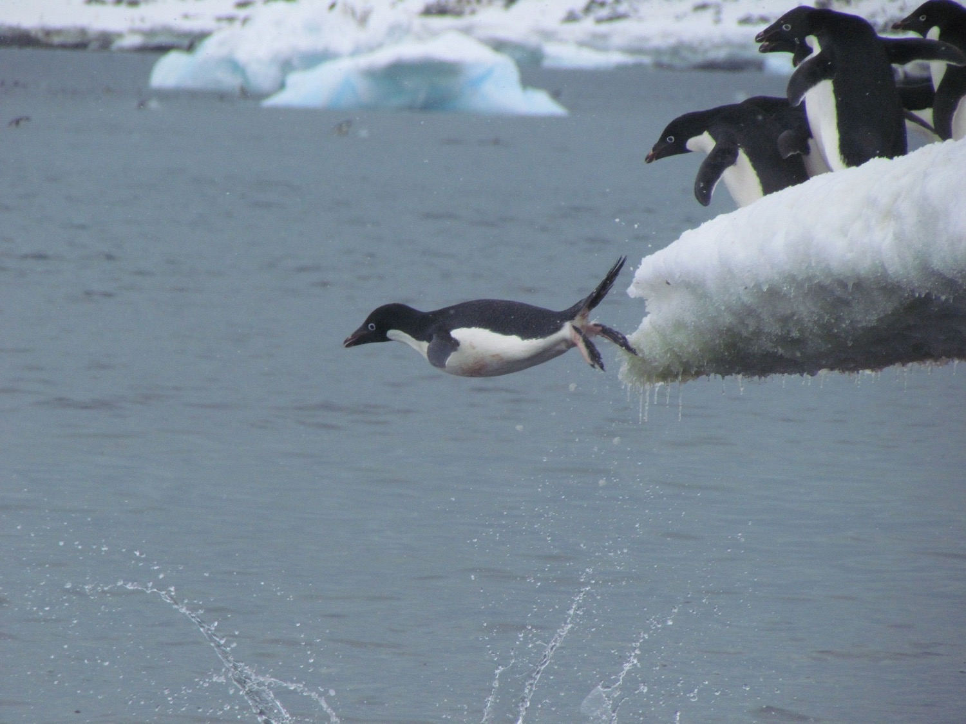
News not always good…

Slide 10
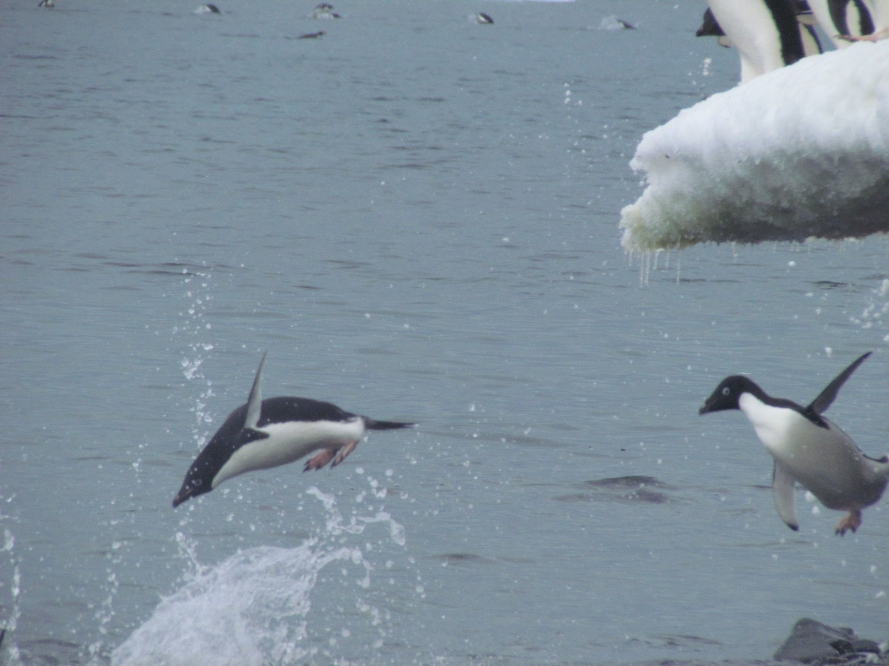
But before taking a long walk on a short pier…

Slide 11
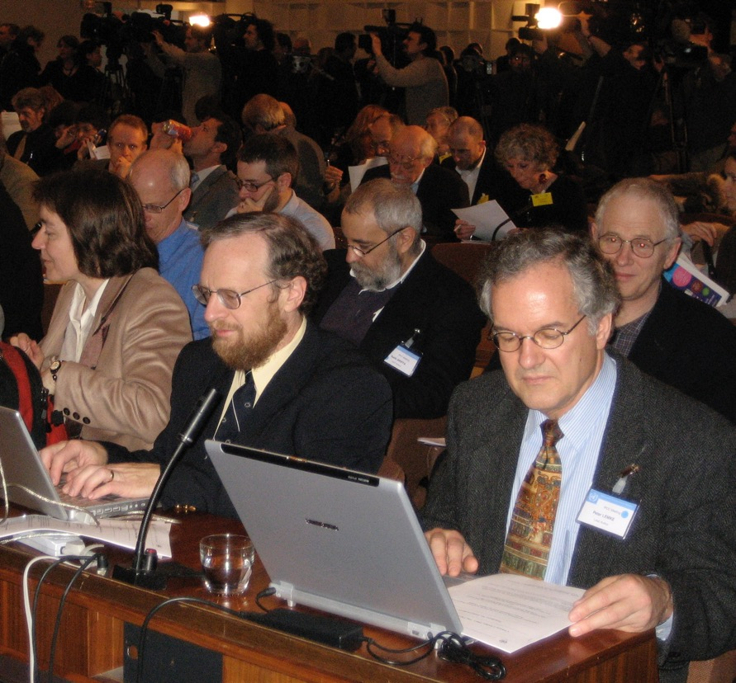
Like many others, I helped United Nations on energy and climate (IPCC, 2007 Nobel Peace Prize)
If you turned all of our reports into a tweet or two…
IPCC, UNESCO, Paris co-recipient of Nobel Peace Prize in 2007
(photo Melinda Tignor)

Slide 12
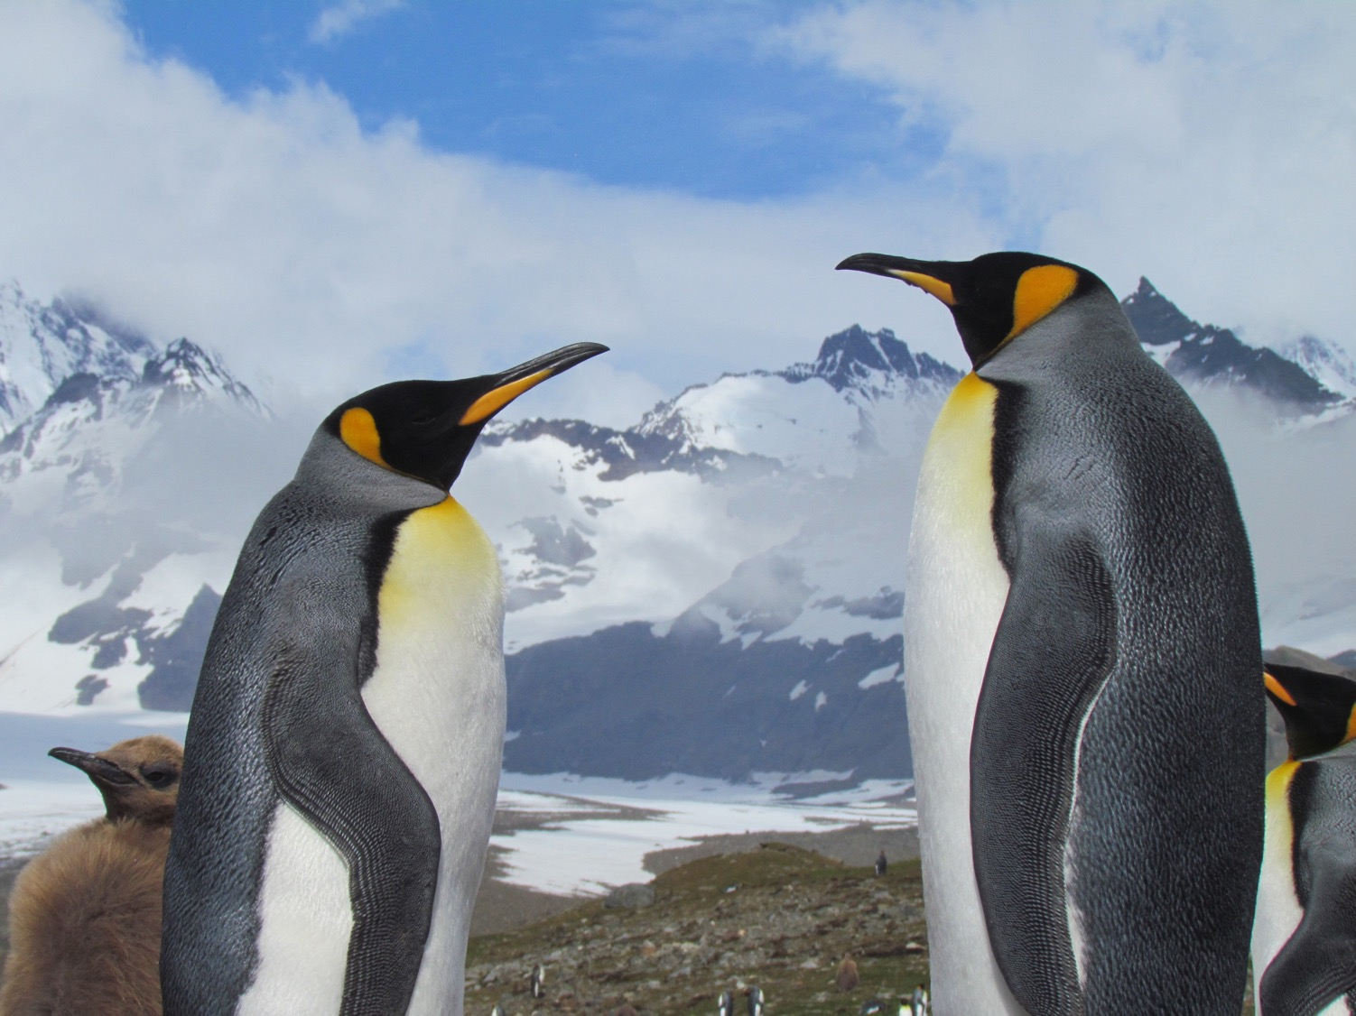
Compared to “business as usual”, efficient responses on climate and energy will give a larger economy with more jobs, improved health and greater national security in a cleaner environment more consistent with the Golden Rule.

Slide 13
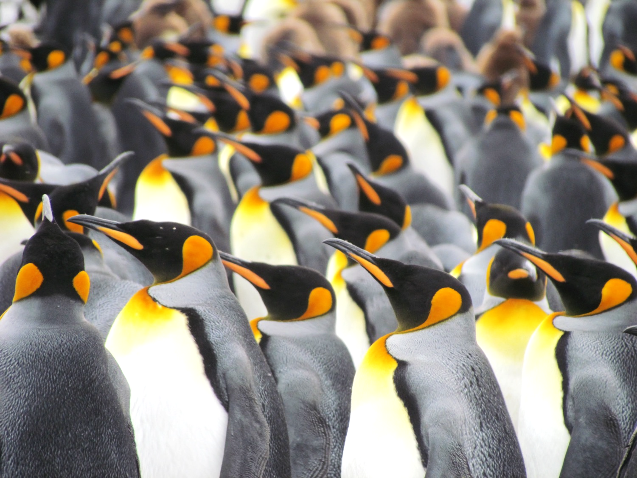
The good news: You’re the first generation in history
that can build a sustainable, economic energy
system, powering everyone essentially forever…

Slide 14
If we remember that we can solve problems
And we go out and solve them

Slide 15
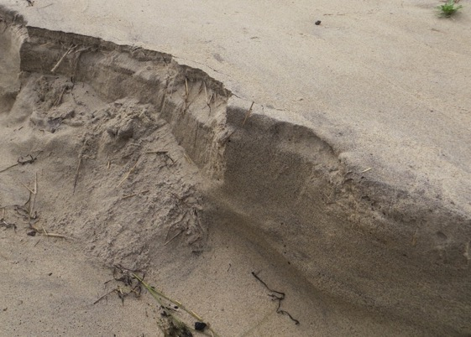
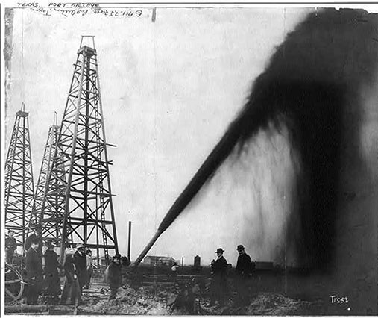
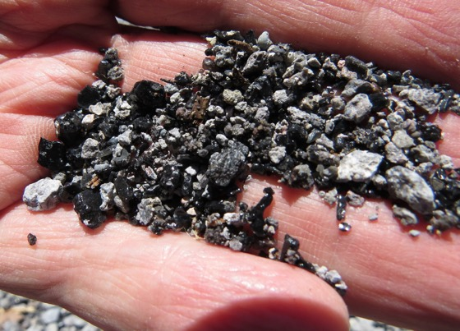
Do-it-yourself cell-phone kit
Just sand, oil, rocks…plus
science and engineering,
design and marketing
Relativity in the GPS
Quantum in the computer
We can solve problems!
Focus here on energy…

Slide 16
Energy use in USA
What we do for ourselves:
2,000 Calories per day
(~100 W—one old lightbulb)
What’s done for us
>200,000 Calories per day
(>10,000 W—lots!)

Slide 17
Energy use in USA
More than 80% Fossil Fuels
What we do for ourselves:
2,000 Calories per day
(~100 W—one old lightbulb)
What’s done for us
>200,000 Calories per day
(>10,000 W—lots!)

Slide 18
Hunter-Gatherers of Energy
Since “discovery” of fire…
We have a long history of energy crises
Burn through a source much faster than nature makes more
Suffer large unintended consequences
Then face shortages (bringing intrusive governments and other problems)
Then find a new source to burn, and repeat

Slide 19
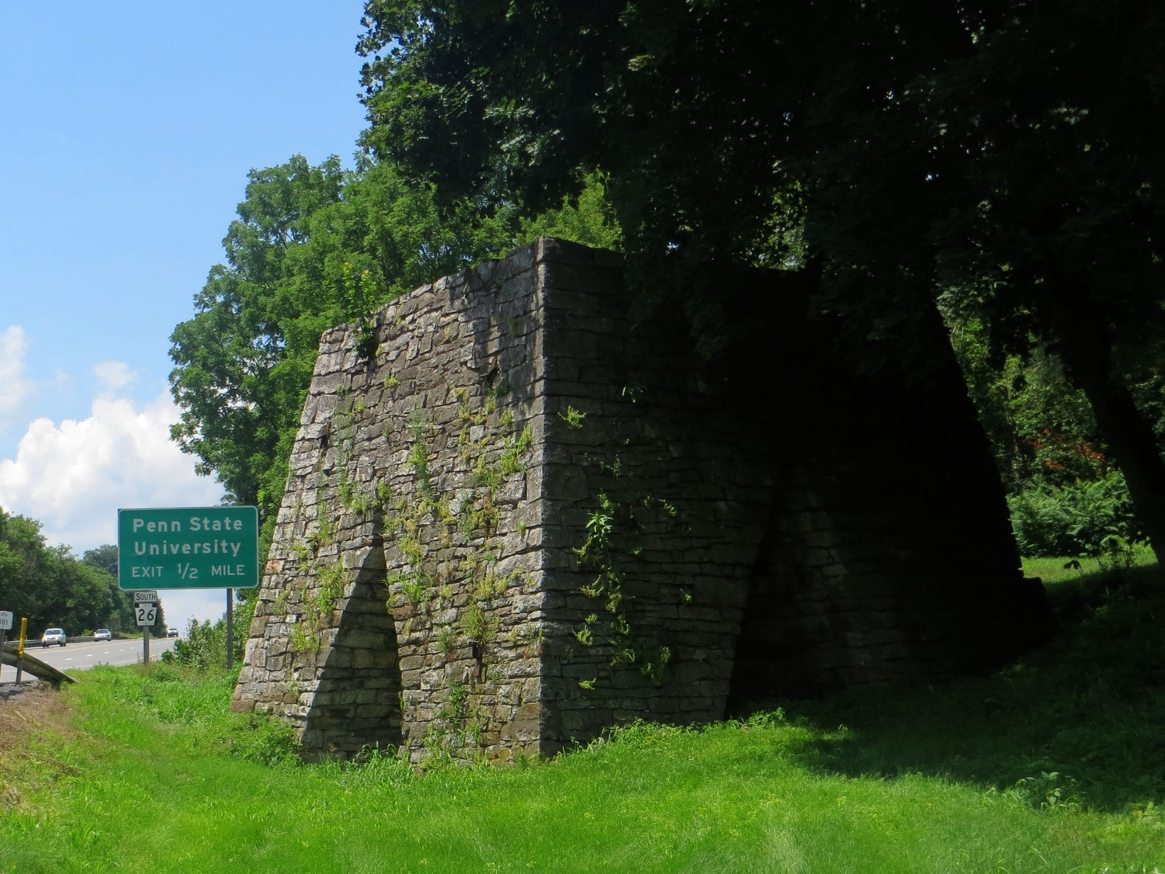

Slide 20
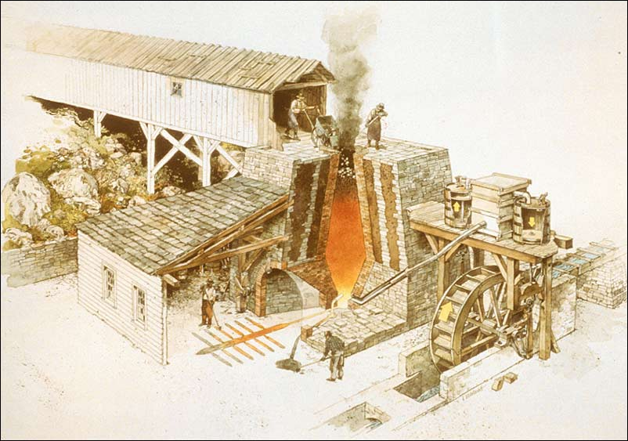
(National Park Service, Richard Schlecht, illustrator)
http://www.cr.nps.gov/nr/twhp/wwwlps/lessons/97hopewell/97visual1.htm

Slide 21
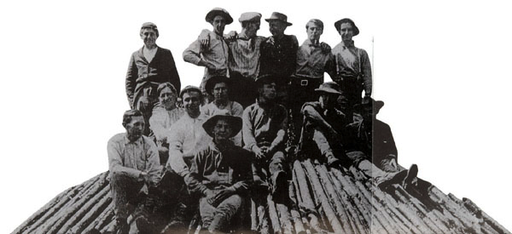
Colliers (also spelled colyers) preparing to make charcoal for use in iron furnaces. This pile would be covered with dirt and then fired for ~2 weeks, with great care to drive off unwanted materials without burning up the wood.
Pennsylvania Historical and Museum Commission
http://www.phmc.state.pa.us/ppet/cornwall/page2.asp?secid=31

Slide 22
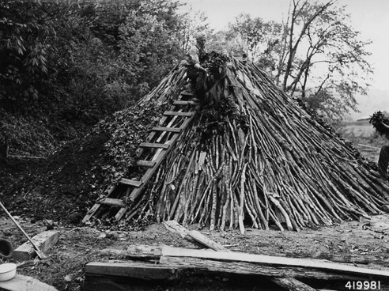
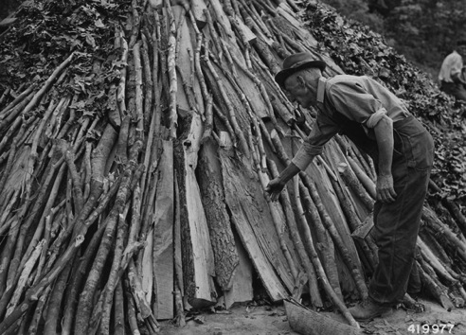
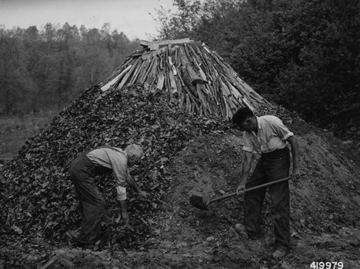
Charcoal making
US National Archives
(reenactment done for historians)
Notes:
Ones I found at the National Archives that we can use without permissions

Slide 23
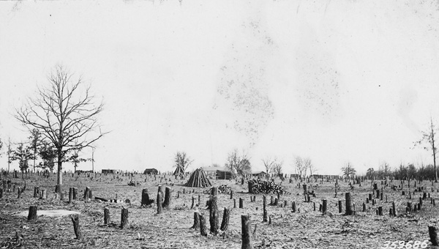
Logging for charcoal—about a square mile of trees per furnace per year to smelt the iron and fuel the workers
Photo US National Archives
Notes:
Ones I found at the National Archives that we can use without permissions

Slide 24
Pennsylvania place names:
→“Furnace” and “Forge”
that we still remember
→Many more have been
largely forgotten
http://pennsylvania.hometownlocator.com/

Slide 25
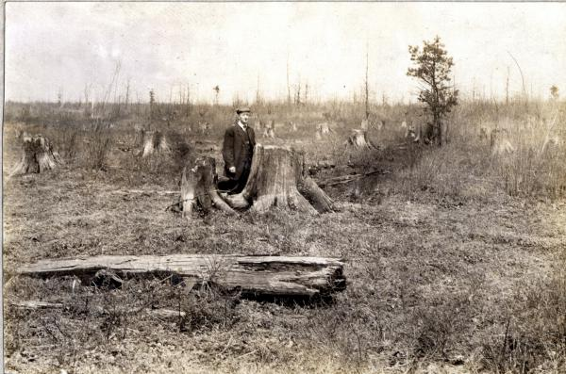
“Penn’s Woods” to “Pennsylvania Desert”
Pennsylvania State Archives, Tioga County, early 1900s, hosted at http://explorepahistory.com/displayimage.php?imgId=1-2-7A
Notes:
Credit: Courtesy Pennsylvania State Archives
This photograph, taken in Tioga County some time in the early 1900s, well documents the deforestation of northern Pennsylvania in the late 1800s and early 1900s. To end the logging practices that had created what he called the "Pennsylvania Desert," and to combat humanity's "tree-destroying instinct," University of Pennsylvania botanist Joseph Rothrock in the 1870s launched a campaign that led to the creation of a state Forestry Commission in the 1890s and state-owned forest reserves that by 2000 included 4 million acres.
http://explorepahistory.com/displayimage.php?imgId=1-2-7A

Slide 26
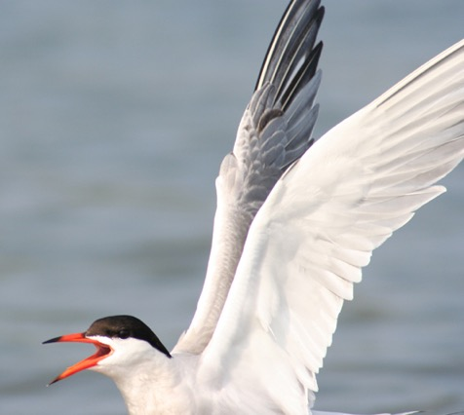
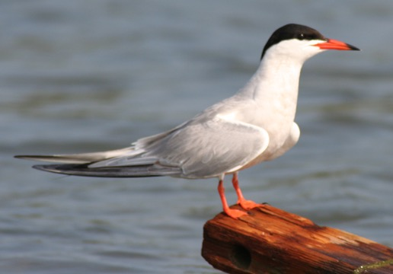
1620: Pilgrims found Cape Cod “wooded to the brinke of the sea”. 1695: Eastham banned even personal logging. Had used wood to boil sea water for salt to pack cod for trade. Solution? Windmill system pumping
water into solar
drying troughs.
NOT just them. Manhattan probably largely deforested still in 1600s, and Common Council passing many laws on property rights to wood, fair trade in wood, how big is a cord, etc. (see, e.g., Howe, R. Notes on the Deforestation of Manhattan Island, 2012, http://www.gothamcenter.org/blotter/?p=690 )
Governments intervene more in times of crisis and shortage…

Slide 27
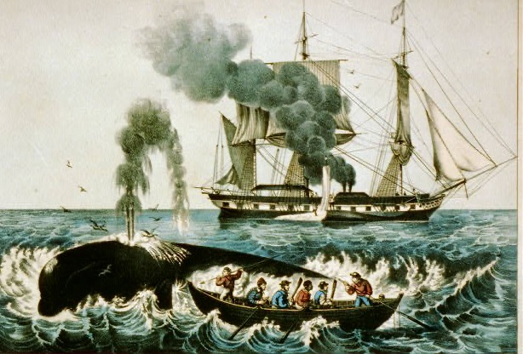
http://www.loc.gov/pictures/item/2002698808/Currier and Ives, Whale Fishery: Attacking a right whale, Library of Congress

Slide 28

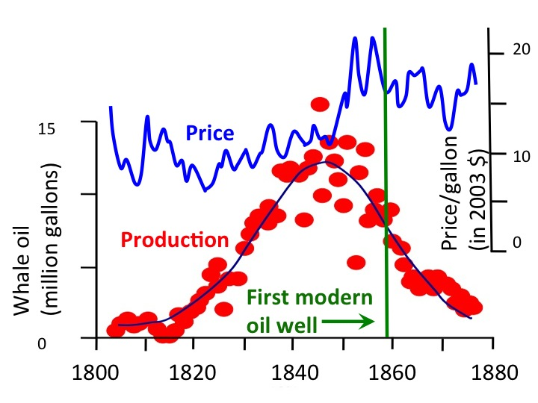
After Bardi, 2004; data from A. Starbuck, History of the American whale fishery, Seacaucus, N.J. 1878
http://www.loc.gov/pictures/item/2002698808/Currier and Ives, Whale Fishery: Attacking a right whale, Library of Congress

Slide 29
We can’t go back—total US whale-oil production in 1800s less than 12 hours of recent US oil use!
http://www.loc.gov/pictures/item/2002698808/Currier and Ives, Whale Fishery: Attacking a right whale, Library of Congress

Slide 30
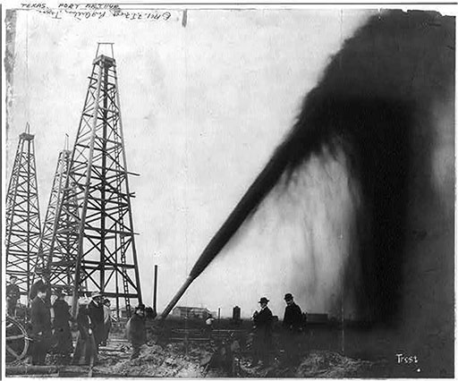
We have trees and whales because we burn fossil trees and fossil algae
NOT a new idea…
Oil gusher in Port Arthur, Texas, c. 1901 Library of Congress Prints and Photographs Division (link is external). © F.J. Frost, no known restrictions on publication.

Slide 31
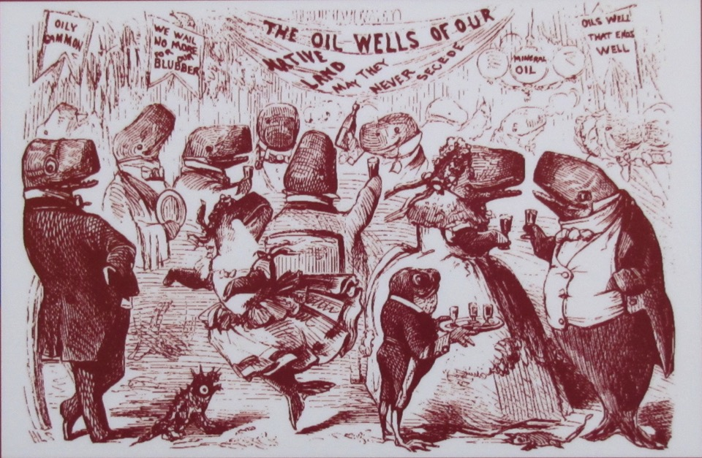
“GRAND BALL GIVEN BY THE WHALES IN HONOR OF THE DISCOVERY OF THE OIL WELLS IN PENNSYLVANIA”, VANITY FAIR, 1861
New Bedford Whaling Museum

Slide 32
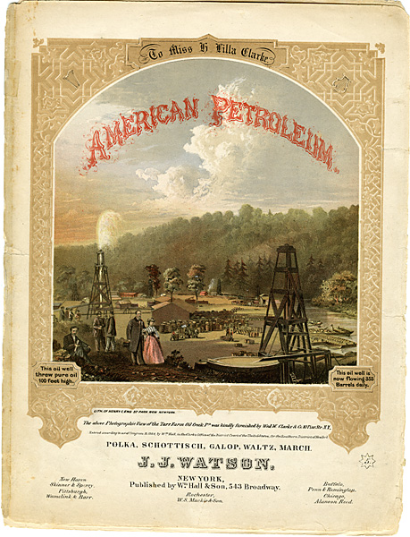
The AMERICAN PETROLEUM POLKA,
1864.
Pennsylvania wells.
“This oil well is now flowing 355 Barrels daily.”
“This oil well threw pure oil 100 feet high.”
Library of Congress

Slide 33
Trees and whales mostly grew back in ~100 years. Large problems until then.
Fossil fuels will grow back in ~100 MILLION years. We must change.
http://www.loc.gov/pictures/item/2002698808/Currier and Ives, Whale Fishery: Attacking a right whale, Library of Congress
Pennsylvania State Archives, Tioga County, early 1900s, hosted at http://explorepahistory.com/displayimage.php?imgId=1-2-7A

Slide 34
But if we burn before
we learn, we will
change climate in
ways we don’t like

Slide 35

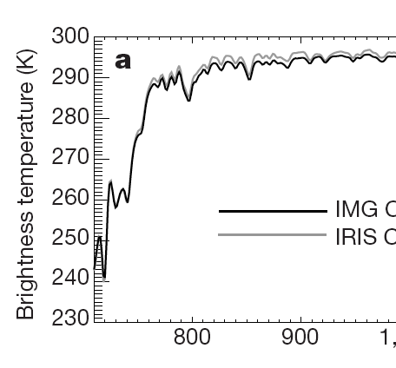

Basis for expecting global warming is PHYSICS
**Known for over a century
**Refined by Air Force after WWII (operations,
communications,
heat-seeking missiles)
**Observed today by
satellites, etc.
**Successfully predictive
Satellite: Energy to space to cool Earth

Slide 36
Basis for expecting global warming is PHYSICS
**Known for over a century
**Refined by Air Force after WWII (operations,
communications,
heat-seeking missiles)
**Observed today by
satellites, etc.
**Successfully predictive
Satellite: Energy to space to cool Earth
Energy blocked by CO₂

Slide 37
Basis for expecting global warming is PHYSICS
**Known for over a century
**Refined by Air Force after WWII (operations,
communications,
heat-seeking missiles)
**Observed today by
satellites, etc.
**Successfully predictive
Satellite: Energy to space to cool Earth
Energy blocked by CO₂
Energy blockable by more CO₂

Slide 38
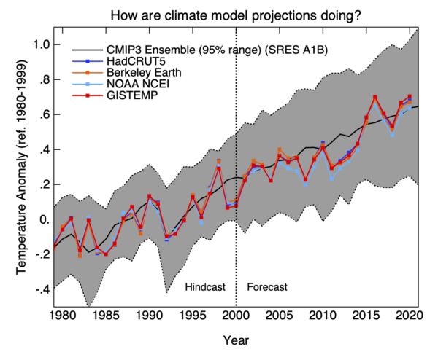
AVERAGE PREDICTION OF MODELS
DATA
(measured by different groups)
http://www.realclimate.org/index.php/archives/2021/01/update-day-2021/

Slide 39
Temperature is rising
We are responsible
Models have been highly accurate
No serious questions on this
AVERAGE PREDICTION OF MODELS
DATA
(measured by different groups)
http://www.realclimate.org/index.php/archives/2021/01/update-day-2021/

Slide 40
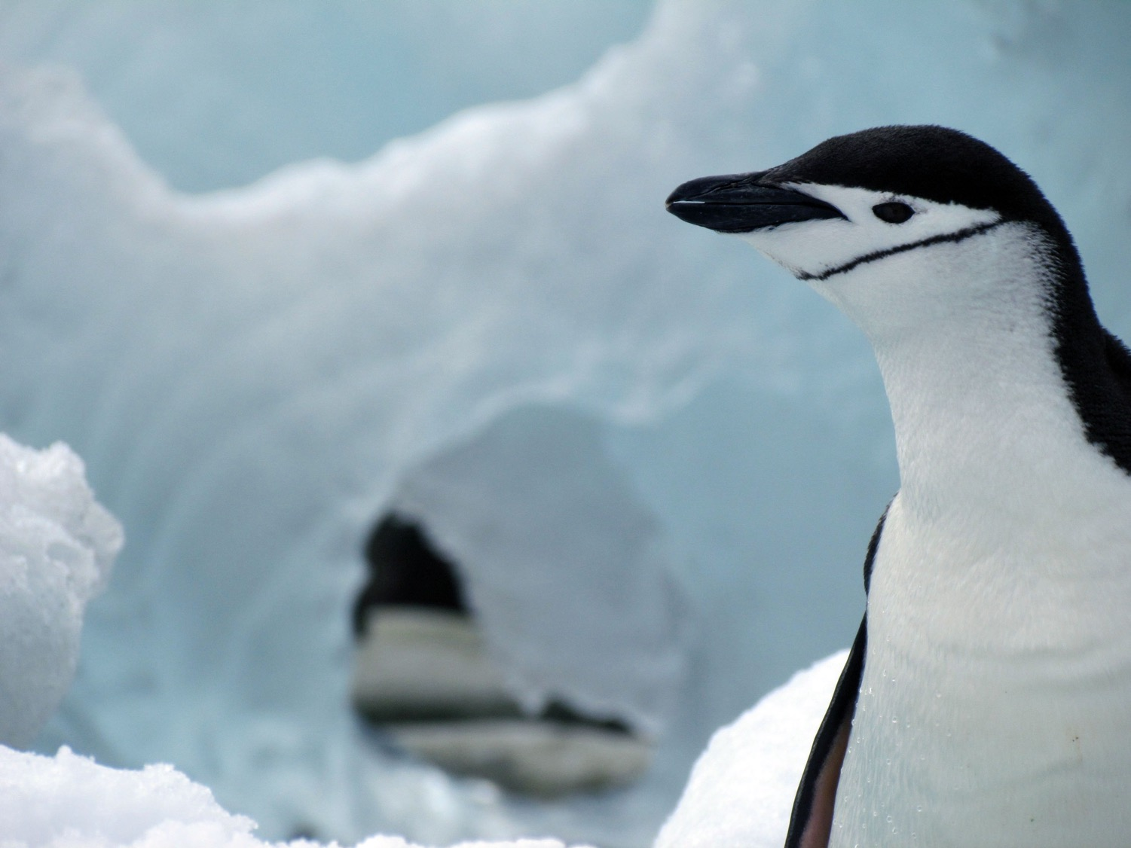
Warming effect of our CO₂ is
not the least bit surprising
(Arrhenius calculated in 1896)
What’s surprising is how much
fossil fuel we burn…
Per person per year in US
→Trash we throw away at curb ½ ton
CO₂ we throw away in air
more than 16 tons
And this is changing climate

Slide 41
I’ll come back to good news
if we restrain CO₂ efficiently
But first, if we don’t…
Coming changes bigger than past
Past changes winners and losers; coming changes mostly losers
Costs rise faster than temperature (“superlinear”)
Uncertainties mostly on “bad” side (a bit better, a bit worse, or a lot worse)

Slide 42
If we don’t restrain CO₂
Heat stress on people and crops
Sea-level rise
More floods and droughts
Strongest storms can grow stronger
Tropical diseases no longer frozen
Ecological stresses and extinctions
Losses especially for poor people in hot places who release little CO₂

Slide 43
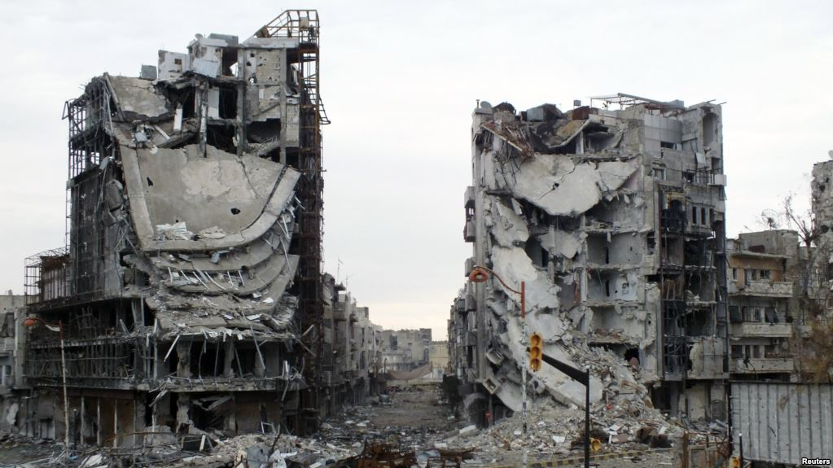
~500,000 people killed in Syrian Civil War (https://www.nytimes.com/2018/04/13/world/middleeast/syria-death-toll.html )
Destroyed buildings are seen on a deserted street in Homs, Syria January 30, 2013. https://editorials.voa.gov/a/iran-complicit-in-syrian-horror/1597170.html

Slide 44
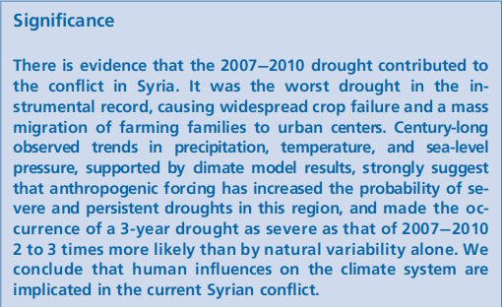
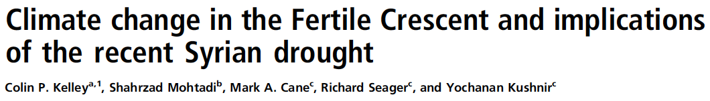
…drought contributed to the conflict in Syria…
…anthropogenic forcing has increased the probability… 2 to 3 times…
2015, Proceedings of the National Academy of Sciences of the USA

Slide 45
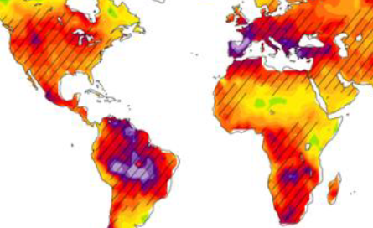
Future drought with warming
Green=less drought
All other colors=more drought or a lot more drought
Zhao, T., and A. Dai, 2015: The Magnitude and Causes of Global Drought Changes in the 21st Century under a Low-moderate Emissions Scenario. J. Climate. doi:10.1175/JCLI-D-14-00363.1, in press.

Slide 46
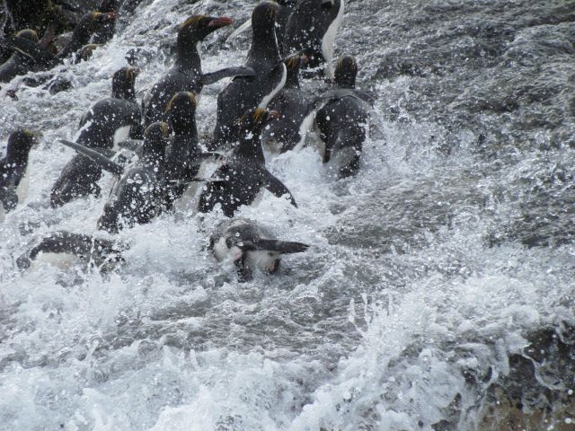
The sea is rising

Slide 47
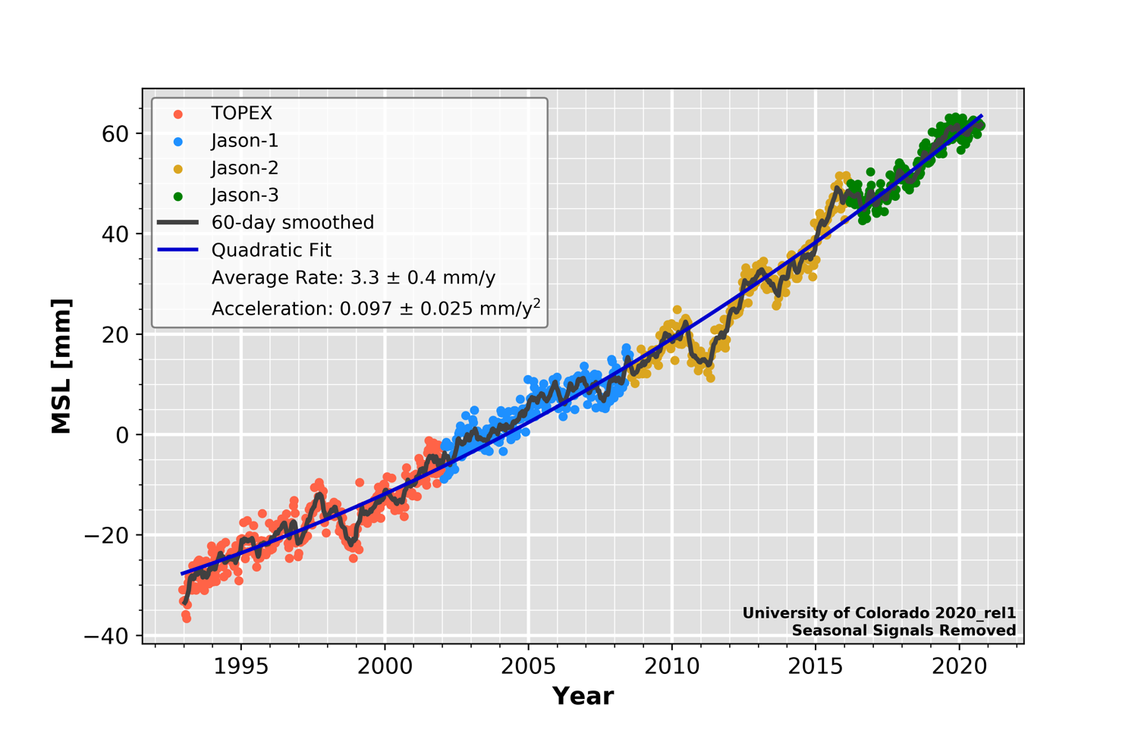
Sea-level rise slow (~1 foot in 90 yrs) but accelerating. Already matters…http://sealevel.colorado.edu/
Almost 4
inches
since
1993
Sea-level rise since 1993 (mm)
0 20 40 60 80
1993 2000 2010 2020

Slide 48
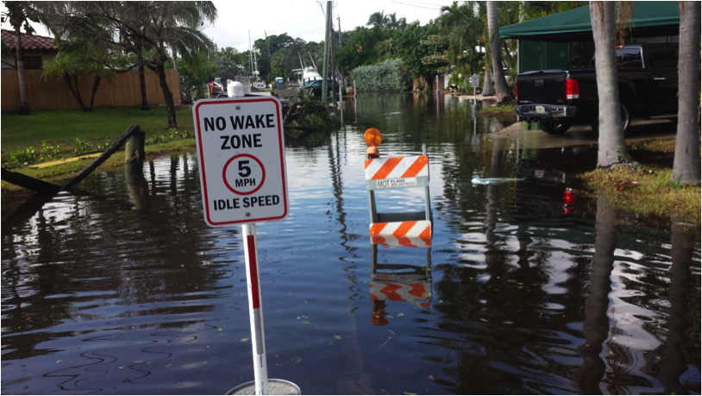
Fort Lauderdale street on a “king” high tide—not a storm!
(Rise here above global average because of changes in ocean circulation, etc., but global rise does matter here)
http://www.domesticpreparedness.com/preparedness/three-storms-demonstrate-five-forms-of-flooding/
(I don’t own copyright on this, the next few, on the IPCC, etc.; I’m using under what I understand to be fair use for this educational presentation)

Slide 49
“Nuisance” flooding
Fort Lauderdale street on a “king” high tide—not a storm!
(Rise here above global average because of changes in ocean circulation, etc., but global rise does matter here)
http://www.domesticpreparedness.com/preparedness/three-storms-demonstrate-five-forms-of-flooding/
(I don’t own copyright on this, the next few, on the IPCC, etc.; I’m using under what I understand to be fair use for this educational presentation)

Slide 50
“Adaptation”
“Nuisance” flooding
Fort Lauderdale street on a “king” high tide—not a storm!
(Rise here above global average because of changes in ocean circulation, etc., but global rise does matter here)
http://www.domesticpreparedness.com/preparedness/three-storms-demonstrate-five-forms-of-flooding/
(I don’t own copyright on this, the next few, on the IPCC, etc.; I’m using under what I understand to be fair use for this educational presentation)

Slide 51
High tide, NOT a storm
Octopus swam in
http://www.miamiherald.com/news/local/community/miami-dade/miami-beach/article115688508.html
BY ALEX HARRIS
November 18, 2016 02:48 PM Updated November 18, 2016 05:05 PM
(I don’t own copyright on this, the next few, on the IPCC, etc.; I’m using under what I understand to be fair use for this educational presentation)

Slide 52
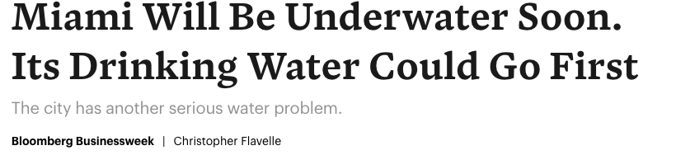
https://getpocket.com/explore/item/miami-will-be-underwater-soon-its-drinking-water-could-go-first?utm_source=pocket-newtab
https://www.bloomberg.com/news/features/2018-08-29/miami-s-other-water-problem
http://www.miamiherald.com/news/local/community/miami-dade/miami-beach/article115688508.html
BY ALEX HARRIS
November 18, 2016 02:48 PM Updated November 18, 2016 05:05 PM
(I don’t own copyright on this, the next few, on the IPCC, etc.; I’m using under what I understand to be fair use for this educational presentation)

Slide 53
Costs rise faster than the ocean rises, as ”nuisance flooding” becomes serious
https://getpocket.com/explore/item/miami-will-be-underwater-soon-its-drinking-water-could-go-first?utm_source=pocket-newtab
https://www.bloomberg.com/news/features/2018-08-29/miami-s-other-water-problem
http://www.miamiherald.com/news/local/community/miami-dade/miami-beach/article115688508.html
BY ALEX HARRIS
November 18, 2016 02:48 PM Updated November 18, 2016 05:05 PM
(I don’t own copyright on this, the next few, on the IPCC, etc.; I’m using under what I understand to be fair use for this educational presentation)

Slide 54
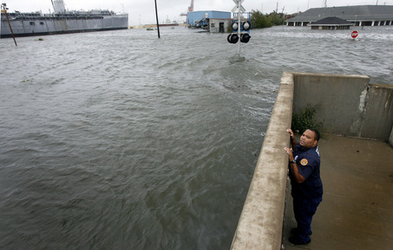
→Hurricane Gustav stayed out of New Orleans—barely
→A little rise could matter
→But what if the water rises out of this picture?
http://www.democraticunderground.com/discuss/duboard.php?az=view_all&address=389x3899732
A New Orleans Police Department officer peers over the Industrial Canal levee
wall from the lower 9th Ward at the high water driven in by Hurricane Gustav.
In the background, upper right is the flooded offices of Southern Scrap.
(I don’t own copyright on this, the next few, on the IPCC, etc.; I’m using under what I understand to be fair use for this educational presentation)

Slide 55
→Hurricane Gustav stayed out of New Orleans—barely
→A little rise could matter
→But what if the water rises out of this picture?
→IPCC projects 99.8% of Antarctic ice doesn’t melt by 2100 even with strong warming…
→Uncertain? A little better, a little worse, a lot worse…
http://www.democraticunderground.com/discuss/duboard.php?az=view_all&address=389x3899732
A New Orleans Police Department officer peers over the Industrial Canal levee
wall from the lower 9th Ward at the high water driven in by Hurricane Gustav.
In the background, upper right is the flooded offices of Southern Scrap.
(I don’t own copyright on this, the next few, on the IPCC, etc.; I’m using under what I understand to be fair use for this educational presentation)

Slide 56
Compared to “business as usual”, efficient responses on climate and energy will give a larger economy with more jobs, improved health and greater national security in a cleaner environment more consistent with the Golden Rule.

Slide 57
Compared to “business as usual”, efficient responses on climate and energy will give a larger economy with more jobs, improved health and greater national security in a cleaner environment more consistent with the Golden Rule.
I’ll show one slide on each

Slide 58
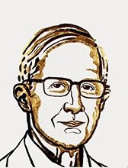
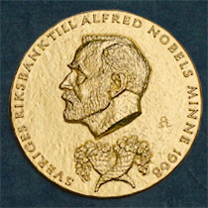
“…for integrating climate change into long-run macroeconomic analysis”
You may meet the person who acknowledges that climate is changing, but says we can’t afford to deal with it
Nobel Prize says we can’t afford NOT to deal with it
Or, efficient response makes us economically better off
William Nordhaus
Co-recipient of Nobel Prize in Economics, 2018
https://nsf.gov/news/news_images.jsp?cntn_id=296861&org=NSF
Illustration by Niklas Elmehed/Nobel Media
https://www.nobelprize.org/prizes/uncategorized/did-you-know/
Notes:
NSF Director France Córdova issued the following statement on the Nobel announcement:
The work of this year's Nobel laureates in economics demonstrates the importance of new scientific insights for the global economy. Both developed new methods that help us understand how to create economic prosperity and sustainable growth. Nordhaus integrated key findings from chemistry and physics into macroeconomics, resulting in new methods to understand the interplay between global, atmospheric public goods and economic outcomes. Romer's research highlights the importance of science and technology as long-term drivers of economic growth -- in the U.S. and around the world. His work has helped us understand the specific economic factors that lead firms to invest in innovation, resulting in new findings showing how governments can encourage new ideas.
The impact of their work illustrates why NSF's investments in basic research and its support for early career researchers benefit the U.S. economy. Each laureate has shown how new scientific findings in fields ranging from atmospheric science to information technology can spur the kind of economic growth that benefits the nation and the world.

Slide 59
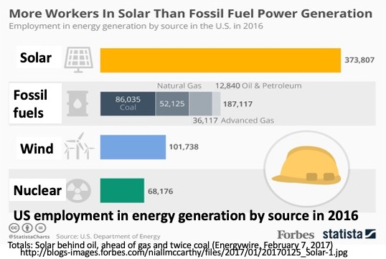
Good fossil-fuel jobs, but looks like fossil fuels are worst major option for getting jobs from energy investment
Likely more fossil-fuel money goes to control of resource (“rent”) rather than making resource useful (workers)

Slide 60
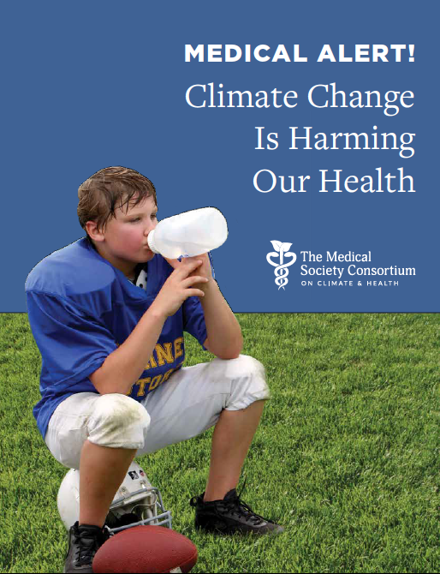
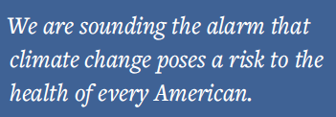
We—physicians in medical societies representing over half of the nation’s doctors—see a need to share our growing understanding and concern about the health consequences of climate change with all Americans. We believe all Americans should know the following:
1. There is a scientific consensus about human-caused climate change.
2. In communities across the nation, climate change is harming our health now.
3. The health of any American can be harmed by climate change, but some of us face greater risk than others.
4. Unless we take concerted action, these harms to our health are going to get much worse.
We believe the most important action we can take to protect our health is to accelerate the inevitable transition to clean renewable energy.
“We believe the most important action we can take to protect our health is to accelerate the inevitable transition to clean renewable energy.”
Very recent study suggests
1 in 5 deaths globally was premature because of particles from fossil-fuel burning
Vohra et al., Environmental Research, 2021
A REPORT FROM:
American Academy of Asthma, Allergy,
Immunology
American Academy of Family Physicians
American Academy of Pediatrics
American Congress of Obstetricians
and Gynecologists
American College of Physicians
American College of Preventive Medicine
American Podiatric Medical Association
National Medical Association
Society of General Internal Medicine
Notes:
Karn Vohra, Alina Vodonos, Joel Schwartz, Eloise A. Marais, Melissa P. Sulprizio, Loretta J. Mickley,
Global mortality from outdoor fine particle pollution generated by fossil fuel combustion: Results from GEOS-Chem,
Environmental Research,
2021,
110754,
ISSN 0013-9351,
https://doi.org/10.1016/j.envres.2021.110754.

Slide 61
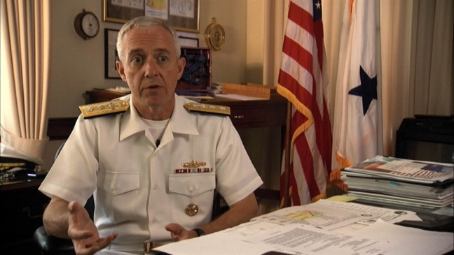

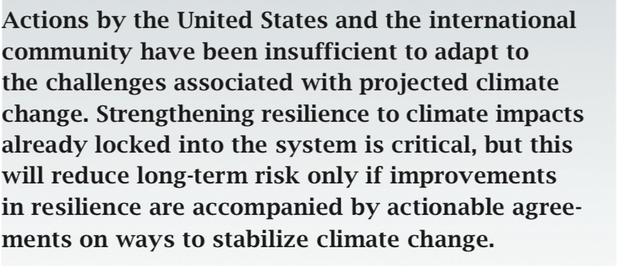

Rear Admiral and Prof. David Titley, Retired. Served on CNA Military Advisory Board

Slide 62
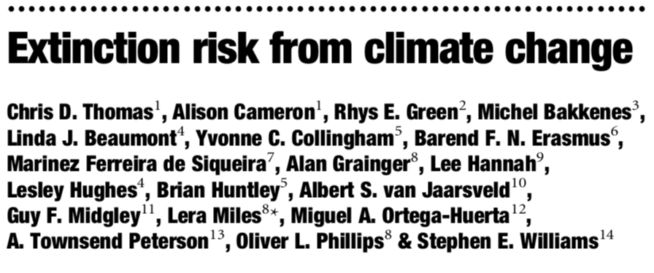
Abstract: “…we predict, on the basis of mid-range climate-warming scenarios for 2050, that 15–37% of species in our sample of regions and taxa will be ‘committed to extinction’…minimal climate-warming scenarios produce lower projections of species committed to extinction…”

Slide 63
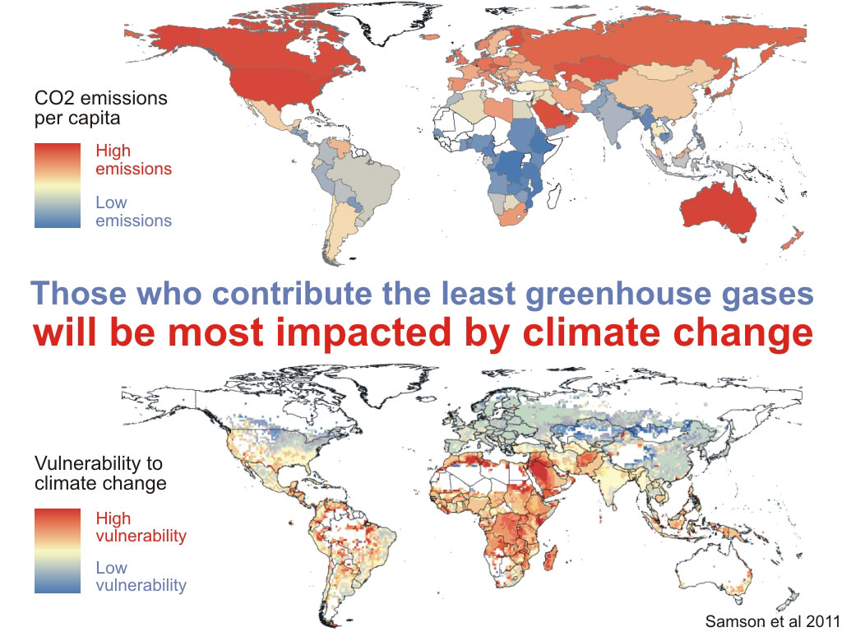
Pope Francis “…it seems clear to me also that climate change is a problem which can no longer be left to a future generation” 9/30/15
Geographic disparities and moral hazards in the predicted impacts of climate change on human populations, Global Ecology and Biogeography, (Global Ecol. Biogeogr.) (2011) 20, 532–544 J. Samson, D. Berteaux, B. J. McGill and M. M. Humphries
http://www.skepticalscience.com/roy-spencers-bad-economics.html Accessed 14mar2012

Slide 64
Compared to “business as usual”, efficient responses on climate and energy will give a larger economy with more jobs, improved health and greater national security in a cleaner environment more consistent with the Golden Rule.

Slide 65
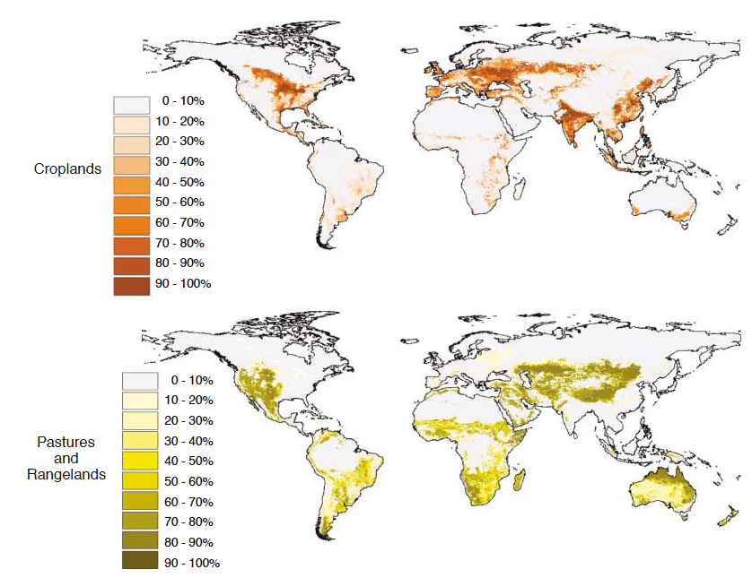
Land for 2000 Calories/day
Foley et al., Science, 2005; for 1990s

Slide 66
Extra land to exceed world energy use with current solar tech.
Land for 2000 Calories/day
Foley et al., Science, 2005; for 1990s

Slide 67
Surely a huge task. Surely not easy. But, economically do-able.
Land for 2000 Calories/day
Foley et al., Science, 2005; for 1990s

Slide 68


~5% of land for wind turbines provides more money than 95% of land for “normal” agriculture
Wind farm on windy parts of world’s plains and deserts would supply ~5x more energy than all human use

Slide 69
International Energy Agency 2020: best solar energy schemes supply “cheapest…electricity in history”, cheaper than coal and gas in most major countries,
with wind also cheaper than fossil fuels
World Energy Outlook 2020
Also see https://www.carbonbrief.org/solar-is-now-cheapest-electricity-in-history-confirms-iea

Slide 70

Agrivoltaics—Some places and crops, adding solar can INCREASE food production while supplying power and money for farmer…much to learn, but great opportunities.
Hassanpour Adeh E, Selker JS, Higgins CW. Remarkable agrivoltaic influence on soil moisture, micrometeorology and water-use efficiency. PLoS One. 2018;13(11):e0203256. Published 2018 Nov 1. doi:10.1371/journal.pone.0203256

Slide 71

“Agrivoltaics” gives best of both worlds…In hot summer of 2018, slightly LARGER farm crop under raised-above-tractors solar than in no-solar control
The APV-RESOLA project was financed by the German Federal Ministry of Education and Research and FONA (Research for Sustainable Development). The partners of the joint project are: Fraunhofer ISE, BayWa r.e. Solar Projects GmbH, Electrizitätswerke Schönau, Demeter farm cooperative Heggelbach, Karlsruhe Institute of Technology, Regional Association of Bodensee-Upper Swabia, and the University of Hohenheim. Further information can be found at the website: www.agrophotovoltaik.de

Slide 72

Agrivoltaics—Money from energy, and happier sheep
https://www.reddit.com/r/oddlysatisfying/comments/92krsa/sheep_getting_shade_from_windmills/

Slide 73

“…with croplands having the greatest median solar potential of approximately 28 W/m². The potential for dual-use, agrivoltaic systems may alleviate land competition or other spatial constraints for solar power development, creating a significant opportunity for future energy sustainability. Global energy demand would be offset by solar production if even less than 1% of cropland were converted to an agrivoltaic system.”

Slide 74

Money from energy, and less evaporation,
so more water and more food
https://cleantechnica.com/2022/02/11/mother-of-all-agrivoltaics-projects-will-link-solar-canopies-irrigation-canals/

Slide 75

Lazard—World’s largest independent investment bank Cheapest energy to add to USA grid, with no subsidies for wind and sun, now typically is wind and sun
Version 3.0, Nov. 2019, https://www.lazard.com/media/451086/lazards-levelized-cost-of-energy-version-130-vf.pdf

Slide 76

Lazard—World’s largest independent investment bank Cheapest energy to add to USA grid, with no subsidies for wind and sun, now typically is wind and sun
Would look even better if fossil fuels priced fairly—we subsidize them much more than renewables
Utility-Scale Solar
(crystalline, thin film)
Wind
Gas Peaking
Nuclear
Coal
Gas

Slide 77

→$5.3 trillion in 2015, 6.5% of world GDP
→China largest, then United States with $0.6 trillion
→Eliminating them estimated to lower CO₂ emissions, reduce air-pollution deaths 55%, raise revenue 4%, and increase social welfare by 2.2% of GDP (that’s big!)

Slide 78

→Don’t kid anyone
→Building a sustainable future
will be hard
→We don’t have all the answers
→But we now know we can

Slide 79
→You’re first generation in history
that knows you can build a
sustainable energy system
→While helping economy,
health, security, employment, environment and ethics

Slide 80

I think that really is good news!

Slide 81
These slides were prepared by Richard Alley, and are made available for personal and educational use. Material for which others hold copyright is provided under fair use, and is for educational purposes only. Effort has been made to ensure that the material is correct, and also freely available for personal and educational use, but no warrant is provided. Copyright of original material is held by Richard Alley.

