Slide 1
Final Business Development Manager Printing Company in Montana
Alexa Smith

Slide 2
Hire Business Development Manager Printing Company in Montana
Alexa Smith

Slide 3
Overview
Job analysis
Job description
Interviewing
Employee testing
Employee selection
Job offer

Slide 4
Business Strategy
Promotion
Business Development Director
Oversees development managers
Star employee
Open position for development manager
Montana

Slide 5
Job Analysis
Conducting analysis
Interview
Past position holder
Executives
Sales managers
Questionnaires
Discrimination
Not useful
Observation
Logs

Slide 6
Job Analysis
Work activities
Managing a sales team
Negotiating contracts
Strategic decision making
Forming relationships
Human behaviors
Communication skills
Extrovert
Negotiation skills
Leadership
Organized
Timely

Slide 7
Job Analysis
Machines, tools, equipment, work aids
Project management software
Print software
Printing materials
Printers
Sheetfed
Letterpress
Bindery
Signage
Performance standards
Peer evaluations
Director, 8 sales managers
Sales numbers
Onboarding/retention statistics
New business development

Slide 8
Job Analysis
Job context
Private office
40+ hours/week
Flexible, travel
Lead 8 sales managers
Human requirements
Bachelor’s Degree - Business related field
4+ years experience
Sales, marketing, or customer service
Printing experience preferred
Travel approx. 25% of time
KSA’s

Slide 9
Job Description
Title: Business Development Manager
Summary: In the position of Business Development Manager, one will increase revenue by seeking new opportunities and broadening our customer base. We want a high-performing individual who can form trusting relationships with clients and capitalize on industry trends.

Slide 10
Job Description
Responsibilities and duties
Contact current and prospective clients
Territory
Increase revenue and opportunities
Goals
Form strategic relationships
Manage territory
Identify clients, coordinate visits, manage team
Sell
Negotiate agreements and volume pricing
Innovate
Industry trends
New market opportunities

Slide 11
Job Description
Authority of incumbent
Reports to: Business Development Director
Supervises: Sales Managers, Department Managers
Works with: Executives, Department Managers, Sales, Printing
Outside the company: Prospective and existing clients
Standards of performance
Peer evaluations
Sales numbers
Onboarding/retention statistics
New business development
Working conditions
Flexible 40+ hours/week
Travel approx. 25% of time

Slide 12
Job Description
Specifications
Trained employee
Education
Past experiences
Willingness to learn
Judgement
Oversee sales team
Negotiate contracts
Enter new markets
Job requirements
Goal-oriented
Extroverted
Leadership
Excellent communication skills
Customer service
Time management skills

Slide 13
Personnel Planning
Internal vs External
Internal
Succession Plan
Bulletin board
Intranet site
Newsletter
Email
External
Internet – LinkedIn, Indeed
Advertisements – Newspaper, Google
Traditional employment agencies
Job fairs
Not using
College internships

Slide 14
Interviewing Structure
Structured
Not in-depth
Lower-level positions
Unstructured
No format
Conversational
No scoring
Intuitive
Discriminatory
HR Observer

Slide 15
Types of Interviews
Confirmation
Behavior
Past situations
Job-related
Ability to do job
Travel, ideal week
Stress
Reaction
Not using
Situational – tough for industry
Puzzle – not relevant

Slide 16
Conducting the Interview
Sequential – one-on-one
HR – confirmation
Web on Zoom
Sales Manager – behavioral, job-related
In-person
Print worker
In-person tour
Business Development Director – stress
In-person
Multiple days
Interviewers discuss
Multiple perspectives

Slide 17
Employee Testing
3 candidates left, testing begins
Reliable/Valid
EEO Compliant
Montana eSkill service
Specific cognitive
Comprehension, numerical ability, deductive reasoning, memory
Sales, trends, relationships
Personality
Extroversion, emotional stability, agreeableness, conscientiousness, openness to experience
Relationships, sales
Not testing
IQ – discriminatory, Native Americans
Achievement – hard to demonstrate
Physical – not necessary

Slide 18
Employee Testing
Substance Abuse/Drug Testing
Interacting with clients
Driving
Machinery
Law
Legal at employer’s expense
May test any prospects
Marijuana is legal
Must comply with testing laws
Mont. Code Ann. 39-2-207
Mont. Code Ann. 39-2-208

Slide 19
Background Check
Verify
Previous employment
Education
Criminal history
Laws
Federal
Fair Credit Reporting Act
Consent
Title VII of the Civil Rights Act of 1964
Discrimination
State
Expense of employer
Mont. Code Ann. 39-2-301
7-year criminal convictions
Mont. Code Ann. 31-2-112
Social media/passwords
Mont. Code Ann. 39-2-307
Notes:
https://iprospectcheck.com/montana-background-checks/#:~:text=In%20Montana%2C%20employment%20background%20checks,disqualify%20an%20applicant%20for%20employment.

Slide 20
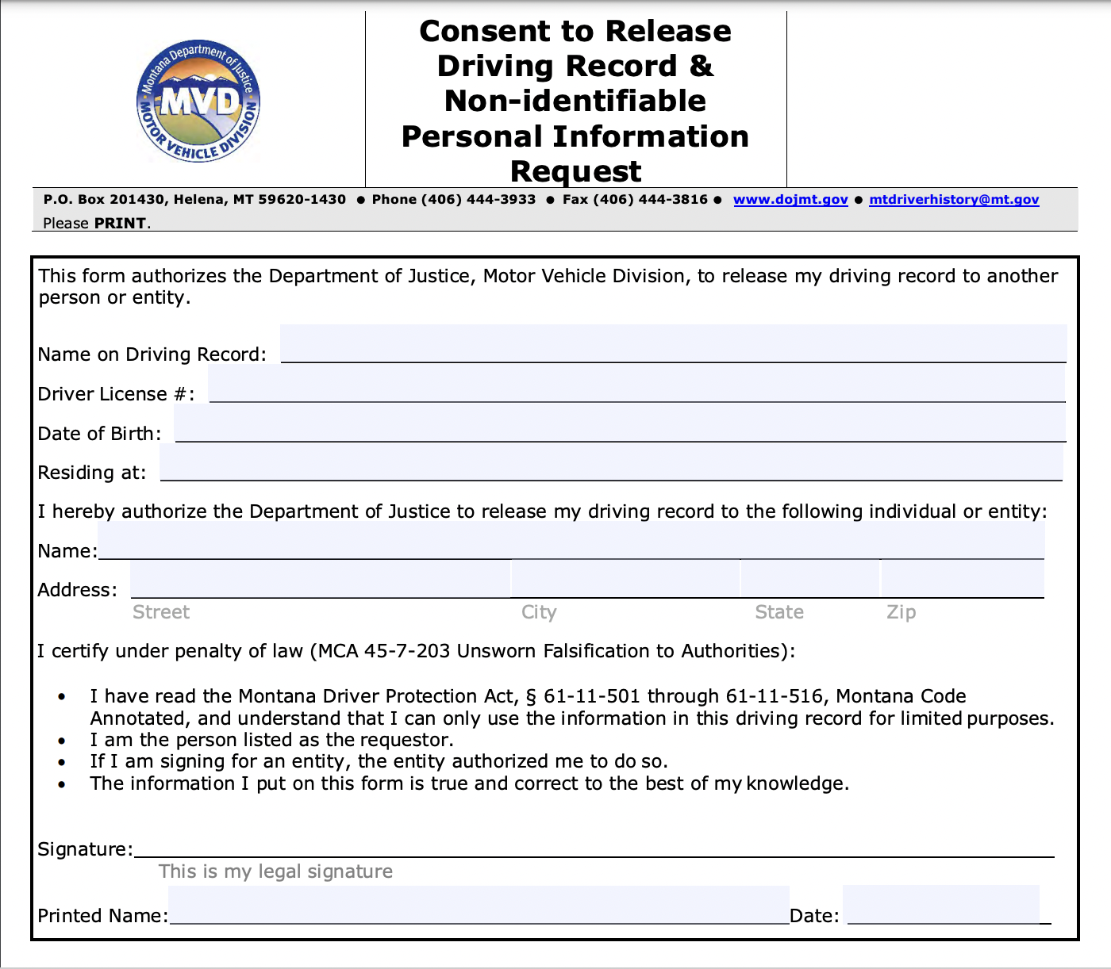
Background Check
Driving record
Traveling
Montana Driver Protection Act, § 61-11-501 through 61-11-516
Immigration law
I-9
Federal

Slide 21
Employee Selection
Hybrid method
70% statistical, 30% judgement
Are they just good at interviewing?
Or do they have the skills?
Statistical
Objective
Evaluate tests
Less discriminatory
Judgement
Subjective
Intuitive
Use interviews/tour
Keep notes

Slide 22
Verbal Job Offer
By Business Development Executive
Pay
Commensurate with experience
Starting at $66,000
Benefits
401(k)
Health insurance
Paid time off
Travel reimbursement
Car allowance
Job duties
Contact current and prospective clients
Manage territory
Sell
Innovate
Travel
Start date
Immediately
Negotiations
Notes:
https://www.onetonline.org/link/summary/11-3131.00
https://www.indeed.com/career/business-development-manager/salaries/MT?from=top_sb#common-benefits

Slide 23
Offer Letter
We are excited to extend an official job offer as of October 3, 2022!
To accept this offer, please read the terms below and sign. By signing, you are indicating that you are willing and capable of completing the tasks listed in the job description. This employment relationship is “at will” for the 18-month probationary period.
Position: Business Development Manager
Working hours: Flexible 40+ hours/week
Pay: Commensurate with experience, starting at $66,000
Benefits: 401(k), health insurance, paid time off, travel reimbursement, car allowance
Job duties: Contact current and prospective customers, manage territory, sell, innovate, travel, etc.
Once again, we would like to congratulate you on earning this position.
Signature Printed Name Date

Slide 24
Equal Opportunity Employer
“This company provides equal employment opportunities to all employees and applicants for employment and prohibits discrimination and harassment of any type without regard to race, color, religion, age, sex, national origin, disability status, genetics, protected veteran status, sexual orientation, gender identity or expression, or any other characteristic protected by federal, state or local laws.
This policy applies to all terms and conditions of employment, including recruiting, hiring, placement, promotion, termination, layoff, recall, transfer, leaves of absence, compensation and training (SHRM, 2018).”
Notes:
https://www.shrm.org/resourcesandtools/tools-and-samples/policies/pages/cms_005022.aspx#:~:text=%5BCompany%20Name%5D%20provides%20equal%20employment,sexual%20orientation%2C%20gender%20identity%20or

Slide 26
Works Cited
https://online.maryville.edu/online-masters-degrees/management-and-leadership/careers/business-development-manager-responsibilities/
https://cdn4.vectorstock.com/i/1000x1000/25/88/profit-money-icon-vector-21582588.jpg
https://ci.billings.mt.us/ImageRepository/Document?documentID=38736
https://b-buildingbusiness.com/wp-content/uploads/2020/10/impact-interview-01.png
https://www.negotiations.com/wp-content/uploads/2017/05/The-Most-Potent-Negotiating-Skill-Is-Listening.png
https://img.directindustry.com/images_di/photo-g/172196-10204779.jpg
https://www.standingcloud.com/wp-content/uploads/2020/03/images1499-5e7d9c5f8bc3a.jpg
https://hrcsuite.com/wp-content/uploads/2019/08/five-job-posting-mistakes-you-should-never-make.jpg
https://leg.mt.gov/bills/mca/title_0390/chapter_0020/part_0020/section_0070/0390-0020-0020-0070.html
https://shrm-res.cloudinary.com/image/upload/c_crop,h_705,w_1254,x_0,y_0/w_auto:100,w_1200,q_35,f_auto/v1/Tools%20and%20Samples/iStock-1132681555_yth9xq.jpg
https://dojmt.gov/wp-content/uploads/Driving-Record-Request-and-Consent-to-Release.pdf
https://hudsonjobsearch.org/wp-content/uploads/2021/01/Zoom-Interview-scaled.jpg
https://intromagic.io/wp-content/uploads/2021/09/Banner-17-1-scaled.jpg
https://www.changeboard.com/images/11982/default/decision-making-in-hr-and-recruitment-how-to-hire-the-right-candidate_201908011559195.png
https://www.shrm.org/resourcesandtools/tools-and-samples/policies/pages/cms_005022.aspx#:~:text=%5BCompany%20Name%5D%20provides%20equal%20employment,sexual%20orientation%2C%20gender%20identity%20or
https://gerstco.com/wp-content/uploads/2018/05/eeoc-large-1024x440.jpg
https://www.onetonline.org/link/summary/11-3131.00
https://www.indeed.com/career/business-development-manager/salaries/MT?from=top_sb#common-benefits
https://contenthub-static.grammarly.com/blog/wp-content/uploads/2021/10/welcome-message-new-employee.jpeg
https://codequotient.com/blog/wp-content/uploads/2021/11/Quick-and-Easy-Guide-to-Offer-Letter-Format.jpg

Slide 27
Works Cited
https://cdn.sanity.io/images/xeonec4d/production/8c4856a370bca6bca2385d5064d22d449b192aa0-1920x1080.png?w=780
https://www.ziprecruiter.com/hiring/job-description-template/business-development-manager
https://elearningindustry.com/wp-content/uploads/2015/10/5-reasons-you-need-to-invest-in-employee-training.jpg
https://www.accountingweb.com/sites/default/files/clientmeetings.jpg
https://www.ice.gov/factsheets/i9-inspection#:~:text=The%20Immigration%20Reform%20and%20Control,sanctions%20for%20employment%2Drelated%20violations.
https://wsd.dli.mt.gov/employers/employer-testing-job-candidates/
https://leg.mt.gov/bills/mca/title_0390/chapter_0020/part_0020/section_0080/0390-0020-0020-0080.html
https://leg.mt.gov/bills/mca/title_0390/chapter_0020/part_0020/section_0070/0390-0020-0020-0070.html
https://dojmt.gov/enforcement/background-checks/
https://www.uscis.gov/i-9
https://us.trabajo.org/job-1373-20220925-dce5266135e32e7ff45763f8939cc9fb?utm_campaign=google_jobs_apply&utm_source=google_jobs_apply&utm_medium=organic
https://lensa.com/business-development-director-printing-solutions-jobs/philadelphia/jd/6b2552d3d6d9cdb53e185a6870f147c2
https://jobs.smartrecruiters.com/AveryDennison/743999798075409-business-development-manager-in-plant-printing-solutions-ipps-
https://pnpstaffinggroup.com/wp-content/uploads/2016/10/Depositphotos_61776573_s-2015.jpg

Slide 28
Train Business Development Manager Printing Company in Montana
Alexa Smith

Slide 29
Overview
Welcome
ADDIE Model
Performance appraisal
Career management

Slide 30
Welcome!
Internal candidate selection
Sales manager got promoted!
Congratulate employee
In-person
Email
Outline information
Start date in new position

Slide 31
Orientation
Basic Info
New office
New assigned parking
Management software login
Organizational Structure
Report to Business Development Director
Oversee 7 sales managers
8 when replacement is found
Socialization
Already know everyone
Promotion luncheon

Slide 32
Onboarding
Human Resources
Explains:
Employee handbook
Position: Business Development Manager
Working hours: Flexible 40+ hours/week
Pay: Commensurate with experience, starting at $66,000
Benefits: 401(k), health insurance, paid time off, travel reimbursement, car allowance
Job duties: Contact current and prospective customers, manage territory, sell, innovate, travel, etc.
Business Development Director
Announces promotion to staff
Answer job-specific questions
Explains mentoring process

Slide 33
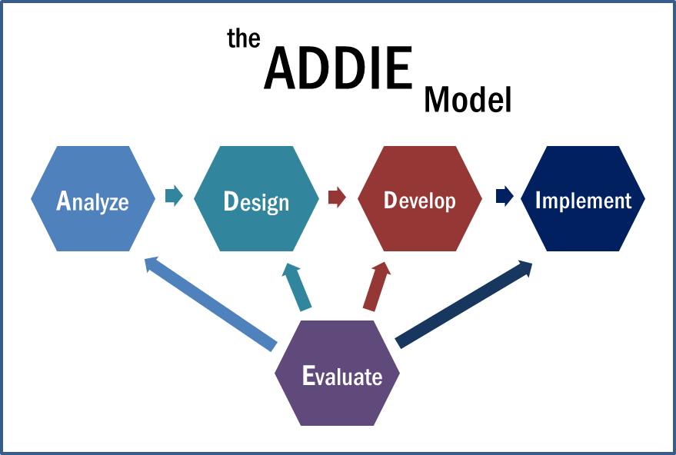
Five-Step Training Process

Slide 34
Analyze
Responsibilities and duties
Contact current and prospective clients
Territory
Increase revenue and opportunities
Goals
Form strategic relationships
Manage territory
Identify clients, coordinate visits, manage team
Sell
Negotiate agreements and volume pricing
Innovate
Industry trends
New market opportunities
Work activities
Managing a sales team
Negotiating contracts
Strategic decision making
Forming relationships
Human behaviors
Communication skills
Extrovert
Negotiation skills
Leadership
Organized
Timely

Slide 35
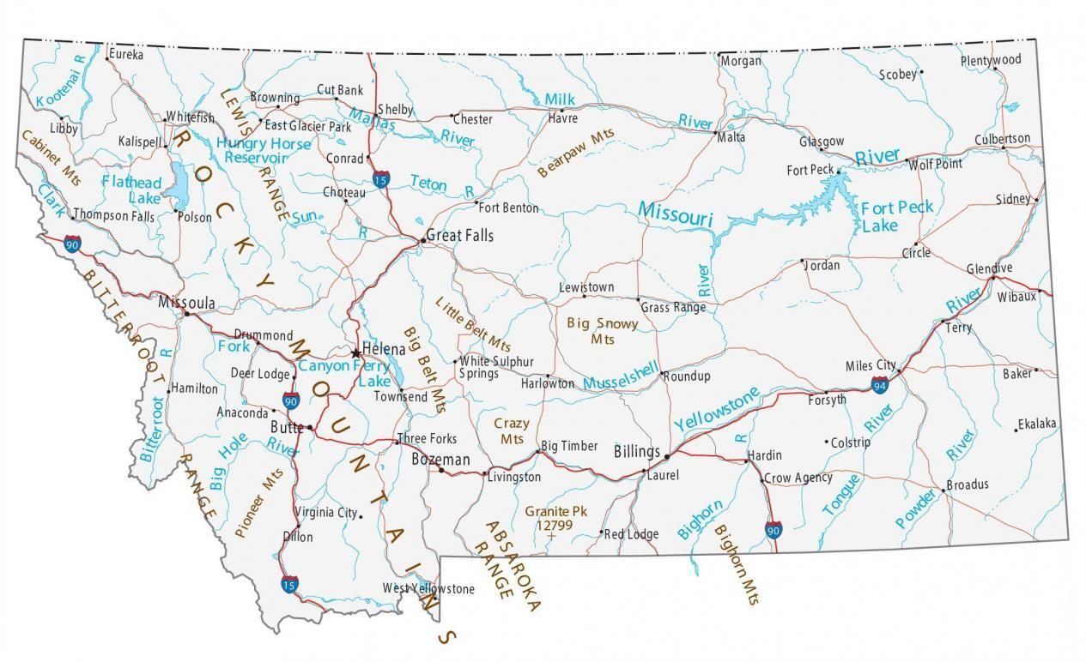
Analyze
To complete job duties:
Current Needs
Understand new software
Database for 8 sales managers
Total client list
Knowledge of printing
Relationships
Coworkers and clients
Strategic Needs
Expand knowledge
In territory and sales
Innovate
Strategic thinking
Grow the business

Slide 36
Design
Learning objectives
Increase clients by 2% in year 1
Increase territory
Understand printing materials
Effectively manage sales team
Increase overall sales by 5%
Retain sales team
Motivational learning environment
Relationship with mentor
Mentor others
Constant feedback
Performance appraisals

Slide 37
Develop
Internal hire
Already understand relationships
Printing information
Assemble training content and materials
Computer-based
Business Development Director, mentor
Reinforce all training
Guide through process

Slide 38
Develop
Training methods
On-sight training
Computer-based activities
Learn new software
PowerPoints
Managing a team
Innovation strategies
Sales and territory management
Trainer resource and manual
Refresher
Printers and software
iPads, workbooks, lectures, support materials
Not necessary

Slide 39
Implement
On-the-job training
Computer/PowerPoint training
Coached by mentor
Business Development Director
Behavior modeling
Job rotation
Observe sales managers
To better manage
Sit in with upper management
Special assignments
Role-play client meeting
Research on territory

Slide 40
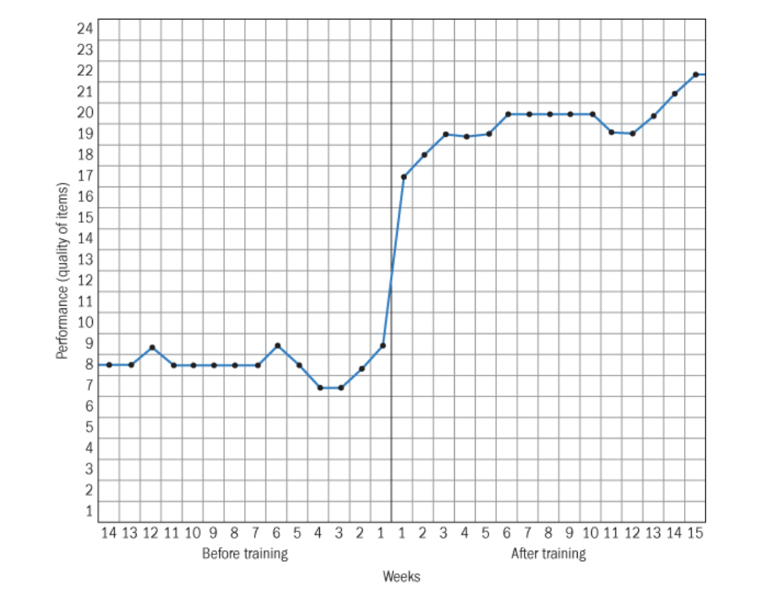
Evaluate
Designing the study
Time series design
Performance before vs. after
Software
Printing materials
Management skills
No controlled experimentation
Hard for this position

Slide 41
Evaluate
Training effects to measure
Reactions
Positive or negative
Learning
Management techniques
New software
Behavior
Enjoying new role vs prefer old
Results
Adequately performing job
Positive feedback from sales managers

Slide 42
Basics of Performance Appraisal
Sets work standards
Job duties
Listed in description
Work activities
Managing a sales team
Negotiating contracts
Strategic decision making
Forming relationships
Human behaviors
Communication skills
Extroversion
Negotiation skills
Leadership
Goals
Effectively lead sales team
Expand company territory
Understand printing materials
Add new clients

Slide 43
Performance Appraisal
Appraiser
Immediate supervisor
Business Development Director
1-2 hours in conference room
Every 3 months, year 1
Then semiannually
Go over narrative forms, graphic rating scale, peer appraisal
Peer appraisal
Results presented by Director
8 salespeople fill out form
Every 3 months, then semi-annually
Not using
Rating committees
Only 1 direct supervisor
Self-ratings
Can self-reflect on appraisals instead
Appraisal by subordinates
Done in peer appraisal
360-feedback
Comparable to peer appraisal

Slide 44
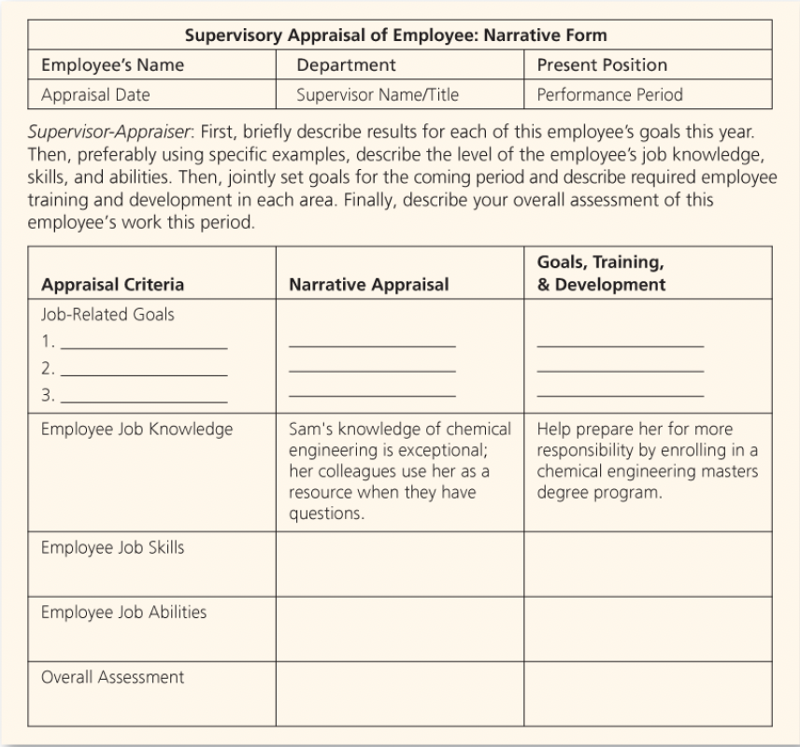
Performance Appraisal Tools
Narrative Forms
Done by Director
Every 3 months, year 1
Then semiannually
Discussed in appraisal
Assess performance
Provide feedback
Graphic Rating Scale
Done by Director
Every 3 months, year 1
Then semiannually
Discussed in appraisal
Assess job traits
Management by objectives
Done quarterly with team
Good for department goals
Not using other methods:
Provide similar feedback
BARS
Critical incident method
Not relevant to the position
Forced distribution
Alternation ranking method
Paired comparison

Slide 45
Performance Appraisal
Appraisal interview
Remedy deficiencies
Reinforce strengths
Appraisal situations
Satisfactory – promotable
Merit pay, bonus opportunities
Satisfactory – not promotable
Small bonus, recognition
Unsatisfactory – correct behavior
Better mentoring, more feedback
Unsatisfactory – uncorrectable
Terminated

Slide 46
Career Management
Coaching
Business Development Director
Monthly meetings
Maintain relationship/trust
Share control
Assess progress
Mentor sales managers
Done by Business Development Manager
Bimonthly meetings
Retention
Succession planning

Slide 47
Career Management
Managing turnover and retention
Direction sharing
Communicate sales/client goals
Recognition and rewards
Employee appreciation events
Send out newsletter highlighting accomplishments
Ongoing feedback
Through mentoring program
By peers

Slide 48
Career Management
Promotion decisions
Competence > Seniority
Seniority $≠$ Competence
How to measure competence
Sales numbers
Business development
Performance appraisals
Formal or informal
Formal
Vertical, horizontal, or other
Vertical

Slide 49
Works Cited
https://pnpstaffinggroup.com/wp-content/uploads/2016/10/Depositphotos_61776573_s-2015.jpg
https://freesvg.org/img/16231559165-star-rating-condensed.png?w=80&h=80&fit=fill&fm=png
https://www.liveabout.com/thmb/qB_DLtQIg7CxkUCoypnhiI2FMRA=/2121x1193/smart/filters:no_upscale()/business-people-using-technology-at-lunch-meeting-456580501-5c42495b46e0fb0001a585bb.jpg
https://www.oreilly.com/content/wp-content/uploads/sites/2/2020/01/gettyimages-504446566-c03f42a7263ad4ed16558091df304b3d.jpg
https://www.cfoselections.com/hubfs/Images/What-Really-Matters-to-Improve-Employee-Retention.png
https://www.brightermonday.co.ke/discover/wp-content/uploads/2018/03/Cover-image-Horizontal-Vs-Vertical-career-Growth-1.png
https://blogv2new.clickfunnels.com/wp-content/uploads/2021/06/Inner-Page-Banner-1.png
https://st2.depositphotos.com/1043879/10966/v/450/depositphotos_109665872-stock-illustration-business-hand-rotate-characters.jpg
https://www.howtolearn.com/wp-content/uploads/2012/02/Positive-Reaction-Negative-Happens-1024x682.jpg
https://res.cloudinary.com/jerrick/image/upload/f_jpg,fl_progressive,q_auto,w_1024/z09uyuw9porxe40apkka.jpg
https://i.etsystatic.com/15691613/r/il/99fe09/2470738746/il_fullxfull.2470738746_2344.jpg

Slide 50
Works Cited
https://i0.wp.com/blogs.cfainstitute.org/investor/files/2015/02/Hiring-a-Career-Coach-Is-It-Worth-It.png?resize=640%2C335
https://thumbs.dreamstime.com/b/valuation-emoticons-stock-valuation-emoticons-stock-vector-118299028.jpg
https://www.liveabout.com/thmb/K5eWy3jFsO4dumHY7kT2g5jk-cM=/3000x2000/filters:fill(auto,1)/good-and-bad-examples-of-feedback-2275923-v1-5b880f1946e0fb0025630b7e-c812eed84c0443768f1e3c3f1bc3c189.png
https://www.morunda.com/wp-content/uploads/2019/02/Job-description-structure-1024x1022.jpg
https://gisgeography.com/wp-content/uploads/2020/02/Montana-Map-1265x772.jpg
https://michiganvirtual.org/wp-content/uploads/2019/01/iStock-614055504-1024x684.jpg
https://www.salary.com/research/salary/benchmark/business-development-director-salary/mt#:~:text=The%20average%20Business%20Development%20Director,falls%20between%20%24156%2C412%20and%20%24197%2C190.
https://www.insperity.com/wp-content/uploads/employee_onboarding_640x302.png

Slide 51
Pay Business Development Manager Printing Company in Montana
Alexa Smith

Slide 52
Overview
Direct/Indirect pay
Pay Policies
Pay-for-performance
Benefits and Services

Slide 53
Pay Law
MT wage transparency attempt
Employees can discuss
Not required in job descriptions
Title VII of the 1964 Civil Rights Act
Compensation discrimination
Notes:
https://www.corporatelaborlaw.com/wp-content/uploads/digital.jpg

Slide 54
Direct Pay
Salary employee
Starting $66,000
Exempt – no overtime
Commission
Not with promotion
Bonus
Profit sharing bonus
Annual, after year 1
Incentives
Performance incentive
Goal based
Quarterly, after 1st quarter
Notes:
https://www.nicepng.com/png/detail/753-7538999_salary-vs-hourly-image-of-exempt-vs-non.png

Slide 55
Indirect Pay
Benefits
Nonfinancial
Paid time off
Insurance
Personal services
Family services
Notes:
https://thumbs.dreamstime.com/b/employee-benefits-personal-leave-insurance-life-retirement-plan-child-care-paid-vacation-sick-health-diagram-color-flat-190273487.jpg

Slide 56
Pay Policies
Market comparison
Based on job evaluation
Compensable factors
Skills, responsibility, printing?
Geography - MT locality pay
Cost of living/year = $43,310
Comparable to U.S. average
Seniority
Does not affect pay
Montana
Missoula, MT
United States

Slide 57
Legal
Minimum wage: $9.20 to $9.95
Not relevant
Social Security
Federal
Retirement savings plan
Employee pays 6.2% of wages
Employer pays 6.2%
Medicare
Federal
Retirement medical insurance
Employee pays 1.45% of wages
Employer pays 1.45% of wages

Slide 58
Legal: Worker’s Compensation
MT
Health Care and Benefits Division, (WCMB)
Out of work for injury
$1.77 per $100
Death and dismemberment
Dependent on injury
Finger vs. leg
Medical Costs
Covered by insurance

Slide 59
Legal: Unemployment Insurance
Montana
Minimum $163
Maximum $552
Calculated by:
1%
Total wages during base period
1.9%
Two quarters in which you earned most
File by phone or online
10 days to appeal
Must provide proof of unemployment
Notes:
https://www.nolo.com/legal-encyclopedia/collecting-unemployment-benefits-montana.html
https://www.explorebigsky.com/wp-content/uploads/2020/12/fraud-alert_original.jpg

Slide 60
Legal: FMLA
Over 50 employees
PTO/vacation + FMLA
Employer maintains health coverage
Worked 1,040 hours in previous 12 months
12 unpaid weeks
Reasons:
Serious health condition
Newborn child
Care for spouse, child, parent
Notes:
https://hr.mt.gov/_docs/newdocs/factsheets/WC-FMLA-ADA-Factsheet_-11-18-15.pdf
https://www.patriotsoftware.com/wp-content/uploads/2016/01/FMLA-2-1.png

Slide 61
Severance Pay
Voluntary
Retires
NONE
Quit
NONE
Involuntary
Layoff, Furlough, Closure
1 week salary/years worked
Dismissal
NONE

Slide 62
Pay-for-Performance
Merit pay
Performance based
Annual increase 1%
Not using
Piecework
No outputs

Slide 63
Pay-for-Performance
Non-financial
Luncheon for promotion
Employee of the month
Quarterly team building activities
Social recognition – good job!
Performance feedback
Notes:
https://t3.ftcdn.net/jpg/04/06/44/34/360_F_406443466_rbEs7qzGEI6JxwyVqQ8Xff211xfmDjwu.jpg

Slide 64
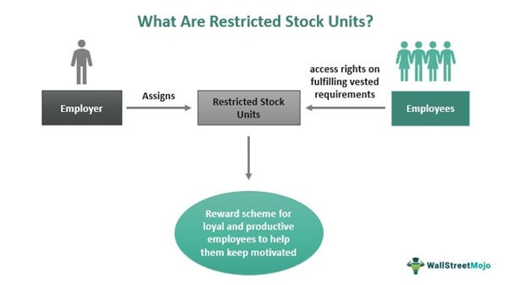
Pay-for-Performance
Incentives for Managers
Short-term
Bonus
Annual company performance
Incentive
Quarterly individual performance
Merit pay
Annual salary increase 1%
Long-term
Restricted stock
Based on performance
30 shares year 1
TBD after year 1
Notes:
https://cdn.wallstreetmojo.com/wp-content/uploads/2017/04/Restricted-Stock-Units.jpg

Slide 65
Organization-wide Incentives
Profit sharing
Current profit-sharing
Annual bonus payout
Not using
Scanlon plans
Earnings-at-risk pay plan
Gainsharing
Employee stock ownership
Instead…
Focus on individual
No free riders
Incentives on performance
Merit pay

Slide 67
Vacations and Holidays
Vacation
Promoted employee
2 weeks paid
Increased from 1
Previous days used
Holidays
Paid
New Year's Day, Memorial Day, Independence Day, Labor Day, Thanksgiving Day, and Christmas Day

Slide 68
Sick Leave
PTO Bank
Lump personal days/holidays, sick days
10 PTO days/year
Buy back option
Purchase PTO days at 50%
Rollover days
2-year periods
Use PTO or buy back
Vacation use or lose

Slide 69
Insurance
Healthcare, PPO
Pay for employee, family buy-in
Basic Health/Hospitalization
Vision 80:20
Dental 80:20
Short-term disability
Up to 30 days
50% of salary
MT Claim site: https://ancillary.bcbsmt.com/#!/
Long-term disability
Buy up to 66 2/3% of salary
100% on employee

Slide 70
Other Insurance Benefits
Long-term care
Employee paid
Offered on pre-tax basis
Health Insurance Portability and Accountability Act of 1996
Life insurance
2x salary
Employee buy up

Slide 71
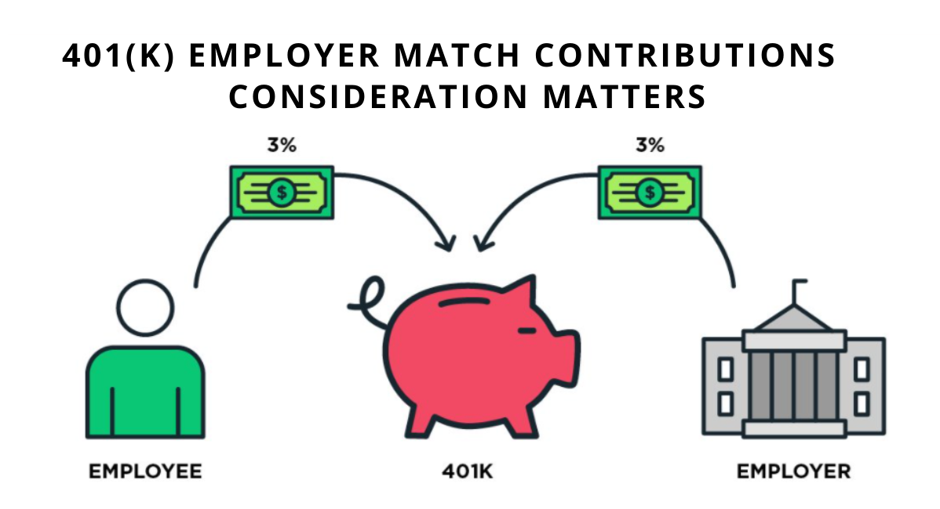
Retirement Benefits
Pension plans
Defined contribution 401 (k)
Company matched up to 3%
Employees contribute
Control investment
Controls payout schedule

Slide 72
Personal Services
Reimbursable expenses
Federal mileage, meals, incidentals
Employee gym
Lunch and learn opportunities
Social and recreational
Team participation
Social outings
Employee assistance program
Legal services
Case-by-case basis
Mental health
Included with insurance
Not offering:
Cafeteria plans
Massages
Yoga

Slide 73
Family-Friendly Benefits
Unpaid maternity leave
Use PTO/vacation
To get paid
FMLA kicks in
Flexible schedules
40+ hours/week
Telecommute 1 day/week
When not traveling/meeting clients
Not provided
Childcare
Educational services
Job share
Work share

Slide 75
Works Cited
https://www.nicepng.com/png/detail/753-7538999_salary-vs-hourly-image-of-exempt-vs-non.png
https://thumbs.dreamstime.com/b/employee-benefits-personal-leave-insurance-life-retirement-plan-child-care-paid-vacation-sick-health-diagram-color-flat-190273487.jpg
https://www.corporatelaborlaw.com/wp-content/uploads/digital.jpg
https://t3.ftcdn.net/jpg/04/06/44/34/360_F_406443466_rbEs7qzGEI6JxwyVqQ8Xff211xfmDjwu.jpg
https://cdn.wallstreetmojo.com/wp-content/uploads/2017/04/Restricted-Stock-Units.jpg
https://www.referenceforbusiness.com/photos/profit-sharing-398.jpg
https://www.mydentalconsultant.com/images/easyblog_articles/142/b2ap3_small_Screen-Shot-2016-06-25-at-11.51.31-A_20160625-155517_1.png
https://www.markspaneth.com/assets/images/blog/_list_image/02_01_17_471038050_BB_560x292.jpg
https://www.nolo.com/legal-encyclopedia/collecting-unemployment-benefits-montana.html
https://www.explorebigsky.com/wp-content/uploads/2020/12/fraud-alert_original.jpg
https://hr.mt.gov/_docs/newdocs/factsheets/WC-FMLA-ADA-Factsheet_-11-18-15.pdf
https://www.patriotsoftware.com/wp-content/uploads/2016/01/FMLA-2-1.png
https://www.insurancenavy.com/images/hmo-vs-ppo-insurance-plans-what-s-the-difference.png
https://cdn-icons-png.flaticon.com/512/4914/4914344.png

Slide 76
Works Cited
https://img.freepik.com/premium-photo/long-term-care-insurance-medicine-health-concept-long-term-care-insurance-policy-table_94120-1970.jpg
https://tehcpa.net/wp-content/uploads/2020/10/401k-employer-match-contributions-consideration-matters.png
https://www.yanrefitness.com/wp-content/webpc-passthru.php?src=https://www.yanrefitness.com/wp-content/uploads/2021/05/Corporate-Gym-Yanre-Fitness.jpg&nocache=1
https://media-exp1.licdn.com/dms/image/C4E12AQEGE9b-_mB7_w/article-cover_image-shrink_720_1280/0/1625557362309?e=2147483647&v=beta&t=pwVGNH0_VHL-dbe-EP_IJioX-cHqhLysFkoTBy-Z8lI
https://www.indeed.com/career/business-development-manager/salaries/Missoula--MT?from=top_sb
https://www.careeraddict.com/uploads/article/61407/workplace-severance-pay.png
https://www.pgpf.org/sites/default/files/ss-trustees-report-email-2019.jpg

Slide 77
Terminate Business Development Manager Printing Company in Montana
Alexa Smith

Slide 78
Overview
At-Will Employment
Discrimination
Voluntary vs Involuntary
Retention Strategies

Slide 79
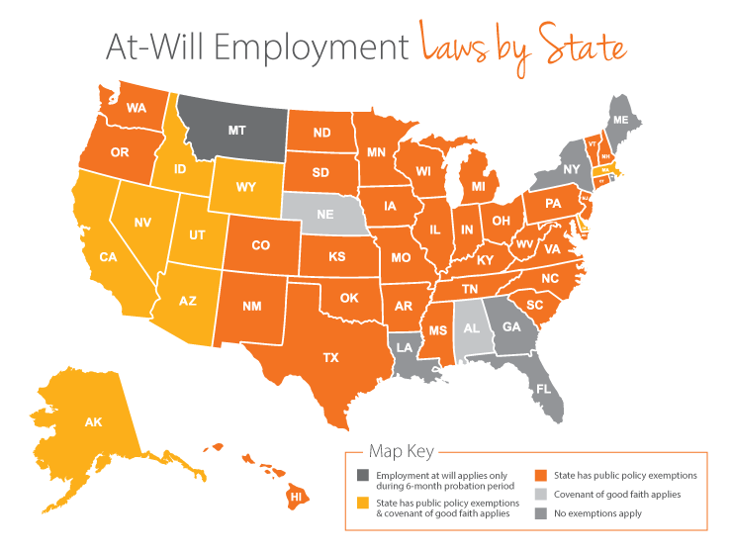
At-Will Employment
MT is NOT an “at-will” state
Montana Wrongful Discharge from Employment Act of 1987
“At-will” ONLY in introduction probation period – 12 months
Established by employer
Can be up to 18 months
Mont. Code Ann. § 39-2-910
After probation period…
MUST have “good cause”
Notes:
https://www.mightyrecruiter.com/recruiter-guide/at-will-employment-wrongful-termination-laws-montana/
https://www.paycor.com/wp-content/uploads/2021/02/Employment-at-Will-Laws-by-State-map.png

Slide 80
Discrimination and Documentation
Discrimination
Monitored by MT Human Rights Bureau
Including but not limited to:
Title VII Civil Rights Act of 1964
Age Discrimination Act
Pregnancy Discrimination Act
Document EVERYTHING
Throughout employment
Prevent getting sued/win lawsuit
“Good cause” for termination
Reasonable, work-related
Unable to perform job duties
Disrupting business operations
Notes:
https://erd.dli.mt.gov/human-rights/human-rights-laws/employment-discrimination/

Slide 81
Voluntary Termination
Initiated by employee
Retires
2 months notice
401 (k)/Social security
At eligible age
Healthcare
COBRA
Dental and Vision
End at retirement
PTO
Paid out
Severance pay
NONE

Slide 82
Voluntary Termination
Quits
2 weeks notice recommended
401 (k)
Vesting, 3 years
Healthcare
Employer $ ends immediately
Will offer COBRA
Dental and vision
Ends immediately
PTO
All accrued is lost
Severance pay
NONE

Slide 83
Voluntary Exit Interview
Conducted by Director and HR
Insights on company
Training process, employees, management
How to improve retention
Better benefits, more services, etc.?
Promotion processes
Frequent, fair?
Salary/benefits
Accurate, comparable?

Slide 84
Involuntary Termination
Conducted by Director and HR
MT Law
Wages paid within 4 hours or end of business day (whichever is first)
Unless there is preexisting written policy
Then next payday or 15 days
Gather evidence/paperwork
Explain unemployment
Severance pay
Not for dismissal

Slide 85
Involuntary Termination Interview
Plan the interview
HR, end of day, private room
Get to the point
Specific documented issues
Describe the situation
Sales are too low…
Territory isn’t expanding…
Loosing clients…
No work for employee…
Listen
Give employee time to explain
Appeal process if needed
Review severance package/unemployment
Next steps
Outplacement counseling

Slide 86
Involuntary Termination Safeguards
1. Allow employee to explain
2. Provide FULL explanation of issue
How and why decision was made
Documented evidence
3. Multistep procedure
Warning if applicable
Appeal process
4. Person dismissing
HR may not be best for layoffs
5. Financial compensation
Severance pay

Slide 87
Steps for Termination – Dismissal
Identify and document issues
Prevents discrimination
“Good cause” in MT
Coach the employee
Try to resolve issues
Offer advice and assistance
Create an improvement plan
How to do X by Y
Terminate the employee
If there is no improvement
Conduct exit interview
Employee willing

Slide 88
Involuntary Termination
Dismissal
Unsatisfactory performance
Not reaching territories, motivating salespeople, adding clients
Misconduct
Stealing, sexual harassment, violence
Lack of qualifications
Cannot do work
Willing to further train first
Job requirements evolved
No longer capable/needed
Wiling to further train/move positions
Insubordination
Unwillingness/disrespect
Strike 1, 2, terminated
Unemployment insurance not offered
No severance pay offered

Slide 89
Involuntary Termination
Reduction of force
Layoff
Permanent layoff
No recall planned
Layoff the “right” people
Furlough
Temporary
May move to permanent layoff
Closure
WARN Act – 100+ employees
60 days notice before
Unemployment insurance explained
PTO is paid out
Severance pay for all
1 week/year worked

Slide 90
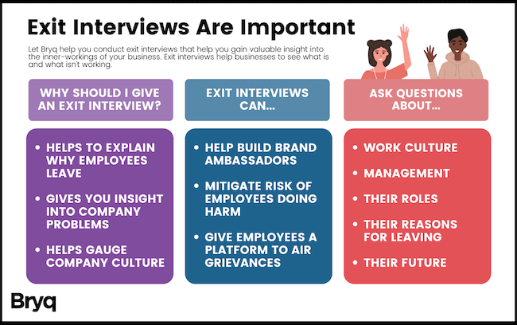
Involuntary Exit Interview
Employee willing
May not want to
Same information as voluntary

Slide 91
Retainment Strategies
Exit interviews
Help learn what employees want
Counteroffer if applicable
Raise pay
Be competitive
Hire smart
Attitude surveys
Career development
Create plan/promote
Be flexible
Telecommuting

Slide 92
Citations
https://erd.dli.mt.gov/labor-standards/wage-and-hour-payment-act/wage-and-hour-faq#:~:text=No.,have%20good%20cause%20for%20termination.
https://www.mightyrecruiter.com/recruiter-guide/at-will-employment-wrongful-termination-laws-montana/
https://www.paycor.com/wp-content/uploads/2021/02/Employment-at-Will-Laws-by-State-map.png
https://mondo.com/wp-content/uploads/2022/06/mass-layoffs-in-2022-whats-next-for-employees.jpg
http://sacemploymentlawyer.com/wp-content/uploads/2017/01/new_california_law.jpg
https://abyde.com/wp-content/uploads/2020/04/Technical-Safeguards-for-Cybersecurity.png
https://blog-consumer.glassdoor.com/app/uploads/sites/2/50-most-common-interview-questions.png
https://www.glassdoor.com/employers/app/uploads/sites/2/2021/02/GoogleDrive_640X469_13-Must-Ask-Exit-Interview-Questions-02-1280x992.png
https://switchgearrecruiting.com/wp-content/uploads/2017/06/5-signs-ee-leaving.jpg
https://cdn.media.amplience.net/i/partycity/662056?$large$&fmt=auto&qlt=default
https://www.i-sight.com/wp-content/uploads/2021/08/iStock-623288530-1024x1024.jpg
https://www.insperity.com/wp-content/uploads/employee-retention-strategies_640x302.jpg
https://www.knightnicastro.com/blog/2022/03/recent-changes-to-montanas-wrongful-discharge-act/
https://www.cbia.com/wp-content/uploads/2020/06/Employment-Discrimination.png
https://www.qualtrics.com/m/assets/wp-content/uploads/2020/10/Screen-Shot-2022-03-28-at-8.47.56-PM.png

