Slide 1
Restoration of Watsonville Vegetation

Slide 2
The plan:
Assess biodiversity of this plot today
Give data to Jenn & Carla to summarize
Restore with native vegetation
Assess biodiversity afterwards and compare

Slide 3
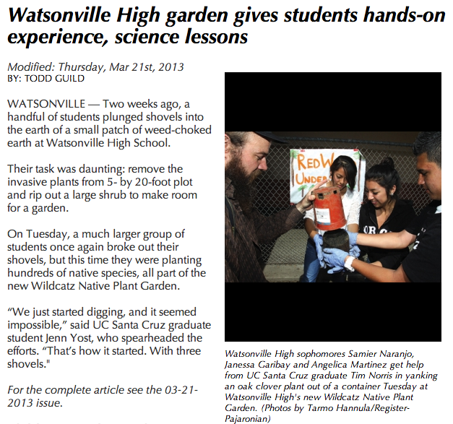

Slide 4
Biodiversity
What is biodiversity?
Why is biodiversity important?
What do healthy ecosystems provide for humans?
Notes:
Stability in an ecosystem is a balance between competing effects.
Students know biodiversity is the sum total of different kinds of organisms and is affected by alterations of habitats.
What is biodiversity?
Why is biodiversity important? Show Greg’s chart.
What are some problems with having a single species in an ecosystem. Disease, medicines, other biodiversity.

Slide 5
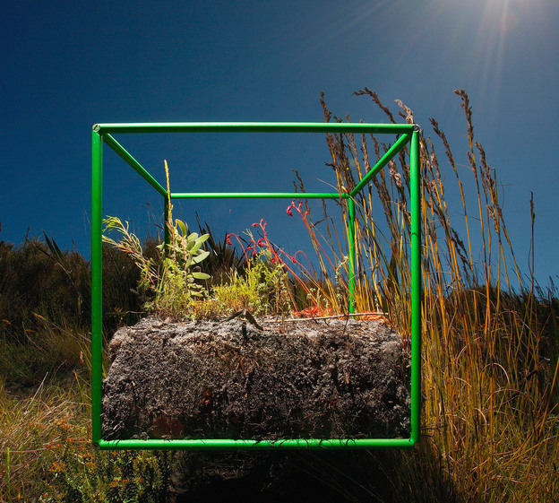

Slide 6
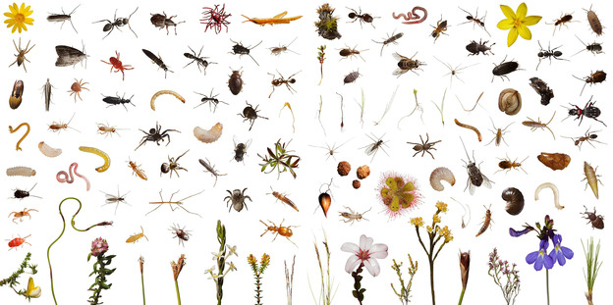

Slide 7
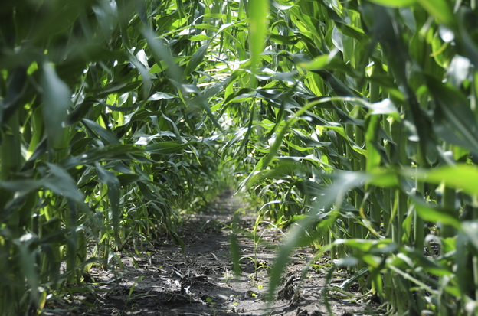
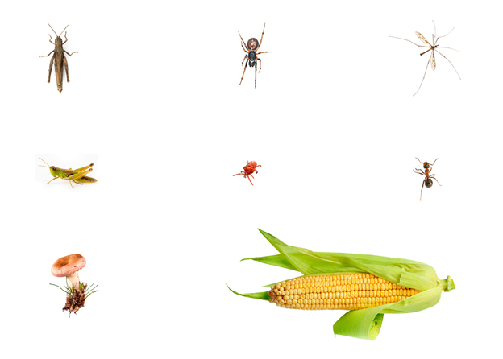

Slide 8
How do we measure biodiversity?
Each of these species are really different…
How do we compare “apples to oranges”?
Many species!
That is A LOT of counting.
http://www.npr.org/blogs/krulwich/2012/11/29/166156242/cornstalks-everywhere-but-nothing-else-not-even-a-bee

Slide 9
Biodiversity can be quantified (counted) in many different ways

Slide 10
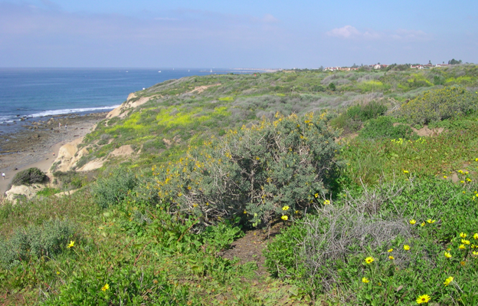
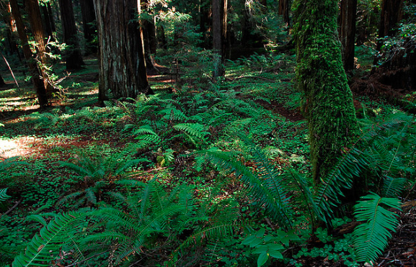

Slide 11
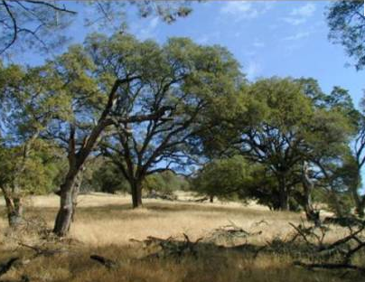
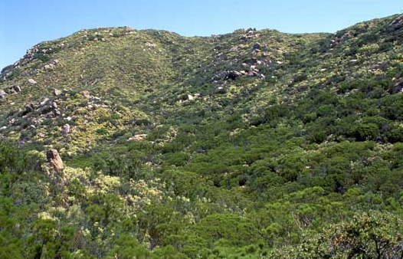

Slide 12
Biodiversity can be quantified (counted) in many different ways
Total number of species
Plants
Number of woody species vs. herbaceous species
Grasses vs. non grasses
Pollinator types (bee pollinated, wind pollinated, bird pollinated)
Differences in leaf shapes
Differences in height
Insects
Number of species
Abundance of a single species
Pollinators vs. non – pollinators

