Slide 1
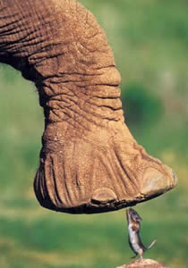
Why Size Matters
Linking form & function through allometry
http://www.upali.ch/bilder1/elemaufus.jpg

Slide 2
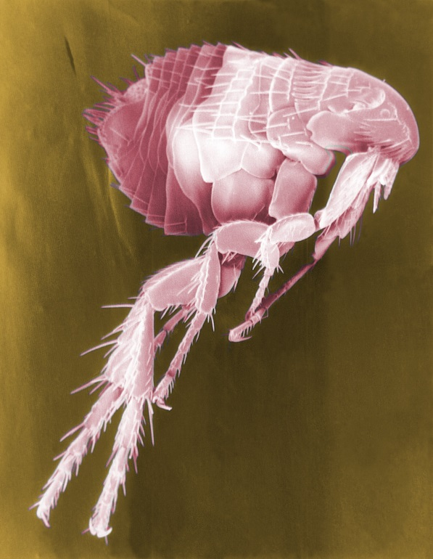
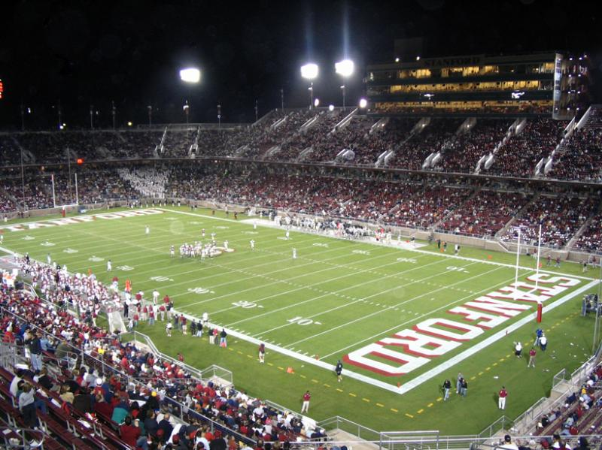
Flea comparison
If a flea was the size of a human…
IT COULD JUMP over 450 FEET! (~1.5 football fields)
http://upload.wikimedia.org/wikipedia/commons/f/f9/Flea_Scanning_Electron_Micrograph_False_Color.jpg
http://darrenmcguinness.files.wordpress.com/2011/01/american-football-stadium.jpg

Slide 3
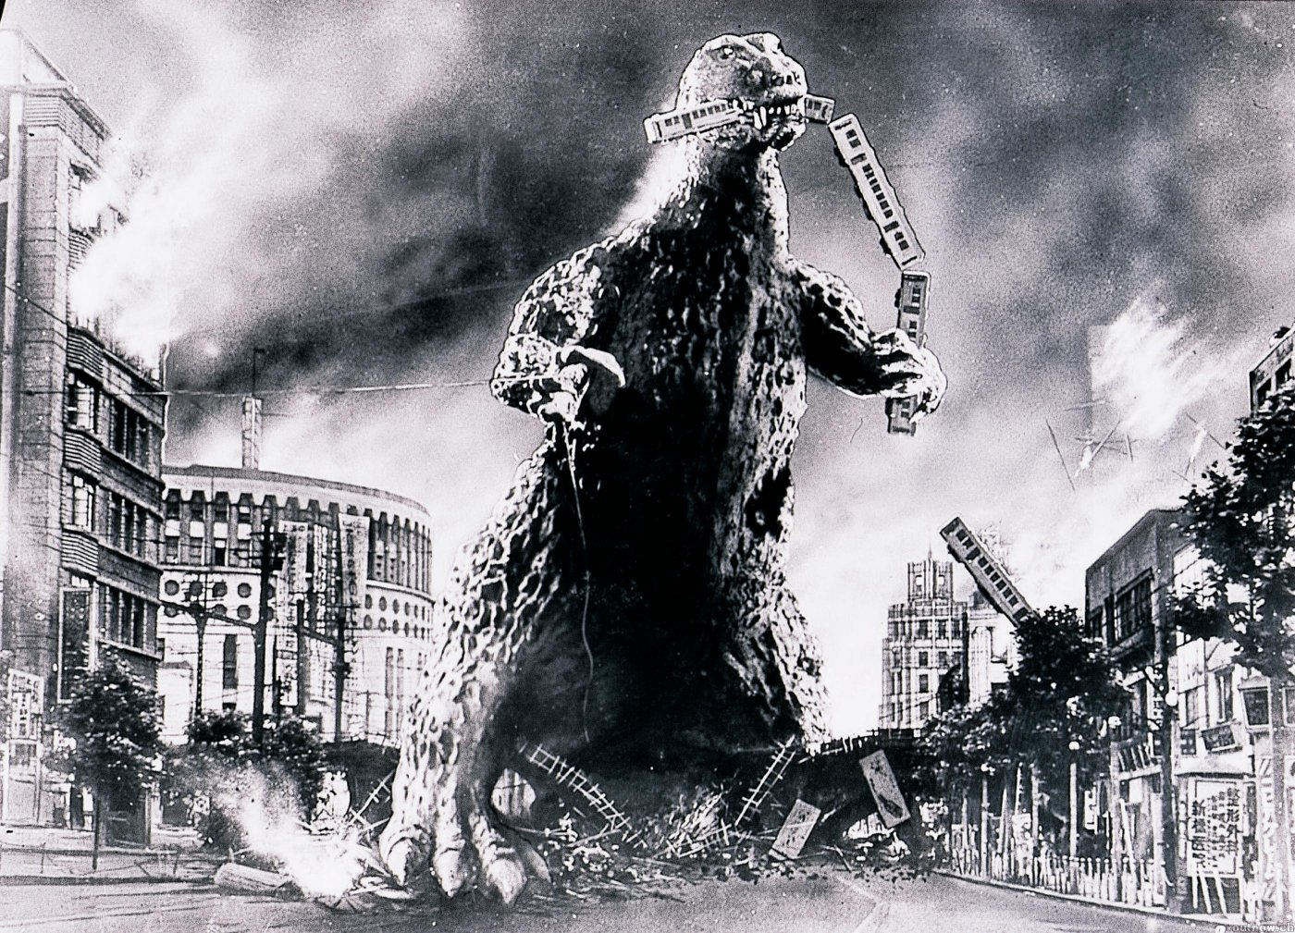
Hollywood loves Scaling! Huge spiders, lizards…
But these animals aren’t
this big in nature
Why not?
http://images.amcnetworks.com/blogs.amctv.com/wp-content/uploads/mt-legacy/scifi-scanner/Earth%20vs%20The%20Spider.gif
http://www.scifinow.co.uk/wp-content/uploads/2012/10/godzilla1954c.jpg

Slide 4
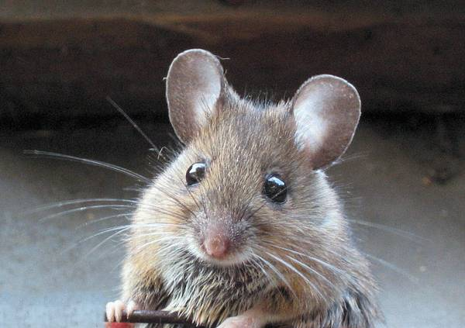
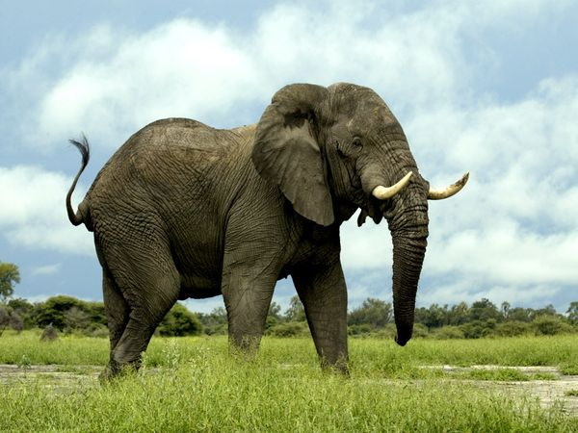
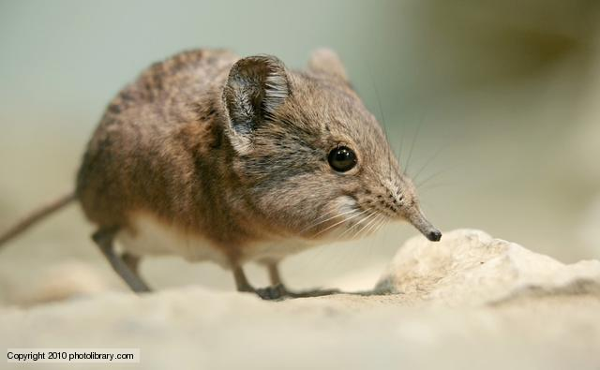
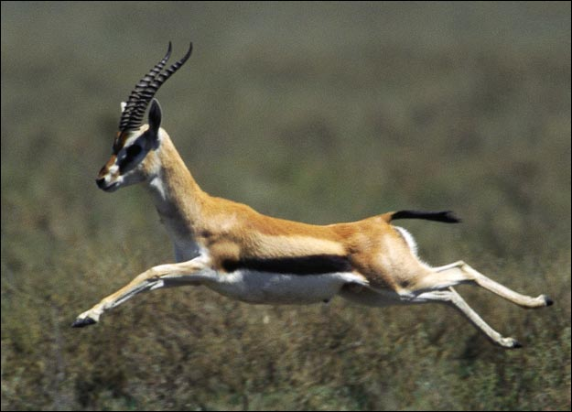
Is bigger better? Does size matter?
Why don’t we see mice the size of elephants?
Why doesn’t a shrew run as fast as a gazelle?
http://www.talismancoins.com/catalog/Alert_and_Friendly_Mouse.jpg
http://ichef.bbci.co.uk/naturelibrary/images/ic/credit/640x395/e/el/elephant_shrew/elephant_shrew_1.jpg
http://4.bp.blogspot.com/-gZNE_XHrF-w/TtOTpuGcVQI/AAAAAAAADQg/LnM7eaACHzM/s1600/gazelle-image-01.jpg

Slide 5
From Hill, Wyse & Anderson (2008)

Slide 6
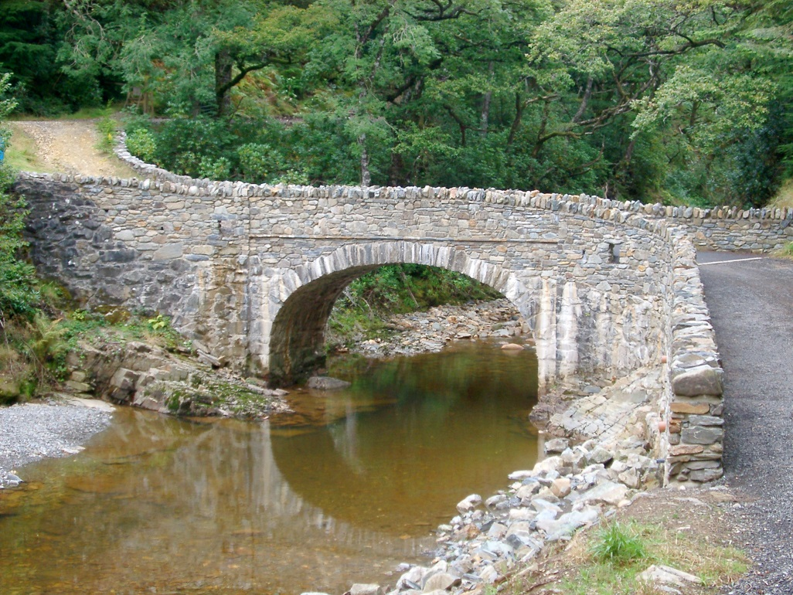
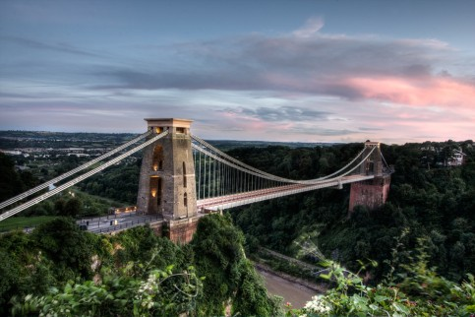
Bridges
Which can be longer?
WHY?

Slide 7
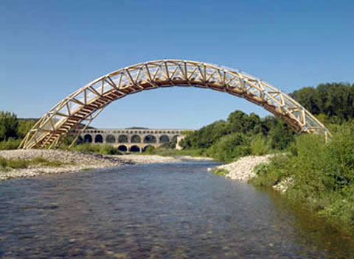
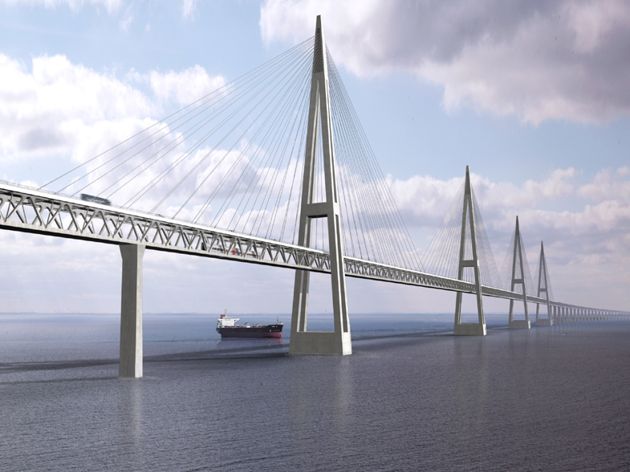
What do these bridges and animals have in common?
Size matters!
Physical limitations can be overcome by changing…
Dimensions (ex: thicker walls)
Materials (ex: brick→steel)
Design (ex: compression→tension elements)
http://bruteforcecollaborative.files.wordpress.com/2010/04/remoulin-paper-bridge01.jpg
http:/http://bruteforcecollaborative.files.wordpress.com/2010/04/remoulin-paper-bridge01.jpg/gcaptain.com/wp-content/uploads/2008/01/Fehmarn_bridge-design.jpg

Slide 8
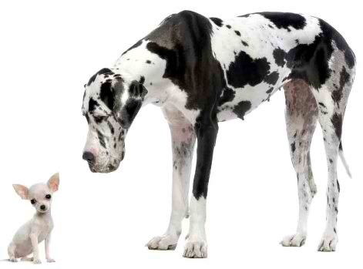
Allometry
How does body size affect physiological function?
◦8,000 species of birds
◦8,000 species of mammals
◦20,000 species of fish
◦>2,000 species of reptiles/amphibians
Great Differences in Size
We can’t measure them all!
Animal Diversity
9 million known species!
http://3.bp.blogspot.com/-Gx9U88n6hkY/Tj9dVZbhzFI/AAAAAAAAABc/f1yl6Xn-3h0/s1600/big_and_small.jpg

Slide 9
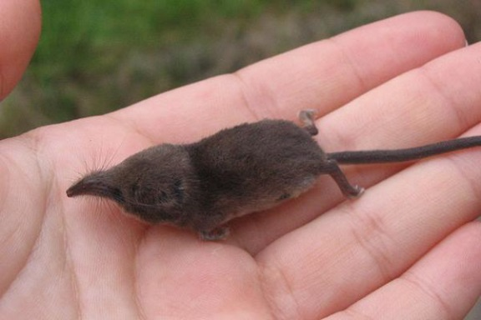
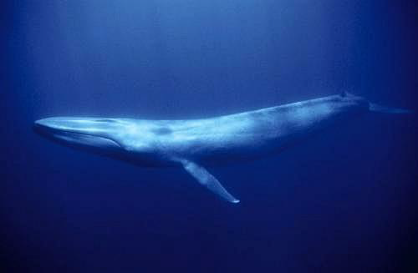
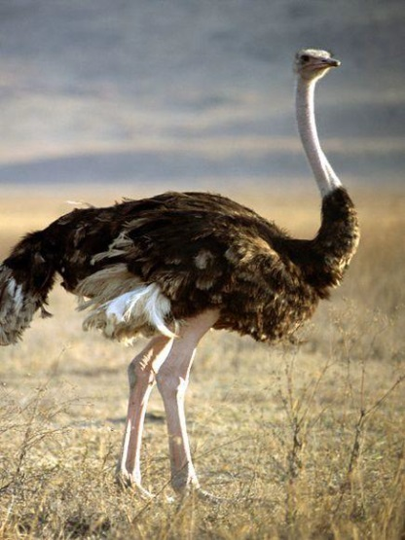
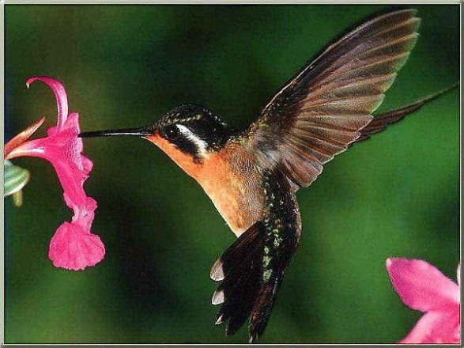
Great Differences in Size
Mammals:
Etruscan shrew (2.5g) →Blue whale (108,862,000 g)
Birds:
Humming bird (2.0g) → Ostrich (100000 g)
From Thometz Allometry Pwpt

Slide 10
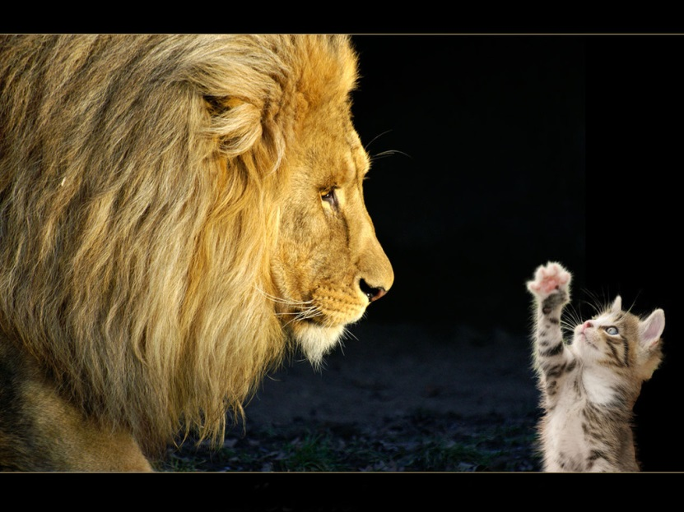
Predictive power?
Can we study one end of the continuum and know something about the other end?
How do structural / functional consequences of changes in size relate in similar organisms?
http://www.scenicreflections.com/files/Big_and_Small_Wallpaper_k1y85.jpg

Slide 11
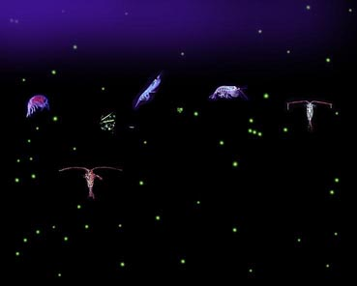
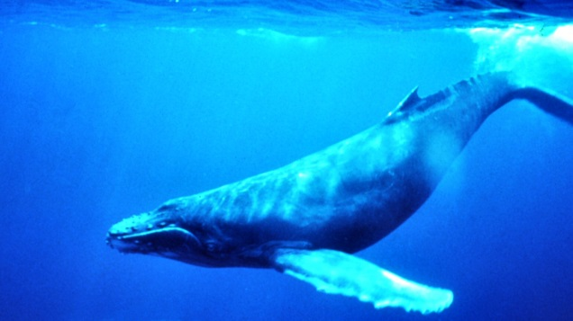
Size Matters!
Allometry: The study of how traits and processes scale with body size
Why is animal size so important?
Almost everything is profoundly affected
by body size
Consider plankton and blue whales…
http://upload.wikimedia.org/wikipehttp://heatherchristenaschmidt.files.wordpress.com/2012/01/blue-whale-qed.jpgdia/commons/6/6e/Plankton_collage.jpg
http://heatherchristenaschmidt.files.wordpress.com/2012/01/blue-whale-qed.jpg

Slide 12
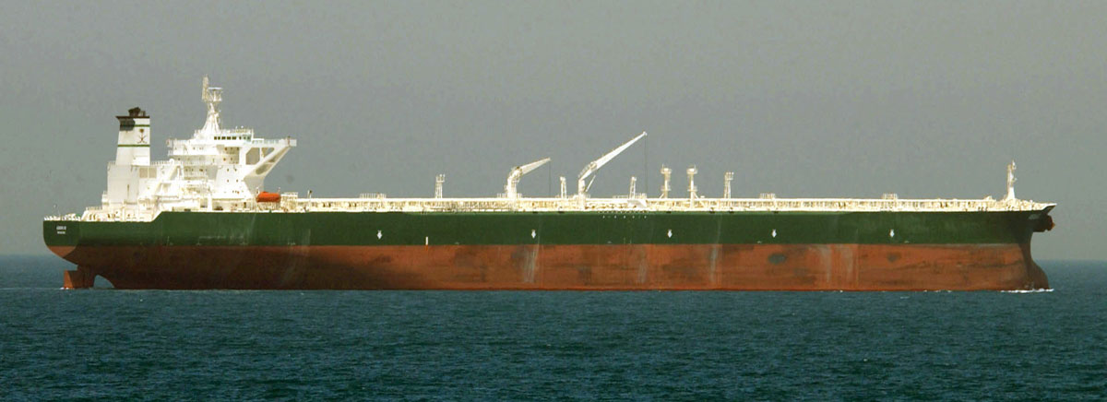
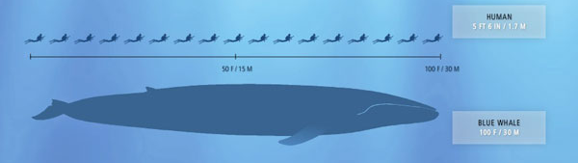
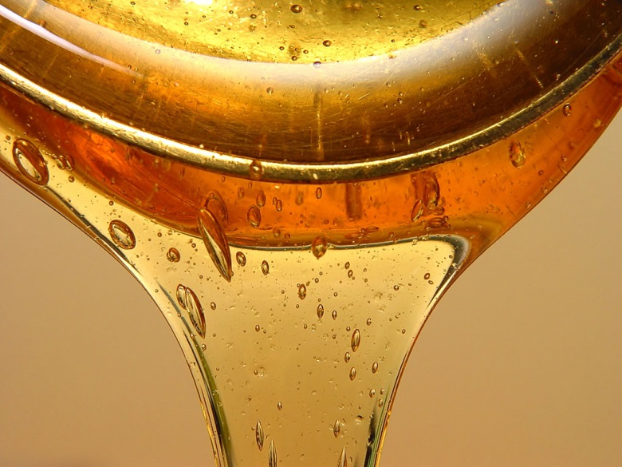
What’s it like being tiny? How about enormous?
Ocean Transport:
Blue whale: travels through ocean like supertanker…
Plankton: experiences water like we experience syrup…
Challenges posed by environment = radically different!
http://files.doobybrain.com/wp-content/uploads/2009/03/blue-whale-stats.jpg, http://upload.wikimedia.org/wikipedia/commons/7/75/Supertanker_AbQaiq.jpg,

Slide 13
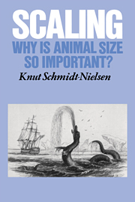
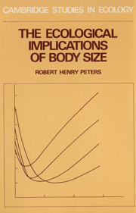
What scales to body size?
ALMOST EVERYTHING!
Rate of energy use
Maximum bird size for flight
Lung volume
Blood volume
Heart weight & rate
Respiration frequency
Jumping distance
Brain size
Gestation time
Age of sexual maturity
100s of other physiological variables!
All vary predictably with body size!
http://assets.cambridge.org/97805213/19874/cover/9780521319874.jpg,

Slide 14
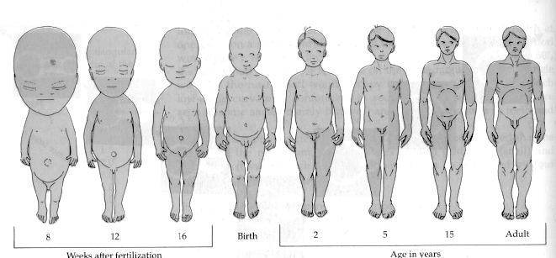
Relative head size during development…
Traits typically do not scale linearly with body size
http://www.blc.arizona.edu/courses/schaffer/182/Giraffe/allometry-human.gif

Slide 15
What is Scaling?
SCALING: structural & functional consequences of changes in size or scale among otherwise similar organisms
2 types of scaling:
Isometric
Allometric
These can be represented graphically
Linear
Nonlinear
https://www.openshift.com/sites/default/files/vertvhoriz.png

Slide 16
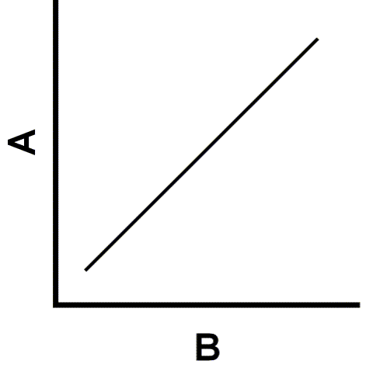
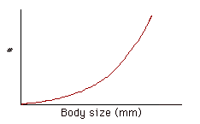
Linear vs Nonlinear Relationships
Linear Relationship:
relating to, or resembling, a straight line
Nonlinear Relationship
Everything else!
Ex: exponential relationship
http://www4.uwsp.edu/psych/stat/7/i42.gif
http://people.cst.cmich.edu/swans1bj/graph/QUEST7B.GIF

Slide 17
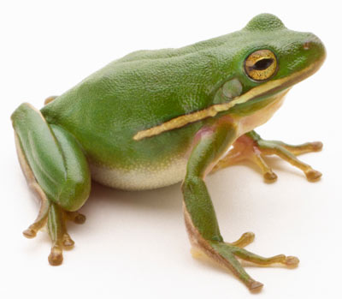
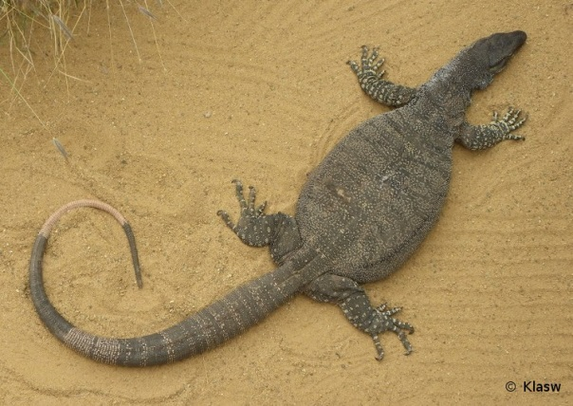
Isometric vs Allometric Scaling
Isometry: changes in size do not lead to changes in proportion
Geometrically-similar…proportional
Scale in a 1:1 manner (linear slope of 1)
EX: a frog’s legs are as long as its body,
even as it grows in size
Allometry: changes in size lead to changes in proportion
Geometrically different…not proportional
DON’T scale in a 1:1 manner
EX: monitor lizards…limbs are relatively longer
in larger lizards
http://fc07.deviantart.net/fs71/f/2010/227/f/e/Lace_monitor_lizard_by_Klasw.jpg
http://static.ddmcdn.com/gif/frog-1.jpg
Notes:
Iso-same
-metry-shape
Geometrically-similar…proportional
Scale in a 1:1 manner
EX: a frog’s legs are as long as its body, even as it grows in size
Allo-different
-metry-shape
Geometrically different…not proportional
DON’T scale in a 1:1 manner
EX: monitor lizards…limbs are relatively longer
in larger lizards

Slide 18
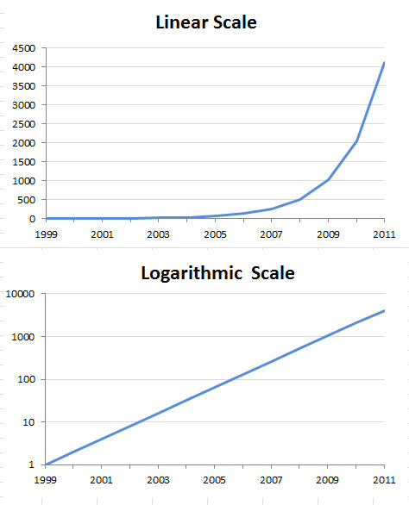
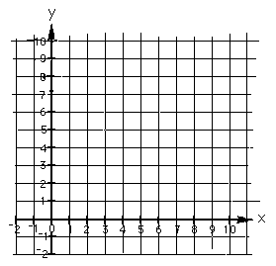
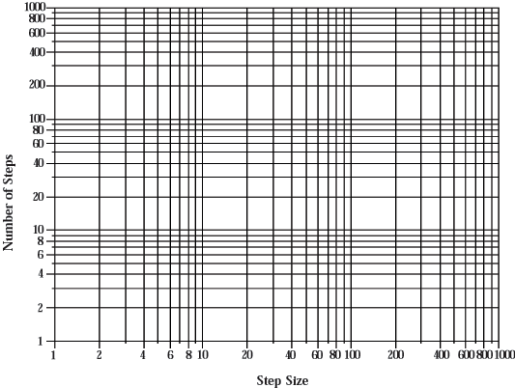
Linear vs Logarithmic Scales
Why use logarithmic scales?
Compress expansive data into a single plot
Generate linear trends for easier comparison
Linear Scale
Logarithmic Scale

Slide 19
Allometric Scaling Equations
Relate a physiological value of interest (y) and body mass by an allometric mass exponent (b)
Log-Transform
Y = a*mass^{b}
Log Y = Log a + b log mass
Figures from C. Farrell (2005)

Slide 22
Metabolic Rate & Body Size
y = a*mass^{b}
y = physiological variable of interest
a = intercept
b = mass exponent (power exponent)
Tells us something about the shape of the relationship (slope of line).
This is a power function (gives curved, not straight line)

Slide 24
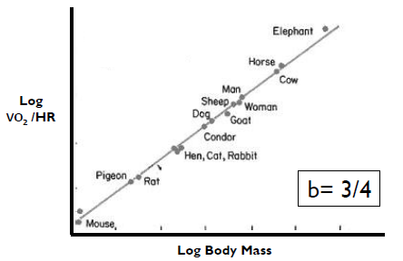
http://levenspiel.com/octave/OL_images/fig2.gif

Slide 25
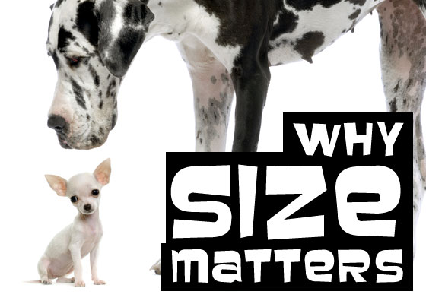
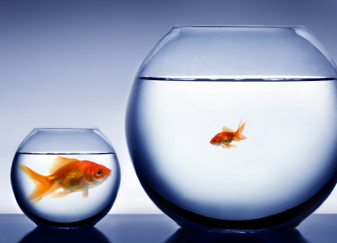
Summary: Why Size Matters
Allometry:
how traits and
processes scale with body size
Think of your OWN allometric relationship…
What things do you think are affected by body size?
http://smallbiztrends.com/wp-content/uploads/2010/02/iStock_000005086698XSmall.jpg
http://blog.tomorrow-people.com/Portals/103687/images/why-size-matters.jpg

Slide 26
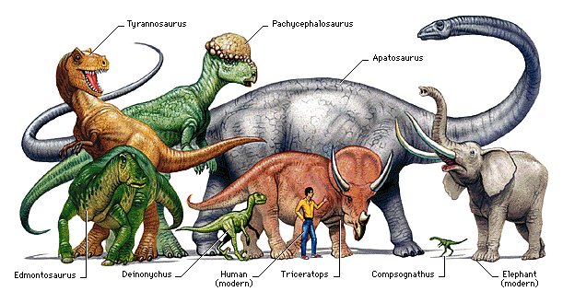
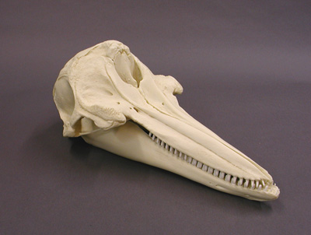
Today’s Lab
Objectives
Become familiar with allometric modeling and calculations in biology
Evaluate the effects of body size on brain size in mammals
Become familiar with using MS Excel to generate graphs and logarithms.
http://www.connecticutvalleybiological.com/images/sp3033.jpg, http://www.k12.hi.us/~kealaint/projects/Spring09Projects/period2/images/DinosaursRef.gif

