Slide 1
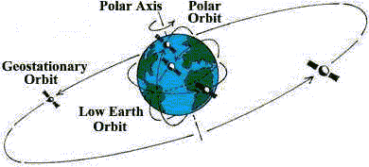
Satellites and Geosynchronous Orbit
Notes:
Source: paos.colorado.edu/~fasullo/1060/resources/satellites.html

Slide 2
Vocabulary
Orbit
Geosynchronous
Period
Centripetal Force
Satellite
Revolution
Rotation

Slide 3
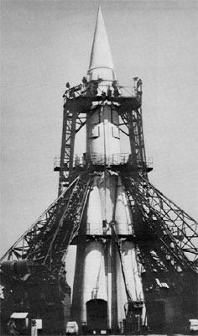
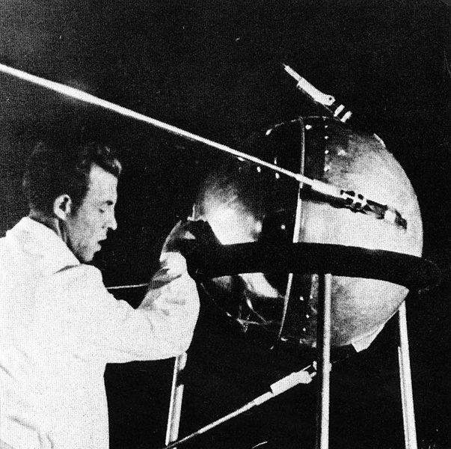
Satellite History
The first satellite was named “sputnik” and was launched by USSR in 1957.
Notes:
Launched in October, 1957
by the USSR
About the size of a beach ball
Payload (on board instruments)
minimized to launch sooner
than expected (it was a race)
Used a 2-stage R-7 rocket with kerosene propellant and liquid oxygen oxidizer (LOX)
Put Soviets ahead of U.S. and other countries during the “space race”
U.S, caught up about a year later, and then JFK in 1961 committed the U.S. to put a man on the moon and return him safely before the end of the decade.
Source: en.wikipedia.org/wiki/Sputnik_1
Source: www.russianspaceweb.com/r7.html

Slide 4
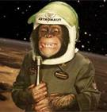
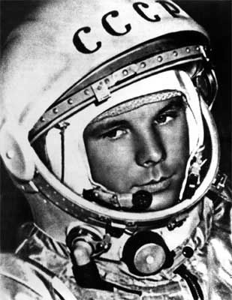
Organisms in Orbit: First Canis lupus familiaris (i.e. dog)
The first dog was Laika, the German Sheppard mutt was launched into orbit in Sputnik 2, in November 1957.
The U.S. sent the first Chimpanzee, named Ham into space in January 1961.
First human in orbit, At 27 years old, Russian cosmonaut, Yuri Gagarin became the first person to orbit in space on April 12, 1961.
Notes:
Source: http://www.findagrave.com/cgi-bin/fg.cgi?page=gr&GRid=11473411
Source: http://www.pinterest.com/marmalord/space-monkeys/
Source: www.english-online.at/.../yuri-gagarin-first-man-in-space.htm
Americans had been launching several monkeys, mice, and other animals into space for about a decade. Although the re-entry plans were successful, many problems/fatalities were encountered on impact in the ocean. As a result, press coverage was somewhat minimized.
After reaching orbit the nose cone was jettisoned successfully but the Blok A core did not separate as planned.^{[7]} This inhibited the operation of the thermal control system. Additionally some of the thermal insulation tore loose causing interior temperatures to reach 104 °F (40 °C). Laika survived for only a few hours instead of the planned ten days because of heat and stress.^{[8]} The orbit of Sputnik 2 decayed and it re-entered Earth's atmosphere on 14 April 1958 after 162 days in orbit.
Laika, the German Sheppard mutt was launched into orbit in Sputnik 2, in November 1957.
The Soviets did not design a re-entry plan. They just wanted to see if, perhaps, they could keep a person alive in space.
She died while in orbit, probably due to overheating, but no one really knows.
April 14, 1958 the capsule re-enters atmosphere and burns up on reentry.
The U.S. sent Ham into space in January 1961.
He was very well trained to handle controls in the capsule on his own.
His trip lasted for about 17 minutes and had several technical problems.
Rescued from his capsule in the Atlantic Ocean
later that day.
At 27 years old, Russian cosmonaut, Yuri Gagarin became the first person to orbit in space on April 12, 1961.
Unlike Laika, he returned safely.
Died in March 1968, in a MiG- 15 jet crash.

Slide 5
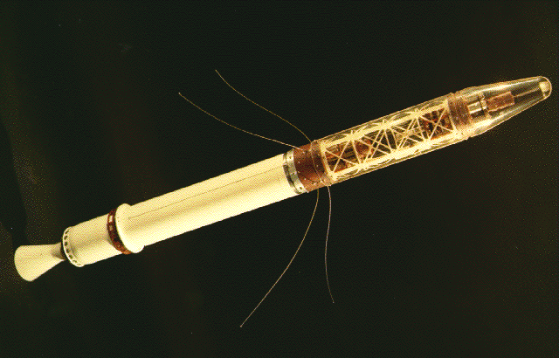
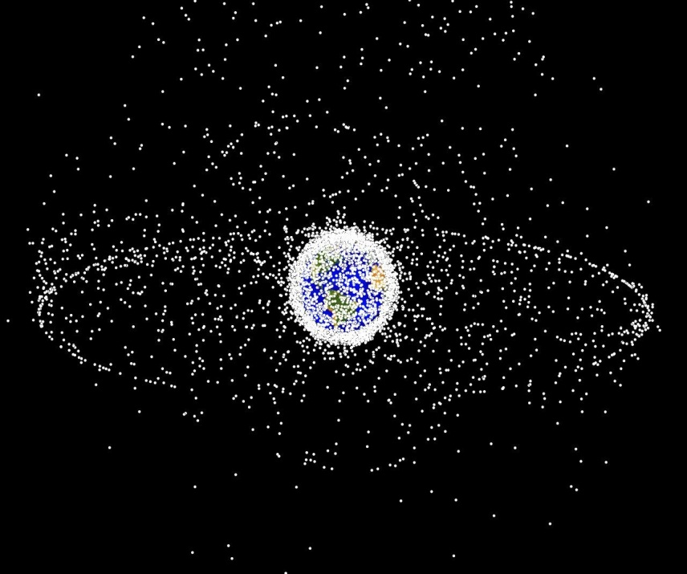
The first U.S. satellite was Explorer 1 in 1958 and we’ve been launching ever since.
There are currently over 1000 operational satellites in orbit around the Globe.
Types of satellites include those for communication, navigation, TV, radio, earth and space weather, environment, research, photography, spying, mapping, and more.
Notes:
First U.S. satellite is Explorer 1 in 1958
There were several mission failures, mostly due to rocket malfunctions.
The first communications satellite was the Telstar satellite launched by the U.S. in 1962.
This marked the beginning of an era.
There are currently over 1000 operational satellites in orbit around the Earth.
There are thousands more that are dead (they generally last between 5 – 20 years) still in orbit. That equates to lots of junk in orbit around our planet.
Many countries have satellites in orbit now, mostly for communication.
Other reasons to put up satellites (some may overlap in purpose) include: navigation, TV, radio, weather, environment, research, photography, spying, mapping, etc.
Source: http://en.wikipedia.org/wiki/Explorer_1
Source: http://en.wikipedia.org/wiki/Space_debris

Slide 6
Satellite Statistics
Notes:
Reference: "." . N.p., n.d. Web. 1 July 2014. <http://www.ucsusa.org/assets/images/nwgs/satellite-quick-facts.gif>.

Slide 7
Types of orbits…
Notes:
Remember that in a GEO orbit, we are only 1/10 of the way to the moon (this image is not to scale). This image also shows LaGrange points 1 and 2 (of 5) where we can orbit satellites utilizing the gravitational pull of the Earth as well as the moon. The Earth also shares 5 LaGrange points with the sun. Several of these areas can be utilized for satellites. Point 4 and 5 are ripe for populating with satellites as they provide for very usable and stable orbits.
Source: en.wikipedia.org/wiki/Orbital_spaceflight
Source: http://www.nasa.gov/pdf/756678main_20130619-NRC_Tech_Panel_Stich.pdf

Slide 8
Types of orbits for satellites
Orbit | Characteristic
Low earth orbit (LEO) | Up to 1240 miles
Medium earth orbit (MEO) | Between 1240 miles and just below 22,240 miles
Geosynchronous | At 22,240 miles
High earth orbit | > 22, 240 miles
Notes:
Source: http://www.nasa.gov/pdf/756678main_20130619-NRC_Tech_Panel_Stich.pdf

Slide 9
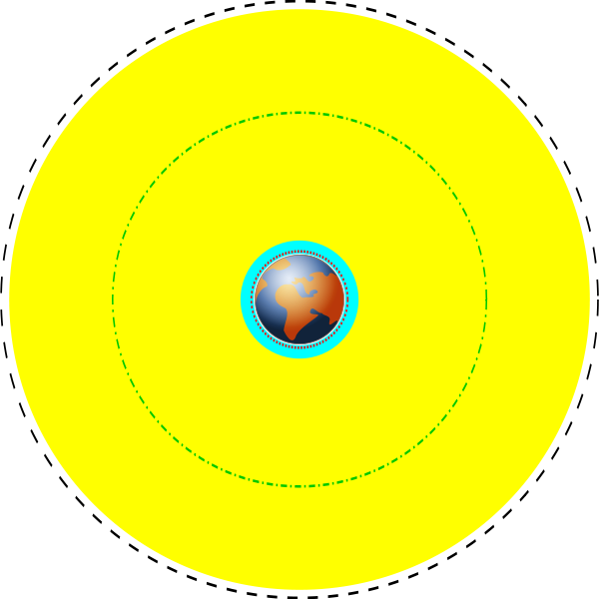
Orbital altitudes
“Various earth orbits to scale; cyan represents low earth orbit, yellow represents medium earth orbit, the black dashed line represents geosynchronous orbit, the green dash-dot line the orbit of Global Positioning System (GPS) satellites, and the red dotted line the orbit of the International Space Station (ISS).”
Source: http://en.wikipedia.org/wiki/Satellite
Notes:
Source: http://en.wikipedia.org/wiki/Satellite

Slide 10
Current Satellite Usage
Many weather and some communications satellites tend to have a high Earth orbit, farthest away from the surface.
Satellites that orbit in a medium (mid) Earth orbit include navigation and specialty satellites, designed to monitor a particular region.
Most scientific satellites, including NASA’s Earth Observing System fleet, have a low Earth orbit.

Slide 11
The GOES-R is a geostationary operational environmental satellite
Makes earth, space, and Solar environmental observations.
A product of Lockheed Martin Space Systems
Will increase public safety, protection of property, and economic health and prosperity.
Notes:
Source: http://www.goes-r.gov/

Slide 12
Satellites in geo stationary orbit
Notes:
Hurry! Space is limited.
Source: http://space.stackexchange.com/questions/2515/how-closely-spaced-are-satellites-at-geo
Look at where the open slots are.

Slide 13
What changes with the radius of the orbit?
The radius of the orbit, which is the distance between the satellite and Earth’s center, determines how quickly the satellite moves around the Earth. An Earth-orbiting satellite’s motion is mostly controlled by Earth’s gravity.

Slide 14
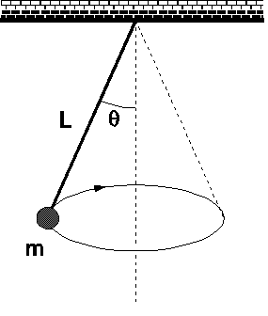
Geosynchronous Orbit Laboratory
In this laboratory, you will find the proportional relationship between velocity V and the Radius R of an object in circular motion under a constant centripetal force.
Notes:
Source: http://www.simplecapa.com/PDF/CAPA5_1110.pdf

Slide 15
Geosynchronous Orbit Laboratory
Next, you will compare the proportional relationship you found between V and R for a constant centripetal force to the proportional relationship between V and R for a constant period, such as satellites have.
Notes:
Source: http://www.grc.nasa.gov/WWW/k-12/rocket/TRCRocket/IMAGES/orbital.gif

Slide 16
How do you do this lab?
Group of four people
Divide your group so that each person has a job. Each group needs a
A) Spinner
B) Counter
C) Recorder
D) Timer
Materials
3 meters of string.
One 250 g mass.
One giant protractor.
Stop Watch.
Calculator.
A computer for writing up the Lab Report.

Slide 17
Prodedure
The spinner spins the mass around at a 45 degree angle for 10 revolutions at one radius.
Time and string length are recorded.
Increase the string length by 5 cm and repeat.
Remember to switch jobs if you get dizzy!
Notes:
Source: http://www.simplecapa.com/PDF/CAPA5_1110.pdf
Source: www.physics.uiowa.edu/~rmerlino/6Spring12/29006_L9.pdf
Source: http://1.bp.blogspot.com/_BKY7hFNdCjw/TU-VnCiSRAI/AAAAAAAAAHE/NAMcQ5EQ9-w/s1600/Dizzy+Girl.jpg

Slide 18
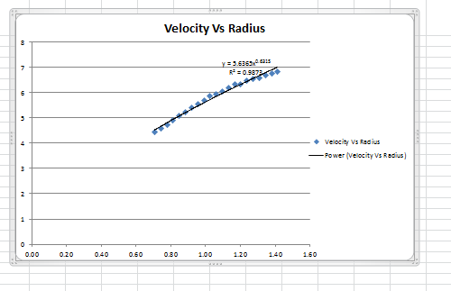
Record your data in the table
Graph your data and get a trend line
Notes:
Source: The Geosynchronous Orbit Laboratory

Slide 19
What is the relationship?
What does your graph look like? Does it go in a straight line? Is it increasing or decreasing? Does it curve up or down? Does it go through the origin? Does it have a y intercept? Does it have a x intercept? Is the slope positive or negative (everywhere?)? Is the graph smooth or are the points sporadic , erratic, and not seem to follow a rule?
If you had to guess, what type of function does your data look like? Does it look like any of these functions?
Notes:
Source: http://www.pinterest.com/swilson01/school-ideas/

Slide 20
Questions?

