Slide 1
Says Who?
How to read scientific literature

Slide 2
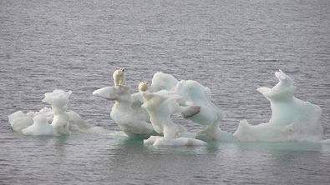
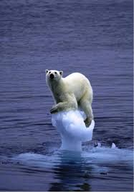
Global Warming & Animals
Notes:
Has anyone seen this picture before during conversation about climate change? Can you tell me what it’s all about?
Photo used to show how polar bears will be impacted by the loss of ice caps. Has caused a lot of controversy!

Slide 3
Inconvenient Truth Clip 1http://www.criticalcommons.org/Members/ccManager/clips/inconvenienttruthpolarbear.mov/view
Al Gore Versus the Polar Bears
http://youtu.be/X9sFgUwiKik
Notes:
Information about the polar bear photo controversy

Slide 4
So Who’s Correct?
When the media presents you with conflicting information….how can you tell what the impact of climate change really is for animals?
TURN TO SCIENCE!!
Notes:
Turn to science!! And that’s what we’re going to do today!

Slide 5
Reading Scientific Literature
Scientists publish their experiments and data in scientific articles
Scientific articles are go through a rigorous, peer-reviewed process before they are published
You can search for the publications in journals available through online databases at your library, and through Google Scholar
Notes:
Explain that google scholar won’t have all of the information, just the abstracts, or summaries

Slide 6
Why Read Scientific Articles?
What’s the purpose in reading scientific articles?
To answer a scientific question!
Check this out!
Notes:
The purpose is to answer a question. In this case, that question is how climate change impacts polar bears.

Slide 7
How is an article structured?
Notes:
Before we read a scientific article, we have to understand it’s structure.

Slide 8
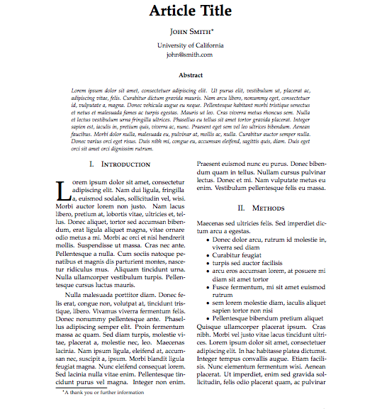

Slide 9
Article Title
Tells you….
Brief Summary
Authors
Institution
Contact Information

Slide 10
Abstract
A brief overview of the paper
Explains WHY the authors did the experiment, HOW they did it, and WHAT they found out
Helps you decide if you want to read the whole paper

Slide 11
Introduction
AKA “Review of Literature”
A detailed explanation of why the authors did the study
Explains all prior research and what we know so far about the topic

Slide 12
Methods
Explains how the experiment was set up
Should be very detailed, so that the reader can replicate the experiment
Often very difficult to understand, so don’t get discouraged!

Slide 13
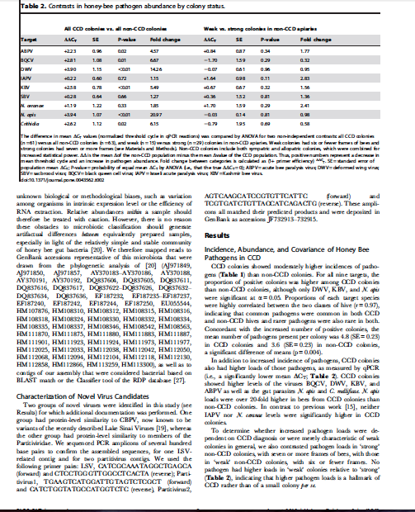
Results
Provides Data the authors use to reach their conclusion
Figures: a way to represent data visually
Tables: organize data for easier reading

Slide 14
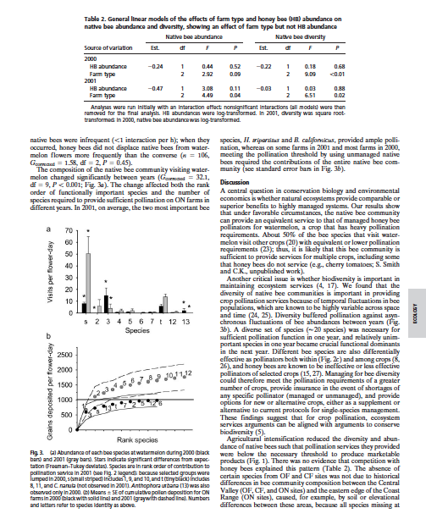
Discussion
AKA “Conclusion” or “Analysis”
Where the author connects the dots
Explains what the results mean, and why are they are important
Often includes suggestions for future research
Sometimes helpful to read this section first to determine if the paper is relevant to your question

Slide 15
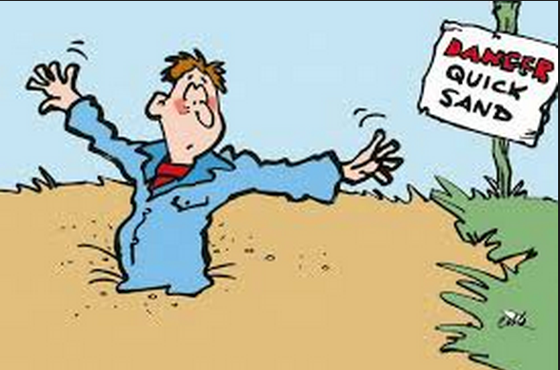
Tips for reading an article

Slide 16
Tips
Don’t read straight through!
Skim first, then work through individual sections, starting with the abstract. You may have to read the whole article multiple times.

Slide 17
Tips
Print out your paper, don’t just read it online!
Make sure to highlight important phrases
Circle words you don’t know!
  Return to them when you’re done reading
  Dictionary.com, accessscience.com

Slide 18
Understanding Methods
Draw a picture for the experiment(s) described --- make a diagram of the experiment, or draw a flow chart of experiment steps

Slide 19
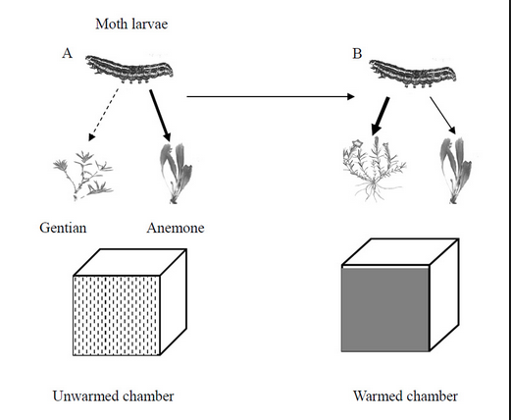
Understanding Methods
Draw a picture for the experiment(s) described --- make a diagram of the experiment, or draw a flow chart of experiment steps

Slide 20
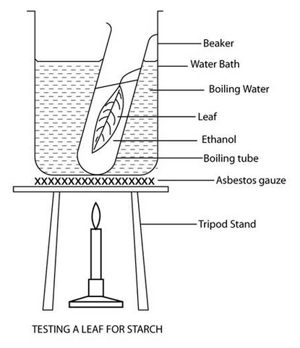
Understanding Methods
Draw a picture for the experiment(s) described --- make a diagram of the experiment, or draw a flow chart of experiment steps

Slide 21
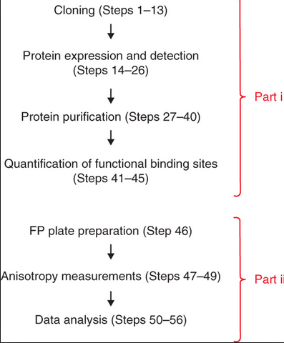
Understanding Methods
Draw a picture for the experiment(s) described --- make a diagram of the experiment, or draw a flow chart of experiment steps

Slide 22
Citing Articles:
In-Text Citations

Slide 23
Citing Articles:
References Cited

Slide 24
Why Cite an Article
Give credit where credit is due!

Slide 25
Why Cite an Article
Give credit where credit is due!
Help readers of your paper identify sources of information

Slide 26
Why Cite an Article
Give credit where credit is due!
Help readers of your paper identify sources of information
Helps you find information you used, later on

Slide 27
Why Cite an Article
Give credit where credit is due!
Help readers of your paper identify sources of information
Helps you find information you used, later on
Helps you avoid plagiarism

Slide 28
Why Cite an Article
Give credit where credit is due!
Help readers of your paper identify sources of information
Helps you find information you used, later on
Helps you avoid plagiarism
Is expected for college-level work

Slide 29
How to Cite a Scientific Article
1) In-text citations: (Author, Year)
2) There are different styles for reference citations, which are placed at the end of an essay or article
MLA, APA are two common styles
OWL Purdue: https://owl.english.purdue.edu/owl/resource/560/06/
Google Scholar citation button: http://scholar.google.com/
Notes:
Don’t focus on this right now.

Slide 30
Reading Scientific Literature
Now it’s your turn to investigate!!!

Slide 31
Reading Scientific Literature
Now it’s your turn to investigate!!!
How does climate change impact different species?
Notes:
Students get to pick 1 of three species with which to investigate the question. They work in groups of 2-3 and receive an article about the species they pick.

Slide 32
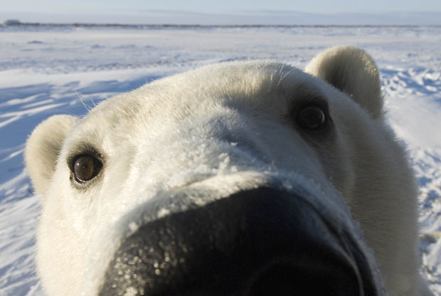
How does climate change impact
Polar Bears
Notes:
Bears living in the arctic circle?

Slide 33
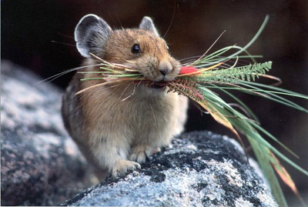
How does climate change impact
American Pika
Notes:
7-8 inches long, live in alpine terrain in rocky areas in california, oregon, colorado, and other states in the US

Slide 34
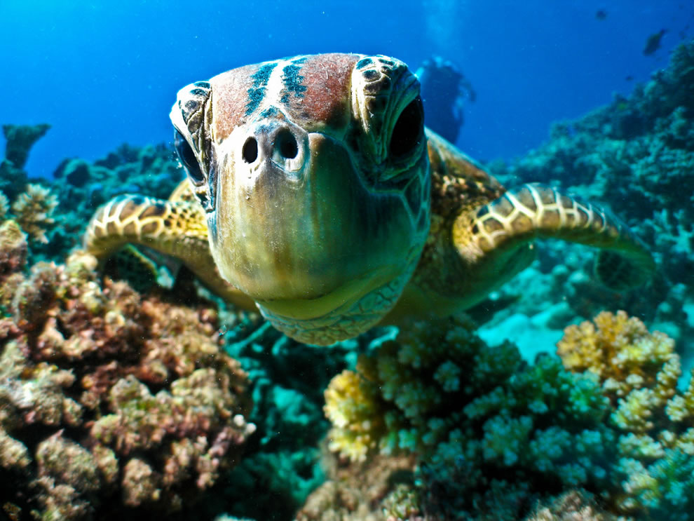
How does climate change impact
Great Barrier Reef Green Turtle
Notes:
Green turtles live in the great barrier reef, which is the world’s largest coral ecosystem, off of Austria

Slide 35
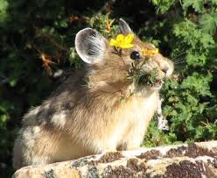
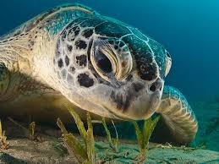
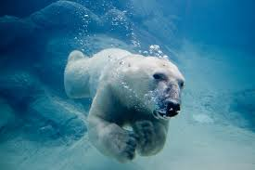
Investigation
Does climate change impact....Polar Bears, American Pikas, & Green Turtles? How?
Form a group of 2-3 students and pick one animal!
Fill out handout, make poster presentation

Slide 36
Poster Prompt
Work with your group, every single student must help present the poster
You will have 4 minutes to present your poster
Answer the investigation question: Does climate change impact species _____? How?
Your poster should include a title, names of the group members, an answer to the investigation question, a diagram/schematic of the methods that the scientists used in their experiment, and 1 APA style citation for your research

