Slide 1
Colors in Chemistry
Learning Polarity with Paper Chromatography
This is a product of the University of California Santa Cruz SCWIBLES Program; NSF GK-12 DGE-0947923
Notes:
Today you guys are going to do a CLASSIC chemistry lab. But, before we start learning about “chromatography” and “polarity” – let’s start with something more familiar.

Slide 2
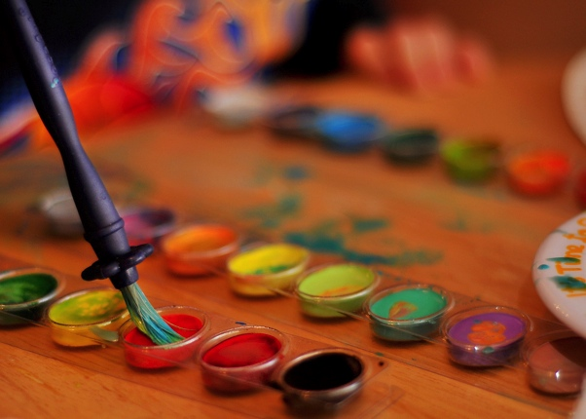
Introduction
How many people have mixed paints?
How many have “unmixed” paints? How do we do that?

Slide 3
Introduction
MIXTURE
VOCABULARY
A compound made up of two or more different substances that are not combined chemically
Notes:
To think about unmixing things, we need to know what a mixture actually is. Talk with a person next to you about the definition of “mixture”.
Paints are mixtures, but so are many other things! In the lab today, we’ll be thinking about marker ink.

Slide 4
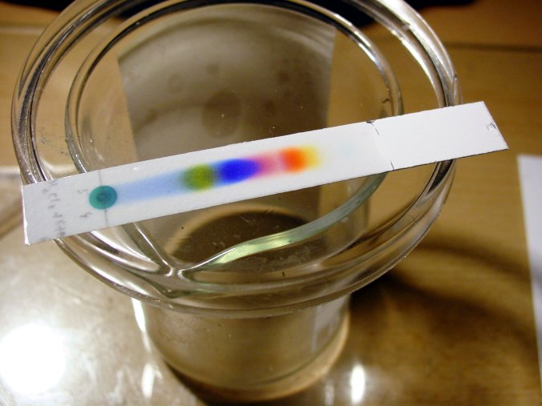
Paper Chromatography
Method for separating mixtures into their components
Uses ink on paper and a solvent to carry the ink up the paper
Notes:
OK, you guys know what paper and ink are. But what is a solvent?

Slide 5
Paper Chromatography
Method for separating mixtures into their components
Uses paper with ink and a solvent to carry the ink up the paper
SOLVENT
VOCABULARY
A substance (usually a liquid) that dissolves something else.
Notes:
Talk with a person next to you about the meaning of the word “solvent”. Report out.

Slide 6
Paper Chromatography
Method for separating mixtures into their components
Uses paper with ink and a solvent to carry the ink up the paper
SOLUTE
VOCABULARY
A substance that dissolves
in a solvent.
Notes:
Talk with a person next to you about the meaning of the word “solvent”. Report out.

Slide 7
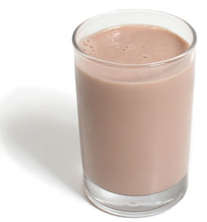
Examples
Chocolate Milk
What is the solvent here?
What is the solute?
Coffee and sugar
What is the solvent here?
What is the solute?
Notes:
OK, you guys know what paper and ink are. But what is a solvent?

Slide 8
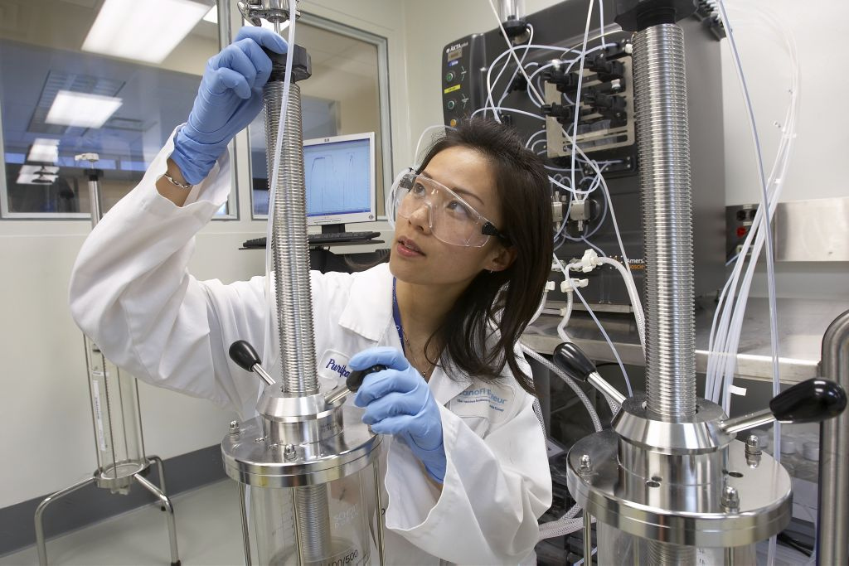
Professional Paper Chromatography
Separating mixtures is VERY useful in the real world!
Environmental labs use it to separate
and measure toxic substances in
the soil, water and air.
Crime labs use it to identify drugs
and analyze evidence.
Notes:
-Professionals use advanced forms of paper chromatography all the time! Environmental managers test samples of water, soil or air and separate out substances that are toxic to humans.
-Crime labs can use advanced chromatography to analyze drugs, paint chips from crime scenes, bodily fluids, and other evidence.
-Let’s talk a little more about what chromatography is…and why it works.

Slide 9
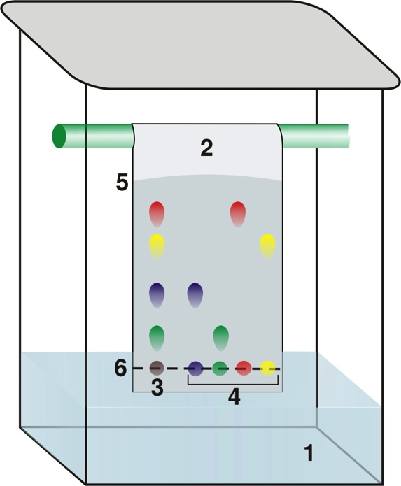
How Does Paper Chromatography Work?
Chromatograph paper
COMPONENTS of the MIXTURE
(pigments)
MIXTURE (ink)
SOLVENT
Notes:
Explain each of the phases and you click through the slide. Be sure to explain that each ink has several “components” or pigments (more on that later).
Talk about what happens to the water? What happens to the ink?

Slide 10
Electronegativity
ELECTRONEGATIVITY
VOCABULARY
The amount of pull that one atom exerts on the electrons that it is sharing with other atoms.
Notes:
The first thing we need to know about to understand why chromatography works to separate mixtures is “electronegativity”. Fortunately, you guys have already learned this! Talk with your partner to remember what electronegativity means.

Slide 11
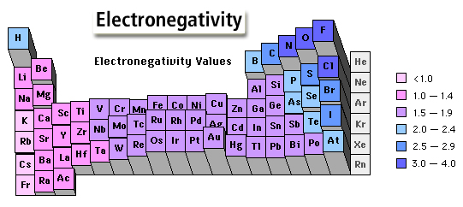
Periodic Trend of Electronegativity
Notes:
So, if you remember your periodic trends, elecronegativity of atoms increases from left to right and bottom to top, with Fluorine being the most electronegative.

Slide 12
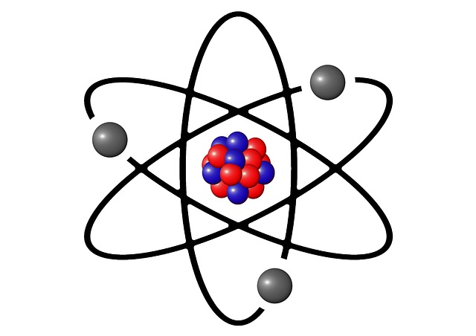
Electronegativity
What happens to the charge of the molecule when one atom is exerting more pull on electrons than another atom?
Notes:
Get a few answers from students, then move on to the next slide to see.

Slide 13
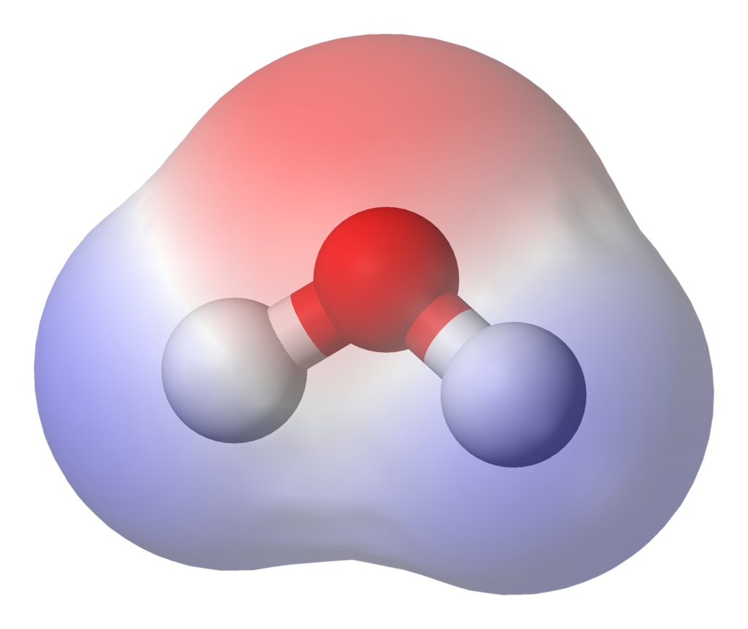
Polarity
δ-
- charge
O atom
DIPOLE
H atom
H atom
+ charge
+ charge
δ+
WATER (H₂O) MOLECULE
Notes:
Here’s your normal water molecule. H – 2 – O. As you can see here, the H and the O’s exert different pulls on the electron and the water molecule gets a positvely charged side and a negatively charged side.
And we have a word for this.

Slide 14
Polarity
POLARITY
VOCABULARY
Separation of electric charge (positive and negative) in a molecule. This leads to a dipole.

Slide 15
Polar or nonpolar?
+ charge
POLAR MOLECULE
VOCABULARY
- charge
A molecule with a permanent separation of charges.
POLAR

Slide 16
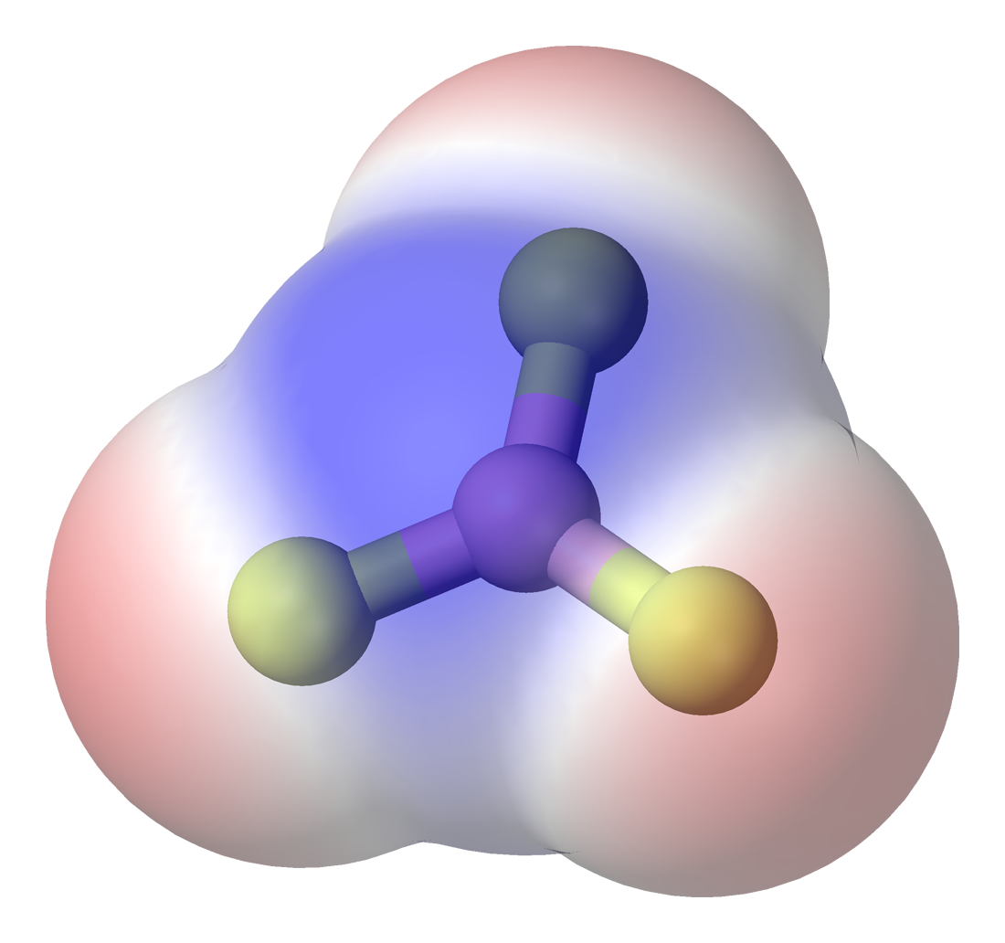
Polar or Nonpolar?
- charge
NON-POLAR MOLECULE
VOCABULARY
+ charge
- charge
A molecule with NO uneven separation of charges.
- charge
NONPOLAR

Slide 17
Polarity
But, what does this mean for chromatography?
Notes:
Before we can answer this question, we need to learn one more vocabulary word.

Slide 18
Solubility
Chocolate Milk
SOLUBILITY
VOCABULARY
How difficult or easy it is to dissolve a substance in a solvent.
Notes:
What about something makes it able to be dissolved? Why do watercolor paints dissolve in water, but oil does not?

Slide 19
Solubility
It’s all about polarity!
LIKE DISSOLVES LIKE
This means that a polar solvent (water) will more readily dissolve polar substances.
What about nonpolar substances?

Slide 20
Paper Chromatography
OK, so….
Polar solutes dissolve in Polar solvents
Nonpolar solutes dissolve in Nonpolar solvents
Notes:
We’ll use this knowledge to do several paper chromatography experiments. But first, a picture example.

Slide 21
Experiment
PIGMENTS of the MIXTURE
Different pigments in the ink have DIFFERENT polarities!!!
As the solvent moves up the paper it separates the ink based on POLARITY!
Notes:
What would the pigments be if the solvent is nonpolar?

Slide 22
Experiment
Solvents
Acetone
More Non-polar
Water
More Polar
Notes:
Explain that the mixture of ink has several pigments – some are more polar, some are less polar. That means some dissolve more readily, some don’t. This is going to allow our pigments to separate. Explain each of the phases and you click through the slide.

Slide 23
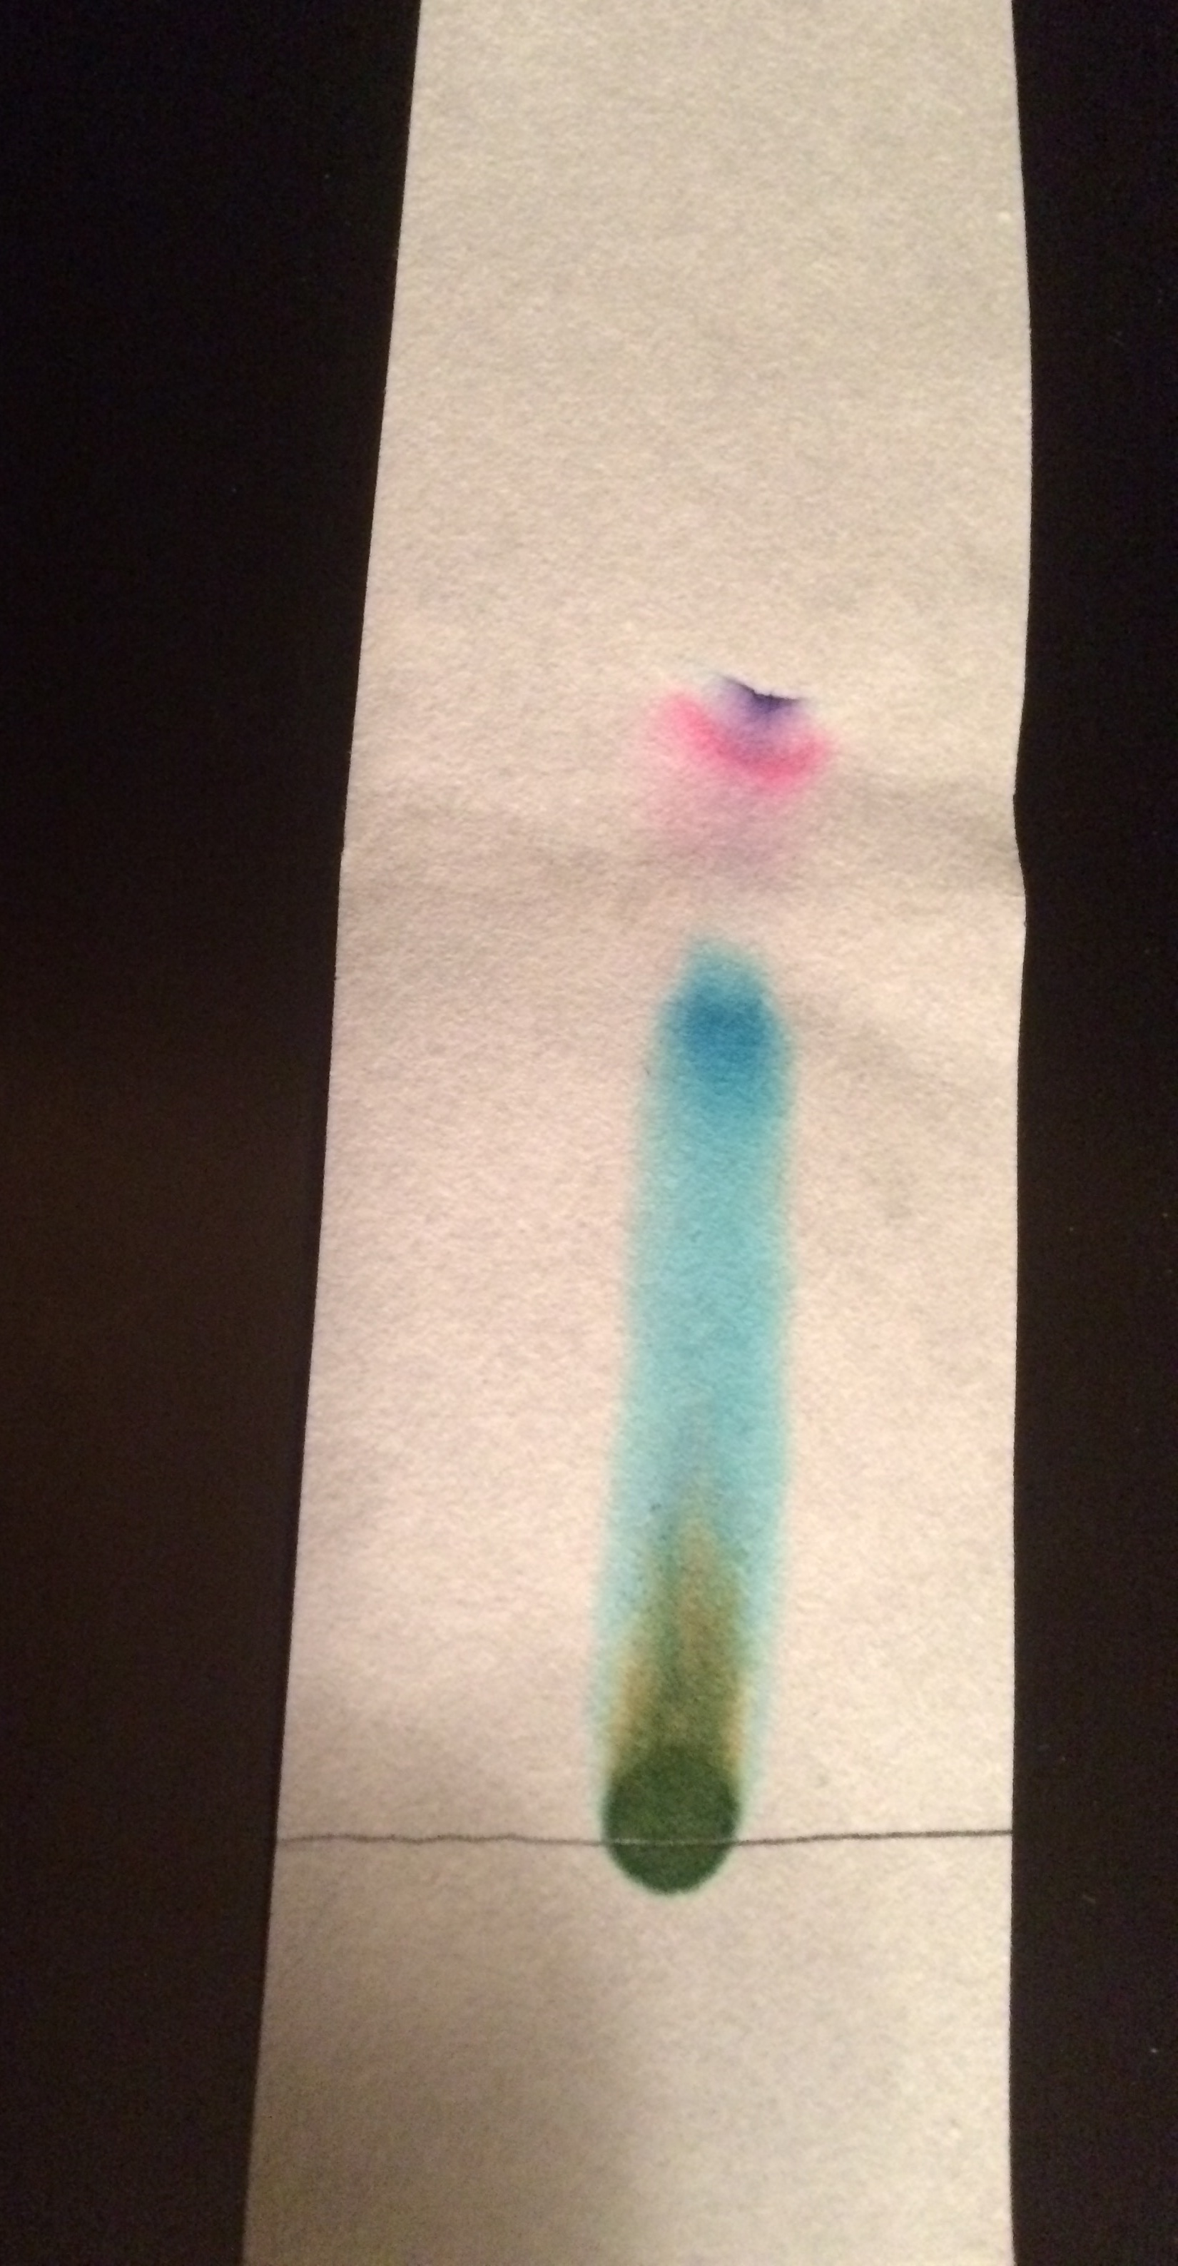
Food Dye and Acetone
Non-polar
Polar

Slide 24
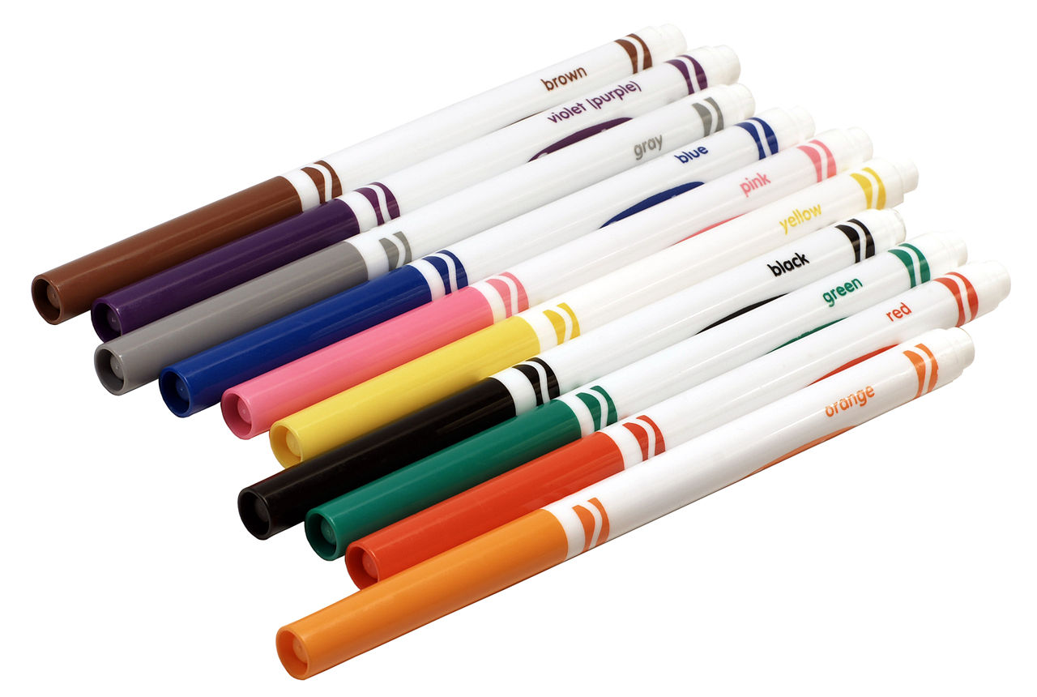
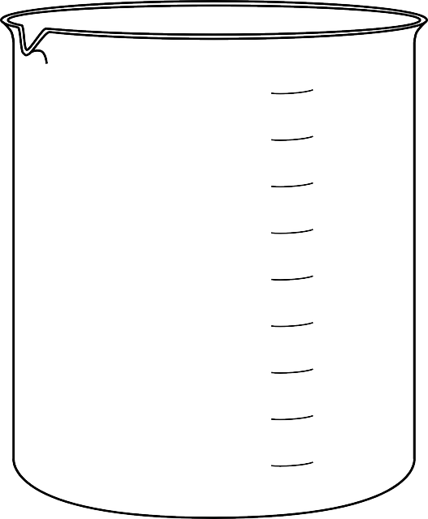
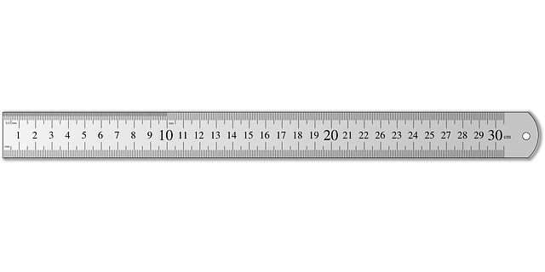
Materials List
2 400 ml beakers
3 strips of chromatography paper
Tap water
Food dye
Toothpick
Popsicle stick
Water-soluble markers (black, assorted colors)
Pencil and colored pencils
Metric ruler
Colors in Chemistry worksheet
Notes:
Here’s the materials that you will need. Let’s go! Let’s watch one test experiment together – VIDEO.

Slide 25
Unknown Substances
A
B
C
D

