Slide 1
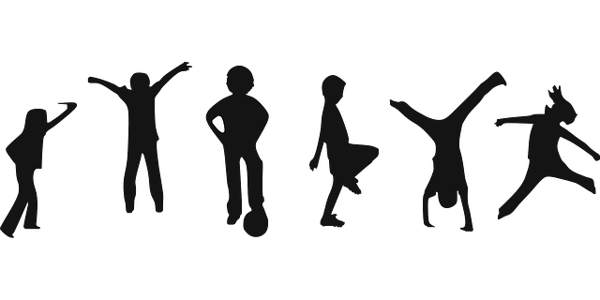
Break a Sweat!
Vital Signs
&
The Importance of Routine Physical Activity
Notes:
This Powerpoint briefly (~20min) introduces the importance of routine physical activity, vital signs
Briefly covers current statistics on inactivity in youth, and the associated health dangers (e.g., obesity, type II diabetes, depression)
Highlights the importance of regular physical activity (60+minutes/day) to maintaining physical and mental health (in this age demographic in particular)…e.g, Strong et al. 2005, Janssen and Leblanc 2010
Introduces vital signs (e.g., respiratory rate, heart rate, body temperature) and their importance for developing individualized physical training programs
Provides description of in-class or at-home activity and report
Graphic: https://pixabay.com/static/uploads/photo/2014/04/03/10/22/children-310223_640.png

Slide 2
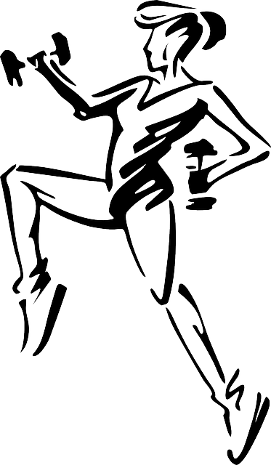
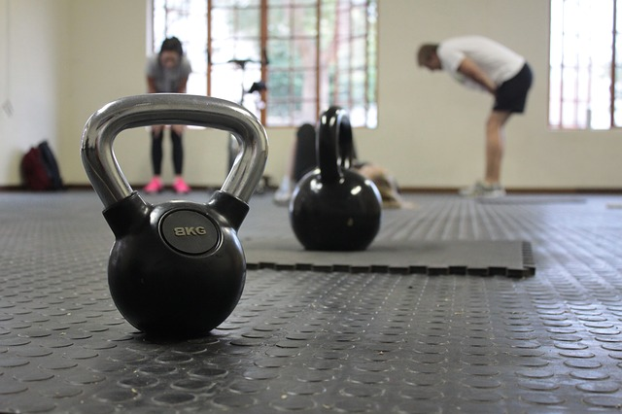
What is exercise?
Any activity requiring physical effort, especially to sustain or improve health and fitness
Notes:
https://pixabay.com/static/uploads/photo/2014/03/25/16/33/jogging-297354_640.png

Slide 3
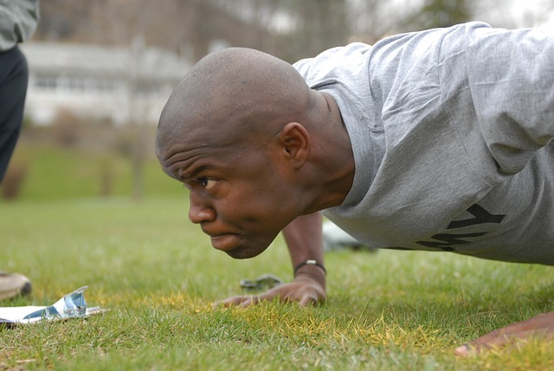
Why is exercise important?
Physical activity can:
improve your health
reduce your risk of getting several diseases; like Type II diabetes, cancer and cardiovascular disease
Health benefits of exercise can be:
Immediate
Long-term
Regular physical activity can
improve your quality of life
Notes:
http://www.betterhealth.vic.gov.au/bhcv2/bhcarticles.nsf/pages/physical_activity_its_important?open
https://pixabay.com/en/black-shape-transport-bicycle-bike-163595/
https://pixabay.com/en/man-exercise-pushups-military-80086/

Slide 4
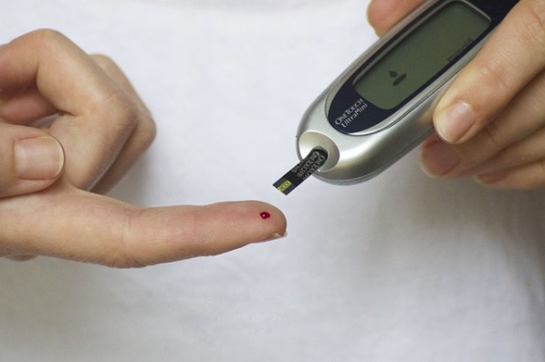
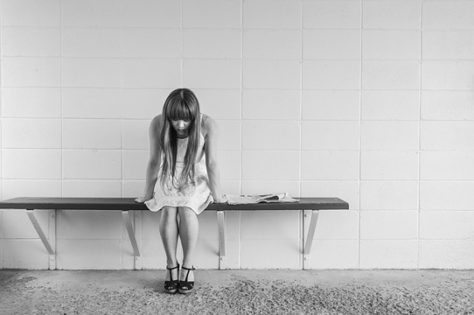
Dangers of inactivity
Failure to exercise can lead to serious health concerns…especially in youth
What are some concerns?
(HINT: we just talked about a few)
Heart Disease
Type II Diabetes
Obesity
Depression
Notes:
https://upload.wikimedia.org/wikipedia/commons/2/27/Computadoras_y_Obesidad.jpg
https://pixabay.com/en/diabetes-blood-finger-glucose-777002/
https://pixabay.com/en/worried-girl-woman-waiting-sitting-413690/

Slide 5
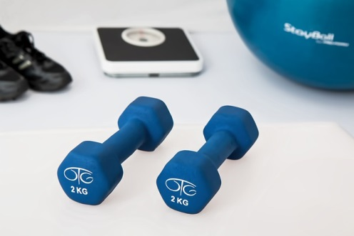
BUT…
Even moderate amounts of exercise can have measurable benefits for high-risk (i.e. obese) youth
Scientific recommendations:
60+ min. of daily moderate physical activity
Aerobic (e.g., running, cycling) activities should
make up the majority of your exercise
Anaerobic activities (e.g., bone & muscle strengthening such as weight lifting) should be incorporated at least 3x per week
Sources:
Janssen & Leblanc 2010
Strong et al. 2005
Notes:
Janssen, I., and A. G. Leblanc. 2010. Systematic review of the health benefits of physical activity and fitness in school-aged children and youth. The International Journal of Behavioral Nutrition and Physical Activity 7:40.
Strong, W. B., R. M. Malina, C. J. R. Blimkie, S. R. Daniels, R. K. Dishman, B. Gutin, A. C. Hergenroeder, A. Must, P. a Nixon, J. M. Pivarnik, T. Rowland, S. Trost, and F. Trudeau. 2005. Evidence based physical activity for school-age youth. The Journal of Pediatrics 146:732–737.
https://pixabay.com/en/clock-kuechenuhr-time-time-of-499042/
https://pixabay.com/en/physiotherapy-weight-training-595529/

Slide 6
how can we measure fitness?
The body gives us feedback…it responds to exercise in a characteristic, measurable way!
We can use our own body’s data to help us develop individualized training programs!
We call the body’s basic, measurable functions…
VITAL SIGNS!
What are 4 routinely monitored vital signs?
Pulse Rate
Respiration Rate
Body Temperature
*Blood pressure
*Blood pressure is not considered a vital sign, but is often measured along with the vital signs
Notes:
http://www.hopkinsmedicine.org/healthlibrary/conditions/cardiovascular_diseases/vital_signs_body_temperature_pulse_rate_respiration_rate_blood_pressure_85,P00866/

Slide 7
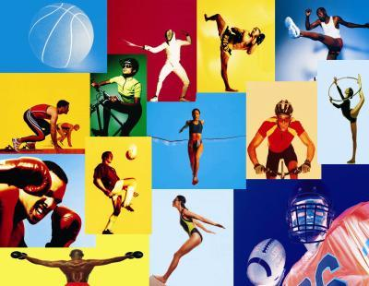
Today’s Activity: Break a sweat!
We’ll focus on 2 of these vital signs …
You’ll learn to measure your own and a partner’s
…and see how these vital
signs respond to different
durations and intensities of
whatever exercise you’d
like to test!
Pulse Rate
Respiration Rate
Get Creative!
Notes:
http://photos2.demandstudios.com/DM-Resize/photos.demandstudios.com/getty/article/190/126/dv0301725_XS.jpg?h=10000&w=400&keep_ratio=1

Slide 8
MATERIALS FOR THIS ACTIVITY
…ARE AVAILABLE AT:
http://scwibles.ucsc.edu/Products/HigginsBryce_Sweat.html
Module Authors:
Caleb M. Bryce, UC Santa Cruz
Ben Higgins, UC Santa Cruz
Sarah Baumgart, Watsonville High School

