Slide 1
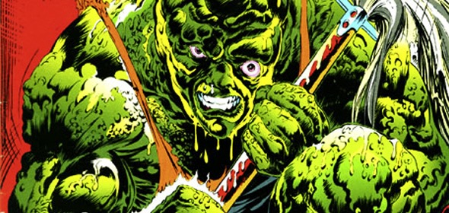
Toxic Avengers:
The human geography of pollution

Slide 2
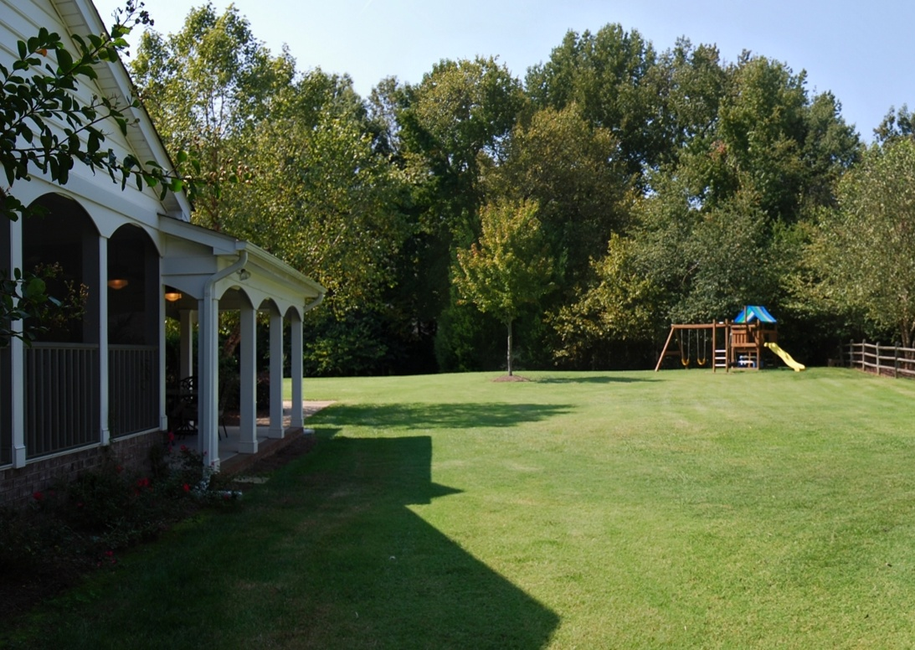
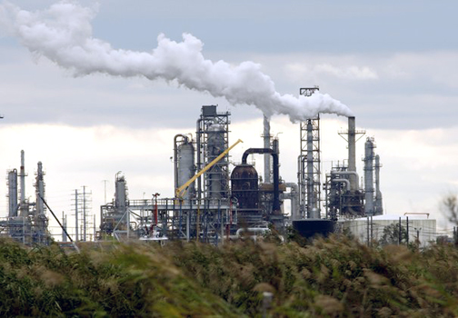
Day #1: Toxic Avengers
Do Now: How would your health be different if the view from your backyard was like the picture on the right instead of the picture on the left? Why?

Slide 3
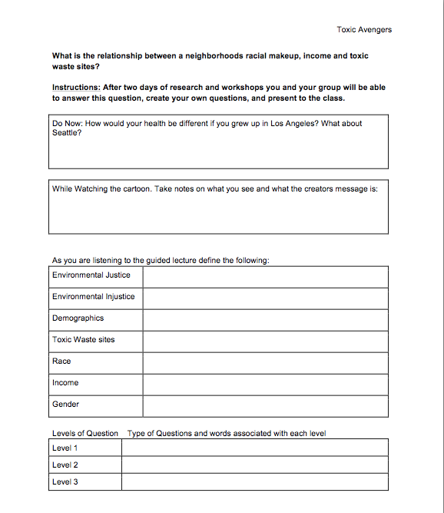
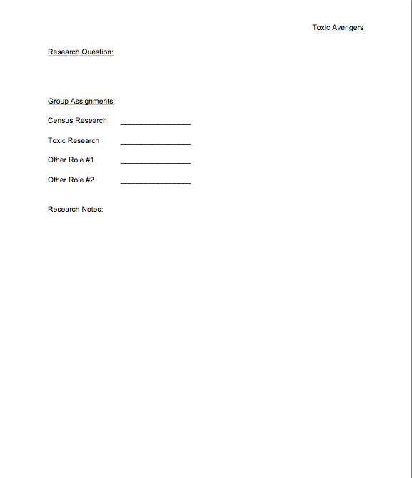
Worksheet

Slide 4
Introduction
While you watch a video about environmental justice and community action, take notes on your activity worksheet.

Slide 5
Vocabulary
Census: information about the people of the US collected every 10 years by the government

Slide 6
Vocabulary
Gender: sex (male or female)

Slide 7
Vocabulary
Race: ethnicity or nationality (caucasian, african american, etc.)

Slide 8
Vocabulary
Education: how far in school a person went (Education < 12G is less than 12th grade)

Slide 9
Vocabulary
Per Capita Income: amount of money earned each person earns

Slide 10
Vocabulary
Demographics: information about populations (per capita income, education, etc.)

Slide 11
Vocabulary
Toxic Waste: solid, liquid, or vapor that can cause harm to living creatures

Slide 12
Vocabulary
EPA: Environmental Protection Agency

Slide 13
Vocabulary
Environmental Injustice: occurs when local governments or companies build environmentally detrimental infrastructure in minority communities

Slide 14
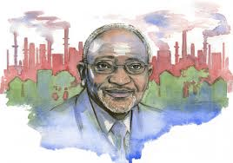
Discovering Injustice
Robert Bullard, nicknamed the “Father of Environmental Justice,” investigated the geographic patterns of pollution
The Environmental Justice Movement used the same tactics as the Civil Rights Movement
Non-violent protest
Civil law suits

Slide 15
Discovering Injustice
Patterns of settlement in US cities resulted in people of color ending up near toxic waste facilities or near locations with high pollution rates (ex. Highways)
Health impacts disproportionately impacted low-income and minority groups
How do you show environmental injustice?

Slide 16
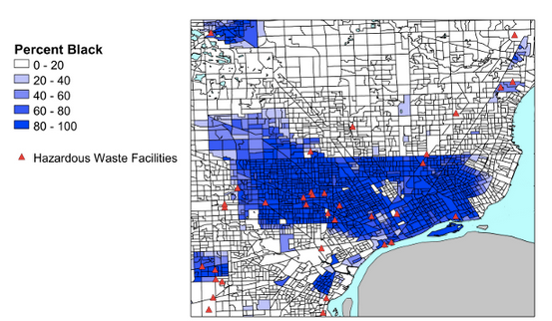
Showing Injustice
How do you show environmental injustice? By mapping it!

Slide 17
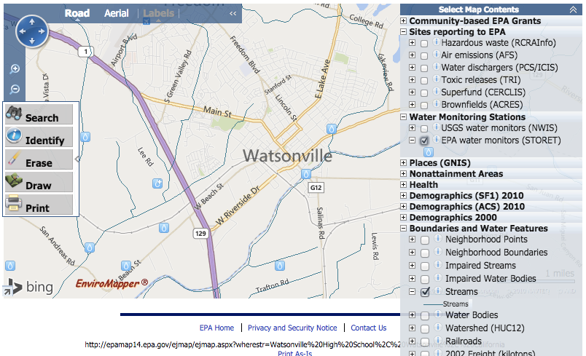
Data Source

Slide 18
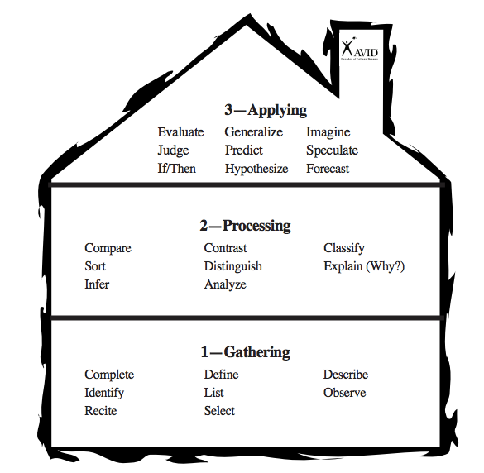
Testable Questions
Example Questions
Level 1: How many toxic waste sites are in Watsonville? (list/id)
Level 2: Are the toxic waste sites within 1000 feet of houses? (analyze)
Level 3: If a toxic waste site is within 1000 feet of a poor or minority neighborhood, what kind of impacts do the people living there face? (If/Then)

Slide 19
Day #2: Toxic Avengers
Do Now:
What is a toxic site? What are demographics?

Slide 20
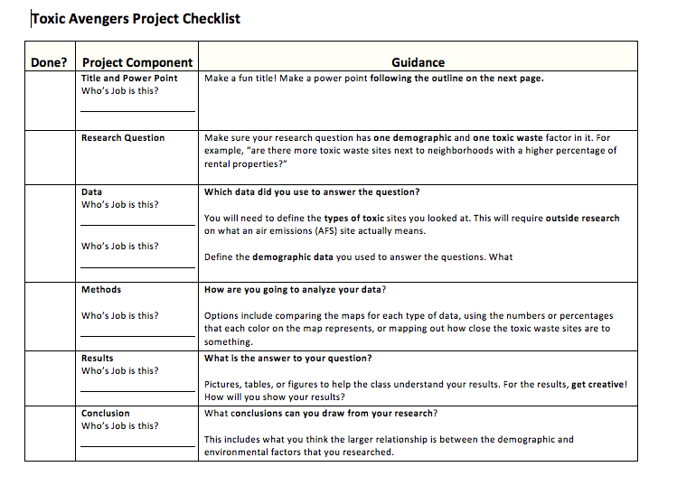
Checklist

Slide 21
What you can DO
While you watch a video about environmental justice and community action, think about how your life would be different if you lived in a different place.

Slide 22
What you can DO
“People who fight… People who do not let the garbage trucks and the landfills and the petrochemical plants roll over them. That has kept me in this movement for the last 25 years. And in the last 10 years, we’ve been winning: lawsuits are being won, reparations are being paid, apologies are being made. These companies have been put on notice that they can’t do this anymore, anywhere.”
- Robert Bullard

