Slide 1
E-literacy
Your guide to evaluating internet websites
Elissa Olimpi, PhD. Candidate, Environmental Studies, UC Santa Cruz
Chrissy MacLean, High school teacher, Watsonville High School
Notes:
iStockphoto

Slide 2
Think-pair-share
What kinds of sources should you use when completing an assignment?
Notes:
15 min
Discuss ideas with partner, share out to class.
Make list on whiteboard of different types of sources.
Highlight that the type of sources you should use depends on the task.
Guide discussion on which types of sources would be useful for different tasks, focusing on source types that would be useful for your subject.

Slide 3
Source evaluation
What is critical about each of these sources if you are going to use them to support a claim or provide information about a topic?
Notes:
Review the list of sources and discuss the question, again making a list on the whiteboard. Students may provide some basic answers, and then after they are given more information, we will return to this question.
To transition to real world examples, ask students what could happen when someone trusts a source without evaluating it.

Slide 4
Marijuana Overdoses Kill 37 in Colorado On First Day of Legalization
Colorado is reconsidering its decision to legalize recreational pot following the deaths of dozens due to marijuana overdoses. According to a report in the Rocky Mountain News, 37 people were killed across the state on Jan. 1, the first day the drug became legal for all adults to purchase. Several more are clinging onto life in local emergency rooms and are not expected to survive.
"It's complete chaos here," says Dr. Jack Shepard, chief of surgery at St. Luke's Medical Center in Denver. "I've put five college students in body bags since breakfast and more are arriving every minute. "We are seeing cardiac arrests, hypospadias, acquired trimethylaminuria and multiple organ failures. By next week the death toll could go as high as 200, maybe 300. Someone needs to step in and stop this madness. My god, why did we legalize marijuana? What were we thinking?”
Colorado and Washington state approved the sale of marijuana for recreational use in November though statewide ballot measures. Under the new policies pot is legal for adult use, regulated like alcohol and heavily taxed.
Notes:
Focus on context, tone, source credibility. Ignore authority for now.
Guiding questions to ask students
Does the information presented in this article support or conflict with what you already know about this issue?
Are the quotes grounded in facts?
How would you describe the style of the writing? Does it sound factual or dramatic?
Embedded clues that the article is satirical:
Names are borrowed from popular TV series (Jack Shepard, Lost; Jesse Pinkman, Breaking Bad)
Medical conditions: hypospadias is a physical birth defect, trimethylaminuria is a metabolic condition
Hyperbolic quotes

Slide 5
Marijuana Overdoses Kill 37 in Colorado On First Day of Legalization
One of the principal arguments of legalization advocates was that cannabis has long been considered safer than alcohol and tobacco and was not thought not to cause overdose. But a brave minority tried to warn Coloradans of the drug's dangers. "We told everyone this would happen," says Peter Swindon, president and CEO of local brewer MolsonCoors. "Marijuana is a deadly hardcore drug that causes addiction and destroys lives. "When was the last time you heard of someone overdosing on beer? All these pro-marijuana groups should be ashamed of themselves. The victims' blood is on their hands."
One of the those victims was 29-year-old Jesse Bruce Pinkman, a former methamphetamine dealer from Albuquerque who had recently moved to Boulder to establish a legal marijuana dispensary. Pinkman was partying with friends when he suffered several seizures and a massive heart attack which ultimately proved to be fatal. Toxicology reports revealed that marijuana was the only drug present in his system. "This is just a terrible tragedy," says his friend Peter. "Jesse was trying to go legit and now this happens? I guess drugs really are as dangerous as they say.”… - The Daily Currant
Notes:
To transition to other real-life examples, reveal that this spoof story was believed by a Maryland police chief and used evidence from the article in his testimony before a state Senate committee considering bills to legalize and decriminalize marijuana.

Slide 6

Hoaxes on social media
http://www.independent.co.uk/life-style/gadgets-and-tech/news/fake-waterproof-iphone-ad-tricks-users-into-destroying-their-smartphones-8835952.html
Notes:
Users who believed the advertisement upgraded their iphones and dunked them in water to test the new feature, which broke their phones.
Spoof advertisement may have originated on 4chan, a forum that promotes uses campaigns on social media to trick the public.

Slide 7
Staged protest in the news
http://www.sfbg.com/googleshoutdown
Notes:
Google employees can take free Google buses to commute to work, making it easier for them to commute and contributing to higher housing prices in the San Francisco Bay Area. Google buses use public bus stops, but don’t pay fees or otherwise invest in local communities. Here, a union representative pretended to be an angry Google employee shouting at protesters. The story was originally covered by the San Francisco Bay Guardian, and the newspaper thought it was real.

Slide 8
Racist & insensitive joke on the news
http://www.sfgate.com/bayarea/matier-ross/article/KTVU-producers-fired-over-Asiana-pilots-fake-4685627.php
Notes:
KTVU News, San Francisco’s Fox affiliate, announced the names of fake pilots aboard Asiana flight 214 when it crashed at San Francisco International Airport in July 2013. The broadcaster confirmed the pilots’ names with an intern at the National Transportation Safety Board. KTVU did not ask their source at NTSB to confirm their position, and NTSB does not release the names of people involved in accidents to the media.

Slide 9
Authority
What questions would you want to know about the author of a source?
Notes:
Explain that identifying the author can help determine source credibility. Ask students what questions they would want to know about an author.
Write student responses on the board., possible grouping into a tree diagram by CRAP categories.

Slide 10
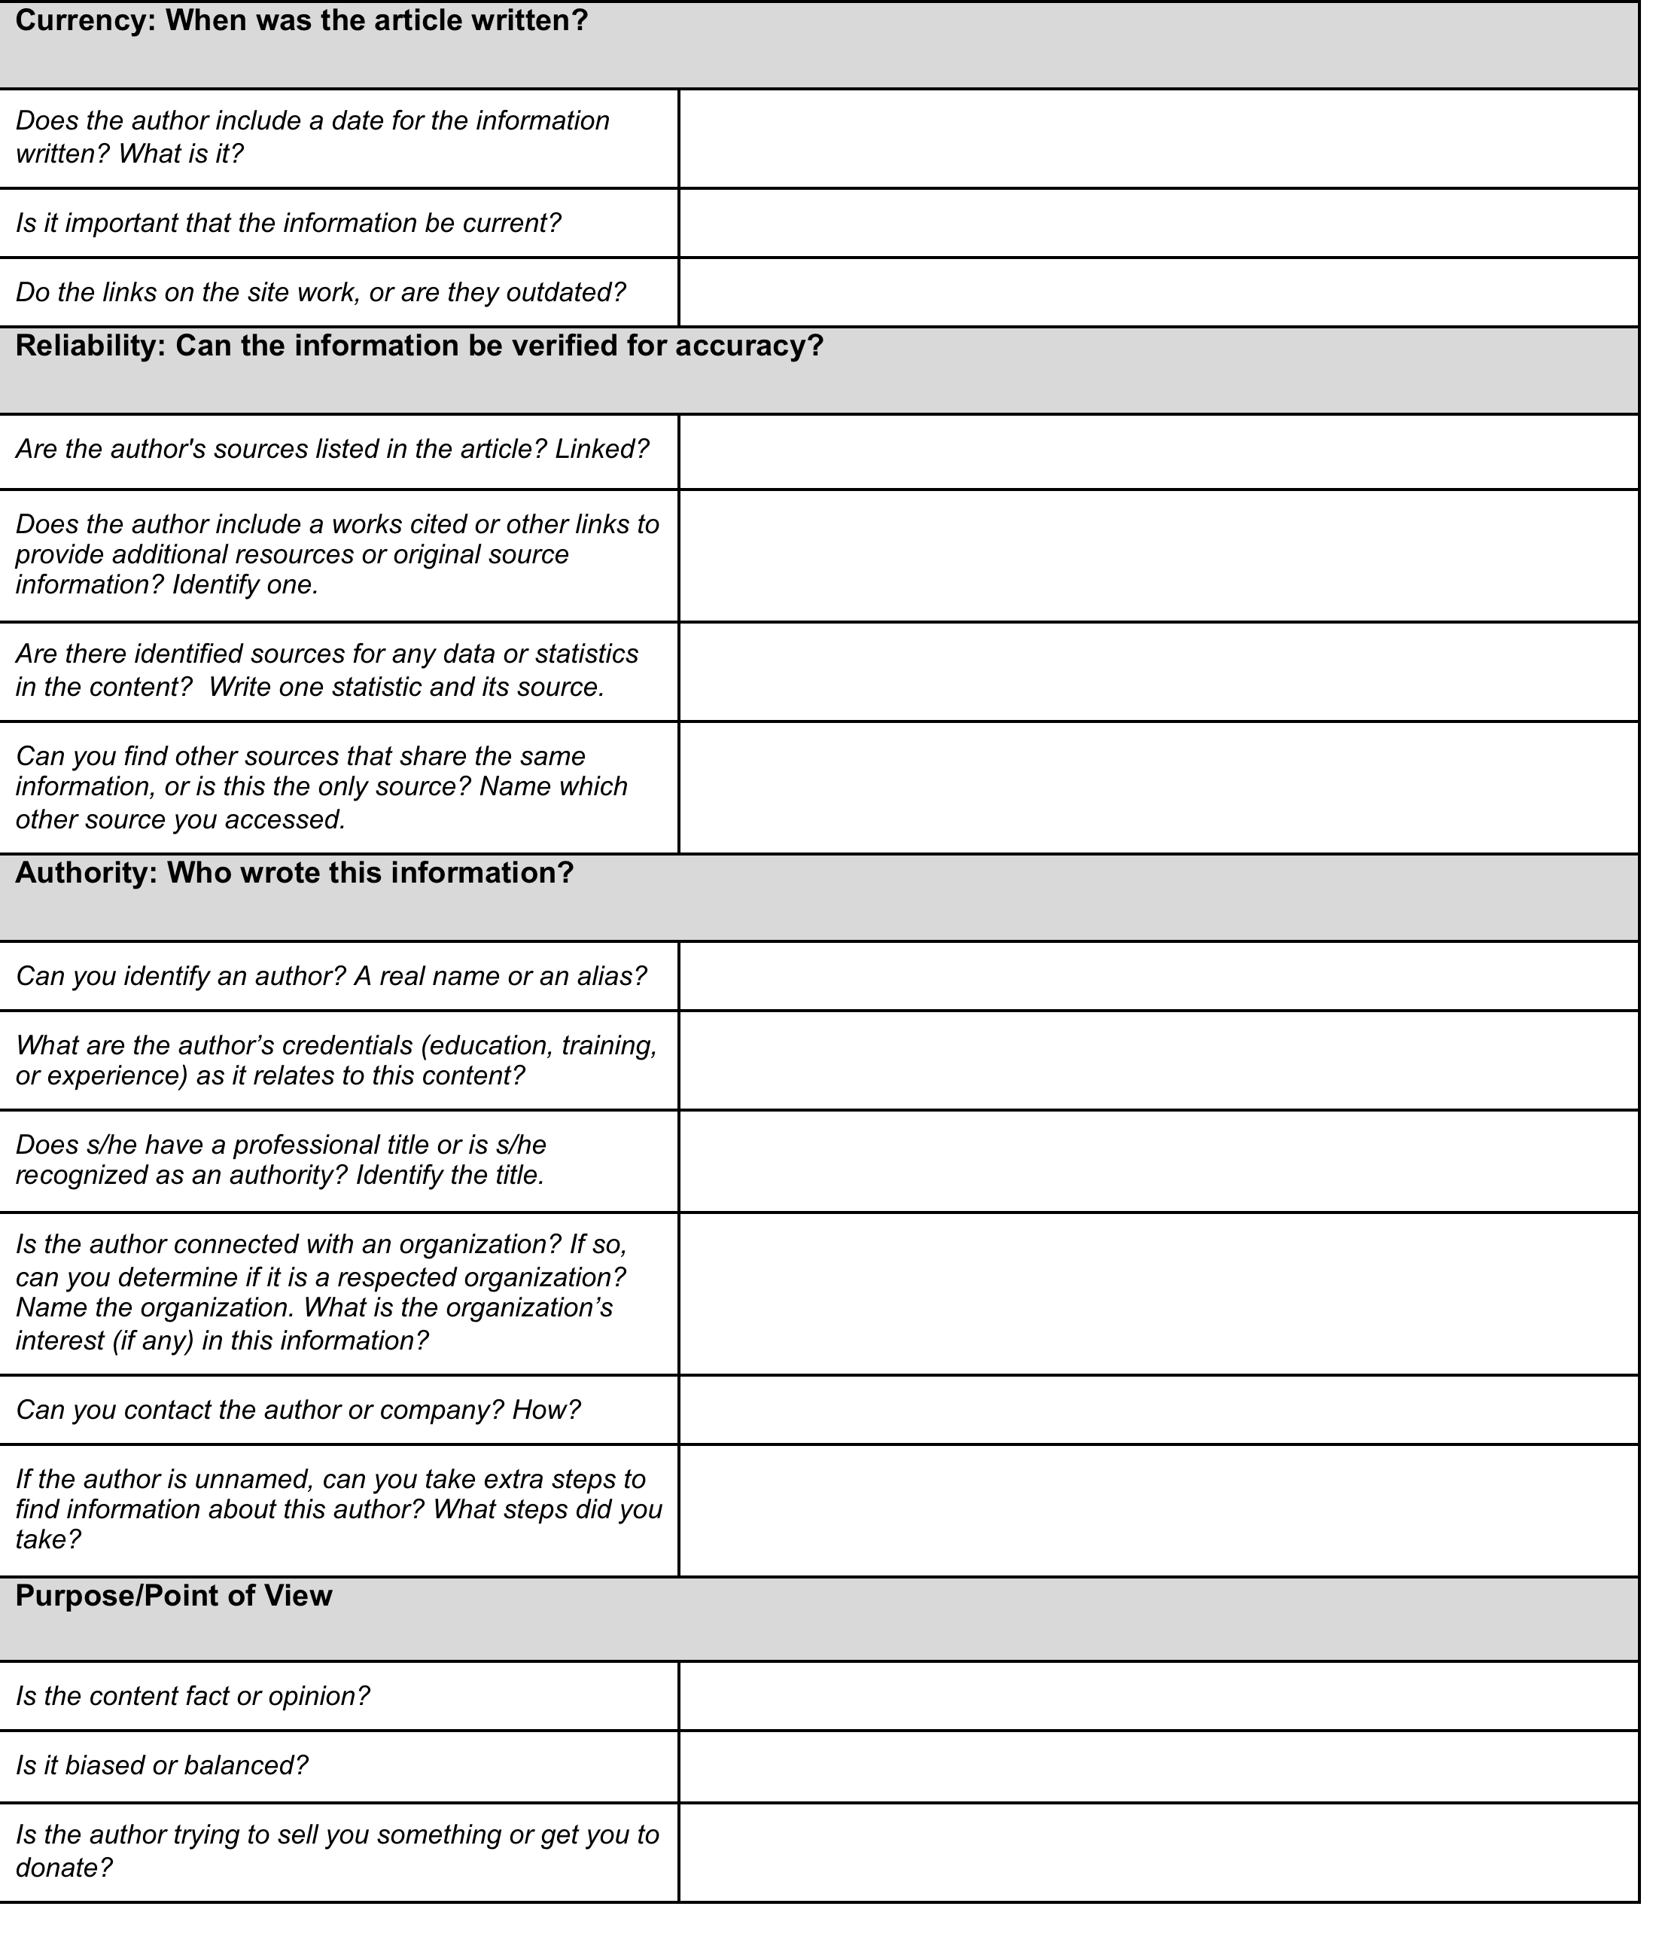
CRAP Assessment

