Slide 1
Go with the Flow!
Does the slope or substrate have a greater impact on the speed of water flow?

Slide 2
The Water Cycle
Precipitation
Condensation
Evapotranspiration
Evaporation
Snowmelt & Runoff
Infiltration
Groundwater Flow & Storage

Slide 3
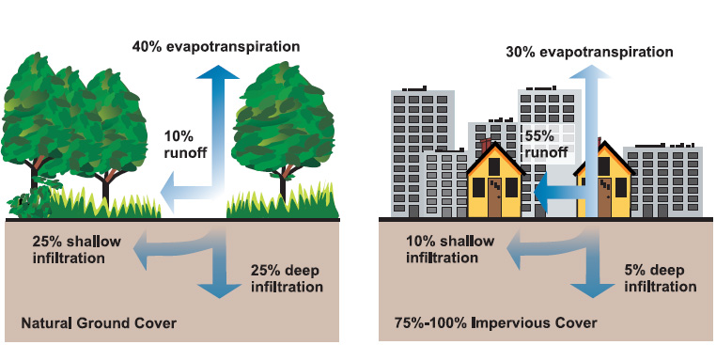
Definitions
Pervious (Permeable): Allowing water to pass through
Impervious (Impermeable): not allowing water to pass through

Slide 4
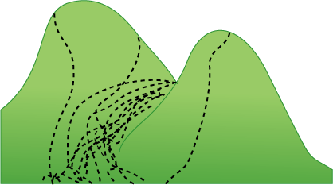
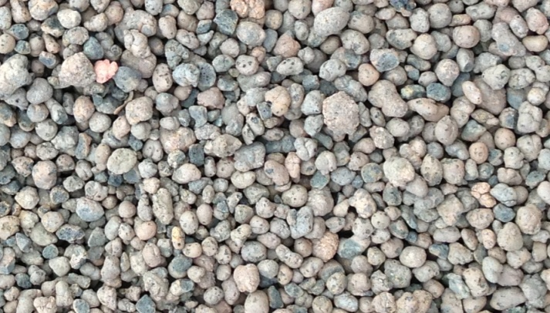
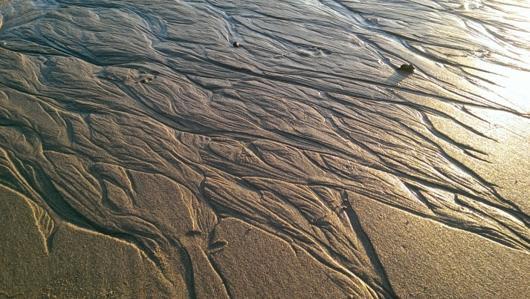
Definitions
Slope (Gradient): Steepness
Substrate: The Material that underlies something

Slide 5
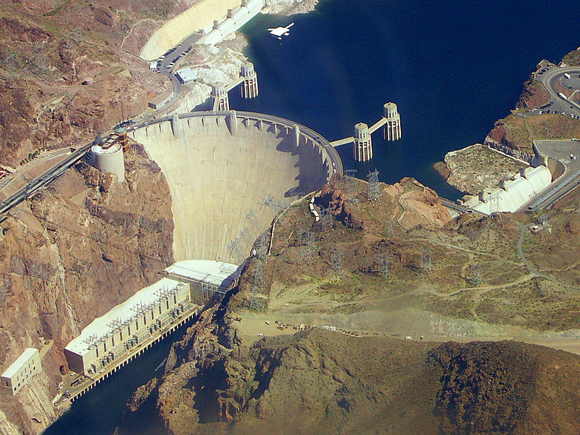
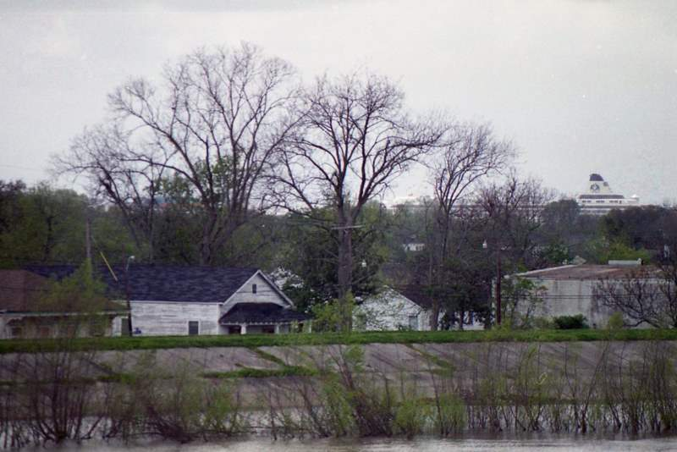
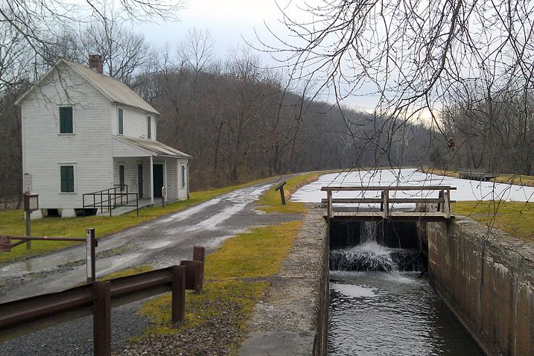
Civil Engineers Build Water Resource Structures
Dams
Levees
Canals
Hoover Dam, Colorado River, Nevada/Arizona border
Levee, Mississippi River, New Orleans, LA
C&O Canal, Oldtown, MD

Slide 6
What happens when the Levee Breaks?
Great Mississippi Flood, 1927

Slide 7
Southeast Floods
North Carolina, 1916

Slide 8
Great Mississippi flood
Illinois, 1927

Slide 9
Broken Levee
Sacramento River Delta

Slide 10
Flooding after Hurricane Katrina
New Orleans, LA

Slide 11
Flooding after Hurricane Katrina
New Orleans, LA

Slide 12
Six Flags after Hurricane Katrina
New Orleans, LA

Slide 13
Flooding after Hurricane Katrina
New Orleans, LA

Slide 14
Flooding After Hurricane Sandy in New York City

Slide 15
Alicante Flood
Spain, 1997

Slide 16
Skawa River flood
Poland, 2001

Slide 17
Flooding after Rain
Mexico, 2007

Slide 18
How Do You Think the Speed of Water Flow Will Differ?
Steep Slope
Flat Slope

Slide 19
How Do You Think the Speed of Water Flow Will Differ?
Farm Field
Storm Drain

Slide 20
Lab Activity
What happens to the speed of water flow at different slopes?
What happens to the speed of water flow over/through different substrates?

