Slide 1
Visualization Basics
Introduction to Tableau

Slide 2
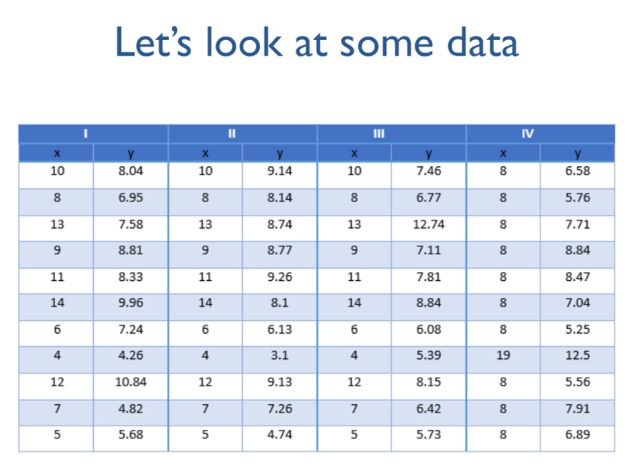
Notes:
Here’s some data. The are 4 sets of data here, each with 11 sets of x-y coordinates. Looking at this table, it seems that the numbers are random – there’s no relationship between the coordinates.

Slide 3
Notes:
Let’s look at some more information about these data sets. By running a few simple statistical tests, we cam determine the mean, variance, correlation and linear regression, which can tell us more about our data.
It turns out that these four data sets all have the same means, the same variances, the same x-y correlations, and even boil down to an identical linear regression.
In fact, it looks like these four data sets are practically identically based on this analysis.

Slide 4
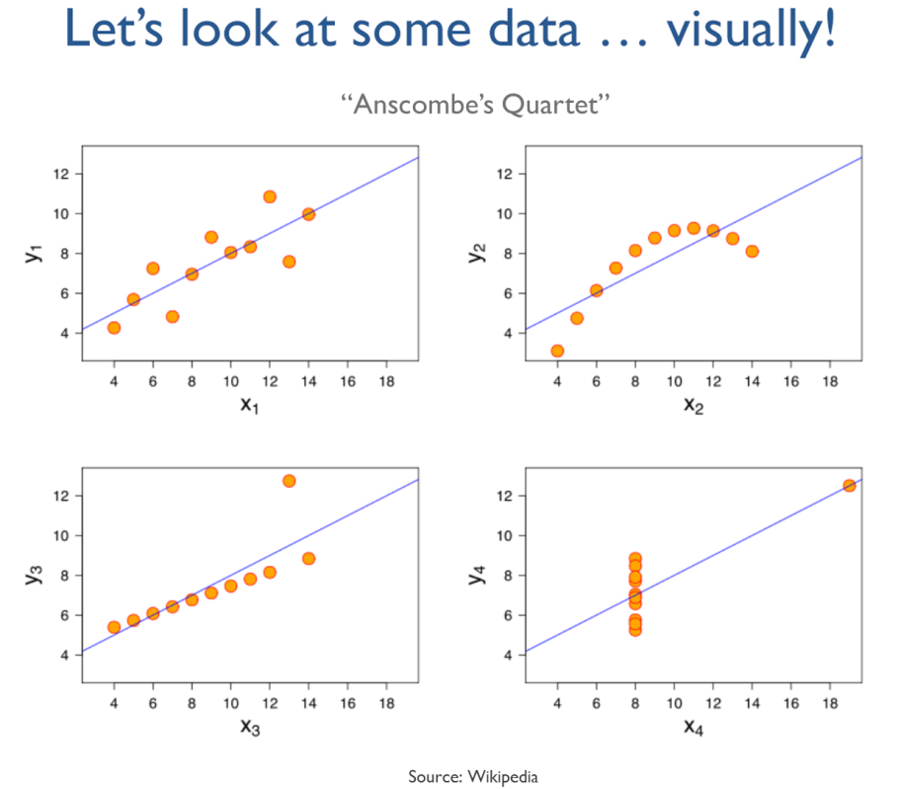
Source: Wikipedia
Notes:
Here are these same four data sets, plotted visually, with trend lines.
Anscombe’s Quartet was created in 1973 by Francis Anscombe, a statistician. He developed this to show the importance of graphing data, as opposed to just applying statistical tests to analyze information.
This example is one of the basic reasons that visualization is so important – it helps us identify trends within our data that may be obfuscated by statistical tests, or would take us more time to realize.

Slide 5
Why visualize?
Data visualization is not a personal preference, to be done “just in case some people are more visual.” It is a necessity!
The previous slide is a classic example of how some insights can only be found through visualization.
The first step in understanding your data should always be to examine it visually. Visualization can play a critical role in helping you figure out what the interesting questions are.
Remember the picture superiority effect: pictures are retained at much higher rates than words.
Notes:
Picture superiority – this is backed up by decades of research. If you can communicate your data with a well-designed picture, people will remember that much better than a table of numbers…this is more important than ever given how much data is being used in business

Slide 6
Why visualize?
A good visualization reduces the time to insight. Here’s a simple example:
You receive a report of monthly revenues by product and region. Which were your five highest-revenue product/regions last month?

Slide 7
Why visualize?
Let’s add color:
Color automatically focused your brain – no mental calculations/comparisons needed!
For some applications, eliminating all distractions with a very simple viz can be effective:

Slide 8
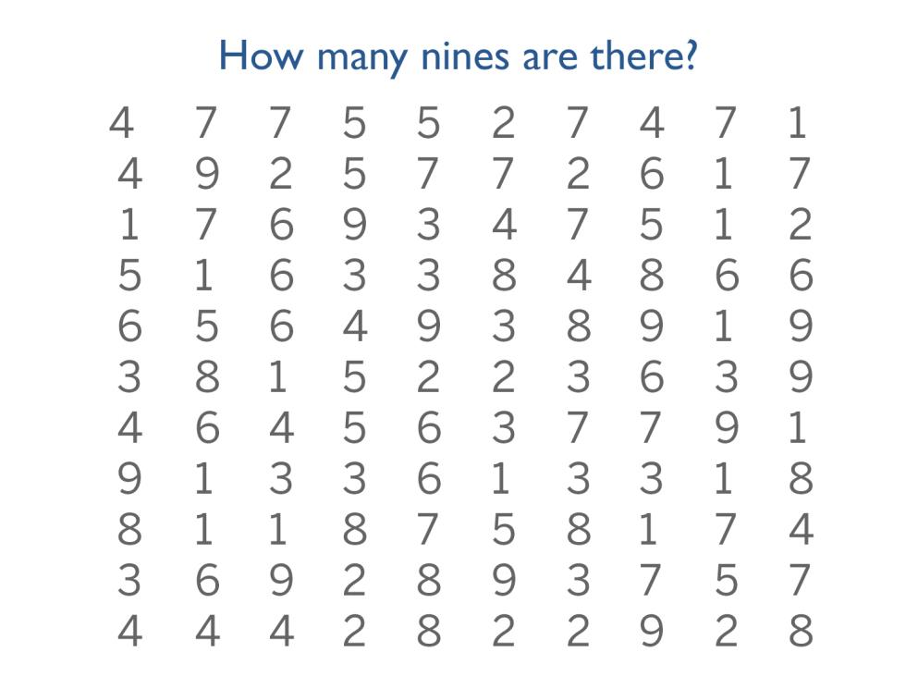

Slide 9
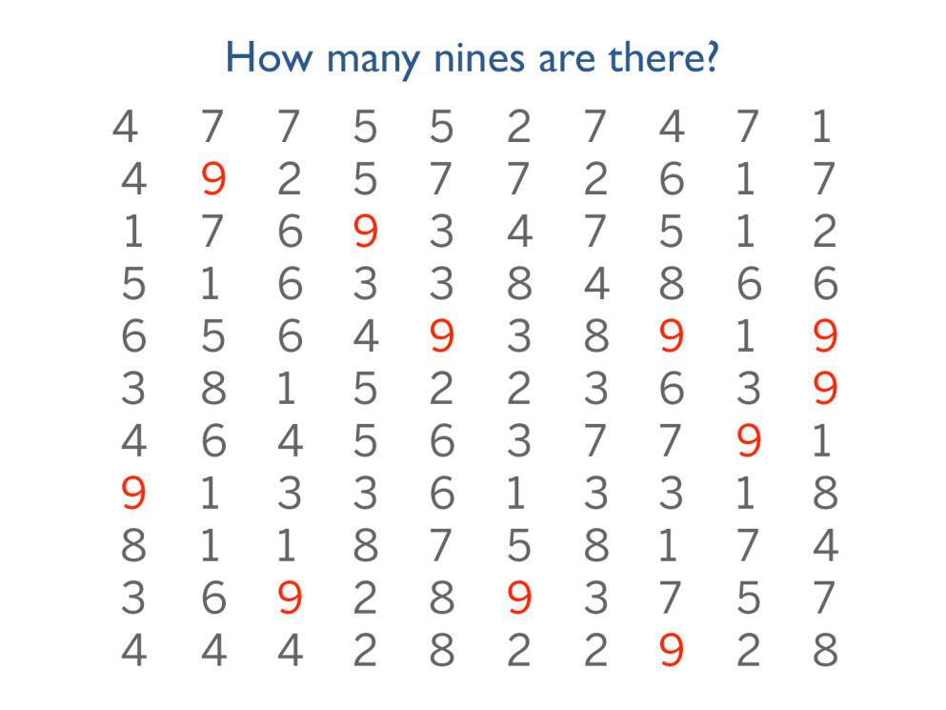
Notes:
NOW count the nines. How many nines do you see? Raise your hand when you know. (There are 11 nines)
It’s amazing how much easier it is to find and see the nines as soon as they’re picked out in gold.

Slide 10
Using Color
FACT: approximately 8% of men worldwide are color blind.
Avoid red/green palettes! Blue/orange is a good alternative.
For continuous data, color ramps are effective.
For discrete data, always try to limit colors (under 5 is ideal).
The use of too many colors makes it hard to distinguish, and also requires frequent referencing of the legend.
If you limit yourself to just a few colors, then your audience can actually remember what’s what. Be kind to your reader!

Slide 11
Notes:
This is a mistake that is pretty common. You have about 150 different data points and you’re mapping them to color but this is bad because I can’t tell if the blue is Albania or Cameroon

Slide 13
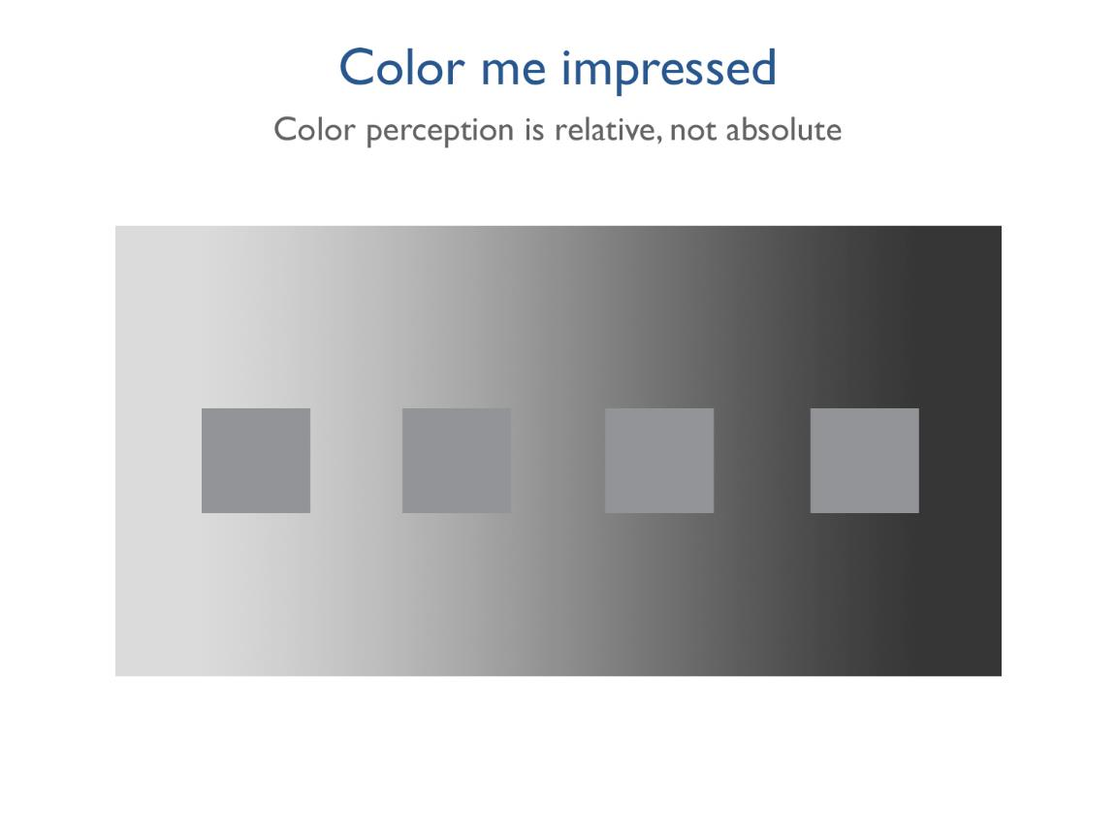
Notes:
Color is relative, not absolute.
Which of these squares is lightest? If we’re trying to encode meaning into color, we have to pay attention to how the viewer will perceive that color in context

Slide 14
Notes:
They’re all the same color but we didn’t know that until we had a consistent background – what are the implications for your data visualization best practices?
When using color – provide your users with a consistent background so they can determine differences and non-differences. Knowing they’ll sense a difference, help them to only perceive it if it’s actually there.
it’s not enough to just use color, be mindful of visual best practices to make the story accurate.

Slide 15
Notes:
When you’re working with quantitative data these two practices work really well. Negative profit as orange and positive profit as blue – red and green are more traditional, but this is color-blind friendly. If I had this bar chart without the colors, I might think that appliances, bookcases, and copiers were all performing about the same for us because their sales are roughly equal.
But when I add profit to color on this bar chart it’s immediately obvious that bookcases are actually losing money for us, as are supplies and tables
A word of caution – do not overuse color! With a bar chart, it is easy to see that one bar is about twice as long as another. On the other hand, it is nearly impossible to perceive that one color is twice as far along on a color ramp than another color. Color ramps can effectively display general information, but not specifics.

Slide 17
Your brain on autopilot (Kahneman’s “System 1”)
Evryneoe can raed txet, eevn if the letetrs are scrmeblad. The olny tnihg taht mtetras is taht the fsrit and lsat leertts are in the rgiht pcales. Tihs is one of the mnay enctixig tgnihs you wlil laern in tihs cslas!
Notes:
The human brain will quickly, “automatically” perform some processing. We want to take advantage of this in our visualizations. Tableau lets you take advantage of what we know from research to reduce the time to insight in your viz.

Slide 18
Pie charts – NO!
The only effective pie charts that I have seen:
Is a Pie Chart a Good Idea?
Japan
Hello, my name is ______ and it has been ____ months since my last pie chart.
Notes:
[[MAYBE REMOVE THIS SLIDE BASED ON THE AUDIENCE]]

Slide 19
Pie charts – NO!
From visualization guru Edward Tufte: “the only worse design than a pie chart is several of them.”
Pie charts are tempting because everyone understands what they are meant to convey (the various parts of a whole), but it is much harder to compare slices of a pie than it is to compare length or height (especially when slices become very thin):
Notes:
there is extensive research showing that people are MUCH worse at interpreting the left-hand chart vs. the right-hand chart.
This is a well-established best practice. It is shocking that you still see so many pie charts. Do not be part of the problem!

Slide 20
Notes:
Relative proportions, proportions of the whole = tree maps
Relationships between data = scatter plot

Slide 21
Notes:
Orient data so people can read it easily. You read English from left to right so as much as possible, we want our data to go left to right.
How many of you have the urge to tilt your head to make the chart on the left easier to read? Don’t make your audience to that! Tilt it for them ☺

Slide 22
Notes:
Let’s start talking about the different types of data. There are three key types of data.
Qualitative, categorical – there is no clear order to the data and they don’t have a clear relationship to each other, they don’t contain numbers
Qualitative, ordinal – the have a relationship to each other but you can’t measure the distance between them but you understand how the compare in relationship to one another
Quantitative – these data are numbers, you can do math with them, and you know exactly what the difference between them is (their relationship to one anther – the difference between 5% and 10%).
Quantitative data can be further broken down into discrete and continuous data. Discrete can be considered a “count” of something, continuous data is a measurement which can be broken down to lower levels of details.
Basically, the type of data you have impacts the ways in which you can visually represent it.

Slide 23
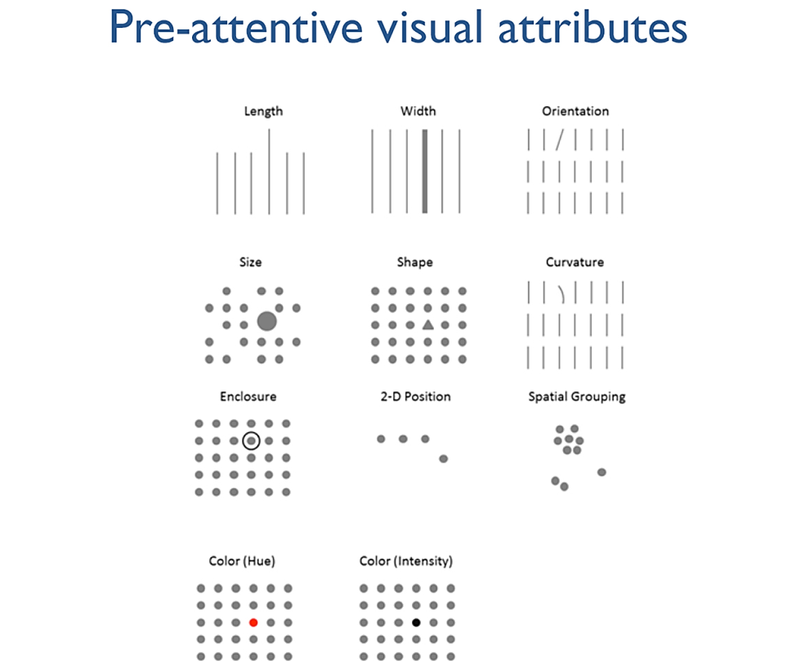
Notes:
By visualizing data, we are tapping into our ability to understand information pre-attenively.
Pre-attentive attributes are pieces of information we can process visually almost immediately, before sending the information to the attention processing parts of our brain. This is information we process and understand almost subconsciously. These are generally the best ways to present data, because we can see these patterns without thinking too hard.

Slide 24
Notes:
Note that position is the best way across all 3 types of data. We can easily understand the relationship between two data points represented on an x and y axis.

Slide 25
Notes:
Filled maps work well when you have defined areas like states or cities and only one measure.
For this map, we are looking at infant mortality across Cuban provinces – see can see that there are two pockets of 4-6 deaths per 1,000 live births

Slide 26
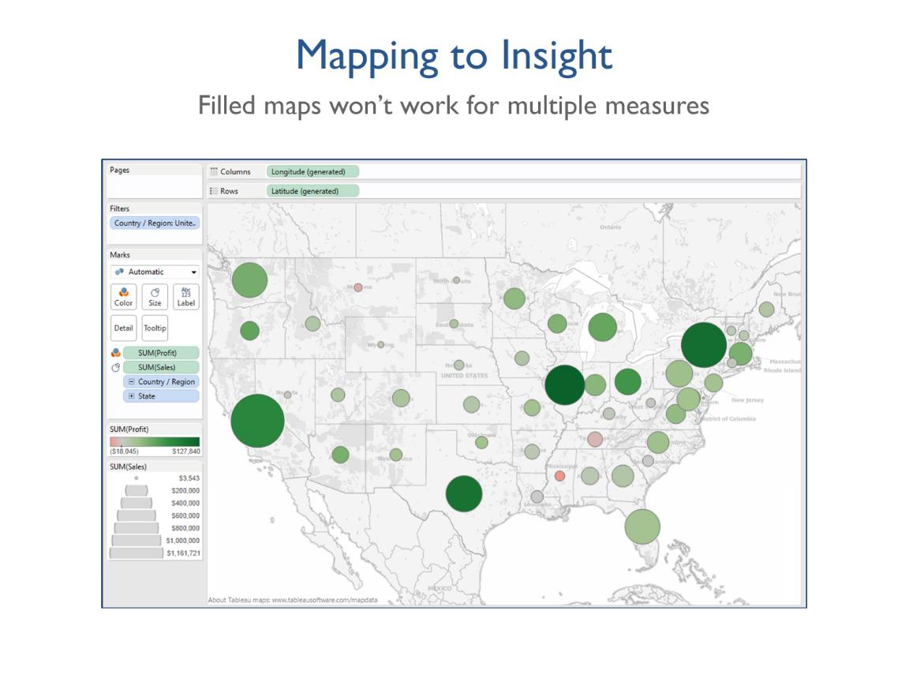
Notes:
As soon as you pull in a second measure, say sales, filled maps don’t work.
We still have a map here but with profit on color and sum of sales on size, we are unable to use a filled map.
How is using a map more useful here than a bar chart? Answer – looking at regional differences – we’re doing pretty well on the Eastern seaboard but not so hot in the Midwest, for example.

Slide 27
Notes:
What do you think the 5 second test is?
The goal is that you should know what is going on in the dashboard in 5 seconds.
This one is good b/c you know exactly what it is – good title, clear why map was used.

Slide 28
Notes:
And have a good title, too! This title immediately tells me what I am looking at. A title here such as “My Dashboard” would not be helpful.

Slide 29
Notes:
After creating something you are ready to publish, invite some colleagues and show them your visualization. Now you’ll hand over the mouse and let them click through everything, come up with potential issues and uncover broken parts. A viz review is the same concept behind software engineers holding a code review or an author using an editor before publishing his novel.
EVERYONE who publishes an externally-facing visualization should conduct a viz review. Anyone publishing an externally-consumed viz goes through this process.
Based on the 5 second dashboard test, the purpose of the dashboard should be immediately clear. What problem does this solve OR what question does it answer? Is this immediately clear?
2. Have you used the space effectively? Is there a better way to display the data?
3. Don’t add things just because you can. Make sure everything on the viz is useful and valuable to the end user. Oftentimes the simplest vizes tell the most compelling story.
4. Have you utilized filters, highlights and other actions to provide interactivity to the end user? Now go through each of these and make sure it displays as you would expect – be sure to check various scenarios and edge cases.
5. Make sure to include a color legend, etc.

Slide 30
(2014 poll data)
Notes:
Draw on the 5 questions from the viz review:
What question does this answer? In this case, the question is “how do Facebook users see 2016 political candidates”
Is the information displayed in the best way?
Pie charts are hard to compare, no sorting of the individual candidates
Second row of red labels could be ambiguous
Does everything add value? Alternating the republicans and democrats titles and color schemes doesn’t help
Functional interactivity? no
Clear labels? Unclear title, All caps are hard to read

Slide 31
After

