Slide 1
Approximate Inference through Sequential Measurements of Likelihoods Accounts for Hick’s Law
Xiang Li
NYU
with Luigi Acerbi and Wei Ji Ma

Slide 2
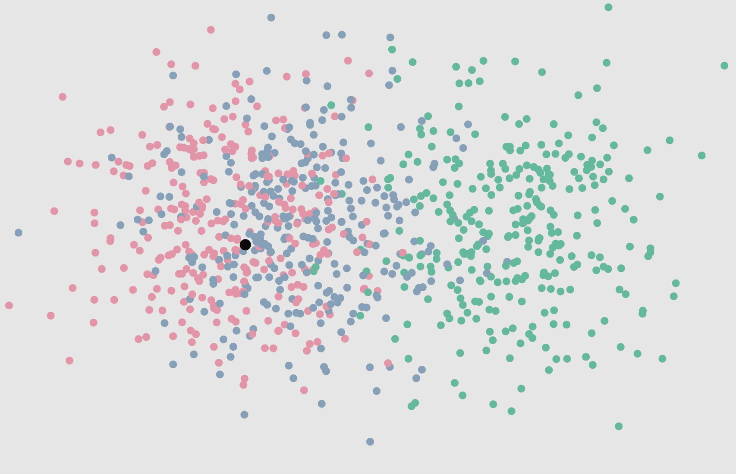
Which category did the black dot come from?
Li & Ma (2017)
Notes:
Give the question, give the intuition

Slide 3
Inference among multiple categories
Optimal inference is implemented by Bayes’ rule
which maximizes probability correct
Notes:
Today’s topic is about…
First of all, we assume equal priors throughout the presentation. Considering unequal priors is trivial in general.
If we choose the category with the largest posterior
Just as black dot color clouds experiment show

Slide 4
Inference among multiple categories
Optimal inference is implemented by Bayes’ rule
which maximizes probability correct
What if inference has limited “resolution”?
Specifically, we assume that the likelihoods can only be “measured” in a noisy way.
Notes:
Today’s topic is about…
First of all, we assume equal priors throughout the presentation. Considering unequal priors is trivial in general.
If we choose the category with the largest posterior
Just as black dot color clouds experiment show

Slide 5
Inference among multiple categories
Optimal inference is implemented by Bayes’ rule
which maximizes probability correct
What if inference has limited “resolution”?
Specifically, we assume that the likelihoods can only be “measured” in a noisy way.
Central question of the project
How to sequentially refine the approximation if each measurement is costly?
We are looking for an active sampling strategy.
Notes:
Today’s topic is about…
First of all, we assume equal priors throughout the presentation. Considering unequal priors is trivial in general.
If we choose the category with the largest posterior
Just as black dot color clouds experiment show

Slide 6
Related frameworks
Evidence accumulation (Wald & Wolfowitz, 1948; Ratcliff, 1978): but not Bayesian

Slide 7
Related frameworks
Evidence accumulation (Wald & Wolfowitz, 1948; Ratcliff, 1978): but not Bayesian
Resource rationality (Griffiths, Lieder, & Goodman, 2015): but they sample from a known posterior. We gradually approximate the posterior.

Slide 8
Related frameworks
Evidence accumulation (Wald & Wolfowitz, 1948; Ratcliff, 1978): but not Bayesian
Resource rationality (Griffiths, Lieder, & Goodman, 2015): but they sample from a known posterior. We gradually approximate the posterior.
Information sampling (Oaksford and Chater, 1994): but this is sampling directly from the environment. We work at a more abstract level.

Slide 9
Related frameworks
Evidence accumulation (Wald & Wolfowitz, 1948; Ratcliff, 1978): but not Bayesian
Resource rationality (Griffiths, Lieder, & Goodman, 2015): but they sample from a known posterior. We gradually approximate the posterior.
Information sampling (Oaksford and Chater, 1994): but this is sampling directly from the environment. We work at a more abstract level.
Bayesian optimization (Jones, Schonlau, & Welch, 1998): machine learning technique to choose a sequence of parameter combinations to evaluate

Slide 10
Inference from observation
N categories
Each observation is informative only about one category

Slide 11
Inference from observation
N categories
Each observation is informative only about one category
Likelihood of the i^{th} category
is the set of observations made for i^{th} category

Slide 12
Inference from observation
N categories
Each observation is informative only about one category
Likelihood of the i^{th} category
is the set of observations made for i^{th} category
Posterior of the i^{th} category

Slide 13
Abstraction step
Now forget about the “raw observations” x_{i} and think about the likelihoods L_{i} abstractly

Slide 14
Abstraction step
Now forget about the “raw observations” x_{i} and think about the likelihoods L_{i} abstractly
Posterior of i^{th} category:

Slide 15
Abstraction step
Now forget about the “raw observations” x_{i} and think about the likelihoods L_{i} abstractly
Posterior of i^{th} category:
Key concept: Instead of explicitly modeling noisy observations from the environment, we model noisy “measurements” of the likelihood.
j^{th} measurement of i^{th} likelihood: l_{ij}
Assume lognormal noise:
Assume conditional independence

Slide 16
Additional assumptions
Prior over the likelihoods L_{i}

Slide 17
Additional assumptions
Prior over the likelihoods L_{i}
A sequence of actions in discrete time
Action set: at each time step, the agent has two possible actions:
Decide on a category and receive a reward for correctness
Make a new measurement: select a category, receive one measurement from that category, pay a cost, go to next time step

Slide 18
Summary of the problem
There are true posteriors but those are unknown to the agent.

Slide 19
Summary of the problem
There are true posteriors but those are unknown to the agent.
Given a prior over likelihoods L_{i}, noise in the measurements of L_{i}, a reward for correctness, and a cost per measurement, what is a good policy?

Slide 20
Summary of the problem
There are true posteriors but those are unknown to the agent.
Given a prior over likelihoods L_{i}, noise in the measurements of L_{i}, a reward for correctness, and a cost per measurement, what is a good policy?
The Bellman equations are intractable. Therefore consider myopic policies instead (thinking one step ahead)

Slide 21
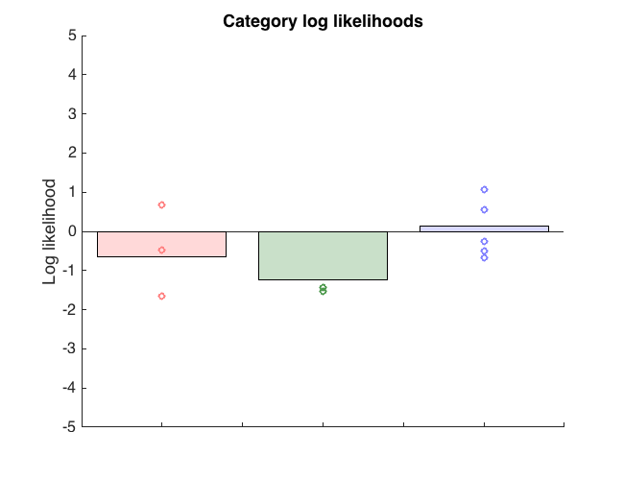
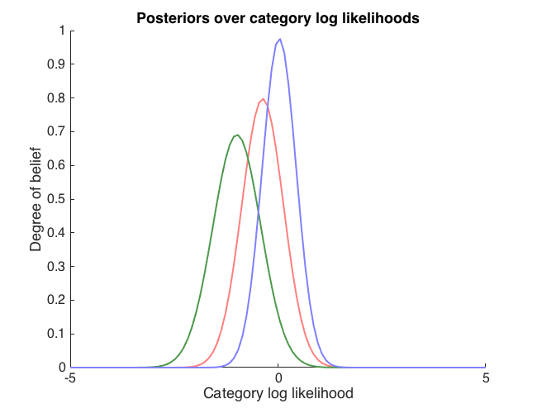
Approximate algorithm
Step 1. Based on current noisy measurements of all likelihoods, calculate a posterior distribution over each category likelihood {L₁, ... , L_{n}}

Slide 22
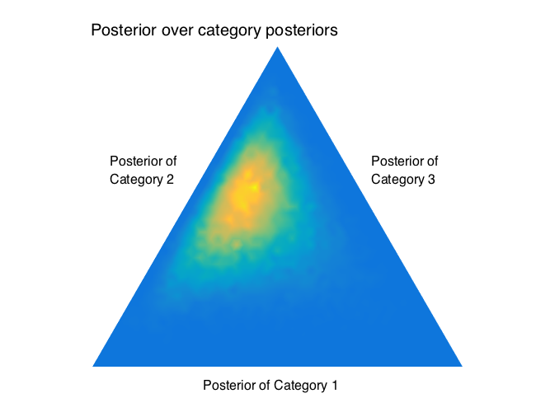
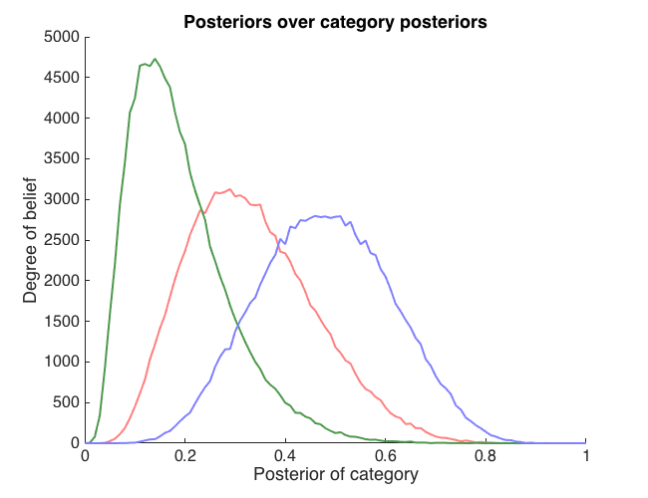
Approximate algorithm
Step 2. Use those to calculate a posterior distribution over the posteriors {P₁, ... , P_{n}}

Slide 23
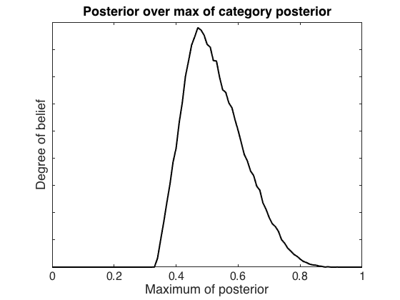
Approximate algorithm
Step 3. Based on that posterior, calculate a posterior distribution over the max posterior M=max {P₁, ... , P_{n}}. We denote this by p(M|data).
M

Slide 24
Approximate algorithm
Step 4. Consider each category a candidate for making another measurement.
Separately for each category i, simulate a new measurement from that category based on current knowledge (Thompson sampling)
Calculate the reduction R_{i} in Var(M|data) due to this simulated measurement.
Step 5. Is max{R₁,…,R_{n}} > threshold?
If so, choose argmax category to make a new measurement from. Make an actual measurement. Go back to Step 1.
If not, decide: choose the category that maximizes Ε[P_{i}].

Slide 25
Result
high
Sampling cost
low

Slide 26
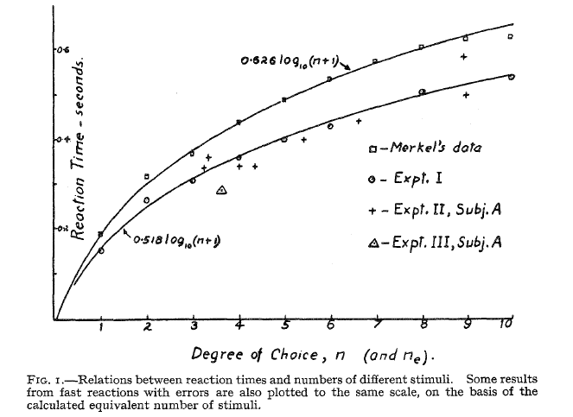
Hick’s law
Hick, 1952

Slide 27
Hick’s law
Found experimentally in light detection (Hick, 1952), dual tasks (Damos & Wickens, 1977), pitch judgment (Simpson & Huron, 1994), key strokes (Logan, Ulrich, & Lindsey, 2016)
Has been explained in terms of competing race model (Usher & McClelland, 2001) and a memory-based model (Schneider & Anderson, 2010)

Slide 28
Conclusion
We conceptualized approximate inference as a process of making noisy “measurements” of category likelihoods (one category at a time).
A myopic iterative measurement policy shows a relationship between the number of iterations and the number of categories that resembles Hick’s law.

Slide 29
Open questions and possible extensions
More direct experimental evidence?
Assumption that each observation is informative only about one category
Other stopping rules
Other acquisition functions
Memory decay
Relation with other models

