Slide 1
Obfuscation in competitive markets
Ernst Fehr Keyu Wu

Slide 2
Introduction

Slide 3
Obfuscation
“Basically, any action by the seller that raises the cost of price (and attribute) search by potential customers can be thought of as obfuscation.” (Ellison and Ellison, 2018)

Slide 4

For example…
Notes:
Digital single-lens reflex camera

Slide 5

For another example…

Slide 6
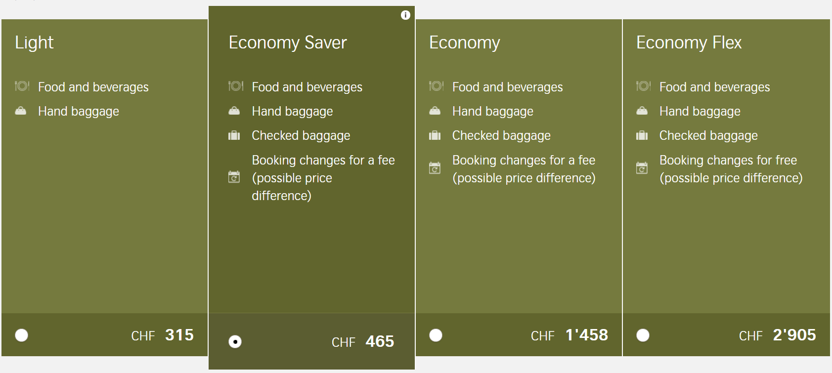
For another example…

Slide 7
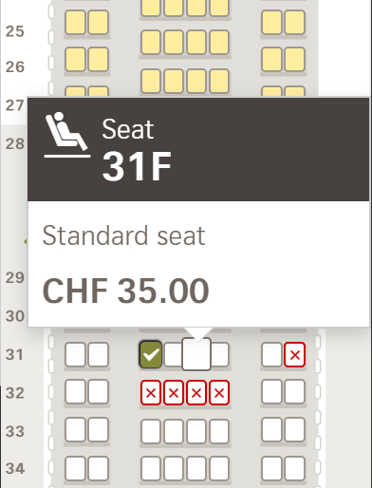
For another example…
Notes:
So you may end up paying a lot more than the price you thought you only had to pay

Slide 8

For another example…
Notes:
So you may end up paying a lot more than the price you thought you only had to pay

Slide 9
This may be harmful for consumers!
The situation where products have many features or come with many add-ons is very pervasive
The complexity of these “features” make consumers not able to comprehend each alternative, not to mention comparing among them
- so they are no longer regular price discrimination/bundle sale
Differentiation in trivial features is not innovation but exploitation!
Notes:
Say: complexity will be the form of obfuscation we consider in our study
Trivial features also include those that have always been standard in an expected good; but they are now brought up to the front and listed as a “feature” where products can be differentiated.
Greater variety: there was empirical evidence that health insurance providers put not easily noticeable dominated products on their websites.
Price discrimination: when products are decomposed to too many components, low-value types are uncertain whether they are really getting all the necessary components they want, and high types are paying too much because add-ons are priced high (need to compensate for the low price of the basic products and overall price increases because of high complexity).
Inefficient feature innovation: toilet paper/shampoo/towels in hotels (???), accessory packages of electronic products, or the seat reservation of a flight ticket.
This is the sort of obfuscation hiding behind fancy and good looking features that do not look harmful, but in fact can be. Purely exploitative obfuscation, once noticed and once consumers are educated, can be regulated easily and backfire easily. So we want to draw attention to this sort of obfuscation that can be pervasive and harmful as well. If we are able to get no obfuscation in the no efficiency gain design, we can even say that this is perhaps one of the most important scenario where obfuscation will happen, instead of the very general scenarios argued by many theoretical papers so far.

Slide 10
Literature
Theoretical literature
- Ellison (2005), Gabaix and Laibson(2006), Spiegler(2006), Carlin(2009), Wilson(2010), Gaudeul and Sugden (2011), Ellison and Wolitzky (2012), Chioveanu and Zhou (2013), and many others
Empirical literature
- Ellison and Ellison (2009), Li and Dinlersoz (2012), Miravete (2013), Hackl et al. (2014), McDonald and Wren (2014), Seim et al. (2016a), and many others
Experimental literature
- Kalayci and Potters (2011), Kalayci (2015), Kalayci (2016), and a few other non-market experiments
Notes:
If we are able to get no obfuscation in the no efficiency gain design, we are able to say that these theories all miss a very important element, and point out additional literature that shows that competition does not foster obfuscation.

Slide 11
Important Open Questions
Are sellers able to escape the “zero-profit” trap by obfuscating consumers with add-on features? If so, how much profit do sellers make from obfuscation?
Do sellers indeed use headline prices to attract consumers' attention, so that consumers are more likely to buy products with low headline prices? (Ellison, 2005; Hossain and Morgan, 2006; Chetty et al. 2009; Allcott, 2015; Taubinsky and Rees-Jones, 2018; and many others) If so, do sellers reduce headline prices even below marginal cost, but still earn higher profits?
Do sellers' choose inefficiently high obfuscation levels that even reduce overall (consumer + producer) surplus ?
What factors explain the level of obfuscation?
Notes:
Say: experiments are very good in answering many of these questions, because we know exactly the production cost, eliminate noisy heterogeneity and confounds in the field, and can control for environmental factors. We will answer the first 4 in the presentation today, and our study can answer many more additional questions.
Loss-leader: used in a multi-product setting; well yes here we don’t have multi-product but the headline price serves similarly as a way to attract buyers. And the fact that it works in the field already show that many buyers like the upgraded products (so they find value higher than price) although the price is really above marginal cost. Sellers are able to charge high price for them exactly because of the search cost. Or in another word, we might as well allow buyers in our experiment to choose the base product only from any seller, but we really do not anticipate them doing that because these features are apparently nice.
(may put the following after experimental design) We do not (yet) focus on
- Shrouding attributes (so buyers are fully aware of the possible existence of feature values and prices)
- Deceptive advertising (so any information displayed about the product is true)
- Obscure perception of feature value or price because of unfamiliarity with jargons etc. (so buyers are provided the accurate levels of feature values and prices)
- Incomparability because of format difference (so complexity is measurable on a continuous scale)
- Uncertain or optional add-on costs (so there is no change that any add-on cost will not occur and no element of buyers’ overconfidence or over-optimism)
Our only frictions are searching process and aggregation of multiple features.

Slide 12
Experimental design
Notes:
To the objection that student subjects are not rational sellers (Crosetto et al. 2017): in market experiments, incentives and certain market moral code crowd out motives like risk aversion and social preference (Roth et al. 1991; Holt, 1995), and professional managers do not behave in ways that are systematically different from students (Siegel & Harnett, 1964; Abbink & Rockenbach, 2006; Frechette, 2015).

Slide 13
Basic setting
Posted-offer market with 6 sellers and 10 buyers trading phones
Sellers sell a homogenous base product
- same marginal production cost of the base product: 5
- no limit on quantity
Buyers derive a basic value (WTP) from the base product
- each buyer is randomly assigned 1 of the 5 possible basic values, 20, 15, 10, 5, and 0
- each buyer can buy 1 unit max
Notes:
Roles remain the same across the whole study (except the sellers‘ filler task in Part 3), and these are common information
Everything is denoted in ECU
Even with heterogenous features, the products can still be seen as homogeneous in the sense that the value of each feature can be seen as a negative price, the game is perfectly symmetric among sellers, and no buyer has a special prior preference for any of the 6 sellers or products.
The extra cost is a function of the extra value, which will be specified later.
The above is common information among sellers and buyers

Slide 14
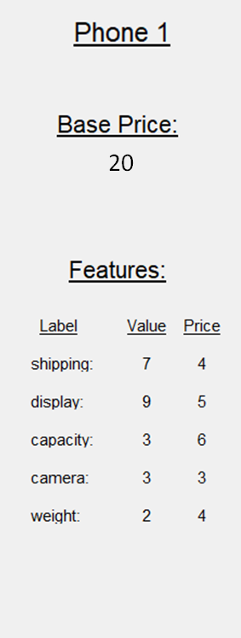
Basic setting
Posted-offer market with 6 sellers and 10 buyers trading phones
Sellers sell a homogenous base product
- same marginal production cost of the base product: 5
- no limit on quantity
Buyers derive a basic value (WTP) from the base product
- each buyer is randomly assigned 1 of the 5 possible basic values, 20, 15, 10, 5, and 0
- each buyer can buy 1 unit max
Sellers can also add features to the base product, with each feature having
- a label, which just makes the product less abstract
- an extra value for buyers, which cost sellers 50% to produce
- an extra price that sellers charge buyers
shipping:
display:
capacity:
camera:
warranty:
Notes:
To make things simple right now, these features are not optional. Consumers have to buy the whole bundle if they accept this offer.
Even if we allow for both the inferior product and the full product to be sold for each sellers, we have fair confidence to say though that not many buyers will go for the inferior product, especially after several periods, because they will soon realize all the features are valuable.
All products come with these features and consumers can only accept all or not buy. This can be thought of as the situation where you buy some printer, and you can only use the ink that is compatible with it. Or remember that in the bundle sale, you cannot always choose which components you want and which you do not. Or, think of a situation where you have a standardized good in mind that you want to buy, but in the end find that actually not all the features you want are included in the offered “base product“, and will just have to pay the extra for that standardized good you had in mind.

Slide 15
Overview of design (simplified)
Part 1
Obfuscation Market
20 periods
1.1 Seller Stage: Sellers design product
1.2 Buyer Stage: Buyers buy under costly time
Part 2
Bertrand Market
(Control Treatment)
The same as Part 1, with the only difference being that full transparency and simplicity are enforced
10 periods
Notes:
This is a simplied summary of the design, where we omit many complementary parts that are slightly less important.

Slide 16
Sellers’ decisions
Base price
Number of features
- 0 to 6 features are allowed
Sum of feature values
- more features allow a higher sum of feature values
- can be seen as technological upper bounds on the value that each feature can create that applies to all sellers in an industry
Sum of feature prices
shipping:
display:
capacity:
camera:
warranty:
Notes:
Introducing two-digit value or prices first makes our complexity measure unstandardized, and introduces additional heuristics that buyers may take that is completely not controllable and not the same across different products. We need an upper bound on feature value/price anyway for the experiment to run. Even if we completely separate these two choices, we need to find a way to standardize complexity ex post (number of features is no longer a good measure, so those with a high value will be expanded anyway), which may not be consistent with how buyers feel and how sellers believe.
Damn it, explain this restriction more. Relate to the real-world examples.
Purely exploitative obfuscation is possible here (set the sum of feature values to 0, say)
So sellers’ earnings from a trade comes from both the base product and the extra features.

Slide 17
Buyers’ information at the beginning
Time cost in the market is 0.1 per second, but there is no time limit
Search process
Notes:
In principle buyers can spend as much time in the market as they would like to spend. During the experimental sessions, experimenters will intervene if a buyer spends more than 2 minutes and 30 seconds in a period.

Slide 18
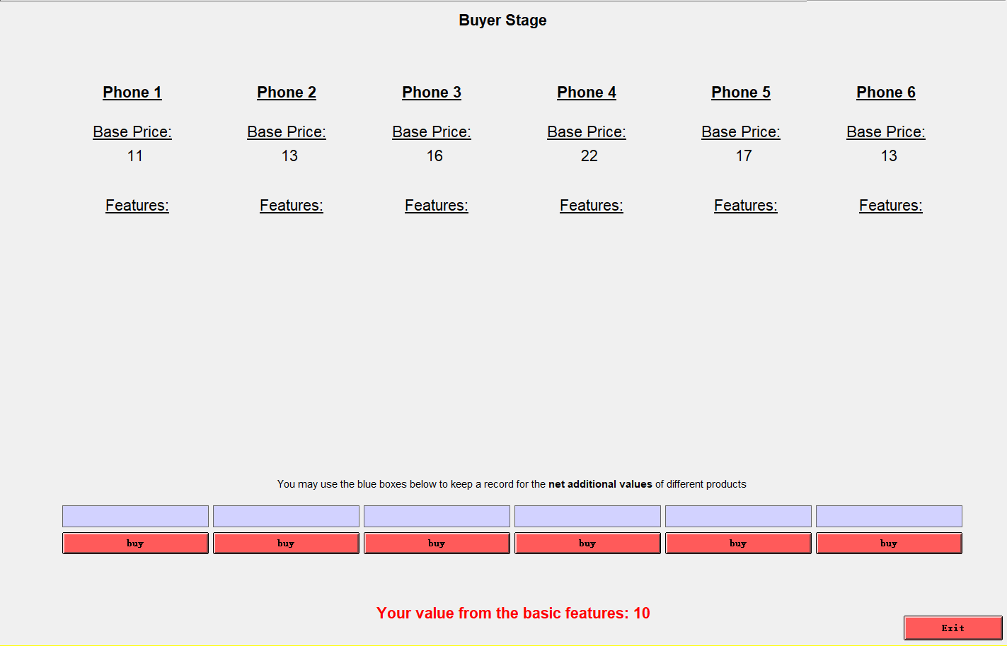

Slide 19
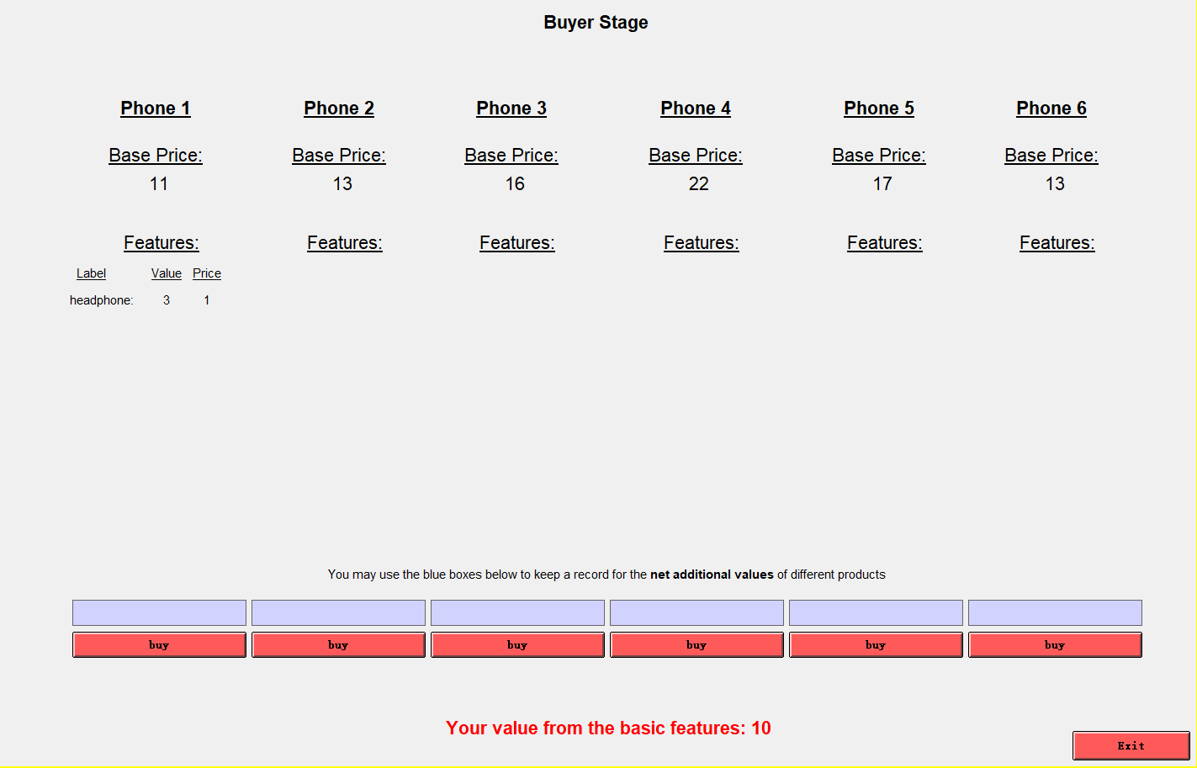

Slide 20
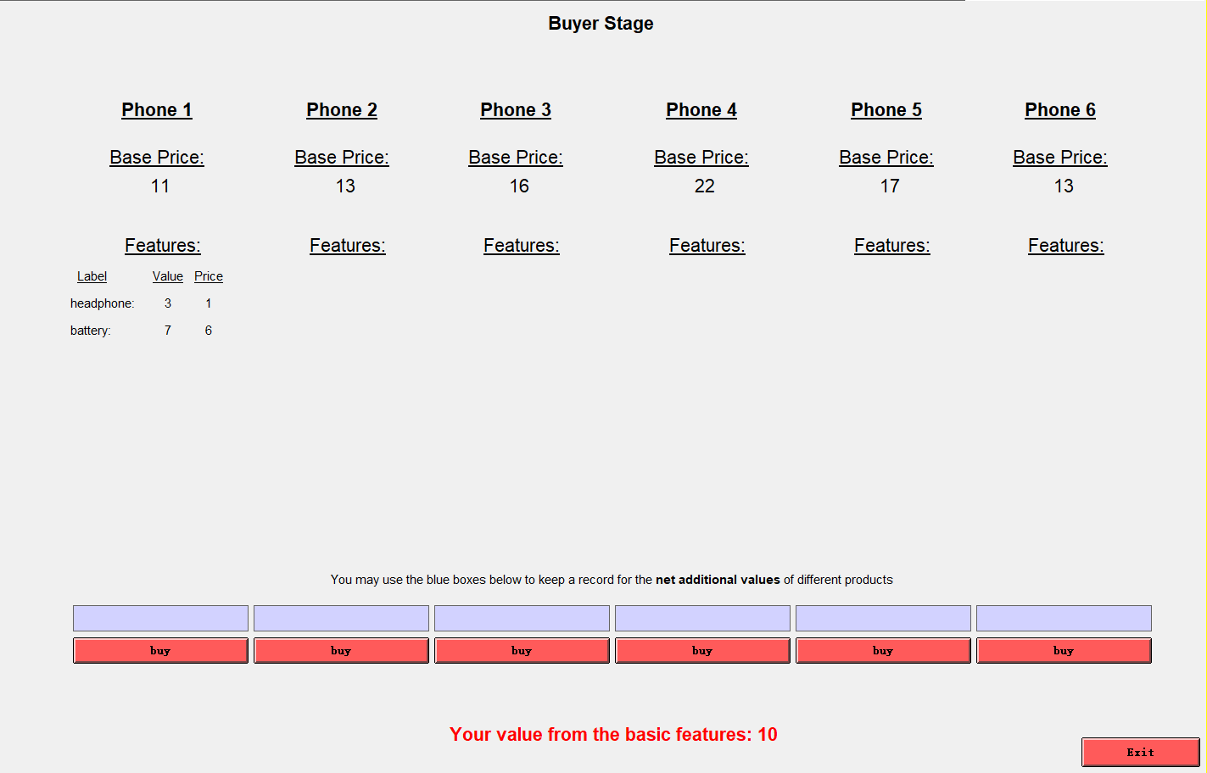

Slide 21


Slide 22
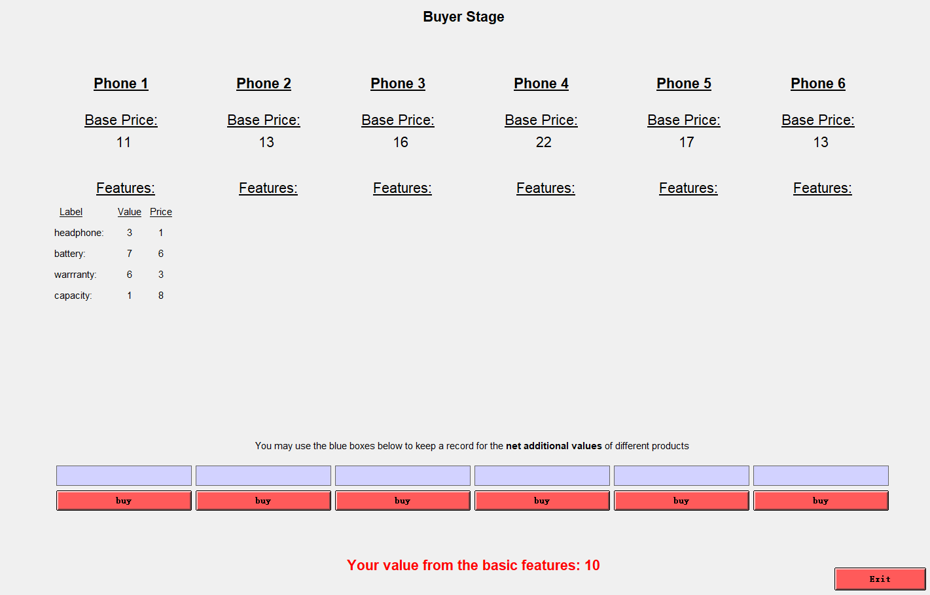

Slide 23
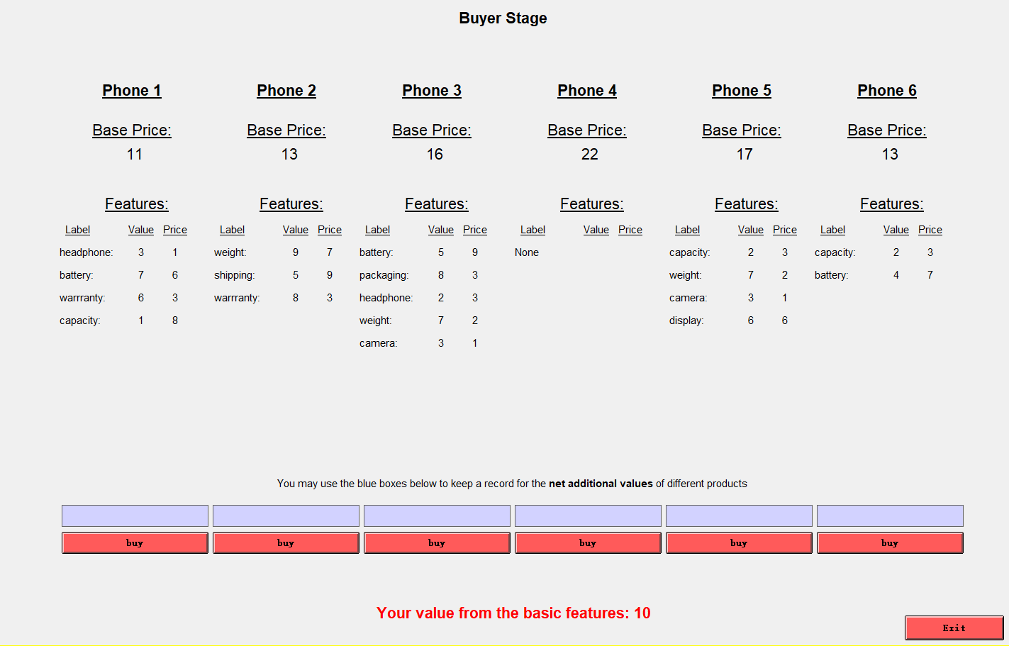

Slide 24
Overview of design (simplified)
Part 1
Obfuscation Market
20 periods
1.1 Seller Stage: Sellers design product
1.2 Buyer Stage: Buyers buy under costly time
Part 2
Bertrand Market
(Control Treatment)
The same as Part 1, with the only difference being that full transparency and simplicity are enforced
10 periods
Notes:
This is a simplied summary of the design, where we omit many complementary parts that are slightly less important.

Slide 25
Part 2: Bertrand market
Sellers make exactly the same decisions, but each product is summarized by one number “net additional value” only and displayed to buyers

Slide 26
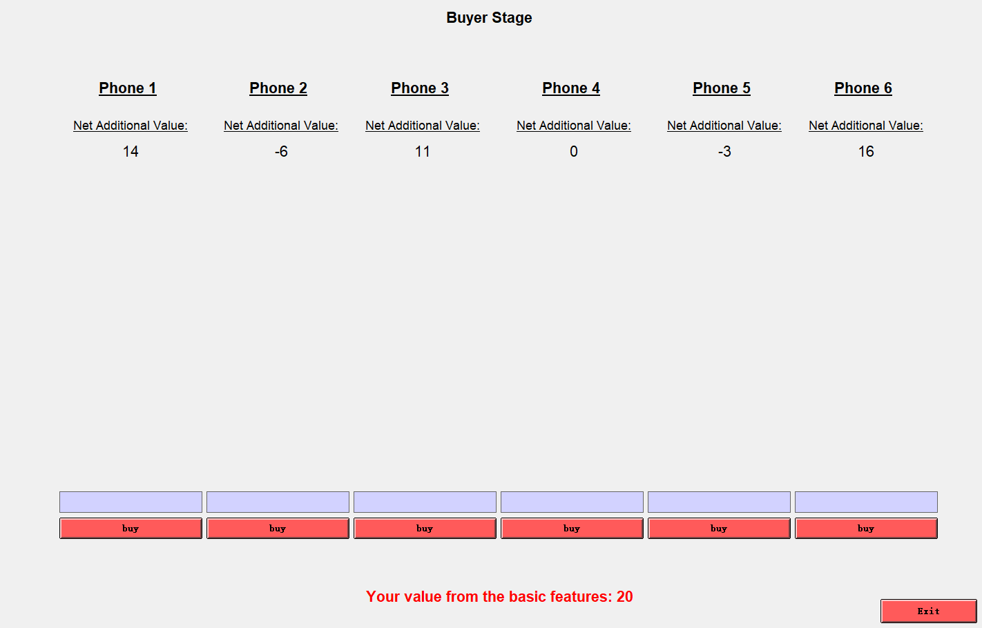

Slide 27
Overview of design (simplified)
Part 1
Obfuscation Market
20 periods
1.1 Seller Stage: Sellers design product
1.2 Buyer Stage: Buyers buy under costly time
Part 2
Bertrand Market
(Control Treatment)
The same as Part 1, with the only difference being that full transparency and simplicity are enforced
10 periods
Notes:
This is a simplied summary of the design, where we omit many complementary parts that are slightly less important.

Slide 28
Treatment conditions
Half Cost Treatment: sum of feature costs is always 50% of sum of feature values
Notes:
The optimal feature value is 30 rather than 44. Only 4 features are needed, and 5 and 6 features are completely unnecessary.
Sellers are provided with a table specifying the sum of feature costs for each possible sum of feature values.
May add the treatment of no efficiency gain if that works out…

Slide 29
Treatment conditions
Half Cost Treatment: sum of feature costs is always 50% of sum of feature values
Convex Cost Treatment: sum of feature costs is a convex function of sum of feature values
Notes:
The optimal feature value is 30 rather than 44. Only 4 features are needed, and 5 and 6 features are completely unnecessary.
Sellers are provided with a table specifying the sum of feature costs for each possible sum of feature values.
May add the treatment of no efficiency gain if that works out…

Slide 30
A small part of results
Notes:
The data is collected at University of Zurich.

Slide 31
Do sellers obfuscate (even inefficiently)?
Notes: The offered line in Convex Cost Treatment is significantly higher than 4 (p = 0.026) and significantly lower than the offered line in Half Cost Treatment (p = .009). All significance tests are clustered on the group level.
Notes:
Remember in the convex cost treatment, an average of 4 features should be enough, but the average reaches about 5.
Buyers have no problem buying complicated products, probably because most features look nice (values higher than prices).
Consider correct for 0s (but may not, because each feature is a 2-second gap anyway).
About what these two treatments say about how efficiency gain affects obfuscation level: at points where there is the biggest efficiency gain, sellers have the largest room to still appear nice (value > price) while earning profits. If sellers have limited ability to appear nice (when efficiency gain is low or zero), obfuscating by adding features will not converge to a similarly high level because buyers can always reasonably quickly judge whether each feature is nice or not and how much, with comparison with their time cost of viewing one feature and competitors (so attenuating value over more features is also bad).

Slide 32
Do sellers escape zero-profit trap?
Notes:
Consumer surplus is transferred to sellers in 2 steps:
1) the best product in the market is not necessarily providing the max possible consumer surplus (which only requires 1 of the 6 sellers to do it);
2) consumers do not always reach the max offered consumer surplus in the market.
I will explain why starting from here Bertrand market results are good benchmark but not before: I will explain the formula, and say that look, now we plot this net additional value, which is the one measure that summarizes products in the Bertrand market. So although all the components of this measure we just talked about in the Obfuscation market does not matter in the Bertrand market, but here it starts to matter.
Compared to the Bertrand market, we see that this consumer welfare loss is purely due to the complexity of the market.
For the Bertrand Market in the Convex Cost Treatment, I dropped 2 groups where there were a programming error (I am extremely terribly sorry…)

Slide 33
Do sellers escape zero-profit trap?
Notes:
This slide addresses the concern that in a Bertrand competition, a slight differentiation in goods can create a downward sloping demand function and therefore earn positive profit. The rationale there is that people have preference over these differentiated features; however here, these features are homogeneous to buyers, and it is the complexity that allows sellers to earn profits. In the exact same Bertrand with the same differentiation but no complexity, every buyer ends up with a better product and a lower price.
Consumer surplus is transferred to sellers in 2 steps:
1) the best product in the market is not necessarily providing the max possible consumer surplus (which only requires 1 of the 6 sellers to do it);
2) consumers do not always reach the max offered consumer surplus in the market.
I will explain why starting from here Bertrand market results are good benchmark but not before: I will explain the formula, and say that look, now we plot this net additional value, which is the one measure that summarizes products in the Bertrand market. So although all the components of this measure we just talked about in the Obfuscation market does not matter in the Bertrand market, but here it starts to matter.
Compared to the Bertrand market, we see that this consumer welfare loss is purely due to the complexity of the market.
For the Bertrand Market in the Convex Cost Treatment, I dropped 2 groups where there were a programming error (I am extremely terribly sorry…)

Slide 34
Do sellers escape zero-profit trap?
Notes: The max offered line in the Obfuscation Market is significantly lower than in the Bertrand Market (p = 0.000 in Half Cost Treatment and p = 0.010 is Convex Cost Treatment). The average traded line is also significantly lower than the max offered line in the Obfuscation Market (p = 0.001 in Half Cost Treatment and p = 0.001 is Convex Cost Treatment). All significance tests are clustered on the group level.
Notes:
Consumer surplus is transferred to sellers in 2 steps:
1) the best product in the market is not necessarily providing the max possible consumer surplus (which only requires 1 of the 6 sellers to do it);
2) consumers do not always reach the max offered consumer surplus in the market.
I will explain why starting from here Bertrand market results are good benchmark but not before: I will explain the formula, and say that look, now we plot this net additional value, which is the one measure that summarizes products in the Bertrand market. So although all the components of this measure we just talked about in the Obfuscation market does not matter in the Bertrand market, but here it starts to matter.
Compared to the Bertrand market, we see that this consumer welfare loss is purely due to the complexity of the market.
For the Bertrand Market in the Convex Cost Treatment, I dropped 2 groups where there were a programming error (I am extremely terribly sorry…)

Slide 35
Do headline prices attract attention and thus become low?
Buyers’ values
Buyers’ values
Sellers’ cost
Sellers’ cost
Notes: The offered base price line in the Half Cost Treatment from Period 11 on is significantly lower than 5 (p = 0.024). All significance tests are clustered on the group level.
Notes:
We might say why we have “or complex”: sales tax is a percentage and this is added complexity… The effort to find where and how much these added prices are is also complexity. The none-salient part is easy to “teach”, but the complexity part (which means consumers would rather not spend time figuring it out) is a way harder problem to solve.
The base price drops below cost almost to the price floor to attract consumers
Why there shouldn’t be Bertrand graphs: in Bertrand market, the separation of base price, feature values, and feature prices are completely meaningless (so is the number of features)! None of the three enter the considerations of sellers or buyers separately! Only the summed “net additional value” matters! So the data for these 3 parts are just noise that we should not use to distract our audience. Also, the AVERAGES of these prices matter in the Obfuscation market, because essentially every offer is playing a role; but in Bertrand market, it’s not really true given that the market is so transparent.

Slide 36

Where do sellers earn profits?
Notes:
Sellers get most of their earnings from the extra features, while consumers are actually earning little surplus from the features
Buyers do not really end up with much better products than the average products in the market
I don’t think there should be a Bertrand graph again, for the same reasons.

Slide 37
Where do sellers earn profits?
Buyers’ earnings
Sellers’ earnings
Buyers’ earnings
Sellers’ earnings
Notes: The sum of feature prices line is significantly higher than the sum of feature costs line (p = 0.001 in Half Cost Treatment and p = 0.008 in Convex Cost Treatment). All significance tests are clustered on the group level.
Notes:
Sellers get most of their earnings from the extra features, while consumers are actually earning little surplus from the features
Buyers do not really end up with much better products than the average products in the market
I don’t think there should be a Bertrand graph again, for the same reasons.

Slide 38
Important Open Questions & Answers
Are sellers able to escape the “zero-profit” trap by obfuscating consumers with add-on features? Yes! If so, how much profit do sellers make from obfuscation? Up to 40% of consumer surplus!
Do sellers indeed use headline prices to attract consumers' attention, so that consumers are more likely to buy products with low headline prices? Yes! (Ellison, 2005; Hossain and Morgan, 2006; Chetty et al. 2009; Allcott, 2015; Taubinsky and Rees-Jones, 2018; and many others) If so, do sellers reduce headline prices even below marginal cost , but still earn higher profits? Yes!
Do sellers' choose inefficiently high obfuscation levels that even reduce overall (consumer + producer) surplus ? Yes!
What factors explain the level of obfuscation? Efficiency-enhancingness of features facilitate obfuscation, because they allow the complex products to still look nice rather than obviously exploitative (eg. in Ellison & Wolisky, 2012)!
……
Notes:
Say: experiments are very good in answering many of these questions, because we know exactly the production cost, eliminate noisy heterogeneity and confounds in the field, and can control for environmental factors. We will answer the first 4 in the presentation today, and our study can answer many more additional questions.
Loss-leader: used in a multi-product setting; well yes here we don’t have multi-product but the headline price serves similarly as a way to attract buyers. And the fact that it works in the field already show that many buyers like the upgraded products (so they find value higher than price) although the price is really above marginal cost. Sellers are able to charge high price for them exactly because of the search cost. Or in another word, we might as well allow buyers in our experiment to choose the base product only from any seller, but we really do not anticipate them doing that because these features are apparently nice.
(may put the following after experimental design) We do not (yet) focus on
- Shrouding attributes (so buyers are fully aware of the possible existence of feature values and prices)
- Deceptive advertising (so any information displayed about the product is true)
- Obscure perception of feature value or price because of unfamiliarity with jargons etc. (so buyers are provided the accurate levels of feature values and prices)
- Incomparability because of format difference (so complexity is measurable on a continuous scale)
- Uncertain or optional add-on costs (so there is no change that any add-on cost will not occur and no element of buyers’ overconfidence or over-optimism)
Our only frictions are searching process and aggregation of multiple features.

Slide 39
Feature values & prices
How do sums of feature values and feature prices evolve?
Notes:
Sellers get most of their earnings from the extra features, while consumers are actually earning little surplus from the features
Buyers do not really end up with much better products than the average products in the market
I don’t think there should be a Bertrand graph again, for the same reasons.

Slide 40
Unnecessary complexity
Do sellers make their products overly complicated than their sums of feature values require?
Notes:
Sellers make their products unnecessarily complex, which obfuscates the market even more. The last a few columns cannot over obfuscate much, by construction of the design.
Consider correct for 0s (but may not, because each feature is a 2-second gap anyway).

Slide 41
An additional obfuscation
The average differences between the value and price of all the features are supposed to be the same because each feature value and price are randomly assigned…
Notes:
The features that are more on the top turn out to be more valuable, although they are supposed to be randomized if no seller ever intentionally re-randomizes to have this pattern in their products

Slide 42
Consumer welfare loss 1
How many consumers bought the best product available in the market?

Slide 43
Consumer welfare loss 2
How much time do buyers choose to spend in the market?
Notes:
Compared to the Bertrand market, consumers waste costly time to search
Consumers on average do not choose to spend much time searching, although if they are willing they can and maybe tell the markets more perfectly
There is some complexity difference in the two treatments, but the time that buyers choose to spend in the markets are not very different

Slide 44
Consumer welfare loss 3
Do buyers all trade when it is beneficial?
Notes:
Compared to the Bertrand market, there are fewer trades taking place

Slide 45
Consumer welfare loss 3
How much efficiency is lost from insufficient trade?
Notes:
Compared to the Bertrand market, there are fewer trades taking place

Slide 46
Coverage of consumer search
How much of the market do consumers search?
Notes:
Less than half of the market is covered by consumer search
There exist repetitive searches, which is another inefficiency (limited memory?)

Slide 47
Depth of consumer search
How far do consumers search each product on average?
Notes:
The difference is because there is in general less complexity in the convex cost treatment. Across the 2 treatments, the average number of searched features per product is XX.

Slide 48
First searched product
Are consumers attracted by low headline prices?
Notes:
Consumers are attracted by low headline prices
If you have A LOT OF time, have a slide show of 1st, 2nd, 3rd, … searched product

Slide 49
What product is profitable?
 | Half Cost Treatment |  | Convex Cost Treatment
 | Units sold | Profits | Units sold | Profits
Base price | -0.17*** (0.01) | -1.22** (0.36) | -0.14*** (0.01) | -1.24** (0.35)
Number of features | -0.07 (0.09) | -1.61* (0.66) | -0.08 (0.11) | -0.41 (1.31)
Ʃ Feature values | 0.06*** (0.01) | 0.36*** (0.08) | 0.06** (0.01) | 0.34 (0.20)
Ʃ Feature prices | -0.04** (0.01) | 0.45** (0.16) | -0.04 (0.02) | 0.05 (0.39)
Base price: min in mkt | 0.16** (0.02) | 2.38*** (0.59) | 0.11** (0.03) | 1.89*** (0.37)
Number of features: min in mkt | -0.12 (0.04) | -1.60*** (0.32) | -0.17 (0.10) | -2.93 (1.92)
Ʃ Feature values: max in mkt | -0.02 (0.02) | -0.02 (0.25) | -0.00 (0.01) | -0.31 (0.23)
Ʃ Feature prices: min in mkt | -0.00 (0.02) | 0.06 (0.21) | 0.00 (0.02) | 0.45 (0.38)
Constant | 2.75** (0.76) | 3.81 (10.43) | 2.44** (0.55) | 27.41* (11.86)
Notes: The regressions are clustered on the group level. *** indicates significance at the 0.01 level, ** at the 0.05 level, and * at the 0.10 level.
Notes:
Half cost treatment, and just say if in convex cost treatment we have similar results.
Cluster on the group level

