Slide 1



Multiattribute multialternative decisions as a consequence of efficient computation
Sloan-Nomis Workshop
Vickie Li
chui.li@psy.ox.ac.uk
Chris Summerfield
Notes:
Today I will be talking about “multi-attribute multi-alternative decisions as a consequence of efficient computation.” The project is still at its beginning stage, so any comments would be very appreciated.

Slide 2

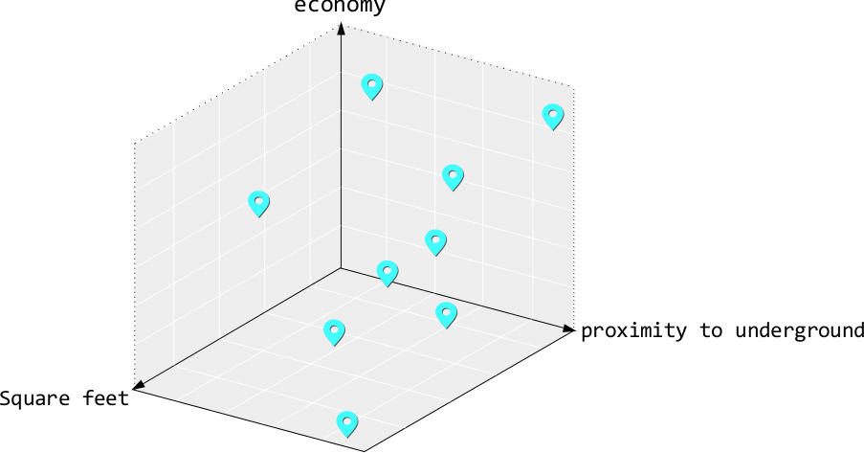
Multiattribute multialternative decisions
In real life, we need to make decisions about multiple options that are characterised with multiple attributes
Notes:
Decisions we face in the real world often involve choosing from multiple options in a choice set, and each of these options is multi-dimensional. For example, choosing which apartment to rent would involve checking out the rent, the size, and the location for each of the apartment we are interested in.
Since naturalistic options can be characterised by multiple attributes, we can visualise or describe each option in a multi-dimensional space.

Slide 3
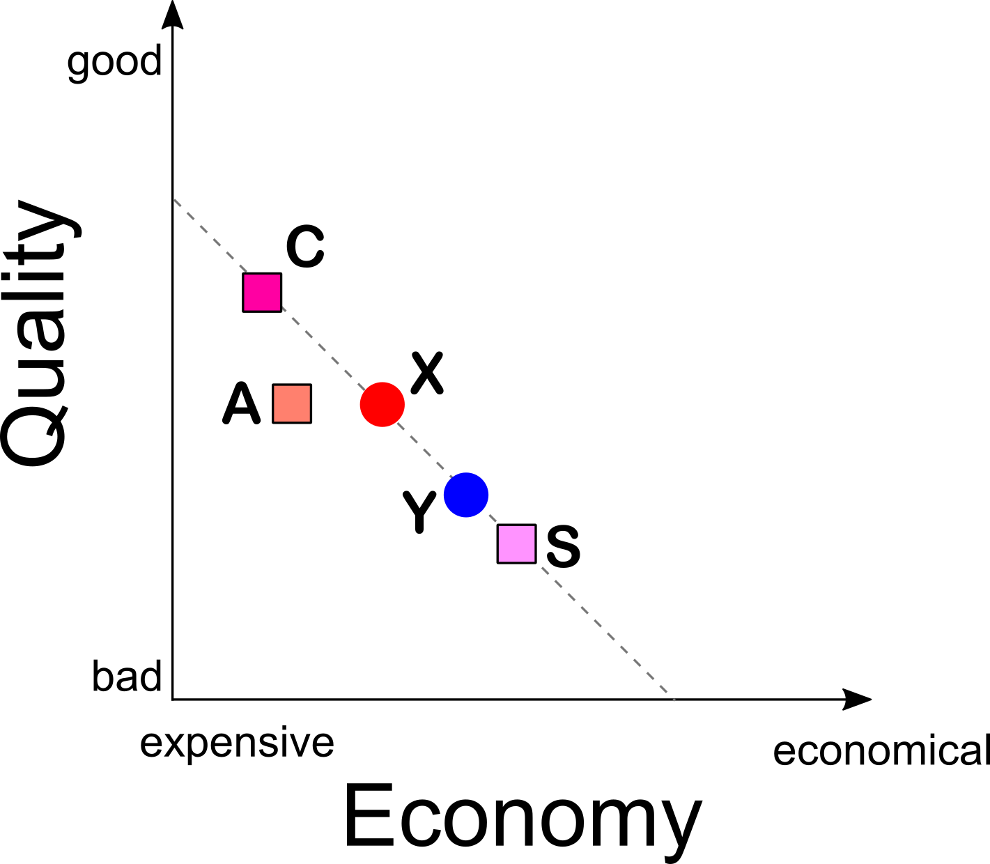
Decoy effects
Compromise
Attraction
Similarity
Preference for multi-dimensional options reverses in a stereotypical way
Notes:
In a simple case where options are described with only two attributes, such as quality and price. A large body of literature in judgement and decision making suggests that human preference can be reversed in a predictable manner when they are presented with three options. For instance, a decision maker might have a preference that he prefers a better quality but more expensive item X or a cheaper item Y that has mediocre quality. People usually would prefer X over Y when they are presented along with a third option called as a decoy – in squares. Commonly, three types of decoys have been defined – Compromise, Attraction and Similarity decoy. The definition of the decoy depends generally on its location in this two dimensional space.

Slide 4
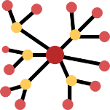
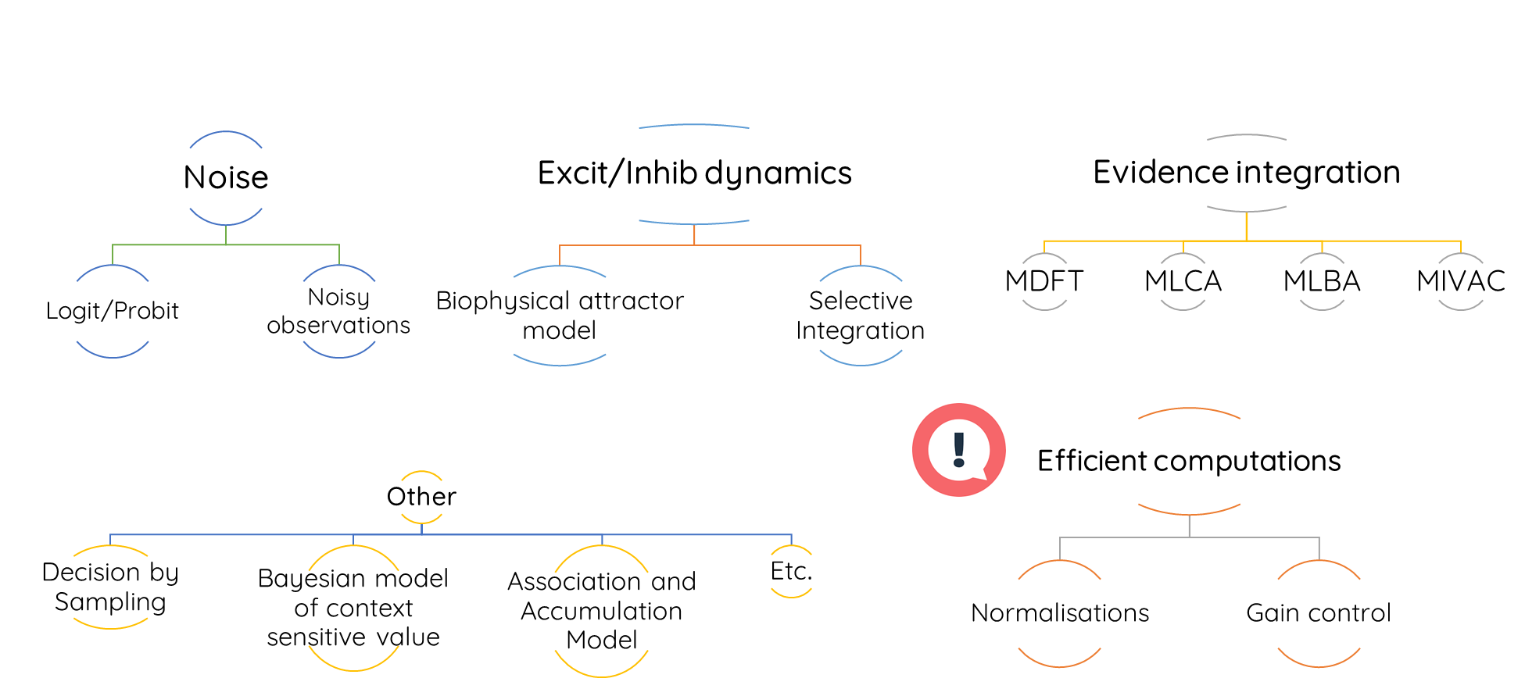

Models on context-dependent decisions
Range Normalisation
Range Adaptation
Divisive Normalisation
Notes:
Diverse theoretical models have been proposed in the cognitive science and neuroscience domain to explain these decisions. They ranged from models that assume preferences are constructed inaccurately- that is the noise models, to temporal dynamics models that might incorporate realistic biophysical features of the human brain. Each class of models has its strengths in terms of either the explanatory power, model simplicity, or biological plausibility. The class of models that I am particularly interested in is those that assume the brain constructs preferences based on efficiency-principled and biologically-plausible computations, such as range adaptation by padoa-schioppa, range normalisation by Soltani and colleagues, divisive normalisation by louie and Glimcher.

Slide 5
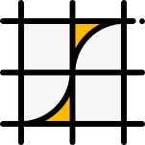
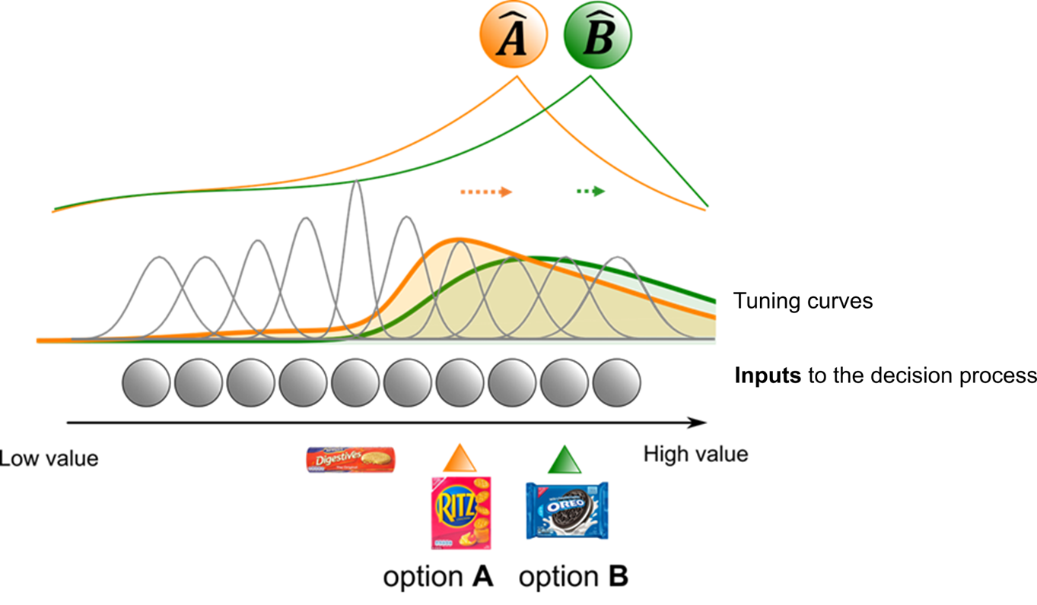
Adaptive Gain model
Decoy
Contextual signals from the environment governs the gain for processing consistent information during decision-making tasks
Cheadle et al., 2014; Li et al., 2018
Notes:
Lastly, there is this adaptive gain model, which has a different functional form. However the spirit of the model aligns with the two forms of normalisation schemes.
The adaptive gain model is a recent computational framework that proposes that contextual signals determine how multiplicative gain is allocated to information that is consistent with the context. Importantly, what we mean by context here depends on the task at hand. Both the statistics of the environment or behavioural relevance can serve as a context. A recent work of mine with Chris showed that population codes that involve sharpening of tuning curves on neurons that encode the context can explain a variety of perceptual, cognitive and value-based phenomena.

Slide 6
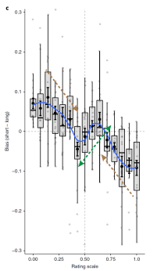
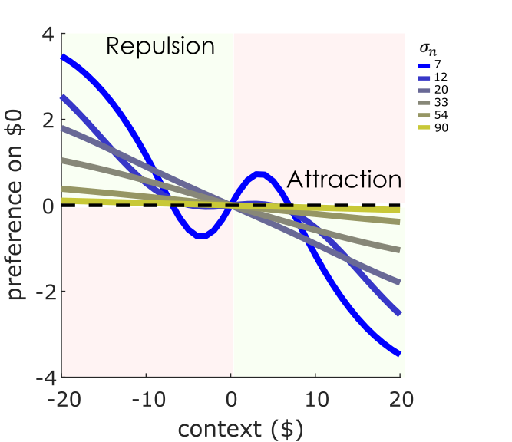
Adaptive Gain model
Polania, Woodford & Ruff (2019)
Inherent repulsion and attraction dynamics caused by the sharpening is the basis for capturing behavioural biases
Notes:
The reason is precisely because of the inherent repulsion and attraction dynamics predicted by the model. For example, $0 prospect can be seen as a bad outcome when the context generally offers positive prospects. Alternatively, it might appear as a good outcome when the context offers negative prospects. Here, different coloured lines correspond to a parameter in the model that controls the degree of sharpening. Our model predicts that an agent who is highly influenced by the context display a preference illusion pattern which is described in a recent work by Polania and colleagues.

Slide 7

Key motivations
No empirical work has systematically examined context effects with parametric decoy values that span the entirety of attribute space
It remains unexplored how decoy effects can arise from efficiency-principled and biologically-plausible computations
Notes:
This project consists of two independent goals.
Many of the models were proposed to explain decoy effects based on some choice set they constructed specifically. These models made predictions on how preference should change as a function of parametric decoys, however, no one has empirically investigated this.
Importantly, some recent work in psychology and behavioural economics showed that decoy effects can reverse, not exist in certain tasks or not exist in certain people. By testing decoys that can span the entire attribute space, we avoid having to loosely define the decoy types for our choice set. Lastly, a separate goal of this project is to investigate if it is possible to distinguish different biologically plausible efficient computations simply using behavioural choice data.

Slide 8

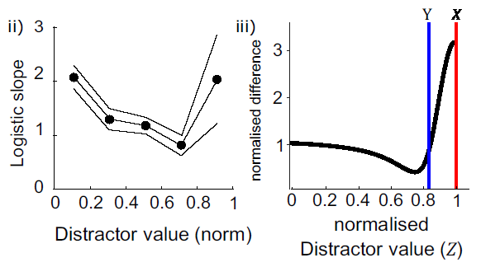
benchmarks
Positive and negative distractor effect in the single attribute case
Louie, Khaw & Glimcher (2013)
Li et al. 2018
Notes:
For each of the model of interests, we can take some qualitative benchmarks to test whether the model makes different predictions.
First, we can look at the simplest case where options are only defined by a single attribute. In the Louie and colleagues task, they found that the relative preference on the best and the second best option depends on the value of a third inferior option. In particular, human subjects showed a decreasing preference for the best option as the distractor value increases up to when the distractor approaches the value of the target options, then the preference for the best option increases again. Using the adaptive gain model, we are able to model both negative and positive influence of the distractor.

Slide 9
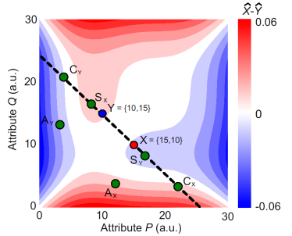
benchmarks
The effect of parametric decoy values in the attribute space
Li et al. 2018
Notes:
We can then use model simulation to predict how preference change as a function of parametric decoys. Let’s say we have two iso-valued options here: X and Y, and they each dominate in one of the attributes. Then we can simulate how each combination of decoy attribute values predicts a preference on option X over option Y. Here, what I am showing is the model estimated difference in the value for option X and Y. with red surface meaning a preference for option X, and blue surface meaning a preference for option Y. The adaptive gain model is able to predict all three decoy effects –Similarity, Compromise, and Attraction decoy using a single set of parameters.

Slide 10
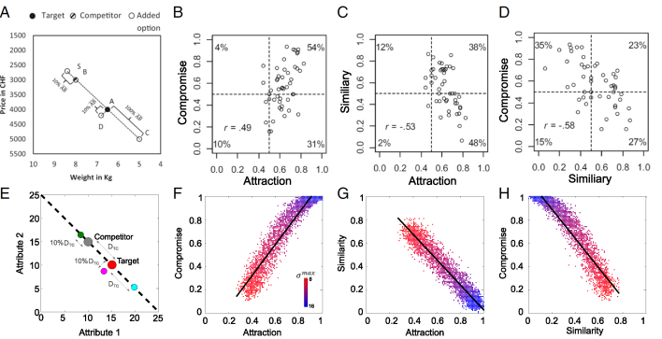
benchmarks
Intercorrelation of decoy effects and individual differences
Berkowitsch, Scheibehenne & Rieskamp (2014)
Li et al. 2018
Notes:
We can also simulate how the three decoy effect correlate with each other as previous work has shown that not all people display all three decoy effects. At the cohort level, people usually simultaneous show attraction and compromise effect but not with similarity effect.
We created 40 simulated subjects, assuming that each of them have different sensitivity to the context, modulated by a parameter in our model. Plotting their relative preference for the target option, we can see that the model is able to re-create the correlation of the three decoy effects.

Slide 11
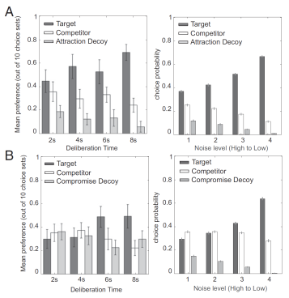
benchmarks
The effect of time pressure on the strength of decoy effects
Li et al. 2018
Notes:
Lastly, previous work showed that participants display stronger decoy effects if they have more time to deliberate for their decisions. This finding is in fact in contrast to heuristic-based models which assumed that heuristics occurs when one has little time to think. To ask whether our model can capture this, we assume that a shorter time to deliberate means more noise in the decision-making process. By varying the signal to noise ratio, we saw that our model predicts a stronger decoy effect under low noise level or longer deliberation condition.

Slide 12

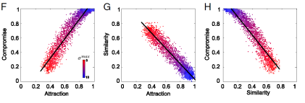
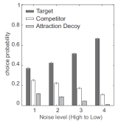
benchmarks
Positive and negative distractor effect in the single attribute case
The effect of parametric decoy values in the attribute space
The effect of time pressure on the strength of decoy effects
Intercorrelation of decoy effects
Li et al. 2018
Notes:
For all of the model of interest, we can simulate whether the model can capture these qualitative benchmarks. However, for today, I will focus on the parametric decoy effect.

Slide 13

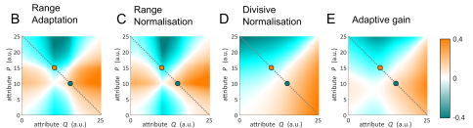
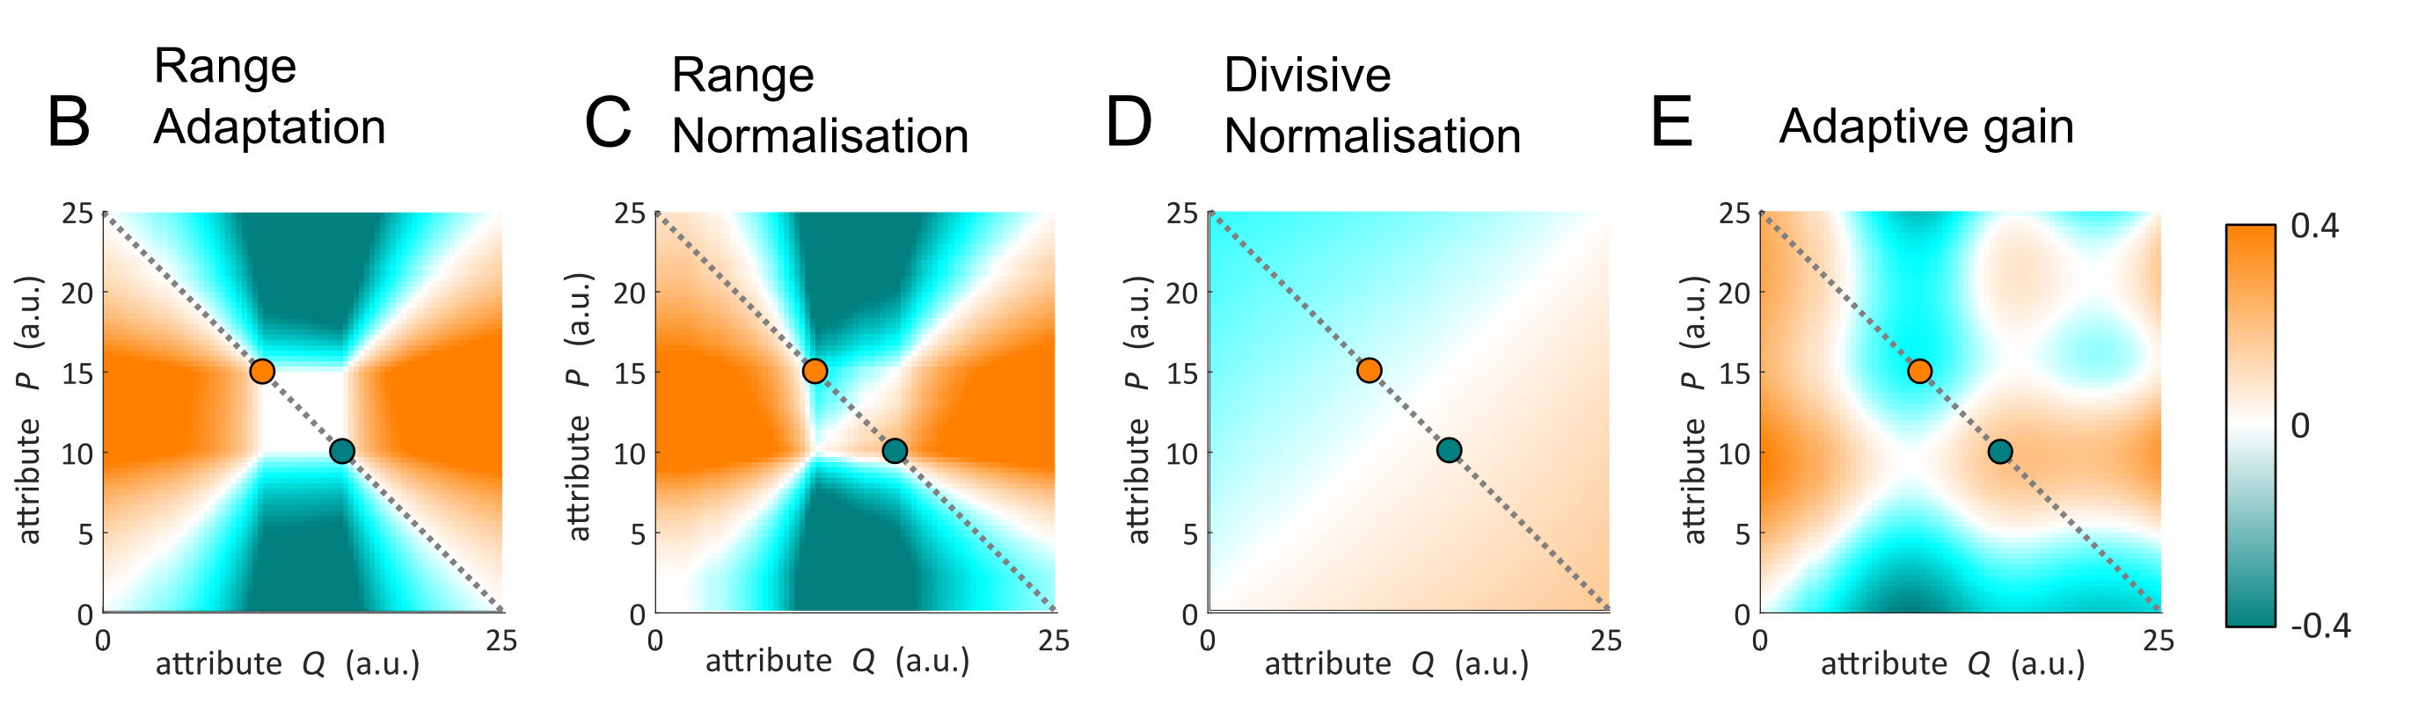
Qualitative signatures
Attribute-wise comparison
Alternative-wise comparison
Notes:
We assume that participants can engage in two types of comparison process. They could compare options within each attribute and then average the choice probability for option selection, Or they can first integrate attribute values before comparisons.
It results in 8 different models, including two versions of range normalisations, divisive normalisation and adaptive gain model.

Slide 14
Qualitative signatures
Attribute-wise comparison
Alternative-wise comparison
Distant decoys should result in a stronger decoy effect (Soltani et al., 2012)
All three decoy effects can be explained by single parameterisation (Berkowitsch et al. 2014)
The model has the flexibility to explain reversals of decoy effects (Spektor et al. 2018)
Notes:
For each of these 2D maps we can check whether each model can predict the followings:
it has been shown that people exhibit stronger decoy effects with more distant decoys. Some individuals display all three decoy effects in the same task, so does the model have a set of parameters that can capture all three decoy effects? Lastly, some recent work showed that decoy effects can be reversed. E.g. an attraction decoy that should boost the preference for option X now results in a preference for option Y.

Slide 15

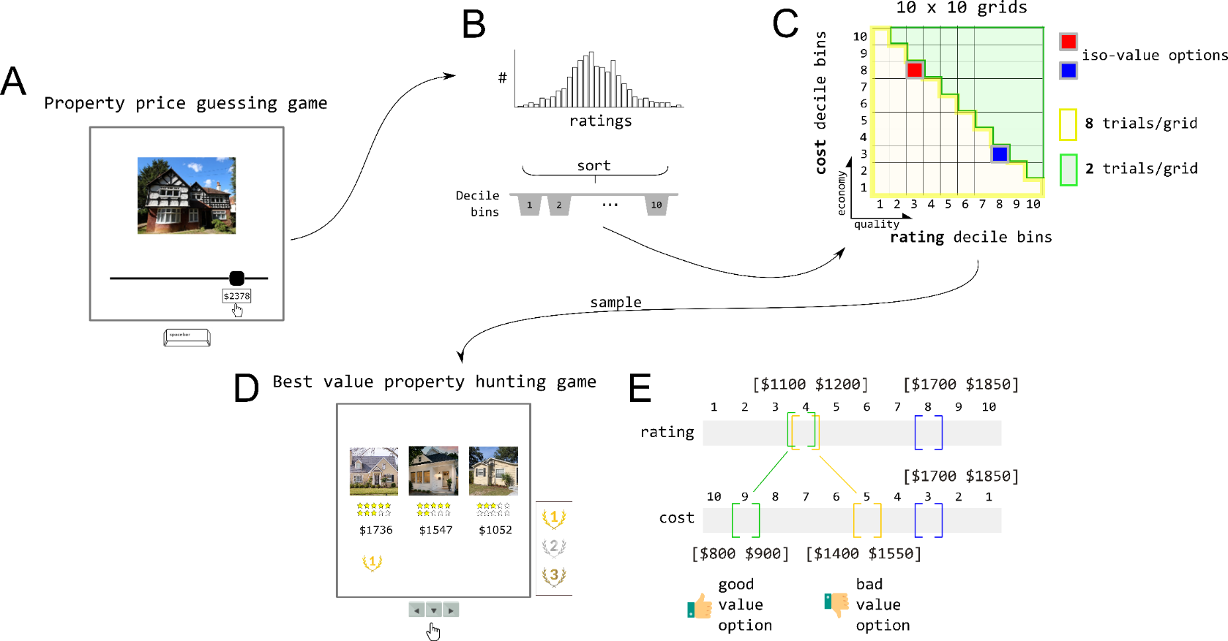
Task
We invented a decoy task with options that are carefully calibrated based on participants’ preferences
Notes:
Next, we created a task so that the human choice data can be used as a basis for quantitative model comparison. Let me go through the task.

Slide 16
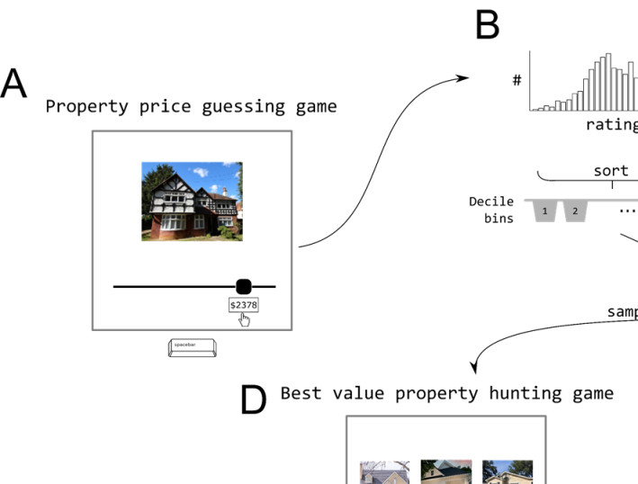
Notes:
Subjects first need to complete a “property price guessing game”, which is a rating task. They are shown with a US property image I found in Zillow, and they have to guess what is the market monthly rent of this house.

Slide 17
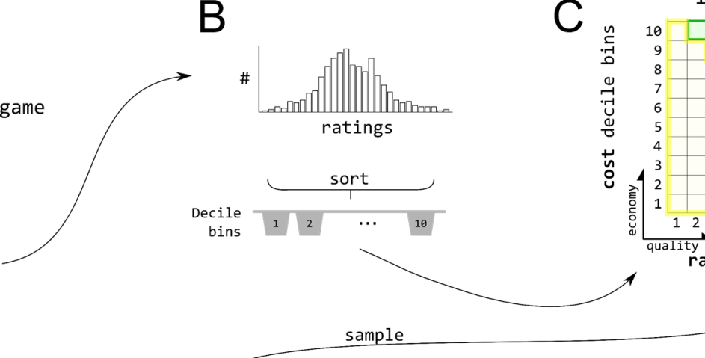
Notes:
In total, they see 250 unique houses and make two ratings each. Taking these ratings, we discretise them into 10 decile bins.

Slide 18
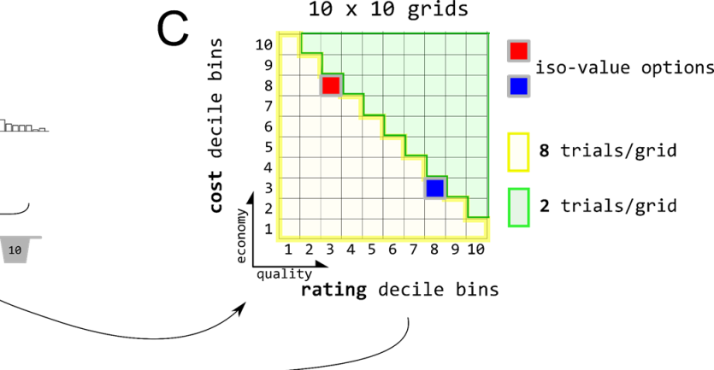
Notes:
To construct the choice task, we assume that each house can be described by two attributes: quality and economy. We assume that the quality dimension is reflected by how much the participant think the house worth in market price. We then construct the cost or economy dimension, which refers to how much we --the experimenter is charging someone to rent a particular house.

Slide 19
Notes:
Importantly, the bin edges of the cost bins match perfectly with the rating decile bins. Therefore grids in the diagonal here represent options that have a matching quality and cost, which we call them iso-value options.

Slide 20
Notes:
Grids that are under the diagonal refers to options that are inferior. Grids that are above the diagonal refers to options that are superior.

Slide 21
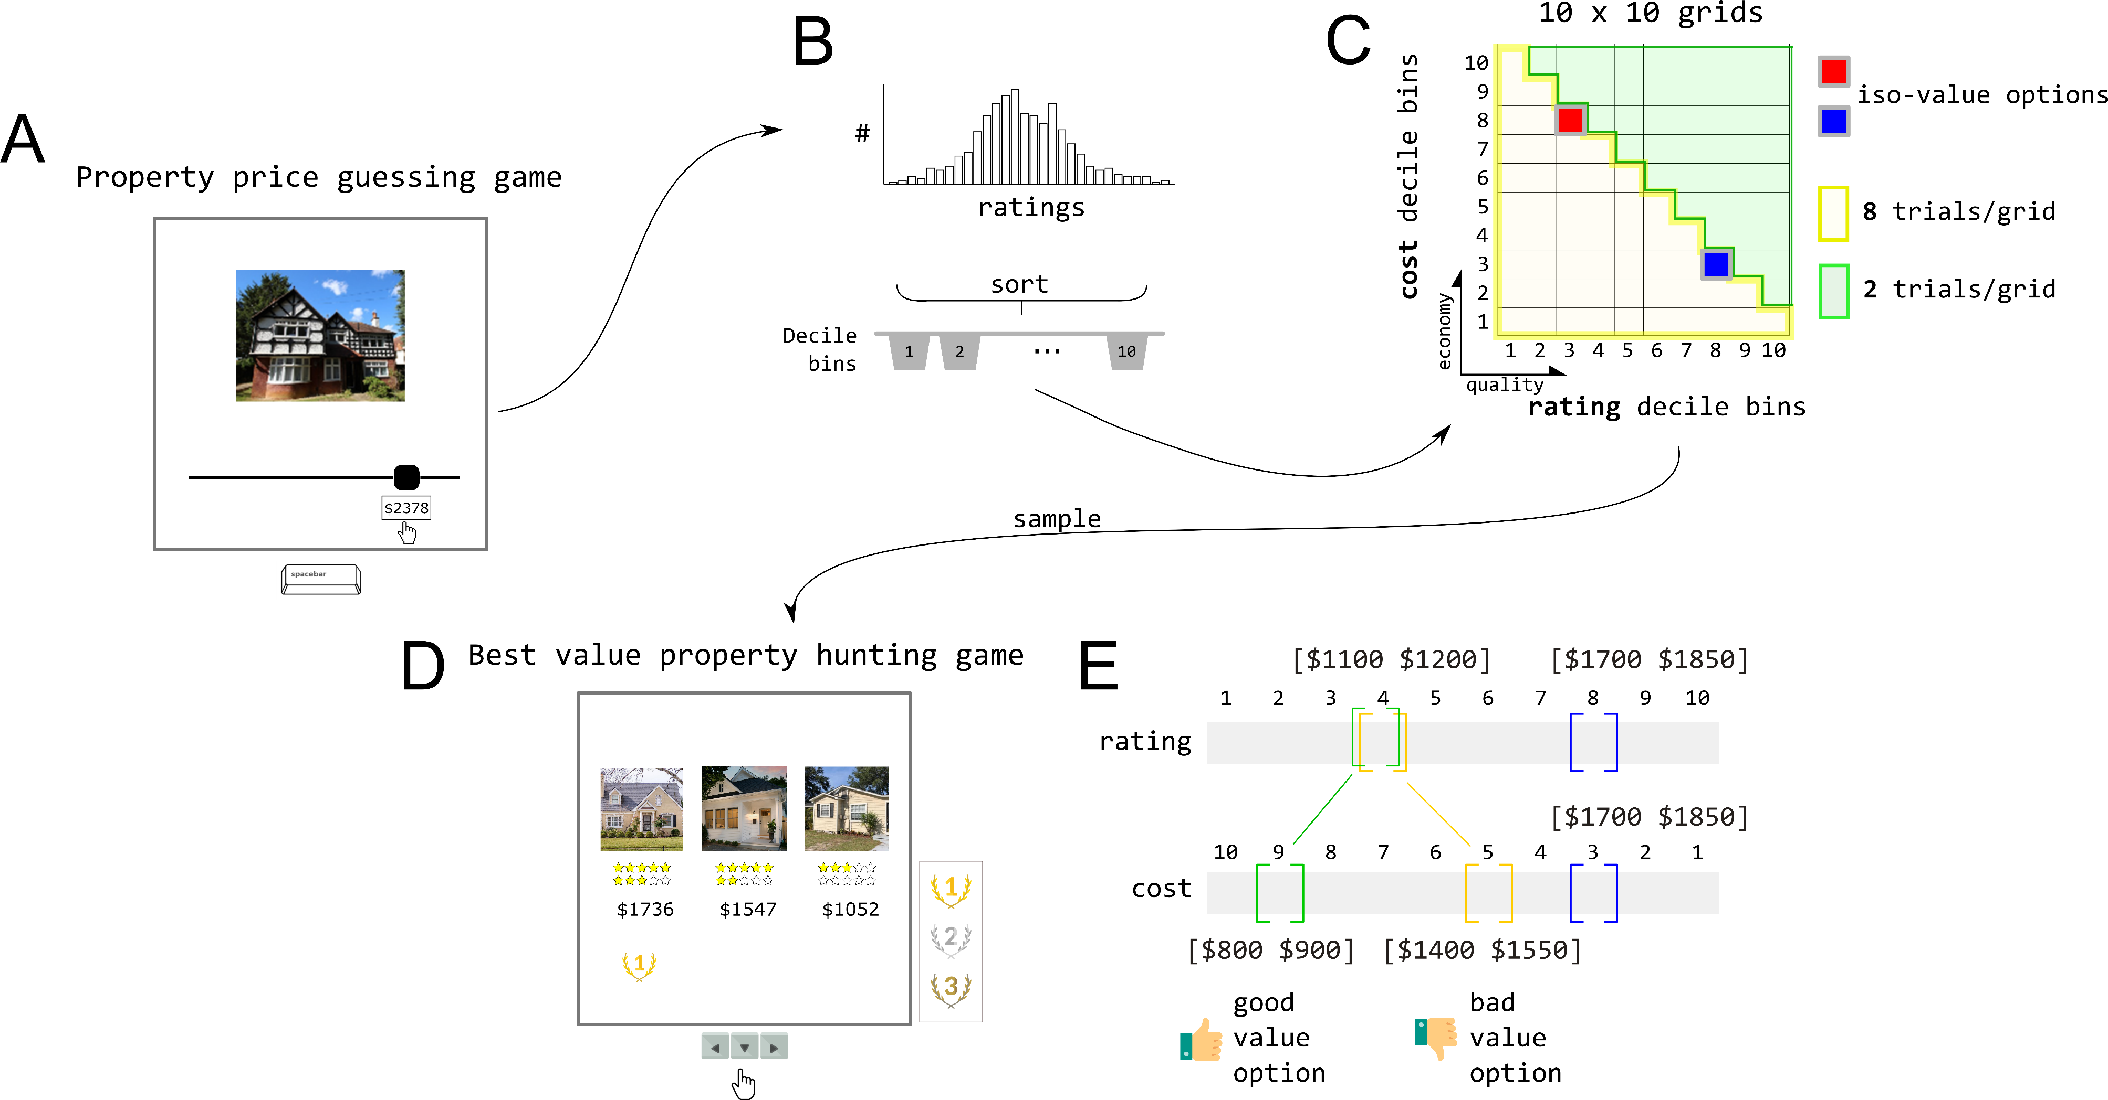
Notes:
We sample different options into the choice task. On each trial, we show them three options. Two of the options are iso-value options i.e. option that has a matching rating and cost (they are the red and blue grid I showed on the last slide). The third option is a decoy option that can be sampled from any of those 10 x 10 grids. Under each option, there is a star rating and a price. They represent how much they rated this house and how much it cost to rent this house for a hypothetical tenant. Subjects need to give three recommendations from the best value to the worst value, that is pick the option that costs little to rent but worth a lot in market price. Their recommendation performance gets translated into a real bonus payment at the end of the experiment.

Slide 22
Notes:
Here is an example of how an option can be iso-value or good value or bad value. An option is iso-valued when the rating and the cost is matching. The same house that is charged with a lower cost is a better value option than when it is charged with a higher price.

Slide 23
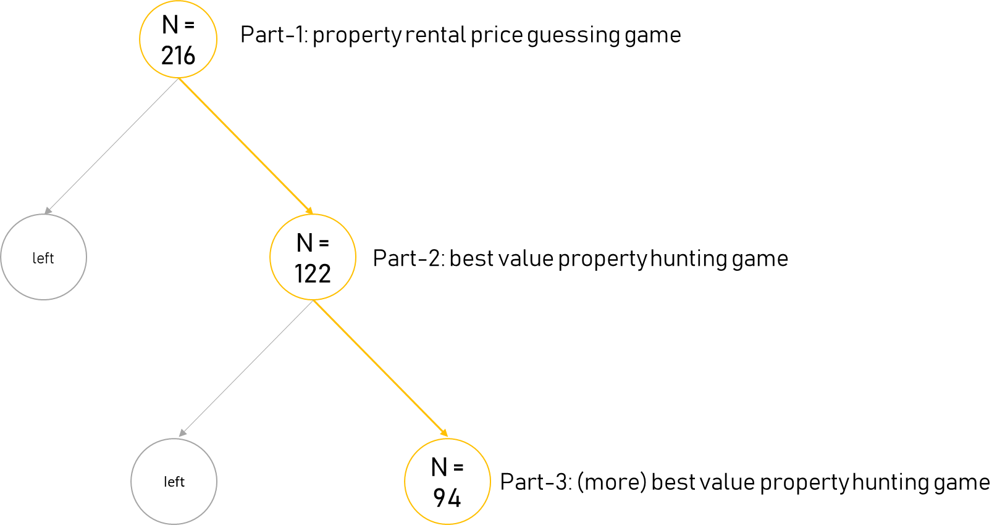
Participants
Notes:
We have just collected some pilot data. So far, we have got 122 mturk US-located subjects completed the choice task. Out of which, 94 of them opt-in to complete more trials of the choice task. Not explicitly mentioned to the subjects, the third choice task consists of the same choice sets presented in randomised trial order. In this case, we can measure to what extent subjects repeat their choice.

Slide 24

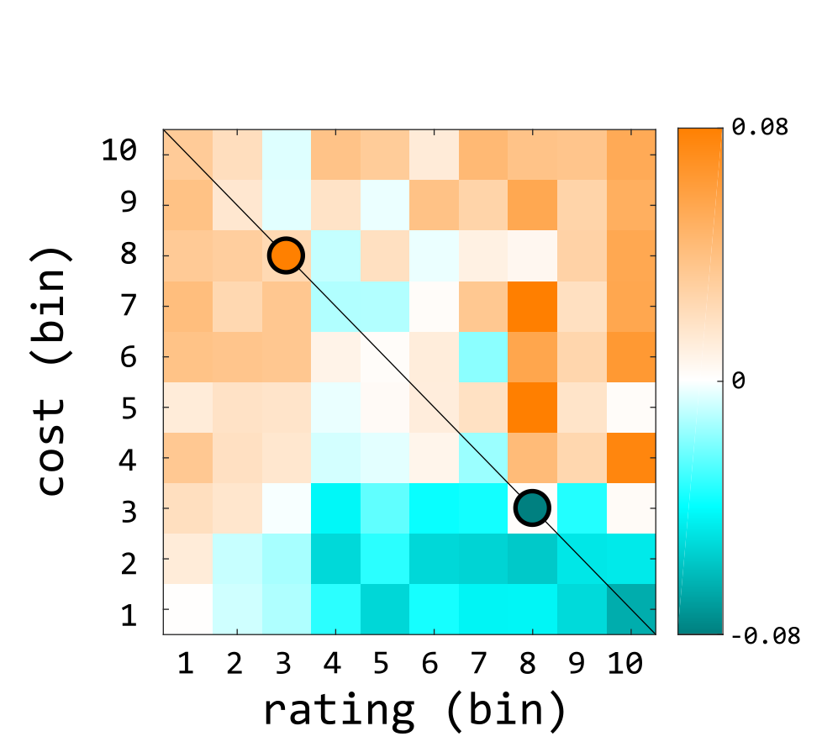
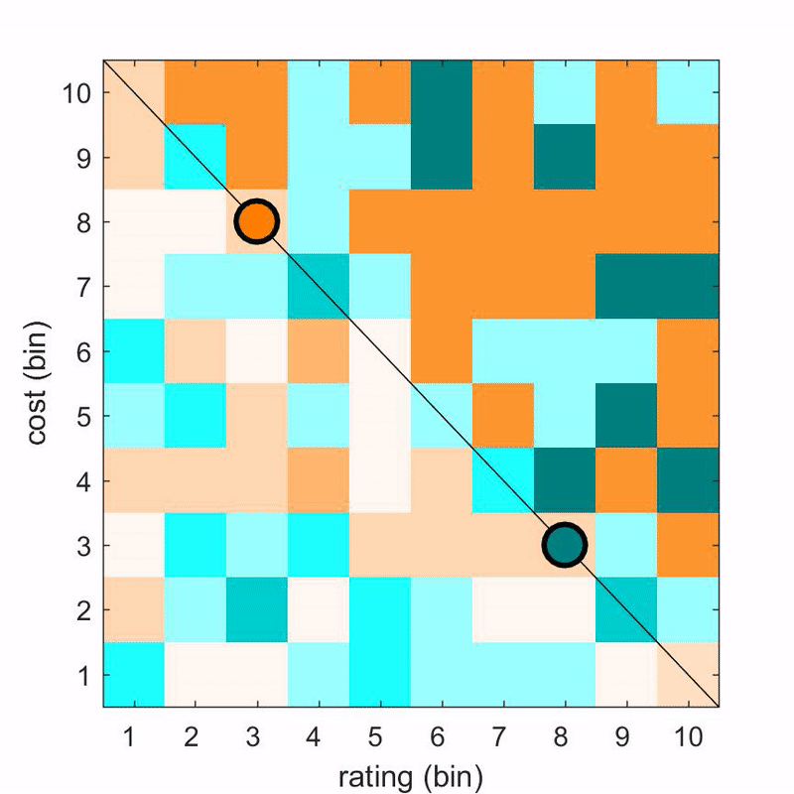
Parametric decoy choice pattern
Group average
Individual choice pattern
X
Y
Notes:
Here is the choice data based on those subjects. On the left, it shows the relative choice preference for option X over option Y for decoy options that fall into each of the 10 x 10 grids, averaged across all subjects.

Slide 25
Parametric decoy choice pattern
Group average
Individual choice pattern
X
Y
Notes:
We found that our task shows very strong attraction and compromise effect. On the right here, I am showing you the relative choice preference from each individual subject.

Slide 26

Preliminary model fits
Divisive Normalisation
Range Normalisation
Range Adaptation
Adaptive Gain
Preliminary model fitting showed the possibility to disentangle models in terms of both qualitative and quantitative comparisons
Notes:
I have just started to fit some models on attribute-wise comparisons. For the first try, I fitted these models to the human group average choice probability. It looks like it is possible to separate different models qualitatively and quantitatively. For my next step, I am going to complete model fitting for the rest of the models.

Slide 27

Open questions
Open large-scale dataset
What can we get out of individual’s choice data?
  Decoy effects as a consequence of aggregating idiosyncratic individual choices?
Notes:
When this project started, the primary goal was to offer the scientific community a large-scale open dataset for those who are interested in putting their model at test using this data set. This was to address the recent call for the need to replicate a series of behavioural phenomena. Especially in the recent years, some papers from psychology and economics domains suggests that decoy effects might appear in more specific settings and also might be weaker than we think. Part of the reason we think that is the case perhaps has a lot to do with the fact that the definition of decoys is not quantitatively defined. Before we collect more data, I hope that we have created a task that is methodologically rigorous and is accepted by the community.
A related open question would be whether individual choice data is meaningful. We saw that individual choice pattern is very variable. However, averaging the pattern results in something like the canonical decoy effects. One possible explanation for this is that decoy effects are in fact an outcome of some idiosyncratic choices which is highly dependent on very trivial factors.

Slide 28
Thank you

Slide 29

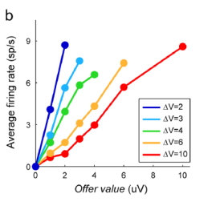
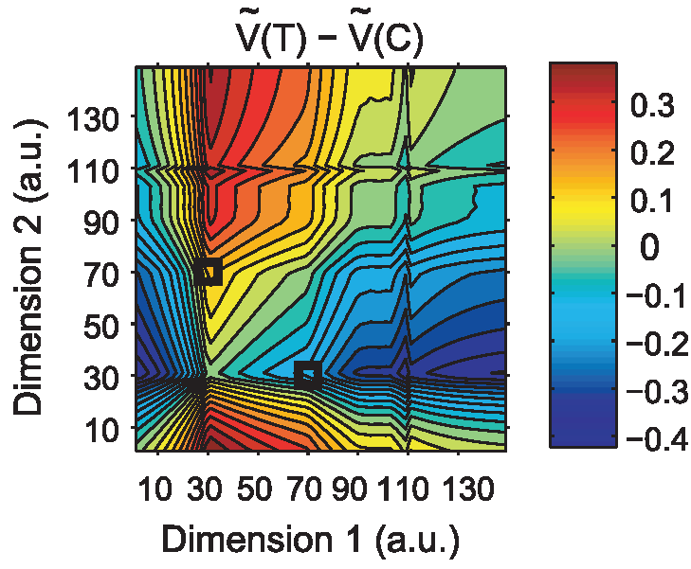
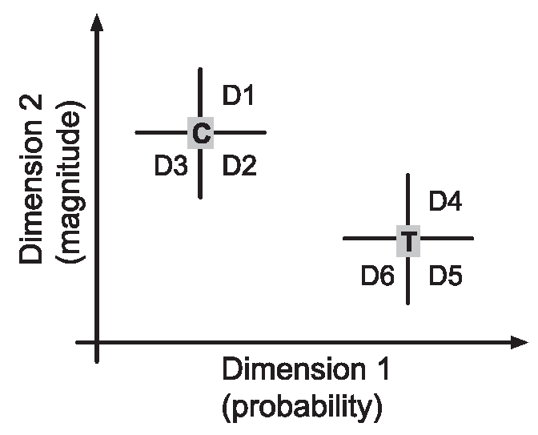
Efficient computations
Range adaptation
Range normalisation
Padoa-Schioppa (2009)
Soltani, De Martino & Camerer (2012)
Notes:
In particular, two forms of normalisation schemes have been proposed in the service of achieving neural efficiency. One form of normalisation scheme suggests the neural activity is scaled by the range of values observed by the observer. This is motivated by the observation that firing rate of neurons in the orbitofrontal cortex does not scale linearly with the options we face but depend on the range of values we observe.
In an experiment, monkey has to choose between two juices. The ratio on the amount of juices from each option varies on a trial by trial way. They found that the population activity in the orbitofrontal cortex depends on the value range in an experimental session – that is the difference between the maximum value and the minimum value of juices in a particular session.
Later, behavioural modelling work showed that decoy effects can be explained by a similar adaptation scheme where the range of values is defined by the choice set we face on a given trial. Soltani and colleagues tested the model with a gamble task with three options using 6 different locations as decoys.

Slide 30
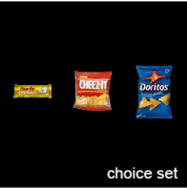
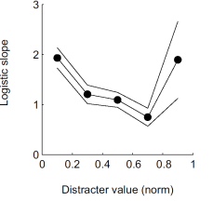
Efficient computations
Divisive normalisation
Louie, Khaw & Glimcher (2013)
Notes:
The other form of normalisation scheme is the divisive normalisation, which was originally proposed to explain neural codes in brain areas responsible for sensory processing. Unlike range adaptation schemes, divisive normalisation assumed that neural activity is scaled by the total activity from a pool of neurons- such as the total neural activity for encoding existing options in a choice set. Later work showed that the parietal region – a brain area that is known for accumulating evidence for a decision or action appears to perform divisive normalisation, and that such a model can explain context-dependent value-based choice.

Slide 31

Next steps
  Complete model fitting
  Model fitting on trial-by-trial choice data
  Exhaustive qualitative comparisons
    Intercorrelations
    Effect of time pressure
    Effect of choice set distributions
  Collect more data

Slide 32
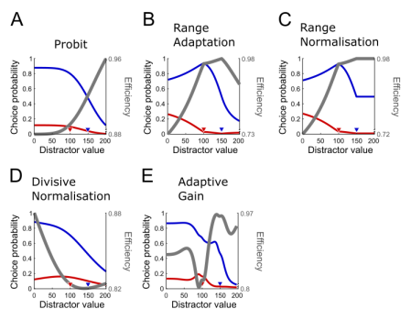
Simple distractor effect
Model | Positive distractor effect | Negative distractor effect
Probit | High distractor | N/A
Range adaptation | Low distractor | High distractor
Range normalisation | Low distractor | High distractor
Divisive normalisation | High distractor | Low distractor
Adaptive gain | High distractor | Low distractor

Slide 33
Rating consistency

Slide 34
Choice consistency

