Slide 1
Ian Cheng's Emissaries
By Azaliia & Cicci

Slide 2
A brief introduction to the topic
Ian Cheng (b. 1984) is an American artist known for his live simulations, which explore the nature of mutation and human behaviour. His simulations, commonly understood as “virtual ecosystems” Emissaries’ (2015-17) is a series of live simulation works (‘Emissary In the Squad of Gods’ (2015), ‘Emisary Forks At Perfection’ (2015-16) and ‘Emissary Sunsets The Self’ (2017)) created using a video game engine. Described by the artist as “a video game that plays itself,” the works are comprised of computer-generated simulations

Slide 3
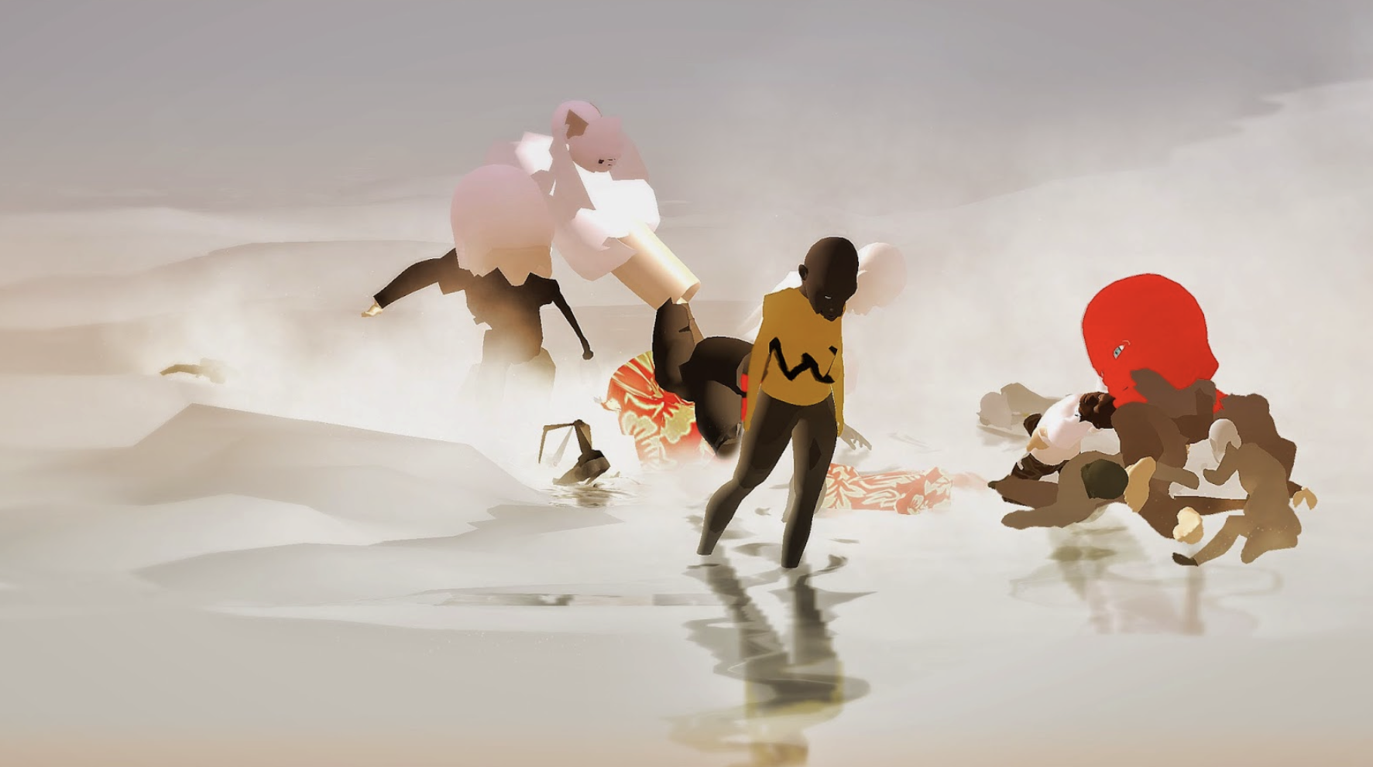
Emissaries
Emissaries is a trilogy of simulations about cognitive evolution, past and future, and the ecological conditions that shape it. It is composed of three interconnected simulations, each centered on the life of an emissary who is caught between unraveling old realities and emerging weird ones.

Slide 4
Visual Features:
Dynamic and evolving digital environments: Cheng's works often involve simulated worlds or ecosystems that continuously change and evolve over time.
Responsive elements: Cheng's artworks can respond to external stimuli, creating a sense of unpredictability.

Slide 5
Technical Features:
Algorithmic systems: Cheng employs complex algorithms and computational processes to generate the behavior and interactions of the characters and elements within his artworks.
Real-time simulations: Many of Cheng's works are real-time simulations, meaning that they are generated on the fly and can respond to inputs or environmental conditions.
Machine learning and artificial intelligence: Cheng sometimes incorporates AI-powered systems that can learn and adapt based on their interactions within the simulated worlds.

Slide 6
Material Features:
Digital media: Cheng's artworks are created using digital tools and technologies, often blurring the lines between video games, computer animation, and art.
Video game aesthetics: Cheng draws inspiration from video game aesthetics, incorporating elements such as avatars, game mechanics, and virtual landscapes into his artworks.

Slide 7
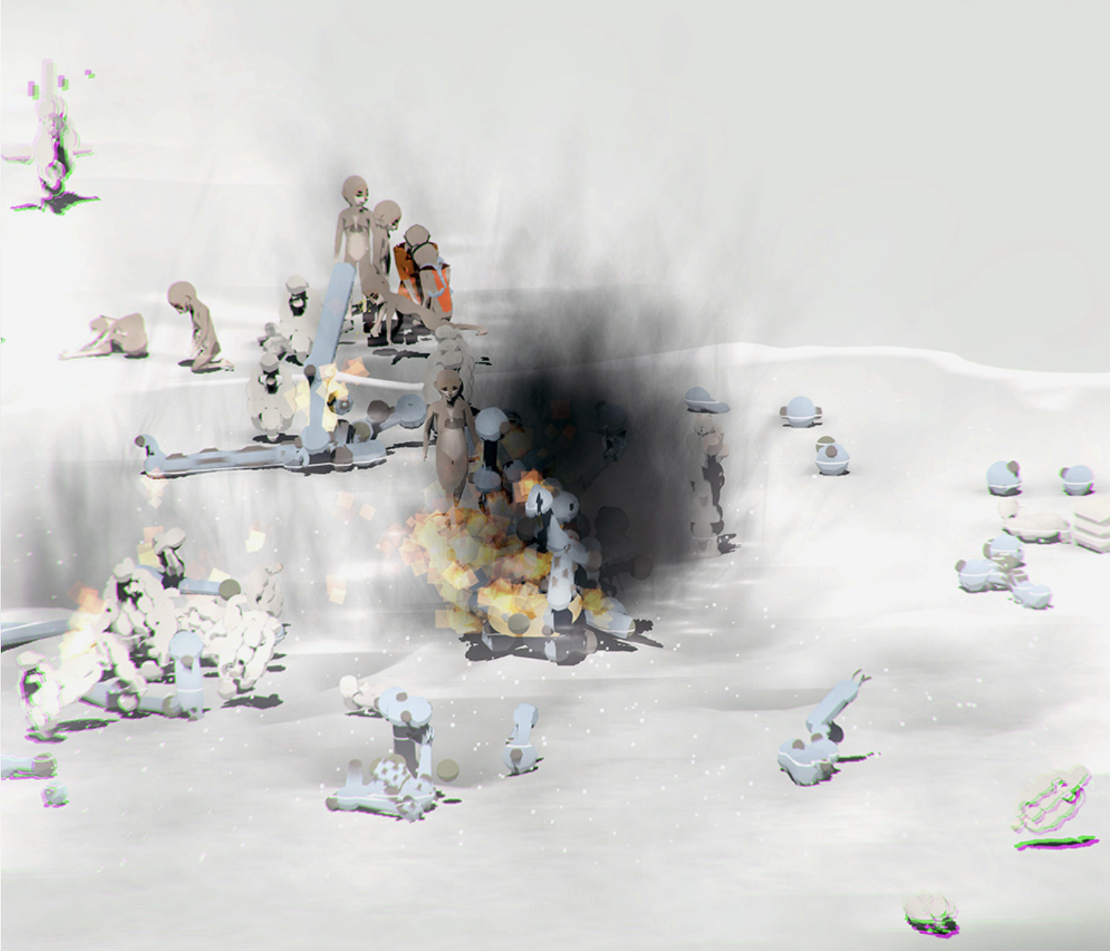
Why he did this project?
“I wanted to make art that lets you get outside yourself, outside your known constellation of feelings. I want to feel pleasurably confused.” “In 2014, I had the idea that I wanted to make an animated children's film about cognitive evolution, how the brain developed and what environmental conditions caused it to develop. The Emissaries soon became a clever story about cognitive evolution set on a volcano in Indonesia.”

Slide 8
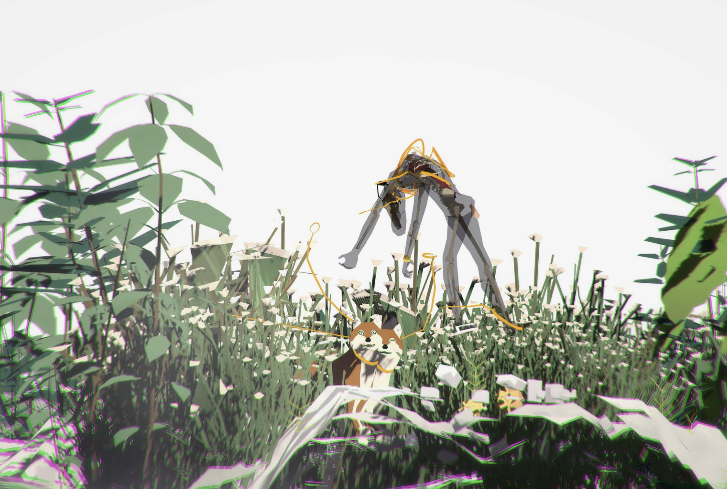
Inspiration
The Origin of Consciousness in the Breakdown of the Bicameral Mind’ (1976) by Julian Jaynes. The look of ‘Emissaries’ is inspired by the Japanese film director Hayao Miyazaki, where everything in the background, such as nature, is unique.

Slide 9
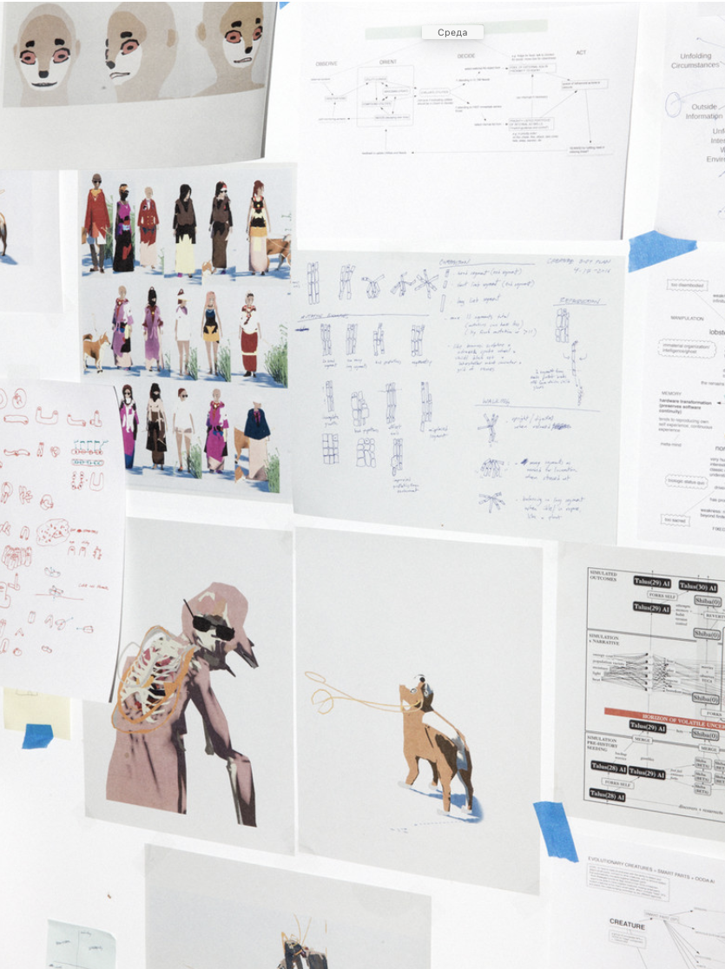
What needed for the project
Narrative premise. Concept design. Lifecycle design. Sound design. Modeling . Animation. Programming persistent systems. Programming AI. Graphics programming . Version control. Graphic design. Exhibition design. Negotiating with contractors. Team morale. Energy .

Slide 10
Emissary in the Squat of Gods simulates an ancient community living with the threat of a volcanic eruption. Emissary Forks At Perfection takes place many thousands of years in the future.,AI resurrects the remains of a 21st century human celebrity into this unrecognizable world and sends Shiba [Emissary], a canine superpet, to extract one final impression of man under stress. Emissary Sunsets the Self simulates the peak days of AI, now evolved into an oceanic substance and merged with the landscape to form a Sentient Atoll.

Slide 11
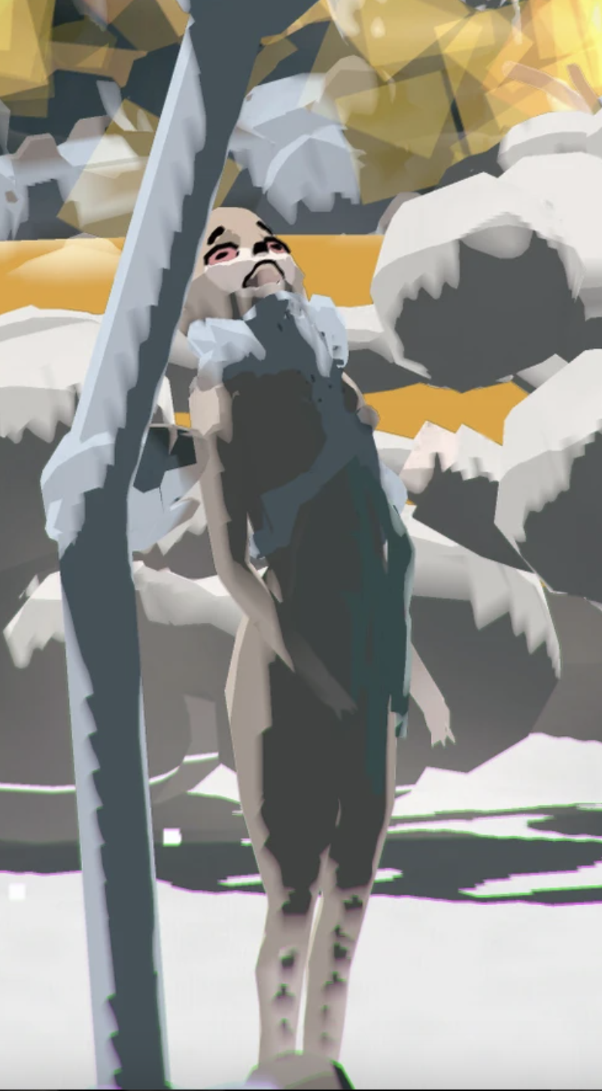
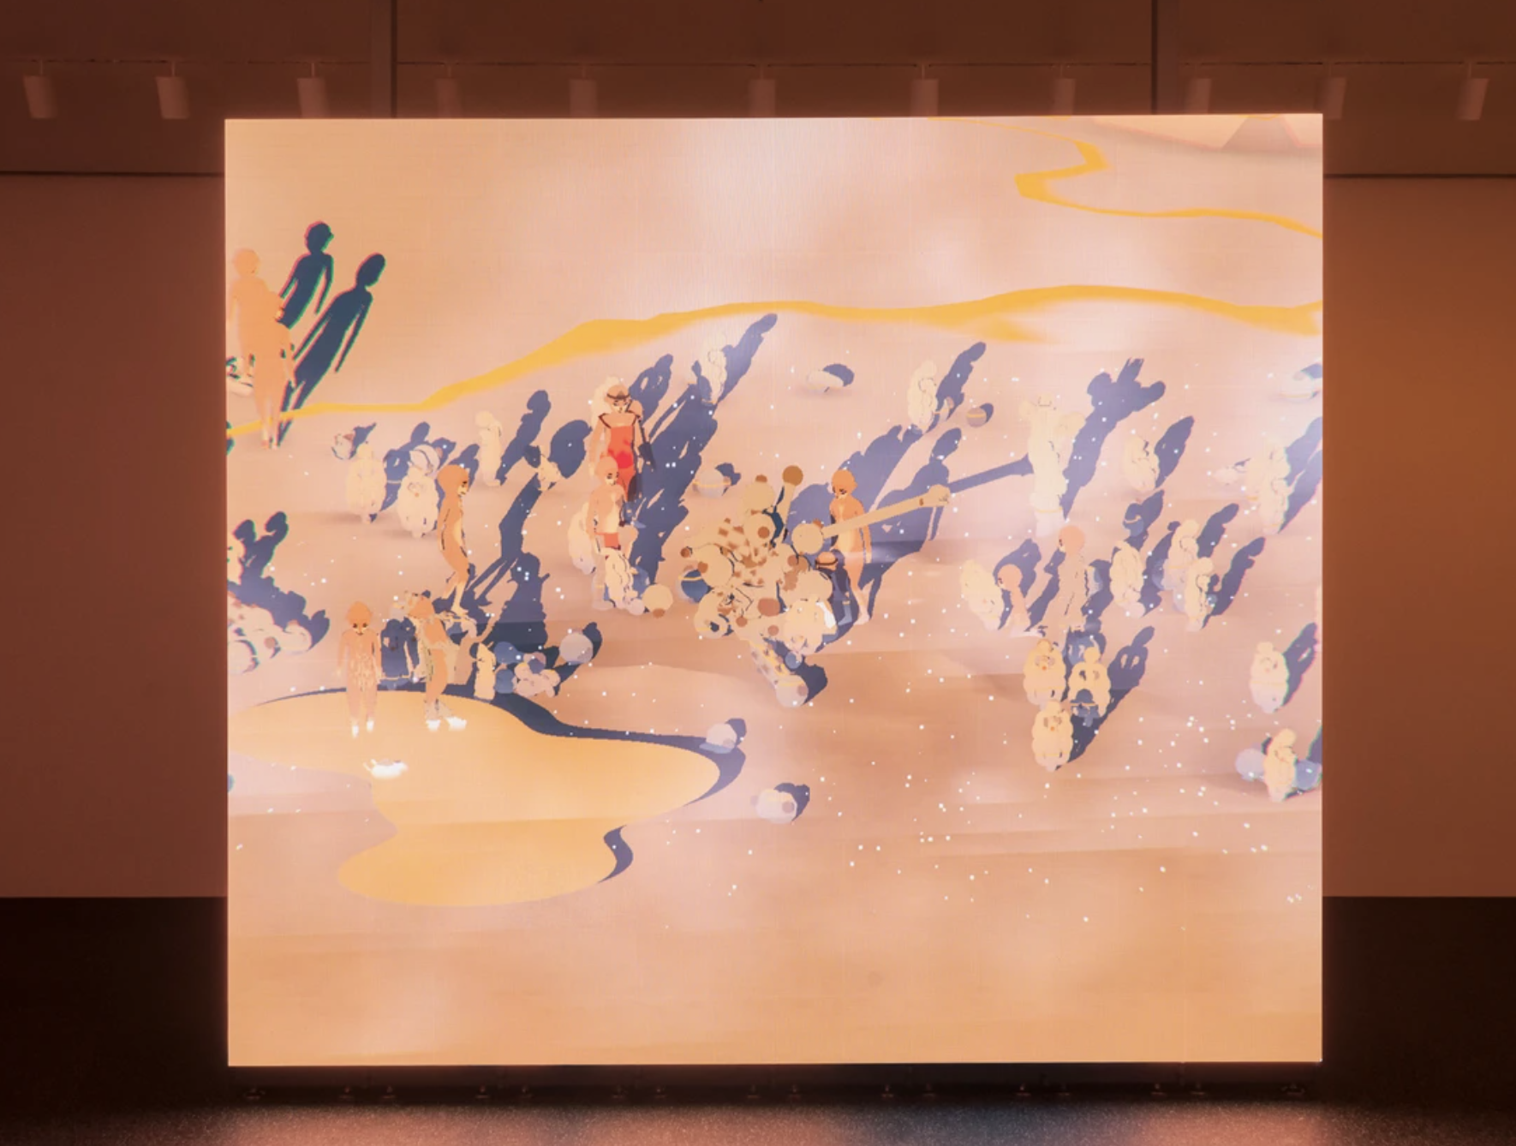
Learn from Ian Cheng’s work
significance:
Science
Programming
Art
Nature
movements

Slide 12
Inspirations
1.weird yet adorable
2.vivid movements

