Slide 1
Community Research Progress
Max, Scarlet, Steve

Slide 2
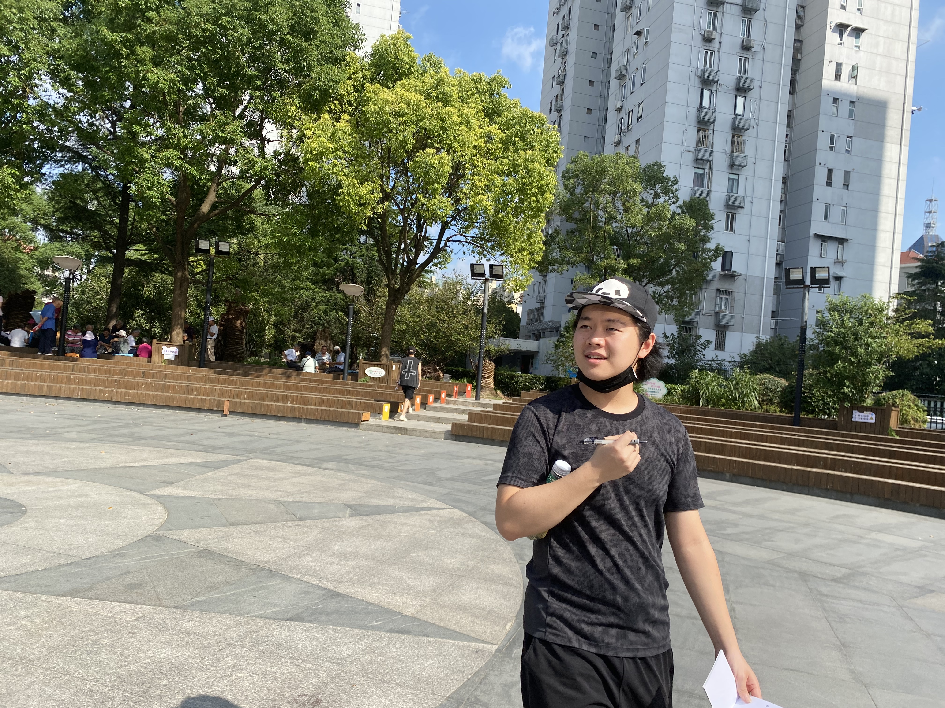
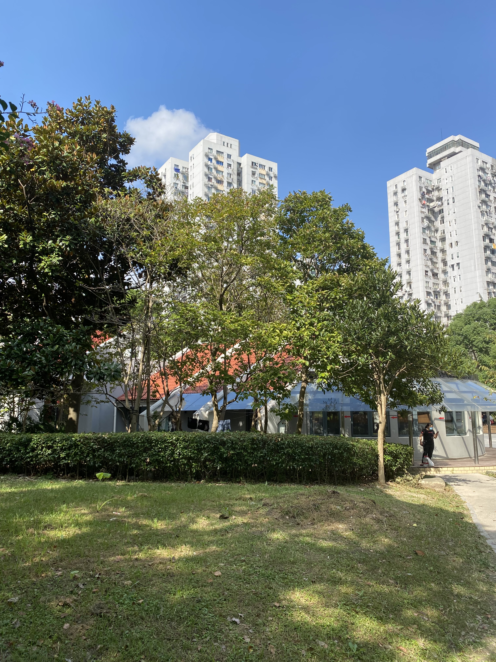
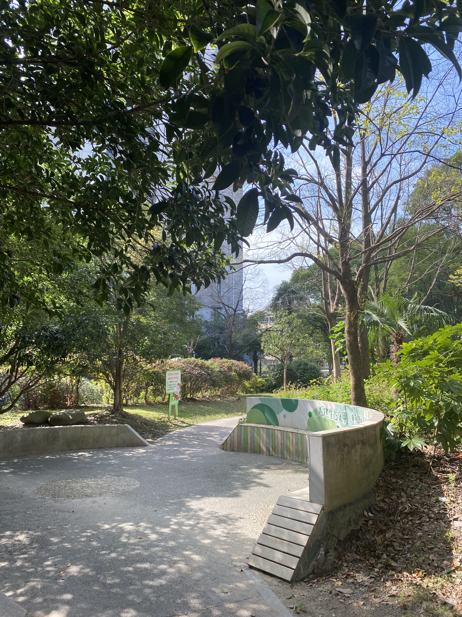
On-Site Visit at the Neighborhood

Slide 3
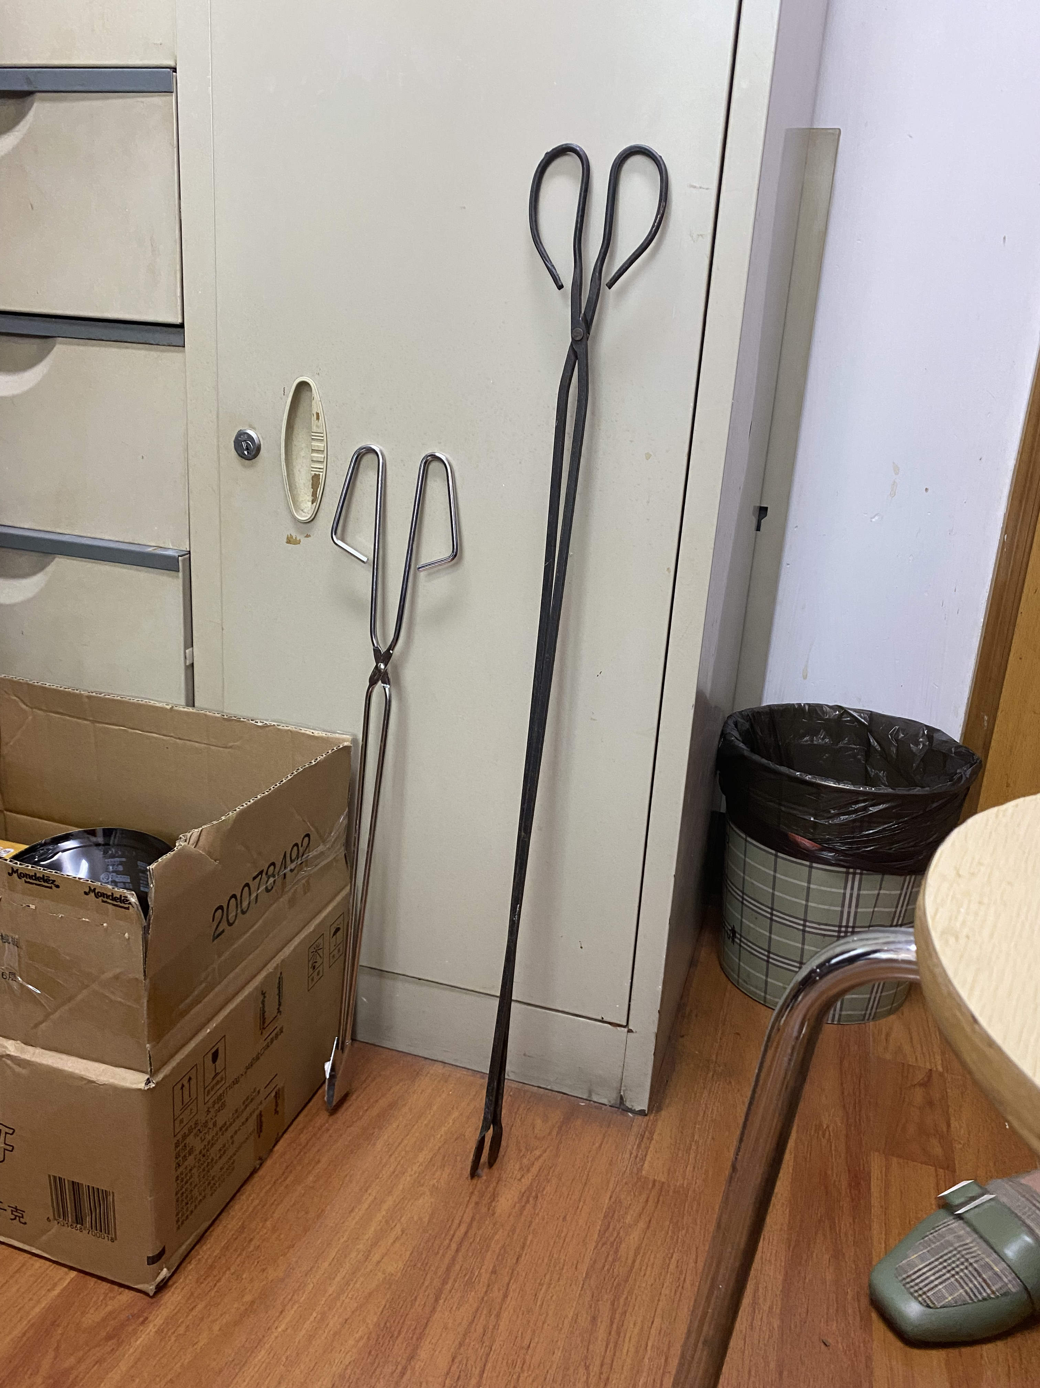
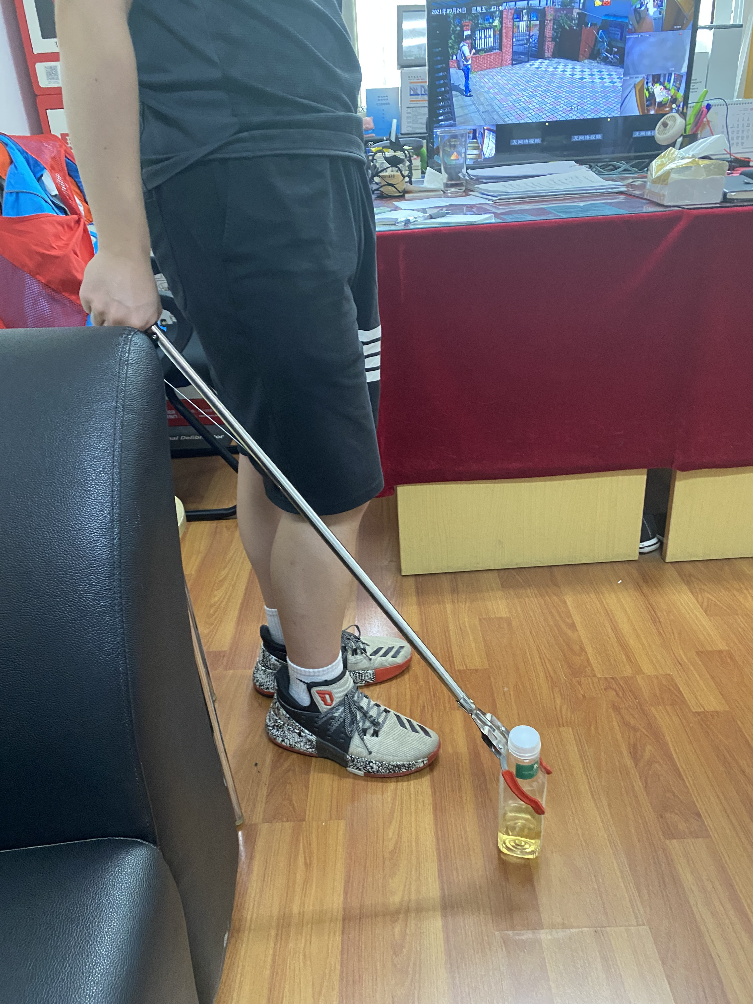
Proposal 1: Trash Collecting Clamp
Pain Points:
Requires too much hand strength to clamp
Not long enough (requires crouching)

Slide 4
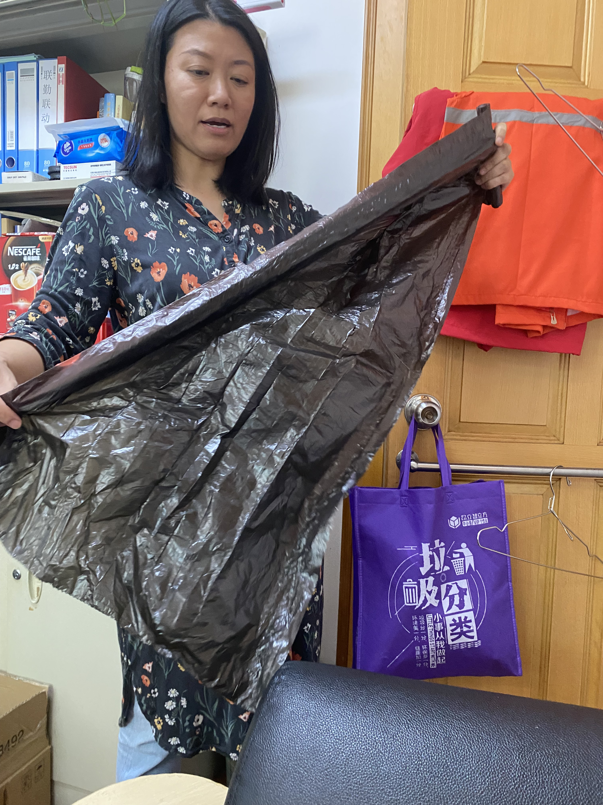
Proposal 2: Reusable Trash Collecting Bag
Size of trash bag typically carried by the trash collectors

Slide 5
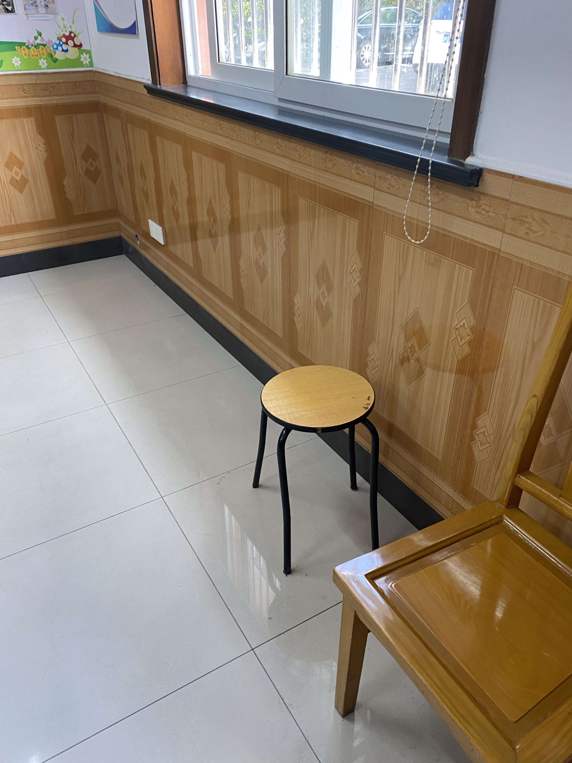
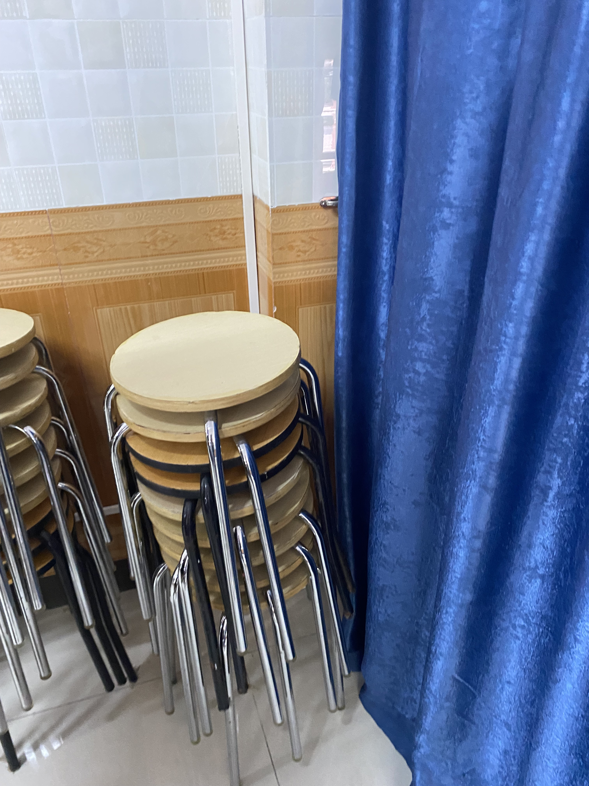
Proposal 3: Recycled Plastic Chair
The set of chairs currently in use lack a long use life
Crooked chair legs

Slide 6
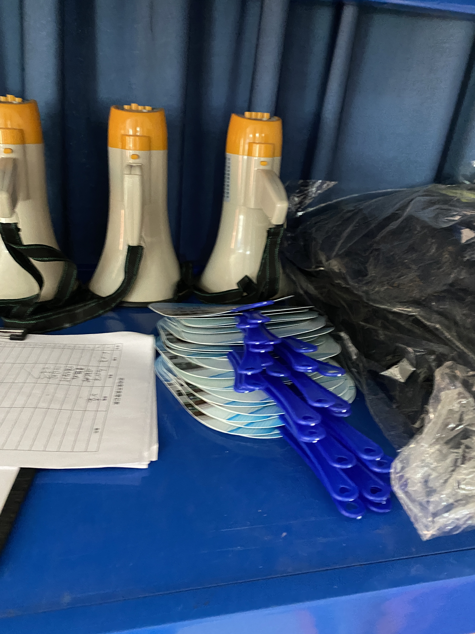
Proposal 3: Recycled Plastic Fan

Slide 7
Art Installation: Bon Appetit
Max, Scarlet, Steve

Slide 8
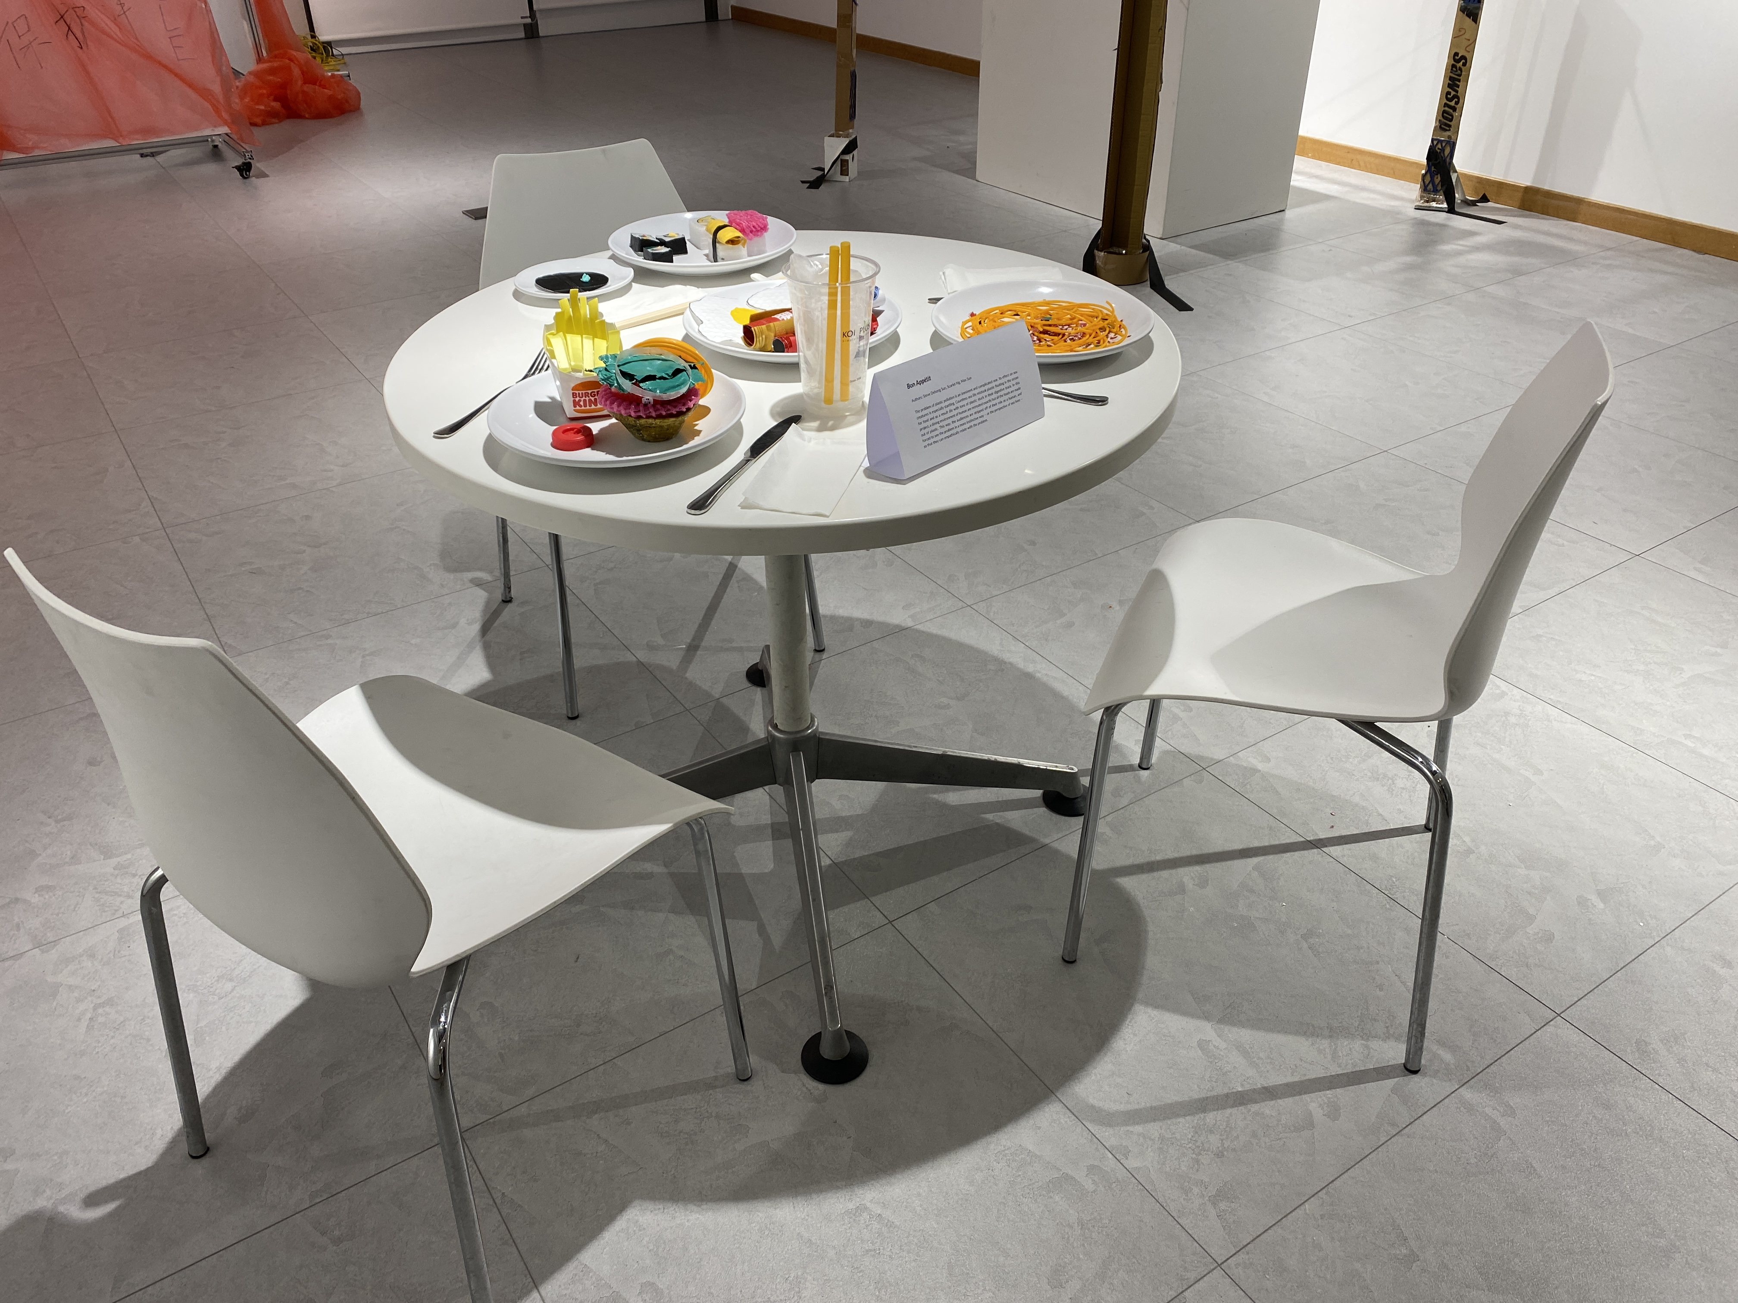
Community Research Progress
Max, Scarlet, Steve

Slide 9
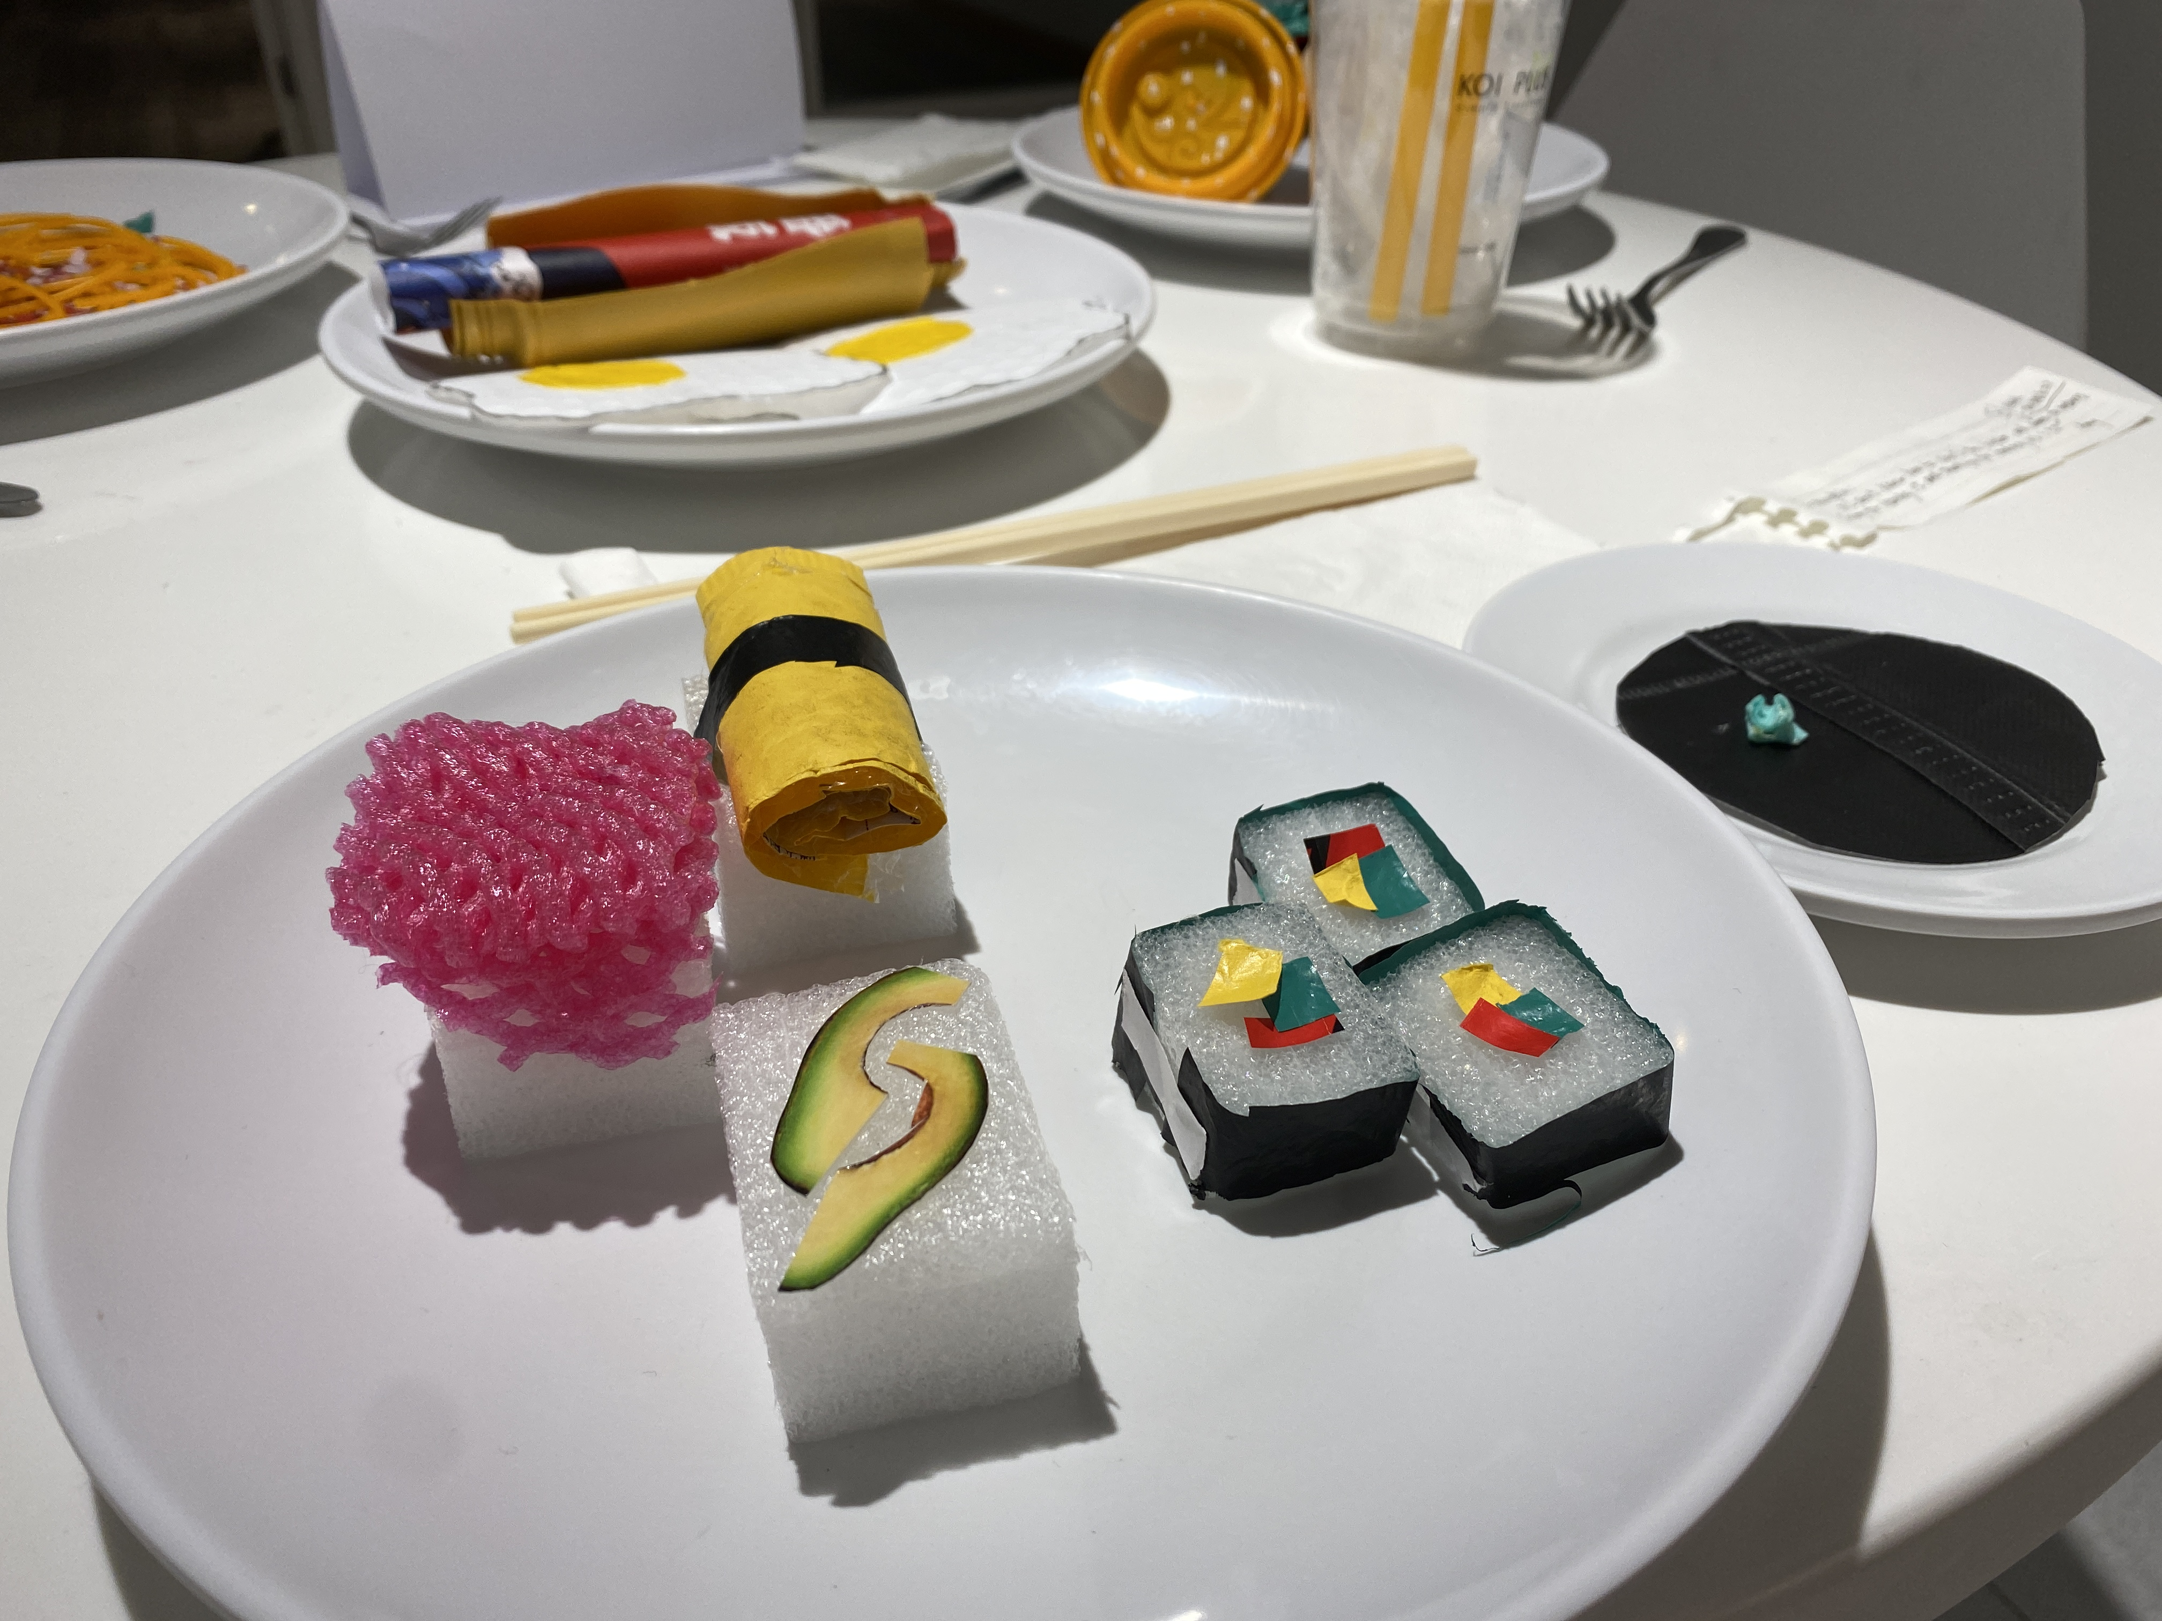
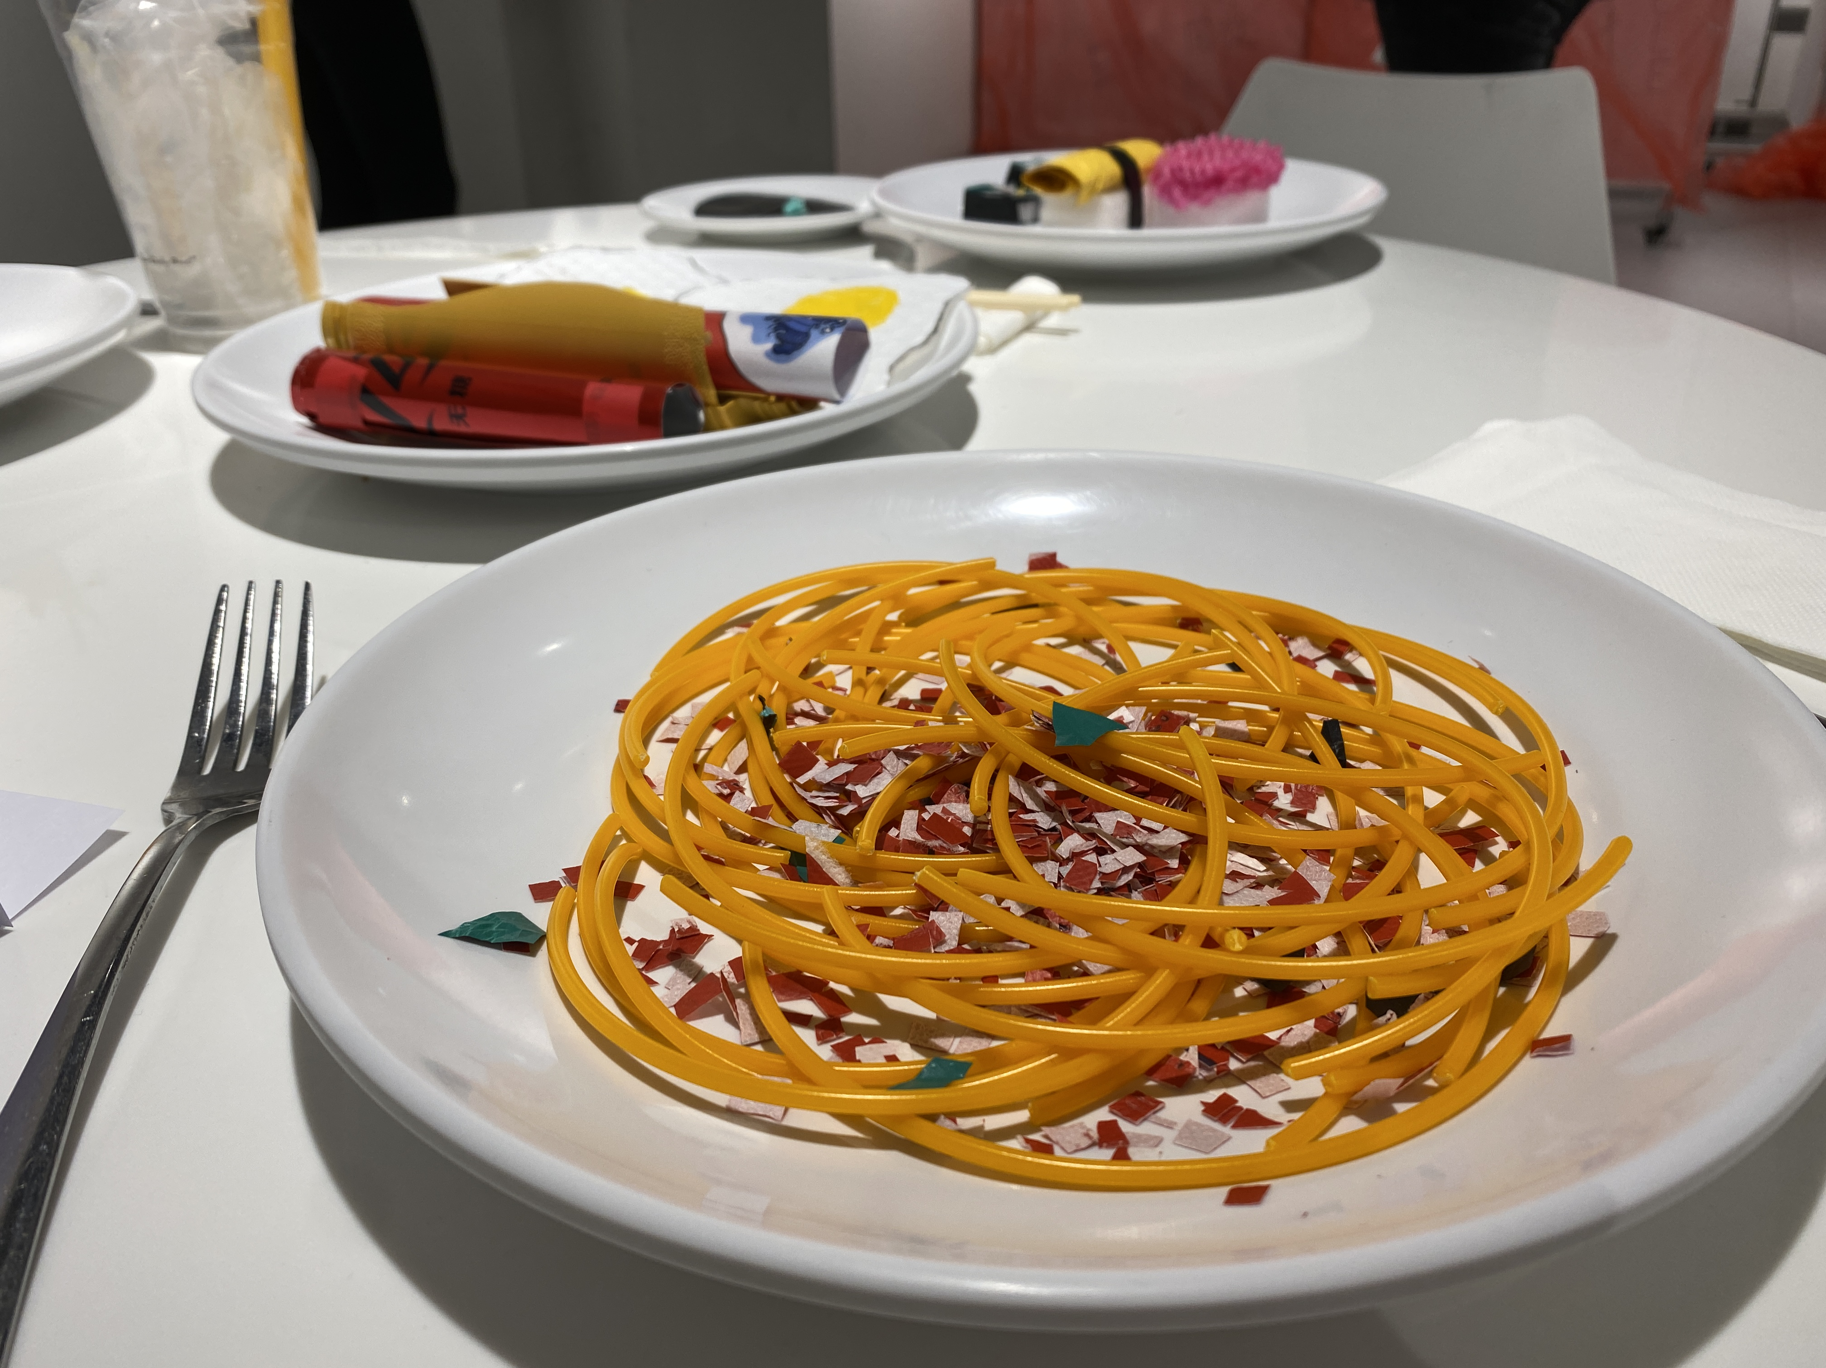

Slide 10
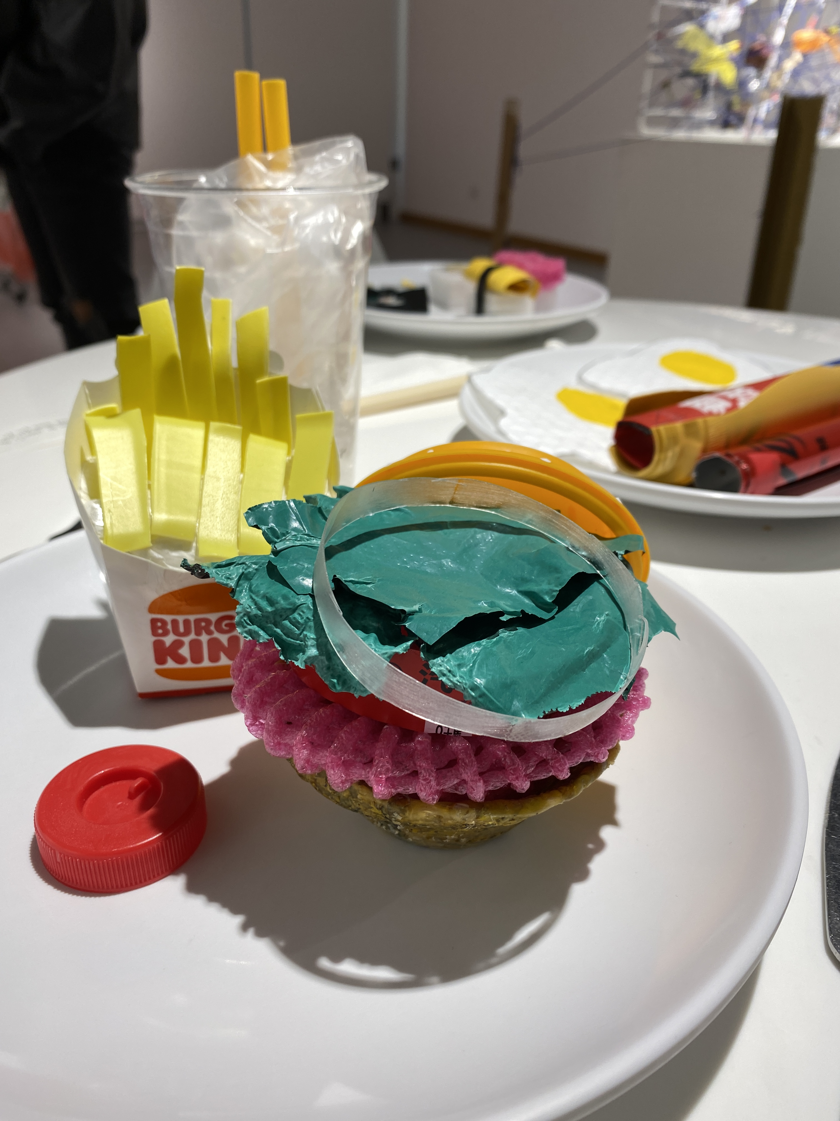

Slide 11
