Slide 1
Access and Assistive Technology in Historic Sites and Museums
Class 1, 1/28/19
Dr. Amy Hurst and Dr. Anita Perr
Lauren Race

Slide 2
Who are we?
Instructor introductions and experience
Amy
Anita
Lauren

Slide 3
Who are you?
Name, degree program, why you in this class, most recent museum visit.

Slide 4
Why are Museums Important?
Informal Education Centers!
Children who visited a museum during kindergarten had higher achievement scores in reading, mathematics, and science in third grade than children who did not. [https://www.imls.gov]
Preserve History!
Fun activity!

Slide 5
Are museums accessible to everyone?
The very features that make historic sites so evocative and immersive often present accessibility challenges for people with disabilities, who comprise more than a quarter of people living in the United States—over 85 million people. This project will increase the capacity of historic sites to develop rich, sensory-based interpretive experiences that are accessible to visitors with disabilities. Historic sites vary widely in terms of their physical characteristics, size, staffing capacity and budget. Recommended solutions will range from simple, lower-cost prototypes to higher-end approaches.

Slide 6
“Sensory Tools”
A collaboration between NYU and the Intrepid Museum
https://sites.google.com/view/sensory-tools-project/home

Slide 7
What is the “Sensory Tools” Project?
Three-year project will focus on developing a free, digital publication titled Sensory Tools for Interpreting Historic Sites that will offer strategies for increasing visitor engagement through interpretation that is accessible for visitors with disabilities and achievable by historic sites of all sizes.
Sensory Tools will outline a series of design processes and solutions that take into consideration a range of needs related to visitor movement, vision, hearing, range of motion, cognitive comprehension and sensory experiences.
Sensory Tools will lead to increased access, enjoyment, and understanding of historic sites through their spaces and collections.
https://sites.google.com/view/sensory-tools-project/home

Slide 8
Plan for Today
Syllabus overview and Introduction
Intrepid and Sensory Tools Intro
Lecture
Human Centered Design
Universal Design and Assistive Technology
Museum fundamentals:
Museum vs. historical sites
Informal learning overview
Interpretation
Field trip and class logistics

Slide 9
Syllabus Overview
https://wp.nyu.edu/ap_classes_museums_s20/

Slide 10
Human Centered Design
(the short version)

Slide 11
Foundations to a User-centered Approach
Early focus on users and tasks: directly study cognitive, behavioural, anthropomorphic & attitudinal characteristics
Empirical measurement: users’ reactions to and performance on scenarios, manuals, simulations & prototypes are observed, recorded and analysed
Iterative design: when problems are found in user testing, fix them and carry out more tests
Preece: http://www.id-book.com/secondedition/

Slide 12
Fundamental Activities
Establishing requirements
Understand users, determine support product can provide
Designing alternatives – *core activity of ID*
Suggest ideas to meet requirements
Prototyping
Lots of methods! (more later)
Evaluating
Determine usability of a product
Notes:
Understanding who the target users are and determining what kind of support the product can provide
The core activity of ID – suggesting ideas to meet the requirements. 2 sub-activities – conceptual and concrete design. Conceptual – (high level) what people can do and what concepts are needed to understand what to do. Concrete – product details – colors, sounds, images to use, etc.
Lots of ways. Paper-based good at early stages to help identify problems
Determining usability and acceptability of a product

Slide 13
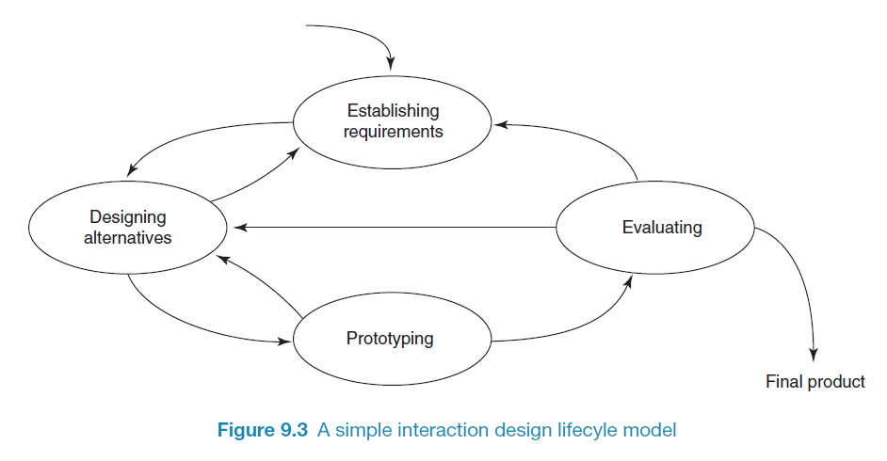
A simple interaction design lifecycle model
Preece: http://www.id-book.com/secondedition/
Notes:
preece
The 4 activities are intertwined and not linear.
After eval – may go straight to designing alternatives or it may be necessary to go back and establish more requirements

Slide 14
Universal Design vs. Assistive Technology
(the short version)

Slide 15
People have diverse abilities
In this class we will focus on function and ability, not diagnosis
Motor
Hand, finger, leg, torso movement
Cognitive
Short / long term memory, attention, decision making
Sensory
Vision, hearing, touch
Function and abilities are rarely constant
Needs can change due to fatigue, medication, environment, the weather…
Individual can experience these changes short or long term

Slide 16
How do we design for diverse abilities?
Understand your users to the best of your ability
User analysis: Who are they?
Task analysis: What are they trying to do?
Environmental analysis: Where are they trying to do this activity?
More on this later in the semester.

Slide 17
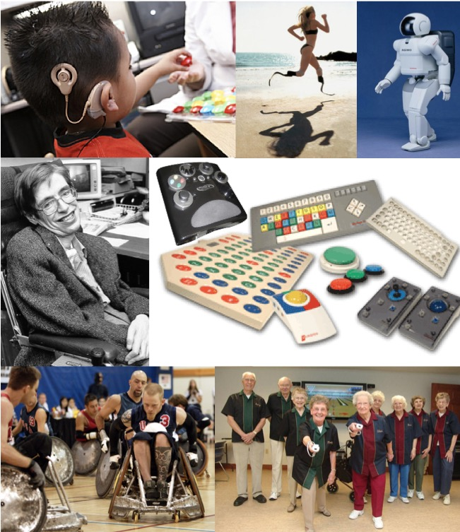
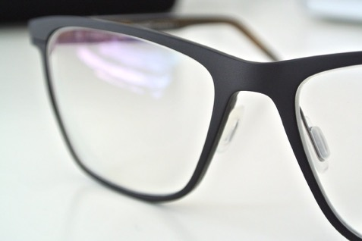
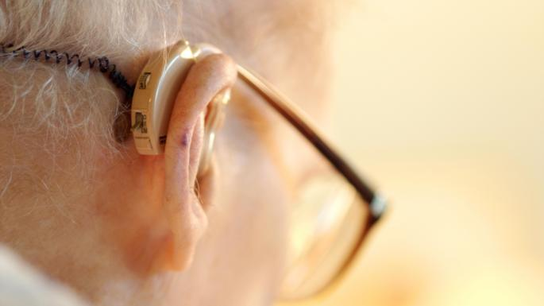
What is Assistive Technology?
“any item, piece of equipment, or product system, whether acquired commercially off the shelf, modified, or customized, that is used to increase, maintain, or improve functional capabilities of individuals with disabilities.” – US Access Board
Notes:
When I talk about AT, I use the broad definition from the Access Board. Which can be simplified to be anything that is used to increase, maintain or improve the capabilities of individuals with disabilities.

Slide 18
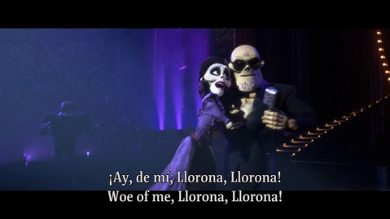
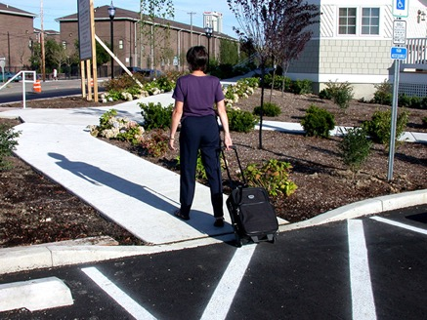
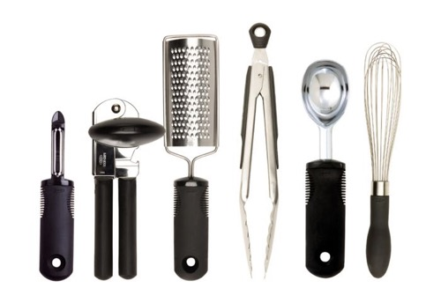
What is Universal Design?
“The design of products and environments to be usable by all people, without the need for adaptation or specialized design.” --Center for Universal Design at North Carolina State University
Captions and Subtitles in video
We will talk about
7 Principles of
Universal Design later…
Curb Cuts
https://pressbooks.ulib.csuohio.edu/accessibility/chapter/chapter-1/
OXO Good Grips (oxo.com)

Slide 19
What is the difference between Assistive Technology and Universal Design?

Slide 20
Museum Introduction

Slide 21
Museum Definition
This is getting tricky:
https://icom.museum/en/activities/standards-guidelines/museum-definition/
New proposed definition
Museums are democratising, inclusive and polyphonic spaces for critical dialogue about the pasts and the futures. Acknowledging and addressing the conflicts and challenges of the present, they hold artefacts and specimens in trust for society, safeguard diverse memories for future generations and guarantee equal rights and equal access to heritage for all people.
Museums are not for profit. They are participatory and transparent, and work in active partnership with and for diverse communities to collect, preserve, research, interpret, exhibit, and enhance understandings of the world, aiming to contribute to human dignity and social justice, global equality and planetary wellbeing.

Slide 22
What is the difference between a historic site and a museum?
Can one place be both?

Slide 23
Historic Site and Landmark Definition
National Historic Landmarks (NHLs) are historic places that hold national significance. The Secretary of the Interior designates these places as exceptional because of their abilities to illustrate U.S. heritage. Today, we have almost 2,600 NHLs in the United States.
https://www.nps.gov/orgs/1582/index.htm
The Intrepid Aircraft carrier is a National Historic Landmark
“Historic sites” is a more general term for places with significant history, but not registered as a national historic landmark
Across the United States, 45% of museums are historic sites, historical societies or historic preservation organizations.

Slide 24
What is Interpretation?

Slide 25
Museum Interpretation
Interpretation is “an educational activity which aims to reveal meaning and relationships through the use of original objects, by firsthand experience, and by illustrative media, rather than simply to communicate factual information.” (Tilden, 1957, p. 8)
The National Association for Interpretation (NAI) defines interpretation as a “communication process that forges emotional and intellectual connections between the interests of the audience and the meanings inherent in the resource.” (Brochu and Merriman, 2002).
“Interpretation is, essentially, storytelling. It’s my job to tell a story about a person, thing or place: bringing it to life in such a way that people can relate to it, appreciate and understand it – and take something of the experience away with them. Often, it’s about revealing links between bits of information that people already know – rather than feeding them completely new ‘facts and figures’.” (Mark Woolmer, museumsandheritage.com)
.
https://www.nps.gov/idp/interp/101/foundationscurriculum.pdf
https://advisor.museumsandheritage.com/blogs/youre-interpreting-interpretation-non-interpreters/

Slide 26
Examples of Museum Interpretations
https://www.museumsassociation.org/museum-practice/interpretation
Exhibition labels, hand-held guides, films, trails, theater …

Slide 27
How do we make sure Interpretation is Accessible to all visitors?
This is what we will focus on!

Slide 28
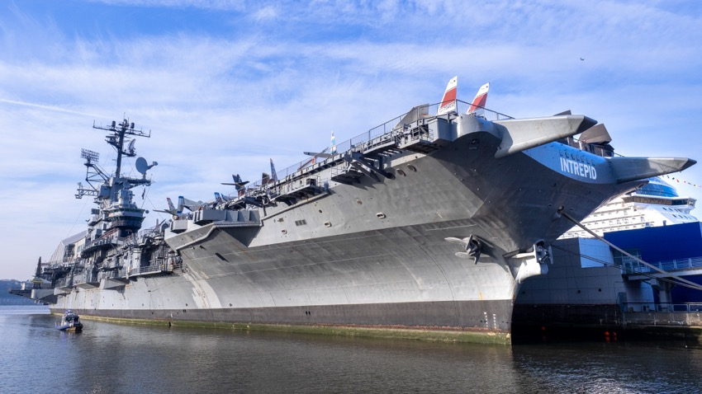
Intrepid Air, Sea, Space Museum
Goal of visit
See examples of 3 access challenges
Places that visitors can’t go
Things behind glass
Multisensory
See how Intrepid team addresses challenges
Meet collaborators (Digital Frictions class, OT research students, Intrepid)
Photo of Intrepid Aircraft (wikipedia.org)

Slide 29
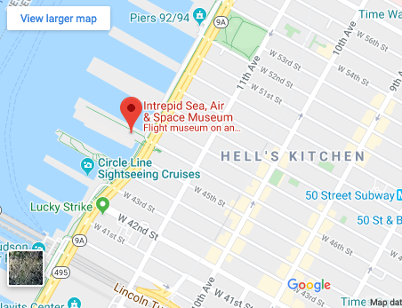
Intrepid Logistics
Timing
Arrive at 6:30, don’t come if you can’t be there by 7pm.
Where to meet
Meet at Hanger 1 (main entrance closest to 46th and 12th avenue
What to bring
Must wear appropriate foot gear (closed toe shoes)
Minimize backpacks and stuff they bring (they have strict security)
Other
Ask before taking pictures
They may ask for photo release
https://www.intrepidmuseum.org/Plan-Your-Visit/Getting-Here.aspx

Slide 30
For Next Week
Assignments
https://wp.nyu.edu/ap_classes_museums_s20/assignments/
Go to a museum (other than Intrepid) and look for accessibility problems / wins within exhibit and content interpretation.
Complete worksheet posted to class website to identify at least 3 problems / wins.
Complete Readings #1
6,9,15 in Diversity, Equity, and Museums
Designing Accessible Interactives
Field Trip Prep!

Slide 31
Assignment #1
(Lauren)
https://wp.nyu.edu/ap_classes_museums_s20/assignments/

Slide 32
Field Trip Logistics
We are not meeting in Brooklyn next week.
I will send an email with lots of details!

Slide 33
What time do we start class?
6:30pm or 6:45pm?

