Slide 1
Determine the need for new skill sets to meet today’s evolving disaster preparedness field.
Independent study Fall 2021, Student: Cynthia Martinez
Faculty Supervisor: Dr. Robyn Gershon
An independent study presented by Cynthia Martinez

Slide 2
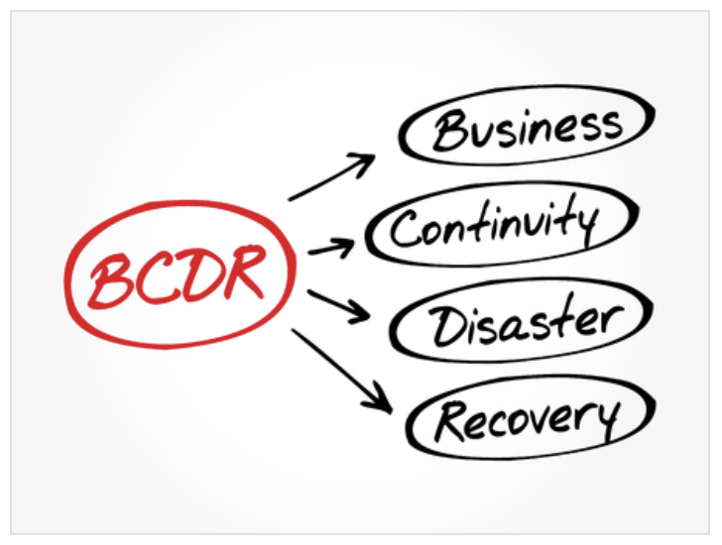
Independent study Fall 2021, Student: Cynthia Martinez
Faculty Supervisor: Dr. Robyn Gershon
The field of disaster preparedness/management has grown exponentially in the past five years.
This increased demand presents new challenges in the growing field of disaster management education and in particular, in the public health sector. While the demand for public health disaster management professionals is increasing, the field is also rapidly increasing in complexity, and practitioners are expected to have a wide range of skill sets, including analytic, communications, problem-solving and critical thinking.
Reference: (https://www.ucf.edu), Image: https://www.123rf.com/photo_122622225

Slide 3
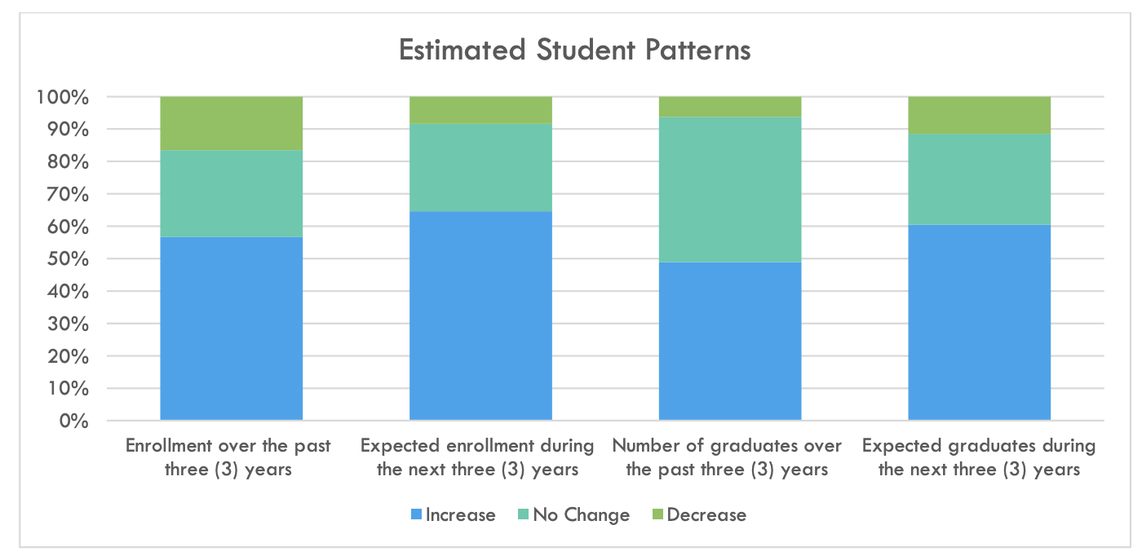
Independent study Fall 2021, Student: Cynthia Martinez
Faculty Supervisor: Dr. Robyn Gershon
The demand for disaster managers is growing in parallel to the increased number of natural disasters and crises. According to a 2020 FEMA survey; both undergrad and graduate programs have seen a 50% increase in enrollment and expect an increase in enrollment over the next three years¹.
Figure 2 Chart from 2020 FEMA website illustrates the expected increase in student enrollments in the next 3 years.
Source: https://training.fema.gov/hiedu/docs/latest/2020_fema_hied_state_of_the_community_survey_and_report.pdf

Slide 4
Independent study Fall 2021, Student: Cynthia Martinez
Faculty Supervisor: Dr. Robyn Gershon
The effort to educate these professionals is hampered however by a lack of high-quality efficient programs, both undergrad and graduate, especially for those aspiring to careers in public health settings.
There is demand for graduates with skills that are applicable in the disaster management field, but we don’t know, for instance, what skills are specifically needed in today’s challenging environment in the field of public health disaster management.
Information obtained from this study would prove valuable for the Public Health Disaster Preparedness academia community.

Slide 5
Independent study Fall 2021, Student: Cynthia Martinez
Faculty Supervisor: Dr. Robyn Gershon
Objective:
To address if there is a need for new or modified skills to meet today’s evolving disaster preparedness field, this study proposes to conduct a quantitative survey comprised of 6 essay response formatted questions with professionals who are GPH alumni, working in a range of positions in the field of public health disaster management, (including health care settings, departments of health (local, national), offices of emergency management, and other settings where they may be emergency management professionals with MPH degrees and or certificate in disaster studies.

Slide 6
Independent study Fall 2021, Student: Cynthia Martinez
Faculty Supervisor: Dr. Robyn Gershon
Design
Invitations were sent out to 12 alumni graduates via email and through the social media platform LinkedIn, the demographics were comprised of 3 males and 9 female professionals.
Criteria for study participation; must be an alumnus from either the certificate program or MPH graduate that has been in the field for a minimum of a month to 10 years. The purpose is to obtain a range of data from new hires that have been on the job for a year or less to senior staff.
Reference: (https://www.ucf.edu), Image: Adobe stock

Slide 7
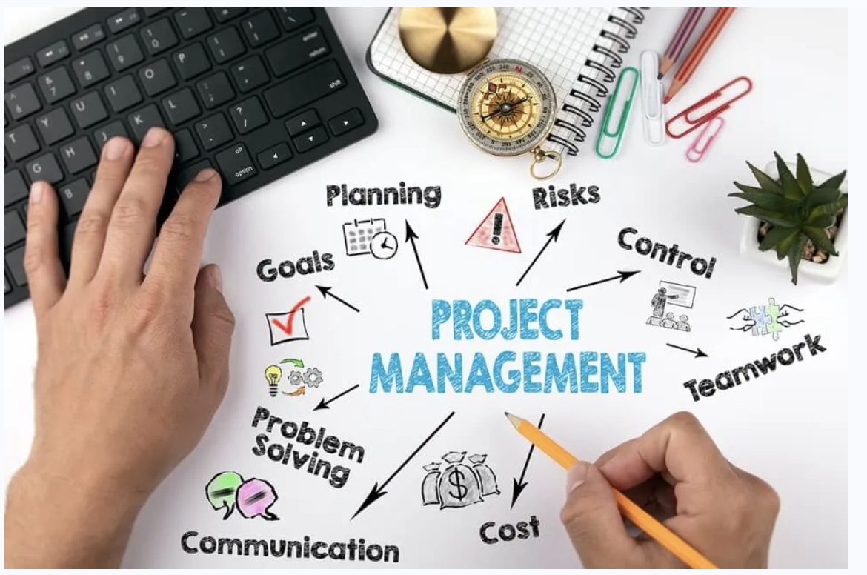
Independent study Fall 2021, Student: Cynthia Martinez
Faculty Supervisor: Dr. Robyn Gershon
Results
The survey consisted of 6 questions using the Qualtrics platform. Responses were answered via essay format. There were 6 responses, five females, and one male alumnus; one respondent was through LinkedIn while the remainder replied to the email invites. The top 3 in demand skill sets in the field were the following:
Project Management, a scenario-based course where you could learn to manage an incident from beginning to completion. Project management is key in the disaster management field.
Photo Source:: https://www.herzing.edu/skills/project-manager

Slide 8
Independent study Fall 2021, Student: Cynthia Martinez
Faculty Supervisor: Dr. Robyn Gershon
Time Management
Learn the process of planning and exercising strategic control of time spent on specific activities, especially to increase effectiveness, efficiency, and productivity before and after an event... A time management system is a designed combination of processes, tools, techniques, and methods.
Photo Source:: https://biz30.timedoctor.com/time-management-at-home/

Slide 9
Independent study Fall 2021, Student: Cynthia Martinez
Faculty Supervisor: Dr. Robyn Gershon
Financial Management
Understanding finances in the disaster science field, funds request, knowing money allocation and the ability to track it. Familiarize yourself the reimbursement process and indirect cost issue show money moves in an agency, how to use finances as a leadership tool - as incentives to decide how to shift money around from vaccine funding to mass fatality planning.
Photo Sourcehttps://www.dreamstime.com/stock-illustration- financial-management-important-components-image94368114

Slide 10
Independent study Fall 2021, Student: Cynthia Martinez
Faculty Supervisor: Dr. Robyn Gershon
People Management
Both within their department and in the public, one alumnus identified it as public interaction, which she felt as dramatically different from the skills students learn in public speaking.
Conflict management resolution and de-escalation training when dealing with non-health educated public such as vaccinations and Covid-19 as an example. In general, education programs that teach students to account for human behavior.
Photo Source: https://www.freepik.com/premium-vector/people-group-icon-business-person-team-management-socializing-persons-silhouette

Slide 11
Independent study Fall 2021, Student: Cynthia Martinez
Faculty Supervisor: Dr. Robyn Gershon
Resourcefulness
It’s never too early in your career to start collecting names of people, organizations, or non-profits that may be of service before or after an event.
An example: Suppose your community encountered a flooding event, and in its aftermath left debris everywhere. You as a professional in the field have the names of people who own cleaning services companies with access to several trucks and dumpsters.
Source: https://depositphotos.com/similar-vectors/224150002.html?qview=182251602

Slide 12
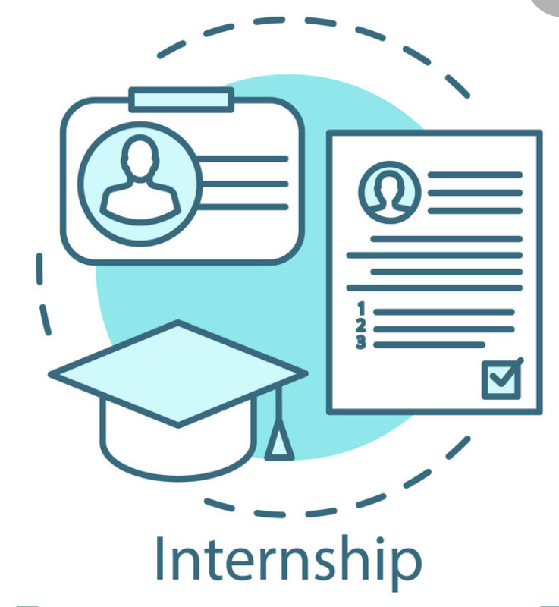
Independent study Fall 2021, Student: Cynthia Martinez
Faculty Supervisor: Dr. Robyn Gershon
Internships
The value of internships; seek out internships in areas that are of interest to you. Getting exposure to the field and having hands on experience together with the educational component makes an exponential difference.
Photo Source: https://www.vectorstock.com/royalty-free-vector/internship-concept-icon-part-time-job-vector-29165578

Slide 13
Independent study Fall 2021, Student: Cynthia Martinez
Faculty Supervisor: Dr. Robyn Gershon
CASPER
Students interested in leadership roles in an ICS- Incident Command Station should learn about CASPER- The Community Assessment for Public Health Emergency Response. CASPER is designed to provide public health leaders and emergency managers information about a community so they can make informed decisions- https://www.cdc.gov/nceh/casper/overview.htm.
Students should also consider taking the following FEMA courses 300 & 400:
ICS-300 Intermediate ICS for Expanding Incidents: ICS-300 provides training and resources for personnel who require advanced knowledge and application of the ICS. This course expands upon information covered in the ICS-100 and ICS-200 courses.
ICS-400 Advanced ICS: This course provides training and resources for personnel who require advanced application of ICS. This course expands upon information covered in ICS-100 through ICS-300.
Reference: Chenel et. al., Jan. 2, 2020, Photo: All-free-download.com

Slide 14
Independent study Fall 2021, Student: Cynthia Martinez
Faculty Supervisor: Dr. Robyn Gershon
Ride-Alongs
To get a sense of how infrastructure operates in the community, participate in ride alongs with fire, police, and public works agencies. Ride-alongs would expose you to how the community infrastructure works.
Learn weather monitoring, learn how to read radars, and weather terminology as weather events are becoming increasingly severe and frequent.
Reference: Cartwright, 2020 Photo: Original image from National Museum of Health and Medicine. Digitally enhanced by rawpixel.

Slide 15
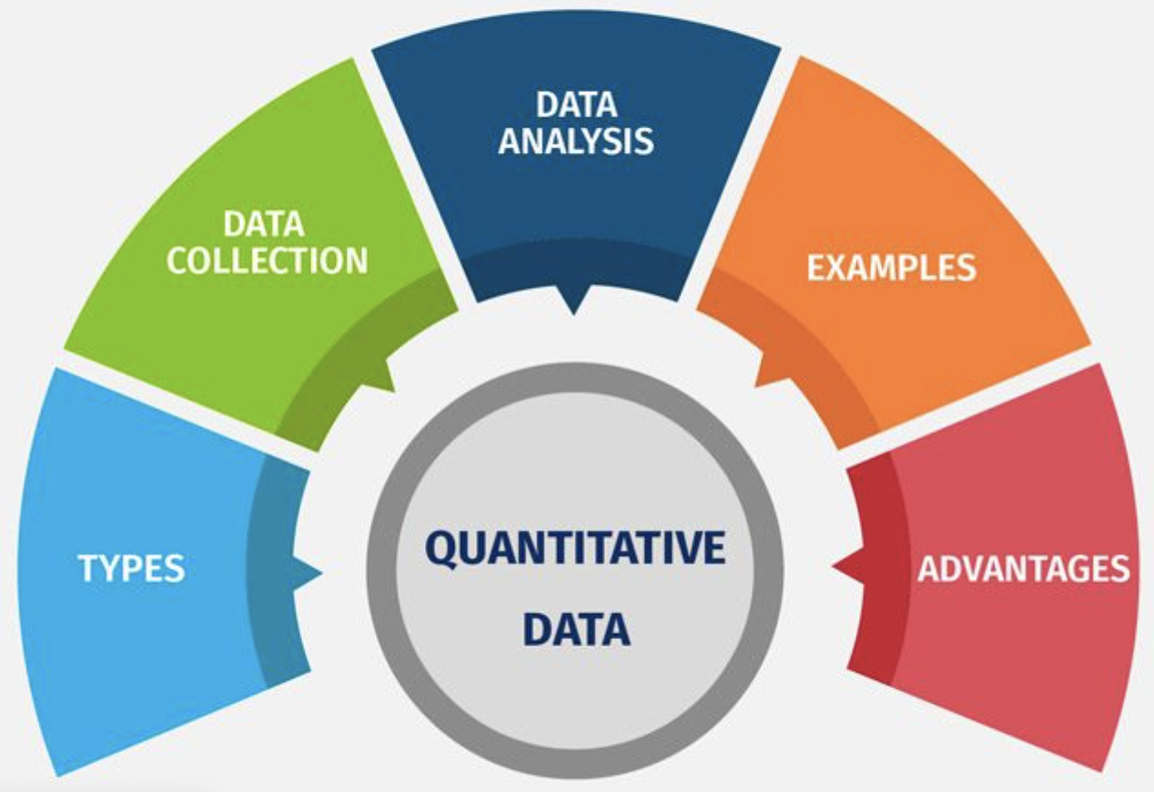
Independent study Fall 2021, Student: Cynthia Martinez
Faculty Supervisor: Dr. Robyn Gershon
Administrative skills
Administrative skills is an important component in the field. Learn how to use Google Suite /Google Docs for project management.
Excel training for data input, as well as it’s quantitative capacities.
Qualitative thinking of data research.
Learn to frame things in a positive light: Example: instead of saying there is a need for additional training, say there is an opportunity for additional training.
Student: Cynthia Martinez
Thesis Advisor: Dr. LeConté Dill
Second Reader: NYU School of Public Health
Image source: https://www.questionpro.com/blog/quantitative-data/

Slide 16
Independent study Fall 2021, Student: Cynthia Martinez
Faculty Supervisor: Dr. Robyn Gershon
Conclusion
As the increase and impact of disaster events continue to grow worldwide, there is an equally increasing demand for qualified professionals in the field.
Example: An alumnus I interviewed was a 2020 graduate with both an MPH and the Advanced Certificate program and her position was created in response to the Covid-19 crisis.
This small study provided the opportunity to interview alumni in a field that is experiencing exponential growth, their contributions provided valuable information for both current and prospective students.

Slide 17
Conclusion (Cont.)
Independent study Fall 2021, Student: Cynthia Martinez
Faculty Supervisor: Dr. Robyn Gershon
Future competencies will be reevaluated and modified to incorporate the data provided in this and future studies.
Additional studies are warranted as the NYU Public Health Disaster Preparedness advances in both the certificate and eventual graduate programs. Competencies must be updated from data received from studies to enhance the student’s education to better prepare for the evolving and growing demands of the field.

Slide 18
References:
Independent study Fall 2021, Student: Cynthia Martinez
Faculty Supervisor: Dr. Robyn Gershon
Bennett, DeeDee. (June 2020). “2020 FEMA Higher Education State of The Community: Annual Survey and Report.” Report for FEMA Higher Education Program. Emmitsburg, MD. Retrieved from: https://training.fema.gov/hiedu/docs/latest/2020_fema_hied_state_of_the_community_survey_and_report.pdf
Kennedy M, Carbone EG, Siegfried AL, et al. Factors Affecting Implementation of Evidence-Based Practices in Public Health Preparedness and Response. J Public Health Manag Pract. 2020;26(5):434-442. doi:10.1097/PHH.0000000000001178, Retrieved from: https://pubmed.ncbi.nlm.nih.gov/32732716/
FEMA, Emergency Management Institute, Retrieved from: Trainingfema.gov
UW Flexible Option Team, Competency-Based Education: What It Is, How It’s Different, and Why It Matters to You, 11/2019
Retrieved from: https://flex.wisconsin.edu/stories-news/competency-based-education-what-it-is-how-its-different-and-why-it-matters-to-you/#:~:text=Competency%2Dbased%20education%20turns%20that,ve%20reviewed%20the%20learning%20resources

