Slide 1
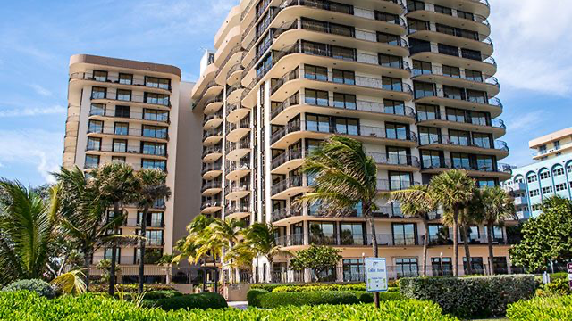
2021 Miami Condo Collapse
Global Health Disaster Preparedness and Response, Spring 2024
Justin T. Andries

Slide 2
Table of Contents
Introduction
Facts of the Case
Epidemiological Aspects
Management of Event
Communication of Event
Brief Summary

Slide 3
Introduction
In 2021, there was a partial collapse of a 12-story beachfront Condo in Miami, Florida.
Noted to be one of the deadliest structural disasters in American history
98 people were killed
Hundreds injured

Slide 4
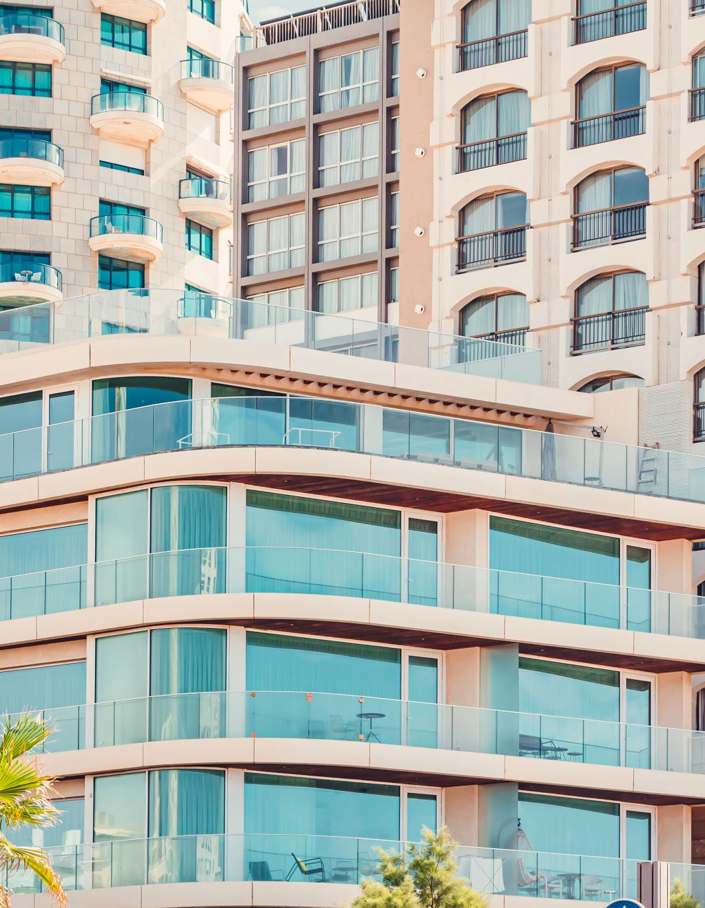
Facts of the Case
On June 24, 2021, Champlain Towers South
12 story, 136 unit beachfront condo in Surfside Florida
98 dead
Nearly $30 million allocated for an Investigation launched by the National Institute of Standard and Technology (NIST)
As of June 2023, FEMA had obligated about $107 million in response to the Champlain Towers South Collapse
Funds provided financial assistance to individuals for housing and other needs
Also funds supported state and local recovery efforts

Slide 5
Epidemiological Aspects of the Event
Building Maintenance and Structural Issues
Investigators examined the building’s maintenance records, including any past structural issues, repairs or renovations
Looked for patterns of neglect or deferred maintenance that could have compromised the building structural integrity
Structural Inspections and Evaluations
Investigators analyzed data from structural inspections and evaluations conducted before the collapse
Environmental Factors
Factors such as exposure to saltwater, corrosion, and geological conditions unique to the area were also examined.

Slide 6
Management of Event
FEMA
On site almost immediately after event occurred
One of the main organizations managing event
U.S. Army Corps of Engineers
Provided technical assistance
Assisted with geotechnical, structural safety, and debris removal
Federal teams, NIST, and local Investigators

Slide 7
Communication of Event
Presentation from Mayor Francis Suarez
Major News Outlets
CNN, NYT, NPR, ETC.
Social Media Coverage
Instagram, Twitter, TikTok
US Government Accountability Office (GAO)
Depicted investigations underway
Expressed empathy
Provided information of what investigators found
Gave updates on when new information should be available
Notes:
Based on all communications of this event, it was concluded that the design and construction team failed to comply with building codes when the condominium was constructed in 1981

Slide 8
Summary
The 2021 Champlain Towers South building collapse in Miami Florida was a tragic event that occurred on June 24th, 2021.
The collapse tragically resulted in the loss of 98 lives, with many more injured or missing.
Extensive search and rescue operations were undertaken to locate survivors trapped in the rubble.
Multiple investigations were launched to determine the causes of the collapse
Factors under scrutiny included structural integrity, building maintenance, potential environmental influences and adherence to building codes and regulations.

Slide 9
Thank You

Slide 10
Works Cited
CNN. (2021, June 30). Survivors of the Miami-Dade building collapse remain hopeful as rescue efforts continue. Retrieved from https://www.cnn.com/2021/06/30/us/miami-dade-building-collapse-wednesday/index.html
NPR. (2023, September 7). Investigation into the Surfside, Florida, condo collapse at Champlain Towers South continues. Retrieved from https://www.npr.org/2023/09/07/1198296548/surfside-florida-condo-collapse-champlain-towers-south-investigation-nist
NPR. (2024, March 8). Cause of the Surfside, Florida, Champlain Towers South condo collapse identified. Retrieved from https://www.npr.org/2024/03/08/1236628075/surfside-florida-champlain-towers-south-condo-collapse-cause
Government Accountability Office. (n.d.). Preliminary observations on building collapse in Surfside, Florida (GAO-24-106558). Retrieved from https://www.gao.gov/assets/870/865938.pdf
Government Accountability Office. (n.d.). Lessons learned from the building collapse in Surfside, Florida (GAO-24-106558). Retrieved from https://www.gao.gov/products/gao-24-106558

