Slide 1
Before plastics: Drinks from bottles and straws
Hassan Abuhaliga

Slide 2
Overview
Introduction
History of drinking straws
History of bottled drinks
Plastic
Proposed Solutions
Conclusion

Slide 4
History of drinking straws

Slide 5
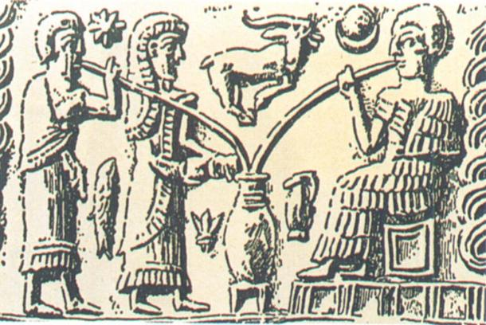
3000 B.C. Sumerians of Mesopotamia

Slide 6
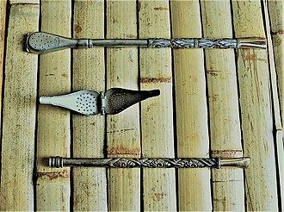
1600s Bombilla Tea-filtering Straws

Slide 7
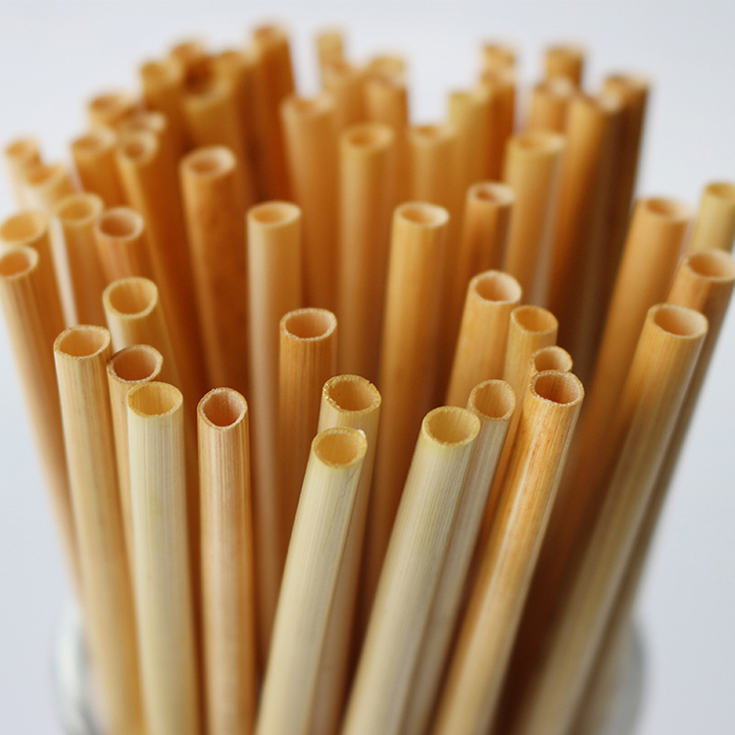
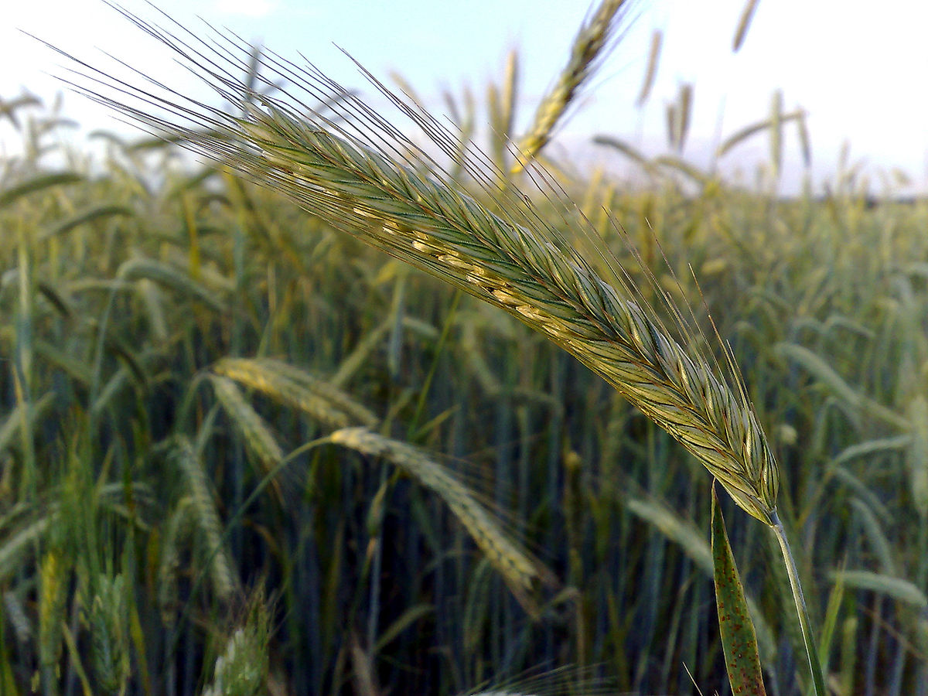
1800s Straws Made from Grains

Slide 8
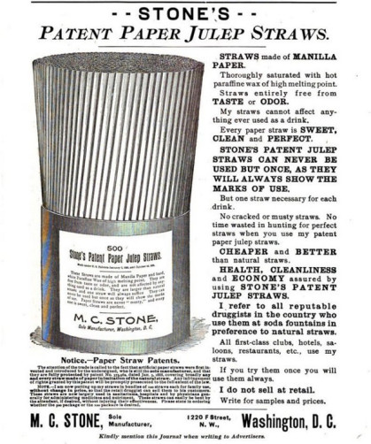
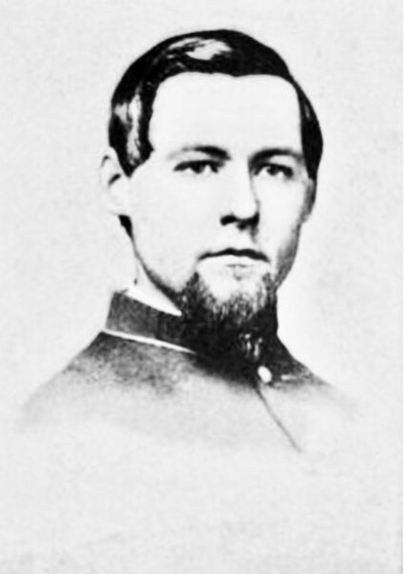
1888 Marvin Stone

Slide 9
History of bottled drinks

Slide 10
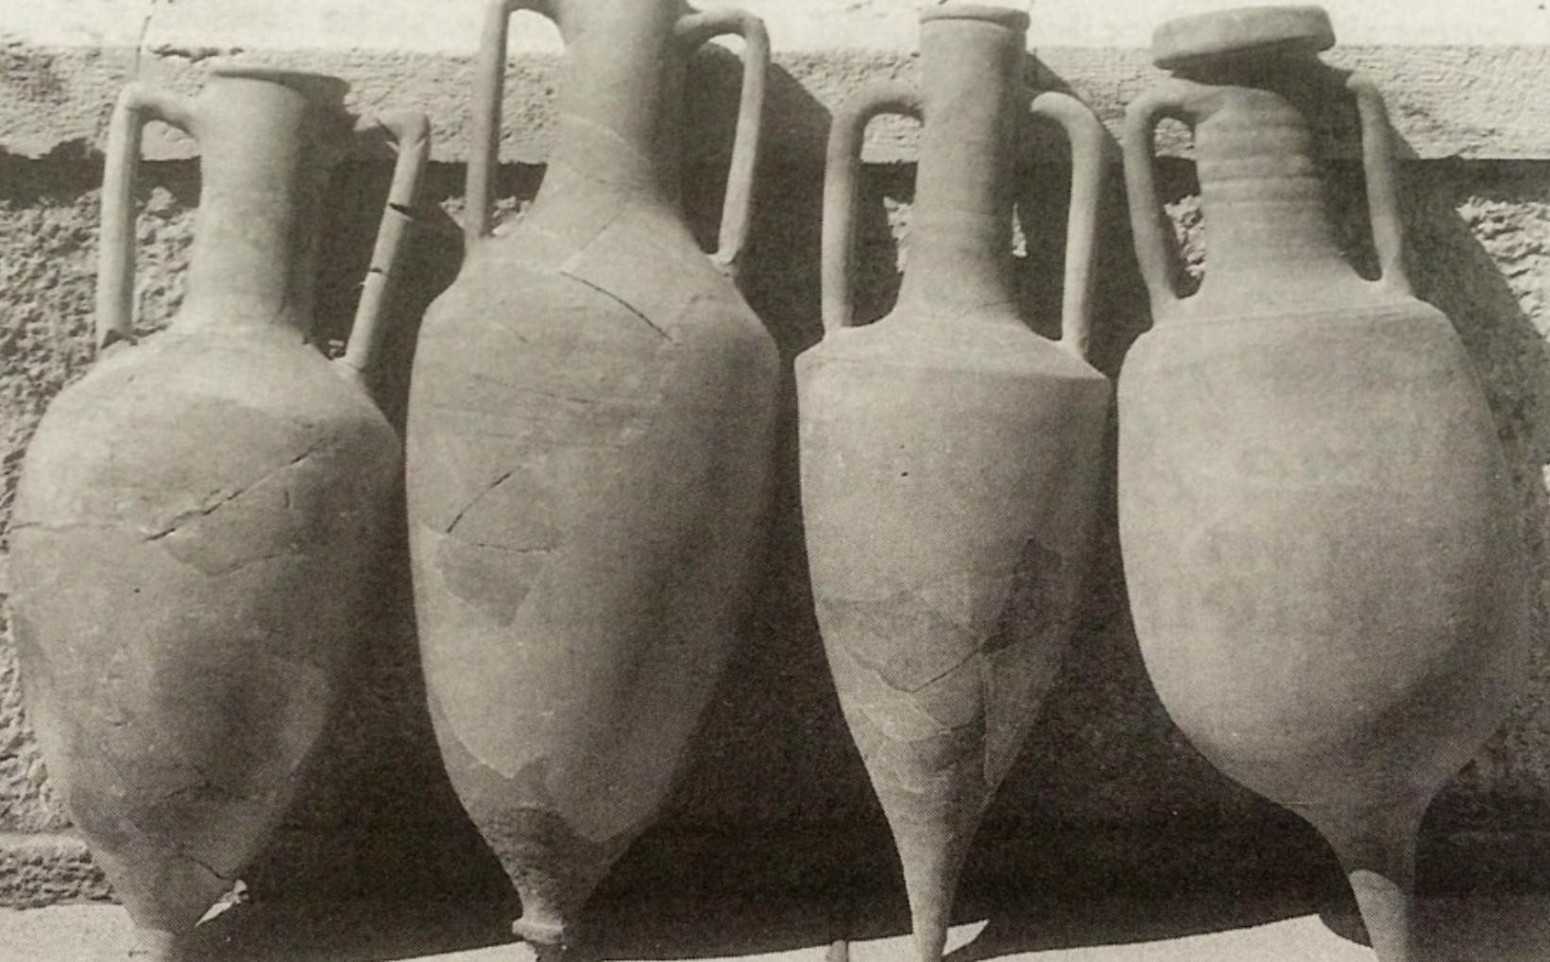
Ancient Civilizations Casks and Urns

Slide 11
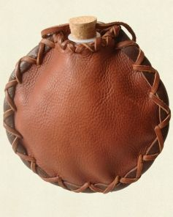
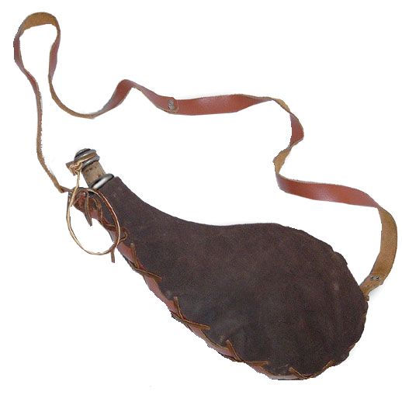
Medieval Societies Waterskins

Slide 12
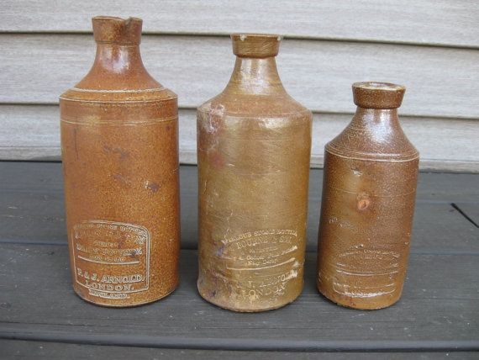
1600s Clay Bottles

Slide 13
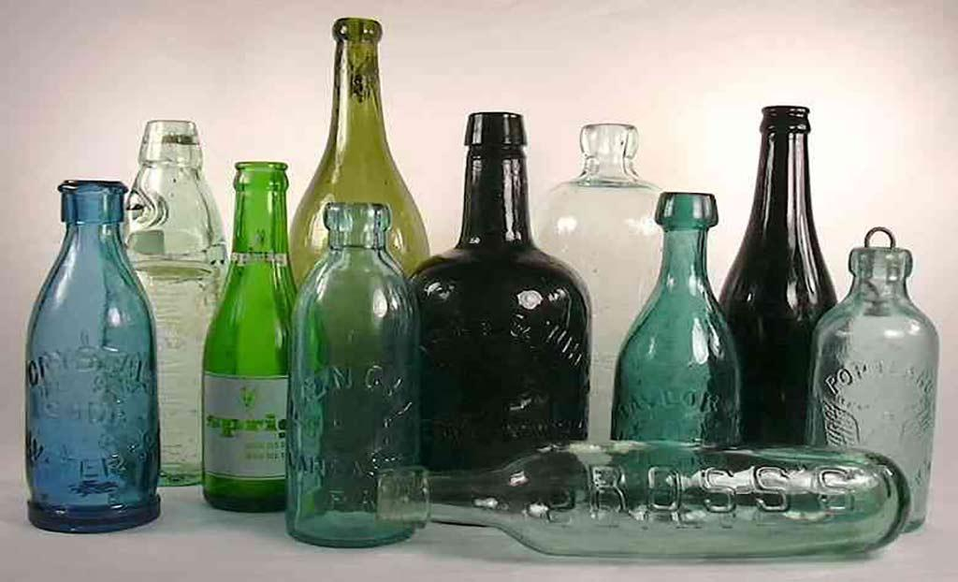
1700s Bottled Water

Slide 14
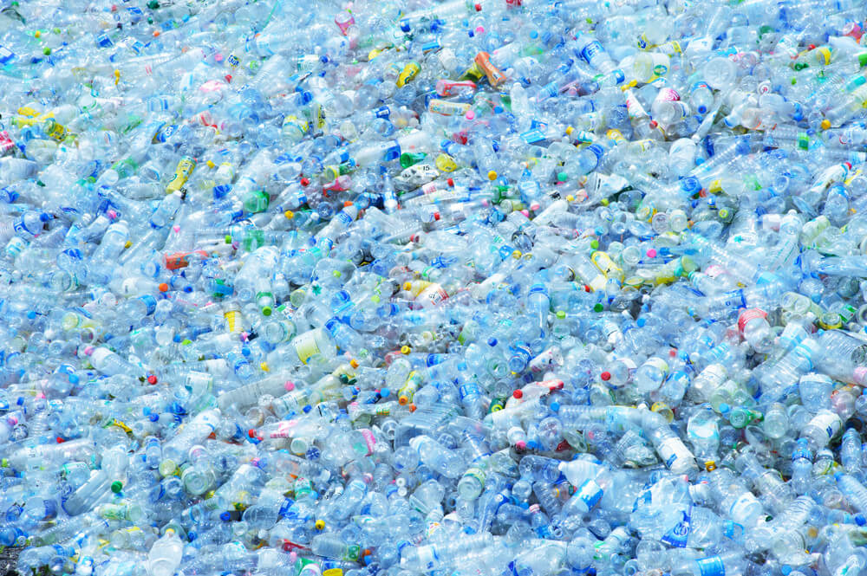
Plastic

Slide 15
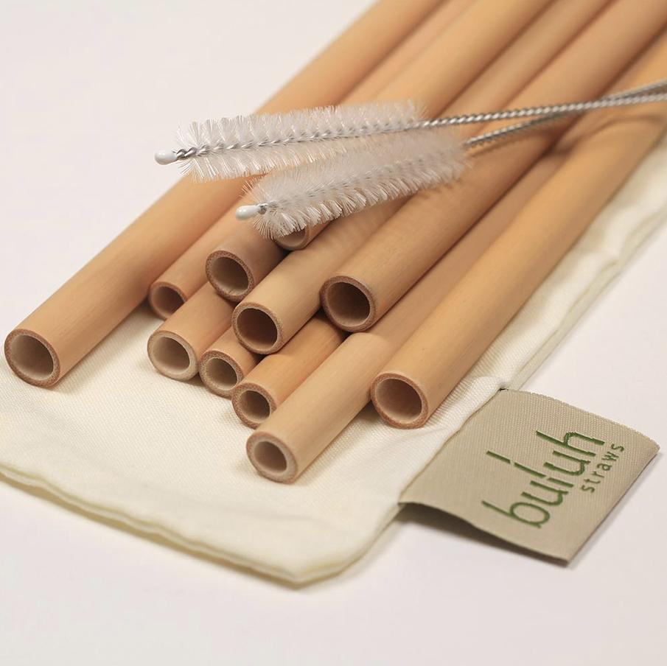
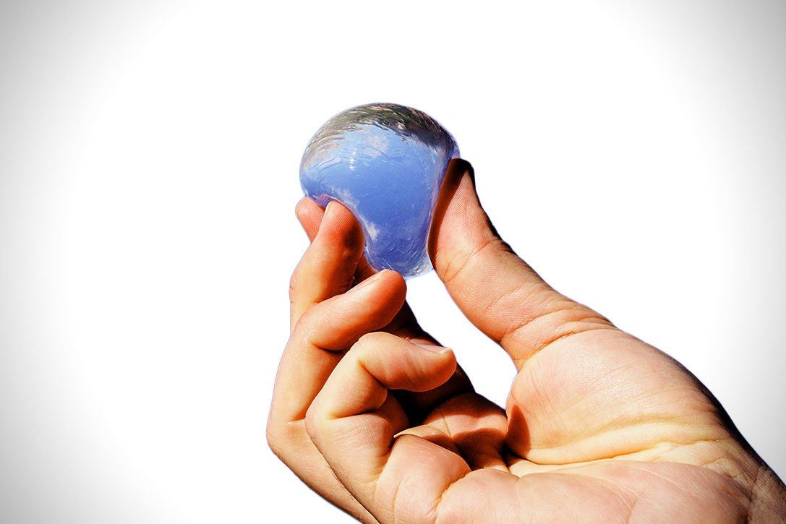
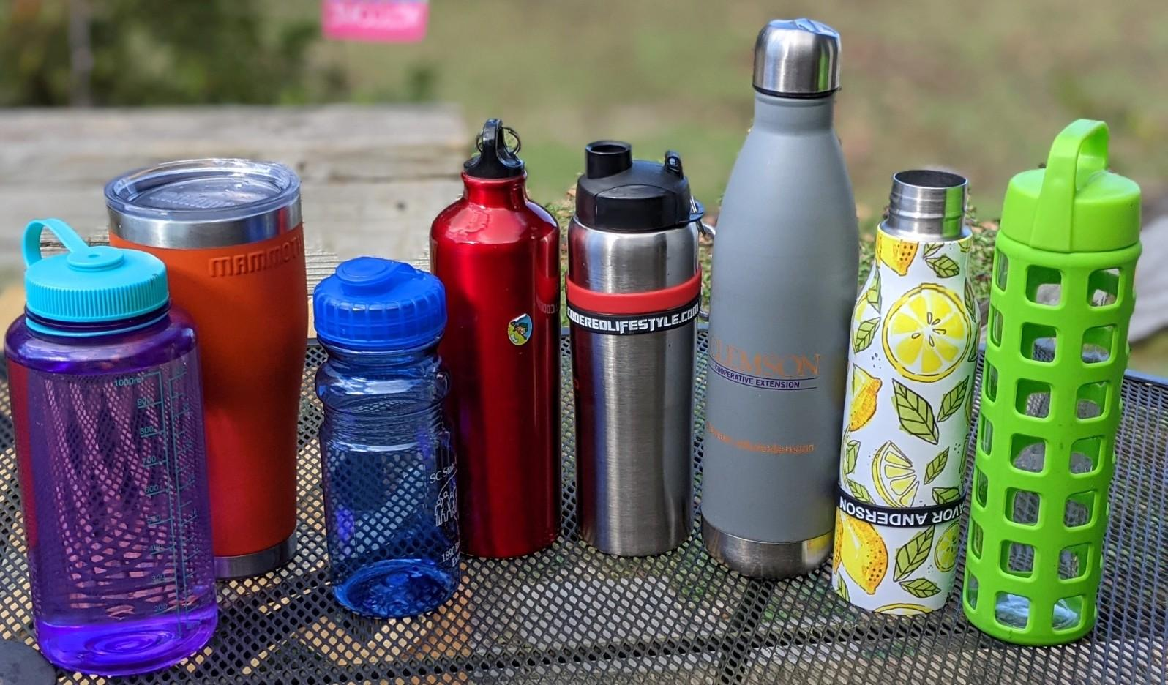

Slide 16
References
https://blog.bccresearch.com/birth-of-the-bottled-water-industry
https://www.tembopaper.com/news/history-of-paper-straws
https://www.qualitylogoproducts.com/promo-university/history-of-reusable-water-bottles.htm
https://mitte.co/2019/01/28/from-birth-to-ban-glass-to-plastic-a-global-history-of-bottled-water/

