Slide 1
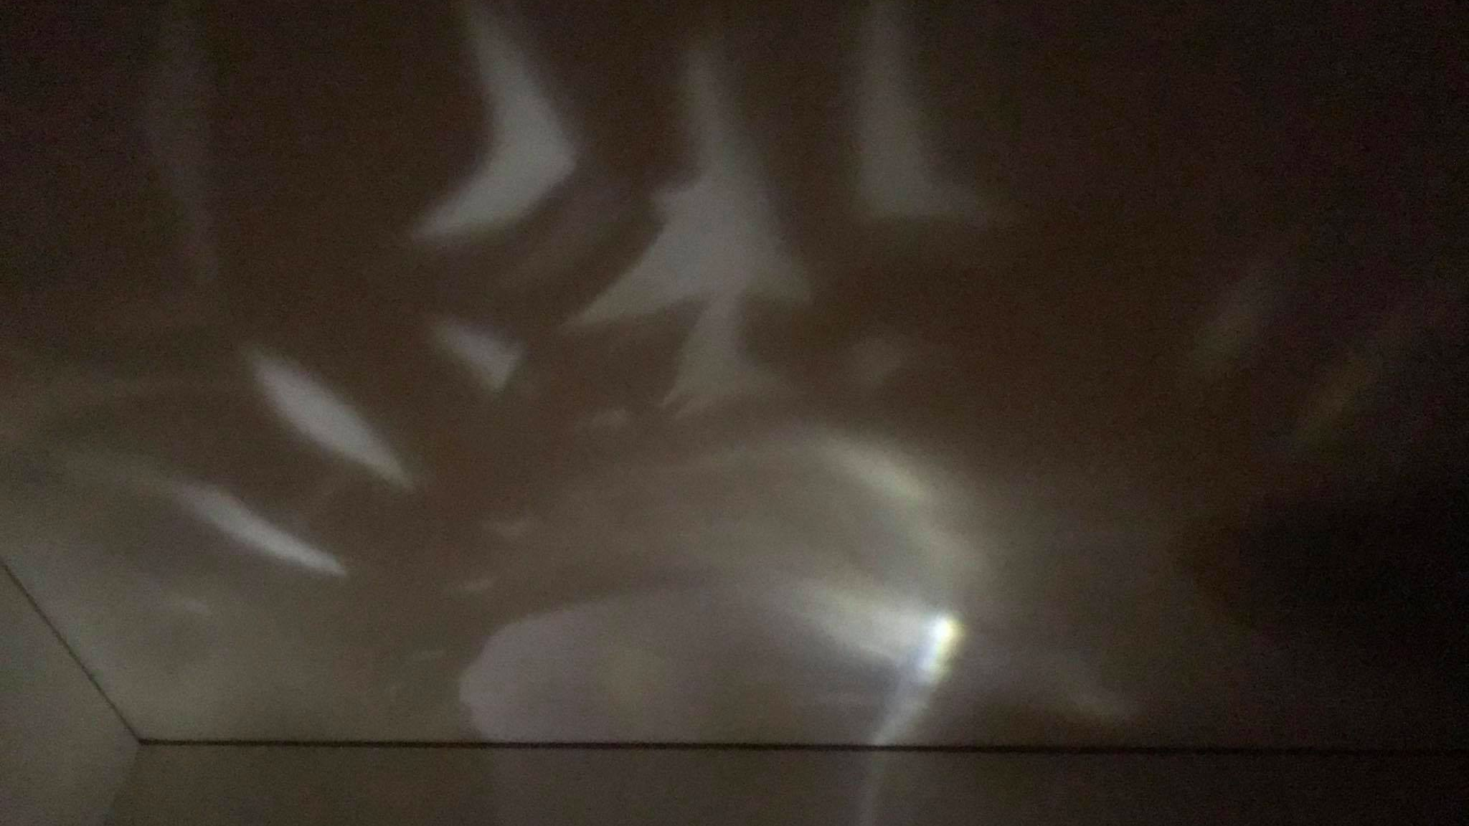
Upcycling Light
Fanisi, Hannah, Ward

Slide 2
Notes:
fanisi

Slide 3
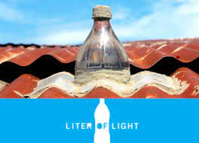
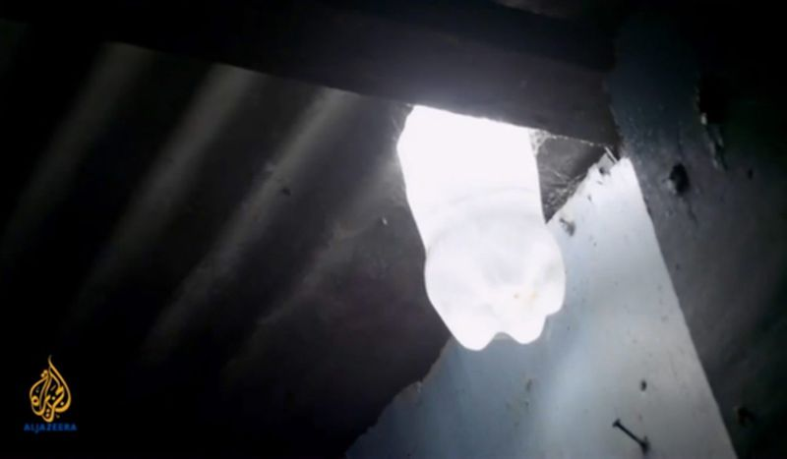
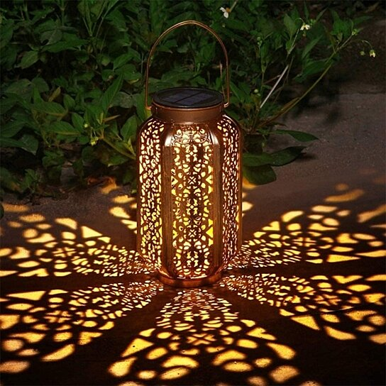
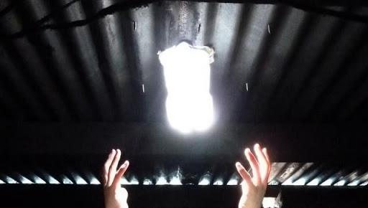
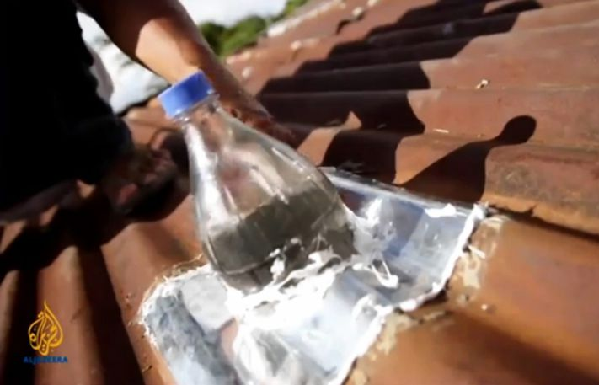
Notes:
hannah

Slide 4
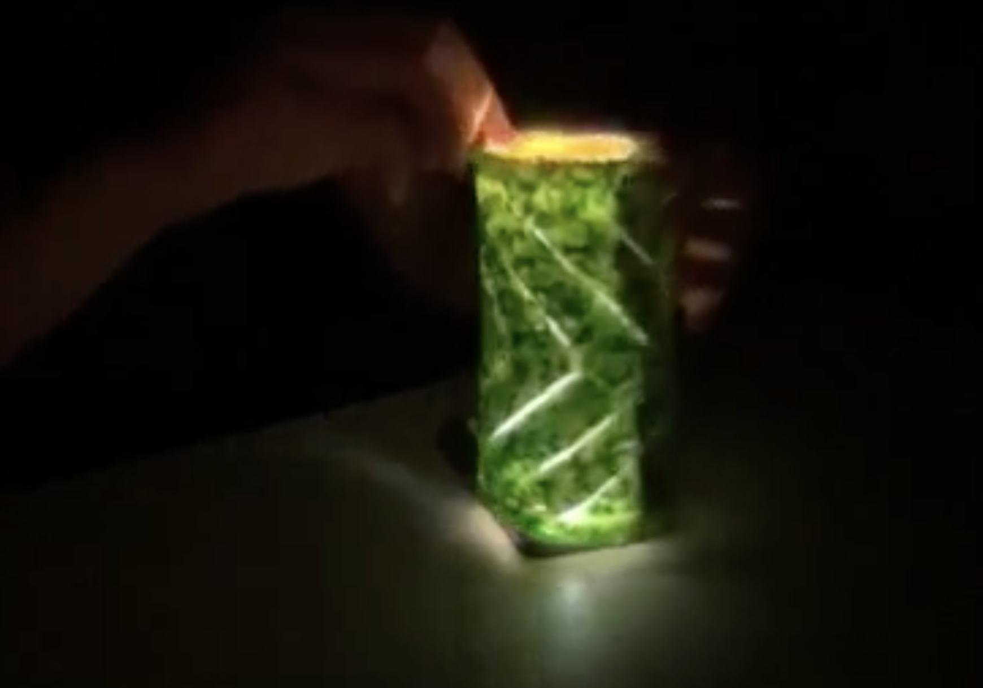
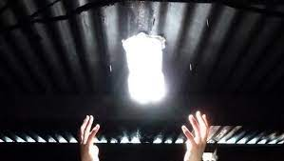
Project Aims
To build a light source that is:
accessible to all
uses no new raw resources
is aesthetic as well
To bring dynamic patterned light into any home or space
To help provide a reliable source of lighting when electricity is disrupted or when power systems fail
Notes:
ward

Slide 5
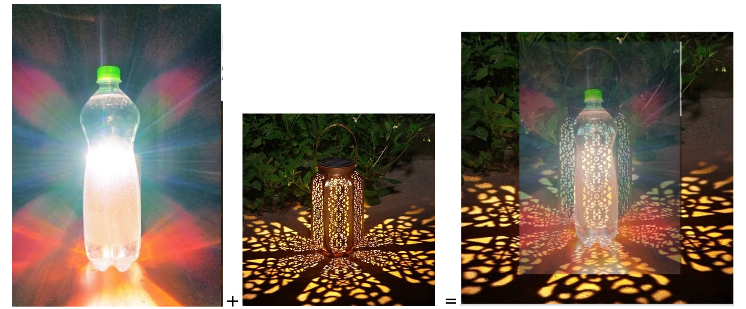
A Conceptual Visualization

Slide 6
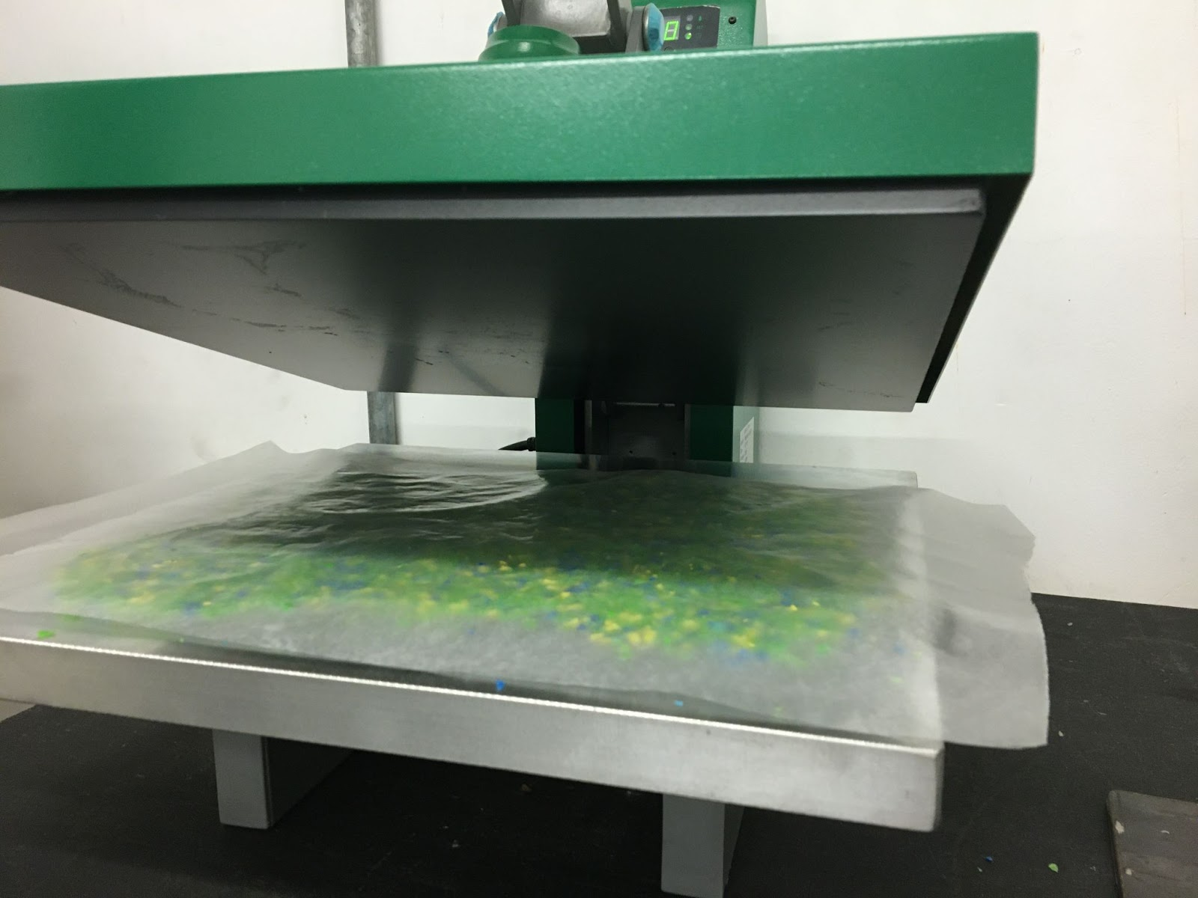
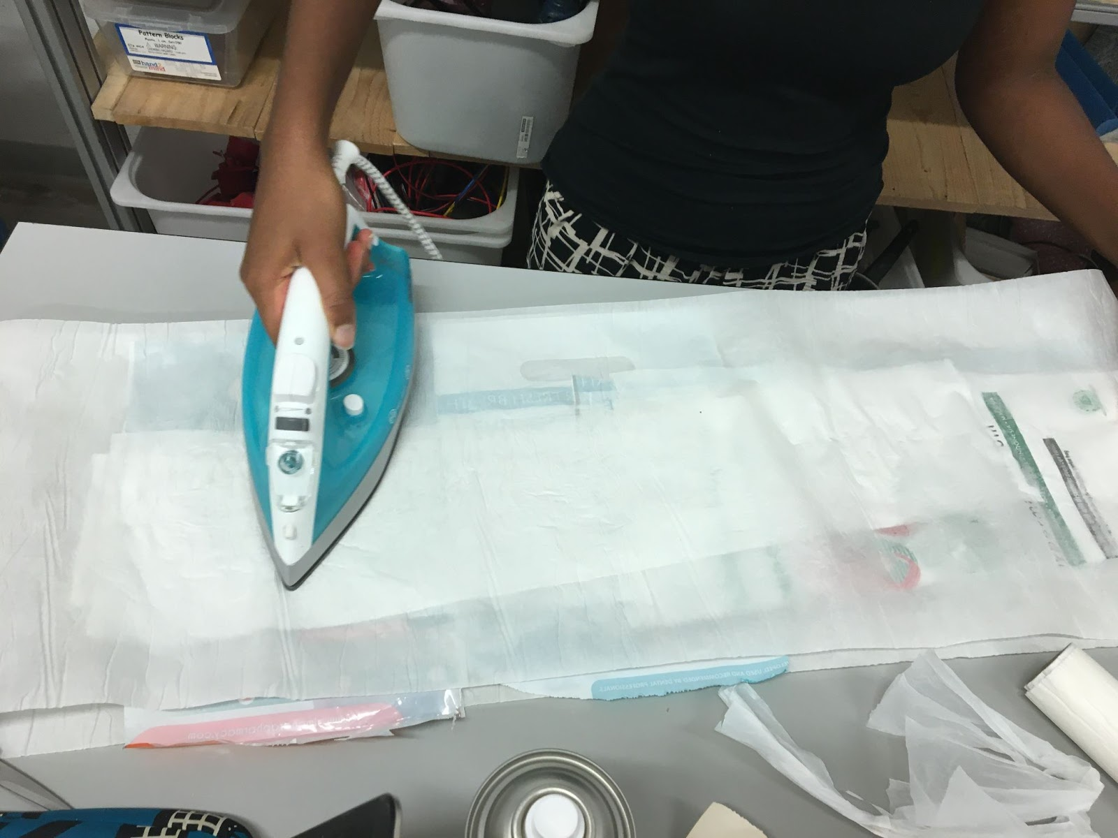
Process
Experiments to create solid rectangles and then examine how malleable they were and how light propagated through them.
To create an ordinary, solid lantern, we knew that light would have to be able to travel directly through the material; or to create a patterned design, the solid portions need to be impermeable to light and the cut-out portions must allow light to pass through.
Experimenting with different methods to form solid rectangular panels (an oven-melted baking sheet filled with shredded plastic; and a heat-pressed shredded plastic layer) and a flexible rectangle out of fused plastic bags.
We then experimented with cutting designs out of these plastic sheets and we tested shining a lightbulb through them. Based on whichever plastic sheet was the most successful, we will construct the final lantern design and affix it to the bleach-and-water light source bottle.
Notes:
hannah
methods that can be easily accessible -- anyone with iron and scissors and ironing paper could do plastic bags
iterations / challenges
bending / folding- wasnt as malleable as we thought
heat gun then started to melt

Slide 7
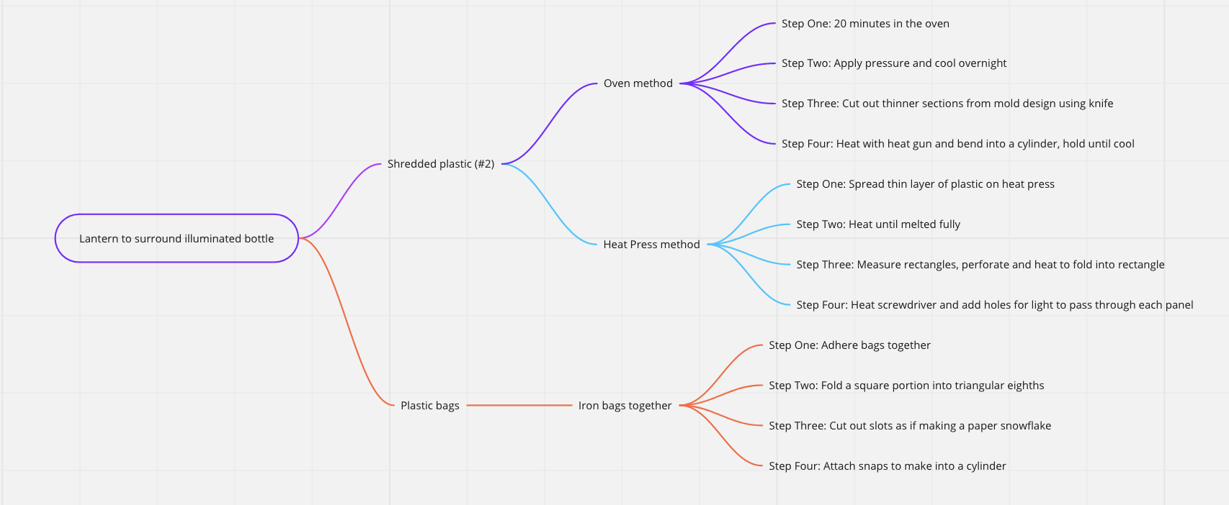
Notes:
fanisi and hannah
number 2 plastic HDPE

Slide 8
CHALLENGES
Thickness of plastic
Shaping of plastic
Paper sticking to plastic

Slide 9
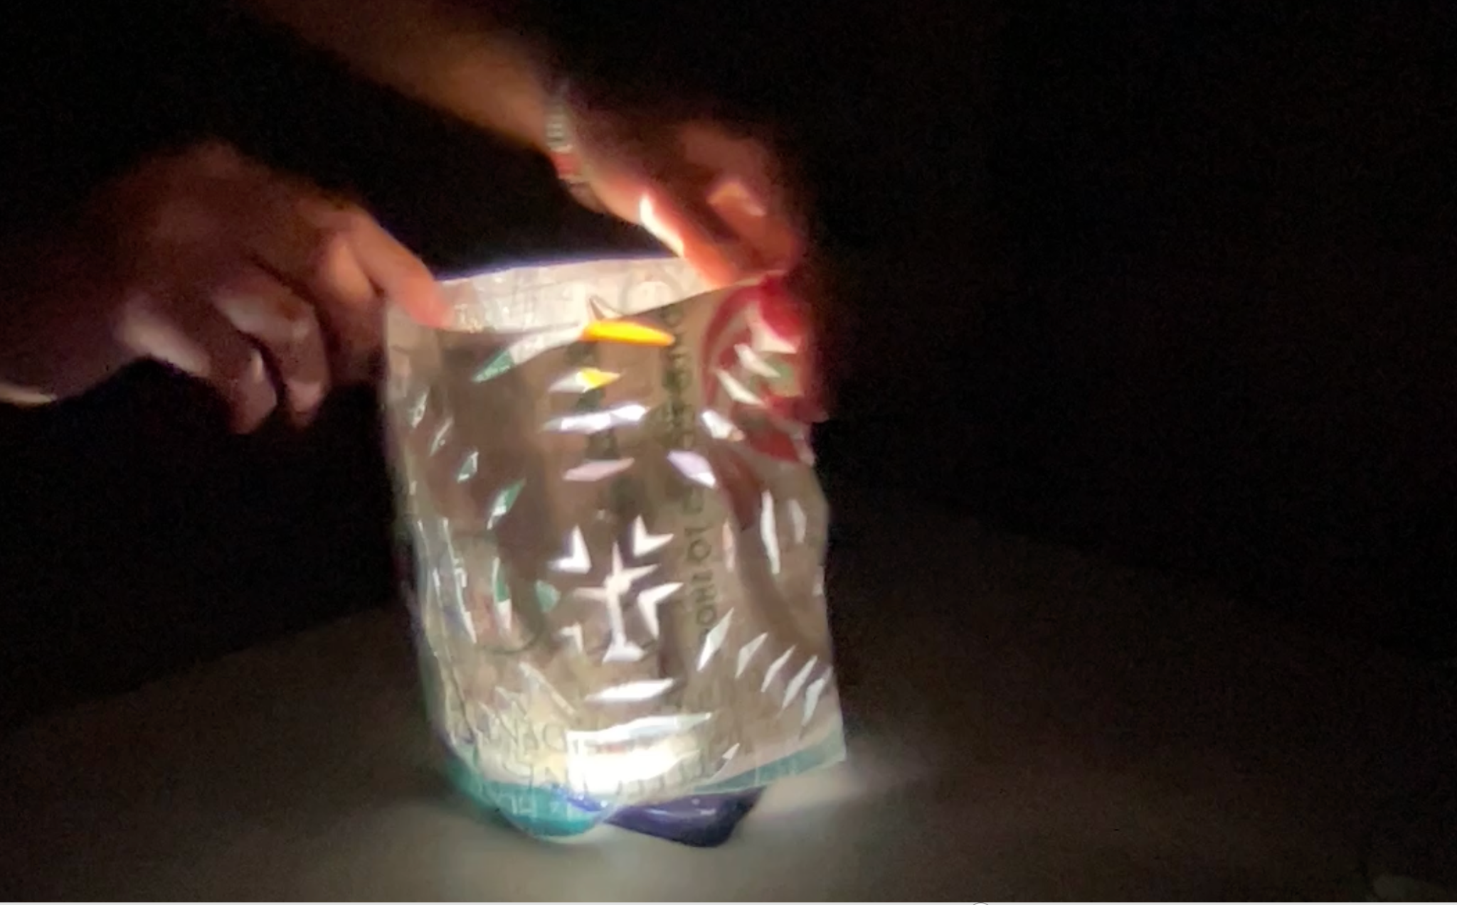
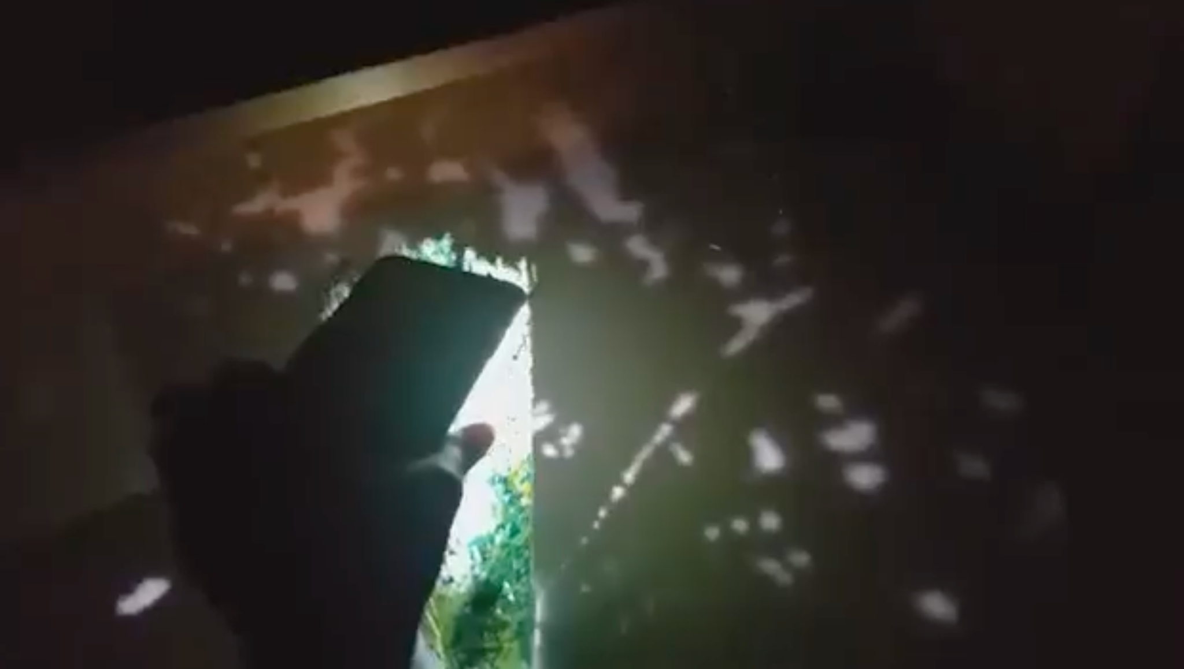
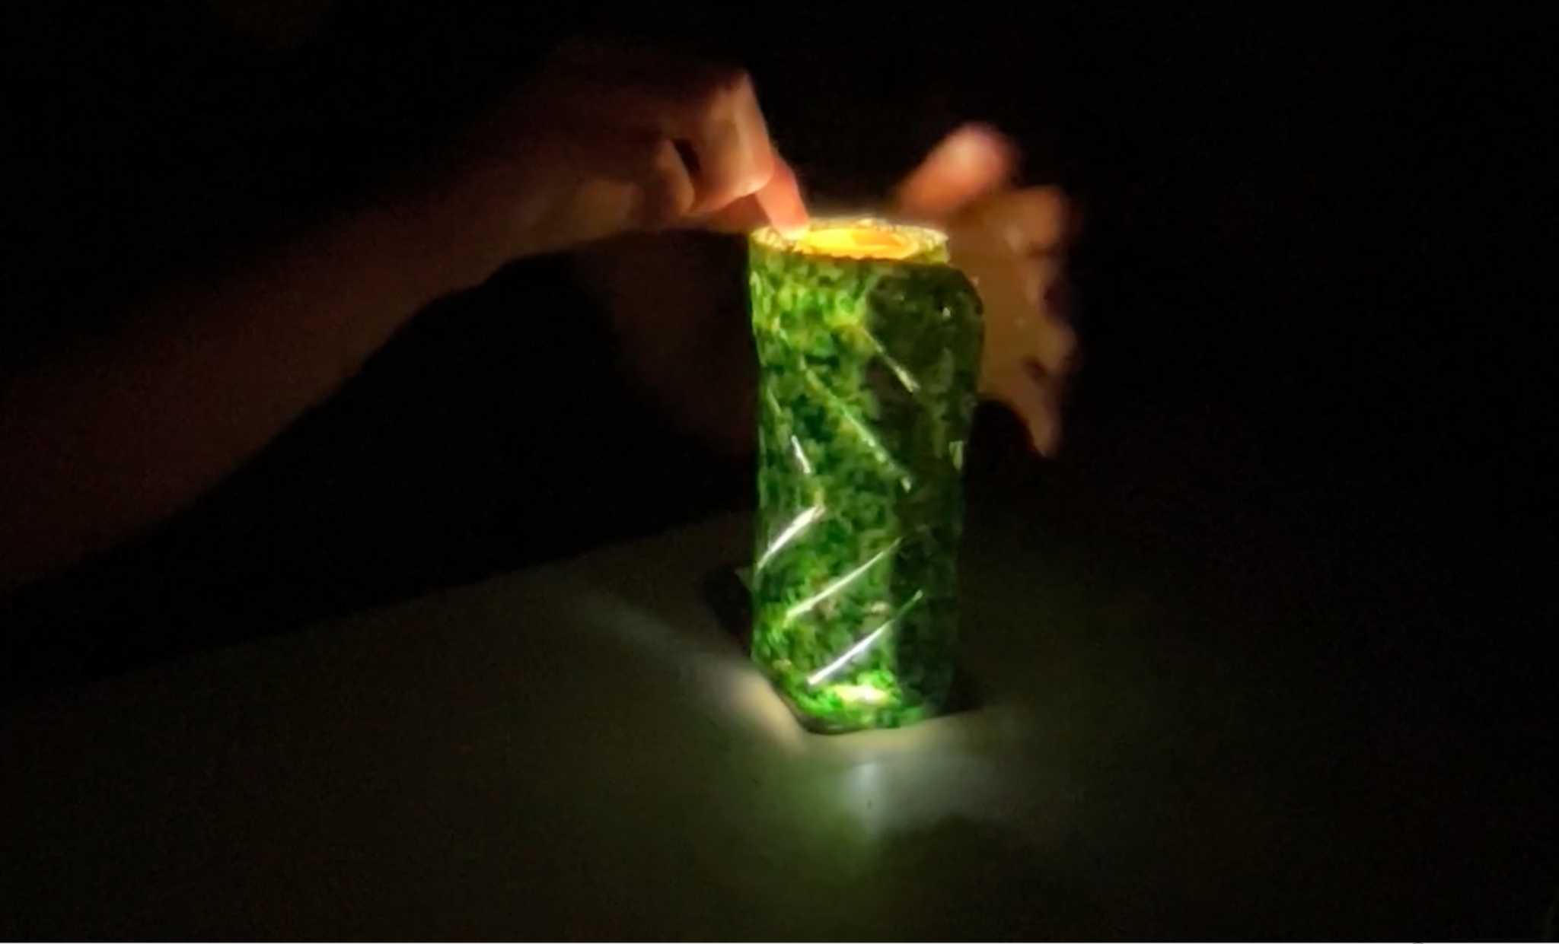
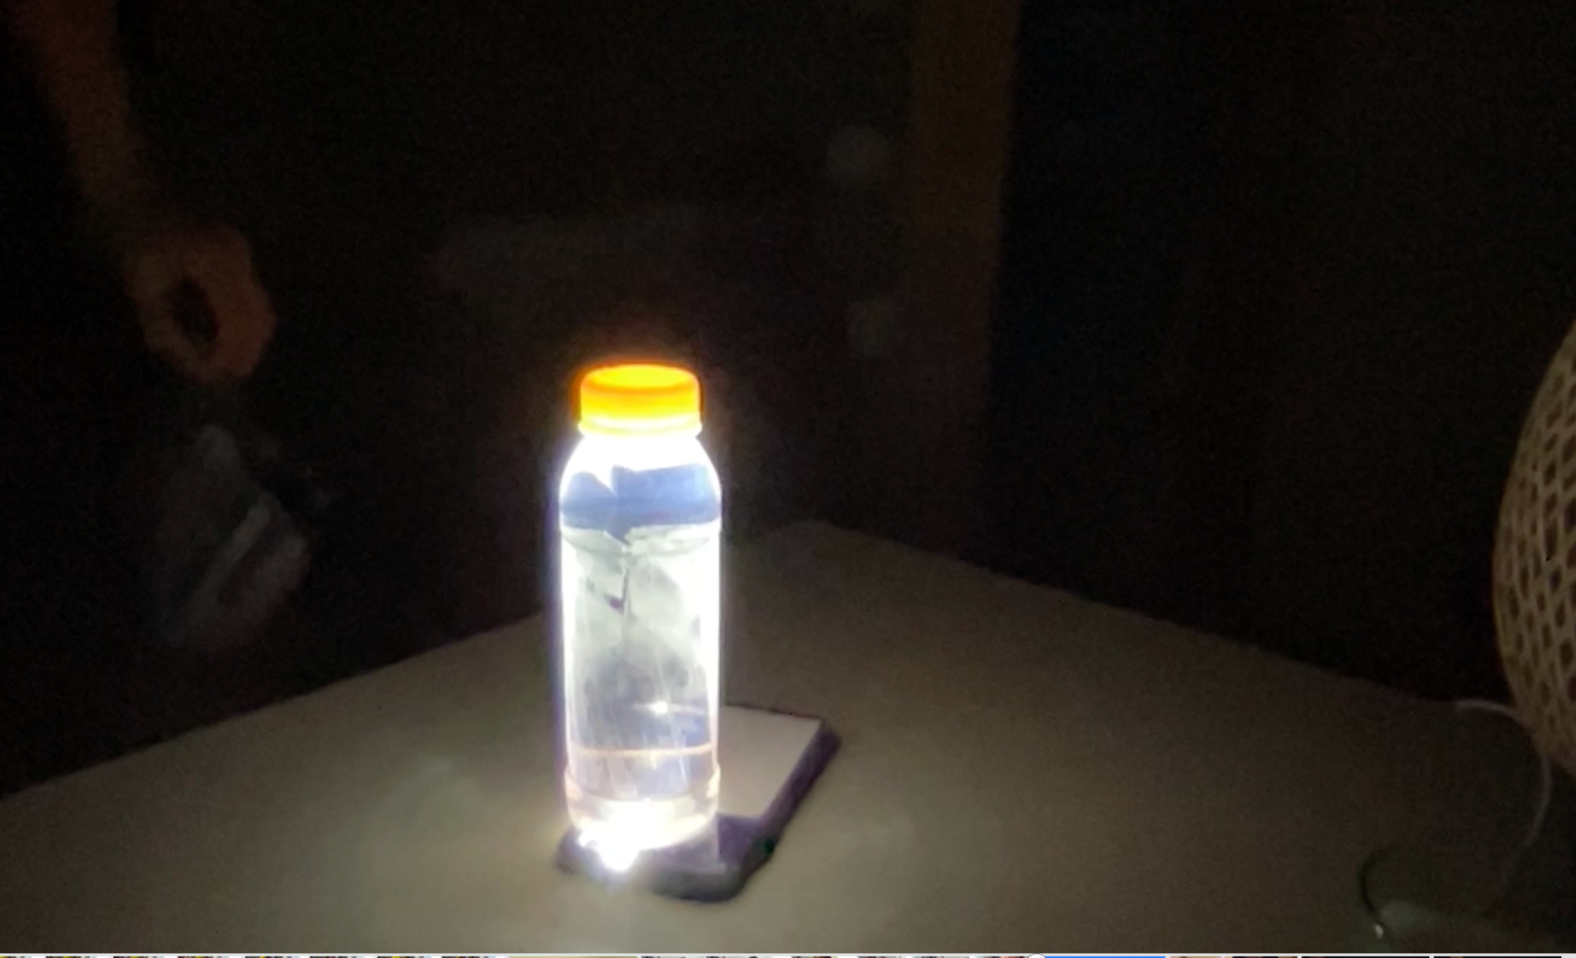
Notes:
future iterations - how to improve
lighter to make more luminous
darker to make patterns more distinct
The final stage of implementation would consist of setting up a solar panel to illuminate the bottle. This has been done in many contexts, and eliminates the need for watertight insertion into ceilings, because the light and lantern could be set up anywhere after being charged by a solar panel in the way.

Slide 10
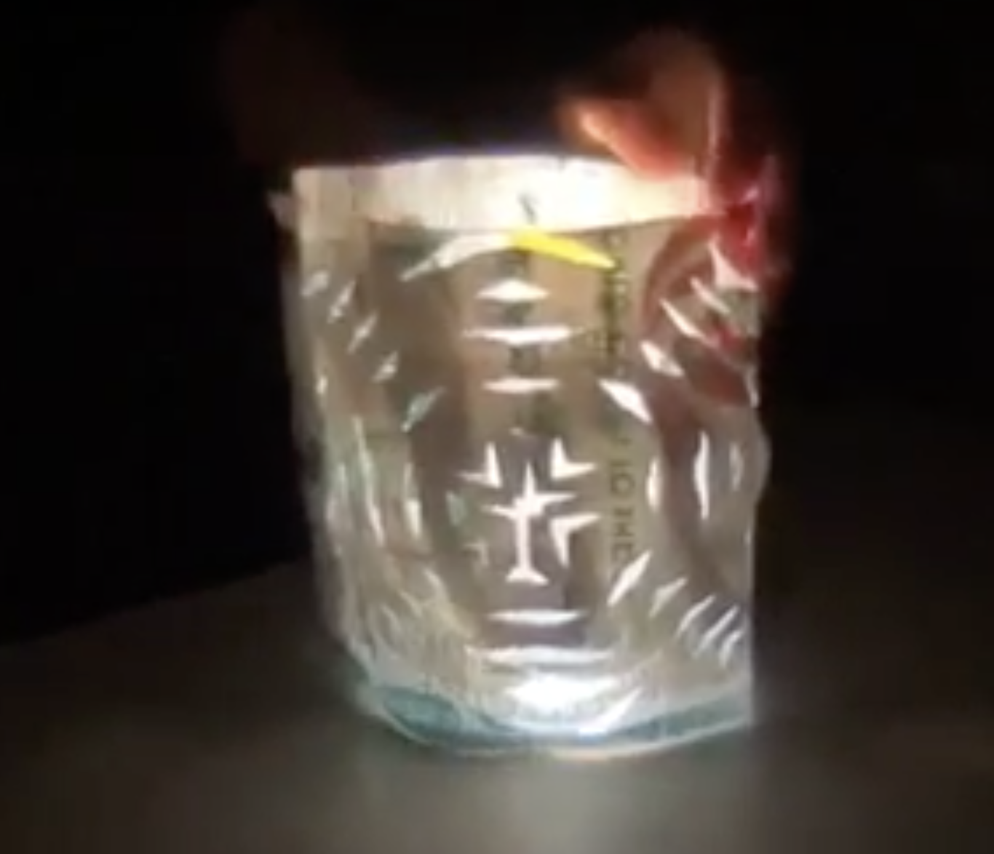
Notes:
ward

Slide 11
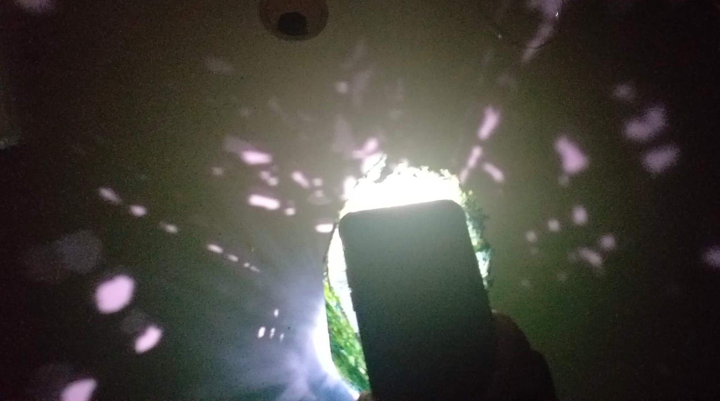
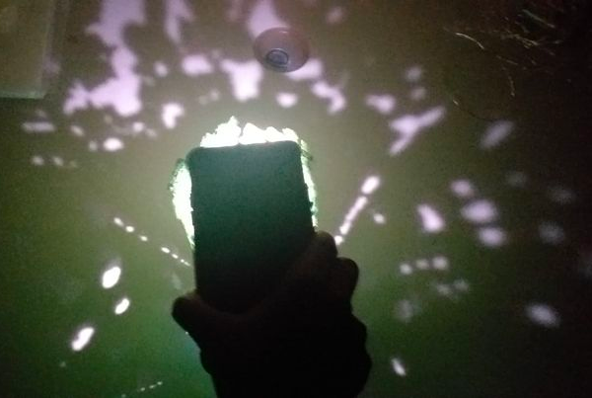
Notes:
ward

Slide 12
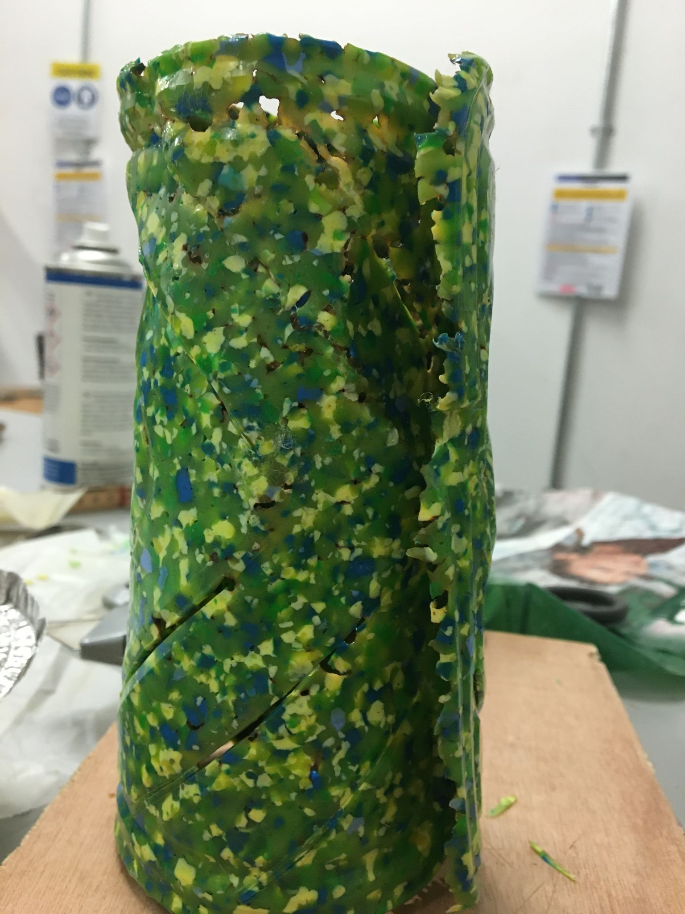
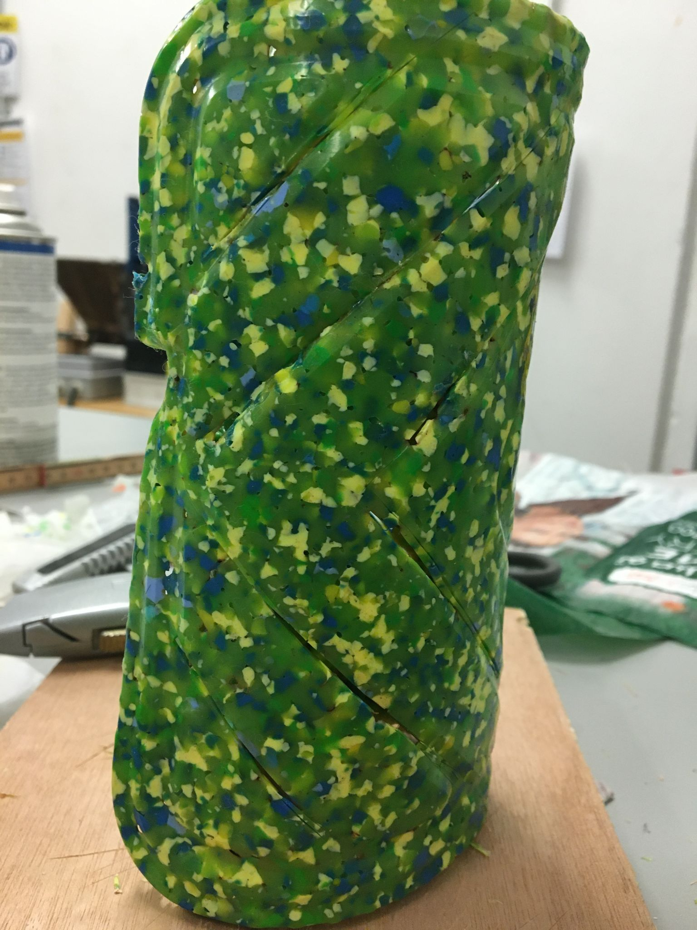

Slide 13
Citations for mood board:
Solar panel: https://www.wur.nl/en/Research-Results/Research-Institutes/Environmental-Research/Programmes/Green-Climate-Solutions/Climate-smart-agriculture.htm
Disasters: https://www.wionews.com/india-news/double-crisis-natural-disasters-dont-stop-for-coronadvirus-308890
Garden bottles: https://www.thisiscolossal.com/2013/02/urban-vertical-garden-built-from-hundreds-of-recycled-soda-bottles/
Plastic Chandelier: https://www.bouf.com/vendors/sarah-turner-eco-art-design/
Bottle top lamp: https://smartrecycleideas.wordpress.com/2014/08/13/creative-plastic-recycling-ideas-for-plastic-straws-1/
Rubble image with tree: https://www.weforum.org/agenda/2019/12/extreme-weather-climate-change-displaced/
Colour palettes: https://www.color-hex.com/color-palette/45299 and https://www.schemecolor.com/earthy-green-and-brown.php
Street light: https://www.ready.gov/power-outages
Liter of light street light: https://revolve.media/circular/liter-of-light-repurposes-bottles-rural-communities

